Slide 1
MedTech ERP — Workflow Screens
Each slide contains a screenshot with a short workflow description.

Slide 2
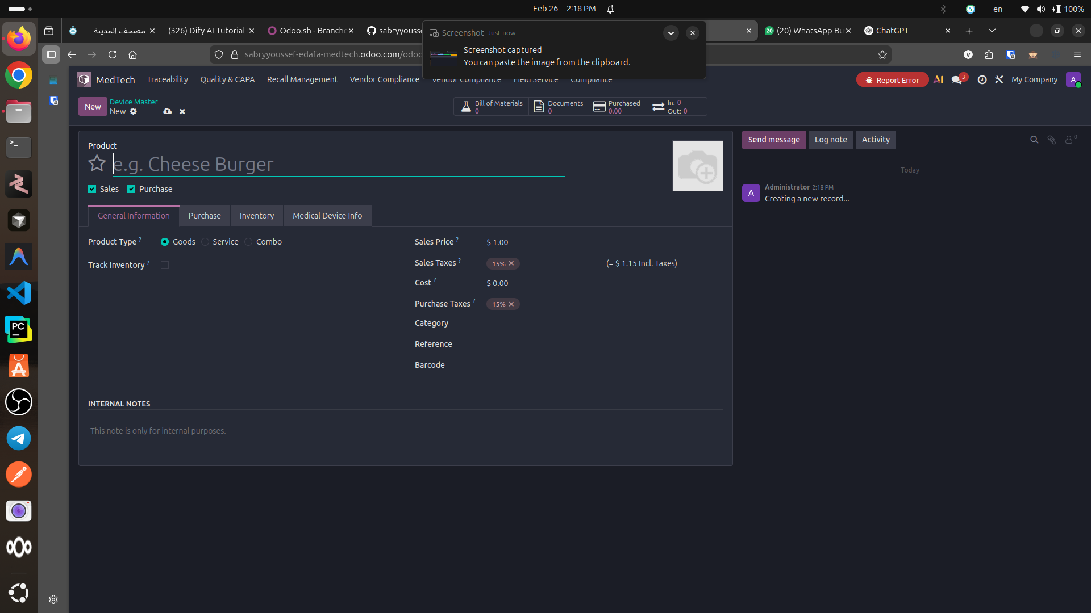
Step 1
Step 1 — Create a Device Master (Product): define the base product record (Sales/Purchase, pricing, taxes, internal notes). This becomes the single source of truth for commercial and technical attributes.

Slide 3
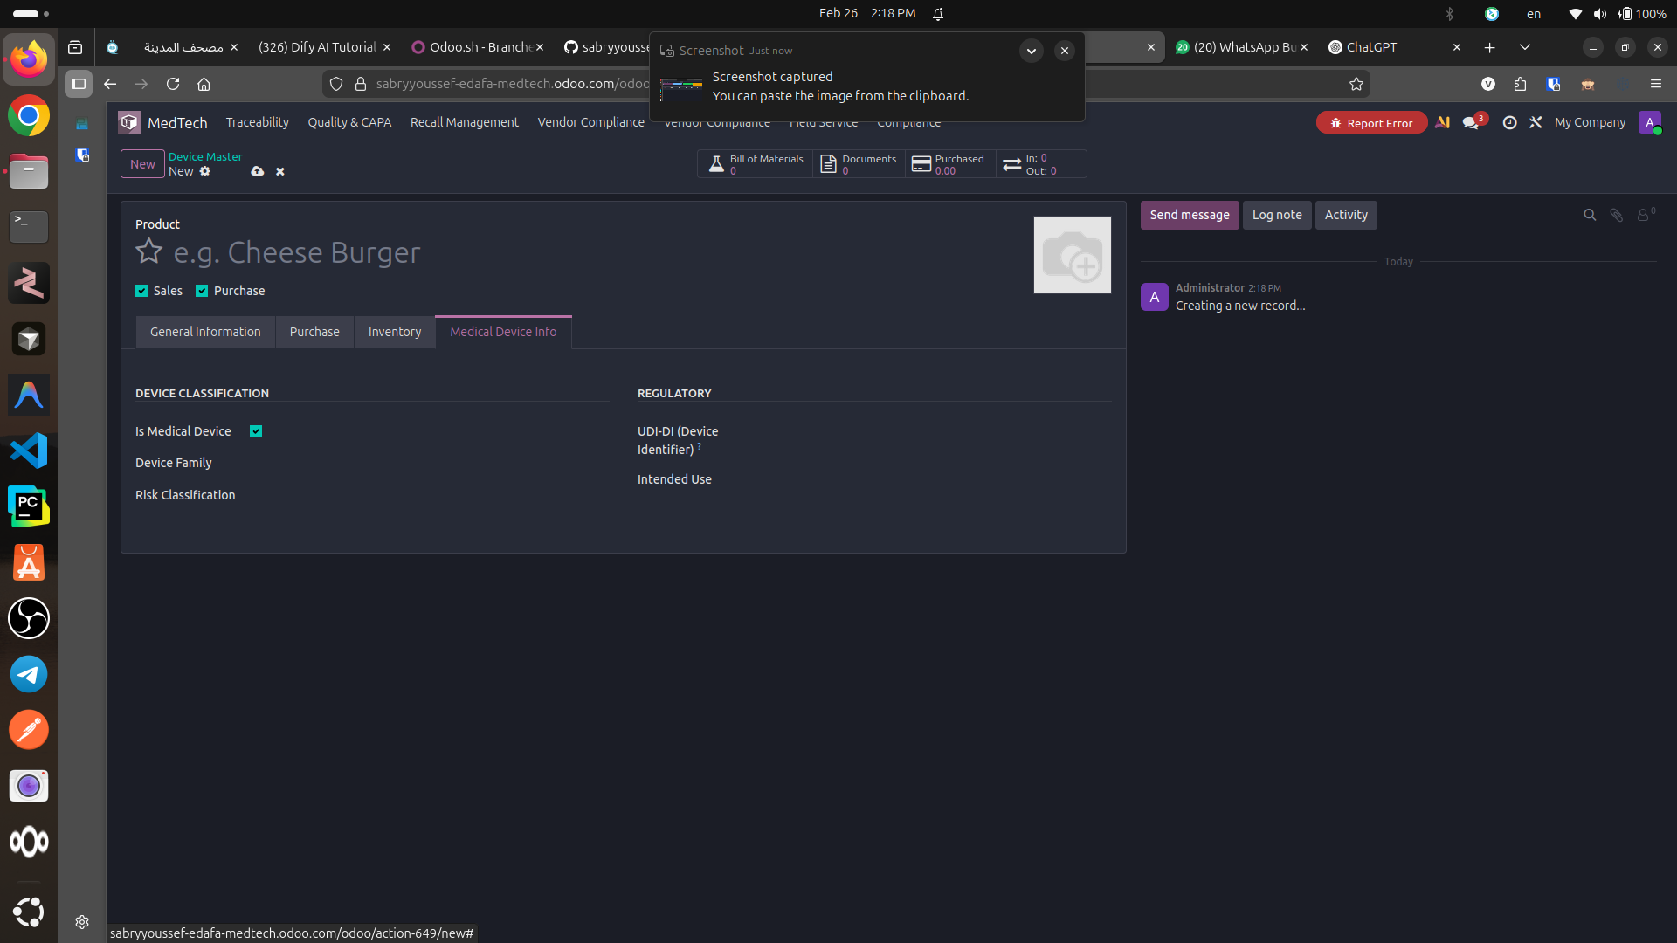
Step 2
Step 2 — Flag as Medical Device: in the Medical Device Info tab, mark the product as a regulated medical device to unlock compliance fields and downstream traceability objects.

Slide 4
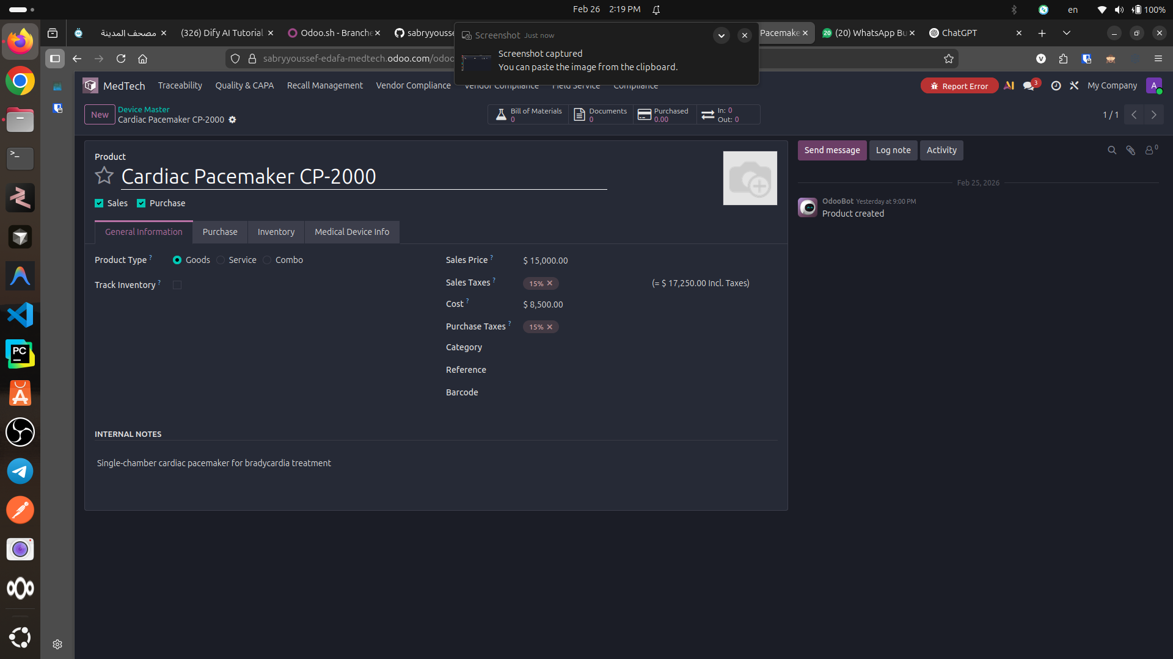
Step 3
Step 3 — Populate Product Master Data: enter device name, price/cost, and supporting description. This is the record that sales, procurement, and inventory will reference.

Slide 5
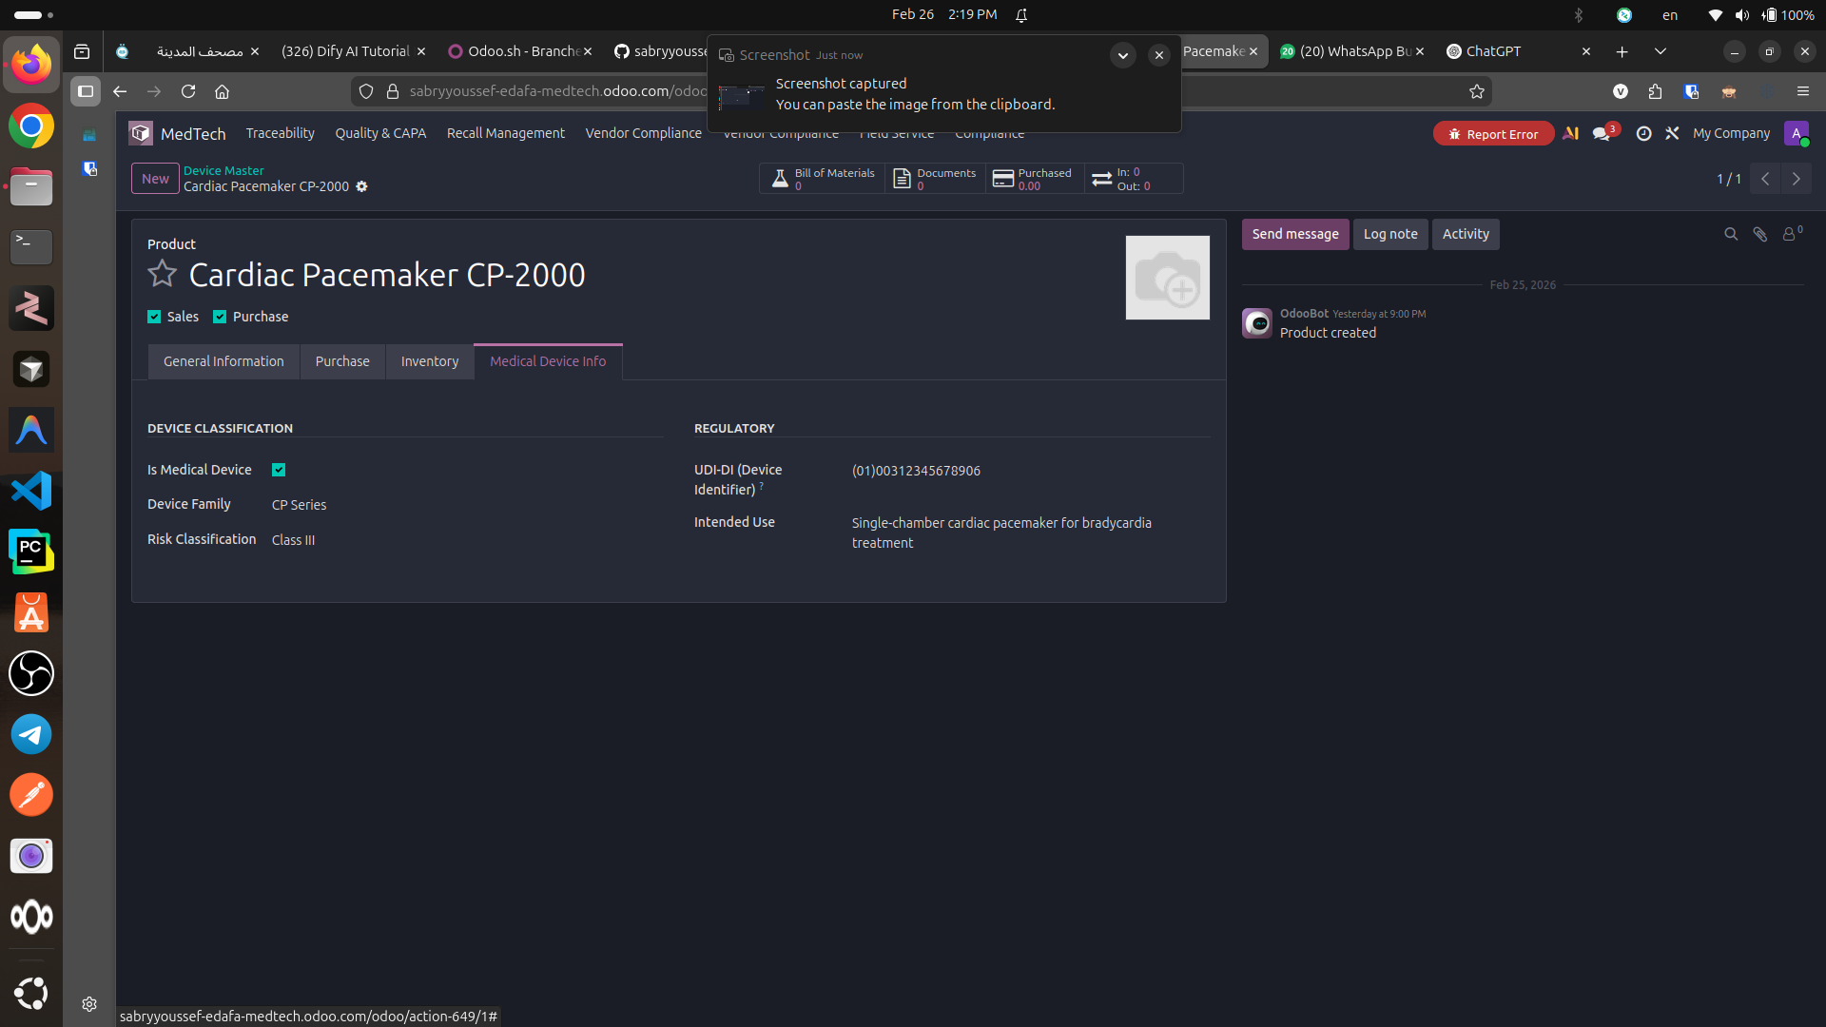
Step 4
Step 4 — Capture Regulatory Attributes: set device family, risk class, UDI-DI, and intended use. These fields drive UDI registry, DHR compilation, and compliance reporting.

Slide 6
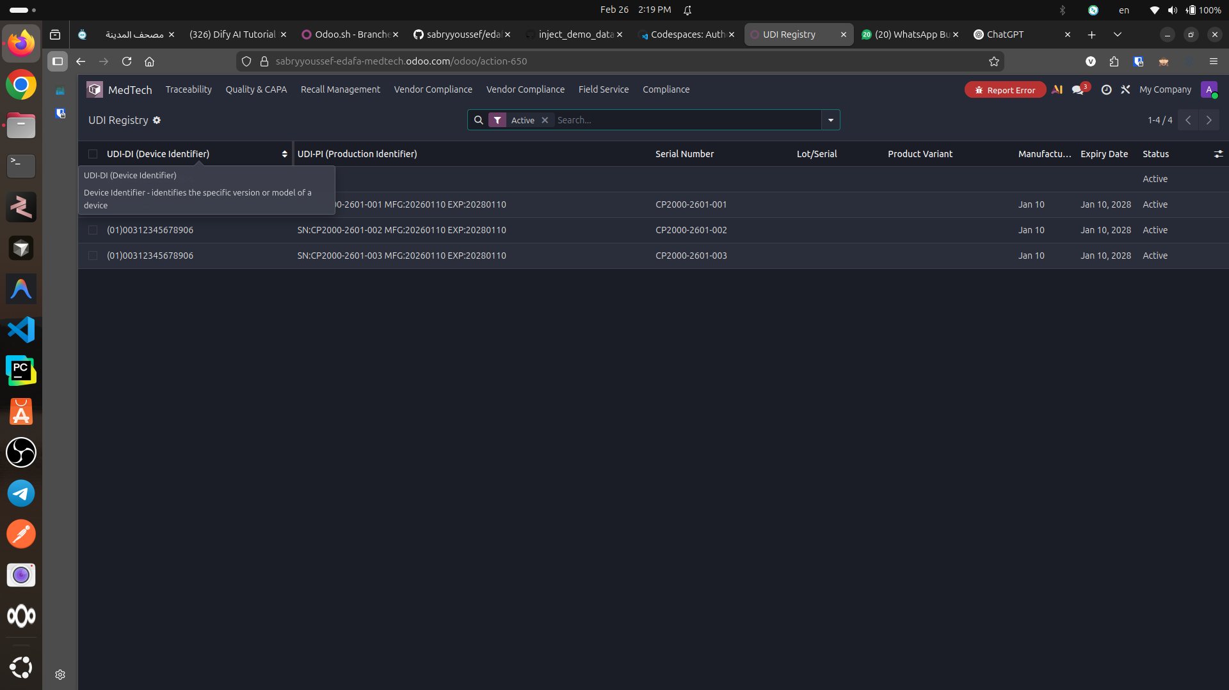
Step 5
Step 5 — Create UDI Registry Entries: generate/maintain UDI records (UDI-DI + UDI-PI) for each produced unit or lot/serial. This anchors end-to-end traceability.

Slide 7
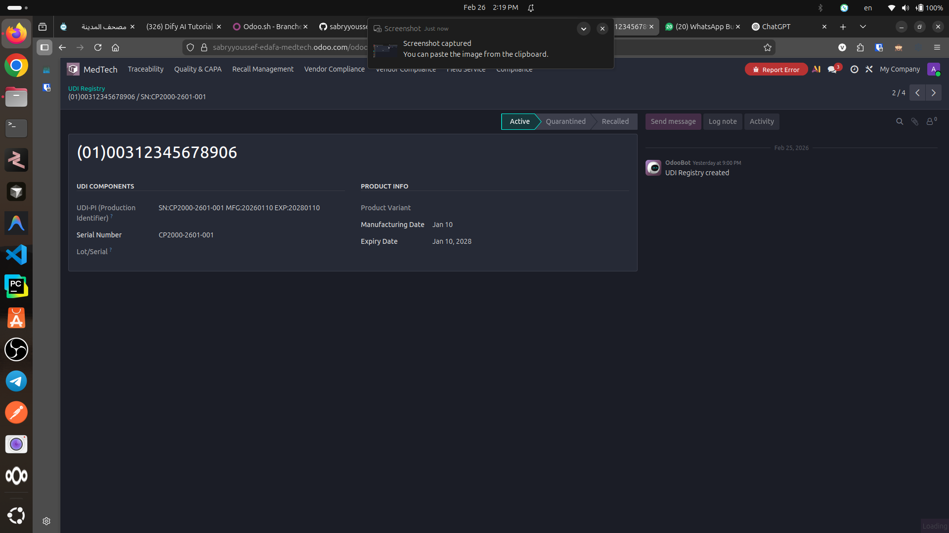
Step 6
Step 6 — Review a UDI Record: confirm UDI-PI, serial, manufacturing and expiry dates, and current status. This is what you trace during investigations, recalls, and audits.

Slide 8
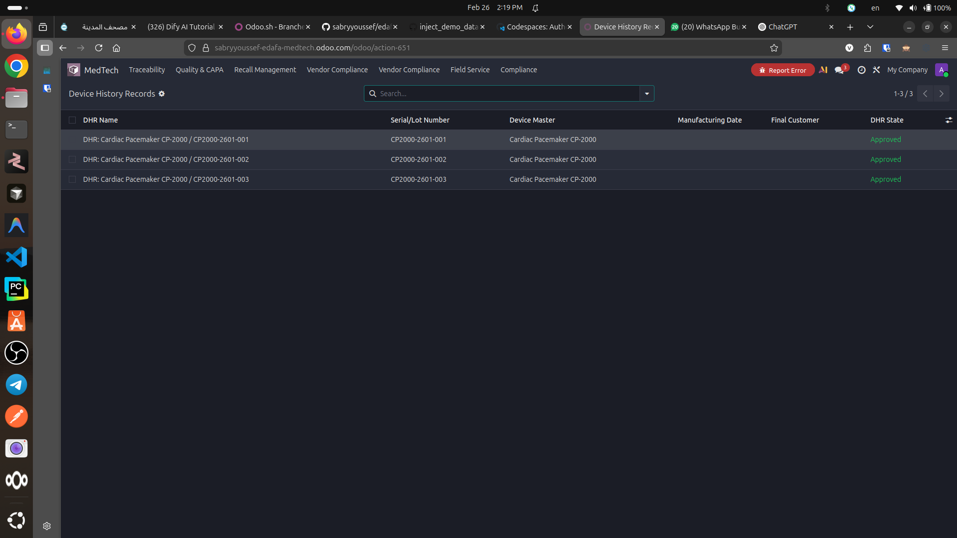
Step 7
Step 7 — View Device History Records (DHR) List: each manufactured unit/lot gets a DHR. Status (e.g., Approved) indicates the batch record is complete and audit-ready.

Slide 9
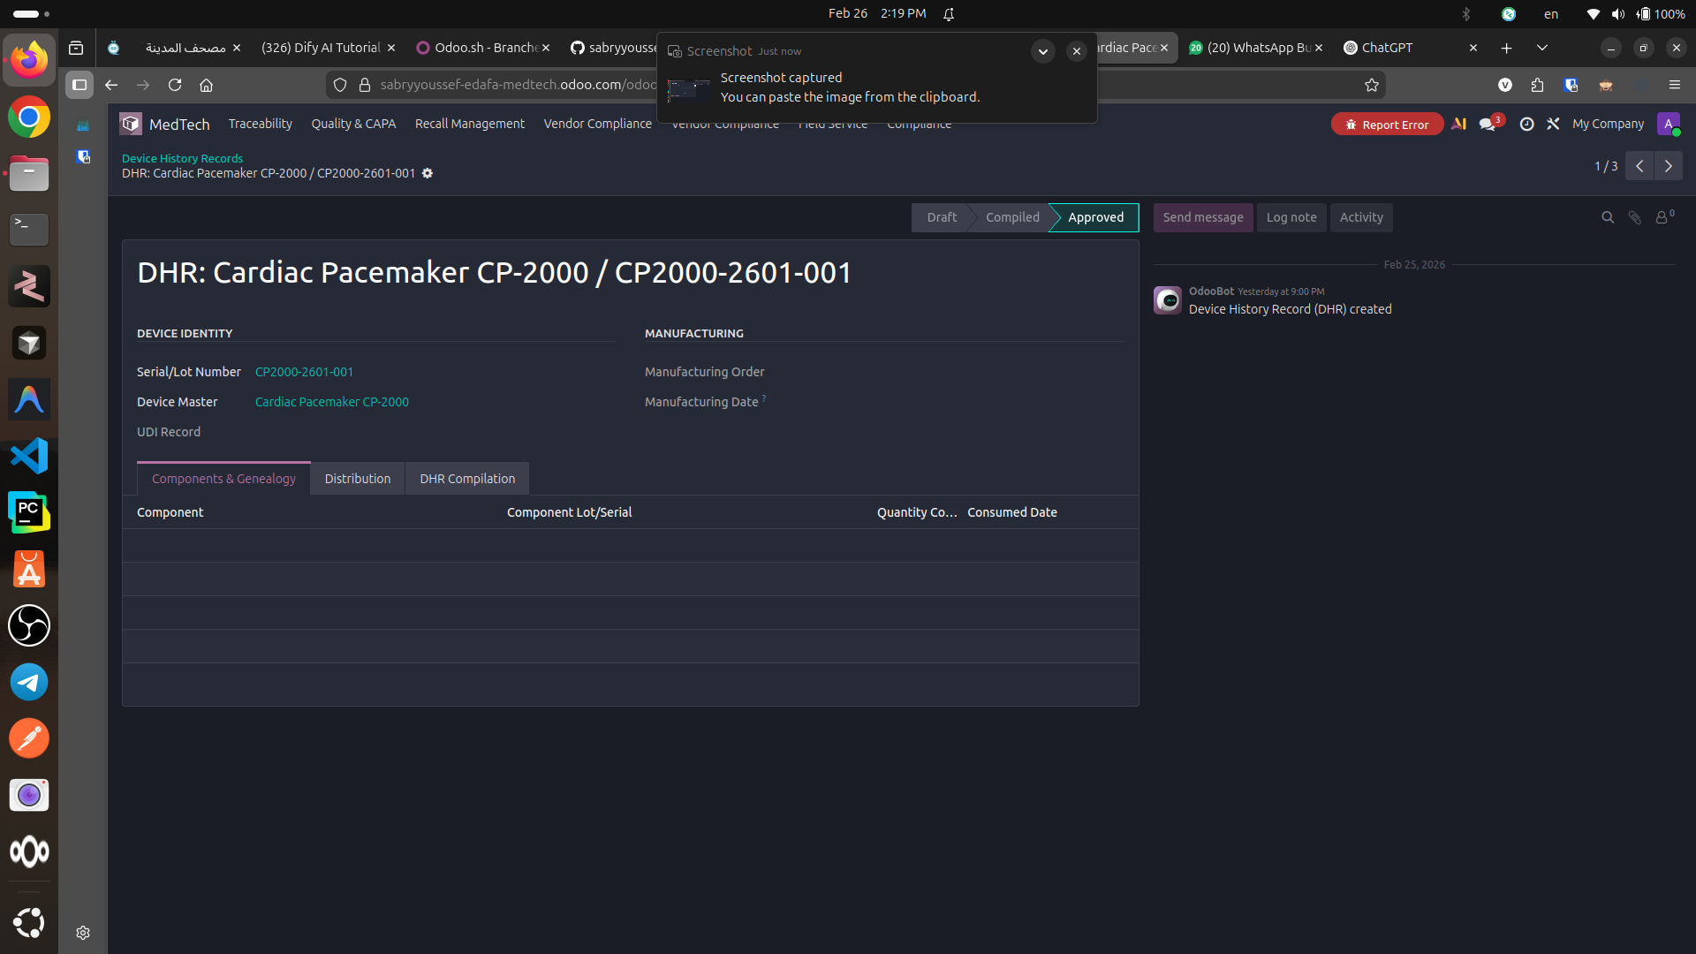
Step 8
Step 8 — DHR: Components & Genealogy: link consumed components and genealogy to prove exactly what went into the unit/lot (backward traceability).

Slide 10
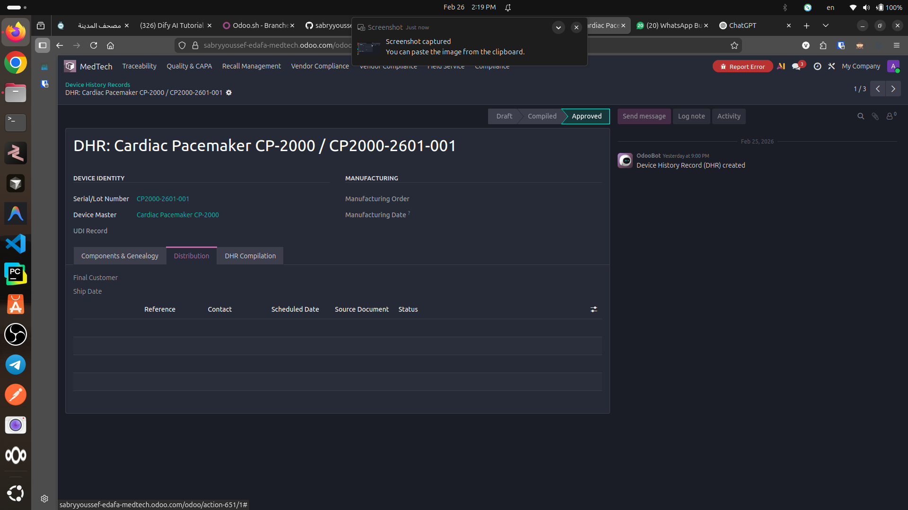
Step 9
Step 9 — DHR: Distribution: capture customer/ship references and distribution evidence to enable forward traceability and targeted recall execution.

Slide 11
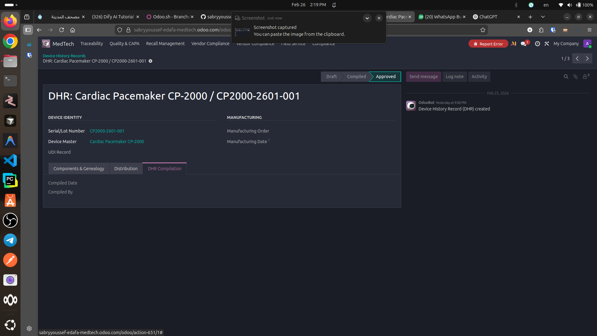
Step 10
Step 10 — DHR: Compilation: record who compiled the DHR and when. This is the governance checkpoint before moving to Approved.

Slide 12
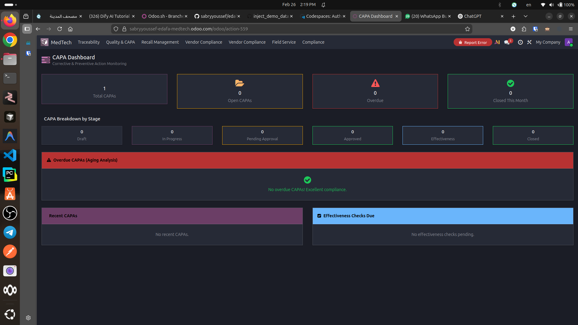
Step 11
Step 11 — CAPA Dashboard: monitor corrective and preventive actions (open, overdue, approvals, effectiveness checks). This is the control tower for quality remediation.

Slide 13
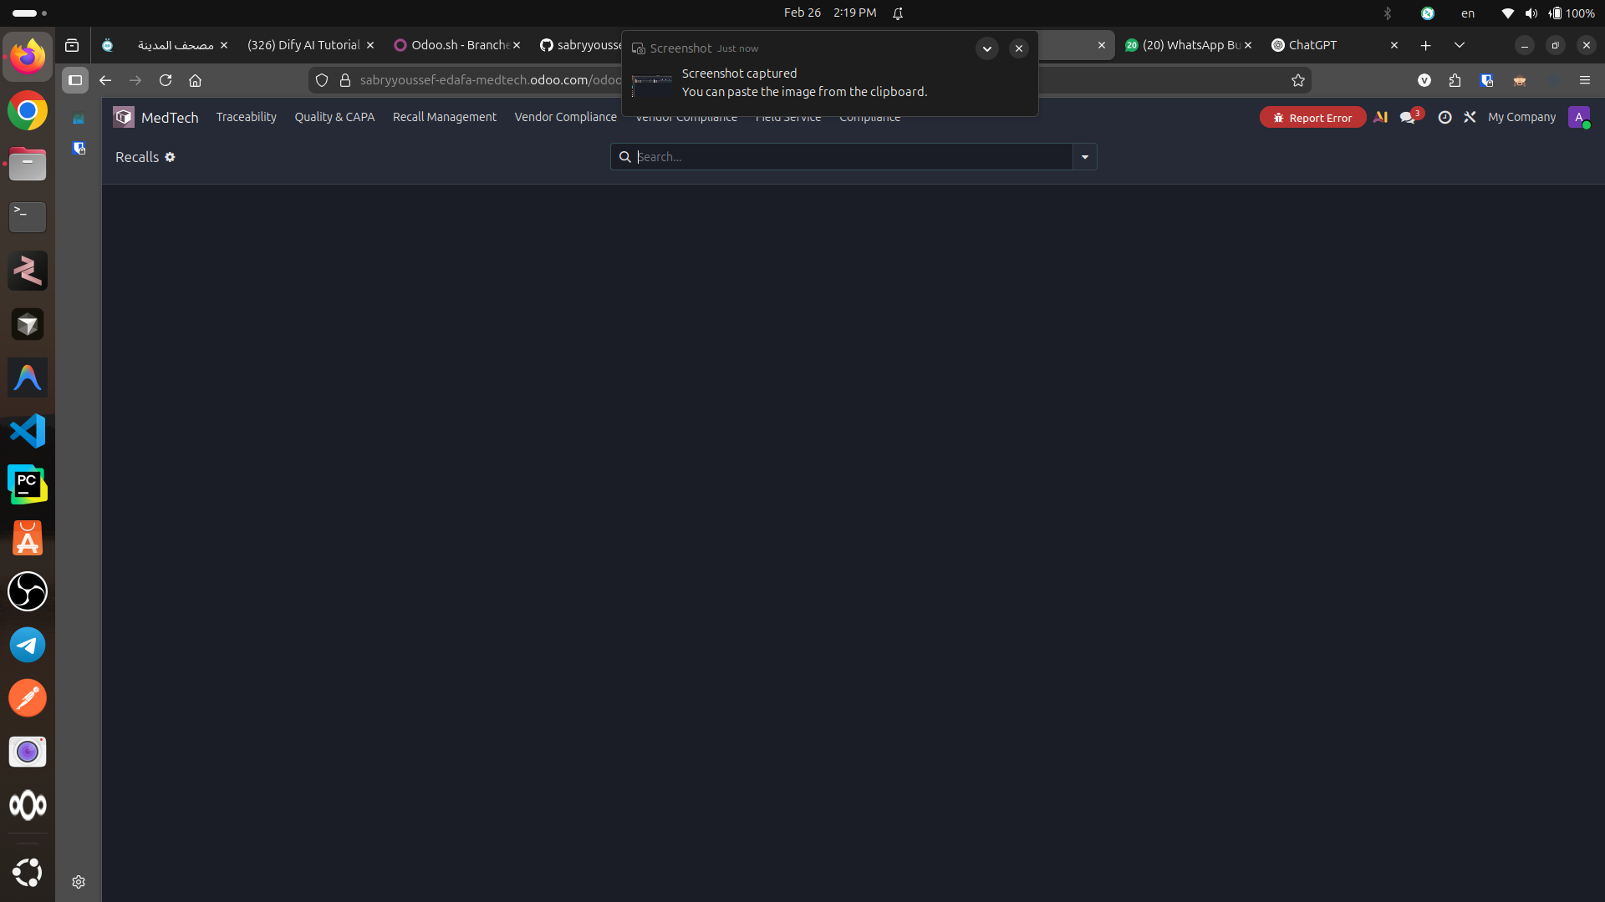
Step 12
Step 12 — Recall Management: create recall events and associate impacted UDIs/lots. Used for regulatory notifications, customer communications, and closure evidence.

Slide 14
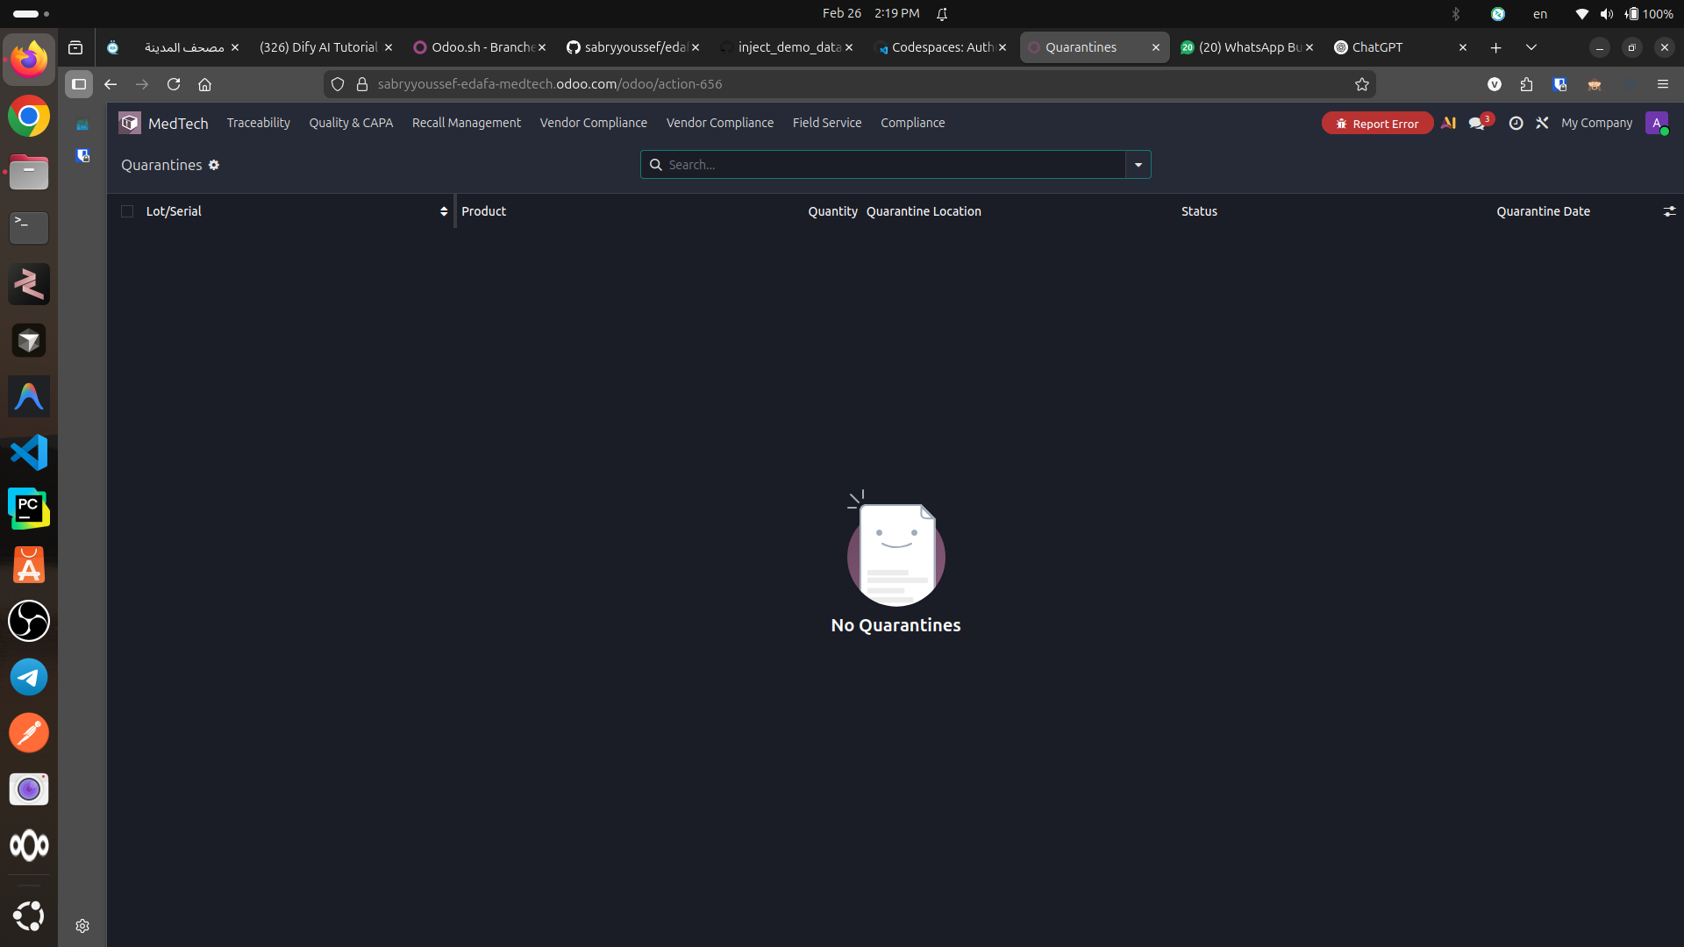
Step 13
Step 13 — Quarantine Management: quarantine lots/serials to block movement/sales while investigation is ongoing. Controls risk exposure immediately.

Slide 15
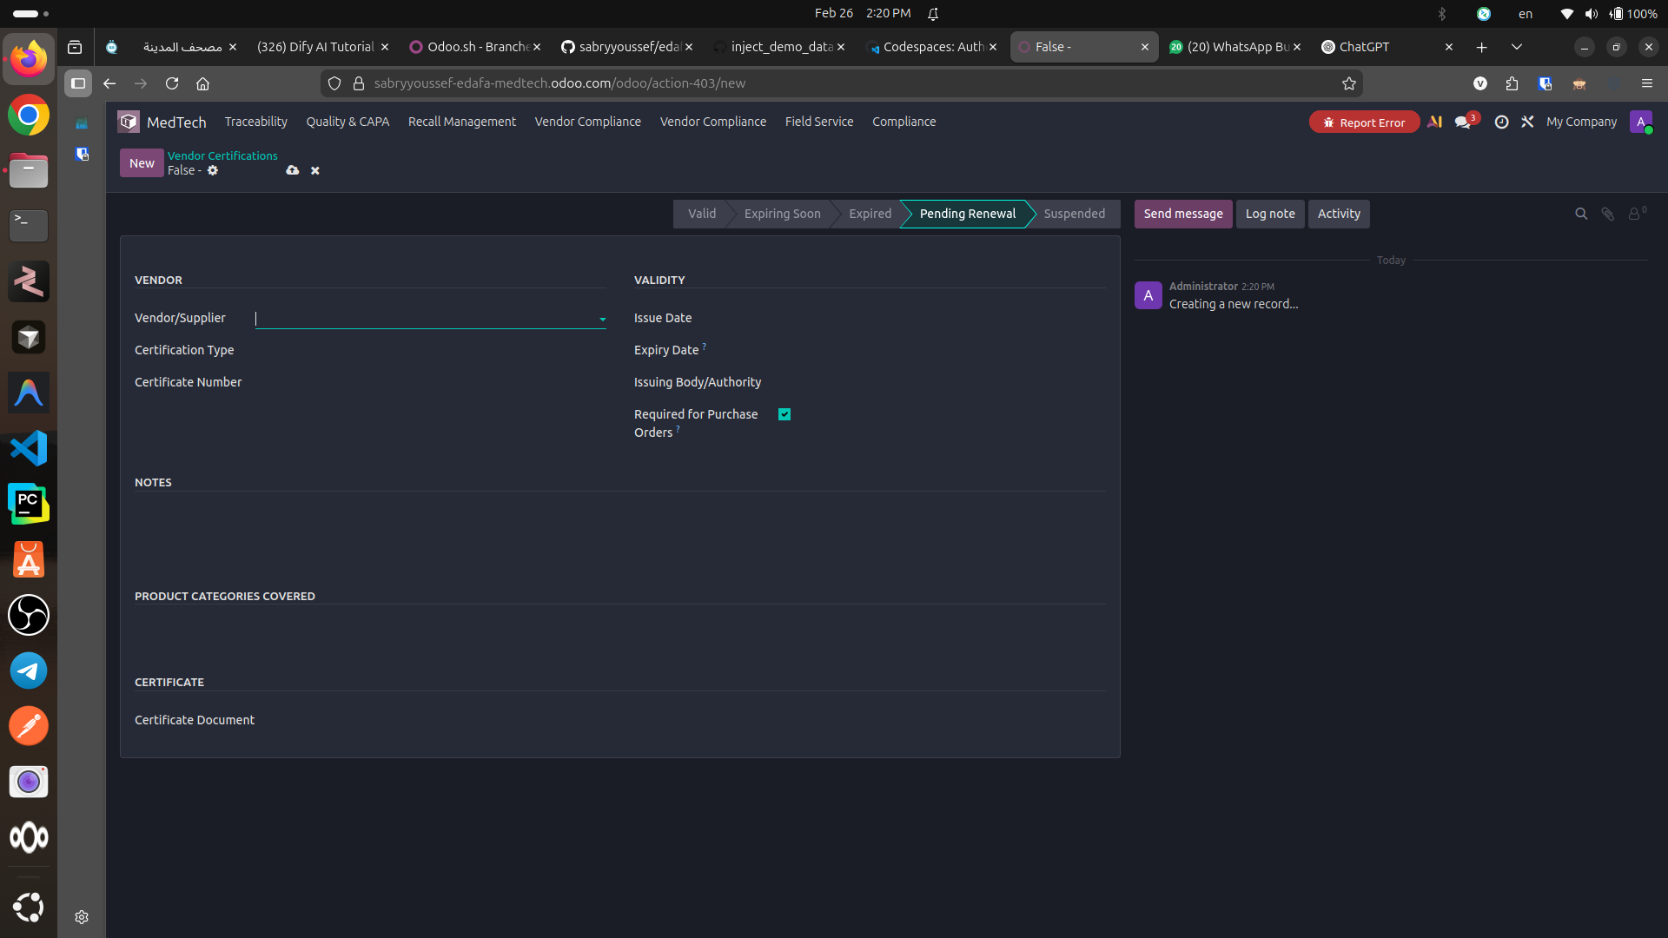
Step 14
Step 14 — Vendor Certification: maintain supplier certificates (type, number, issuing authority, validity dates). Enforce purchasing gates based on compliance status.

Slide 16
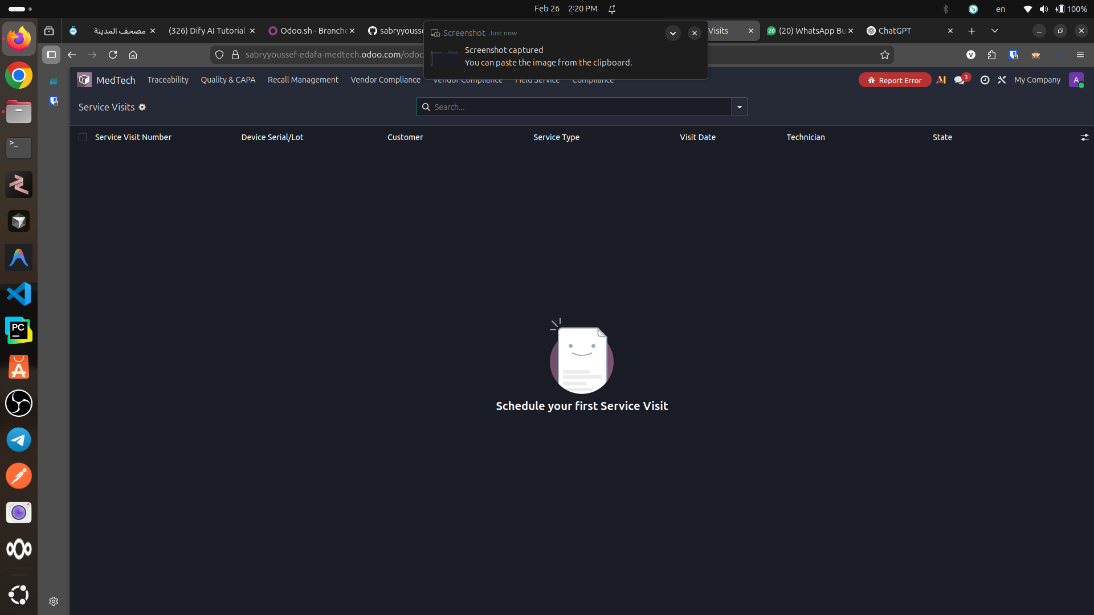
Step 15
Step 15 — Field Service Visits: plan and track onsite service by device serial/lot, customer, technician, and visit outcomes (service compliance + traceability).

Slide 17
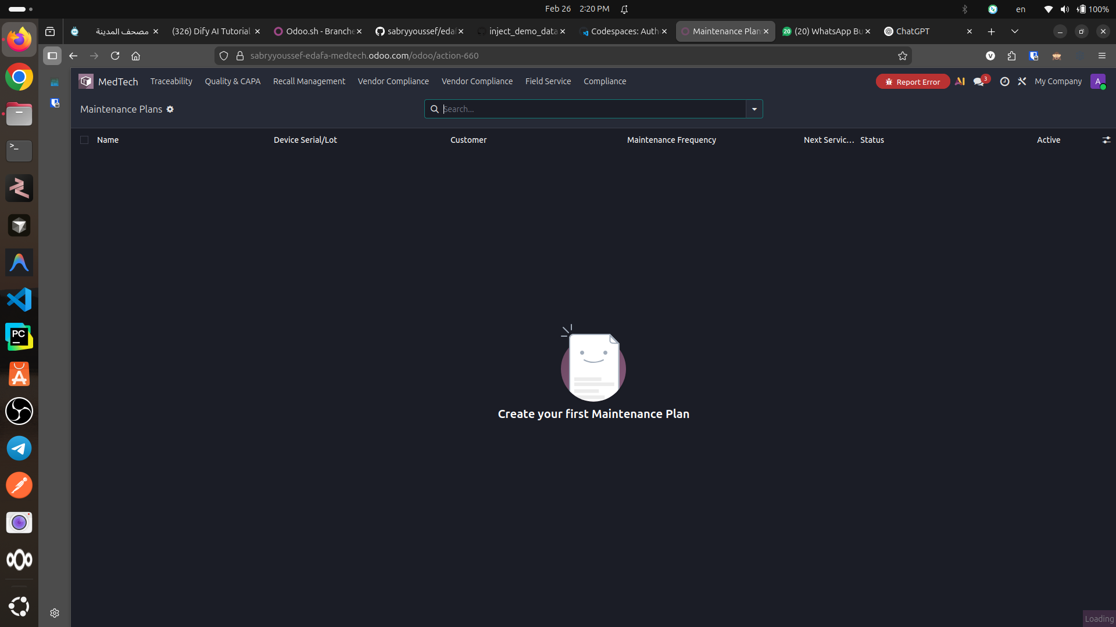
Step 16
Step 16 — Maintenance Plans: schedule preventive maintenance per device and customer, with frequency and next service date to reduce failures and support compliance.

Slide 18
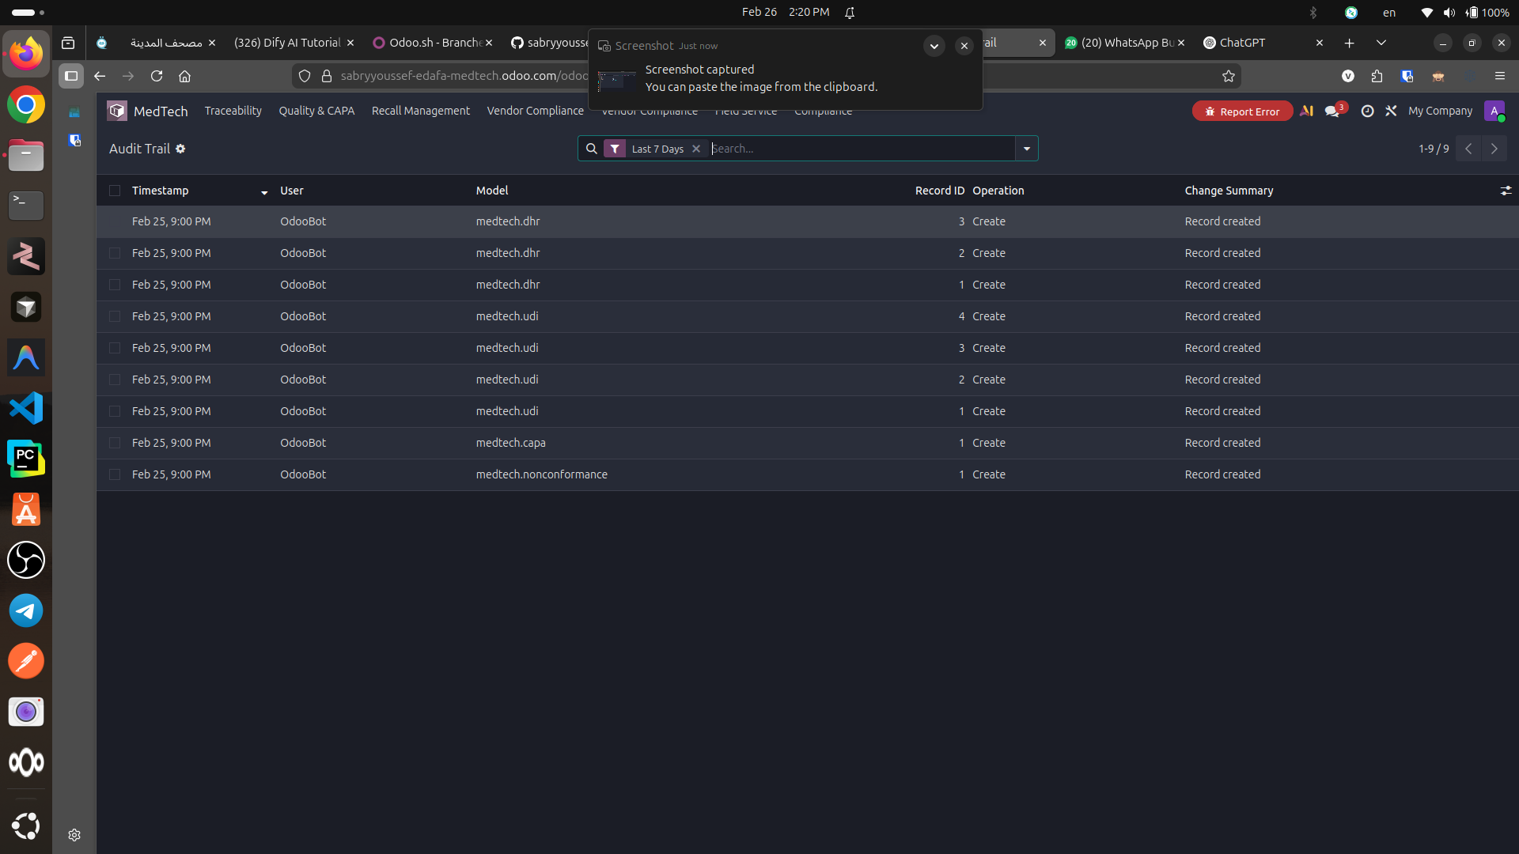
Step 17
Step 17 — Audit Trail (Log): system-level record of who did what and when across compliance models (UDI, DHR, CAPA, nonconformance). Essential for audits.

Slide 19
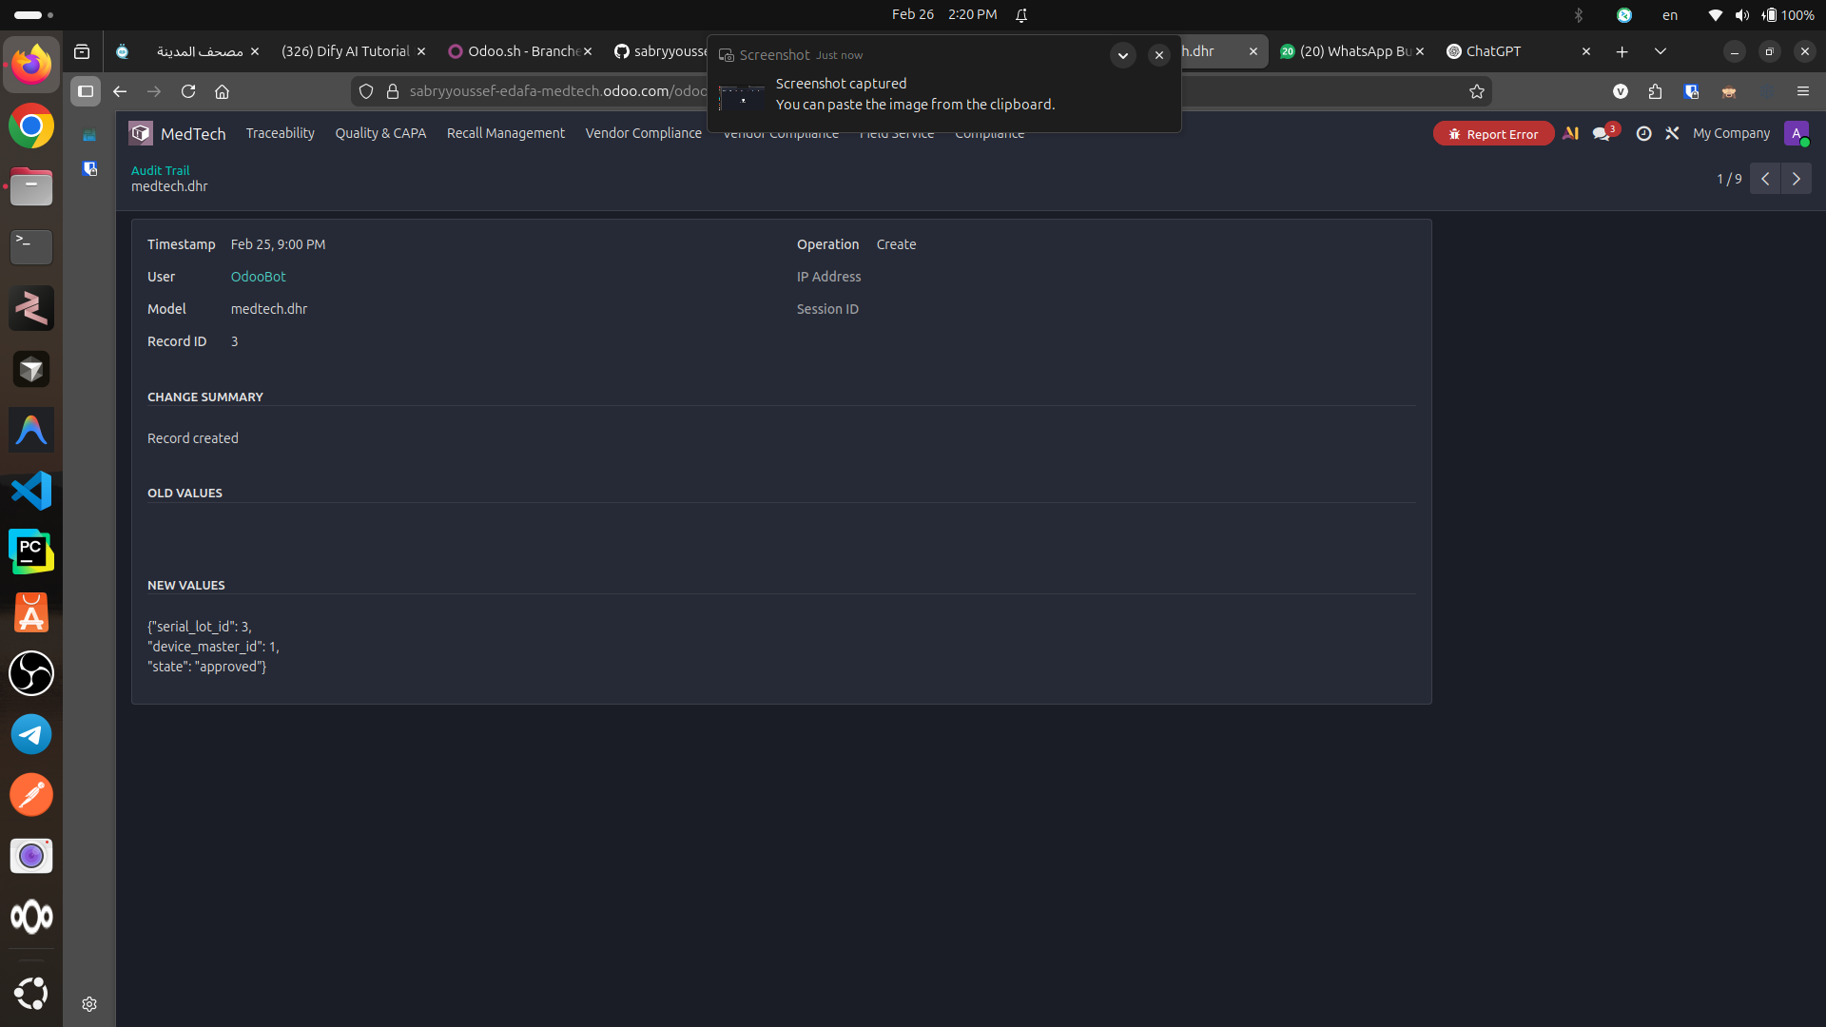
Step 18
Step 18 — Audit Trail Detail: view the exact create/update payload (old/new values). This is your forensic evidence for auditors and internal investigations.

Slide 20
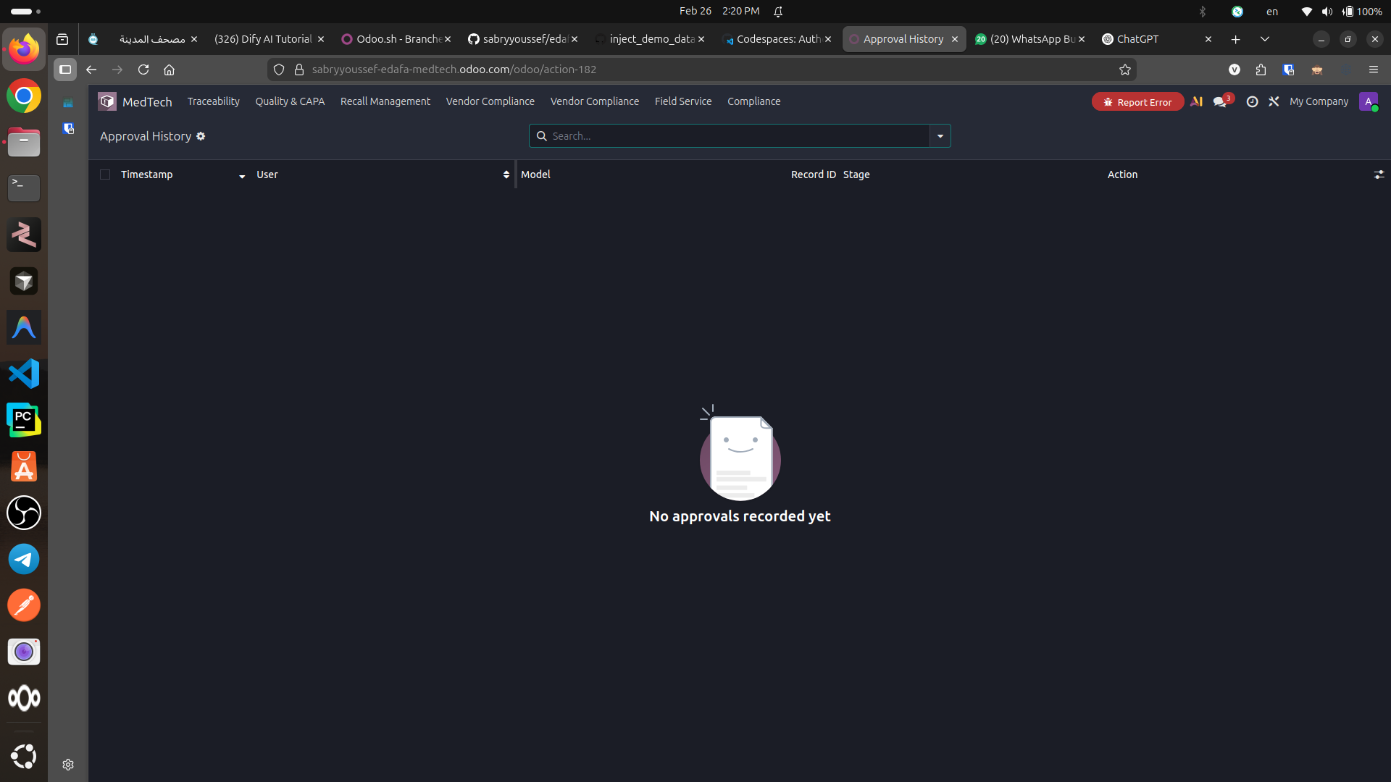
Step 19
Step 19 — Approval History: centralized history of approvals across workflows. Useful for governance reporting and demonstrating controlled processes.

