Slide 1
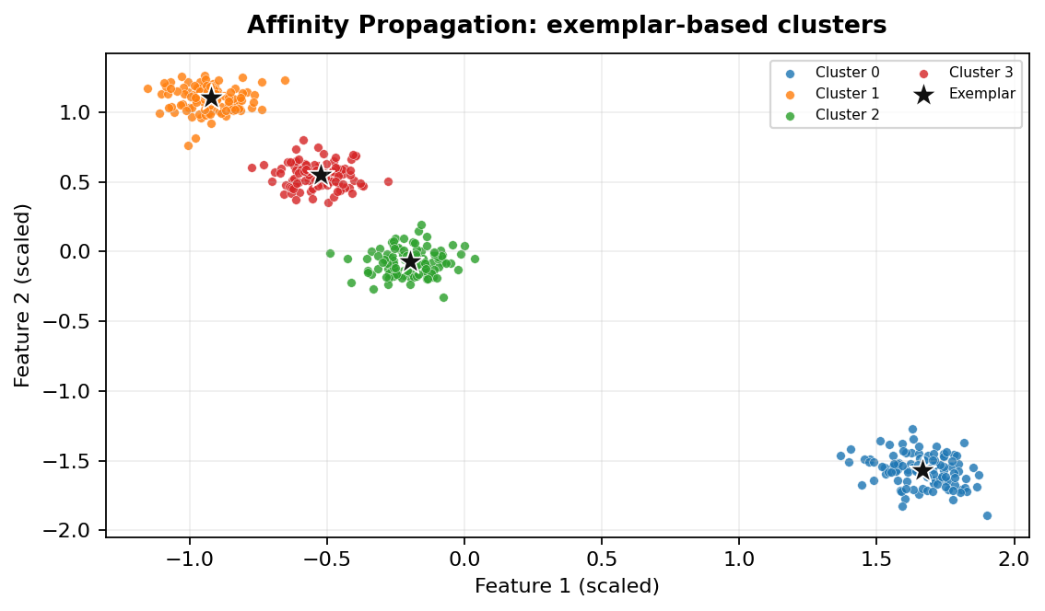
MACHINE LEARNING • UNSUPERVISED CLUSTERING
Affinity Propagation
1. What it does and when to use it
Find representative examples (exemplars) and let the data suggest the number of clusters.
Core idea
Points exchange messages about which other points should represent them. The selected exemplars become cluster representatives; nearby points are assigned to an exemplar.
Typical use cases
• Grouping products or documents around representative examples.
• Exploratory segmentation when the cluster count is not known.
• Small-to-medium datasets where pairwise similarities are practical.
01 / 18

Slide 2
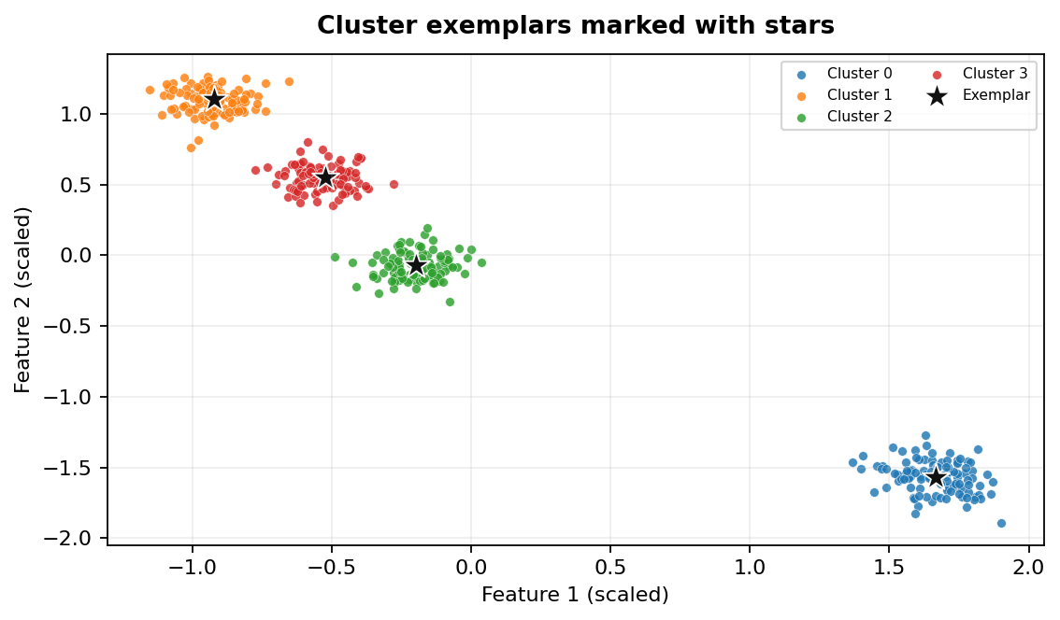
MACHINE LEARNING • UNSUPERVISED CLUSTERING
Affinity Propagation
2. Reading the graph and using it in Python
Typical workflow
• Prepare numeric features and handle missing values.
• Scale features when distance or neighbourhood calculations are used.
• Choose parameters based on data shape and domain knowledge.
• Fit the algorithm, inspect labels, then validate cluster quality.
Important parameters
preference: influences how many exemplars are selected; damping: stabilises message updates; affinity: similarity definition; max_iter and convergence_iter: stopping controls.
scikit-learn note
Use `AffinityPropagation(...).fit(X)` or `.fit_predict(X)`. Read `labels_` and `cluster_centers_indices_`; it is a model class, not the standalone `spectral_clustering()` function.
Interpretation: each colour represents a predicted cluster; black crosses indicate noise where applicable.
02 / 18

Slide 3
MACHINE LEARNING • UNSUPERVISED CLUSTERING
Affinity Propagation
3. Advantages, limitations and practical tips
PROS
CONS / WATCH-OUTS
✓ No need to specify the number of clusters in advance.
✓ Produces real data points as exemplars.
✓ Can work with a precomputed similarity matrix.
– Pairwise similarity storage can be expensive (roughly quadratic memory).
– Results can be sensitive to preference and damping.
– May converge slowly or fail to converge on difficult data.
03 / 18

Slide 4
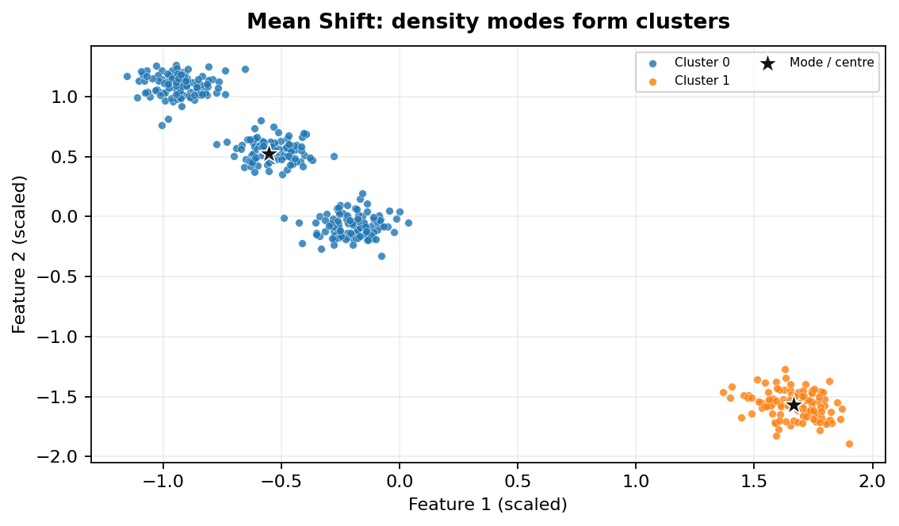
MACHINE LEARNING • UNSUPERVISED CLUSTERING
Mean Shift
1. What it does and when to use it
Discover dense regions by moving candidate centres toward local peaks in the data density.
Core idea
A window is placed around a point. The centre repeatedly shifts toward the mean of nearby points; points converging to the same density mode form a cluster.
Typical use cases
• Finding dense regions in image or feature-space segmentation.
• Exploratory grouping when the number of clusters is unknown.
• Locating modes or hotspots in spatial data.
04 / 18

Slide 5
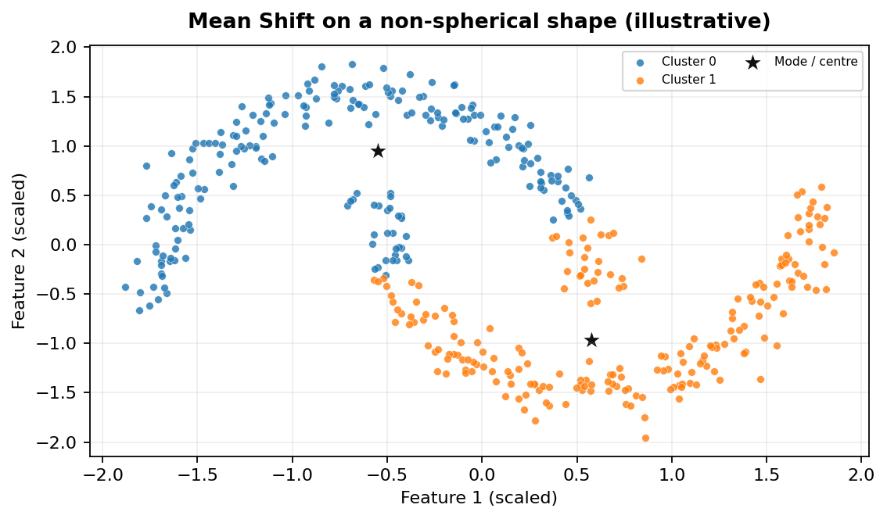
MACHINE LEARNING • UNSUPERVISED CLUSTERING
Mean Shift
2. Reading the graph and using it in Python
Typical workflow
• Prepare numeric features and handle missing values.
• Scale features when distance or neighbourhood calculations are used.
• Choose parameters based on data shape and domain knowledge.
• Fit the algorithm, inspect labels, then validate cluster quality.
Important parameters
bandwidth: neighbourhood/window size and the most important setting; bin_seeding: speeds up candidate seed selection; min_bin_freq: filters sparse seed bins.
scikit-learn note
Use `MeanShift(...).fit(X)` or `.fit_predict(X)`. Read `labels_` and `cluster_centers_`. Estimate bandwidth with `estimate_bandwidth()` when appropriate.
Interpretation: each colour represents a predicted cluster; black crosses indicate noise where applicable.
05 / 18

Slide 6
MACHINE LEARNING • UNSUPERVISED CLUSTERING
Mean Shift
3. Advantages, limitations and practical tips
PROS
CONS / WATCH-OUTS
✓ Does not require the number of clusters beforehand.
✓ Can identify irregularly shaped dense regions.
✓ Conceptually intuitive: clusters correspond to density peaks.
– Bandwidth selection strongly affects the result.
– Can be computationally expensive on large datasets.
– May merge nearby groups or split broad groups depending on bandwidth.
06 / 18

Slide 7
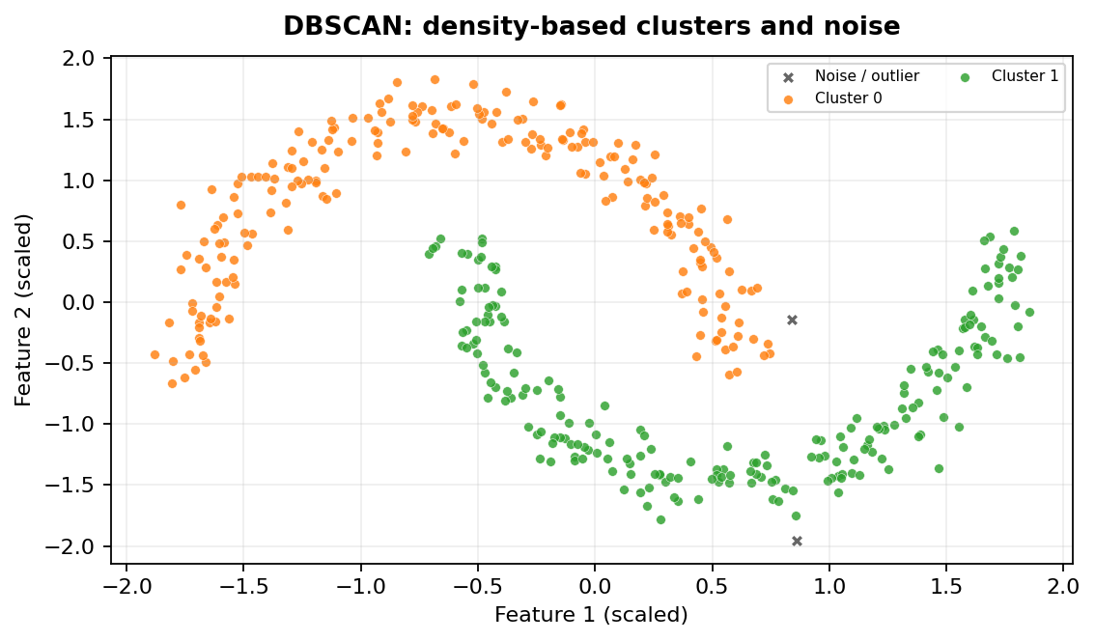
MACHINE LEARNING • UNSUPERVISED CLUSTERING
DBSCAN
1. What it does and when to use it
Group points connected through dense neighbourhoods and mark isolated points as noise.
Core idea
A core point has at least `min_samples` points within distance `eps`. Density-reachable points expand a cluster; points not assigned to a cluster are labelled noise (`-1`).
Typical use cases
• Geospatial hotspot and location clustering.
• Detecting outliers in sensor or transaction features.
• Clusters with non-spherical or irregular shapes.
07 / 18

Slide 8
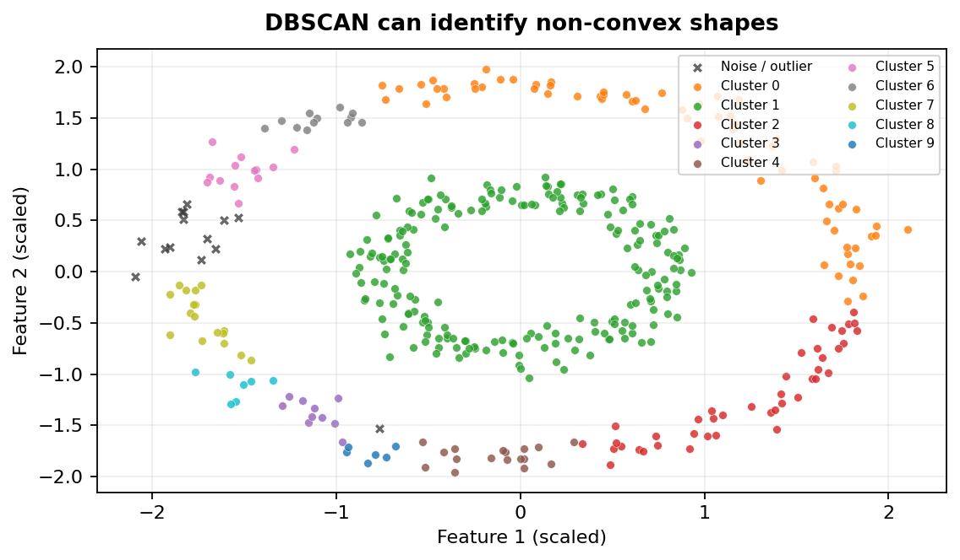
MACHINE LEARNING • UNSUPERVISED CLUSTERING
DBSCAN
2. Reading the graph and using it in Python
Typical workflow
• Prepare numeric features and handle missing values.
• Scale features when distance or neighbourhood calculations are used.
• Choose parameters based on data shape and domain knowledge.
• Fit the algorithm, inspect labels, then validate cluster quality.
Important parameters
`eps`: maximum neighbourhood distance; `min_samples`: density threshold; `metric`: distance measure; `algorithm` and `leaf_size`: neighbour-search controls.
scikit-learn note
Use `DBSCAN(...).fit(X)` or `.fit_predict(X)`. Read `labels_` and `core_sample_indices_`. DBSCAN has no `cluster_centers_` attribute; calculate a mean manually only if a representative mean is useful.
Interpretation: each colour represents a predicted cluster; black crosses indicate noise where applicable.
08 / 18

Slide 9
MACHINE LEARNING • UNSUPERVISED CLUSTERING
DBSCAN
3. Advantages, limitations and practical tips
PROS
CONS / WATCH-OUTS
✓ No need to specify the number of clusters.
✓ Finds arbitrary-shaped clusters.
✓ Explicitly identifies noise and outliers.
– One `eps` value may not fit clusters with very different densities.
– Sensitive to feature scaling and parameter choice.
– Distance-based neighbourhood queries can become costly in high dimensions.
09 / 18

Slide 10
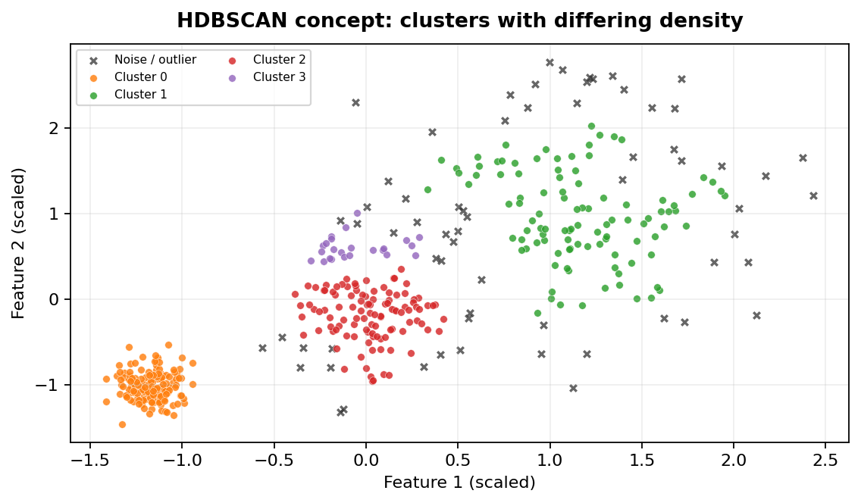
MACHINE LEARNING • UNSUPERVISED CLUSTERING
HDBSCAN
1. What it does and when to use it
Build a hierarchy of density-based clusters and select stable groups across density levels.
Core idea
HDBSCAN examines density structure at multiple distance scales, builds a cluster hierarchy, and selects clusters that persist (remain stable) across scales. It can label outliers as noise.
Typical use cases
• Data where clusters have different densities.
• Exploratory anomaly detection with noise labels.
• Complex datasets where DBSCAN's single `eps` is difficult to tune.
10 / 18

Slide 11

MACHINE LEARNING • UNSUPERVISED CLUSTERING
HDBSCAN
2. Reading the graph and using it in Python
Typical workflow
• Prepare numeric features and handle missing values.
• Scale features when distance or neighbourhood calculations are used.
• Choose parameters based on data shape and domain knowledge.
• Fit the algorithm, inspect labels, then validate cluster quality.
Important parameters
`min_cluster_size`: smallest group worth retaining; `min_samples`: conservativeness/density requirement; `metric`: distance measure; `cluster_selection_method`: how stable groups are selected.
scikit-learn note
Recent scikit-learn versions provide `from sklearn.cluster import HDBSCAN` (introduced in 1.3). Otherwise install the separate `hdbscan` package and use `import hdbscan`. Check your environment's version.
Interpretation: each colour represents a predicted cluster; black crosses indicate noise where applicable.
11 / 18

Slide 12
MACHINE LEARNING • UNSUPERVISED CLUSTERING
HDBSCAN
3. Advantages, limitations and practical tips
PROS
CONS / WATCH-OUTS
✓ Handles varying cluster densities better than a single-`eps` DBSCAN run in many cases.
✓ Does not require a fixed number of clusters.
✓ Provides useful membership strengths and outlier scores in supported implementations.
– More complex to explain and tune than DBSCAN.
– Can require substantial memory and computation.
– Results still depend on minimum cluster size, distance metric and data representation.
12 / 18

Slide 13
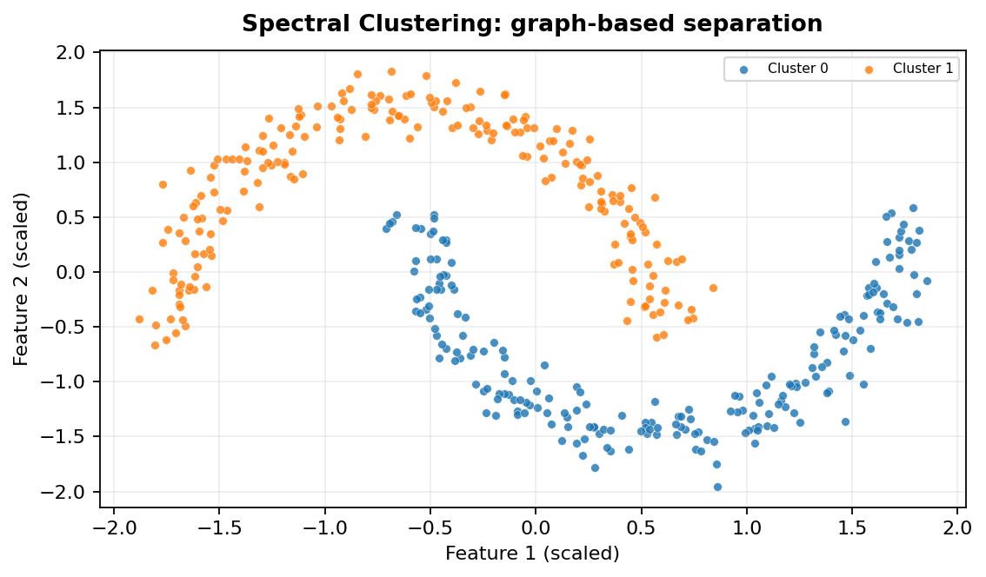
MACHINE LEARNING • UNSUPERVISED CLUSTERING
Spectral Clustering
1. What it does and when to use it
Represent data as a similarity graph, then use graph eigenvectors to reveal connected groups.
Core idea
Construct a similarity graph, compute a low-dimensional embedding from eigenvectors of its graph Laplacian, then cluster that embedding (commonly with KMeans).
Typical use cases
• Image segmentation and grouping pixels or regions.
• Non-convex structures such as two moons or concentric circles.
• Graph/community-style grouping when pairwise similarity is meaningful.
13 / 18

Slide 14
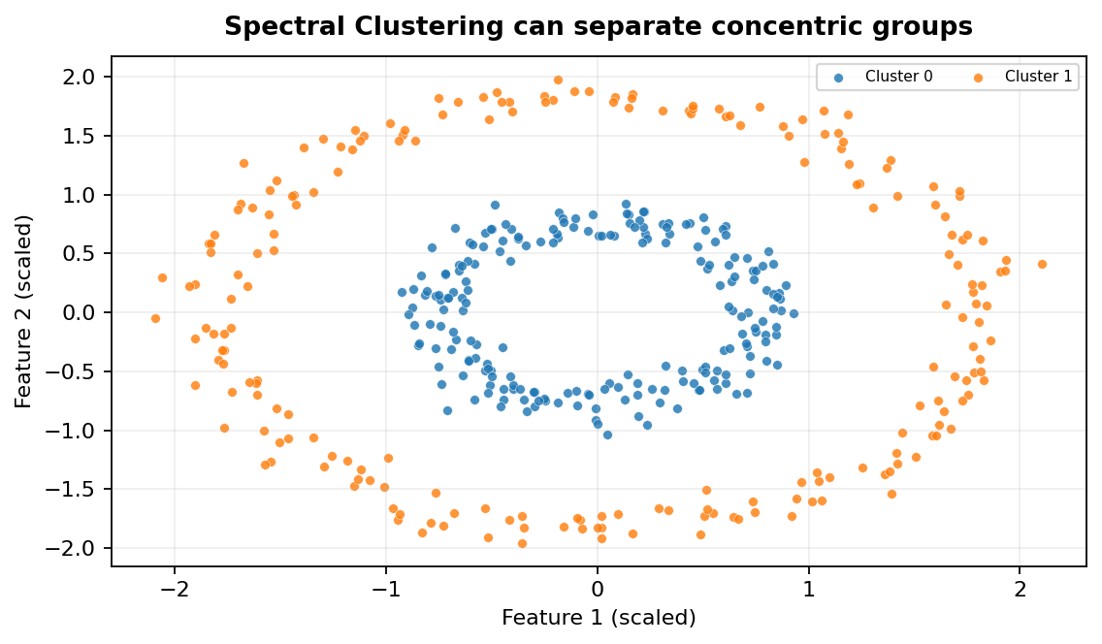
MACHINE LEARNING • UNSUPERVISED CLUSTERING
Spectral Clustering
2. Reading the graph and using it in Python
Typical workflow
• Prepare numeric features and handle missing values.
• Scale features when distance or neighbourhood calculations are used.
• Choose parameters based on data shape and domain knowledge.
• Fit the algorithm, inspect labels, then validate cluster quality.
Important parameters
`n_clusters`: desired groups; `affinity`: similarity construction (`nearest_neighbors`, `rbf`, or precomputed); `gamma`: RBF kernel width; `n_neighbors`: graph neighbourhood size.
scikit-learn note
Use `SpectralClustering(...).fit_predict(X)` for the estimator. `spectral_clustering(affinity_matrix, ...)` is a standalone function that takes a precomputed affinity matrix and returns labels.
Interpretation: each colour represents a predicted cluster; black crosses indicate noise where applicable.
14 / 18

Slide 15
MACHINE LEARNING • UNSUPERVISED CLUSTERING
Spectral Clustering
3. Advantages, limitations and practical tips
PROS
CONS / WATCH-OUTS
✓ Can separate non-convex shapes that challenge centroid methods.
✓ Flexible: similarity graph can encode domain-specific relationships.
✓ Useful when graph connectivity is more meaningful than raw distance.
– Usually requires the number of clusters in advance.
– Similarity graph construction and parameter choices matter greatly.
– Eigen-decomposition can be expensive for large datasets.
15 / 18

Slide 16
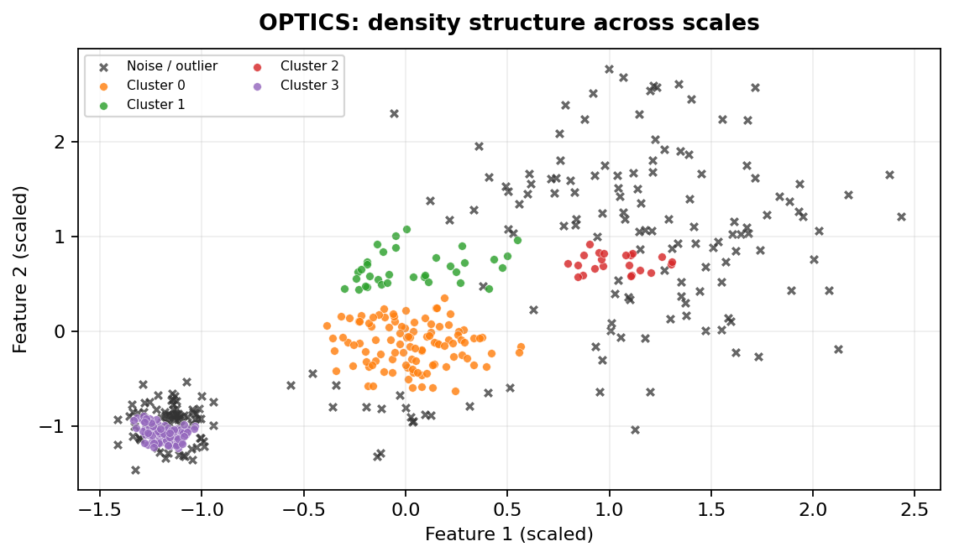
MACHINE LEARNING • UNSUPERVISED CLUSTERING
OPTICS
1. What it does and when to use it
Order points to reveal density structure across a range of neighbourhood radii.
Core idea
OPTICS creates an ordering of points and records each point's reachability distance. Valleys in the reachability plot often indicate dense clusters; extraction rules turn the ordering into labels.
Typical use cases
• Exploring data with clusters of different densities.
• Spatial analysis where a single DBSCAN `eps` is unsuitable.
• Density-based outlier analysis and cluster-structure exploration.
16 / 18

Slide 17
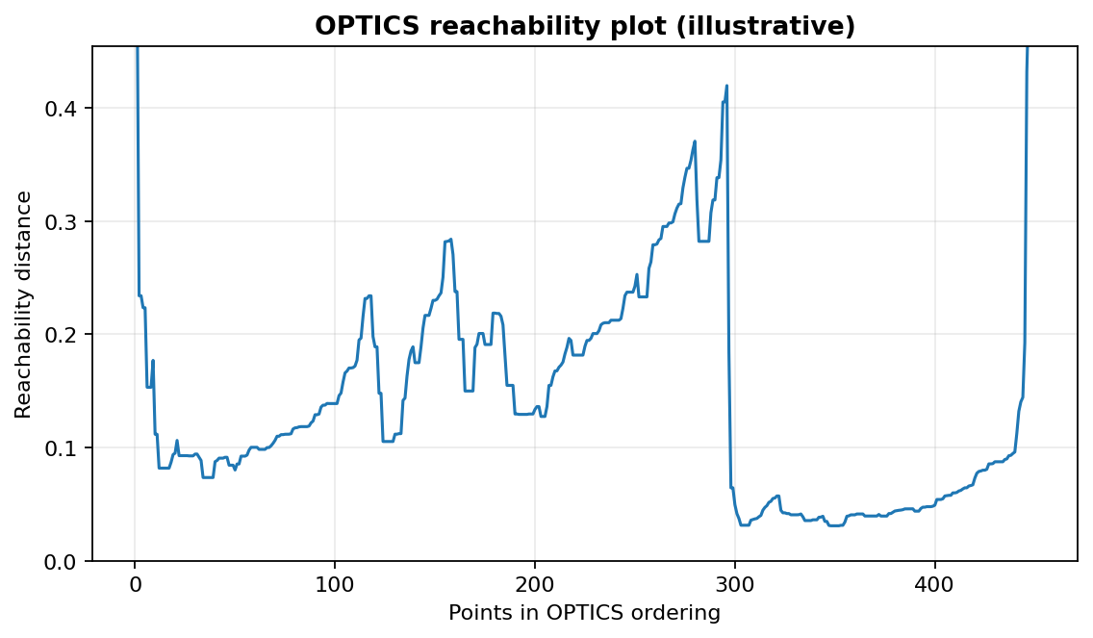
MACHINE LEARNING • UNSUPERVISED CLUSTERING
OPTICS
2. Reading the graph and using it in Python
Typical workflow
• Prepare numeric features and handle missing values.
• Scale features when distance or neighbourhood calculations are used.
• Choose parameters based on data shape and domain knowledge.
• Fit the algorithm, inspect labels, then validate cluster quality.
Important parameters
`min_samples`: neighbourhood density requirement; `max_eps`: search radius limit; `xi`: steepness threshold for automatic extraction; `min_cluster_size`: smallest extracted cluster.
scikit-learn note
Use `OPTICS(...).fit(X)` or `.fit_predict(X)`. Read `labels_`, `ordering_`, and `reachability_`. It does not provide KMeans-style centroids.
Interpretation: each colour represents a predicted cluster; black crosses indicate noise where applicable.
17 / 18

Slide 18
MACHINE LEARNING • UNSUPERVISED CLUSTERING
OPTICS
3. Advantages, limitations and practical tips
PROS
CONS / WATCH-OUTS
✓ Explores multiple density scales in one run.
✓ Can reveal clusters with varying densities.
✓ Produces a reachability plot that helps inspect cluster structure.
– The reachability plot can be harder to interpret than simple labels.
– Parameter choices still affect extracted clusters.
– May be slower than DBSCAN for some datasets and configurations.
18 / 18

