Slide 1
History
Chapai Nawabganj is located on the north-western part of Bangladesh. It is a part of the Rajshahi Division. Originally, it was a sub-division of Malda district. In 1947, it was severed from Malda and was given to East Pakistan as a sub-division of Rajshahi district. It became a separate district of Bangladesh in 1984. The north and west part of Chapai Nawabganj is bounded by Malda and Nadia of India, east is by Naogaon and south-east is by Rajshahi district.

Slide 2
About Chapainawabganj
The area of Chapainawabganj is 1702.55 Sq Km. It is under Rajshahi Division. There are 04 Municipalities in Chapainawabganj named Chapainababganj, Shibgonj, Rohonpur and Nachole. The number of Upazilla (sub district) in Chapai Nawabganj district is 05, named- Chapainababganj, Shibgonj, Nachole, Gomastapur and Volahat containing 45 Unions, 619 Mauzas and 1135 Villages.

Slide 3
About Chapainawabganj
The postal code of Chapai Nawabganj district is 6300 and NWD Code is 0781. Total Parliament seat in Chapai Nawabganj is 03. During the liberation war, Chapai Nawabganj was under Sector Number 07. Urbanization rate of the district is 19.44%. Average rainfall of the region is 186 cm.

Slide 4
Population
The total population of Chapai Nawabganj district is 16,47,521 (Male- 810,218 and Female- 837,303).Population Density 968/Sq Km and annual growth rate is 1.44%.

Slide 5
Literacy
The Literacy Rate of Chapai Nawabganj district is 42.90% (Male- 41.60% and Female- 44.30%). School attendance rate is 49.80% for 5 to 24 years age group.

Slide 6
River
Padma,
Mohanonda,
Punarbhaba,
Tangon,
Maragada,
Pagla,
Nondaguja etc.

Slide 7
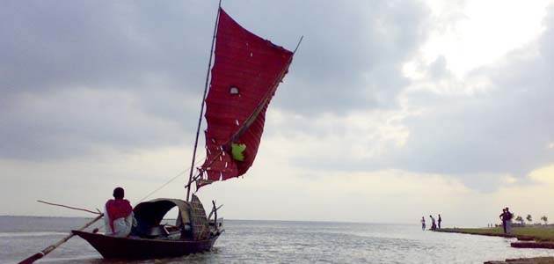

Slide 8
Mango, Guava, Jack-Fruit, Water Melon, Maize, Litchi, Oil seeds Paddy, jute, sugarcane, wheat, Betel Leaf, pulses, guava, Palm etc

Slide 9
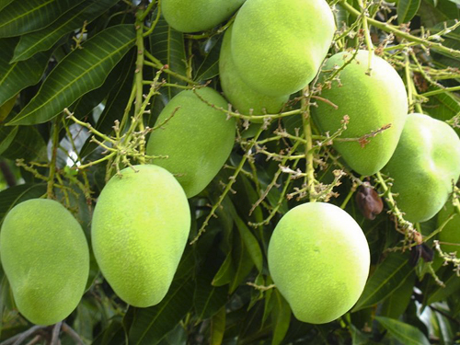

Slide 10
Historical Place
Choto Sona Mosque, Rajshadin Gaur of Bokhtier Khalgi, Graveyard and Mango Orchard of Shah Neamot Ullah, Landscape of Babu Dying, Kanchat Rajbari, Sah Suja Hambolkhana, Nowda Tomb, Darsbari, Shibmondir and couple of Temp in Huzabpur, Darashbari Mosque, Royal palace, Baragharia Kacharibari (Revenue Office), Chapai Mosque, Naoda Stupa (Buddhist monument), Nachole Palace, Graveyard of Birsresta Captain Mohiuddin Jahangir, Adina College and Idrishi Bhaban etc.

Slide 11
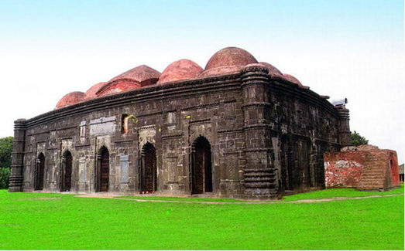

Slide 12
THANK YOU

