Slide 1
CN3: EXERCISE 1 INSTRUCTION

Slide 2
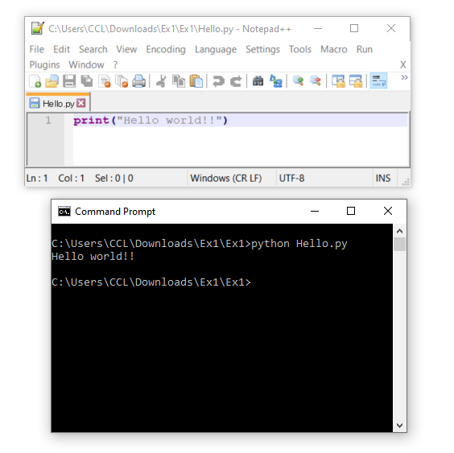
Software guides
How to run a Python file (https://en.wikibooks.org/wiki/Python_Programming/Creating_Python_Programs)
  python filename.py

Slide 3


Exercise-1
Internet
clientSocket.connect(destAddress)
# send the request
clientSocket.send(message.encode())
# start to receive the reply
response = clientSocket.recv(4096).decode()
Message
Response
Web server
Client
Your computer
** To answer Lab questions, complete the template “Client.py” in the folder

Slide 4
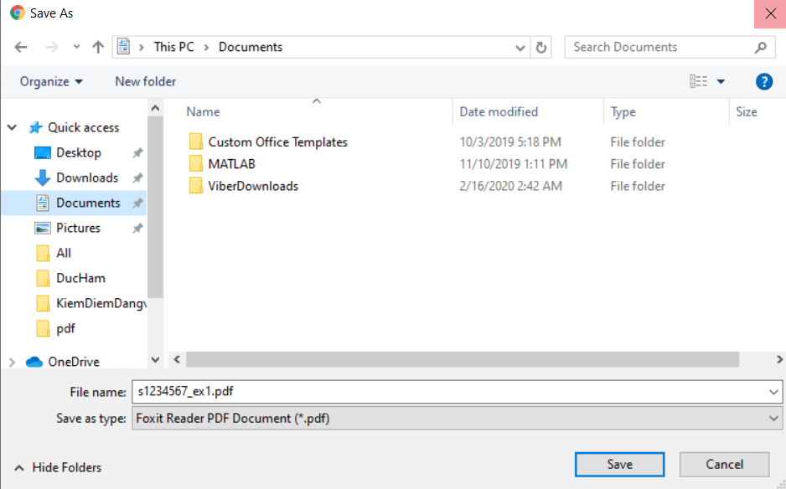
Report Submission
Save your report in .pdf file
N: Exercise number (1→4)
Example: s1234567_Ex1
yourStudentID_ExN

Slide 5
Report Submission
Each exercise has two parts:
  Lab questions: simple network programming with Python. Your answer should have codes, screen captures, and discussions.
  Homework questions: related to the knowledge of the lectures
Please submit your report as one PDF file to our eLMS (Moodle) site
If you have questions on exercises, please ask the TA

