Slide 1

Cost Estimation of superstructure of a rectangular One storied masonry building
CE 206
Engineering Computation Sessional
Presented By-
Md. Abdul Motin Khosru (1904136)
Md. Noyan Mony (1904142)
Rajesh Sharma Arghya (1904148)
Sabuj Biswas (1904154)
Sohely Anjum (1904160)
Md. Abdul Aziz (1904163)

Slide 2
Verandah
Verandah
Verandah
Room-01
Room-02
Room-01
Room-01
Room-02
Room-02
Case-01
Case-02
Case-03
Problem Analysis
Verandah
Verandah
Verandah
Room-01
Room-02
Room-01
Room-01
Room-02
Room-02
Case-04
Case-05
Case-06
Notes:
Summary:
Total six case
Pattern Differs only in two case

Slide 3
Inputs:
Dimension of the Plan (inner edge to inner edge)
Dimension of Room-01?
Dimension of Room-02?
Dimension of Veranda? (Outer Edge to Outer Edge)
Height of Section?
Dimension of Column? (in [x y] direction)
Number of Column in Verandah?
Dimension of door [x z]
Number of door
Dimension of window [x z]
Number of window
No of Stairs
Length of Stairs
Dimension of cornice in [x y] direction
Thickness of Cornice
Height and Thickness of Parapet Wall (in [h t] format)
No of Common Door?
Total Dropwall Length in [x y] direction
Height and Thickness of Dropwall? (in [h t] format)
No of Common Window between rooms and verandah
Number of Outside Window
Steps of Solving

Slide 4
Flowchart
Start
Inputs
Check for Conditions
Not Satisfied
Satisfied
Steps of Solving
Estimate amount and cost of
Materials
Show Error Message
End

Slide 5
Output:
Quantity and Total Cost of:
BFS
CC
Floor Finish
Brickwork in superstructure
RCC in Column
RCC in Lintel
RCC in Roof
Lime Concrete in Roof
Bricks in Parapet
Brickwork in Stair
Inside Plastering
Outside Plastering
Skirting
RCC in dropwall
Steps of Solving

Slide 6
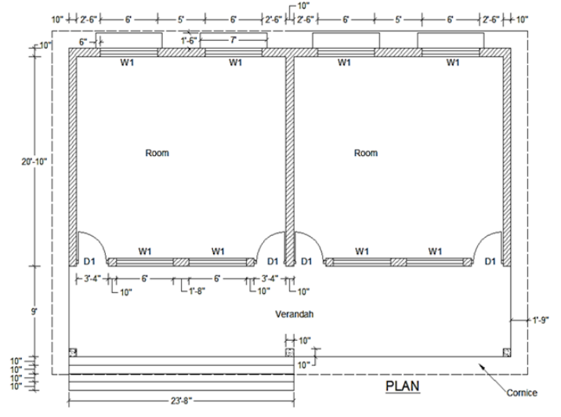
Example

Slide 7
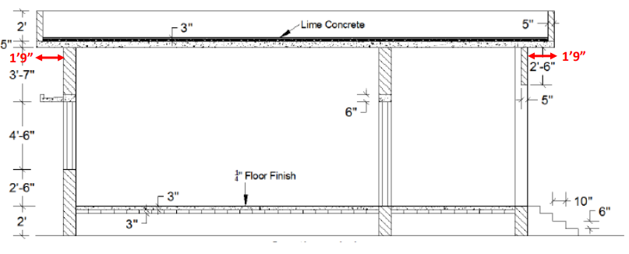
Example

Slide 8
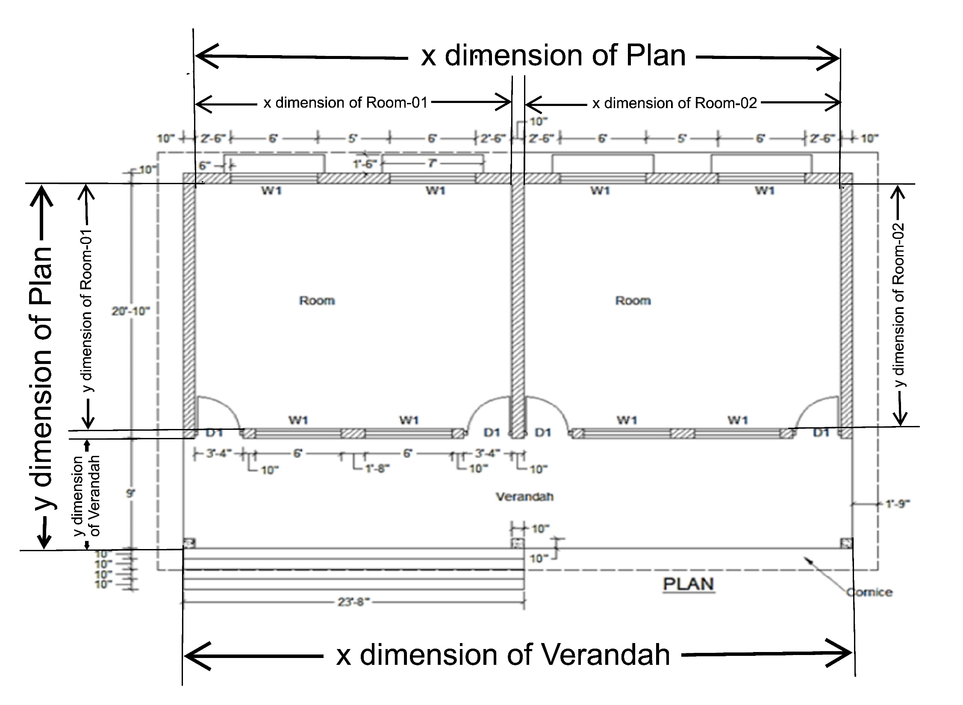
Room -01 22’x20’
Room -02 22’x20’
Example
Verandah 46’6”x9’

Slide 9
Condition Explanation (Case-01):
if ((r1(1)+r2(1)+tw==p(1))&&(r1(2)+v(2)+tw==p(2))&&(r1(1)+r2(1)+3*tw==v(1))&&r1(2)==r2(2))
Dimension of Room-01: r1(1)= 22; r1(2)= 20;
Dimension of Room-02: r2(1)= 22; r2(2)=20;
Dimension of Verandah: v(1)= 46.5’; v(2)= 9;
Dimension of Plan: p(1)= 44.8333’; p(2)= 29.8333’
Wall Thickness: tw=0.8333’ ;
Check For Conditions:
i) r1(1)+r2(1)+tw= 22+22+0.8333= 44.833’;
ii) r1(2)+v(2)+tw= 20+9+0.8333= 29.833’;
iii) r1(1)+r2(1)+3*tw= 22+22+3*0.8333= 46.5’;
iv) r1(2)=r2(2)=20’;
Example

Slide 10
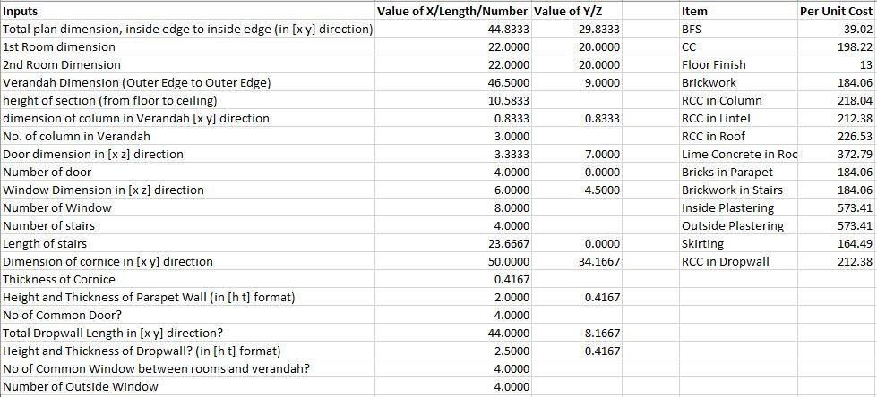
Inputs
Example

Slide 11
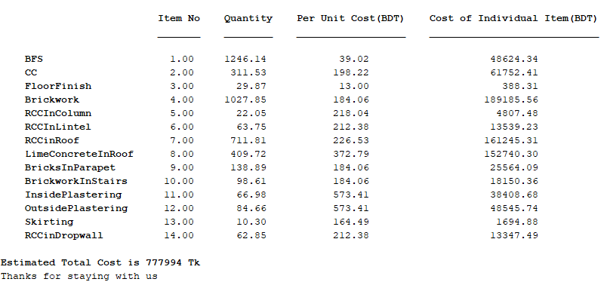
Output
Example

Slide 12
THANK YOU

