Slide 1
ADVANCED MEDICAL IMAGING RESEARCH
Physics-Informed AI for Better Breast Cancer MRI
A 6,400× Speedup in Quantitative IVIM Parameter Mapping via Two-Stage Deep Learning
AAPM IVIM Challenge • VICTRE Digital Breast Phantoms (400 Test Patients)

Slide 2
BACKGROUND
The Clinical Motivation: Why Breast MRI Needs AI
01 / High Cancer Burden
• Leading Women's Cancer
Breast cancer is the most common malignancy worldwide with 2.3M diagnoses annually.
• Dense Tissue Limit
Standard mammography struggles with dense breast tissue, making MRI critical for screening.
02 / Contrast Dye Risks
• Gadolinium Exposure
Conventional contrast MRI requires injecting dyes, posing health risks for kidney patients.
• Contrast-Free IVIM
Diffusion MRI (DW-MRI) tracks natural water movement — requiring zero contrast injections.
03 / Math Fitting Trap
• Slow CPU Fitting
Traditional non-linear curve fitting (NLLS) takes ~4 minutes per patient slice.
• Noisy Output
Fails under clinical noise, producing grainy, unreliable maps that impede diagnosis.

Slide 3
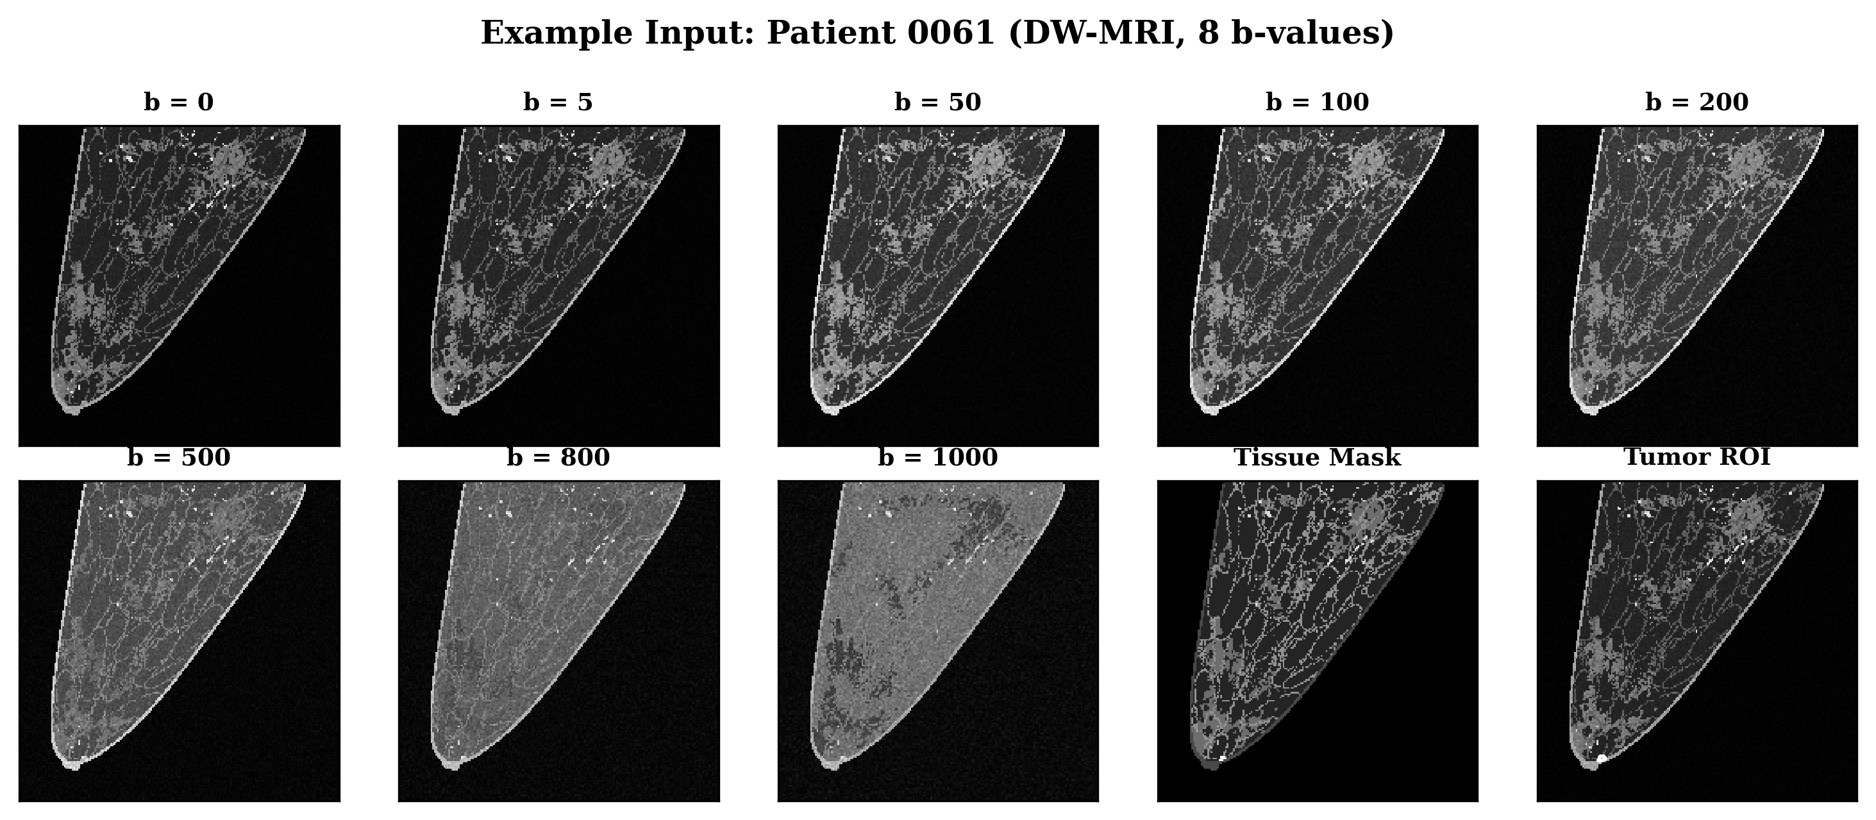
BIOPHYSICAL BASIS
What is IVIM? Water Diffusion & Micro-Blood Flow
Separating Two Microscopic Signals
• Perfusion Fraction (f)
Measures micro-capillary blood volume. Elevated in malignant tumors due to tumor-induced blood vessel growth (angiogenesis).
• Tissue Diffusivity (Dt)
Measures true water molecule movement through tissue. Restricted in dense, cell-packed tumor environments.
• Pseudo-Diffusivity (D*)
Measures blood flow velocity in tiny capillaries. Helps radiologists distinguish benign vs. malignant lesions.

Slide 4
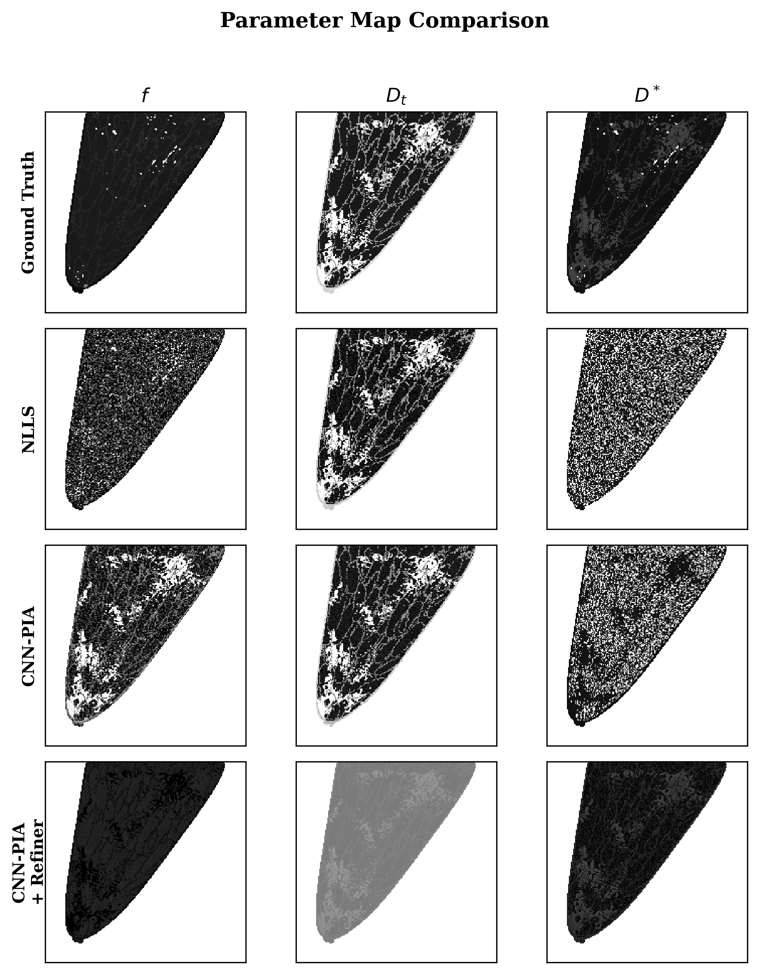
THE CHALLENGE
Why Traditional Curve Fitting (NLLS) Fails in Practice
Limitations of NLLS Fitting
— Sequentially Slow
Fits 40,000 pixels one-by-one on CPU cores. Requires ~4 minutes per 2D slice and cannot run on GPU.
— Ignores Spatial Context
Treats every pixel in isolation, discarding natural anatomical continuity across neighboring tissue regions.
— Extreme Noise Sensitivity
Fails to converge or outputs heavy salt-and-pepper noise at realistic clinical noise levels.

Slide 5
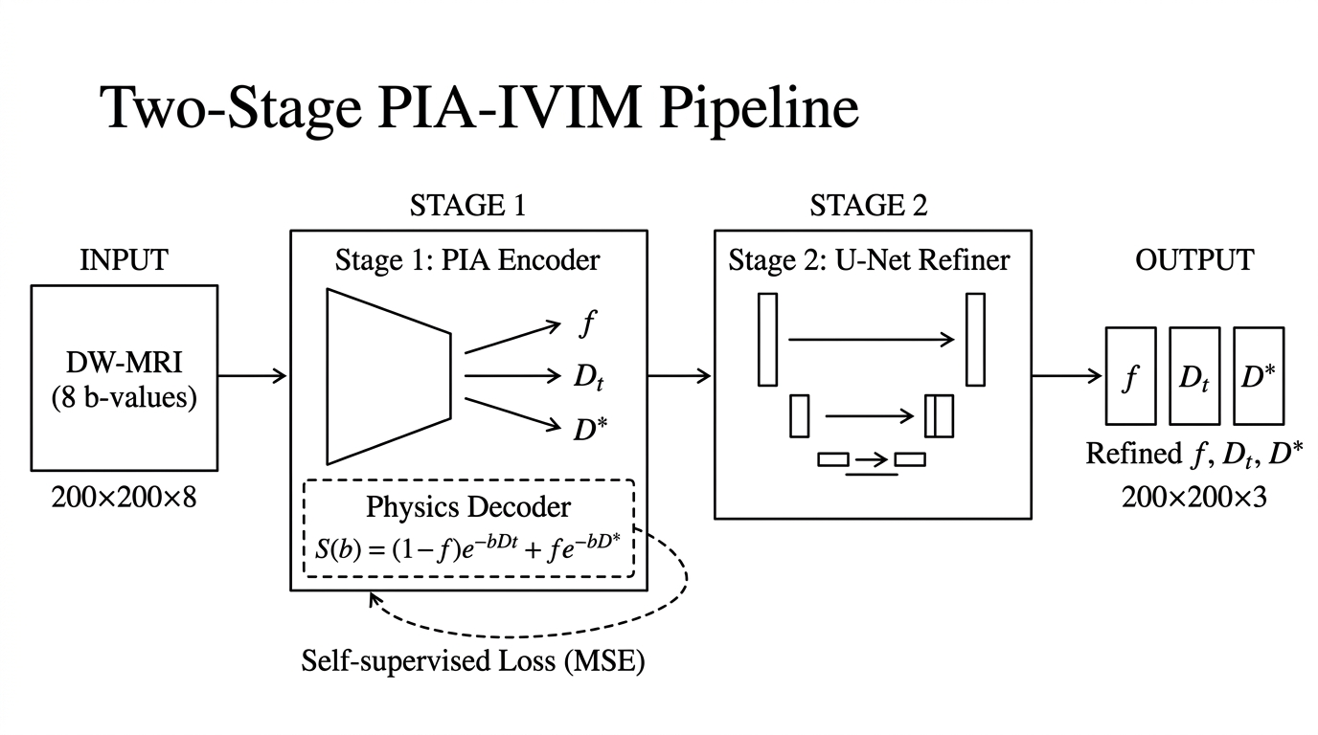
PIPELINE ARCHITECTURE
The Proposed Solution: Two-Stage Physics-Informed AI

Slide 6
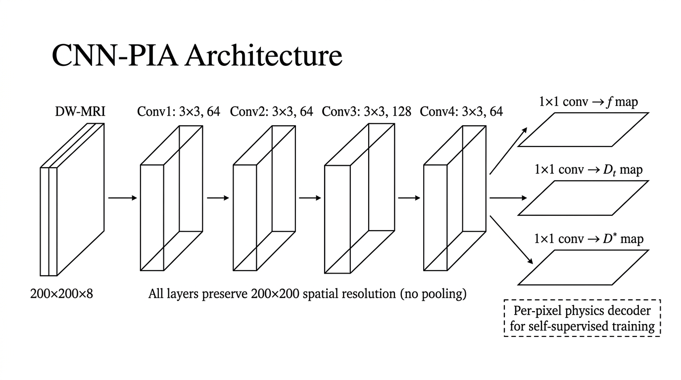
STAGE 1 ARCHITECTURE
Stage 1: Physics-Informed Autoencoder (PIA)
Self-Supervised Physics Decoder
• Self-Supervised Learning
Trains directly on raw DW-MRI signal decay without requiring expert-annotated parameter labels.
• Embedded Physical Decoder
The decoder is the exact bi-exponential physics model: S(b) = (1-f)e^(-bDt) + fe^(-bD*).
• Biological Parameter Bounds
Enforces strict physical parameter limits through bounded activation functions (f in [0.05, 0.35]).

Slide 7
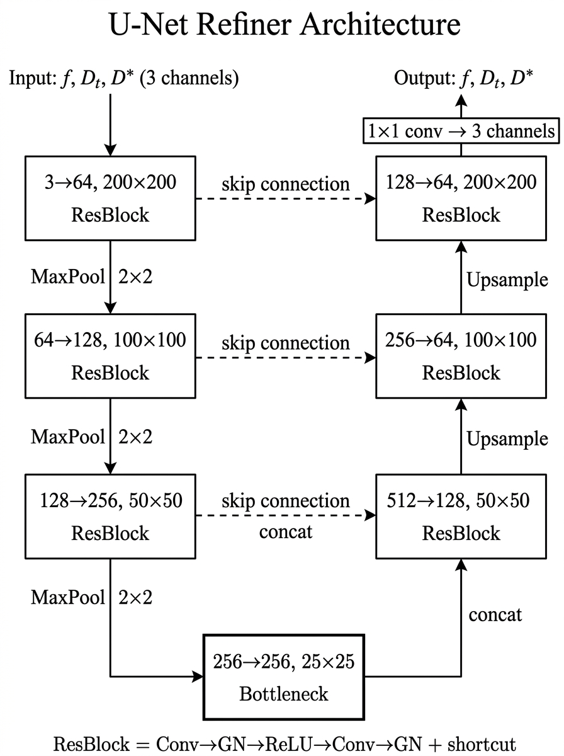
STAGE 2 ARCHITECTURE
Stage 2: Spatial Refiner (U-Net Denoising)
Exploiting Multi-Scale Spatial Context
• 3.5M Parameter U-Net
Processes all 3 Stage 1 parameter maps together to leverage spatial continuity across pixels.
• Multi-Scale Residual Blocks
Downsamples images through ResBlocks to analyze broad regional context, then upsamples back to 200×200 resolution.
• Tumor-Weighted Supervision
Trained with extra loss weighting over tumor regions to maintain sharp boundary definition around malignancies.

Slide 8
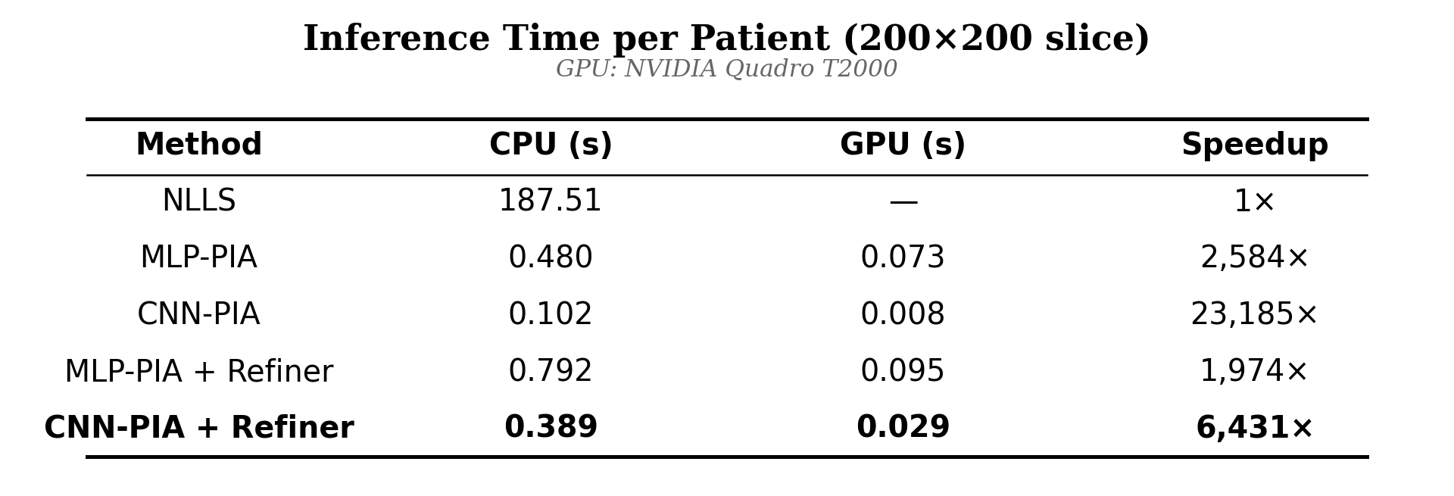
PERFORMANCE BENCHMARK
Result 1: 6,400× Speedup for Real-Time Diagnostics
GPU INFERENCE SPEED
29 ms
per patient slice on GPU (vs. 187 seconds for NLLS)
• 6,431× Speedup vs. NLLS • Real-time mapping directly on MRI console workstations while the patient is still scanning.

Slide 9
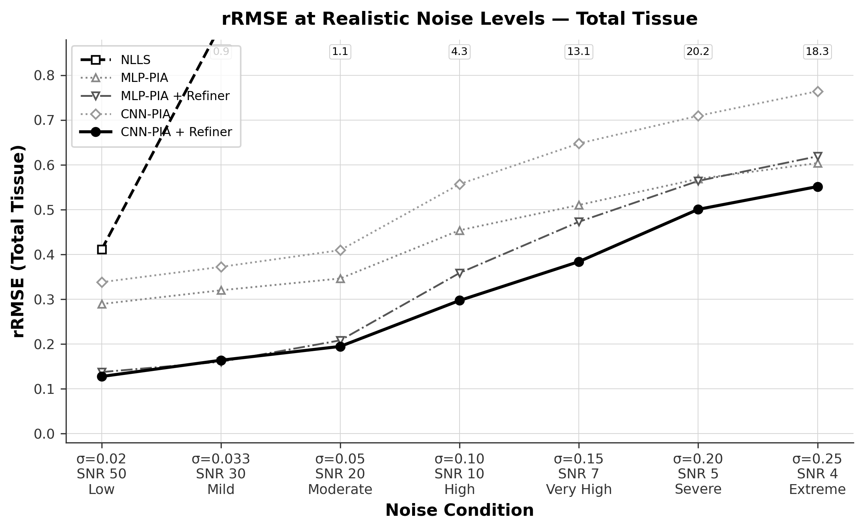
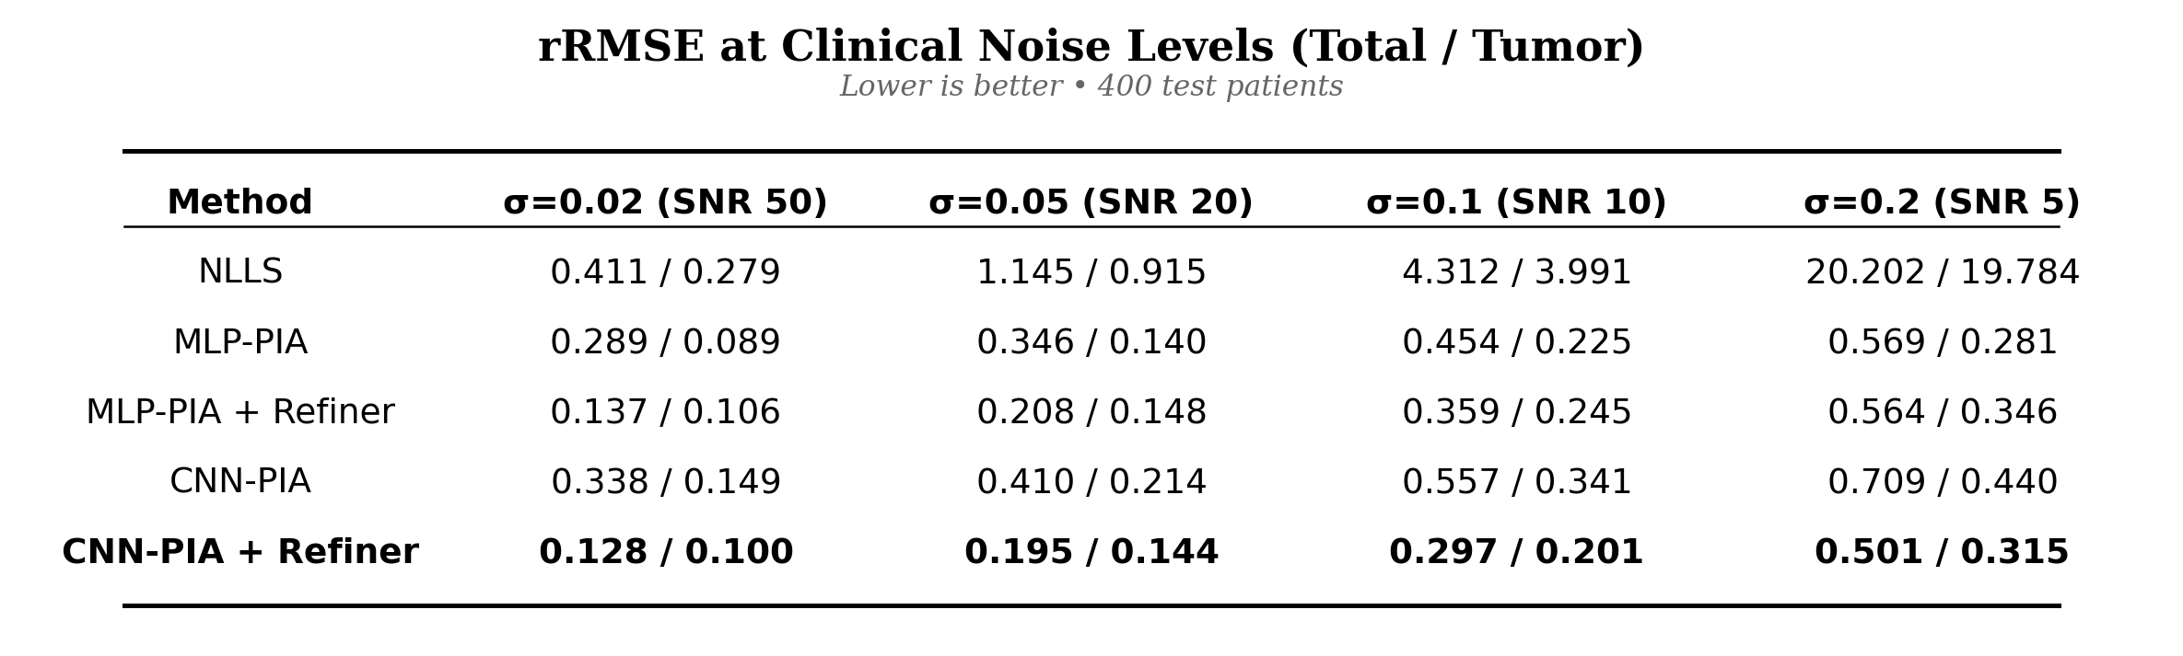
NOISE ROBUSTNESS
Result 2: High Stability Across Clinical Noise Levels

Slide 10
QUALITATIVE EVALUATION
Visual Proof: Parameter Map Quality
Key Observations
— Ground Truth
Reference biophysical parameter maps derived from VICTRE breast phantoms.
— NLLS Fitting
Heavy salt-and-pepper noise and lost tissue contrast make diagnosis impossible.
— CNN-PIA (Stage 1)
Captures clear macro structure but retains mild pixel-level variance.
— CNN-PIA + Refiner
Reconstructs smooth, crisp parameter maps nearly identical to Ground Truth.

Slide 11
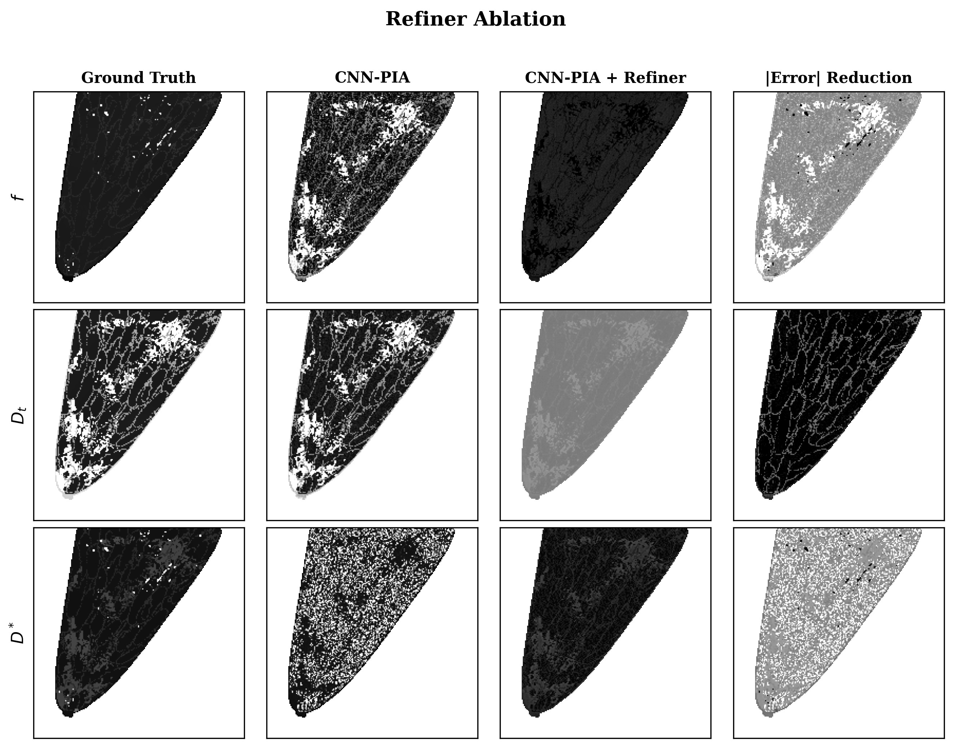
ABLATION STUDY
Refiner Ablation: Visualizing Error Reduction

Slide 12
REAL-WORLD VALUE
Clinical Impact: Advancing Breast Cancer Diagnostics
HOSPITALS & RADIOLOGISTS
Real-Time Console Runs
Executes in 29 milliseconds directly on scanner workstations, giving radiologists immediate quantitative maps during patient exams.
PATIENTS
Contrast-Free Screening
Enables high-accuracy microvascular imaging without gadolinium contrast dye injections — completely safe for renal patients.
RESEARCH & BEYOND
Self-Supervised & Scalable
Requires zero expert-annotated labels for Stage 1. Readily adaptable to prostate, brain, liver, and pancreatic IVIM MRI protocols.

Slide 13
SUMMARY & CONCLUSION
PIA-IVIM: A Breakthrough for Breast DW-MRI
— 6,431× Speedup: 29 ms per patient slice on GPU vs. 187 seconds for NLLS fitting.
— 33× Noise Stability: Total rRMSE of 0.28 vs. 9.4+ for NLLS at high noise (SNR 10).
— Physics + AI Synergy: Combines a self-supervised physics autoencoder with a multi-scale U-Net spatial refiner.
— Clinical Value: Enables safe, rapid, contrast-free quantitative screening for breast cancer diagnostics.

