Slide 1
Physics-Informed Variational Autoencoders for Prostate MRI
Can a neural inverse model quantify its own uncertainty at clinical noise?
Sabyasachi Chowdhury · Aaron Garay
MS Applied Data Science Capstone · The University of Chicago
In collaboration with the Sanford J. Grossman Center of Excellence in Prostate Imaging and Image-Guided Therapy

Slide 2
Prostate cancer is over-biopsied because the imaging is ambiguous
≈168,000 men per year in the US undergo a biopsy after a false-positive PSA test — an invasive procedure driven by a blood test that cannot distinguish indolent from aggressive disease.
MRI could triage them. Benign and malignant prostate tissue differ in what they are made of: cancer replaces open glandular lumen with dense epithelium.
But standard multiparametric MRI returns a radiologist's score (PI-RADS), not a measurement. It is subjective and it does not say what the tissue is.
The quantitative alternative: estimate the actual tissue composition of every voxel — how much epithelium, stroma, and lumen it contains.
Where this work sits. The obstacle is not the scanner. It is the estimation problem that turns a scan into numbers.
THE INVERSE PROBLEM
16 MRI measurements per voxel
↓
9 tissue parameters per voxel
Nonlinear, near-degenerate, and measured at SNR ≈ 20:1.

Slide 3
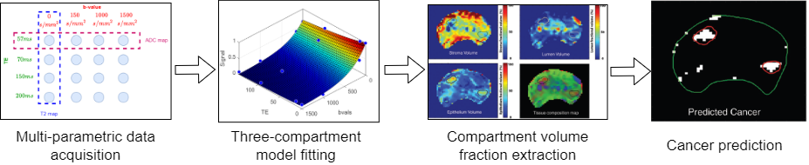
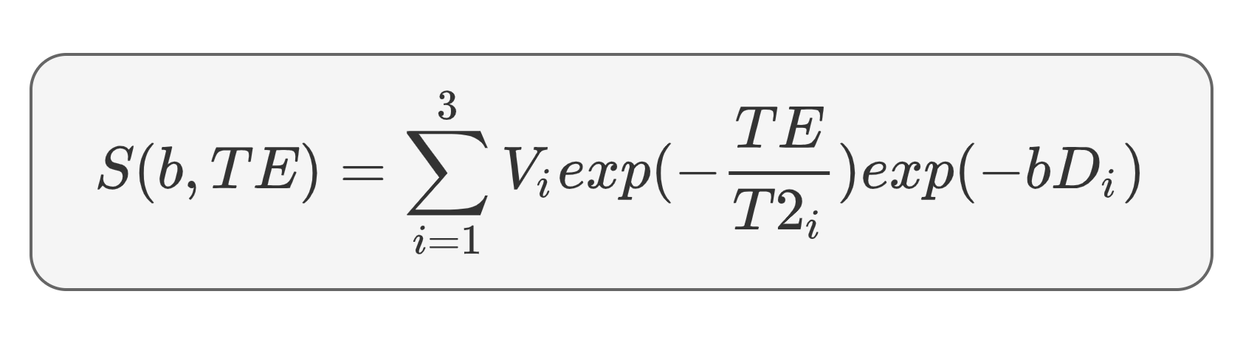
Hybrid Multidimensional MRI turns a scan into a composition map
Established method — Grossman Center, UChicago (Chatterjee et al., Radiology 2018 / 2022)
1. Collect a 4x4 matrix of signals as a function of ‘b’ and ‘TE’ for each image voxel
3. This fit yields volume fractions of stroma, lumen, and epithelium in each voxel
4.Tissue composition provides a cancer risk map
2. Fit 3-compartment model in ‘b’/’TE’ space
Diagram reproduced from the 8/16/2024 Grossman Center progress report.

Slide 4
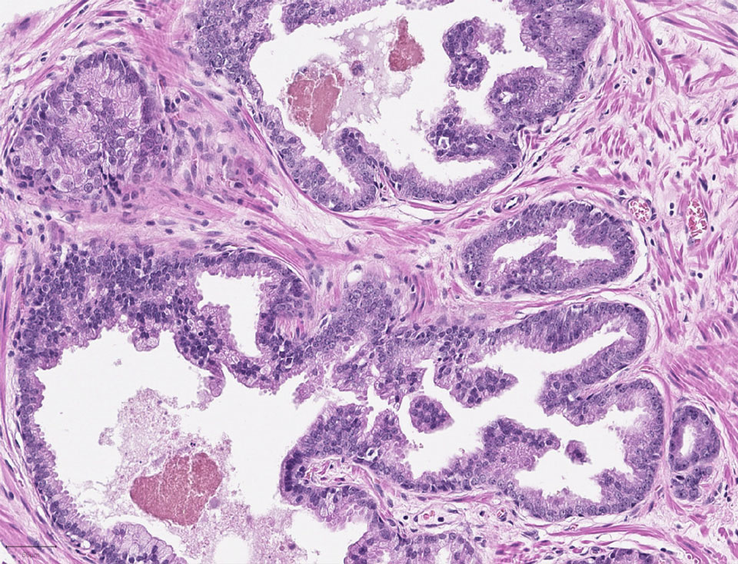

Three tissue compartments, nine numbers per voxel
Histology defines the compartments; each one decays differently along b and TE
epithelium
stroma
lumen
Signal decay along b and TE
Compartment | D (10⁻³ mm²/s) | T₂ (ms) | Biological meaning
Epithelium | 0.30 – 0.70 | 20 – 70 | Cell-dense; expands with cancer
Stroma | 0.70 – 1.70 | 40 – 100 | Fibromuscular supporting tissue
Lumen | 2.70 – 3.00 | 500 – 1000 | Fluid-filled gland space; lost to cancer
Signal model: Panagiotaki et al. (2014). Figure reproduced from the 8/16/2024 Grossman Center progress report.

Slide 5
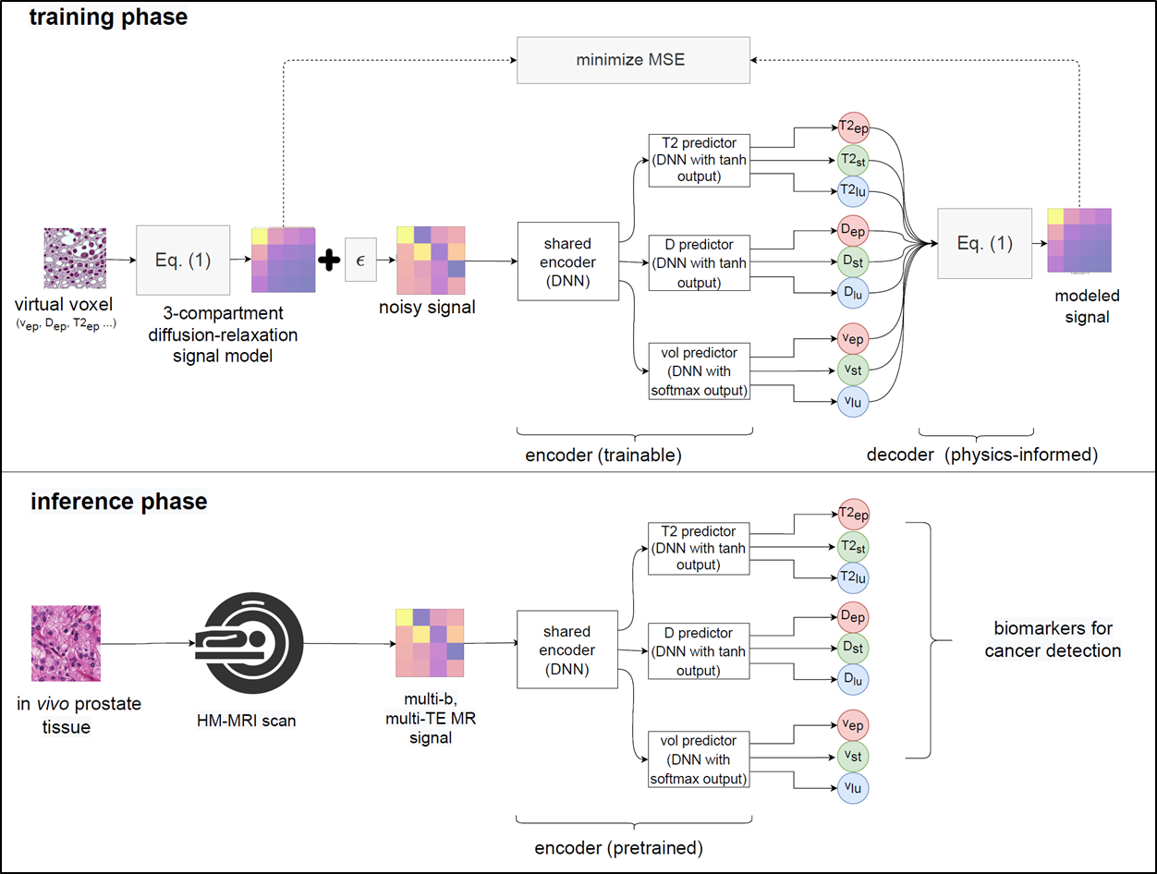

Prior work: replace the fit with a learned inverse — PIA
WHY THE CLASSICAL FIT FAILS
NLLS fits each voxel independently — no information shared, no prior to break the degeneracy. It lands on a bound and stays there.
THE KEY IDEA
The decoder is the physics equation itself — fixed, not learned. Only the encoder trains, so the only way to reconstruct the signal is to emit parameters that actually explain it.
Bounds are architecture, not penalties: D = D̄ + ΔD·tanh(z), v = softmax(z). A negative diffusivity is unrepresentable.
Amortized inference: per-voxel optimization becomes one forward pass. The prior lives in the weights, learned across thousands of voxels.
Architecture figure reproduced from the 8/16/2024 Grossman Center progress report (Gundogdu et al.).

Slide 6
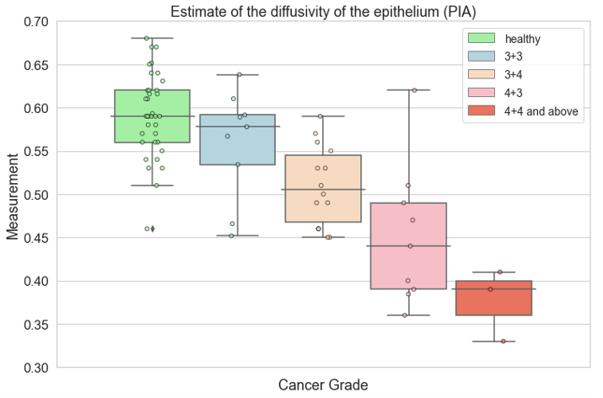
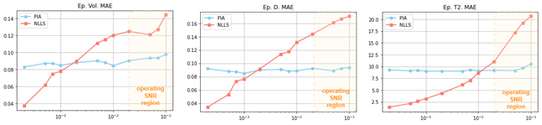
PIA worked — and produced biomarkers NLLS could not
Robust to noise
Clinically meaningful
volume fraction
D
T₂
mean absolute error vs noise standard deviation (log scale)
NLLS error (red) climbs steeply with noise; PIA (blue) stays flat across the operating SNR region.
Epithelial diffusivity — a quantity NLLS cannot recover — falls monotonically with Gleason grade.
What it left open. PIA returns one number per parameter. It cannot say when that number should not be trusted — and a clinician acting on a composition map needs exactly that.

Slide 7



The proposal this capstone inherits: make the biomarkers random variables
HM-MRI
PIA
PIvA
Biomarkers* are unknowns in series of equations (acquired signals) -> solve for them via NLLS
Biomarkers are latent variables in an autoencoder, the encoder emulates the inverse of f
Biomarkers are random variables. Use Bayesian methods to model their posterior probability given an MRI signal
Grossman Center, next-year proposal (8/16/2024): "Building on our success in PIA, we will develop a Bayesian deep learning framework … Develop PIvA for HM-MRI · Compare PIvA against NLLS and PIA in silico · Correlate PIvA with histopathology."
Framing diagram reproduced from the 8/16/2024 Grossman Center progress report.

Slide 8
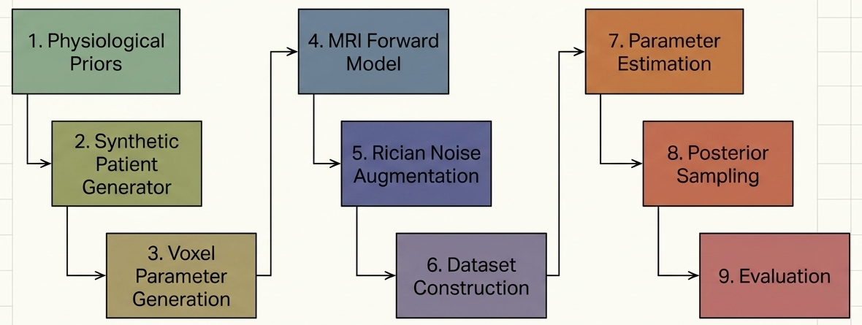
This capstone: from proposal to evidence
The proposal asks three things — build PIvA, compare it against NLLS and PIA in silico, and establish what its posterior is actually worth. This section answers all three. The third answer is the interesting one.
01 DESIGN & DATA
A two-tier synthetic testbed: one hierarchical patient cohort, one fixed physics decoder, four estimators scored on the same 240 held-out voxels.
02 WHAT WE FOUND
Point accuracy is solved — the learned inverse beats NLLS decisively. Uncertainty is not: the posterior is confidently, and anti-informatively, wrong.
03 WHAT IT MEANS
A mechanistic diagnosis of why, a full-covariance posterior that partly fixes it, and an honest account of what still cannot be claimed.
The end-to-end pipeline: physiological priors → synthetic patients → forward model → Rician noise → estimation → posterior sampling → evaluation.

Slide 9
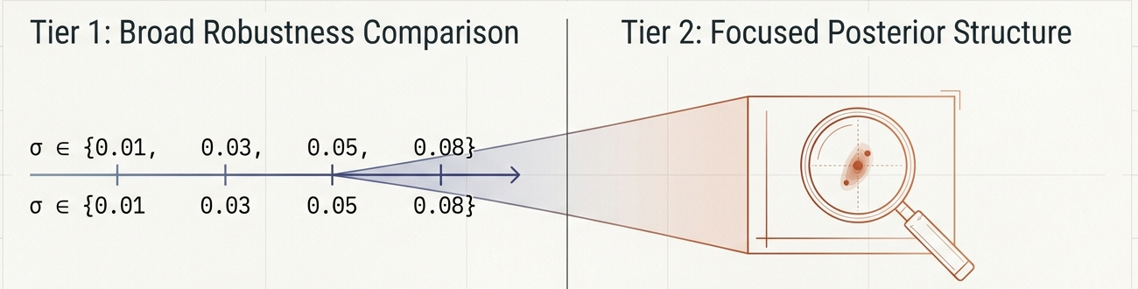
A two-tier design: sweep broadly, then zoom in
TIER 1 · BROAD ROBUSTNESS
Five estimators × four Rician noise levels. NLLS · PIA · three diagonal-PIVA variants whose physiological constraint is tight, doubled, or unconstrained-positive.
Asks: does accuracy degrade gracefully with noise, or fail abruptly at the clinical level?
TIER 2 · FOCUSED POSTERIOR STRUCTURE
Diagonal Gaussian PIVA vs. full-covariance Cholesky PIVA with ILR volume fractions — at σ = 0.05 only, the clinical reference level.
Asks: does posterior structure buy calibrated uncertainty?
Held fixed within a tier: the acquisition grid, the clean test parameters, the noisy test observations, the physiological ranges, and the evaluation functions.

Slide 10
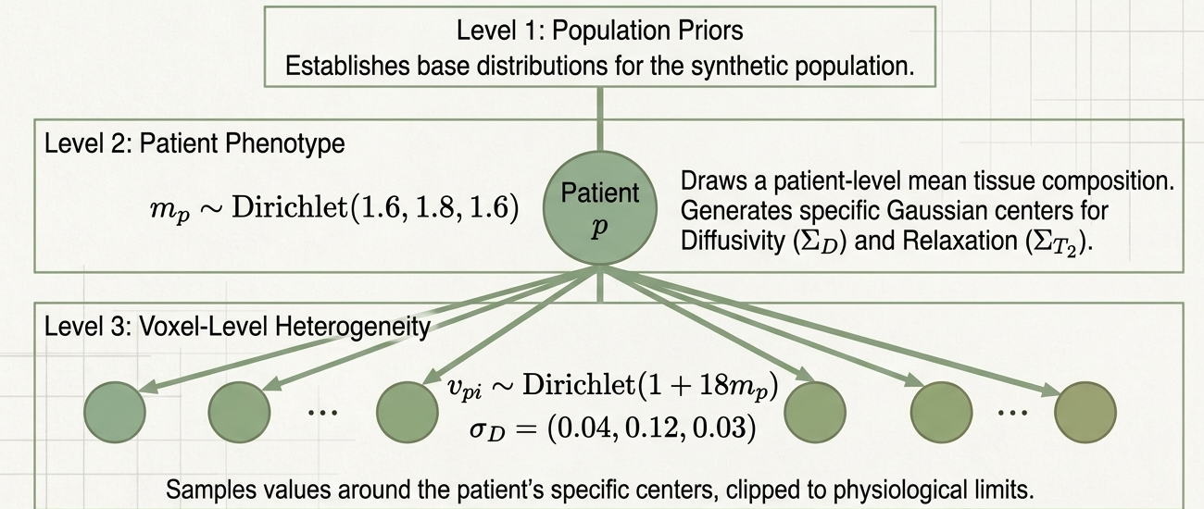
The cohort: variation injected at two levels
There is no patient data — the entire study runs on a generator built from physiological priors
AND THEN NOISE
Rician, not Gaussian — magnitude MRI is the modulus of a complex signal, so the noise is not Gaussian at low signal.
Training draws σ ~ U(0.01, 0.08) per voxel; evaluation sweeps fixed σ ∈ {0.01, 0.03, 0.05, 0.08}.
THE SPLIT
122,880 training observations — 80 patients bootstrapped to 120, then Rician-augmented twice.
240 held-out voxels — 24 patients × 10, generated on a separate seed. Every estimator is scored on exactly these.
Why the hierarchy matters: between-patient phenotype stays separable from within-patient heterogeneity, so the data are not merely i.i.d. voxels.
Cohort diagram from the project's computational blueprint.

Slide 11
Four estimators, one fixed physics decoder
All four consume the same 16-channel input and are scored on the same held-out cohort
Estimator | Inference | Output | Latent representation | Objective
NLLS (baseline) | Per-voxel optimization | Point estimate | 8 free parameters, v_lum = 1 − v_ep − v_st | Bounded least squares
PIA | Amortized | Point estimate | 9 outputs, softmax fractions | MSE against the clean signal
PIVA (diagonal) | Amortized | Diagonal Gaussian posterior | z ∈ ℝ⁹ | MSE + β · D_KL (β-VAE ELBO)
PIVA v2.0 (full cov.) | Amortized | Full Gaussian posterior | z ∈ ℝ⁸, ILR fractions | MSE + β · D_KL (full-covariance KL)
WHAT VARIES
Only the inference machinery — how the 16 measurements are turned into 9 parameters. Every difference in the results is therefore attributable to that choice alone.
WHAT DOES NOT
The decoder is Eq. (1) in every row — fixed, with no trainable layers. Posterior inference for the two probabilistic rows is 25 Monte Carlo passes per voxel.

Slide 12
Accuracy: the learned inverse wins decisively
Held-out cohort, 240 voxels, σ = 0.05 (SNR ≈ 20:1) — all models from a single matched run
Estimator | D R² | T₂ R² | v R² | D MAE | T₂ MAE (ms) | v MAE
NLLS (baseline) | 0.926 | 0.807 | 0.267 | 0.222 | 92.7 | 0.125
PIA (deterministic) | 0.984 | 0.960 | 0.593 | 0.091 | 35.5 | 0.093
PIVA (probabilistic) | 0.987 | 0.966 | 0.577 | 0.080 | 33.5 | 0.097
WHAT HOLDS
Embedding the physics as a fixed decoder beats per-voxel fitting on every parameter family. T₂ error falls from 93 ms to 34 ms.
Volume fraction — the parameter that carries the cancer signal, and the one NLLS handles worst — more than doubles in R².
AND IT HOLDS UNDER NOISE
Across σ ∈ {0.01 … 0.08}, NLLS volume-fraction R² decays from 0.43 to −0.14. PIA stays between 0.81 and 0.48; PIVA between 0.78 and 0.47.
Making the model variational cost nothing in point accuracy. PIVA matches — and marginally beats — PIA.

Slide 13
Uncertainty: the posterior is confidently wrong
PIVA-Tight, σ = 0.05. A 95% credible interval should contain the truth 95% of the time.
PIVA-Tight, σ = 0.05 | D | T₂ | v
95% CI empirical coverage | 0.156 | 0.085 | 0.053
Nominal target | 0.950 | 0.950 | 0.950
Calibration r (σ vs |error|) | −0.121 | −0.040 | +0.267
β-sweep (PIVA-Tight) | 0.01 | 0.10 | 1.00 | 3.00
D R² | 0.988 | 0.987 | 0.984 | 0.939
D 95% CI coverage | 0.086 | 0.151 | 0.307 | 0.349
v R² | 0.568 | 0.580 | 0.571 | 0.143
A negative calibration r means: the voxels the model reports as uncertain are the ones it gets right. The uncertainty is not merely miscalibrated — it is anti-informative, which is worse than reporting none at all.
COVERAGE IS NOT NOISE-DRIVEN
D coverage is 0.197 at σ = 0.01 and 0.154 at σ = 0.08. It does not move with the noise level, which rules out an aleatoric explanation and points at something structural.
AND β CANNOT BUY IT BACK
Raising β widens the intervals monotonically but never reaches 0.35 for D — and by β = 3.0 volume-fraction R² has already collapsed to 0.14. No setting achieves both.

Slide 14
Why: the constraint that guarantees plausibility destroys the uncertainty
Dᶜ = D̄ + ΔD · tanh(z) ⟹ ∂D/∂z = ΔD · (1 − tanh²z) → 0 as |z| grows
1 · THE ENCODER LEARNS LARGE |μ|
Large |μ| is optimal for reconstruction. But once |μ| ≳ 3 the tanh saturates, and latent uncertainty is compressed roughly 100× on its way into parameter space.
The reported σ is measuring tanh geometry, not posterior width.
2 · THE KL BILL IS PAID BY μ, NOT σ
KLⱼ = ½μⱼ² + ½(σⱼ² − 1 − log σⱼ²)
KL stays large (≈30–57) because μ is large — not because σ_z is healthy. Nothing in the objective floors the per-dimension σ, so KL pressure never actually forces it up.
3 · AND THAT EXPLAINS THE SIGN
Voxels near the physiological centre have unsaturated tanh — larger reported σ — and are also easier to predict.
Voxels near the boundary have saturated tanh — σ ≈ 0 — and higher error.
Hence the negative calibration r, exactly as observed.
The consequence: this is not a hyperparameter failure. It is a structural property of the constraint parameterization — which means it has a structural fix.

Slide 15
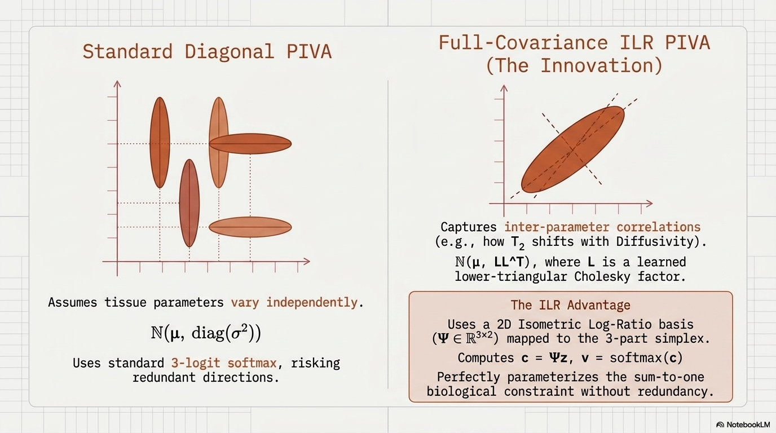
v2.0 — give the posterior a shape it can actually use
One change at a time: same decoder, same window, same β = 0.1 recipe, same 240-voxel cohort
DIAGONAL POSTERIOR — parameters vary independently
FULL COVARIANCE + ILR — parameters are allowed to correlate
q(z|x) = 𝒩(μ, diag σ²)
q(z|x) = 𝒩(μ, LLᵀ)
A diagonal posterior is axis-aligned by construction. But the physics genuinely couples the parameters — T₂ and D trade off against each other inside a compartment — so it is structurally incapable of representing the real ambiguity.
L is a learned lower-triangular Cholesky factor (36 free entries for an 8-dim latent). ILR removes the softmax null direction — softmax(v + c·𝟏) = softmax(v) — where 98.7% of the volume block's posterior variance had collapsed. Latent drops 9 → 8.
Credit: the full-covariance direction is adapted from Finkelstein et al. (2026), whose physics-structured VAE (PS-VAE) applies the same physics-simulator-plus-full-covariance idea to quantitative molecular MRI. arXiv:2602.03317.

Slide 16
Full covariance fixes the geometry — not the sharpness
PIVA-Tight, σ = 0.05. Post-hoc calibration fits one scalar temperature per compartment on a held-out half.
Parameter | Raw cov. Diagonal | Raw cov. Cholesky-ILR | Calibrated Diagonal | Calibrated Cholesky-ILR | Calib. width (% of range)
D_ep | 0.096 | 0.367 | 0.908 | 0.958 | 88.6%
D_st | 0.071 | 0.158 | 0.958 | 0.967 | 84.7%
D_lum | 0.346 | 0.629 | 0.983 | 0.950 | 70.1%
T₂_ep | 0.088 | 0.200 | 0.908 | 0.908 | 55.7%
T₂_st | 0.050 | 0.142 | 0.833 | 0.950 | 103.6%
T₂_lum | 0.179 | 0.546 | 0.908 | 0.925 | 112.8%
v_ep | 0.025 | 0.121 | 0.917 | 0.925 | 50.4%
v_st | 0.021 | 0.092 | 0.842 | 0.950 | 64.4%
v_lum | 0.092 | 0.142 | 0.900 | 0.925 | 28.5%
WHAT IMPROVED
Raw coverage rises for all nine parameters — T₂_lum nearly triples, 0.179 → 0.546. The correlated posterior is genuinely a better description of the ambiguity.
After per-compartment calibration, seven of nine improve, and eight land within ±0.03 of the 0.95 target.
Point accuracy is a wash — D marginally better, T₂ marginally worse. The upgrade should be judged on uncertainty, not headline R².
But sharpness is unsolved: several calibrated intervals span 70–113% of the parameter's entire physiological range. An interval that wide is technically calibrated and clinically useless.

Slide 17
What we can claim, what we cannot, and what comes next
ESTABLISHED
Physics-informed amortized inference beats per-voxel NLLS at clinical SNR — decisively, on every parameter family, on one shared held-out cohort.
Making the model variational costs nothing in point accuracy.
A full-covariance posterior with an identifiable volume latent improves raw coverage for all nine parameters.
And the calibration failure is diagnosed to a specific piece of math, not blamed on tuning.
NOT ESTABLISHED
Calibrated, sharp uncertainty. This is the project's headline negative result, and it stands.
The data are entirely synthetic, generated by the same equation the network inverts — an inverse-crime setup. It measures whether the problem is solvable in principle, not transfer to a scanner.
240 test voxels, halved again for calibration; single seed, no error bars; and the NLLS baseline is optimistically biased by masking failed fits.
NEXT — AND THE MATH SAYS WHERE
1 · Replace tanh with linear + clamp. A constant Jacobian means σ_D = ΔD · σ_z propagates directly instead of being crushed. This follows from the diagnosis and is the obvious next run.
2 · Add free-bits KL, Σⱼ max(λ, KLⱼ), to floor per-dimension σ so the objective can no longer pay its KL bill with μ alone.
3 · Split conformal calibration for guaranteed coverage that preserves sharpness, rather than inflating intervals.
4 · Real data — a held-out patient cohort such as ProstateX, once the synthetic result is stable.
The one-sentence version: a physics-informed encoder can invert this problem accurately. Whether it can say how sure it is remains open — and we know why.

Slide 18
Thank you
Sabyasachi Chowdhury · sabyachow@gmail.com
Aaron Garay · aaron.m.garay@gmail.com
github.com/sabya-chow/PIVA-prostate-MRI

