Slide 1


A project on Bus Ticket reservation system
Application Development Using Java 7

Slide 2
INTRODUCTION
This project is basically a proposal for issue and management of bus tickets based on the patent admin.
The main player/actor of this system are customers and admin.
Admin has access to all the fields and customer needs to get them verified by the admin.

Slide 3
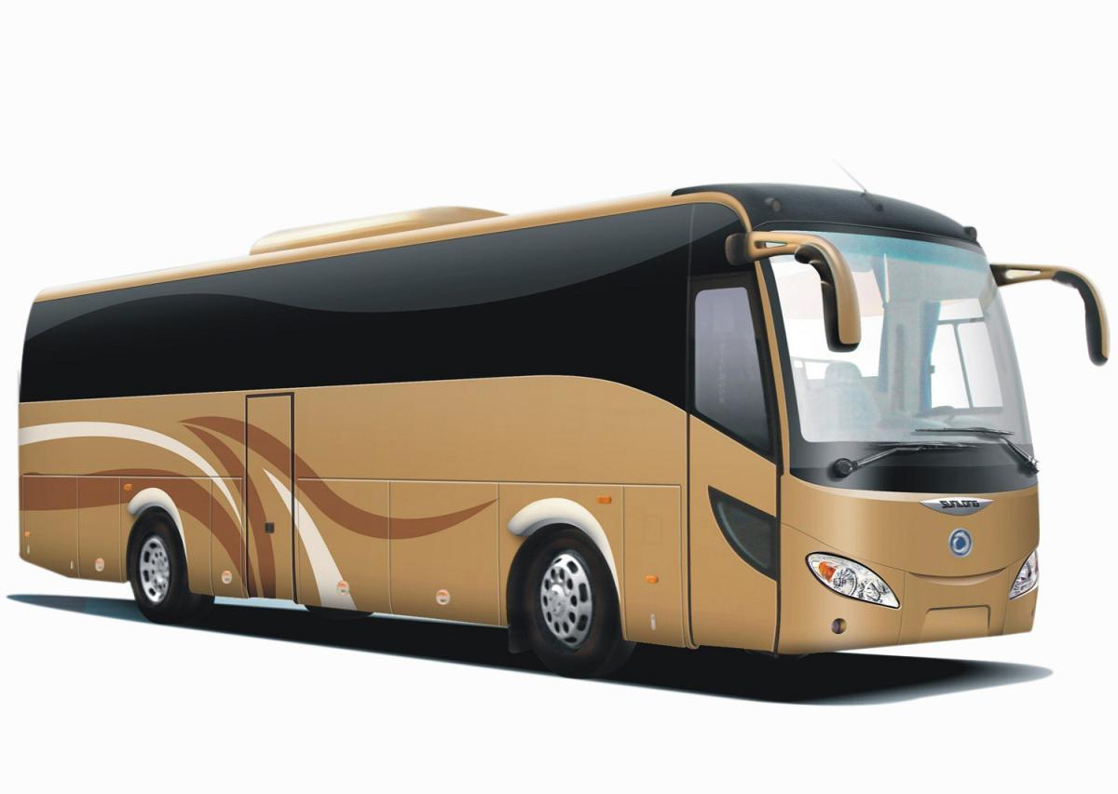
Role of Administrator
Add New Buses
Cancel A Bus
Update Bus fare
View All Database

Slide 4

Database of Buses
Bus No | From | To | Bus Type | Date | Total Seat | Fare
1 | Kolkata | Digha | Volvo AC | 7.07.2013 | 60 | 280
2 | Durgapur | Esplanade | Deluxe AC | 8.07.2013 | 65 | 155
3 | Kharagpur | Patna | Ra One | 8.07.2013 | 75 | 300
It can be accessed by Admin only .

Slide 5
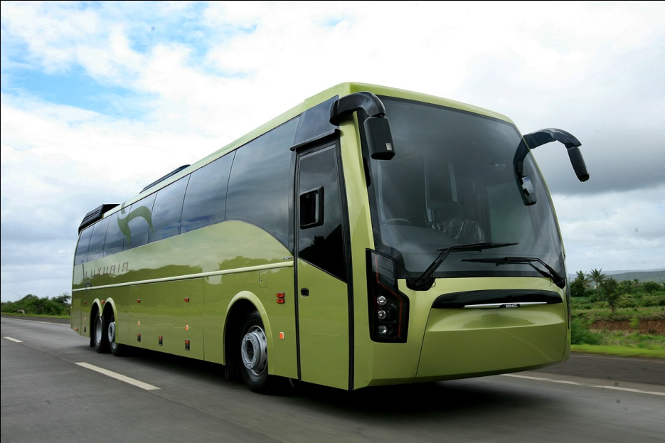
Role of Customer
Book Ticket
Cancel Ticket
View Ticket
Show Seat

Slide 6
Database of Tickets
Ticket No | From | To | Bus Type | Bus Id | Date | Fare | Seats Booked
1 | Kalyani | Digha | Volvo AC | 1 | 7.07.13 | 280 | 4
2 | Durgapur | Esplanade | Deluxe AC | 4 | 8.07.13 | 155 | 7
3 | Ranchi | Patna | Volvo-LCD | 3 | 8.07.13 | 300 | 10

Slide 7
Future Scope of Improvements
In future, there will be new works on this project.
Large number of Customers can access this software at the same time
Printing system will integrate this process.

Slide 8
CONCLUSION
Nowadays, bus agencies are taking important role in
transportation, and to make reservation reliable they need a strong system that they will make reservation easier, faster and safer.
This project designed to meet requirements of a bus reservation System.

Slide 9
Project Presented By
Name | College
Somnath Ghose Roy | Netaji Subhash Engineering College
Sayantan Majumder | Netaji Subhash Engineering College
Sabyasachi Pahari | Netaji Subhash Engineering College
Manish Sinha | Netaji Subhash Engineering College
Kundan Kumar | Netaji Subhash Engineering College
Globsyn Summer School 2013

