Slide 1
Module Overview
Lesson 1
Lesson 2
Time Series Analysis
Clustering

Slide 2
Module 1:
Machine Learning
LESSON 1:
Clustering
After completing this lesson, you will be able to:
Discuss common clustering algorithms.
Discuss performance metrics used in clustering.
Create and evaluate a clustering model.

Slide 3
What is Clustering?
Clustering is a method of grouping data points into similar clusters.
Clustering uses the features of individual items to find similar items.
For example:
find similar customers,
group sentences with
similar topics,…
Notes:
Clustering is a method of grouping data points into similar clusters.
Clustering uses the features of individual items to find similar items.
Clustering models help you identify relationships in a dataset that you might not logically derive by browsing or simple observation.
It is a type of unsupervised learning.
It can be used in unlabeled data.
Examples:
Find similar customers:
A marketing company wants to group customers to be able to customize their strategies according to these groups.
Determine branch optimal location:
A bank wants to cluster their customers based on their address to determine the location where they need to put in a branch.
Find similar people by demographics:
An e-commerce company would like to group their customers according to their demographics to find appropriate targets for its products.
Group sentences with similar topics or sentiment in text analytics.
A franchise restaurant company wants to analyze customer feedback.

Slide 4
K-Means Cluster Algorithm
K-Means is one of the simplest and the best-known unsupervised learning algorithms.
K-Means divides objects into k (k = 2,3,…) clusters.
Target number – k indicates the number of centroids you want in the model.
The centroid is a point that is representative of each cluster.
K-Means algorithm assigns each incoming data point to one of the clusters by minimizing the within-cluster sum of squares.
Notes:
There are 4 common approaches for clustering: Centroid-based Clustering, Density-based Clustering, Distribution-based Clustering and Hierarchical Clustering. And there are various algorithms used for these approaches. For example, K-means for Centroid-based Clustering, Density-Based Spatial Clustering of Applications with Noise (DBSCAN) is for Density-based Clustering, Expectation–Maximization (EM) for Distribution-based Clustering and hierarchical agglomerative clustering algorithm for Hierarchical Clustering.
Among various clustering algorithms, the best-known algorithm, K-means will be covered here.
When you configure a clustering model using the k-means method, you must specify a target number k indicating the number of centroids you want in the model. The centroid is a point that is representative of each cluster. The K-means algorithm assigns each incoming data point to one of the clusters by minimizing the within-cluster sum of squares.
When processing the training data, the K-means algorithm begins with an initial set of randomly chosen centroids, which serve as starting points for each cluster, and applies Lloyd's algorithm to iteratively refine the locations of the centroids. The K-means algorithm stops building and refining clusters when it meets one or more of these conditions:
The centroids stabilize, meaning that cluster assignments for individual points no longer change and the algorithm has converged on a solution.
The algorithm completed running the specified number of iterations.

Slide 5
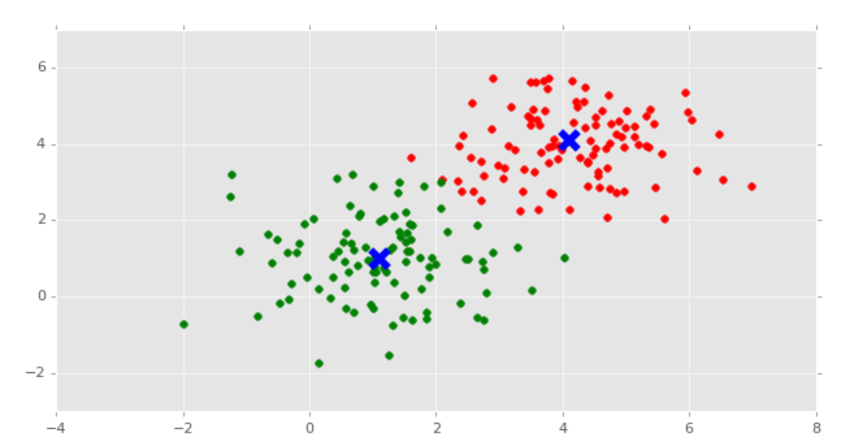
K-Means Cluster Algorithm (continued)

Slide 6
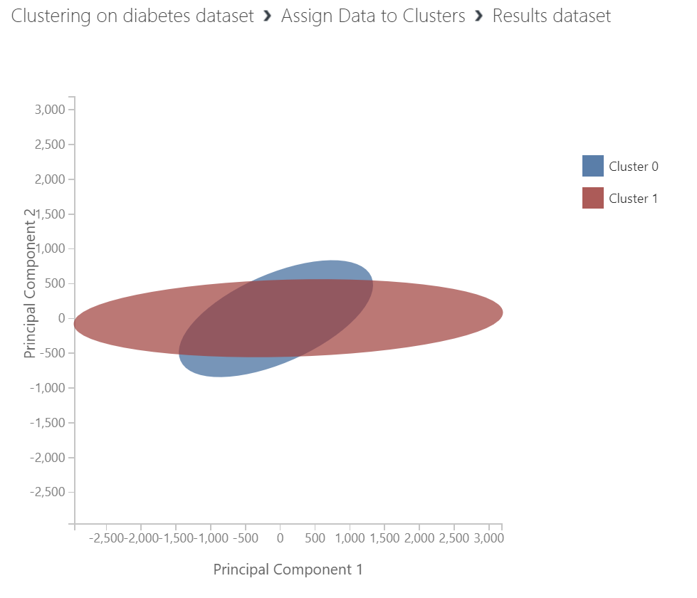
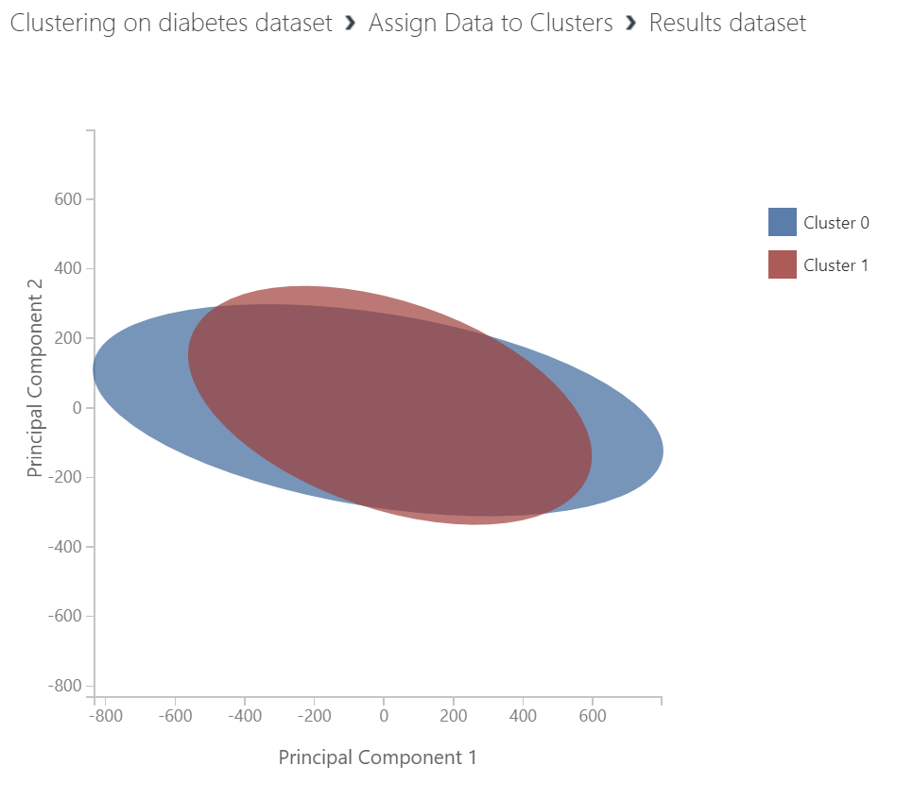
K-Means Clustering Model Performance
PCA Graph computes two principal component axes.
It summarizes the multi-dimensional differences between the clusters.
The cluster assignments are plotted along the axes.
Notes:
The principal components visualization (PCA Graph) can be used to understand how the clusters are related to each other, in a two-dimensional graph. The PCA captures the differences between clusters in the model using a simple chart. For example, although the cases in this model vary greatly by dimensions such as the number of pregnancies, age, blood pressure, and so forth, it is difficult for humans to visualize the differences in five dimensions! Therefore, the PCA graph computes two principal component axes that summarize the multi-dimensional differences between the clusters, and the cluster assignments are plotted along these axes.
For example, the charts on the slide compare the clusters for the same model by changing the impact of one-feature. The model group diabetes cases into clusters. The first one adds insulin measurements as a feature to the model and the second one removes that feature since there are lots of missing data. You can see that it is much easier to distinguish between cases in cluster 0, although even they overlap quite a bit.

Slide 7
Classification Model Performance
Positive or 1
Negative or 0
True: model predicted correctly
False: model predicted incorrectly
Binary classification
True: model predicted correctly
False: model predicted incorrectly
TP
FP
TN
FN
Notes:
Example: Classify Email as SPAM
Binary classification has two classes:
Positive or 1: Model predicts a certain email to be a spam.
Negative or 0: Model predicts the email is NOT a spam.
Two possibilities for each prediction:
True: Model predicted correctly
Model predicted a certain email to be spam, while the email WAS actually spam.
Model predicted a certain email was not spam, and it actually was NOT spam.
False: Model predicted incorrectly
Model predicted an email to be spam, while it was NOT spam.
Model predicted an email was not spam, while it WAS spam.
Four possible combinations of classification and prediction:
True Positive (TP): Classify an email as spam, while it WAS spam.
True Negative (TN): Classify an email as not spam, while it was NOT spam.
False Positive (FP): Classify an email as spam, while it WAS NOT spam.
False Negative (FN): Classify an email as not spam, while it WAS spam.

Slide 8
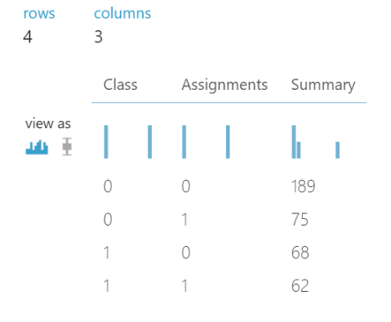
Clustering Model Performance
If labels are known, a simple confusion matrix can be generated to see how accurate the cluster assignments are.
Actual Positives
Actual Negatives
Predicted Positives
TP | FP
FN | TN
Predicted Negatives
Notes:
Confusion Matrix
Counts of True Positive (TP), True Negative (TN), False Positive (FP), False Negative (FN) are displayed in a Confusion Matrix. When the data is labeled, clustering model performance might be evaluated like a classification model.
Class refers to actual values and assignments refer to predicted ones on the chart above.

Slide 9
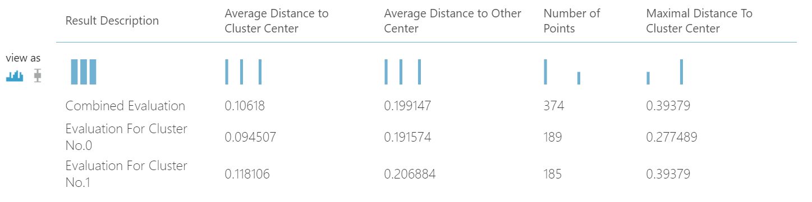
Clustering Model Performance (continued)
Metrics for clustering models:
Number of Points (Observations) shows how many data points were assigned to each cluster, along with the total overall number of data points in any cluster.
Average Distance to Cluster Center represents the closeness of all points in a cluster to the centroid of that cluster.
Average Distance to Other Center represents how close, on average, each point in the cluster is to the centroids of all other clusters.
Maximal Distance to Cluster Center represents the maximum of the distances between each point and the centroid of that point’s cluster.
Notes:
https://support.minitab.com/en-us/minitab/18/help-and-how-to/modeling-statistics/multivariate/how-to/cluster-k-means/interpret-the-results/all-statistics-and-graphs/
The Combined Evaluation score at the top of each section of results lists the average scores for the clusters created in that particular model.
This top-ranked model happened to create three clusters; other models might create two clusters, or four clusters. Therefore, this combined evaluation score helps you compare models with different number of clusters.
The scores in the column, Average Distance to Cluster Center, represent the closeness of all points in a cluster to the centroid of that cluster.
The scores in the column, Average Distance to Other Center, represent how close, on average, each point in the cluster is to the centroids of all other clusters.
You can choose any one of four metrics to measure this distance, but all measurements must use the same metric.
The Number of Points column shows how many data points were assigned to each cluster, along with the total overall number of data points in any cluster.
If the number of data points assigned to clusters is less than the total number of data points available, it means that the data points could not be assigned to a cluster.
The scores in the column, Maximal Distance to Cluster Center, represent the maximum of the distances between each point and the centroid of that point’s cluster.
If this number is high, it can mean that the cluster is widely dispersed. You should review this statistic together with the Average Distance to Cluster Center to determine the cluster’s spread.

Slide 10
Classification Performance Metrics
Confusion Matrix
Counts of TP, TN, FP, FN are displayed in a Confusion Matrix.
Classification performance metrics are derived from elements of the confusion matrix.
Actual Positives
Actual Negatives
Predicted Positives
TP | FP
FN | TN
Predicted Negatives
Notes:
Confusion matrix can also be created for multi-class classifications. Binary classification provides a simpler way to explain the confusion matrix and classification performance metrics.
In an ideal case, FN = 0 and FP = 0. In real life that is not possible. Errors will result in FP and FN. We try to reduce FP and FN to improve classification model performance.
Whether we should focus on reducing FP or FN depends on the case and business requirements.
Suppose that we are working on a cancer detection model. In such a case we should try to reduce False Negatives (FN). If a non-cancerous patient is incorrectly classified as
having cancer (False Positive), s/he will go for additional tests. BUT if a patient that has cancer is classified as non-cancerous (False Negative), they will not go for another test
and their condition will remain untreated. This is an example of a case where reducing FN is more important than reducing FP.
Now suppose that we have created a model that classifies emails as spam or not spam. In this case, we may want to focus on reducing False Positives. If someone has sent job applications
and is expecting emails from potential employers, they wouldn’t want those emails to be incorrectly classified as spam. So in this case, we focus on reducing FP.

Slide 11
Classification Performance Metrics (continued)
Accuracy
Percentage of correct predictions.
(TP + TN) /(TP + TN + FP + FN).
Use when the imbalance between the two classes is not large.
TP | FP
FN | TN
Notes:
Accuracy is the total number of correct predictions (TP + TN) divided by the total number of predictions. Multiply by 100 to get a percentage.
Explained differently, accuracy is a measure of how often the model makes a correct prediction.
Accuracy is not a good performance measure if a large majority of target variables belong to one class.
Suppose that our model detects cancer, and that we have a sample size of 100 people, out of which 7 people actually have cancer. If during validation
our model classifies all participants as cancer-free, then TP = 0, TN = 93, and accuracy of our model will be 93%. Considering the fact that our model
has missed ALL of the positive cases, can we say that it is a good model due to its high accuracy?

Slide 12
Classification Performance Metrics (continued)
Precision: Percentage of positive predictions that were correct.
TP/(TP + FP)
Lower FP → Higher Precision
Recall/Sensitivity: Percentage of actual positives that were predicted correctly.
TP/(TP + FN)
Lower FN → Higher Recall
TP | FP
FN | TN
TP | FP
FN | TN
Notes:
Precision shows the percentage of positive classifications that were correct. It is the number of True Positives (TP) divided by the total number of positive classifications (TP + FP).
The total number of positive predictions TP+FP. The number of correct positive predictions is TP. Hence, (TP / TP+FP) * 100 is the percentage of positive predictions that were correct.
Suppose in a model that is supposed to detect cancer, we have a sample of 100 people, of which 10 people actually have cancer. If our model misses the prediction on all cancer-free
patients and predicts all 100 participants as having cancer, then TP = 10, and FP = 90. In this case the precision of the model would be (10/10+90)=0.1 or 10%.
Recall shows the percentage of actual positives that were predicted correctly. The number of actual positive classifications is TP+FN. The number of correct positive predictions is TP.
Suppose in the cancer detection model with a sample size of 100 where 10 participants actually have cancer, the model predicts that all 100 participants have cancer. In this case,
the number of negative predictions is zero. This means FN = 0 and TP = 10. So the Recall of the model is (10 / 10 + 0) * 100 = 100%. Precision is not about catching all positive cases.
The number of False Negatives plays no role in determining Precision.
Precision and Recall can be compared.
Precision is a measure of how precise or accurate the model is, by finding out of those cases that were predicted as positive how many of them were actually positive. Of all of the
cases that our model predicted as having cancer, how many of them were correct. So even if we the model predicts that only one of the cases has cancer and that prediction is correct, then
TP = 1 and FP = 0, which means Precision of the model is 100%.
Recall is more about catching ALL positive cases correctly. So if the model catches more cases that are actually positive, then we would expect Recall to be high. Suppose in the cancer detection
model, with a sample size of 100 where 10 participants actually have cancer, our algorithm predicts that all 100 individuals have cancer. In this case TP = 10 and FN = 0. This results in
the Recall to be (10 / 10 + 0) * 100 = 100%.
Precision = TP/(TP + FP).
Lower FP → Higher Precision.
Recall/Sensitivity = TP/(TP + FN).
Lower FN → Higher Recall.
Choice of metric depends on the case. Example:
FN more costly in disease detection → Use Recall.
FP more costly in detecting spam emails → Use Precision.
If business needs and requirements determine that reducing False Negatives is more important, then use Recall.
If reducing False Positives is more important, then use Precision.
For algorithms that deal with cases like spam detection, high number of False Positives can be more costly (classifying an email containing a job offer as spam). So for these cases use Precision, and reduce FP
to increase Precision.
For algorithms that deal with detecting disease or fraudulent transactions, high number of False Negatives is very costly/dangerous. So for these cases, use Recall as the metric and try to reduce FN
so that Recall is high.

Slide 13
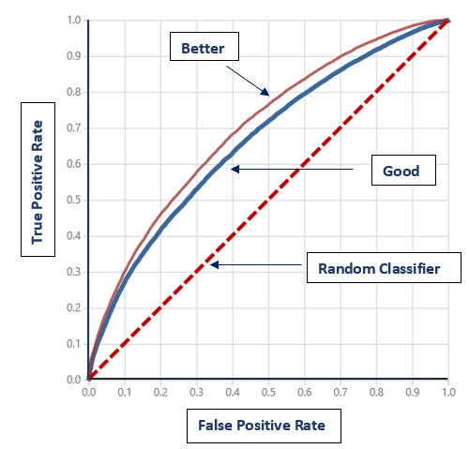
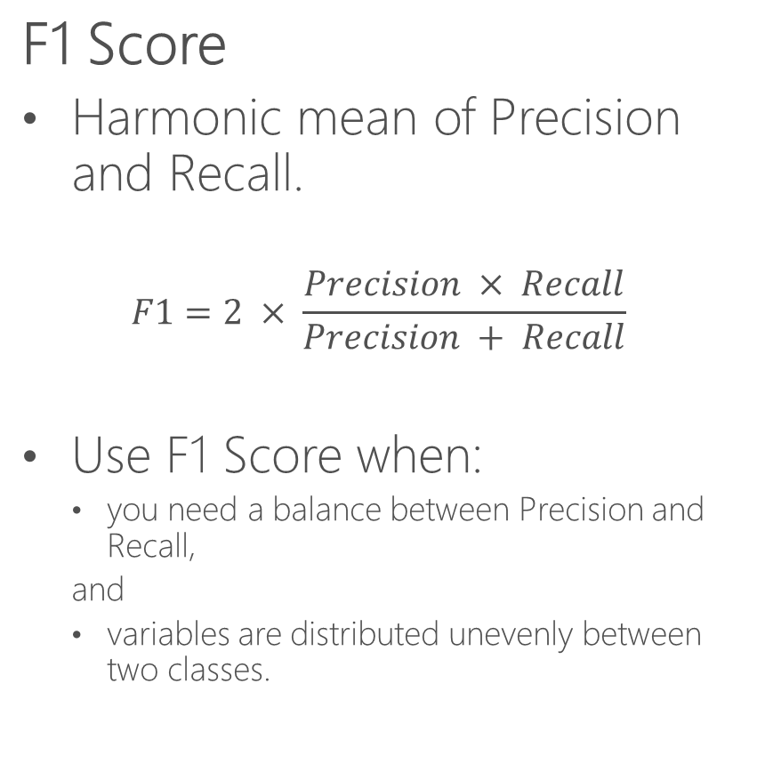
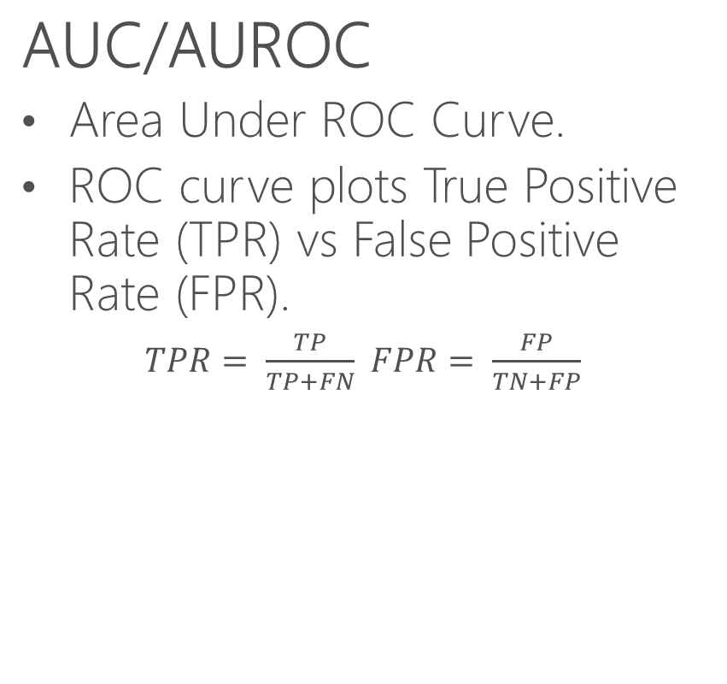
Classification Performance Metrics (continued)
F1 Score
Harmonic mean of Precision and Recall.
$$F1=2 × \frac{Precision × Recall}{Precision + Recall}$$
Use F1 Score when:
you need a balance between Precision and Recall,
and
variables are distributed unevenly between two classes.
AUC/AUROC
Area Under ROC Curve.
ROC curve plots True Positive Rate (TPR) vs False Positive Rate (FPR).
$TPR= \frac{TP}{TP+FN}$ $FPR= \frac{FP}{TN+FP}$
Notes:
F1 Score:
Arithmetic mean of two numbers is tilted toward the larger number, while the harmonic mean tilts toward the smaller number.
F1 score can bethought of as the weighted average between Precision and Recall. It is a number between 0 and 1, with 0 as its worst value and 1 as its ideal value.
F1 score is used when you want to improve your model such that there is a balance between Precision and Recall. If there is a big difference between the two,
then the F1 score is closer to 0. If the difference between Precision and Recall is small (the two are balanced), then the F1 score is closer to 1.
ROC: Receiver Operating Characteristic. ROC curves were used in WWII to evaluate the ability of radar receiver operators in differentiating between signal and noise.
ROC curves now have applications in machine learning, statistics and other areas. ROC curves can be used to measure performance of binary and multi-class classifiers.
ROC curve plots TPR (y axis) against FPR (x axis). TPR and FPR are rates, so they are both in the range [0,1].
Actual or total number of positives = TP + FN
Actual or total number of negatives = TN + FP
AUC: Area Under the Curve, in this case Area Under the ROC Curve.
Performance metric is the area under the ROC curve.
Random guessing results in AUC = 0.5.
Classifier AUC should be greater than 0.5.
Higher AUC indicates better performance.
If a model guesses randomly (worst case), it means that the probability that each data point is classified as positive or negative is 1/2.
As a result, ROC curve of a classifier that guesses randomly is a straight line.
Curves with higher AUC indicate better performance.
-- DIAGRAM IS NOT IN THIS SLIDE ----
Suppose that the diagram in this slide shows the actual positives and negatives in a sample of emails where “+” signs represent spam emails, and “-” signs represent non-spam emails.
Actual positive count = 11
Actual negative count = 12
We create a classification model to identify spam emails. A vertical line shows the decision boundary of our model, where all data points to the left of the line are predicted as spam, and all data points to
the right of the line are predicted as non-spam. Suppose that we test our model at three thresholds T1, T2, T3, and at each threshold calculate TPR and the corresponding FPR.
If we choose T1 as the threshold → TP = 4 and FP = 1 and FN = 7 → TPR = 4/11 and FPR = 1/12
If we choose T2 as the threshold → TP = 8 and FP = 3 and FN = 3 → TPR = 8/11 and FPR = 3/12
If we choose T3 as the threshold → TP = 10 and FP = 10 and FN = 1 → TPR = 10/11 and FPR = 10/12
Now imagine that we start at the far left and move the threshold line all the way to the right and at various points calculate pairs of (FPR, TPR). Plotting these points will show the ROC curve for our model.

Slide 14
Lesson Summary
Use clustering to find similar patterns in groups of data.

Slide 15
Module 1:
Machine Learning
LESSON 2:
Time Series Analysis
After completing this lesson, you will be able to:
Discuss Time Series Analysis.
Discuss Time Series Components.
Discuss Time Series Analysis Methods.

Slide 16
Time Series Analysis
Time Series Analysis
Analysis of one variable.
Over equally spaced time intervals.
Requires Time Series data.
Goals of Time Series Analysis.
Identify patterns in the past.
Forecast future values

Slide 17
Time Series Data vs Cross-Sectional Data
Time Series Data
Data about one variable.
Collected over a period of time.
Closing price of a stock on a daily, weekly, monthly or quarterly basis.
Household electricity consumption on a daily basis.
Use a line chart to visualize.
Cross-Sectional Data
Data about multiple variables.
Collected at one point in time.
Data on education, age, gender, and income in US counties in 2009.
Data on age, construction, material and degree of damage on buildings in an earthquake.
Use a scatter plot to visualize.
Notes:
The difference between Time Series and Cross-Sectional data will become clearer when we compare scatter plots with line charts in Time Series examples in the next few slides.
Example of cross-sectional data: data collected from a random sample of individuals about their age, gender, level of education, marital status, zip code, and income. This data is collected once in a certain year or month.
Example of Time Series data: Number of tourists that enter the U.S. on a monthly basis, over a five-year period.

Slide 18
Time Series Examples
Quarterly retail turnover
Source: DataMarket
http://datamarket.com/data/list/?q=provider:tsdl
Notes:
Quarterly retail turnover from 1982-Q3 to 1992-Q1
The graph on the right represents the Time Series. The scatter plot on the left is included only to clarify why scatter plots are not used to graph Time Series data. Looking at the scatter plot, one may think that the graph is showing two sets of data, parallel with each other.
Note: Data for these graphs was downloaded from DataMarket.com. Graphs were created locally after modifying data.

Slide 19
Time Series Examples (continued)
Monthly hotel data
Source: DataMarket
http://datamarket.com/data/list/?q=provider:tsdl
Notes:
Monthly hotel data on this slide is an example of a Time Series data that shows an increasing trend over time.
Note: Data for these graphs was downloaded from DataMarket.com. Graphs were created locally after modifying data.

Slide 20
Time Series Examples (continued)
Average electricity consumption per household – Iowa City 1971-1979
Source: DataMarket
http://datamarket.com/data/list/?q=provider:tsdl
Notes:
Average electricity consumption per household in Iowa City from 1971 to 1979 is an example of a Time Series dataset that does not show a trend.
Note: Data for these graphs was downloaded from DataMarket.com. Graphs were created locally after modifying data.

Slide 21
Applications of Time Series Analysis
Manufacturing
Forecast demand
Energy companies
Forecast consumption
Federal Reserve
Forecast inflation
Airlines
Forecast the number of travelers
and many others…
Notes:
Accurate forecast s important. Forecast should not be mush higher than or much less than the actual market demand.
Demand for a product may change for various reasons (seasonality, etc.). Manufacturers need to forecast future demand in order to keep up with inventory. Producing too much of a food item will result in items that will remain on the shelf for a longer period of time and become stale. Producing below market demand will result in losing customers to competitors.
Energy companies use Time Series data to forecast energy consumption so that they can prepared to generate enough energy that meets the demand.
Federal reserve uses financial data to forecast inflation.
Airlines use Time Series data to forecast the number of travelers, so that they can prepare in advance by having enough aircrafts in their fleet.

Slide 22
Components of Time Series Data
Level
Average value of data points.
Trend
Upward or downward trend.
Cyclical component
Periodic variations over a period of time that is usually longer than a year.
Seasonality
Periodic variations over a short period of time, usually one year.
Random Noise
Residual changes that follow no pattern.
Notes:
A Time Series dataset is a combination of two or more of these components. Some literature do not include “level” as one of the components, and some do not include cyclical variation.
Trend is an upward or downward trend over a long period of time. Trend can be caused by factors such as change in population, prices, productivity, etc.
Seasonality is a cyclical component that repeats over a short (compared to cyclical) period of time, usually one year. Examples of factors that may cause seasonal variations are weather and cultural customs. For example, sales of ice cream increases in summer, but goes down in the winter. More toys are sold during the holiday season than other times of the year.
Cyclical changes may not be as regular as seasonal changes. An example of cyclical change is the change in the function of a business (sales, earnings, etc.) due to factors such as recession. Cyclical variation is not a seasonal change. For example daily changes in temperature.
Random noise is the result of short-term variations that could be related to unforeseen factors such as droughts, earthquakes, etc.

Slide 23
Components of Time Series Data (continued)
Time Series data is a combination of two or more of the listed components
Two models for combining components
Additive
Components are added up
f(t) = Trend + Cycles + Seasonality + Noise
Additive model is linear
Multiplicative
Components are multiplied
f(t) = Trend * Cycles * Seasonality * Noise
Multiplicative model is non-linear
Notes:
If variations around the trend do not change with the level (average value of data points) of the time series, it is better to use an additive model. Otherwise, it is better to use a multiplicative model.

Slide 24
Stationarity
A Time Series is called stationary if its statistical properties are constant:
Constant mean
Constant variance
Time-independent autocorrelation
Stationarity means no trend in time series.
White noise is stationary.
Stationarity makes it relatively easy to forecast.
Most time series are non-stationary in their original form.
Non-stationary data can be transformed into stationary.
Notes:
A time series is called stationary when its statistical properties such as mean, variance and autocorrelation are constant.
Constant statistical properties makes forecasting easy.
White has constant mean and variance and is not correlated with its past values. This means that CORR(S_{t}, S_{t-k}) = 0 where S_{t} is random noise at time t.
Components such as trend, cyclical variance and noise are factors that make a time series non-stationary. Most time series are not stationary in their original form, but in many cases, forecasting models assume that the time series can be transformed into a series that is approximately stationary. Transformations can be used to turn a non-stationary time series into stationary.

Slide 25
Stationarity (continued)
Stationary vs non-stationary
Stationary
Non-Stationary
Source: DataMarket
http://datamarket.com/data/list/?q=provider:tsdl
Notes:
Note: Data for these graphs was downloaded from DataMarket.com. Graphs were created locally after modifying data.

Slide 26
Autocorrelation
Correlation between time series and a delayed/lagged version of itself.
Delay or lag - measured in units of time steps.
Lag n autocorrelation: correlation between Y_{t} and Y_{t-n}.
Normalized version of autocovariance.
Varies in the range [-1, 1].
Significant in time series analysis methods.
Notes:
Significance of autocorrelation becomes clear in the next topic where we discuss time series analysis methods.
Time series are often said to have memory because the value at one time step may impact or influence values in other time steps. Autocorrelation can also be looked at as a method to quantify the memory of time series.
Autocorrelation can also be explained as correlation between pairs of values with a given lag. For example, lag 2 autocorrelation is the correlation between Y_{t} and Y_{t-2}.
Covariance between random variable X and its delayed version (t-1, t-2, etc.) denoted here by d: Autocovariance_{d}(X_{t}) = Covariance(X_{t}, X_{t-d})
Standard deviation of random variable X: STD(X_{t})
Covariance of a delayed version of the time series with itself is called autocovariance: Autocovariance_{d}(X_{t}) = Covariance(X_{t}, X_{t-d})
Autocorrelation is the normalized version of autocovariance: Autocorrelationd(X_{t}) = Autocovarianced(X_{t}) / (STD(X_{t}) * STD(X_{t-d}))
This means that autocorrelation is in the range [-1,1].
When a time series is stationary (or estimated to be stationary), its variance is constant, which means that its standard deviation is constant. This means that in the above expression for autocorrelation STD(X_{t}) = STD(X_{t-d})
Therefore, STD(X_{t}) * STD(X_{t-d}) = VAR(X_{t})

Slide 27
Autocorrelation Function (ACF)
Autocorrelation Function (ACF) is the coefficient of correlation between two values in the series.
Notes:
ACF is a method to measure the linear relationship between a data point in the time series and the previous datapoints in the same time series.
Significance of autocorrelation becomes clear when we discuss Time Series analysis methods.
Autocorrelation outside of the range [-0.05, 0.05] is the 95% confidence interval. This means that we can say with confidence that bars whose values are outside of this range are not by chance, and that their values show the correlation between the time series and the related lagged version.

Slide 28
Lesson Summary
Use time series analysis to analyze trend and forecast.

