Slide 1
Module 2: Data Cleaning and Model Improvement

Slide 3
Module Overview
Lesson 1
Lesson 2
Lesson 3
Initial Data Analysis
Data Cleaning
Model Improvement

Slide 4
Module 2:
Data Cleaning and Model Improvement
LESSON 1:
Initial Data Analysis
After completing this lesson, you will be able to:
Describe Variables and Summary Statistics
Explore Data
Visualize Data
Perform Univariate and Bi-variate
Data Analysis

Slide 5
Variables
Variables are attributes/characteristics of an object
Age, average height, weight, price, minimum speed, etc.
Variable types:
Categorical/qualitative: gender, vehicle type, etc.
Numerical/quantitative: temperature, count of cars, weight, height, etc.
Discrete: specific integer values (number of students, etc.)
Continuous: any value in a range (weight, temperature, etc.)
Independent
Not impacted by other variables being measured
Features/Inputs to an experiment
Manipulated to study impact on dependent/target variable(s)
Dependent
Value depends on independent variable(s)
Notes:
Statistics is used to collect and interpret data on objects of interest.
Examples of objects: individuals, animals, cars, cities, stocks, etc.
Objects have attributes or characteristics that can be measured or take on values. For example, age, gender, income, color, etc,.
Models test impact of independent variables on the dependent variable.

Slide 6
Describing Variables
Two methods to describe a variable
Summary/descriptive statistics
Quantitatively describe features of a data set
Mean, median, standard deviation, etc.
Visualization
Qualitatively describe features of data sets
Histograms, box plots, etc.
Notes:
Summary or descriptive statistics are numbers that summarize features of a data set.

Slide 7
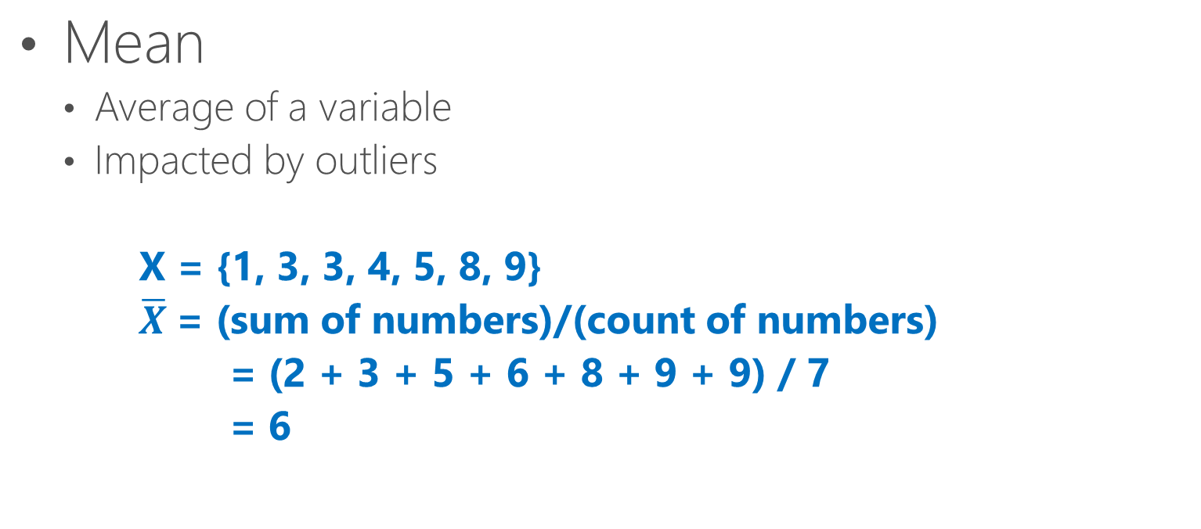
Summary Statistics
Mean
Average of a variable
Impacted by outliers
X = {1, 3, 3, 4, 5, 8, 9}
$\overline{X}$= (sum of numbers)/(count of numbers)
= (2 + 3 + 5 + 6 + 8 + 9 + 9) / 7
= 6
Notes:
Average is the arithmetic mean (sum of numbers/count of numbers).
Average height of students in a class. Average amount of rain in an area in a month.

Slide 8
Summary Statistics…Cont’d
Median
Middle point of a sorted data set
Not impacted by outliers
Mode
Number that appears most frequently
Min
Smallest value
Max
Largest value
X = {1, 3, 3, 4, 5, 8, 9}
median
X = {1, 3, 3, 4, 5, 8, 9}
mode
X = {1, 3, 3, 4, 5, 8, 9}
Min Max

Slide 9

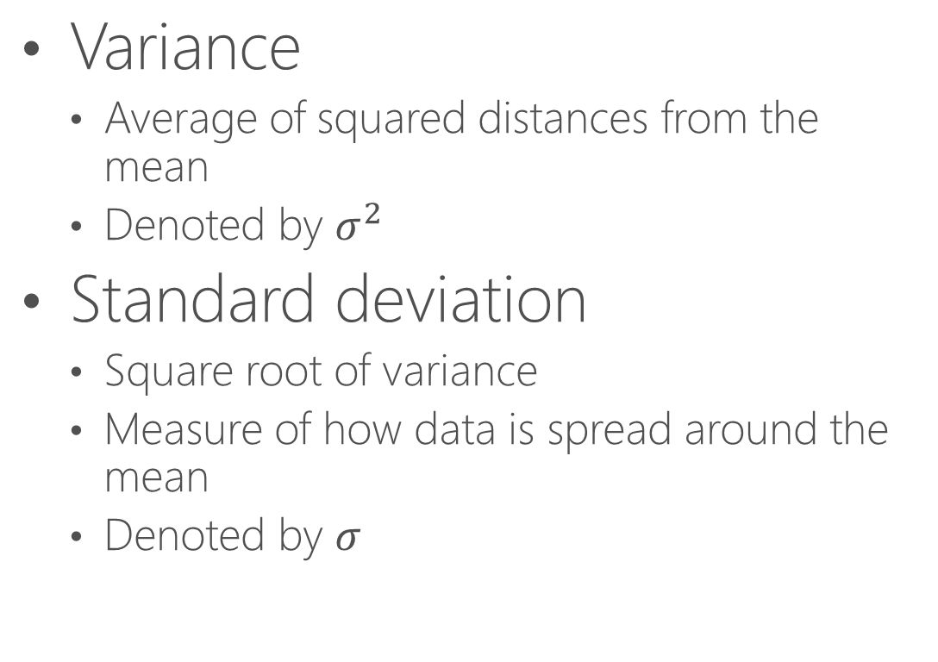

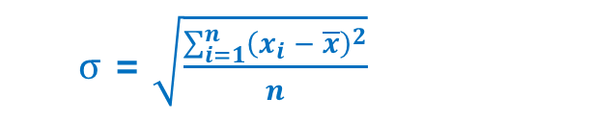
Summary Statistics…Cont’d
$σ$ = $\sqrt{\frac{\sum_{i=1}^{n}{{\left(x_{i} − \overline{x}\right)}^{2}}}{n}}$
Variance
Average of squared distances from the mean
Denoted by $σ^{2}$
Standard deviation
Square root of variance
Measure of how data is spread around the mean
Denoted by $σ$
$σ$ = 1
$σ$ = 2
Notes:
Plots in the slides are from the same distribution but different standard deviations. Range of values is different when STD changes.

Slide 10
Summary Statistics…Cont’d
Quartiles
Values that divide sorted data points into quarters
Second quartile is the median
The difference between Q3 and Q1 is called the Interquartile range or IQR
Unique values
Count of distinct data points
Missing values
Count of missing data points in the variable
X = {1, 3, 3, 4, 5, 8, 9}
Q1
Q2
Q3
Notes:
First quartile is the middle value between Min and the median. Second quartile is the median. Third quartile is the middle value between the median and Max.

Slide 11
Data Visualization
Provides qualitative understanding of data
Simplifies delivering concepts
Helps identify patterns
Displays spread of data
Shows if data is symmetric
Shows if outliers are present
Displays relationships among variables

Slide 12
Data Visualization Methods
Histogram
Displays distribution of continuous data
Range of values divided into bins
Bins are consecutive and do not overlap
Used in univariate analysis
Max
Q3
Q1
Q2
Box plot
Summarizes distribution of data
Used in univariate analysis
Min
Scatter plot
Display correlation between two variables
Used in bi-variate analysis
Notes:
Other data visualization methods are:
Line plots: Useful for displaying change over time
Bar charts: Useful when comparing quantities among different categories
Histogram in the slide shows count of a series of digits in the range of 1-100.

Slide 13
Univariate Data Analysis
Analyzes all variables individually
Describes each variable and understands its distribution
Finds patterns
Finds missing values and outliers
Does not deal with relationships
Analysis method depends on variable type
Categorical variables
Frequency tables
Count and % count
Continuous variables
Central tendency: mean, median, mode, etc.
Dispersion or spread: variance, standard deviation, min, max, quartiles, etc.

Slide 14
Bi-variate Data Analysis
Analyzes exactly two variables
Identifies relationships between two variables
The variables could depend on each other
Dependent variable
Independent variable(s)
Analysis method depends on combination of categorical and continuous variables
Notes:
Bivariate data can be stored in a table with two columns

Slide 15
Bi-variate Data Analysis… Cont’d
Two continuous variables
Scatter plots
Used to find the relationship between two variables
Relationship can be linear or nonlinear
Correlation
Can show degree or strength of relationship
Two categorical variables
Chi-Square test
Determines if variation in collected data is by chance or caused by a variable
Two-way table
Rows show categories of one variable
Columns show categories of the other variable
Stacked column chart
Visual for a two-way table
Notes:
Correlation does not mean causation.

Slide 16
Bi-variate Data Analysis… Cont’d
One continuous and one categorical variable
Box plots
Z-Test
Statistical hypothesis test
Determines if the difference between sample mean and population mean is significant
Used when sample size is large (>30)
Preferred over T-test when the population standard deviation is known
T-Test
Statistical hypothesis test to determine if the difference between sample and population means is significant
Used when sample size is < 30
Useful when the standard deviation of the population is not known
ANOVA
Analysis of Variance
Used when dealing with more than two populations
Notes:
Box plots can be used to perform bi-variate analysis between a continuous variable and a categorical variable. For example, comparing summary statistics of income based on gender, level of education, etc.
Z-Test, T-Test and ANOVA are forms of inferential statistics that allow us to use findings from a sample and generalize them to the population
Z-Test is used when variables have a normal or close to normal distribution
T-test follows a T distribution

Slide 17

Demonstration: Initial Data Analysis
Explore Data
Create Summary Statistics
Create Histograms and Boxplots Using Python
Create a Correlation Matrix
Create Pair-Wise Scatter Plots Using R
Notes:
M02_L01_Demo01_Initial_Data_Analysis.docx

Slide 18
Lab: Explore the Data
In this lab you will explore data in a dataset
Notes:
Labs\M02L01Lab01\17749_M02_L01_Lab01.docx

Slide 19
Knowledge Check
Can a numeric variable be categorical?
What is the difference between summary statistics and visualization?
What is the significance of standard deviation?
What are the preferred data visualization methods for univariate and bi-variate data analysis?
Notes:
Yes, some numeric variables can be treated as categorical. For example, number of cylinders in automobiles, number of years to study to obtain a degree (high school, bachelors, masters, PhD)).
Summary statistics use numbers to describe the data quantitatively, while visualization uses graphs to provide a qualitative description of data.
Standard deviation provides a measure of how the data is spread around the mean.
Histograms are used for univariate data analysis. Scatter plots are used for bi-variate data analysis on two continuous variables. Box plots can be used for both univariate data analysis, and bi-variate data analysis between one categorical and one continuous variable.

Slide 20
Module 2:
Data Cleaning and Model Improvement
LESSON 2:
Data Cleaning
After completing this lesson, you will be able to:
Remove Duplicates and Unrelated Observations
Treat Missing Values
Treat Outliers
Perform Feature Engineering

Slide 21
Unwanted Rows
Duplicate Rows
Observations with identical values in all significant features
Irrelevant Rows
Observations unrelated to the problem being studied
Notes:
Duplicate observations are the ones that have identical values in columns that are significant to the study, not necessarily all columns of the dataset.
Irrelevant rows have data in significant columns/features that are not related to the study. For example, when studying topics related to pregnancy, observations from male participants should be excluded.

Slide 22
Unwanted Rows… Cont’d
Possible causes:
Merged datasets from various sources
Human error
Can negatively impact
Efficiency and performance of the model
Interpretation of data
Duration of data analysis
Notes:
Unwanted values can impact summary statistics.

Slide 23
Dealing With Missing Values
Missing data in a variable
Impacts analysis of the behavior of the variable (univariate analysis)
Impacts analysis of the variable’s relationship with other variables (bi-variate analysis)
May result in a biased model
May result in wrong classifications or predictions

Slide 24
Types of Missing Data
Missing completely at random (MCAR)
Cause of missing data is independent of values in any of the variables
Missing values randomly distributed across all observations
Missing at random (MAR)
Cause of missing data not related to values of missing data
Cause of missing data could be related to some of the non-missing values of other variables
Missing Not at Random (MNAR)
Cause of missing data in a variable related to the values of missing data of the variable
Notes:
Types of missing data are called “Missing Value Mechanisms.”
MCAR: We are assuming that whether or not a value is missing, is not related to other values in the dataset. In other words, there is no pattern.
Data is MCAR when for example a participant unintentionally misses a question, or some of the tubes containing blood samples are accidentally dropped/destroyed, etc.
If we can predict (using some method like regression, common sense, etc.) which observations have missing values, then the missing values are not MCAR
MAR: Percentage or ratio of missing values could change based on other observed values. For example, when collecting data about income, more male participants had missing values for age than female participants. IOW, the reason someone did not answer a question (age, in this case), depends on values of one or more other variables (gender, in this case).
MCAR and MAR are also called ignorable missing data mechanisms.

Slide 25
Treat Missing Values
Deletion
Use when data is MCAR or MAR
Different approaches:
Delete rows that have one or more missing values
Analyze all cases where all variables of interest are present
Delete column
Use for variables that are not significant
Imputation
Impute with mean, median or mode
Impute using prediction models
Notes:
There is no perfect or best way to treat missing values.
In pair-wise deletion, no row is removed. Analysis is done on using observations that have all features available. For example, to calculate covariance between pairs of variables, only those observations where both data points are present are used, and observations where at least one of the data points is missing are ignored. As a result, when calculating covariance of pairs of columns, we are likely to end up with different numbers of data points for different pairs of variables.
With pairwise deletion, interpretation may become difficult because there may be different numbers of observations in different combinations.
Delete column/feature when for example at least 60% of values are missing.

Slide 26
Demonstration: Missing Values
Explore Missing Value Mechanism
Notes:
M02_L02_Demo01_Missing_Values.docx

Slide 27
Dealing with Outliers
Outliers are measurements significantly distant from other observations.
Can be the result of natural variability in the data or error.
Outliers can skew your model and possibly lead to less than optimal results.
Outliers can also be valid and very useful in detecting things like fraud or equipment failure.
Notes:
Outliers in data sets are those measurements that are significantly distant from other observations and can be a result of variability or even error. Outliers can skew the results of your experiments and possibly lead to suboptimal results. However, outliers could be valid and very useful to detect things such as fraud or equipment failure.
It is important not to just arbitrarily remove anything that looks out of place. Outliers should be individually evaluated with some domain knowledge to determine if they are the result of an error or variability in the data set.

Slide 28
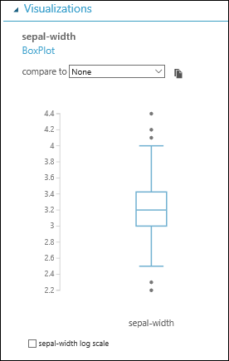
Identifying Univariate Outliers
Outliers can be detected during the data exploration phase of your machine learning project.
Univariate outlier detection deals with a single variable.
Box Plots and histograms can be used to visually detect univariate outliers.
When viewing datasets in a boxplot, outliers are shown as separately plotted points.
Notes:
If a data value is very far away from the quartiles (either much less than Q1 or much greater than Q3, it is sometimes designated an outlier. Instead of being shown using the box plot, outliers are usually shown as separately plotted points.
The standard definition for an outlier is a number which is less than Q1 or greater than Q3 by more than 1.5 times the interquartile range (IQR = Q3 = Q1). That is, an outlier is any number less than Q1 – (1.5 x IQR) or greater than Q3 + (1.5 x IQR).

Slide 29
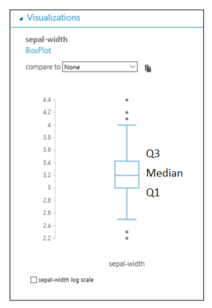
Calculating Outliers with IQR
Data points located more than 1.5 times IQR either below Q1 or above Q3 can be considered outliers
These are data points beyond the whiskers
Peak Values: N > Q3 + (1.5 x IQR)
SubPeak Values: N < Q1 – (1.5 x IQR)

Slide 30
Identifying Bivariate Outliers
Bivariate outliers deal with exactly two variables.
Scatterplots can be used to visually identify outliers when both variables are continuous.
In the case of one continuous variable and one categorical variable, a MultiboxPlot can be used for visual identification and comparison.
Notes:
Some of the Multivariate Outlier Detection Techniques popularly used are the Mahalanobis Distance, Cook’s Distance, etc.

Slide 31
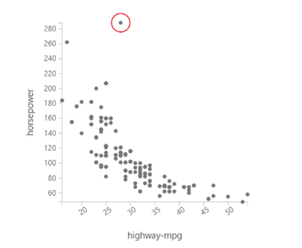
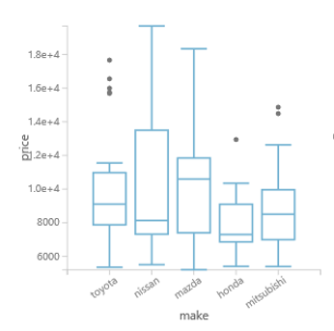
Identifying Bivariate Outliers… Cont’d
Scatter Plot
Multibox Plot

Slide 32
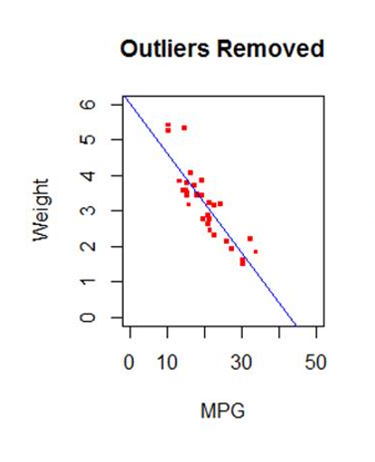
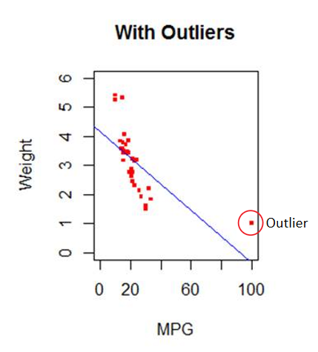
Outlier Impact on Model Fit
Outliers can have significant impact on the model as viewed in the linear regression model below.
Notes:
Influential Points change estimates substantially when omitted.
Can steer model from general truth.
Leverage - x_{i} value is far from others so value will change value of f greatly
If you move x_{i} then f(x) moves proportionally. The proportionality constant is called the leverage of point i.
Leverage depends on x_{i} but not on y_{i}. It depends on how far away xi is from the mean of the x_{i}'s.
Influential Points do not necessarily have high leverage
High Leverage Points are not necessarily influential.

Slide 33
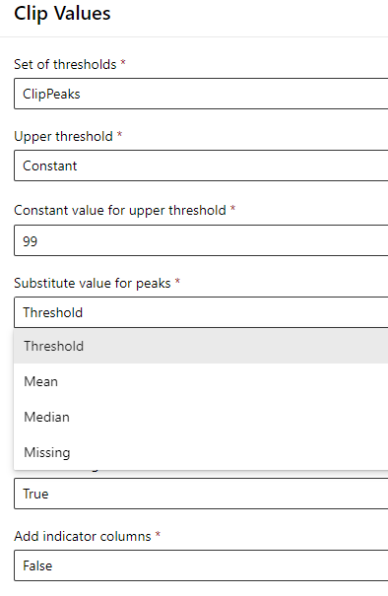
Treating Outliers
Options for treating outliers using the Clip Values Module in Azure ML designer.
Not all Outliers should or need to be treated. Outliers should be investigated to determine the origin of the outlier.
Substitution Options
Threshold – Replace clipped Values with the specified threshold value
Mean – Replace clipped values with the mean of the column values.
Median – Replace clipped values with the median of the column values.
Missing – Replace clipped values with the missing (empty) value

Slide 34
Demonstration: Outliers
Use Clip Values Module to Treat Outliers
Notes:
M02_L02_Demo02_Outliers.docx

Slide 35
Feature Engineering
Create new features from existing raw features
Normalize data for better predictive power by:
Aggregating
Categorizing
Splitting
Power Transform
Feature engineering is a combination of science and art

Slide 36
What is a Feature?
Training data is a matrix consisting of observations and features
Each attribute is considered a feature that describes each instance or observation
Features in the dataset should describe the patterns in the data
Features
Observations
Notes:
Training data is a matrix consisting of observations at the row level, each of which has a set of attributes, or features, at the column level

Slide 37
Importance of Feature Engineering
Enhances the predictive power of the ML model
Helps differentiate patterns in the data
Enables qualitative data to be quantified

Slide 38
Feature Selection
Selecting a subset of the original feature set to reduce dimensionality
Excluding features that will have little to no impact on model performance
Feature selection is applied once all necessary features are created

Slide 39
Common Feature Engineering Methods
One-Hot-Encoding
Binning
Log Scale
Hashing

Slide 40
One-Hot-Encoding
The process of representing categorical features in a way that makes prediction more efficient at scale
Algorithms cannot produce predictions using categorical data, which is mostly non-numeric
This method assigns a binary value to represent the feature’s original classification and category

Slide 41
Binning
Distributing numerical features into value ranges called “bins” or “buckets”
Each bin is identified with a “Bin ID”
Distribution methods:
Equal Width
Adaptive, quantiles
Quartiles
Deciles
Notes:
Often times with continuous numeric data, we run into anomalies such as extremely high or extremely low values which skew the dataset.
Binning categorizes the numeric features within ranges, correctly isolating and binning any outliers.
Depending on the dataset, you will want to apply two different types of binning: by a fixed and equal width or by adaptive, non-fixed distributions such as by quantiles (deciles, quartiles, etc.)

Slide 42
Logarithmic Scale
Normalizing numerical distributions containing uneven magnitudes
Using statistical transformations called power transform
Expand and shrink numerical ranges
Achieve a uniform and normalized scale throughout the feature

Slide 43
Feature Hashing
Mapping a set of data, or features, of varying sizes to indices of fixed sizes, or hash values
The resulting indices are represented as a vector of features
Feature Hashing is memory efficient, fast, and reduces dimensionality

Slide 44
Demonstration: Feature Engineering
One-Hot-Encoding
Binning
Logarithmic Scale
Grouping Categorical Values
Feature Hashing
Notes:
M02_L02_Demo03_Feature_Engineering.docx

Slide 45
Lab: Feature Engineering
Treat missing values
Identify Outliers
Clean Dataset
Train and Evaluate Model
Notes:
\Labs\M02L02Lab01\17749_M02_L02_Lab01.docx

Slide 46
Knowledge Check
What are missing value mechanisms?
What is the impact of imputing missing values with mean?
Why is it important to identify and evaluate outliers?
Name two options for treating outliers.
Name two ways that Feature Engineering can impact a Machine Learning algorithm.
How does one-hot-encoding transform data?
Notes:
Missing completely at random (MCAR): Cause of missing data is independent of values in any of the variables. Missing values are randomly distributed across all observations.
Missing at random (MAR): Cause of missing data could be related to some of the non-missing values of other variables. Missing values are distributed in one or more subsamples, not all observations
Missing not at random (MNAR): Cause of missing data in a variable could be related to the values of missing data of the variable, or related to feature(s) not included in the dataset.
Imputing with mean reduces the variance.
Outliers can come from several sources including data entry error, measurement error, or could simply by valid and showing variability in the underlying data. Outliers that originate from error can be treated in a number of ways in order to prevent the skewing of the resultant data model.
Outliers can be replaced with the mean, median, threshold, or replaced with empty values.
Feature engineering enhances predictive power, differentiates patterns in data, and allows qualitative data to be quantified.
One-hot-encoding transforms data by converting a categorical variable into binary representations.

Slide 47
Module 2:
Data Cleaning and Model Improvement
LESSON 3:
Model Improvement
After completing this lesson, you will be able to:
Describe Bias and Variance
Describe & Implement Feature Selection
Describe & Implement Regularization
Describe & Implement Parameter Sweeping
Describe & Implement Cross-Validation

Slide 48
Model Improvement Principles
Avoid over-fitting and under-fitting
An over-fit model is too fit to the training dataset
An underfit model does not show a proper fit to the training dataset
Underfit (simple)
Overfit
Notes:
Performance of an underfit model is poor because it is too simple and uses fewer parameters. For example, a linear model is a straight line and has only one parameter.
An underfit model also shows poor performance when used on a dataset other than the one it was trained on. As a result, variability in performance of an underfit model is not high.
The goal of machine learning is to create a model that can identify the pattern that we are looking for, based on available data points. Some of those data points do not contribute to identifying the pattern. Instead, they contribute to what is called random noise.
A good model is the one that can ignore the noise. A model that fits both the pattern and noise, is an overfit model.
The idea is to create a model that is not too fit to the dataset used to train it. An over-fit model may show higher variance for the performance metric when it is tested with different datasets.
More parameters can make a model complex and over-fit. For example, a linear model is simpler than a quadratic (2nd degree) polynomial, which is more complex than a cubic (3rd degree) polynomial.
Graphs in this slide were drawn around the same data points.
The graph on the right is too fit to the data. It is a polynomial of a high degree. A small change in some of the data points may have a large impact on this graph.
The graph on the left is simple. It is a polynomial of the first degree (straight line). A change in one of the data points will have a small impact on this graph, because it is not too fit to the data that was used to train it.

Slide 49
Model Improvement Principles…Cont’d
Overfit models
Have low performance error when used on the training dataset
Have high performance error when used on test/evaluation and other datasets
Have unpredictable performance
Have more parameters and are more complex
Underfit models
Have high performance error when used on the training dataset
Have high performance error when used on test/evaluation and other datasets
Show consistently poor performance
Have fewer parameters and are simple
Notes:
Underfit models show poor performance on the training as well as test/evaluation datasets. Underfit models have too few parameters and as a result are too simple.
For example, a linear model (straight line) has only one parameter (polynomial of degree 1).
Overfit models show poor performance on test/evaluation dataset, but good performance on the training dataset. Because of this, overfit models are not good predictors.
An overfit model is too fit to the training dataset and as a result does not generalize well. Overfit models have too many parameters (polynomial of a high degree) and as a result are more complex.

Slide 50
Model Improvement Principles…Cont’d
Bias
Inability of a model to find the true relationship between the features and the label in the training dataset
Difference between actual and predicted values
Variance
Sensitivity of a model to change in data
Difference between performance errors when used on different datasets
Bias and Variance Tradeoff
Overfit models have high variance and low bias
Underfit models have low variance and high bias
Model with the right fit has a balance between bias and variance
Notes:
A model that is too sensitive to changes in data is said to have high variance. An overfit model has good performance with the training dataset, but poor performance with other datasets.
So, variation in performance is high for an overfit model.
The best choice for a model is one that creates a balance between bias and variance.

Slide 51

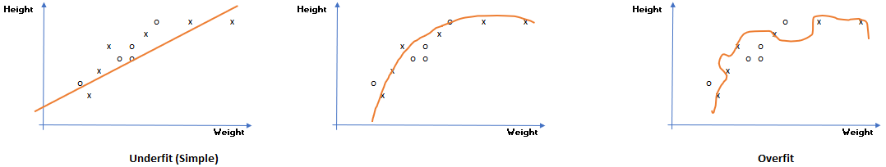
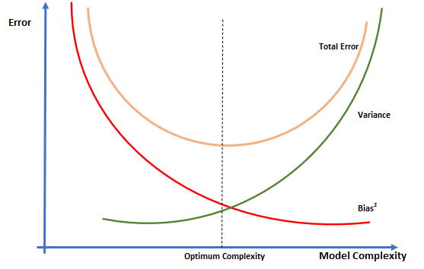
Model Improvement Principles …Cont’d
Notes:
In the figures shown, points represented by “x” are data points used to train the model, and the ones represented by “o” are the ones used for testing/validation.
The linear model on the left has low variance and high bias. The model on the far right is a complex one that has high variance and low bias.
The second model is the point between the two extremes, balances bias and variance and is the ideal model.
The third graph shows the tradeoff between bias and variance, and their relationship with model complexity and performance.

Slide 52
Model Improvement Principles… Cont’d
Avoid overfit and underfit models
Choose models that provide a balance between bias and variance
Test different models
Choose the right performance metric
Use model improvement techniques
Feature Selection
Regularization
Parameter Sweeping
Cross Validation

Slide 53
Model Improvement Methods
Feature Selection
Find relative importance of features
Simpler models generalize and predict better
Regularization
Technique used to reduce overfitting by shrinking feature coefficients
Two regularization techniques:
L1 Regularization:
Shrinks coefficients of less important features to zero and removes them
Generates simpler models
L2 Regularization:
Shrinks parameters but does not remove them
Performs better when model depends on all features
Notes:
Features that have no significance may introduce noise and negatively impact the outcome.
Regularization helps keep model simpler and avoid overfitting. It accomplishes this by favoring polynomial of lower degrees. This means that regularization “tries” to make the model more linear by reducing curvatures.
A polynomial of higher degree is chosen only if it significantly reduces error.
Regularization is helpful when dealing with a dataset that has a large number of features compared to the amount of data that it provides to the model.
In Azure ML, increasing the regularization weight results in shrinkage of coefficients → (when examining feature importance, weight of features moves toward zero as you increase regularization weight).

Slide 54
Model Improvement Methods… Cont’d
Sweeping Model Parameters
Tests a model numerous times using different parameter values
Used to identify optimum values of parameters
Can show sensitivity of a model to certain parameters
Two options in Azure ML to sweep parameters
Sweep entire grid
Random sweep
Notes:
In Azure ML Studio, the “Tune Model Hyperparameters” module provides options for parameter sweeping.
Sweep entire grid takes longer but yields better results
Random sweep is faster

Slide 55
Model Improvement Methods… Cont’d
Cross-Validation
Used to determine if model is over-fitted
Divides data into multiple folds
Measures performance metrics in each fold
Computes the mean and standard deviation of the metrics across all folds
Small variations in metrics indicate a model that generalizes well
Computationally intensive
Notes:
Cross-validation works by dividing the dataset into a set number of folds, say 10. Then the algorithm is trained using 9 of the folds and evaluated using the fold that was left out. This is repeated by changing the fold that is kept out. At each iteration, the evaluation metric is recorded. After iterating through all folds (10 times in this example), mean and standard deviation of the evaluation metrics are computed. Consistent values (low variance) of the selected metric across all folds indicate that the model is not sensitive to specific data points, which is desirable.

Slide 56
Demonstration: Model Improvement
Bias and Variance
Feature Selection
Regularization
Parameter Sweeping
Cross-Validation
Notes:
M02_L03_Demo01_Model_Improvement.docx

Slide 57
Data Science Life Cycle
Define Business Objectives
Import Data
Initial Data Analysis
Clean Data
Deploy Model
Evaluate Model
Optimize Model
Create Model
Notes:
Different life cycles are available in industry that use different methodologies.
Data science life cycle helps create a structure for a data science project by outlining the sequence of steps in the project, from the beginning to the end.

Slide 58
Lab: Model Improvement
Use model improvement methods to optimize your model
Notes:
\Labs\M02L03Lab01\17749_M02_L03_Lab01.docx

Slide 59
Lab: Model Deployment (optional)
Operationalize your model
(optional)
Notes:
\Labs\M02L03Lab02\17749_M02_L03_Lab02.docx

Slide 60
Knowledge Check
What is an overfit model and why should it be avoided?
Which model improvement methods can identify less important features?
What is the preferred model improvement method when all features are important?
What are Azure ML options for parameter sweeping?
How do you interpret results of cross-validating a model?
Notes:
An overfit model is a model that is too fit to the training dataset. Overfit models should be avoided because they are sensitive to specific values of data.
Feature Selection (using Permutation Feature Importance in Azure ML Studio), and L1 Regularization.
L2 Regularization performs better when the model depends on all features.
Azure ML offers two options for parameter sweeping: 1) Sweep entire grid, which takes longer but yields better results, 2) Random sweep, which is faster.
For a selected metric, examine the values of the metric across all folds, and its variance. If the metric does not show large variations across different folds (has low variance), then most probably the model is not over-fitted.

Slide 61
Module Summary
Initial Data Analysis
Data Cleaning and Feature Engineering
Model Improvement

