Slide 1
Module 3: Azure Machine Learning Service

Slide 3
Module Overview
Lesson 1
Lesson 2
Lesson 3
Lesson 4
Azure Machine Learning Service Fundamentals
Azure Machine Learning Service Model Training
Azure Machine Learning Service Model Deployment
Pipelines in Azure Machine Learning Service

Slide 4
Module Overview
Lesson 5
Lesson 6
MLOps
Responsible AI

Slide 5
Module 3:
Azure Machine Learning Service
LESSON 1:
Azure Machine Learning Service Fundamentals
After completing this lesson, you will be able to:
Describe Azure Machine Learning service.
Describe Azure Machine Learning service features.
Steps to Build, Train and Deploy a Model

Slide 6
Science?
What is Azure Machine Learning Service?
Combination of Azure cloud services and Python SDK.
Allows data scientists and developers to:
Create environment
Prepare data
Build models
Train models
Test models
Manage models
Track experiments
Deploy models
Notes:
Azure Machine Learning service blurs the line between responsibilities of different teams involved in the process, and enables data scientists and developers to perform all tasks (end-to-end) involved in a data science project.
Demo: M03_L01_Demo01_Create_Workspace
Lab: M03_L01_Lab01_AML_Workspace_and_Compute_Instance

Slide 7
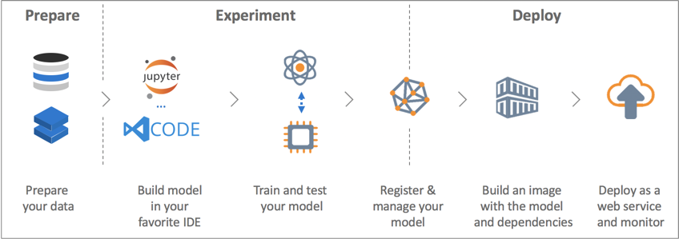
What is Azure Machine Learning service…Cont’d
Notes:
Azure Machine Learning service is a cloud service that you use to train, deploy, automate, and manage machine learning models, all at the broad scale that the cloud provides.
Demo: M03_L01_Demo01_Create_Workspace
Lab: M03_L01_Lab01_AML_Workspace_and_Compute_Instance

Slide 8
Science?
What is Azure Machine Learning Service?...Cont’
Stages of a traditional data science project:
DevOps team provisions and configures an environment.
Data scientists and developers build and train model.
DevOps team deploys and scales trained model.
Stages of a data science project using Azure Machine Learning service:
Data scientists and developers create an environment.
Data scientists and developers build and create model.
Data scientists and developers deploy and scale trained model .
Notes:
Traditionally, data scientists depend on DevOps team for the first part of the process, which is provisioning and configuring the environment, as well as the third (last) part, which is deploying and scaling the model. Azure ML service removes the dependency of data scientists on other teams for steps 1 and 3 of the process.
Demo: M03_L01_Demo01_Create_Workspace
Lab: M03_L01_Lab01_AML_Workspace_and_Compute_Instance

Slide 9
Science?
Azure Machine Learning Workspace
Top-level resource for Azure Machine Learning
Provides a centralized place to work with all artifacts created while using Azure Machine Learning
Stores training runs including logs, metrics, outputs, and snapshot of the scripts
Training runs can be used to identify the run that produces the best model

Slide 10
Science?
Accessing Azure Machine Learning Service
Tools for workspace interaction:
Web
Azure Machine Learning studio
In any Python environment with the Azure Machine Learning SDK for Python.
In any R environment with the Azure Machine Learning SDK for R (preview).
On the command line using the Azure Machine Learning CLI extension
Visual Studio Code with Azure Machine Learning Extension
Notes:
Demo: M03_L01_Demo01_Create_Workspace
Lab: M03_L01_Lab01_AML_Workspace_and_Compute_Instance

Slide 11
Science?
What is Azure Machine Learning studio?
Azure Machine Learning studio is the web portal for data scientist developers in Azure Machine Learning.
It combines no-code and code-first experiences for an inclusive data science platform.
Three ways to machine learning projects in the studio:
Azure Machine Learning designer
Automated Machine Learning UI
Notebooks

Slide 12
Azure ML studio and Azure ML designer cience?
Azure ML studio
Cloud-based environment to train, deploy, automate, manage, and track ML models
Productivity tool for all skill levels to accelerate end-to-end ML lifecycle
Code-first experience, drag-and-drop designer and automated machine learning
Azure ML designer
Part of Azure ML studio for UI-based ML experience
Provides a visual canvas to build, test, and deploy machine learning models
Uses Azure Machine Learning workspace to organize shared resources
pipelines, datasets, compute resources, registered models and real-time endpoints
Notes:
https://docs.microsoft.com/en-us/azure/machine-learning/concept-designer
Datasets, compute resources, registered models and pipelines are examples of shared resources organized by the machine learning workspace.

Slide 13
Science?
Compute Targets for Azure ML Designer
Compute targets
Attached to your Azure Machine Learning Workspace
Can be used to run pipelines and host deployed models as real-time endpoints or pipeline endpoints (for batch inference)
Compute Target | Training | Deployment
Azure Machine Learning Compute | ✓
Azure Kubernetes Service |  | ✓
Notes:
A pipeline is a compute resource, it is attached to your workspace and runs on a compute target. Compute targets can be reused it for future runs.
Default compute target can be set for the entire pipeline, which will result in every module using the same compute target by default. However, it is also possible to specify compute targets on a per-module basis.
When the compute resource is idle, it auto-scales to zero nodes to save cost. So, while using it again after a delay, five minutes of wait time might be experienced while it scales back up.

Slide 14
Science?
Azure Machine Learning Service Features
Support for open-source technologies
Scikit-learn
TensorFlow
CNTK
PyTorch
Automated machine learning
Automated data preprocessing
Automated algorithm selection
Automated hyperparameter selection
Notes:
CNTK: Microsoft Cognitive ToolKit
Sometimes the terms parameter and hyperparameter are used interchangeably, which technically is not correct. Sometimes depending on the context, the term parameter may refer to both parameters and hyperparameters. Difference between model parameters and hyperparameters:
Model parameters are configuration variables whose values can be learned/estimated from data. Coefficients of a logistic regression or linear regression model are examples of parameters. Parameters are calculated/estimated/learned from data during training and are needed by the trained model when making predictions.
Model hyperparameters are variables whose values cannot be learned/estimated/calculated from data. Values of hyperparameters are provided by the person who builds the model and runs the experiment. There are no formulas to find best values of hyperparameters. They are often used to improve model performance. We can use trial and error and rules of thumb to come up with selected values for hyperparameters. Hyperparameter vales are initialized at the beginning of training, and they can be updated during the course of training to improve performance. Regularization rates are examples of hyperparameters.
Demo: M03_L01_Demo01_Create_Workspace
Lab: M03_L01_Lab01_AML_Workspace_and_Compute_Instance

Slide 15
Science?
Azure Machine Learning Service Features (Cont’d….)
Azure Machine Learning Pipelines:
Allow collaboration on different steps of a data science project:
Data preparation
Model training and testing
Model deployment
Allow rerunning selected step(s).
Allow unattended runs of selected steps.
Allow using a mix of execution environments for different steps.
Allow creating templates for reusability.
Notes:
A pipeline is a combination of steps grouped together to perform a certain function. Azure has three pipeline technologies
Azure pipelines
Azure Machine Learning pipelines
Azure Data Factory pipelines
An Azure ML pipeline can combine different phases (prepare data, train model, deploy and evaluate) of a machine learning project. Each phase of the project may consist of multiple steps. For example, data preparation phase may consist of various steps such as treating missing values, data normalization, data transformation, hyper-parameter tuning, etc.
Different steps in a pipeline can run in different execution environments (compute targets) such as local computer, Azure Databricks, Azure HDInsight, etc.
Demo: M03_L01_Demo01_Create_Workspace
Lab: M03_L01_Lab01_AML_Workspace_and_Compute_Instance

Slide 16
Science?
Azure Machine Learning Service Features (Cont’d….)
Flexible compute targets for training:
Local computer
Azure Machine Learning compute cluster
Azure Machine Learning compute instance
Remote VM
Azure Databricks
Azure Data Lake Analytics
Azure HDInsight
Azure Batch
Notes:
A compute target is the environment where you train your model. Compute targets are also called execution environments.
You can use Azure portal, Azure Machine Learning SDK or CLI to create a compute target. A compute target that was created in another service such as HDInsight can be attached to your Azure Machine Learning workspace.
Demo: M03_L01_Demo01_Create_Workspace
Lab: M03_L01_Lab01_AML_Workspace_and_Compute_Instance

Slide 17
Science?
Azure Machine Learning Service Features (Cont’d….)
Training compute target feature supportability.
Compute Target for Training | Automated Machine Learning | Azure Machine Learning Pipelines | Azure Machine Learning designer
Local Computer | Yes
Azure Machine Learning compute cluster | Yes | Yes | Yes
Azure Machine Learning compute instance | Yes (through SDK) | Yes
Remote VM | Yes (SDK local mode only) | Yes
Azure Databricks | Yes | Yes
Azure Data Lake Analytics |  | Yes
Azure HDInsight |  | Yes
Azure Batch |  | Yes
Notes:
Supportability of Azure Machine Learning service features varies based on the compute target.
Azure machine learning pipelines do not support local compute target.
GPU acceleration is available on a local computer target if the compute target meets the GPU hardware and software requirements.
Demo: M03_L01_Demo01_Create_Workspace
Lab: M03_L01_Lab01_AML_Workspace_and_Compute_Instance

Slide 18
Science?
Azure Machine Learning Service Features (Cont’d….)
Compute targets for inference:
Local Web Service
Azure Container Instances (ACI)
Azure Kubernetes Service (AKS)
Azure Machine Learning Compute Clusters
Azure Functions (preview)
IoT device (preview)
Integration with Visual Studio Code Tools for AI.
Develop AI solutions in Windows, Linux Ubuntu and MacOS
Deploy models created in ONNX format.
Notes:
You can use the appropriate compute target for deployment, based on the desired scale, goal, expected load and response time, and other factors.
ONNX: Open Neural Network Exchange
Demo: M03_L01_Demo01_Create_Workspace
Lab: M03_L01_Lab01_AML_Workspace_and_Compute_Instance

Slide 19
Science?
Key Components of Azure ML Service
Workspace
Models
Images
Experiments
Deployments
Pipelines
Data Stores
Compute Targets
Notes:
Workspace defines the boundaries of the project where the remaining components are created. Other components such as models, images, compute targets and deployment services are created in the workspace.
Workspace itself, is created in an Azure resource group.
Demo: M03_L01_Demo01_Create_Workspace
Lab: M03_L01_Lab01_AML_Workspace_and_Compute_Instance

Slide 20
Science?
Azure Machine Learning Service Workspace
Requirements for creating a workspace:
Workspace name
Azure subscription ID
Resource group name
Location
Components created for each workspace:
Key Vault
Container Registry
Storage Account
Application Insights
Notes:
Creating a workspace requires the following three parameters:
1. Workspace name
2. Azure subscription ID. If you don’t have an Azure subscription, you can get a free trial subscription. The trial subscription is also called pay as you go.
3. Name of the resource group in which the workspace is to to be created. If you specify a resource group name that does not exist, Azure will first create a new resource group using the name you have specified, and then create the workspace in that resource group.
When you create a new workspace, the following four components are created in the resource group for that workspace: Key Vault, Container Registry, Storage Accounts, Application Insights. Each workspace has its own Key Vault, Container Registry, Storage Account and
A resource group can contain multiple workspaces.
Demo: M03_L01_Demo01_Create_Workspace
Lab: M03_L01_Lab01_AML_Workspace_and_Compute_Instance

Slide 21
Science?
Steps to Build, Train and Deploy a Model
Obtain Azure subscription.
Create a resource group in your Azure subscription.
Create a workspace in a new or existing resource group.
Use Azure portal
Import dataset
Analyze and prepare data
Notes:
Demo: M03_L01_Demo01_Create_Workspace
Lab: M03_L01_Lab01_AML_Workspace_and_Compute_Instance

Slide 22
Science?
Steps to Build, Train and Deploy a Model (Cont’d….)
Train model
Use automated machine learning or algorithm of your choice.
Test and tune model
Register model
Choose compute target for deployment
Create scoring file
Create environment configuration file
Prepare an inference configuration
Deploy the model to the compute target.
Test the deployed model, also called a web service.
Notes:
Not all parts of the process require a workspace. For example, importing the dataset, initial data analysis and data cleaning/preparation can be done in a Jupyter notebook installed locally. This requires that the required packages such as AzureML to be installed locally.
Demo: M03_L01_Demo01_Create_Workspace
Lab: M03_L01_Lab01_AML_Workspace_and_Compute_Instance

Slide 23
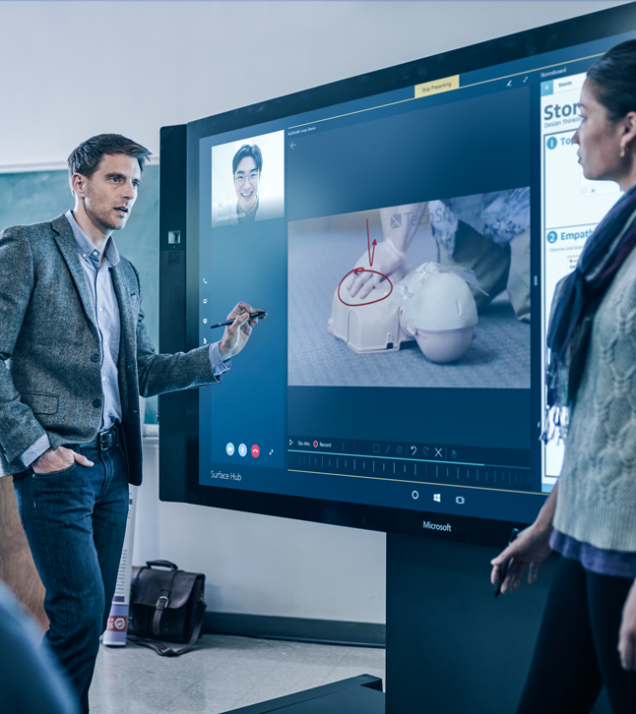
Demonstration: Azure Machine Learning Service
Use Azure portal to create a Machine Learning service workspace
Notes:
M03_L01_Demo01_Create_Workspace.docx

Slide 24
Demonstration: Azure Machine Learning Designer
Build, train and deploy a model on AKS compute target using Azure Machine Learning Designer
Notes:
M03_L01_Demo02_Azure_ML_Designer.docx

Slide 25
Lab: Azure Machine Learning Service Workspace and Compute instance
Create an Azure Machine Learning workspace and compute instance
Notes:
17749_M03_L01_Lab01.docx

Slide 26
When should you use Azure Machine Learning service instead of Azure Machine Learning Studio?
What are the requirements for creating an Azure Machine Learning service workspace?
What is the difference between a model parameter and a hyper-parameter?
What are the main tools for workspace interaction?
What are the compute targets supported by Azure ML Designer?
What are the similarities and differences between Azure ML studio and Azure ML Studio (classic) ?
Notes:
Use Azure ML service if you use Python, need control over your algorithms, and want to use open-source ML libraries. Use Azure ML Studio if you need a quick way to create a machine learning model and built-in algorithms are sufficient for your project.
Creating a workspace requires an Azure subscription ID, workspace name, name of the resource group where the workspace is to be created, and location.
Model parameters are learned/calculated/estimated from data. Hyper-parameters are variables whose values cannot be learned or estimated from data. The person who runs the experiment estimates the values of hyper-parameters based on rule of thumb and provides the values at the start of the experiment.
Azure Machine Learning studio, Azure Machine Learning designer (preview), Azure Machine Learning SDK for Python and R, CLI extension on the command line
For training compute targets, AML Compute and for inferencing compute targets, Azure Kubernetes Service for real-time inference and AML Compute for batch inference are supported.
Azure ML designer is the UI part of Azure ML studio and drag-and-drop interface experience is similar between Azure ML Studio (Classic) and the designer. On the other hand the differ on the architectural level. Compute targets, and supportability for ML pipeline, ML Ops and Auto ML are the basic differences.

Slide 27
Module 3:
Azure Machine Learning Service
LESSON 2:
Azure Machine Learning Service Model Training
After completing this lesson, you will be able to use Azure Machine Learning service to:
Import datasets
Clean and prepare data
Train model
Save model

Slide 28
Science?
Steps to Build and Train a Model
Set up a development environment.
Create a workspace.
Import data.
Prepare and clean data.
Train model.
Save model.
Notes:
You can Azure machine learning studio as your Python environment by creating jupyter notebooks using Python. You can also install Jupyter notebook on your local machine and install necessary packages such as azureml-sdk, so that you can perform some of the steps locally. Importing a dataset and cleaning the data does not require a workspace. You can prepare your data locally, save it as a dataflow object package, and transfer it to Azure by uploading the dataflow package.
Demo: M03_L02_Demo01_Load_Data_Train_Model

Slide 29
Science?
Set Up a Development Environment
Development environment requirements:
Python 3
Anaconda
Required if the environment is isolated.
Workspace configuration file
Available development environments:
Azure Machine Learning Studio (Using Notebooks, Azure Machine Learning designer, or Automated machine learning UI)
Jupyter Notebooks installed on the local machine or other environments
Data Science Virtual Machine (DSVM)
Visual Studio Code
Azure Databricks
Notes:
Azure Machine Learning Studio enables you to edit in a Jupyter environment and in JupyterLab
DSVM is a preconfigured environment in Azure that has been designed for data science projects. The following components are already installed on DSVM:
Conda
Python 3
Jupyter Notebooks
azureml SDK
If setting up the development environment on your local computer or a remote virtual machine, you need to install Anaconda, create a Python environment, enable and install notebook kernel, install azureml SDK and other necessary packages.
Demo: M03_L02_Demo01_Load_Data_Train_Model

Slide 30
Science?
Create or Load a Workspace
Required package:
from azureml.core.workspace import Workspace
Create a new workspace:
Use Azure portal or code in your development environment.
Save the workspace configuration file:
ws.write_config()
Load an existing workspace:
ws = Workspace.from_config()
Notes:
write_config() saves the workspace configuration file in aml_config/config.json.
Demo: M03_L02_Demo01_Load_Data_Train_Model

Slide 31
Science?
Import Data
Two ways you can import data into the designer:
Azure Machine Learning Datasets
Recommended approach
A reference to the data and its location together with a copy of its metadata
Register datasets in Azure Machine Learning to enable advanced features that help you manage data
Register existing datasets programmatically with the SDK or visually in Azure ML studio
Register output of any module in the designer
Import Data module
Use to directly access data from online data sources
Imports data directly from a data store or HTTP URL
Notes:
Datasets are not copies of your data. It is just a reference to the data and its location together with a copy of its metadata.
Reference: Import data into the designer - Azure Machine Learning | Microsoft Docs
Demo: M03_L02_Demo01_Load_Data_Train_Model

Slide 32
Science?
Prepare and Clean Data
These are some of the libraries that can be used to prepare and clean the data:
Pandas
Numpy
Matplotlib
Notes:
pandas is a fast, powerful, flexible and easy to use open source data analysis and manipulation tool, built on top of the Python programming language.
Numpy is a Python library provides mathematical, logical, shape manipulation, sorting , basic linear algebra, basic statistical operations, random simulation and a lot more.
Matplotlib is a comprehensive library for creating static, animated, and interactive visualizations in Python.
Demo: M03_L02_Demo01_Load_Data_Train_Model
Lab: M03_L02_Lab01_Data_Preparation

Slide 33
Science?
Prepare and Clean Data (continued)
Sample transformation functions:
drop
dropna
rename
concat
transpose
replace
fillna
sum and others…
Notes:
Demo: M03_L02_Demo01_Load_Data_Train_Model
Lab: M03_L02_Lab01_Data_Preparation

Slide 34
Science?
Train Model
Open and run the saved dataflow.
Specify features and the label.
Can use keep_column method.
Split data between train and test datasets:
Load the train_test_split package:
from sklearn.model_selection import train_test_split
Choose between:
Automated Machine Learning
Algorithm of your choice
Notes:
Training a model and the remaining steps require a workspace.
Features are those columns of the dataset that are independent variables. The label column, is the dependent variable, which is the value that you want your modle to predict.
Assuming that you opened the dataflow object as dflow_cleaned, you can use the following sample code to specify features and the label:
X_Features = dflow_cleaned.keep_columns([‘col1’, ‘col2’, …])
Y_Label = dflow_cleaned.keep_columns([‘label_col’])
Demo: M03_L02_Demo01_Load_Data_Train_Model
Lab: M03_L02_Lab01_Data_Preparation

Slide 35
Science?
Train Model: Automated Machine Learning
Automated Machine Learning:
Also known as Automated ML and AutoML
Automates iterative task of model development
Model selection
Hyperparameter tuning
Use Automated Machine Learning for
Classification
Regression
Time series forecasting
Notes:
Automated Machine learning iterates through various algorithms and hyper-parameter values to find a model that has the best fit, taking into account the settings specified for training and the experiment.
You can view the progress of AutoML. After getting the best run and fitted model, you can test the accuracy of the fitted model by using the test dataset to get the predicted values and comparing them with the values of the actual test labels. You can also do this graphically by plotting predicted and actual values against one of the important features.
Demo: M03_L02_Demo01_Load_Data_Train_Model
Lab: M03_L02_Lab02_Regression_using_Automated_Machine_Learning

Slide 36
Science?
Train Model: Automated Machine Learning…Cont’d
Options for using Automated Machine Learning in Azure
Azure Machine Learning Python SDK
For users with programming experience
Can use local machine or remote compute cluster
Training dataset can be on the local machine or in the cloud
Data can be read into Pandas Data Frame or Azure ML Tabular Dataset
Azure Machine Learning studio
For users with limited or no programming experience
Requires using a compute cluster
Requires using a pre-registered training dataset
Notes:
Users with limited or no coding experience can use Azure ML studio.
Users with programming experience can use Azure ML Python SDK.
With Python SDK, AutoML runs can be launched on a local machine or a remote compute such as Azure Databricks cluster or Azure ML compute cluster.
A Dataset can be created from a local file, a datastore, Azure open dataset or a URL.
Azure Blob Storage, Azure File Share, Azure Data Lake Storage and Azure SQL Database are among available options for storing the training dataset in the cloud.

Slide 37
Science?
Train Model: Automated Machine Learning…Cont’d
Automated Machine Learning Parameters
Set metrics to use
Specify algorithms to block
Set exit criterion – metric threshold, training duration
Select cross validation type and number of cross validations
Set maximum number of concurrent iterations
Featurization – enabled, disabled or customized
Scaling and normalization techniques - applied by default
Feature Engineering – generate more features

Slide 38
Science?
Train Model: Automated Machine Learning…Cont’d
Automatic Featurization Techniques
Generate more features – aka feature engineering
Impute missing values
Transform – numeric to categorical
Encode – one-hot encoding and one-hot hash encoding
Drop features that have high cardinality or no variance
Cluster distance
Word embeddings
Notes:
Cluster distance featurization is used when all numeric columns are used when training a k-means clustering model. It creates one new numeric feature per cluster that contains the distance between the centroid of the cluster and each sample.
Word embedding is used to featurize text. It converts vectors of text tokens

Slide 39
Science?
Train Model: Automated Machine Learning…Cont’d
Steps to use Automated Machine Learning:
Determine problem type
Classification, Regression, Time Series forecasting
Decide between using Python SDK or the studio web experience
Determine the source and format of training data
Configure compute target for model training
Local computer, Azure ML Computes, Azure Databricks, remote VMs
Configure AutoML parameters
Submit the run
Examine the outcome

Slide 40
Science?
Train Model: Automated Machine Learning…Cont’d
Configure experiment parameters in Python
Use AutoMLConfig class
Import from azureml.train.automl
Sample options:
task = ‘classification’ | ‘regression’ | ‘forecasting’
training_data = <training data>
primary_metric = ‘AUC_weighted’
label_column_name = ‘<label column name>’
n_cross_validations = <number of cross validations>
time_series_settings = { time_column_name = <time column name>, forecast_horizon = <# test periods>, time_series_id_column_names = <time series ID column names> }
Notes:
from azureml.train.automl import AutoMLConfig
For a complete list of AutoMLConfig options go to azureml.train.automl.automlconfig.AutoMLConfig class - Azure Machine Learning Python | Microsoft Docs

Slide 41
Science?
Train Model: Traditional Machine Learning
Choose appropriate algorithm:
Regression
Classification
etc.
Connect to workspace
Import the appropriate training package depending on the algorithm:
from sklearn.linear_model import ElasticNet
from sklearn.linear_model import LogisticRegression
from sklearn.tree import DecisionTreeClassifier
Notes:
The training package to load depends on your choice of algorithm.
Use the following URLs for more detail on selected models:
https://scikit-learn.org/stable/modules/classes.html#module-sklearn.linear_model
https://scikit-learn.org/stable/modules/classes.html#module-sklearn.ensemble
https://scikit-learn.org/stable/modules/classes.html#module-sklearn.tree
Demo: M03_L02_Demo01_Load_Data_Train_Model
Lab: M03_L02_Lab03_Train_and_Test_a_Regression_Model_Using_ElasticNet

Slide 42
Science?
Train Model: Traditional Machine Learning (Cont’d.)
Optionally define an experiment
Experiment is a collection of individual model runs
Defining and experiment allows you to start logging
from azureml.core import Experiment
experiment = Experiment(workspace = <workspace_name>,
name = “<experiment_name>”)
Notes:
An experiment is like a container that contains multiple runs of a model (also called trials), allowing you to organize multiple runs under a single name. Defining an experiment allows you to enable logging.
Logging can be enabled in different ways during training, image creation, model deployment, etc.
start_logging() is one of the ways logging can be enabled for an experiment. This logs data to your workspace in Azure.
Another method that starts logging locally is setting “show_output=True” when waiting for completion. Examples:
run.wait_for_completion(show_output=True)
compute.wait_for_completion(show_output=True)
service.wait_for_deployment(show_output=True)
Demo: M03_L02_Demo01_Load_Data_Train_Model
Lab: M03_L02_Lab03_Train_and_Test_a_Regression_Model_Using_ElasticNet

Slide 43
Science?
Train Model: Traditional Machine Learning (Cont’d.)
Split data between train and test datasets
Specify inputs (X) and output (Y) for each dataset
from sklearn.model_selection import train_test_split
X_train, X_test, Y_train, Y_test =
model_selection.train_test_split(X, Y,…)
Import the appropriate training package depending on the algorithm:
from sklearn.linear_model import ElasticNet
from sklearn.linear_model import LogisticRegression
from sklearn.tree import DecisionTreeClassifier
…

Slide 44
Science?
Train Model: Traditional Machine Learning (Cont’d.)
Define model based on the training package
model = LogisticRegression()
RandomForestClassifier(random_state = <…>)
RandomForestRegressor(random_state = <…>)
…
Train model
Use fit() to train model
model.fit(X_train, Y_train)

Slide 45
Science?
Save Model
Model can be saved to a pickle (.pkl) file
Pickle file:
Can be loaded later for predictions
Is the serialized version of the model.
Provides an efficient way to save model and transfer over the network.
Can be loaded and un-serialized using the load() method.
Can be used to load the model for further actions.

Slide 46
Science?
Save Model…Cont’d
Use pickle or joblib libraries to save a model
Pickle and joblib serialize Python objects
Joblib is faster on large numpy arrays
import pickle
pickle.dump(<model_name>,<path_and_file_name>)
import joblib
joblib.dump(<model_name>,<path_and_file_name>)
Notes:
Example:
#define model
model = LogisticRegression()
#train model
Model.fit(X_train, Y_train)
#define pickle file name, can specify full path
pkl_filename = ‘mymodel.pkl’
#save model as pickle file
Import pickle
Pickle.dump(model, pkl_filename)

Slide 47
Science?
Register Model
Model registration allows you to store and version the model
A registered model can be downloaded and deployed
from azureml.core.model import Model
model = Model.register(model_path=“<pkl_file_name>", model_name=“<model_name>",
description=“<optional_description>", workspace= <workspace_name>)

Slide 48
Demonstration: Create Azure Machine Learning Compute and Train a Model
Import data, create Azure Machine Learning compute and train a model
Notes:
M03_L02_Demo01_Load_Data_Train_Model.docx

Slide 49
Demonstration: Use AutoML in Azure Machine Learning studio
Use Automated Machine Learning to load data and train a model
Notes:
M03_L02_Demo02_Load_Data_Train_Model_AutoML_GUI.docx

Slide 50
Lab: Data Preparation
Use SDK to import, clean and prepare data
Notes:
17749_M03_L02_Lab01.docx

Slide 51
Lab: Regression Using Automated Machine Learning
Use Automated Machine Learning to build a regression model
Notes:
17749_M03_L02_Lab02.docx

Slide 52
Lab: Train and Test a Regression Model
Use regression to train and test a model
Notes:
17749_M03_L02_Lab03.docx

Slide 53
Knowledge Check
Which aspects of model training are automated by Automated Machine Learning?
How does dataprep.auto_read_file() import data?
Which SDK function gives you summary statistics about your data?
What is a pickle file and what is it used for?
Notes:
Model selection and hyper-parameter tuning.
dataprep.auto_read_file() automates importing of data by analyzing the files in the given folder. It then infers the file type, creates a dataflow object and includes operations needed to read and parse data.
get_profile()
A pickle file is a serialzed version of the trained model. It is used to save the model in a file and provides an efficient way for saving and transferring the model. A pkl file can be loaded for further work on the model.

Slide 54
Module 3:
Azure Machine Learning Service
LESSON 3:
Azure Machine Learning Service Model Deployment
After completing this lesson, you will be able to use Azure Machine Learning service to:
Register model
Deploy model
Test deployed model
Monitor Azure Machine Learning

Slide 55
Science?
Steps to Deploy a Trained Model
Register model
Choose compute target for deployment
Create scoring file
Create environment configuration file
Prepare an inference configuration
Deploy the model to the compute target.
Notes:
Demo:M03_L03_Demo01_Register_Deploy_Test_Deployment
Lab:M03_L03_Lab01_Register_and_Deploy_a_Model

Slide 56
Science?
Register Model
Registering a model:
Stores the model in your workspace.
Assigns a version number to the registered model.
Allows you to provide additional metadata tags.
Model registry:
Tracks model names and version numbers.
Supports models that can be loaded using Python 3.
Supports models trained in Azure Machine Learning or another service.
Required package:
from azureml.core.model import Model
Notes:
If a model is registered more than once by the same name, the model registry assigns a new version number. Each model in the model registry can be uniquely identified by its name and version number.
When registering a model you can provide additional metadata tags which can be used when searching for a model.
Demo:M03_L03_Demo01_Register_Deploy_Test_Deployment
Lab:M03_L03_Lab01_Register_and_Deploy_a_Model

Slide 57
Science?
Choose Deployment Compute Target
Compute Target | When to Use
Azure Kubernetes Service (AKS) | Real-time High-Scale Production
Azure Machine Learning Compute | Batch prediction from Azure ML Pipelines
Azure Container Instance (ACI) | Quick testing
Azure IoT Edge | IoT (preview)
Field-Programmable Gate Array (FPGA) | Web (preview)
Notes:
Use AKS if you need fast response times and auto-scaling.
Use Azure Machine Learning Compute if you have low priority Ms.
Use ACI if you need a quick deployment to validate your model, or if you want to test a model that is being developed.
Use IoT Edge if you want to deploy your model to a Linux or Windows device as an IoT Edge module. At the time of this writing, this is in preview.
Use FPGA if you need very low latency. At the time of this writing, this is in preview.
Demo:M03_L03_Demo01_Register_Deploy_Test_Deployment
Lab:M03_L03_Lab01_Register_and_Deploy_a_Model

Slide 58
Science?
Create Scoring File
Create scoring file score.py.
Includes two functions: init() and run()
init():
Loads the model into a global object.
Runs only once when the container is started.
run(input_data):
Makes the prediction based on input data.
Notes:
A scoring file is used by the web service to show how to use the model.
Scoring file is one of the requirements for creating a container image.
Demo:M03_L03_Demo01_Register_Deploy_Test_Deployment
Lab:M03_L03_Lab01_Register_and_Deploy_a_Model

Slide 59
Science?
Create Scoring File (continued)
Sample code
%%writefile score.py
from sklearn.externals import joblib
from sklearn.linear_model import <algorithm_name>
from azureml.core.model import Model
def init():
global model
model_path = Model.get_model_path(‘<pkl_file_name>’)
model = joblib.load(model_path)
def run(raw_data):
data = json.loads(raw_data)['data’]
data = numpy.array(data)
result = model.predict(data)
return result.tolist()
Notes:
Demo:M03_L03_Demo01_Register_Deploy_Test_Deployment
Lab:M03_L03_Lab01_Register_and_Deploy_a_Model

Slide 60
Science?
Create Environment Configuration File
Environment configuration file:
Used to specify model dependencies.
Defines the conda environment for the model.
Used to make sure all model dependencies are included in the container image.
Also called a conda-dependency file.
Has yml extension.
Notes:
A yml file is one of the requirements for creating a container image.
Demo:M03_L03_Demo01_Register_Deploy_Test_Deployment
Lab:M03_L03_Lab01_Register_and_Deploy_a_Model

Slide 61
Science?
Create Environment Configuration File (cont’d.)
Sample code:
from azureml.core.conda_dependencies import CondaDependencies
env1 = CondaDependencies.create(conda_packages=['scikit-learn’])
with open(“<yml_file_name>","w") as f:
f.write(env1.serialize_to_string())
Notes:
Demo:M03_L03_Demo01_Register_Deploy_Test_Deployment
Lab:M03_L03_Lab01_Register_and_Deploy_a_Model

Slide 62
Science?
Prepare an inference configuration
An inference configuration describes how to set up the web-service containing your model.
Uses Azure Machine Learning environments to define the software dependencies needed for your deployment.
Notes:
Demo:M03_L03_Demo01_Register_Deploy_Test_Deployment
Lab:M03_L03_Lab01_Register_and_Deploy_a_Model

Slide 63
Science?
Prepare an inference configuration
(continued)
Sample code:
from azureml.core.model import InferenceConfig
inference_config = InferenceConfig(runtime= "python",
entry_script="score.py",
conda_file=“<yml_file_name>")
Notes:
image_config provides the requirements for the image. It contains the names of the yml file and the scoring file, while the scoring file in turn points to the model (pkl file).
Demo:M03_L03_Demo01_Register_Deploy_Test_Deployment
Lab:M03_L03_Lab01_Register_and_Deploy_a_Model

Slide 64
Science?
Deploy to Compute Target
Deploy to a compute target as a web service.
Can deploy from:
Trained model
Deployment steps:
Specify deployment configuration
Deploy from a trained model
Process may vary based on deployment compute target.
Notes:
Demo:M03_L03_Demo01_Register_Deploy_Test_Deployment
Lab:M03_L03_Lab01_Register_and_Deploy_a_Model

Slide 65
Science?
Deploy to Compute Target (continued)
Sample code: ACI Deployment Configuration
from azureml.core.webservice import AciWebservice
aciconfig = AciWebservice.deploy_configuration(
cpu_cores = 1,
memory_gb = 1,
tags = {"data": “<tag>", "type": "classification"}, description = ‘<description>')
Notes:
You can deploy either from the trained model or from a container image. Deploying from container image requires that you first register the model and create a container image.
Demo:M03_L03_Demo01_Register_Deploy_Test_Deployment
Lab:M03_L03_Lab01_Register_and_Deploy_a_Model

Slide 66
Science?
Deploy to Compute Target (continued)
Sample code: Deploy from a trained model
from azureml.core.webservice import Webservice
from azureml.core.image import InferenceConfig
inference_config = InferenceConfig(runtime= "python",
entry_script="score.py",
conda_file=“<yml_file_name>")
service = model.deploy(
workspace=ws,
name=‘<service_name>’,
deployment_config=aciconfig,
models=[model],
inference_config = inference_config )
Notes:
The sample code here assumes that you have already chosen ACI as the deployment target and have specified the deployment configuration as “aciconfig”.
Demo:M03_L03_Demo01_Register_Deploy_Test_Deployment
Lab:M03_L03_Lab01_Register_and_Deploy_a_Model

Slide 67
Science?
Consume Deployed Model
A web service is created if image is deployed to:
Azure Container Instance (ACI).
Azure Kubernetes Service (AKS).
Field Programmable Gate Arrays (FPGA).
Deploying as web service creates a REST API.
Can use HTTP to send requests and receive responses.
Need to build a client that can consume the deployed model.
Notes:
REST API works like a web site. You can use http to access it like a resource. You can use Python, C#, Java, and other languages to create a client that can connect to the web service, send input data in the form of a request and receive the prediction in the form of a response.
Demo:M03_L03_Demo01_Register_Deploy_Test_Deployment
Lab:M03_L03_Lab02_Test_a_Deployed_Web_Service

Slide 68
Science?
Consume Deployed Model (continued)
Steps for creating a client:
Find connection information
from azureml.core.webservice import Webservice
service = Webservice(workspace = ws, name = <web_service_name>)
print(service.scoring_uri)
Find data types of the request to send to the service.
Build a client that calls and uses the service.
REST API needs the request to be a JSON document with the following format.
{ "data": [ <input_data> ] }
Notes:
REST API works like a web site. You can use http to access it like a resource. You can use Python, C#, Java, and other languages to create a client that can connect to the web service, send input data in the form of a request and receive the prediction in the form of a response.
You can use the following sample code to get a list of services deployed in your workspace, and then get their connection information. Assuming that ws represents the workspace:
services = Webservice.list(ws)
print(services[0].scoring_uri)
Demo:M03_L03_Demo01_Register_Deploy_Test_Deployment
Lab:M03_L03_Lab02_Test_a_Deployed_Web_Service

Slide 69
Science?
Consume Deployed Model (continued)
Sample code: Use Python to call the web service:
import json
test_input = json.dumps({‘data’:[[i₁, i₂, …]]})
prediction = service.run(input_data = test_input)
Print(prediction)
Notes:
json.dumps() converts the data to json. This is the input data that will be sent to the web service as a request.
Here we are assuming that you have already defined “service”, similar to the way it was done in the previous slide:
service = Webservice.(workspace = ws, name = <web_service_name>)
Demo:M03_L03_Demo01_Register_Deploy_Test_Deployment
Lab:M03_L03_Lab02_Test_a_Deployed_Web_Service

Slide 70
Demonstration: Register and Deploy Model
Register and deploy model as a web service
Notes:
M03_L03_Demo01_Register_Deploy_Test_Deployment.docx

Slide 71
Monitor Azure Machine Learning
Azure Machine Learning creates monitoring data using Azure Monitor
Azure monitor is a full stack monitoring service in Azure.
Metrics for Azure Machine Learning can be analyzed using the Metrics section from the Azure Monitor
Alerts can be created for Azure Machine Learning by configuring Alerts from the Azure Monitor menu.

Slide 72
Demonstration: Monitor Azure Machine Learning
Monitor Azure Machine Learning using Azure Monitor
Notes:
M03_L03_Demo02_Monitor_Azure_Machine_Learning_Using_Azure_Monitor.docx

Slide 73
Lab: Register and Deploy a Model
Register and deploy a trained model
Notes:
17749_M03_L03_Lab01.docx

Slide 74
Lab: Test a Deployed Web Service
Connect to and test a deployed web service
Notes:
17749_M03_L03_Lab02.docx

Slide 75
Lab: Anomaly Detection Using Azure Machine Learning Service
Use Azure Machine Learning workspace and Python in anomaly detection
Notes:
17749_M03_L03_Lab03.docx

Slide 76
Knowledge Check
What happens when you register a model?
What is a scoring file and what does it include?
What is the significance of an environment configuration (yml) file?
What is a Docker container image?
What are the requirements for creating a container image?
Notes:
Registering a model saves it in the workspace and assigns a version number to the registered model.
A scoring file is used by the web service to show how to use the model. It contains two functions: init() and run(), where init() loads the model into a global object and run() makes the prediction based on input data.
A yml file is used to specify model dependencies and makes sure that all model dependencies are included in the container image.
A Docker container image is an executable package of software that includes everything needed to run an application.
Creating a container image requires the model, a scoring file and an environment file.

Slide 77
Module 3:
Azure Machine Learning Service
LESSON 4:
Pipelines in Azure Machine Learning Service
After completing this lesson, you will be able to:
Describe capabilities of Azure machine learning pipelines
Describe advantages of pipelines
Describe components of a machine learning pipeline
Create an Azure machine learning pipeline

Slide 78
Azure Pipelines Overview
A pipeline is a combination of steps grouped together to perform a certain function.
Azure has three pipeline technologies:
Azure pipelines.
Azure Machine Learning pipelines.
Azure Data Factory pipelines.
Notes:
A pipeline, in general, is a logical grouping of tasks. Tasks in a pipeline have been grouped to perform a given function.
Azure pipelines allow you to build, test and deploy applications to any platform and any cloud.
Azure Machine Learning pipelines allow you to create reusable workflows and templates for machine learning.
Azure Data Factory pipelines allow you to orchestrate data movement by defining dependencies between data and related tasks.
Lab: 17749_M03_L04_Lab01_Create_a_Machine_Learning_Pipeline

Slide 79
Azure Machine Learning Pipelines Fundamentals
Azure Machine Learning Pipelines allow you to:
Combine machine learning phases into one configurable workflow as listed:
Prepare data
Train model
Evaluate model
Deploy model
Divide each phase into one or more steps.
Collaborate with other teams on steps involved in each phase.
Save the pipeline in Azure machine learning workspace for future use.
Use different toolkits and frameworks for different steps.
Share the pipeline with others.
Notes:
An Azure ML pipeline can combine different phases (prepare data, train model, deploy and evaluate) of a machine learning project. Each phase of the project may consist of multiple steps. For example, data preparation phase may consist of steps such as treating missing values and normalizing data.
Lab: M03_L04_Lab01_Create_a_Machine_Learning_Pipeline

Slide 80
Azure Machine Learning Pipelines Fundamentals (cont’d.)
Azure Machine Learning Pipelines allow you to:
Run each step in a different compute target
Only remote compute targets are supported
Store intermediate data in supported Azure storage locations
Rerun only selected steps
Reuse data generated in previous runs
Perform unattended runs
Track and version different runs
Can name and version data sources, inputs and outputs
Notes:
Lab: M03_L04_Lab01_Create_a_Machine_Learning_Pipeline

Slide 81
Supported Compute Targets
Azure Machine Learning Compute
Remote VM
Azure Databricks
Azure Data Lake Analytics
Azure HDInsight
Azure Batch
Notes:
https://docs.microsoft.com/en-us/azure/machine-learning/service/concept-compute-target
Azure Machine Learning Pipelines do not support local compute.
Lab: M03_L04_Lab01_Create_a_Machine_Learning_Pipeline

Slide 82
Supported Storage
Pipelines read data from and write data to supported Azure Storage locations.
Available Azure storage services:
Azure Blobs
Azure Files
Azure Queues
Azure Tables
Notes:
Azure Storage is a secure and highly available cloud storage that is managed by Microsoft.
Azure storage includes Azure Blobs, Azure Files, Azure Tables and Azure Queues. You can use Azure portal to view these Azure storage services associated with an Azure ML service workspace.
Lab: M03_L04_Lab01_Create_a_Machine_Learning_Pipeline

Slide 83
Accessing Supported Storage
Pipelines use Azure Machine Learning datastores to access data.
A datastore contains connection information required to access Azure storage:
Subscription ID, token authorization, etc.
With a datastore there is no need to hard-code connection and authorization information in scripts.
A datastore is attached to a workspace.
Notes:
A datastore stores connection information (subscription ID, token authorization, etc.) needed to access storage. This way you do not have to hard-code your connection information in your scripts.
Lab: M03_L04_Lab01_Create_a_Machine_Learning_Pipeline

Slide 84
Accessing Supported Storage (continued)
Creating a workspace registers two datastores:
An AzureBlob datastore named workspaceblobstore.
An AzureFile datastore named workspacefilestore.
The default datastore is workspaceblobstore.
Can get the default datastore for the current workspace:
datastore = ws.get_default_datastore()
You can change the default datastore:
ws.set_default_datastore('datastore_name')
Notes:
When you create a workspace two datastores are created, one for Azure Blob Container and one for Azure File Share. The datastore containing connection information to Azure Blob Container is named “workspaceblobstore” and the datastore that contains connection information to the Azure File Share is named workspacefilestore.
Lab: M03_L04_Lab01_Create_a_Machine_Learning_Pipeline

Slide 85
Storing and Accessing Data
Data is stored in supported Azure storage.
A DataReference object is used to point to data stored in Azure storage.
DataReference object uses a datastore for connection information.
Output data produced by a pipeline step:
Is called intermediate data.
Can be used as input by other future steps.
Is represented by a PipelineData object.
Notes:
For more information on DataReference object and its parameters, go to the following link:
https://docs.microsoft.com/en-us/python/api/azureml-core/azureml.data.data_reference.datareference?view=azure-ml-py
Lab: M03_L04_Lab01_Create_a_Machine_Learning_Pipeline

Slide 86
Pipeline Steps
A pipeline is made up of multiple steps.
Each step in a pipeline:
Is a separate computational unit.
Can run in a different compute target.
Can generate data called intermediate data.
Can consume source data, or intermediate data created by a previous step.
Data created by one step can be used by future steps.
Multiple steps can run in parallel if there is no data dependency.
Notes:
Data created by a pipeline step is called intermediate data.
Data created by one step, can be used by one or more other steps that come later in the pipeline.
Two or more steps can run in parallel as long as there is no data dependency. For example, a step that extracts features can run in parallel with a step that extracts the label because they can use the same data as input. In contrast, a step that splits data into train and test datasets cannot run in parallel with a step that normalizes data if the output of the normalizing step is the input to the step that splits data or one of the prior steps.
Lab: M03_L04_Lab01_Create_a_Machine_Learning_Pipeline

Slide 87
Pipeline Steps (continued)
When a pipeline is re-run, steps that have not changed are skipped.
Steps can be re-used instead of re-run.
Step re-use helps avoid re-running resource-intensive and time-consuming steps.
Pipeline steps can use different frameworks and toolkits.
Sample pipeline step types:
azureml.pipeline.steps.python_script_step
azureml.pipeline.steps.databricks_step
azureml.train.automl.AutoMLStep
Notes:
For a complete list of steps in “azureml.pipeline.steps” package go to the following link:
https://docs.microsoft.com/en-us/python/api/azureml-pipeline-steps/azureml.pipeline.steps?view=azure-ml-py
Lab: M03_L04_Lab01_Create_a_Machine_Learning_Pipeline

Slide 88
How to Create a Machine Learning Pipeline
Set up a development environment.
AMLs Notebooks, DSVM, etc.
Install Azure Machine Learning SDK, if necessary.
Create an Azure Machine Leaning workspace.
Set up a datastore:
from azureml.core import Workspace
ws = Workspace.from_config()
MyDefault_Store = ws.get_default_datastore
Notes:
The steps to create a Machine Learning pipeline do not necessarily have to be in the order shown in these slides.
After designing your pipeline, identifying the dataset and determining its phases and steps in each phase, you are ready to create your pipeline.
You can use a development environment where Azure ML SDK is already installed. For example, AMLs Notebooks
Azure ML workspace holds all pipeline resources.
You can use the workspace default datastore or create a new one
Lab: M03_L04_Lab01_Create_a_Machine_Learning_Pipeline

Slide 89
How to Create a Machine Learning Pipeline (cont’d.)
Upload data to storage:
Use datastore for connection information required to access the storage.
Specify a path where data should be stored.
Create a DataReference object:
from azureml.data.data_reference import DataReference
stored_data = DataReference(
datastore = MyDefault_Store,
data_reference_name = ”FlightDelay_dataset”,
path_on_datastore = (”FlightDelay/part-00000”)
)
Notes:
An example of storing data in a supported storage is reading the data into a pandas or DataPrep data frame and then uploading it to Azure blobs using supported functions and methods.
A DataReference object uses datastore to point to data that has been placed in storage.
Lab: M03_L04_Lab01_Create_a_Machine_Learning_Pipeline

Slide 90
How to Create a Machine Learning Pipeline (cont’d.)
Create a compute target or use an existing one.
Create a new target:
Import required libraries
Specify target configuration
Create compute target
Use default compute target:
MyAml_Compute_Target = ws.get_default_compute_target(”<CPU/GPU>”)
Define run configuration for compute target:
Specify conda and pip package dependencies for pipeline steps.
Specify SDK version.
Notes:
Run configuration for compute target is needed in order to specify which packages (azureml-dataprep, pandas, scikit-learn, etc.) are needed for running pipeline steps in the compute target.
Lab: M03_L04_Lab01_Create_a_Machine_Learning_Pipeline

Slide 91
How to Create a Machine Learning Pipeline (cont’d.)
Create a PipelineData object for output of each step:
PipelineData points to intermediate data generated by a step:
from azureml.pipeline.core import PipelineData
normalized_data = PipelineData(
name = ”normalized_flight_delay_data”,
data_store = default_store
)
Notes:
The sample code on this slide assumes that the pipeline has a step that normalizes data, hence the name normalized_data for data (intermediate data) generated by the step.
Lab: M03_L04_Lab01_Create_a_Machine_Learning_Pipeline

Slide 92
How to Create a Machine Learning Pipeline (cont’d.)
Construct pipeline steps:
Define step input and output.
Define compute target and run configuration.
Define other required parameters depending on step type.
DataCleaningStep = PythonScriptStep(name=“Clean Data",
script_name=“cleanse_datasets.py",
arguments=[<script_inputs>],
inputs=[<DataReference_or_PipelineData>],
outputs=[cleansed_data],
compute_target=MyAml_Compute_Target,
runconfig=MyAml_Run_Config,
source_directory=<path_to_Python_script>,
allow_reuse=True)
Notes:
Input to a step may be the DataReference object that points to the data uploaded to storage, or output of a previous step defined by a PipelineData object.
In the sample code on this slide:
“name” is the name given to the step
“script_name” is the name of the Python script run by the step, which performs the desired task (data cleaning in this example)
“arguments” is used to specify input arguments of the Python script. For more information search online pages for syntax of “argparse” command
“inputs” points to the data used by the step. This can be a DataReference object or a PipelineData object
“outputs” is the name of the PipelineData object that points to the intermediate data generated by the step
“compute_target” is the name of the compute target where you want the step to be executed
“runconfig” is the run configuration for the compute target that you specified earlier in the process. The run configuration specifies the dependencies (conda, pip, etc.) of the Python script that the step will execute
“source_directory” is the path to the location of the Python script specified by script_name srgument
“allow_reuse” specifies whether the step should re-use the results of the previous run. Allow_reuse is enabled by default.
Lab: M03_L04_Lab01_Create_a_Machine_Learning_Pipeline

Slide 93
How to Create a Machine Learning Pipeline (cont’d.)
Build the pipeline.
Use the constructed steps to build the pipeline.
Specify steps that you want to run.
from azureml.pipeline.core import Pipeline
PPLines_Steps = [CleaningStep, NormalizingStep]
MyPipeline = Pipeline(workspace = ws, steps = PPLines_Steps)
Notes:
Lab: M03_L04_Lab01_Create_a_Machine_Learning_Pipeline

Slide 94
Steps to Create a Machine Learning Pipeline
Submit the pipeline:
Specify pipeline name and whether it should regenerate outputs.
from azureml.core import Experiment
PPLine_Run = Experiment(ws, “exp_name”).submit(MyPipeline,
regenerate_outputs = True)
View progress and wait for completion:
from azureml.widgets import RunDetails
RunDetails(PPLine_Run).show()
PPLine_Run.wait_for_completion()
Notes:
Setting regenerate_outputs = True will force regenerating outputs for all steps and prevent re-using data. Regenerate_outputs is disabled by default.
RunDetails(<pipeline_name>).show() displays the progress of the submit phase, as well as the status and RunID of each step.
Lab: M03_L04_Lab01_Create_a_Machine_Learning_Pipeline

Slide 95
Access Intermediate Data in Azure Blob Store
Can view intermediate data using code or in Azure portal.
Steps to access intermediate data in Azure portal:
Access resource group.
Select the storage account associated with the workspace.
In the list of storage services, select Blobs.
In the list of containers select the related container (azureml-blobstore-<ID>).
In the blob store select azureml folder.
Select the RunID associated with the desired step.
Select the folder named after the associated PipelineData.
Identify the correct Block blob (non-zero size).
Right-click the context menu.
Select view/edit blob.
Notes:
You can view the intermediate data in Azure portal or via code.
Sample container name: azureml-blobstore-80206764-c5bb-5c26-a30e-7f6cf1e01868
You can find the RunID of a step in Azure Portal or at the output of “RunDetails(<pipeline_name>).show()” command. To use Azure portal to find the RunIDs take the following steps:
In Azure portal go to the workspace where you created the pipeline.
Select Experiments.
In the list of experiments click on the experiment that was created by the pipeline.
In the list of “All Runs” click on the most recent Run Number that has a Run Type of “azureml.PipelineRun”.
The Details tab of the selected Run Number displays pipeline steps and their RunIDs.
Lab: M03_L04_Lab01_Create_a_Machine_Learning_Pipeline

Slide 96
Lab: Create a Machine Learning Pipeline
Use SDK to create an Azure machine learning pipeline
Notes:
17749_M03_L04_Lab01.docx

Slide 97
Module 3:
Azure Machine Learning Service
LESSON 5:
MLOps
After completing this lesson, you will be able to:
Describe the current challenges of Machine Learning Deployments
Describe Elements of Machine Learning Lifecycle
Explain MLOps and the Role of Azure Machine Learning in this practice

Slide 98
Current Challenge in Machine Learning Deployments
Machine Learning initiatives are getting popular in Enterprise Organizations.
Modern tools and platforms are available to develop models
Deploying to production has its own set of challenges
Model Performance Deteriorates (Data Drift and Concept Drift)
Better model comes up
Continuous process
Notes:
Enterprise organizations in many industries are increasingly making machine learning initiatives a priority.
There were available platforms such as Azure Machine Learning where you can develop models through automl, notebooks, and designer which makes the development easier
But even when you build a model that meets or exceeds expectations, putting it into production has its own share of challenges.
Due to several reasons like data drift (the statistical distribution of the input data has been changed , which results to the trained model not being relevant for the new data) and concept drift (change in the relationships between input and output data like changes in purchasing pattern), a once acceptable model might deteriorate in performance and may not pass to the acceptable level, or perhaps you think you can build an even better model to fit the changing needs of the business.
This is a continuous process, and it only becomes more complex as your business grows.

Slide 99
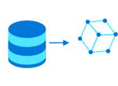
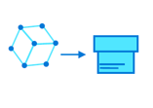
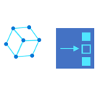
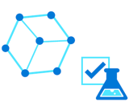
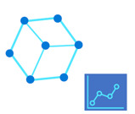
Machine Learning Lifecycle
Train Model
Package Model
Validate Model
Deploy Model
Monitor Model
Retrain Model
Notes:
1. Train and test: First, data scientists need to prepare training
data.
2. Package: ML engineers containerize the model with its
environment, which means creating a container for the
model to run in including all its dependencies.
3. Validate: The team evaluates how model performance comparing to their defined business goals.
4. Deploy: Deploy the model to a scale-out inference cluster in the cloud or on-premises. Once deployed, these models can be called via a REST endpoint to score/inference on new data.
5. Monitor and retrain: Even if a model works well at first, it needs to be continually monitored and retrained to stay relevant and accurate. This is important because the model or the data may have sway away from its original definition or purpose.
Managing the entire lifecycle at an enterprise scale is complicated and requires large amounts of time and resources. Without repeatable processes, data scientists must do everything again and again each time they create and deploy a new model
Many enterprise AI and ML projects rely on traditional software development processes like DevOps to handle these challenges. Although many of the stages are the same, ML modelhas unique traits in creation, deployment, and monitoring which gives additional complexity and considerations.

Slide 100
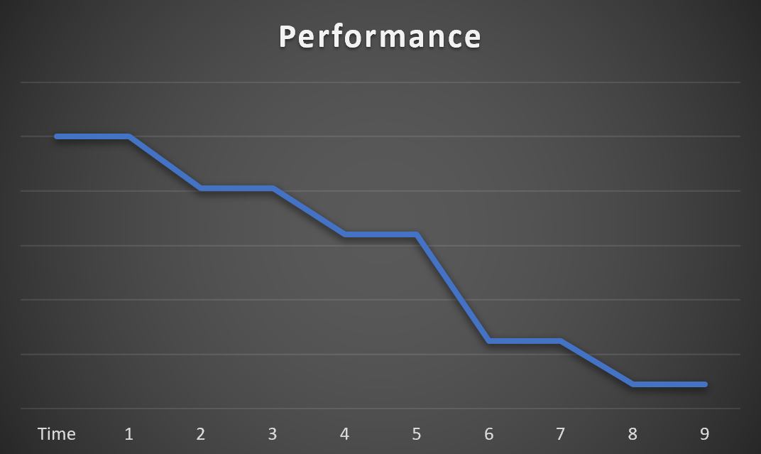
Model Decay
Notes:
Model Decay is the performance degradation over time.
Because machine learning models often deals with non static dataset, their performance can degrade over time. It is very important to monitor it and perform the necessary adjustment. This can be by re-training a new model and deploying it.

Slide 101
ML Models Considerations
In creation, deployment, and monitoring ML Models, these things should be considered:
Code and dataset management
Auditability
Traceabiliy
Explainability
Quality assurance
Notes:
• Code and dataset management: The source code of the model training process has limited value if it is not also accompanied by the dataset or datasets that were used to create the trained model.
• Auditability: It can be difficult to ensure that models meet regulatory standards and performance thresholds over time.
• Traceability: It can also be difficult to trace the result of an inference created in a production environment all the way back to the source code and training data sets used to build a model.
• Explainability: Black box models make it difficult to understand how the model works.
• Quality assurance: Extensive quality checks on both trained models—for interoperability, fairness, and accuracy— and deployed models—for data drift and performance issues—can be exceptionally challenging.
Implementing MLOps would help in ensuring that these challenges were addressed.

Slide 102
What is MLOps?
Machine Learning Operations (MLOps) is based on DevOps principles and practices that increase the efficiency of workflows.
Blend of people, process, and technology to deliver robust, scalable, reliable, and automated machine learning solutions
MLOps applies several principles to the machine learning process, with the goal of:
Faster experimentation and development of models
Faster deployment of models into production
Quality assurance and end-to-end lineage tracking
Notes:
MLOps is a set of processes and tools that enables the data scientists, Machine Learning engineers, and app/solution developers to collaborate and increase the speed of model development. This not a product you that we can deploy but rather a process you engage with at a level according to the organization’s requirement. Like DevOps for app development, MLOps introduces automation and traceability throughout the entire model lifecycle - from data prep and experimentation to deployment and model monitoring.
MLOps is an organizational change that relies on a blend of people, process, and technology to deliver machine learning solutions in a robust, scalable, reliable, and automated way.
Goal of MLOps
Faster experimentation and development of models
Faster deployment of models into production
Quality assurance and end-to-end lineage tracking

Slide 103
7 Principles of MLOps
Version control code, data, and experimentation outputs
Use multiple environment
Manage infrastructure and configurations-as-code
Track and manage machine learning experiments
Test code, validate data integrity, model quality
Machine learning continuous integration and delivery
Monitor services, models, and data
Notes:
When you plan to adopt MLOps for your next machine learning project, consider applying the following core principles as the foundation to any project.
Version control code, data, and experimentation outputs:
Unlike traditional software, data has a direct influence on the quality of machine learning models. Apart from versioning your experimentation code base, by versioning your datasets, you can ensure to reproduce experiments or inference results. Versioning experimentation outputs like models can save effort and the computational cost of recreation.
Use multiple environments:
To have a separate development , testing , and production work, replicate your infrastructure in at least two environments. Access control for users might differ in each environment.
Manage infrastructure and configurations-as-code:
When you create and update infrastructure components in your work environments, use infrastructure as a code to prevent inconsistencies between environments. Manage machine learning experiment job specifications as code, so that you can easily rerun and reuse a version of your experiment across environments.
Track and manage machine learning experiments:
Track the performance KPIs and other artifacts of your machine learning experiments. When you keep a history of job performance, it allows for a quantitative analysis of experimentation success, and enables greater team collaboration and agility.
Test code, validate data integrity, model quality:
Test your experimentation code base that includes correctness of data preparation functions, feature extraction functions, checks on data integrity, and obtained model performance.
Machine learning continuous integration and delivery:
Use continuous integration to automate test execution in your team. Include model training as part of continuous training pipelines and include A/B testing as part of your release, to ensure that only a qualitative model might land in production.
Monitor services, models, and data:
When you serve machine learning models in an operationalized environment, it's critical to monitor these services for their infrastructure uptime and compliance, and for model quality. Set up monitoring to identify data and model drift, to understand whether retraining is required, or to set up triggers for automatic retraining.

Slide 104
MLOps in Azure Machine Learning
Azure Machine Learning provides the following MLOps capabilities:
Create reproducible ML pipelines.
Create reusable software environments for training and deploying models.
Register, package, and deploy models from anywhere.
Capture the governance data for the end-to-end ML lifecycle.
Notify and alert on events in the ML lifecycle.
Monitor ML applications for operational and ML-related issues.
Automate the end-to-end ML lifecycle with Azure Machine Learning and Azure Pipelines.
Notes:
Create reproducible machine learning pipelines. Use machine learning pipelines to define repeatable and reusable steps for your data preparation, training, and scoring processes.
Create reusable software environments. These environments can be used for training and deploying models.
Register, package, and deploy models from anywhere. You can also track associated metadata required to use the model.
Capture the governance data for the end-to-end machine learning lifecycle. The logged lineage information can include who is publishing models and why changes were made. It can also include when models were deployed or used in production.
Notify and alert on events in the machine learning lifecycle. Event examples include experiment completion, model registration, model deployment, and data drift detection. You can use logic app to create an email notification.
Monitor machine learning applications for operational and machine learning-related issues. Compare model inputs between training and inference. Explore model-specific metrics. Provide monitoring and alerts on your machine learning infrastructure.
Automate the end-to-end machine learning lifecycle with Machine Learning and Azure Pipelines. By using pipelines, you can frequently update models. You can also test new models. You can continually roll out new machine learning models alongside your other applications and services.

Slide 105
How MLOps is different than DevOps
Exploration precedes development and operations
Data science lifecycle requires an adaptive way of working
Data quality requirements and data availability constrain the work environment
Machine learning requires a greater operational effort
Machine learning teams requires specialists and domain experts
Notes:
Why do we need to use MLOps? Why can’t we just use DevOps?
Exploration precedes development and operations
Data science projects are different from application development or data engineering projects. Data science projects may or may not make it to production. Example, after an initial analysis, the team might find that the business outcome can't be achieved with the available datasets. Because of this reason, an exploration phase is usually the first step in a data science project to decide whether to push for the next steps.
The experimentation and development stage usually begins when there is enough confidence that the data science project is feasible and can provide real business value. This stage is when development practices become increasingly important. It's a good practice to capture metrics for all of the experiments that are done at this stage. It's also important to incorporate source control so that it's possible to compare models and toggle between different versions of the code if needed.
Data science lifecycle requires an adaptive way of working
If you apply a typical DevOps way of working to a data science project, you might not find success because of the uncertain nature of data quality and its correlatively. Exploration and experimentation are recurring activities and needs throughout a machine learning project.
Data quality requirements and data availability constrain the work environment
For a machine learning team to effectively develop machine learning-infused applications, production data access is desirable across work environments. Considerations in implementing additional steps should be done if production data is isn’t possible due to compliance or technical constraints.
Machine learning requires a greater operational effort
Unlike traditional software, a machine learning solution is constantly at risk of degradation because of its dependency on data quality. To maintain a qualitative solution once in production, continuous monitoring and re-evaluation of data and model quality is critical. It's expected that a production model requires timely retraining, redeployment, and tuning.
Machine learning teams requires specialists and domain experts
While data science projects share roles with regular IT projects, the success of a machine learning team highly depends on a group of machine learning technology specialists and domain subject matter experts. Where the technology specialist has the right background to do end-to-end machine learning experimentation, the domain expert can support the specialist to analyze and synthesize the data, or qualify the data for use.

Slide 106
MLOps Maturity stages
Maturity Level | Training Process | Release Process | Integration into app | People
Level 1 – No MLOps | Untracked, file is provided for handoff | Manual, hand-off | Manual, heavily Data Scientist driven | Siloed
Level 2- Training Operationalized | Tracked, run results and model artifacts are captured in a repeatable way | Manual release, clean handoff process, managed by SWE team | Manual, heavily Data Scientist driven, basic integration tests added | Mix of siloed and cooperative
Level 3 – Release Operationalized | Tracked, run results and model artifacts are captured in a repeatable way | Automated, CI/CD pipeline set up, everything is version controlled | Semi-automated, unit and integration tests added, still needs human signoff | Mostly cooperative with some siloing
Level 4 – Training & Release Operationalized Together | Tracked, run results and model artifacts are captured in a repeatable way, retraining set up based on metrics from app | Automated, CI/CD pipeline set up, everything is version controlled, A/B testing has been added | Semi-automated, unit and integration tests added, may need human signoff | Fully cooperative

Slide 107
Demonstration: MLOps
Create Azure Machine Learning Resources Using Azure DevOps
Notes:
M03_L05_Demo01_MLOps.docx

Slide 108
Module 3:
Azure Machine Learning Service
LESSON 6:
Responsible AI (Preview)
After completing this lesson, you will be able to:
Learn the principles that should guide AI development and use.
Learn different tools in Azure Machine Learning that supports these principles

Slide 109
Responsible AI (Preview)
Principles that should guide AI development and use:
Fairness and Inclusiveness
Fairness assessment component
Reliability and safety
Error Analysis
Transparency
Model Interpretability and Counterfactual What-If
Privacy and security
SmartNoise and Counterfit
Accountability
Machine Learning Operations (MLOps) lineage and Responsible AI scorecard
Notes:
Fairness and inclusiveness
AI systems should treat everyone fairly and avoid affecting similarly situated groups of people in different ways. For example, when AI systems provide guidance on medical treatment, loan applications, or employment, they should make the same recommendations to everyone with similar symptoms, financial circumstances, or professional qualifications.
Azure Machine Learning’s fairness assessment component of the Responsible AI Dashboard enables data scientists and ML developers to assess model fairness across sensitive groups defined in terms of gender, ethnicity, age, etc.
Reliability and safety
To build trust, it's critical that AI systems operate reliably, safely, and consistently under normal circumstances and in unexpected conditions. These systems should be able to operate as they were originally designed, respond safely to unanticipated conditions, and resist harmful manipulation. It's also important to be able to verify that these systems are behaving as intended under actual operating conditions
Azure Machine Learning’s Error Analysis component of the Responsible AI Dashboard enables data scientists and ML developers to get a deep understanding of how failure is distributed for a model, identify cohorts of data with higher error rate than the overall benchmark. These discrepancies might occur when the system or model underperforms for specific demographic groups or infrequently observed input conditions in the training data.
Transparency
When AI systems are used to help inform decisions that have tremendous impacts on people's lives, it's critical that people understand how those decisions were made. For example, a bank might use an AI system to decide whether a person is creditworthy, or a company might use an AI system to determine the most qualified candidates to hire.
A crucial part of transparency is what we refer to as interpretability, or the useful explanation of the behavior of AI systems and their components. Improving interpretability requires that stakeholders comprehend how and why they function so that they can identify potential performance issues, safety and privacy concerns, fairness issues, exclusionary practices, or unintended outcomes.
Transparency in Azure Machine Learning: Azure Machine Learning’s Model Interpretability and Counterfactual What-If components of the Responsible AI dashboard enables data scientists and ML developers to generate human-understandable descriptions of the predictions of a model. It provides multiple views into a model’s behavior: global explanations (for example, what features affect the overall behavior of a loan allocation model) and local explanations (for example, why a customer’s loan application was approved or rejected). One can also observe model explanations for a selected cohort as a subgroup of data points. Moreover, the Counterfactual What-If component enables understanding and debugging a machine learning model in terms of how it reacts to input (feature) changes. Azure Machine Learning also supports a Responsible AI scorecard, a customizable report which machine learning developers can easily configure, download, and share with their technical and non-technical stakeholders to educate them about data and model health and compliance and build trust. This scorecard could also be used in audit reviews to inform the stakeholders about the characteristics of machine learning models.
Privacy and Security
As AI becomes more prevalent, protecting privacy and securing important personal and business information is becoming more critical and complex. With AI, privacy and data security issues require especially close attention because access to data is essential for AI systems to make accurate and informed predictions and decisions about people. AI systems must comply with privacy laws that require transparency about the collection, use, and storage of data and mandate that consumers have appropriate controls to choose how their data is used.
Privacy and Security in Azure Machine Learning: Implementing differentially private systems is difficult. SmartNoise is an open-source project (co-developed by Microsoft) that contains different components for building global differentially private systems. To learn more about differential privacy and the SmartNoise project, see the preserve data privacy by using differential privacy and SmartNoise article. Azure Machine Learning is also enabling administrators, DevOps, and MLOps to create a secure configuration that is compliant with your companies policies. With Azure Machine Learning and the Azure platform, you can:
Restrict access to resources and operations by user account or groups
Restrict incoming and outgoing network communications
Encrypt data in transit and at rest
Scan for vulnerabilities
Apply and audit configuration policies
Besides SmartNoise, Microsoft released Counterfit, an open-source project that comprises a command-line tool and generic automation layer to allow developers to simulate cyber-attacks against AI systems. Anyone can download the tool and deploy it through Azure Shell, to run in-browser, or locally in an Anaconda Python environment. It can assess AI models hosted in various cloud environments, on-premises, or in the edge. The tool is agnostic to AI models and supports various data types, including text, images, or generic input.
Accountability
The people who design and deploy AI systems must be accountable for how their systems operate. Organizations should draw upon industry standards to develop accountability norms. These norms can ensure that AI systems aren't the final authority on any decision that impacts people's lives and that humans maintain meaningful control over otherwise highly autonomous AI systems.
Accountability in Azure Machine Learning: Azure Machine Learning’s Machine Learning Operations (MLOps) is based on DevOps principles and practices that increase the efficiency of workflows. It specifically supports quality assurance and end-to-end lineage tracking to capture the governance data for the end-to-end ML lifecycle. The logged lineage information can include who is publishing models, why changes were made, and when models were deployed or used in production.
Azure Machine Learning’s Responsible AI scorecard creates accountability by enabling cross-stakeholders communications and by empowering machine learning developers to easily configure, download, and share their model health insights with their technical and non-technical stakeholders to educate them about data and model health and compliance and build trust.
The ML platform also enables decision-making by informing model-driven and data-driven business decisions:
Data-driven insights to further understand heterogeneous treatment effects on an outcome, using historic data only. For example, “how would a medicine impact a patient’s blood pressure?". Such insights are provided through theCausal Inference component of the Responsible AI dashboard.
Model-driven insights, to answer end-users’ questions such as “what can I do to get a different outcome from your AI next time?” to inform their actions. Such insights are provided to data scientists through the Counterfactual What-If component of the Responsible AI dashboard.

Slide 110
Machine Learning Fairness (Preview)
Artificial intelligence and machine learning systems can display unfair behavior.
Two common types of AI-caused harms are:
Harm of allocation
Harm of quality-of-service
Fairlearn - open-source Python package that allows machine learning systems developers to assess their systems' fairness and mitigate unfairness
Notes:
Machine learning fairness (preview) - Azure Machine Learning | Microsoft Docs
The Fairlearn open-source package can help you assess the fairness of a model, but it will not perform the assessment for you. The Fairlearn open-source package helps identify quantitative metrics to assess fairness, but developers must also perform a qualitative analysis to evaluate the fairness of their own models. The sensitive features noted above is an example of this kind of qualitative analysis.
In the Fairlearn open-source package, fairness is conceptualized through an approach known as group fairness, which asks: Which groups of individuals are at risk for experiencing harms? The relevant groups, also known as subpopulations, are defined through sensitive features or sensitive attributes. Sensitive features are passed to an estimator in the Fairlearn open-source package as a vector or a matrix called sensitive_features. The term suggests that the system designer should be sensitive to these features when assessing group fairness.
During assessment phase, fairness is quantified through disparity metrics. Disparity metrics can evaluate and compare model's behavior across different groups either as ratios or as differences. The Fairlearn open-source package supports two classes of disparity metrics:
Disparity in model performance: These sets of metrics calculate the disparity (difference) in the values of the selected performance metric across different subgroups. Some examples include:
disparity in accuracy rate
disparity in error rate
disparity in precision
disparity in recall
disparity in MAE
many others
Disparity in selection rate: This metric contains the difference in selection rate among different subgroups. An example of this is disparity in loan approval rate. Selection rate means the fraction of datapoints in each class classified as 1 (in binary classification) or distribution of prediction values (in regression).

Slide 111
Assess errors in ML models (preview)
Model accuracy may not be uniform across subgroups of data.
There may be inputs that fails more often
Consequences of these failures are a lack of reliability and safety, unfairness, and a loss of trust in machine learning altogether.
Error Analysis exposes the distribution of errors to developers in a transparent way
Enables developers to identify & diagnose errors efficiently.
Notes:
Model accuracy may not be uniform across subgroups of data, and there might exist input cohorts for which the model fails more often.
The direct consequences of these failures are a lack of reliability and safety, unfairness, and a loss of trust in machine learning altogether.
Error Analysis moves away from aggregate accuracy metrics, exposes the distribution of errors to developers in a transparent way, and enables them to identify & diagnose errors efficiently.
The Error Analysis component of the Responsible AI dashboard provides machine learning practitioners with a deeper understanding of model failure distribution and assists them with quickly identifying erroneous cohorts of data. It contributes to the “identify” stage of the model lifecycle workflow through a decision tree that reveals cohorts with high error rates and a heatmap that visualizes how a few input features impact the error rate across cohorts. Discrepancies in error might occur when the system underperforms for specific demographic groups or infrequently observed input cohorts in the training data.
Use Error Analysis when you need to:
Gain a deep understanding of how model failures are distributed across a given dataset and across several input and feature dimensions.
Break down the aggregate performance metrics to automatically discover erroneous cohorts and take targeted mitigation steps.

Slide 112
Model interpretability (preview)
Behavior of the models needs to be understood
Questions that needs to be answered:
Why did my model make this mistake?
How can I improve my model?
How can I understand and trust the model’s decisions?
Does my model satisfy legal requirements?
Interpretability helps in diagnosing the model
The Responsible AI dashboard and azureml-interpret use the interpretability techniques developed in Interpret-Community.
Interpret-Community is an open-source Python package for training interpretable models and helping to explain opaque-box AI systems.
Notes:
When machine learning models are used in ways that impact people’s lives, it is critically important to understand what influences the behavior of models. Interpretability helps answer questions in scenarios such as model debugging (Why did my model make this mistake? How can I improve my model?), human-AI collaboration (How can I understand and trust the model’s decisions?), and regulatory compliance (Does my model satisfy legal requirements?).
The interpretability component of the [Responsible AI dashboard] contributes to the “diagnose” stage of the model lifecycle workflow by generating human-understandable descriptions of the predictions of a Machine Learning model. It provides multiple views into a model’s behavior: global explanations (e.g., what features affect the overall behavior of a loan allocation model) and local explanations (e.g., why a customer’s loan application was approved or rejected).
One can also observe model explanations for a selected part as a subgroup of data points. This is valuable when assessing fairness in model predictions for individuals in a particular demographic group..
The capabilities of this component are founded by InterpretML capabilities on generating model explanations.
Use interpretability when you need to...
Determine how trustworthy your AI system’s predictions are by understanding what features are most important for the predictions.
Approach the debugging of your model by understanding it first and identifying if the model is using healthy features or merely spurious correlations.
Uncover potential sources of unfairness by understanding whether the model is predicting based on sensitive features or features highly correlated with them.
Build end user trust in your model’s decisions by generating local explanations to illustrate their outcomes.
Complete a regulatory audit of an AI system to validate models and monitor the impact of model decisions on humans.

Slide 113
Counterfactuals analysis and what-if (preview)
Counterfactual analysis “interrogates” a model to determine what changes to a particular datapoint would flip the model decision.
Use What-If Counterfactuals when you need to:
Examine fairness and reliability criteria as a decision
Debug specific input instances in depth.
Provide solutions to end users and determining what they can do to get a desirable outcome from the model next time.
Notes:
What-if counterfactuals address the question of “what would the model predict if the action input is changed”, enables understanding and debugging of a machine learning model in terms of how it reacts to input (feature) changes.
Compared with approximating a machine learning model or ranking features by their predictive importance (which standard interpretability techniques do), counterfactual analysis “interrogates” a model to determine what changes to a particular datapoint would flip the model decision.
Such an analysis helps in disentangling the impact of different correlated features in isolation or for acquiring a more nuanced understanding on how much of a feature change is needed to see a model decision flip for classification models and decision change for regression models.
The Counterfactual Analysis and what-if component of the Responsible AI dashboard consists of two functionalities:
Generating a set of examples with minimal changes to a given point such that they change the model's prediction (showing the closest datapoints with opposite model precisions)
Enabling users to generate their own what-if perturbations to understand how the model reacts to features’ changes.

Slide 114
SmartNoise and Counterfeit
SmartNoise
Open-source project (co-developed by Microsoft) that contains components for building machine learning solutions with differential privacy.
Differential privacy is a set of systems and practices that help keep the data of individuals safe and private.
In machine learning solutions, differential privacy may be required for regulatory compliance
Counterfeit
Open-source project that comprises a command-line tool and generic automation layer to allow developers to simulate cyber-attacks against AI systems.
Assess AI models hosted in various cloud environments, on-premises, or in the edge
Notes:
SmartNoise is an open-source project (co-developed by Microsoft) that contains different components for building global differentially private systems.
Differential privacy is a set of systems and practices that help keep the data of individuals safe and private. In machine learning solutions, differential privacy may be required for regulatory compliance. In traditional scenarios, raw data is stored in files and databases. When users analyze data, they typically use the raw data. This is a concern because it might infringe on an individual's privacy. Differential privacy tries to deal with this problem by adding "noise" or randomness to the data so that users can't identify any individual data points. At the least, such a system provides plausible deniability. Therefore, the privacy of individuals is preserved with limited impact on the accuracy of the data.
Microsoft released Counterfeit, an open-source project that comprises a command-line tool and generic automation layer to allow developers to simulate cyber-attacks against AI systems. Anyone can download the tool and deploy it through Azure Shell, to run in-browser, or locally in an Anaconda Python environment. It can assess AI models hosted in various cloud environments, on-premises, or in the edge. The tool is agnostic to AI models and supports various data types, including text, images, or generic input.

Slide 115
MLOps Lineage and Responsible AI Scorecard
MLOps Lineage
Information can include who is publishing models and why changes were made.
It can also include when models were deployed or used in production.
Responsible AI Scorecard
Designed for machine learning professionals and data scientists to explore and evaluate model insights and inform their data-driven decisions
Customizable report that you can easily configure, download, and share with your technical and non-technical stakeholders to educate them about your data and model health and compliance and build trust.
Can be used in audit reviews to inform the stakeholders about the characteristics of your model.

Slide 116
Demo: Responsible AI in Azure ML
Fairlearn and Interpretability dashboards and Responsible AI Dashboard in Azure ML Studio
Notes:
M03_L06_Demo1_Responsible_AI.docx

Slide 117
Which are the pillars of Responsible AI?
An example of Fairness
Which is the purpose of the Responsible AI Scorecard?
Notes:
Which are the pillars of Responsible AI?
Fairness and Inclusiviness
Reliability and safety
Transparency
Privacy and security
Accountability
An example of Fairness:
Discriminatory high school admission process
or approval of bank loans
Which is the purpose of the Responsible AI Scorecard?
Explore and evaluate model insights and inform their data-driven decisions

Slide 118
Module 3:
Azure Machine Learning Service
LESSON 7:
Azure Machine Learning Integration with Azure Event Grid (If Time Permits)
After completing this lesson, you will be able to:
Describe Azure Event Grid
Describe Event Grid support for Azure Machine Learning Events
Create event subscriptions and consume Azure Machine Learning events

Slide 119
Science?
What is Azure Event Grid?
Fully managed event routing service
Connects data sources and event handlers
Reads events from event sources such as Azure machine Learning
Sends events to event handlers such as Logic Apps, Azure Functions, etc.
Allows you to speed up automation and simplify policy enforcement
Connects your app with other services
Notes:
Azure Event Grid is a fully managed event routing service that uses a publish-subscribe model. Publishers produce events but do not know which events are handled. They have no idea about the subscribers (if any) of these events. Subscribers decide which events they want to handle.
Using Azure Event Grid, you can do the following:
Connect a data source (where event took place) to an event handler (a service that reacts to events).
Speed up automation and simplify policy enforcement. You can notify Azure automation that an azure resource has been created to perform additional tasks.
Use Event grid together with Logic Apps to orchestrate further tasks.
Demo: M03_L06_Demo01_Event_Grid_Integration

Slide 120
Science?
Azure Event Grid Key Concepts
Event source/publisher
This is where an event was generated
Event
The thing that happened which was emitted from a source
Topic
This is the endpoint where publishers send events
Event subscription
The endpoint to route events
Event handler
This is an app or service that reacts to events
Notes:
Demo: M03_L06_Demo01_Event_Grid_Integration

Slide 121
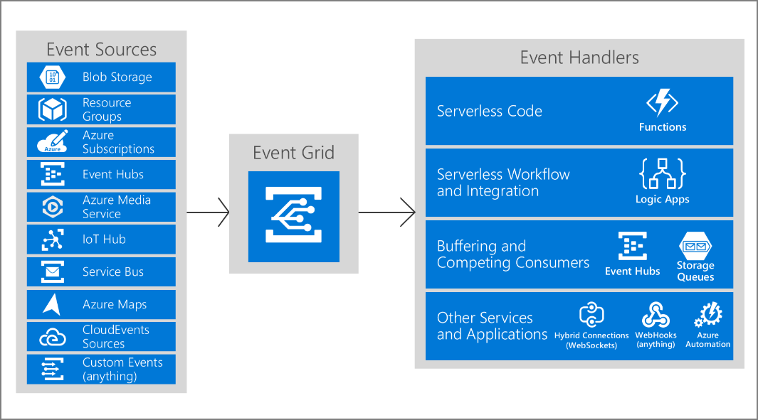
Science?
Event Model
Notes:
Demo: M03_L06_Demo01_Event_Grid_Integration

Slide 122
Science?
Event Grid Support for Azure Machine Learning
Azure Event Grid supports Azure Machine Learning events
Which Azure Machine Learning events can be used?
Run completion
Model registration
Model deployment
Data drift detection
Run status change
Sample use cases:
Send emails on run completion
Use an azure function after a model is registered
Trigger an ML pipeline when drift is detected
Notes:
Azure Machine Learning (AML) handles the entire lifecycle of machine learning process, which includes model training, model deployment, and monitoring. Azure ML events (Run completion,Model registration, Model deployment, Data drift detection) allow applications to react to events during the machine learning lifecycle, such as the completion of training runs, the registration and deployment of models, and the detection of data drift, by using modern serverless architectures.
Run completion – A run is a single trial of an experiment. Every time a run completes, it can produce an event.
Model registration – Model registration enables you to store and version your models in your workspace. When you register a model, it can produce an event.
Model deployment – Azure machine learning lets you deploy your model as a service. This activity can also produce an event.
Data drift detection – whenever there is a change in input data, there is a chance that your machine learning model would be out of date. Your previously good performing model would experience degradation. For example, in a movie recommender system, if there was a change in viewer’s interests (viewers who previously watch comedy films, became more interested in horror films), your model which was trained on an outdated data might be impacted and will provide inaccurate recommendations. The change of data over time is what we call a data drift. This occurrence can produce events.
Run status change – raised when there is a change in run status such as “Not started”, “Running”, “Completed”, and “Failed”.
These events are published through Azure Event Grid. Customers also have choice to build a wide range of event handlers such as Azure Functions, Azure Logic Apps, Event hubs, or generic webhooks.
Sample use cases:
Whenever an experiment is complete, the developer can receive a notification via email.
Whenever a model is registered, an azure function can be trigger to do further tasks.
When there is a data drift, your machine learning pipeline will be triggered to retrain your model.
Demo: M03_L06_Demo01_Event_Grid_Integration

Slide 123
Science?
Azure Event Grid Event Schema
Event Grid schema consists of a set of required properties that a publishing entity should follow
Event schema consists of a set of string properties and a data object
String properties are common to all events from any publisher
Data object itself has properties that are specific to each publisher
Schema properties can be used in filtering events
Notes:
Below is an example of an Event Grid schema used by all publishers
[
{
"topic": string,
"subject": string,
"id": string,
"eventType": string,
"eventTime": string,
"data":{
object-unique-to-each-publisher
},
"dataVersion": string,
"metadataVersion": string
}
]
Demo: M03_L06_Demo01_Event_Grid_Integration

Slide 124
Science?
Event Schema Properties
Property | Type | Description
topic | String | Full resource path to the event source. Value provided by Event Grid.
subject | String | Publisher-defined path to the event subject.
eventType | String | One of the registered event types for this event source.
eventTime | String | The time the event is generated based on the provider's UTC time.
id | String | Unique identifier for the event.
dataVersion | String | The schema version of the data object defined by the publisher.
metadataVersion | String | The schema version of the event metadata. Value provided by Event Grid.
data | Object | Blob storage event data.
Notes:
Below is a sample event response for Microsoft.MachineLearningServices.ModelRegistered event:
[{
"topic": "/subscriptions/{subscription-id}/resourceGroups/{resource-group-name}/providers/Microsoft.MachineLearningServices/workspaces/{workspace-name}",
"subject": "models/sklearn_regression_model:20",
"eventType": "Microsoft.MachineLearningServices.ModelRegistered",
"eventTime": "2017-06-26T18:41:00.9584103Z",
"id": "831e1650-001e-001b-66ab-eeb76e069631",
"data": {
"ModelName": "sklearn_regression_model",
"ModelVersion": 20,
"ModelTags": {
"area": "diabetes",
"type": "regression"
},
"ModelProperties": {
"type": "test"
}
},
"dataVersion": "",
"metadataVersion": "1"
}]
Demo: M03_L06_Demo01_Event_Grid_Integration

Slide 125
Science?
Event Handlers
Event Grid sends events to designated event handlers
Event handlers can be configured to react to an event
They can take actions such as sending an email when the event is triggered
Some of the supported Event handlers are:
Azure Function
Web Hook
Storage queues
Event Hubs
Hybrid Connections
Service bus queue
Service bus topic
Logic apps
Notes:
https://docs.microsoft.com/en-us/azure/event-grid/event-handlers
The above list shows some supported handlers that can perform further actions when the Event Grid sends them an event. Here are some examples:
Logic app can be used to send an email every time that a run completes.
Use Azure functions to deploy a machine learning model when a new model has been registered.
Demo: M03_L06_Demo01_Event_Grid_Integration

Slide 126
Demonstration: Using Event Grid with Azure Machine Learning (Optional Demo)
Create event subscription for an Azure Machine Learning event and use Logic App to handle the event
Notes:
M03_L07_Demo01_Event_Grid_Integration.docx

Slide 127
What are the event types that Azure Machine Learning can emit?
Give three (3) examples of supported event handlers.
When you provision an Azure Event Grid, it is required to provision an Azure VM to host this. Is this True or False?
Notes:
ModelRegistered, ModelDeployed, RunCompleted, DatasetDriftDetected
Azure Function, Web Hook, Storage queues, Event Hubs, Hybrid Connections, Service bus queue, Service bus topic, Logic apps
False. Azure Event Grid is a fully managed event routing service. It provides serverless infrastructure for event-based applications.

Slide 128
Module 3:
Azure Machine Learning Service
LESSON 8:
Azure Databricks (If Time Permits)
After completing this lesson, you will be able to:
Describe Azure Databricks
Describe Machine Learning capabilities of Azure Databricks
Compare Azure Machine Learning service and Azure Databricks

Slide 129



What is Azure Databricks?
A fast, easy and collaborative Apache® Spark™ based analytics platform optimized for Azure
Best of Databricks
Best of Microsoft
Designed in collaboration with the founders of Apache Spark
One-click set up; streamlined workflows
Interactive workspace that enables collaboration between data scientists, data engineers, and business analysts.
Native integration with Azure services (Power BI, SQL DW, Cosmos DB, Blob Storage)
Enterprise-grade Azure security (Active Directory integration, compliance, enterprise-grade SLAs)
Notes:
Azure Databricks features –
Enhance your teams’ productivity
Get started quickly by launching your new Spark environment with one click.
Share your insights in powerful ways through rich integration with PowerBI.
Improve collaboration amongst your analytics team through a unified workspace.
Innovate faster with native integration with rest of Azure platform.
Build on the most compliant and trusted cloud
Simplify security and identity control with built-in integration with Active Directory.
Regulate access with fine-grained user permissions to Azure Databricks’ notebooks, clusters, jobs and data.
Build with confidence on the trusted cloud backed by unmatched support, compliance and SLAs.
Scale without limits
Operate at massive scale without limits globally.
Accelerate data processing with the fastest Spark engine.

Slide 130
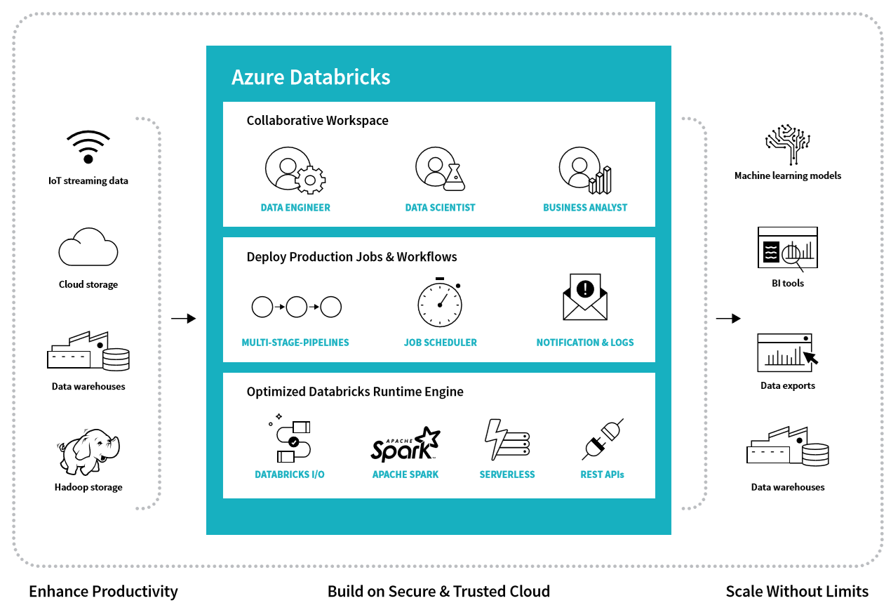
Azure Databricks
A service that sits inside the Azure cloud
Allows you to access all your Azure data sources to apply the power of the Azure Databricks analytics engine
Distribute your results by writing to visual dashboards or back to data warehouses for analytics.
Notes:
Azure Databricks runs on Spark. Data Engineers/Scientists and Business Analysts can all work together in a collaborative space to accomplish batch/stream processing, machine learning, and report authoring.
With Azure Databricks we have the ability to enhance productivity, build upon a secure & trusted Cloud, and Scale without limits.

Slide 131
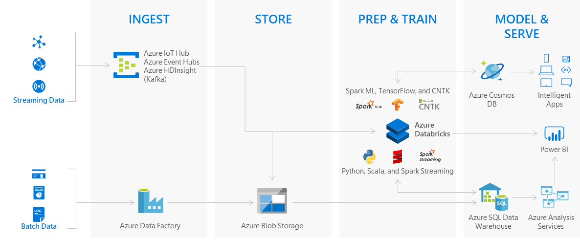
Logical architecture
Notes:
Today’s business managers depend heavily on reliable data integration systems that run complex ETL/ELT workflows (extract, transform/load and load/transform data).
These workflows allow businesses to ingest data in various forms and shapes from different on-prem/cloud data sources; transform/shape the data and gain actionable insights into data to make important business decisions.

Slide 132
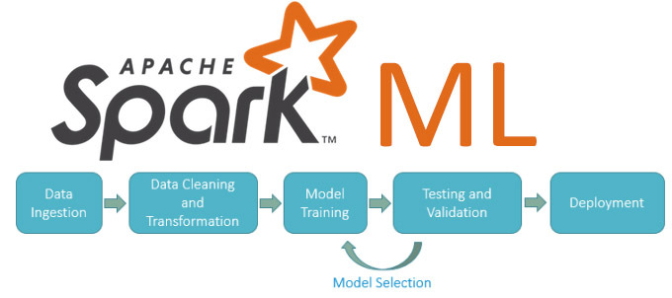
Spark Machine Learning(MLlib) Overview
Set of parallelized machine learning algorithms
Supports Model Selection (hyperparameter tuning) using Cross Validation and Train-Validation Split
Supports Java, Scala or Python apps using DataFrame-based API (as of Spark 2.0)
Notes:
As organizations create more diverse and more user-focused data products and services, there is a growing need for machine learning, which can be used to develop personalizations, recommendations, and predictive insights. Apache Spark’s Machine Learning Library (MLlib) allows data scientists to focus on their data problems and models instead of solving the complexities surrounding distributed data (such as Infrastructure, configurations, and so on).
Spark is now 3.0 and not 2.0
Hyperparameter tuning and AutoML -- Hyperparameter tuning and AutoML - Azure Databricks - Workspace | Microsoft Docs

Slide 133
Goals of Spark MLlib
Algorithms and utilities such as:
Classification
Regression
Clustering
Collaborative filtering
Dimensionality reduction,
Underlying optimization primitives
Built around the concept of a data science pipeline (scikit-learn)
Written entirely using Apache Spark
Integrates well with the agile modeling process
Notes:
Machine Learning Library (Mllib) contains detailed info about the different algorithms (e.g. Classification, Clustering, etc.).
http://spark.apache.org/docs/latest/mllib-guide.html

Slide 134
Azure Databricks Vs Azure ML service
Azure Databricks
What It Is
Databricks’ Spark service as a first party service on Azure
Can be used to work with data using Python, Scala, R, Java, and SQL
Key Components: Unified engine for Batch and Streaming, Spark SQL, Machine Learning (ML) and Graph Computation(GraphX)
Optimized engine for better performance and scalability to process big data
Azure ML service
What It Is
Azure cloud services to build, deploy, and manage models
Has built-in ease-of-use UI
Has built-in Python SDK
Key Components: Models, Experiments, Pipelines, Compute Targets, Images, Deployments

Slide 135
Demonstration: Azure Databricks and Azure ML Integration (Optional Demo)
Create and run a pipeline with the Azure Databricks step using Azure Databricks notebook
Notes:
M03_L08_Demo01_Azure_Databricks_Azure_ML_Integration.docx

Slide 136
What are the advantages of using Databricks on Azure?
What provides scalable machine learning library consisting of common learning algorithms and utilities
Which service should be used to train a model using UI?
Notes:
Q:What are the advantages of using Databricks on Azure?
A:Databricks is integrated with Azure to provide one-click setup, streamlined workflows, and an interactive workspace that enables collaboration between data scientists, data engineers, and business analysts.
Q: What provides scalable machine learning library consisting of common learning algorithms and utilities
A: Apache Spark MLlib
Q: Which service should be used to train a model using UI?
A: Azure Machine Learning

Slide 137
Module 3:
Azure Machine Learning Service
Appendix
Optional materials
Visual Studio Code
Optional Lab: Install and configure VS Code

Slide 138
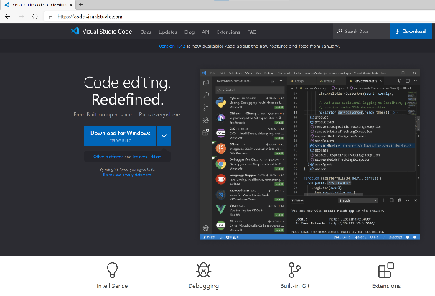
Science?
Visual Studio Code
Lightweight, cross platform code editor
Available for Windows, macOS and Linux
Has a rich ecosystem of extensions for many languages
Python, PHP, Go, C++, C#, Java
Integrates with existing tool chains
Such as Azure ML
Built-in Git support
Developed as an open-source
Over 19,000 VS Code extensions

Slide 139
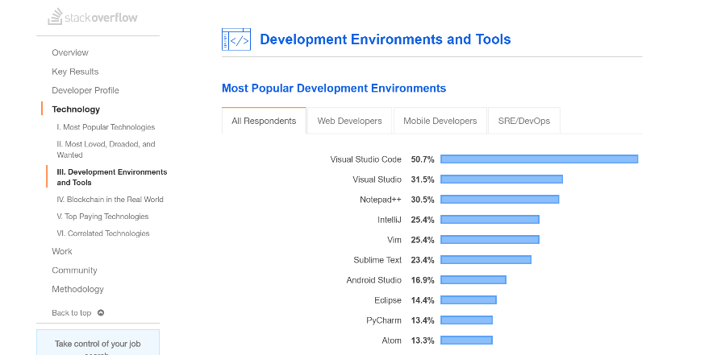
Science?
Visual Studio Code
According to the stack overflow’s 2019 survey, the most popular development environment:
Notes:
https://insights.stackoverflow.com/survey/2019#development-environments-and-tools

Slide 140
Optional Lab: Install and configure VS Code
Install VS Code, Python, and necessary packages to work with Azure ML.
Notes:
17749_M03_L09_Lab01.docx

Slide 141
Module Summary
Model Training and Deployment Using Azure Machine Learning Service
Machine Learning Pipelines
MLOps
Responsible AI
Azure Machine Learning Integration with Azure Event Grid (preview).
Azure Databricks

