Slide 1
Namma Yatri: Where Rides Are Lost
Technical methodology: data preparation, EDA and operational diagnostics
Audience: Technical / Operations Leadership
Namma Yatri EDA | Sabyasachi (Individual submission)

Slide 2
Objective and agenda
AGENDA
OBJECTIVE
1
Data and method
Find where demand converts to rides, and where it leaks.
2,161 searches produced only 983 completed rides: which stage, which zone, which hour?
Give operations teams a fix list backed by the data.
slide 4 and appendix
2
Demand, revenue and payments
slides 5-6
3
Zones and time periods
slides 7-8
4
Funnel, conversion and parameter view
slides 9-10
5
Recommendations and dashboard
slide 11
Namma Yatri EDA | Sabyasachi (Individual submission)
2

Slide 3
Key findings: the leak is supply and zone service, not time of day
45.5%
40.9%
31.7-58.5%
r = 0.90
of searches complete
never get a driver
zone conversion range
revenue vs trip count
Demand is flat: about 41 trips an hour, no real peak hour.
Revenue follows completed trips, not fare (hour vs fare r = -0.01).
Cancellations cluster in four zones, with different causes.
Business implication: fix driver allotment and the 8 weakest zones before any pricing change.
Namma Yatri EDA | Sabyasachi (Individual submission)
3

Slide 4
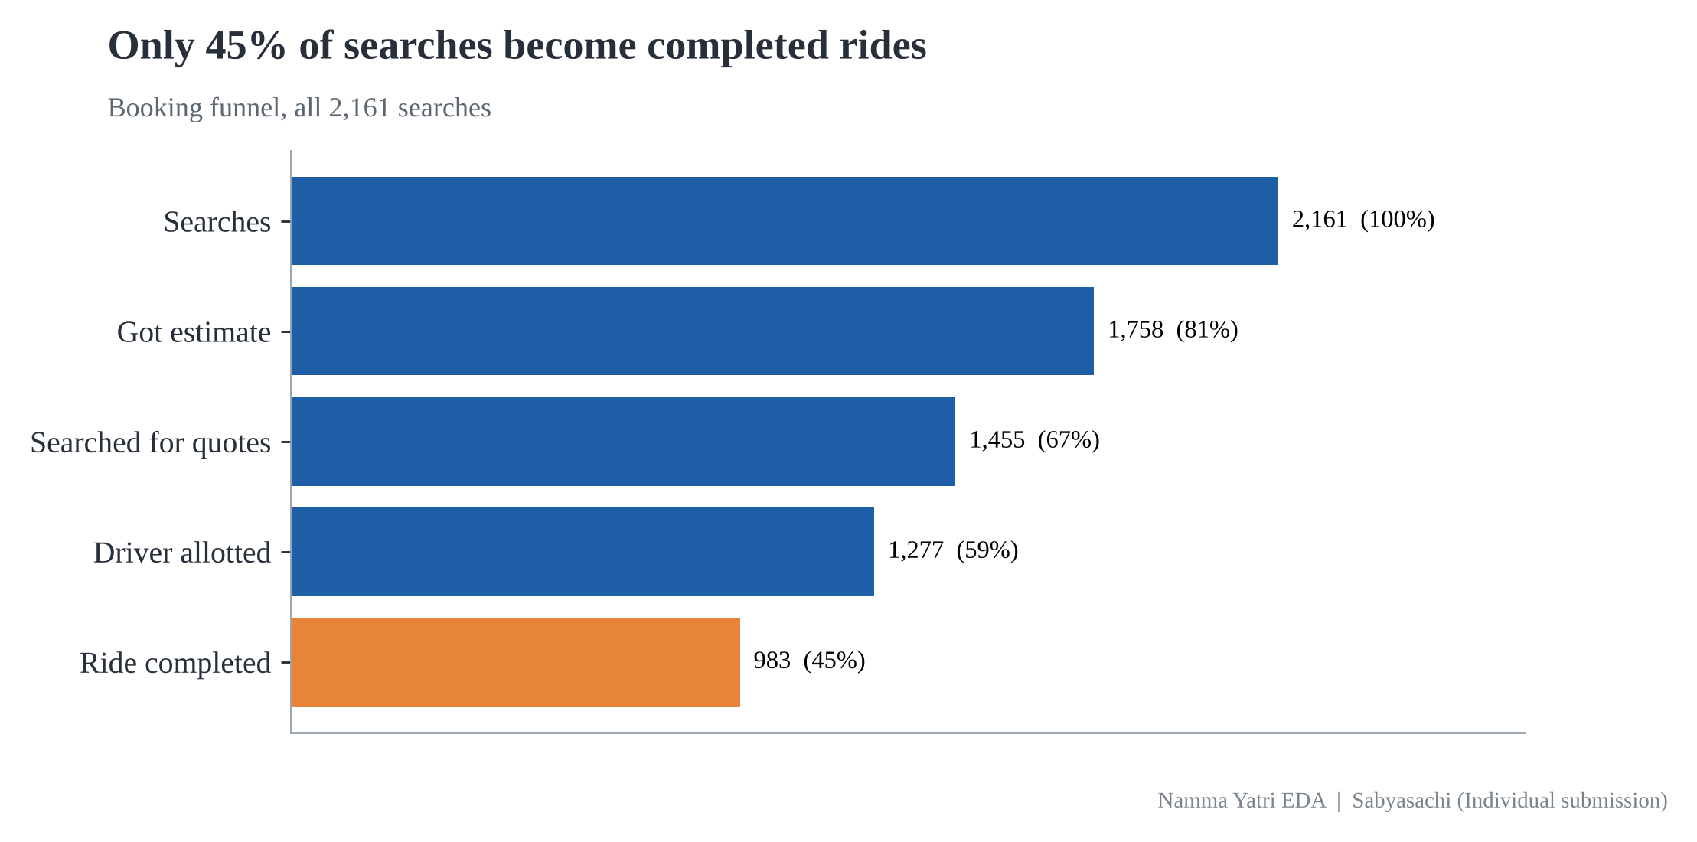
Data preparation: five tables related on Trip_Details, variables classified
Base Trip_Details (2,161) LEFT JOIN Trips on tripid: 983 matched
Zones: loc_from, loc_to = Assembly; payment and hour via ids
0 orphans, row count stays 2,161, fare Rs 7,51,343
Categorical: zones, payment method, hour/period, ids, 0/1 flags | Numerical: searches, fare, distance | Derived: Revenue, Completed trips, Conversion
Namma Yatri EDA | Sabyasachi (Individual submission)
4

Slide 5
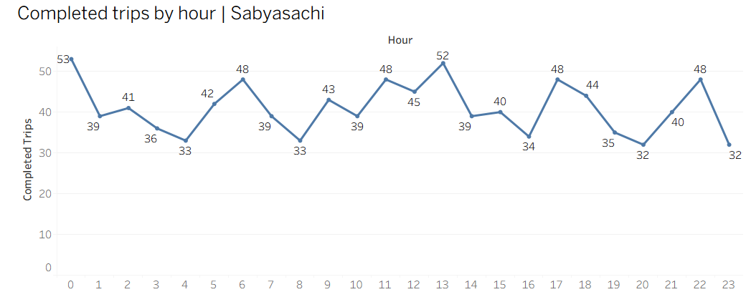
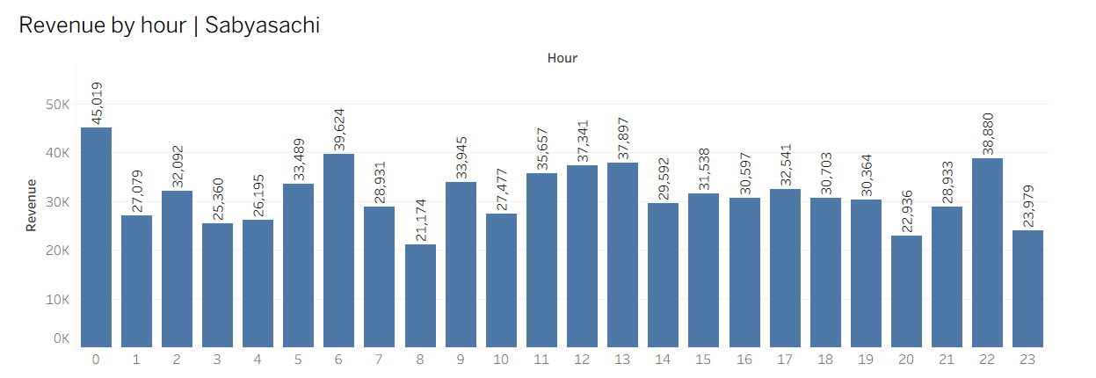
Demand is flat across the day, and revenue follows trip count, not fare
Average 41 trips an hour; peaks only at 00:00 (53) and 13:00 (52).
Revenue vs trips r = 0.90; hour vs fare r = -0.01: add trips, not price.
Implication: no basis for a rush-hour roster or time-of-day surge.
Namma Yatri EDA | Sabyasachi (Individual submission)
5

Slide 6
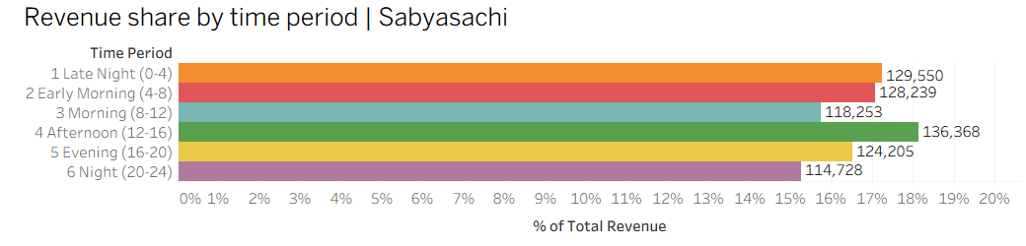
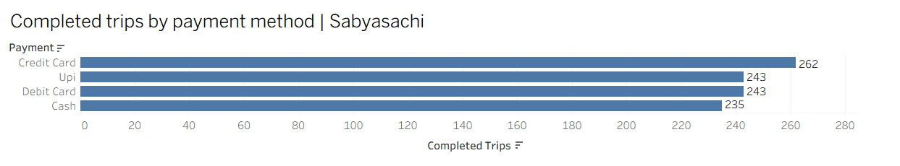
Revenue share by period is even (15-18%); payments are 76% digital
Revenue share by period: 15.3% to 18.1% (Afternoon 18.1%).
Credit card most used (26.7%); cash is only 23.9%.
Implication: cashback on UPI and cards can move the remaining cash rides.
Namma Yatri EDA | Sabyasachi (Individual submission)
6

Slide 7
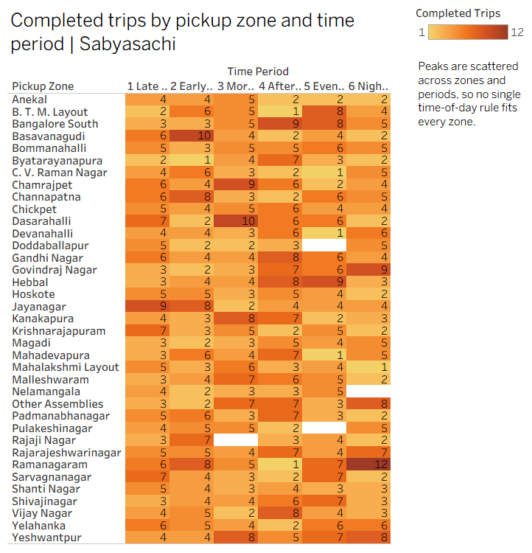
Zone x time reveals what the city total hides
Ramanagaram: 12 trips at Night, 1 in Afternoon
Hebbal peaks 16-20; Bangalore South 12-16
Dasarahalli and Chamrajpet peak in the Morning
Position drivers by zone-period, not by hour alone
Namma Yatri EDA | Sabyasachi (Individual submission)
7

Slide 8
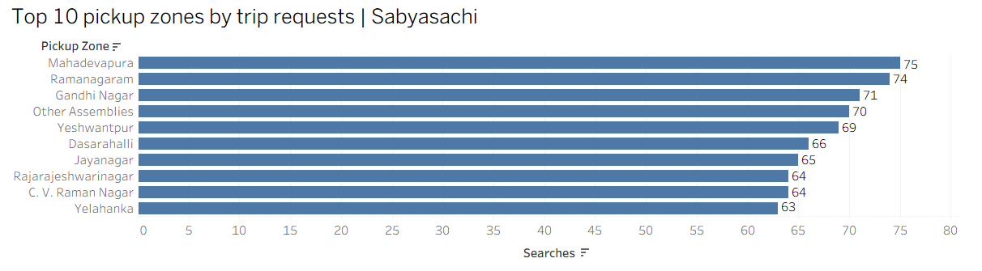
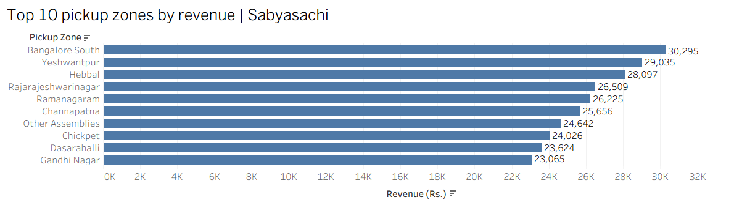
Requests are not revenue: Mahadevapura leads demand, Bangalore South leads revenue
Mahadevapura: 75 requests, only 26 completed (34.7%)
Bangalore South: 57 requests, 33 completed (57.9%), high fare (Rs 918)
Most completed trips: Ramanagaram 39, Yeshwantpur 36
Namma Yatri EDA | Sabyasachi (Individual submission)
8

Slide 9
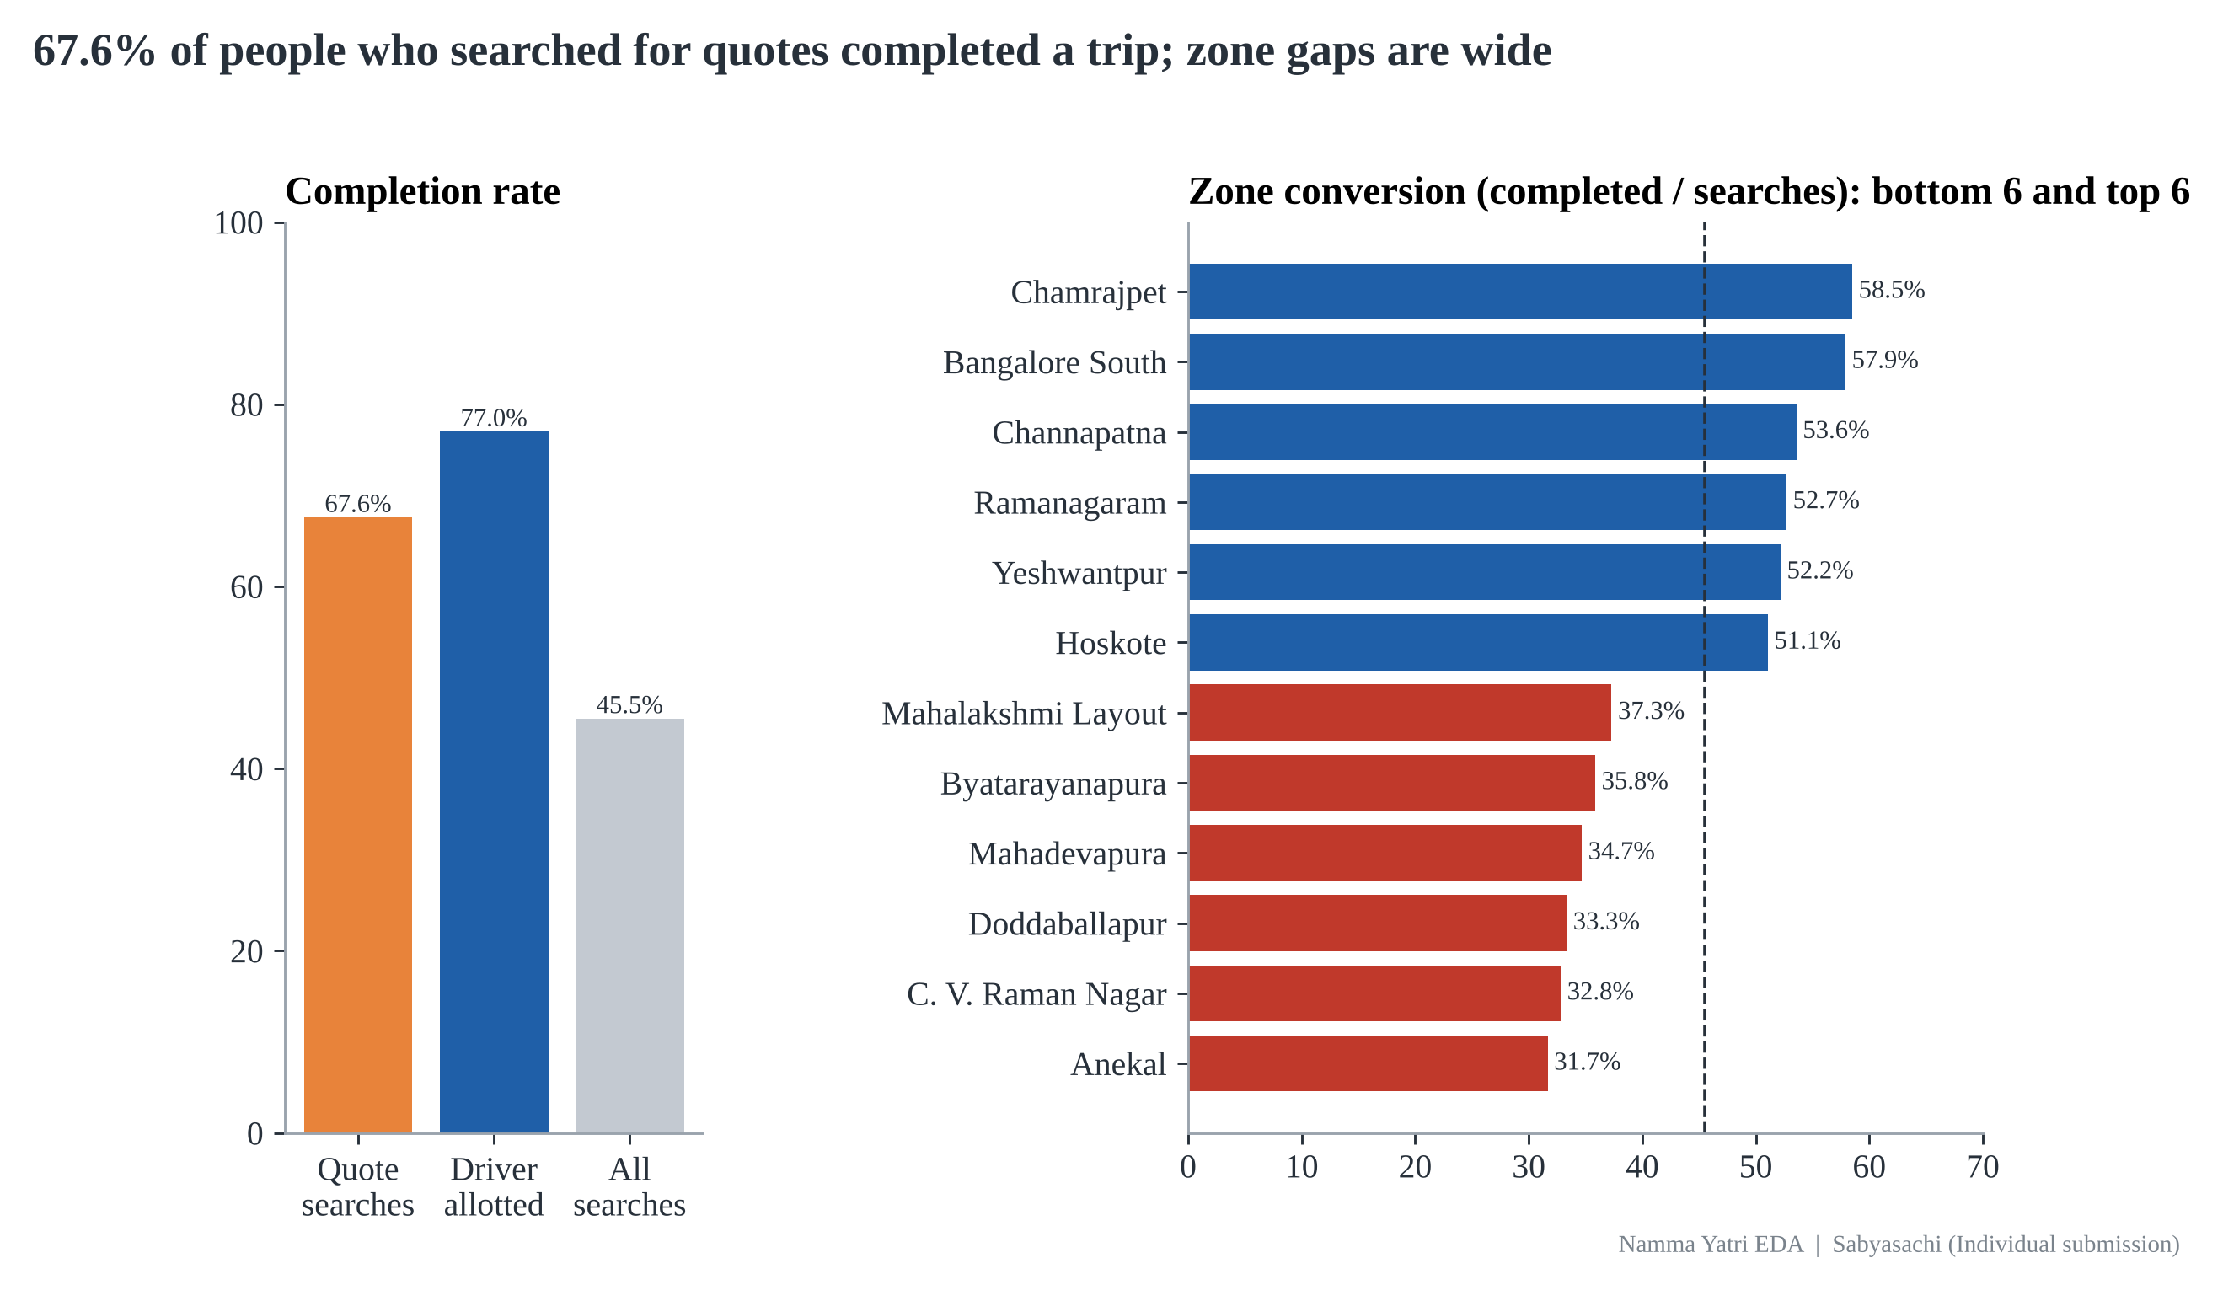
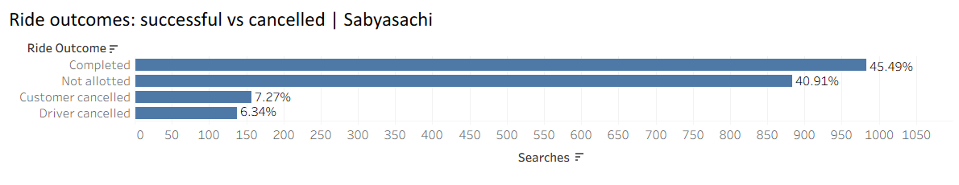
Funnel and conversion: 41% of searches get no driver; zones convert 32% to 58%
41% of searches: no driver
77% of allotted rides finish; 12.3% customer and 10.7% driver cancels
Overall quote-to-completion 67.6%
Weakest: Anekal 31.7%, C. V. Raman Nagar 32.8%, Doddaballapur 33.3%, Mahadevapura 34.7%. Driver-led (Anekal, Mahadevapura) vs customer-led (C. V. Raman Nagar, Doddaballapur).
Namma Yatri EDA | Sabyasachi (Individual submission)
9

Slide 10
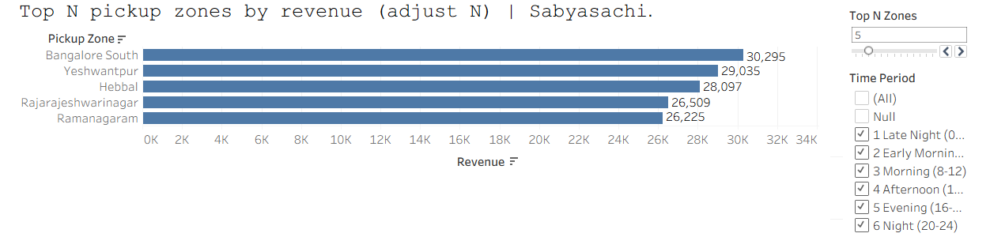
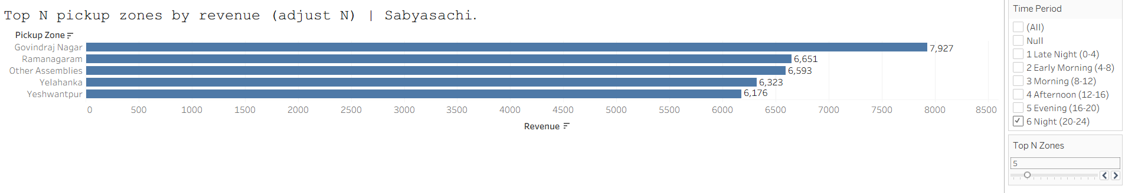
Parameter and filters: Top N zones by revenue, filtered by time period
Top N Zones parameter (3-15) with a Time Period filter. All periods, N = 5:
Bangalore South leads overall (Rs 30,295)
At Night, Govindraj Nagar leads (Rs 7,927)
Night top 5 = Rs 33,670, 29.3% of night revenue
Same dashboard answers different questions
Same view, Night only (20-24), N = 5: the ranking changes completely
Namma Yatri EDA | Sabyasachi (Individual submission)
10

Slide 11
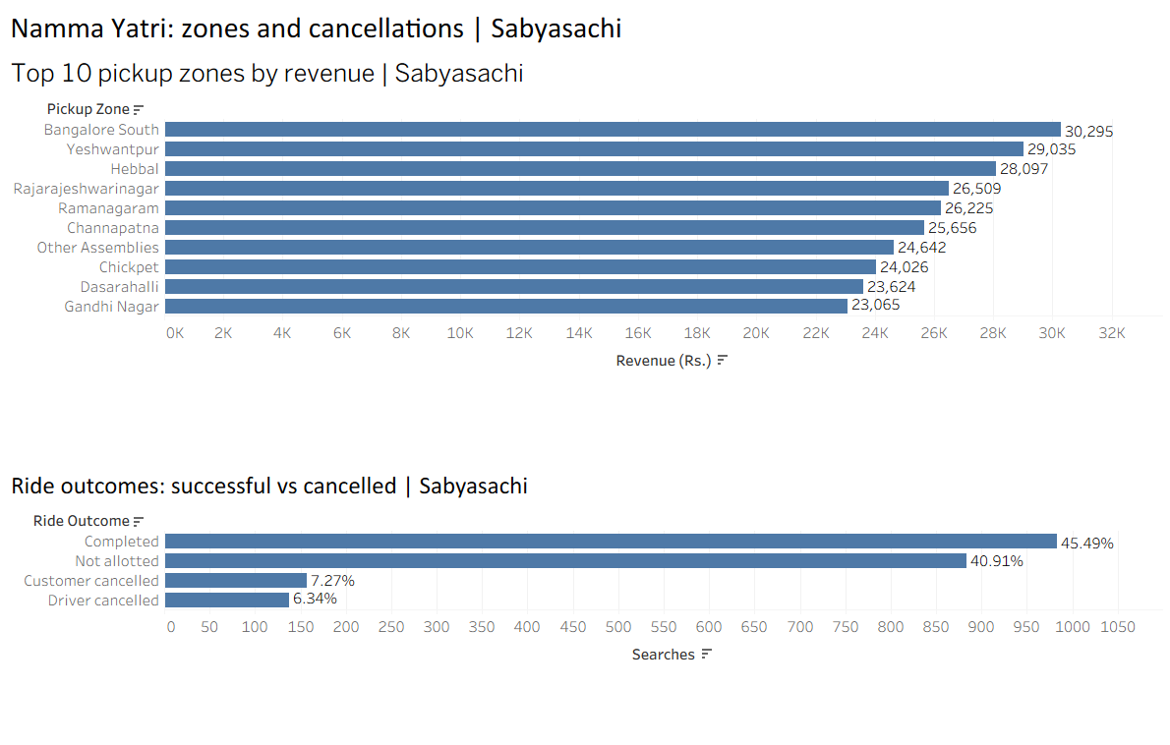
Recommendations and business implications, with the operational dashboard
1. Allotment 59% -> 70%: acceptance bonuses, instant re-assignment. About 200 more rides.
2. Cancellations 23% -> 15%: show destination before accept, wait-time alerts.
3. Fix the 8 weakest zones to >= 45% conversion: pickup incentives where driver-led, ETA fixes where customer-led.
4. Roster by zone-period, not city-wide hours.
5. Log a timestamp on every search; audit fare-per-km.
Namma Yatri EDA | Sabyasachi (Individual submission)
11

Slide 12
Appendix: calculated fields, data quality and assumptions
Calculated fields (Tableau Public)
Hour = [duration] - 1
Time Period = IF [Hour]<4 ... (six buckets)
Revenue = SUM(IF [end_ride]=1 THEN [fare] END)
Completed Trips = SUM([end_ride])
Conversion = SUM([end_ride]) / SUM([searches_for_quotes])
Show Zone = RANK([Revenue]) <= [Top N Zones]
Cancel flags = 0 on 1,041 rows, but 884 never had a driver: cancellations measured only where allotted (23% not 48%)
Fare Rs 1.9-740 per km; correlation with distance 0.006: kept, not trusted for pricing
Only completed trips carry an hour: conversion by period not measurable
Limits: 983 rides, no search timestamps
Namma Yatri EDA | Sabyasachi (Individual submission)
12

