Slide 1
Namma Yatri: Turn More Searches Into Rides
Findings and recommendations to grow revenue in Bengaluru
Audience: Business Leadership
Namma Yatri EDA | Sabyasachi (Individual submission)

Slide 2
Objective and agenda
AGENDA
OBJECTIVE
1
The headline
Grow completed rides and revenue with the demand we already have.
We analysed 2,161 ride searches across 37 Bengaluru zones: where do we lose riders, and what should we do about it?
slides 3-4
2
Which zones to fix and protect
slides 5-6
3
When and how riders pay
slide 7
4
Growth opportunities
slides 8-9
5
Actions, impact and appendix
slides 10-12
Namma Yatri EDA | Sabyasachi (Individual submission)
2

Slide 3
Only 45 of every 100 searches become a ride
2,161
983
45.5%
Rs 7.5 L
searches in the data
completed rides
search-to-ride rate
revenue earned (avg Rs 764 per ride)
Revenue is limited by how many we serve, not by how many search.
Lifting the rate from 45.5% to 55% gives about 200 more rides (about Rs 1.5 L).
Namma Yatri EDA | Sabyasachi (Individual submission)
3

Slide 4
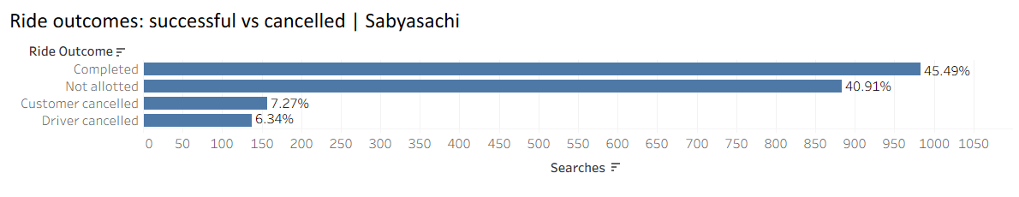
Biggest leak: 4 in 10 searches never get a driver
41%
77%
12%
11%
of searches: no driver
of rides with a driver finish
cancelled by customers
cancelled by drivers
Namma Yatri EDA | Sabyasachi (Individual submission)
4

Slide 5
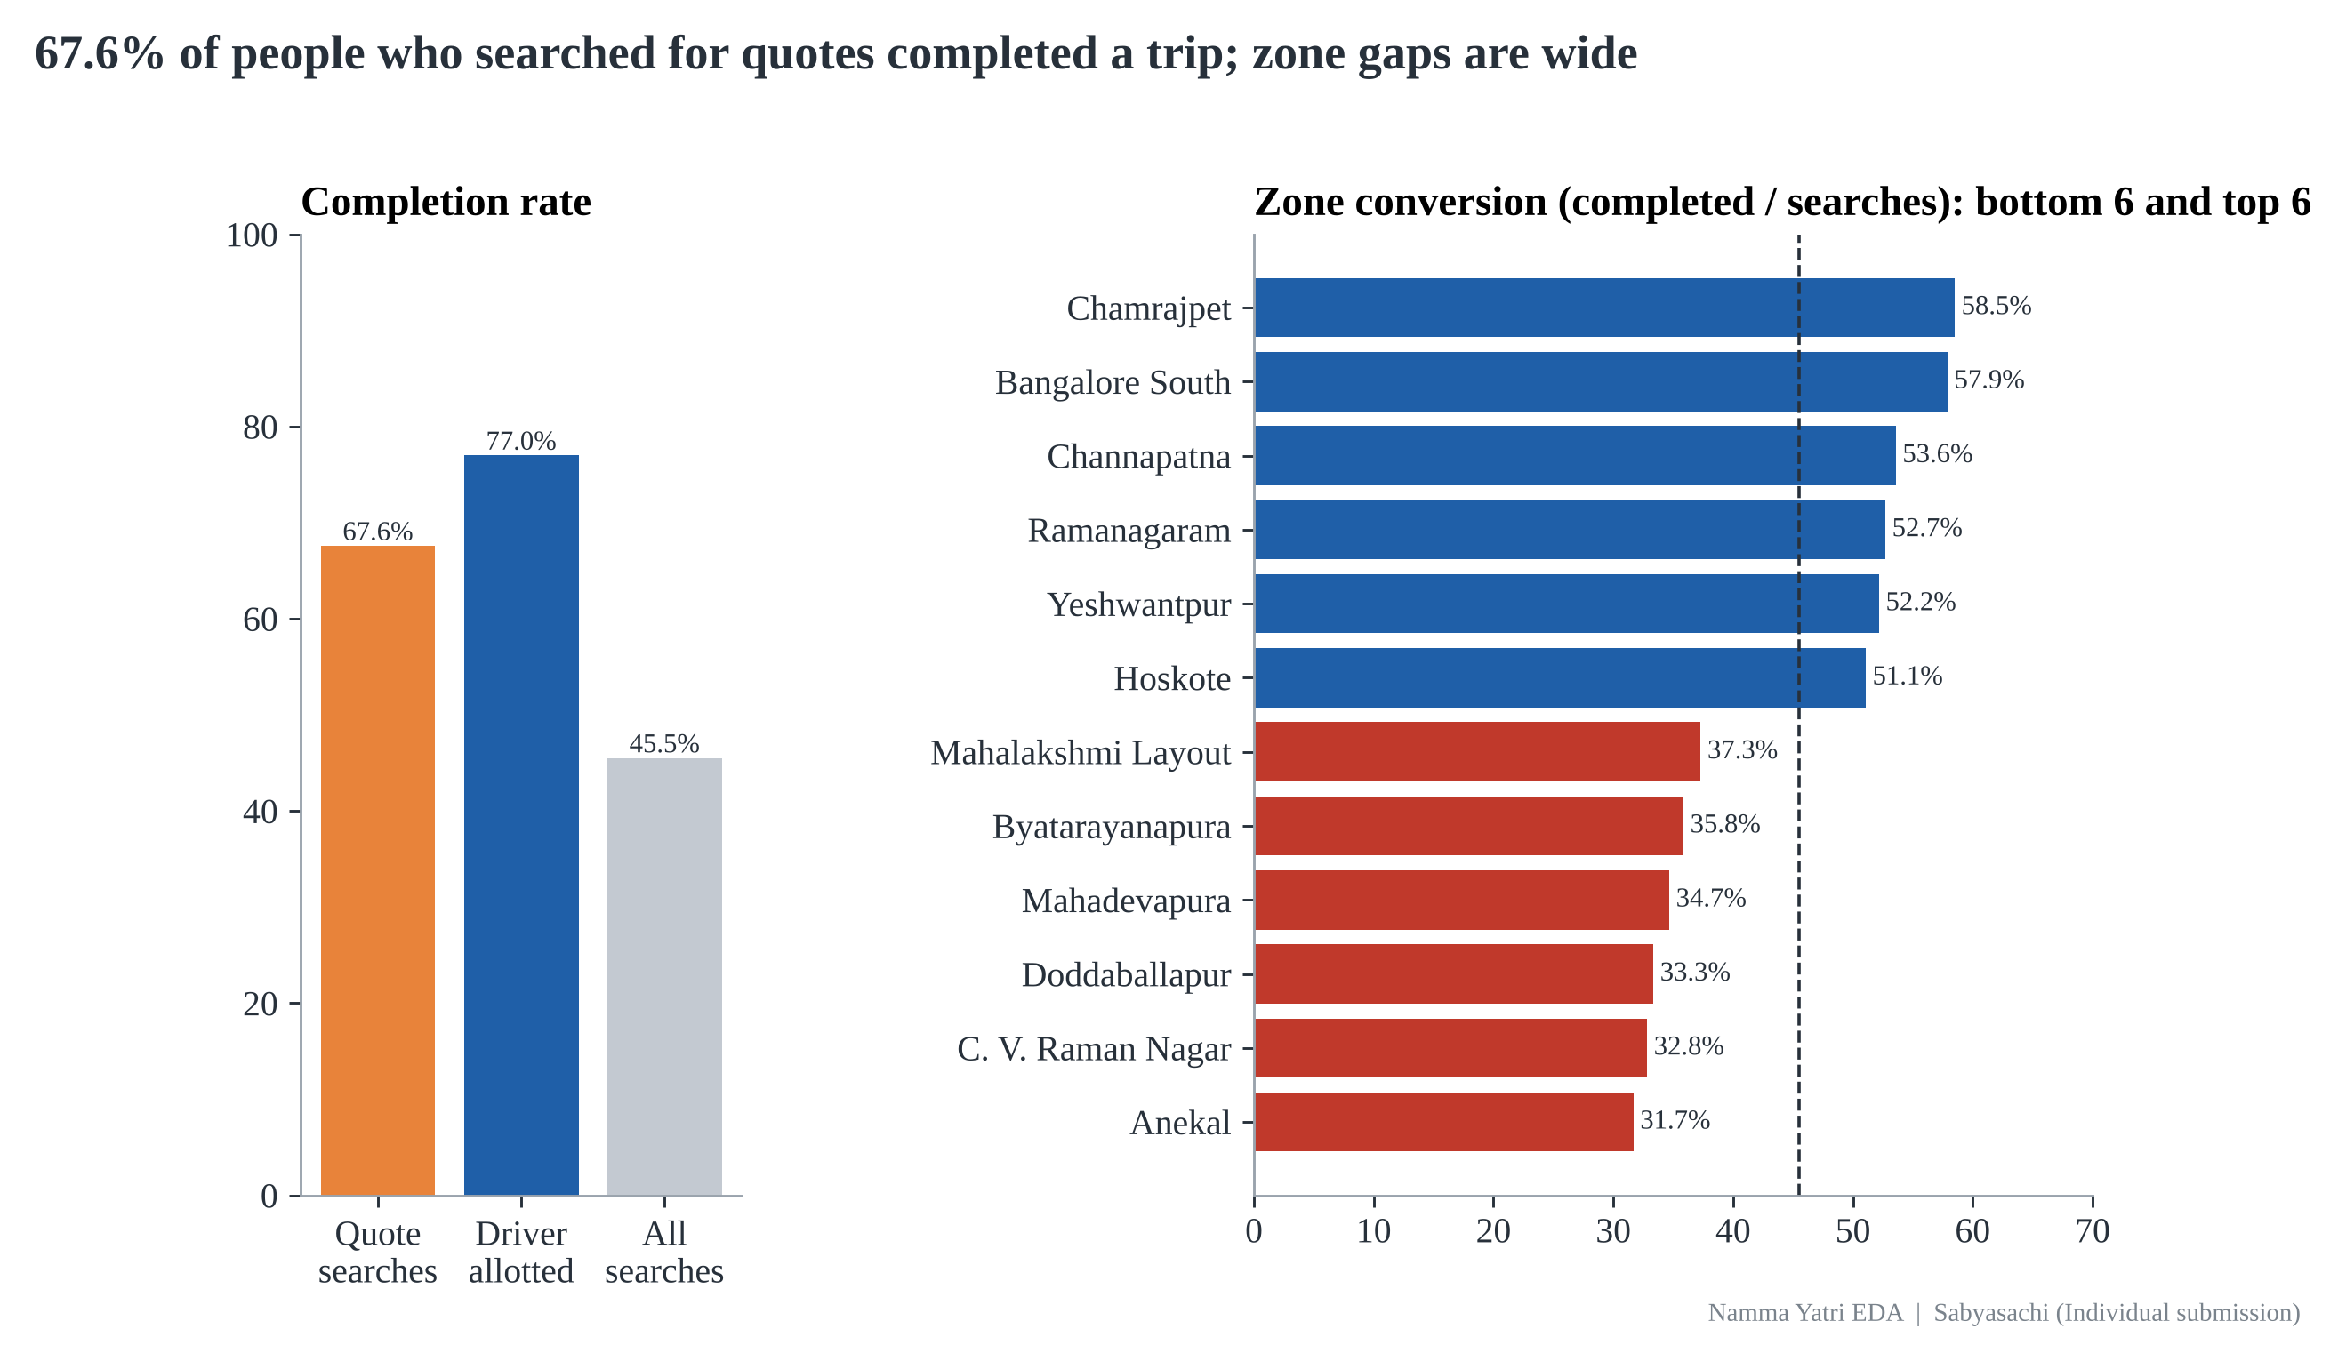
Zone matters more than hour: conversion ranges from 32% to 58%
Fix: Mahadevapura, Anekal, C. V. Raman Nagar, Doddaballapur
Protect: Bangalore South, Chamrajpet, Channapatna
Gap between best and worst zone: 27 points
Namma Yatri EDA | Sabyasachi (Individual submission)
5

Slide 6
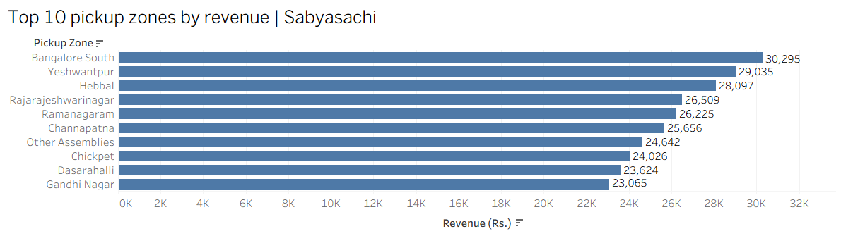
Our best revenue zones convert well; our biggest demand zone does not
Bangalore South: Rs 30,295 from only 57 requests
Mahadevapura: 75 requests (highest) but only 26 rides
Winning formula: high conversion and good fares
Namma Yatri EDA | Sabyasachi (Individual submission)
6

Slide 7
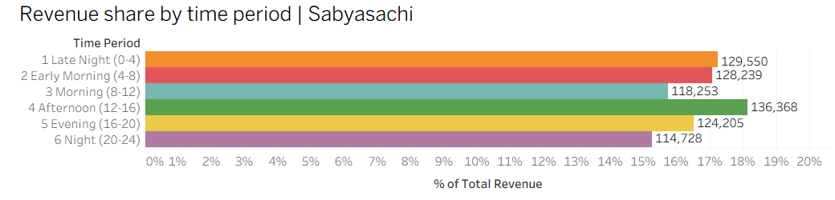
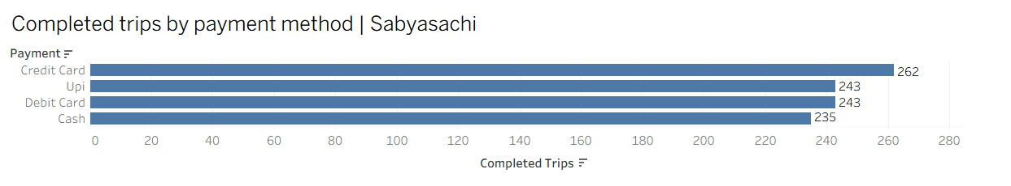
Demand is steady all day, and 3 in 4 rides are already digital
Every time period earns 15-18% of revenue: no case for rush-hour or surge pricing.
76% of rides are digital; cash is 23.9%.
Use off-peak offers in Morning and Night; cashback to move cash riders to UPI and cards.
Namma Yatri EDA | Sabyasachi (Individual submission)
7

Slide 8
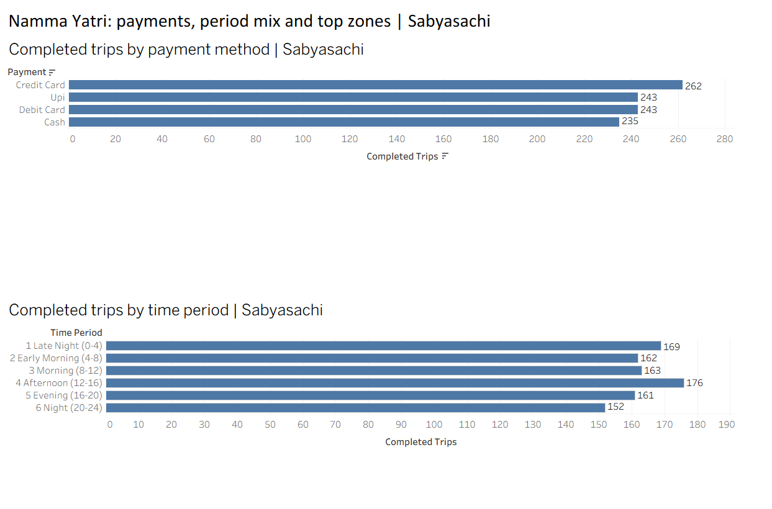
Marketing dashboard: grow volume where fares are high
Payments and period mix at a glance
Top zones guide where to run offers
Use the dashboard to track the five actions
Namma Yatri EDA | Sabyasachi (Individual submission)
8

Slide 9
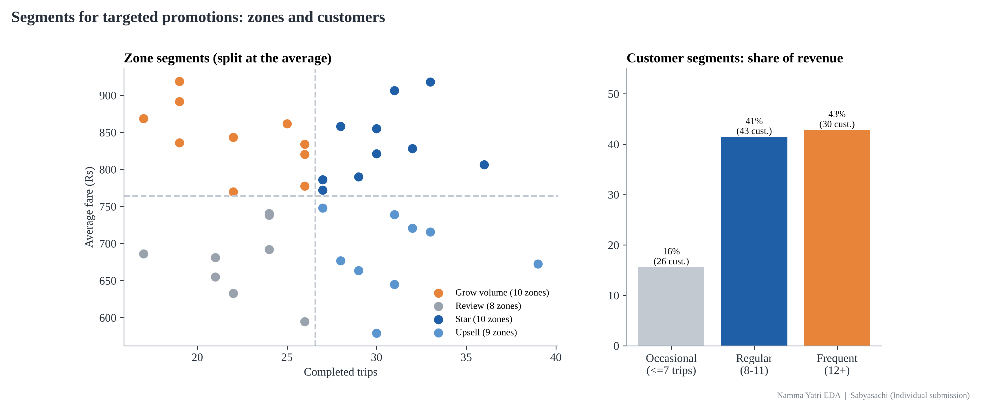
Target promotions by segment: 10 growth zones and 30 frequent riders
Frequent riders: 30 customers = 43% of revenue
Grow-volume zones: high fare, low volume (10 zones); star zones: protect (10); review zones: fix service first (8)
Namma Yatri EDA | Sabyasachi (Individual submission)
9

Slide 10
Recommendations and business impact: five actions for the next quarter
1
Pay drivers for accepting fast
Allotment 59% -> 70%
2
Fix the 8 weakest zones first
Every zone >= 45% conversion
3
Offers in high-fare, low-volume zones (Byatarayanapura, Rajaji Nagar, Doddaballapur)
+25% rides there
4
Morning and Night ride-credits instead of surge
+10% revenue in those periods
5
Cashback for UPI and card
Digital share 76% -> 85%
Namma Yatri EDA | Sabyasachi (Individual submission)
10

Slide 11
Next steps: pilot, measure, then scale
4 weeks
Weekly
1 month
pilot in three weak zones
track allotment and conversion
confirm on a full month of data
Record a timestamp for every search to see conversion by time of day.
Review the fare engine before changing prices: fares do not match distance in this data.
Namma Yatri EDA | Sabyasachi (Individual submission)
11

Slide 12
Appendix: data, definitions and caveats
Data: 5 Namma Yatri tables (searches, trips, zones, payments, hours) combined in Tableau Public; 2,161 searches, 983 completed rides.
Revenue = fares of completed rides only (Rs 7,51,343). Conversion = completed rides / searches for quotes.
Cancellations are measured only where a driver was allotted (n = 1,277).
Caveats: small sample (983 rides); no search timestamps, so conversion by hour cannot be measured; fare does not track distance.
Full methodology, calculated fields and dashboards are in the report and dashboard PDF.
Namma Yatri EDA | Sabyasachi (Individual submission)
12

