Slide 1


Data Engineering using AWS
Building Data Engineering Pipelines leveraging AWS Infrastructure

Slide 2
Getting the Infra ready
EC2-1 (SFTP) IP = <EC2_1_IP> EC2-2 (Ingest) IP = <EC2_2_IP> Key file = key.pem User (Ubuntu) = ubuntu

Slide 3
🧱 1️⃣ Local → EC2-1 (SFTP server)
From your laptop:
ssh -i key.pem ubuntu@<EC2_1_IP>

Slide 4
🧱 2️⃣ Local → EC2-2 (Ingestion server)
ssh -i key.pem ubuntu@<EC2_2_IP>

Slide 5
🧱 3️⃣ Copy key.pem → EC2-2 (VERY IMPORTANT)
scp -i key.pem key.pem ubuntu@<EC2_2_IP>:/home/ubuntu/

Slide 6
🧱 4️⃣ Set permissions on EC2-2
SSH into EC2-2 first:
ssh -i key.pem ubuntu@<EC2_2_IP>
Then:
chmod 400 key.pem

Slide 7
🧱 5️⃣ EC2-2 → EC2-1 (SSH test)
🧱 5️⃣ EC2-2 → EC2-1 (SSH test)
First time it will ask:
Are you sure you want to continue connecting (yes/no)?
Type: yes

Slide 8
🧠 Best practice (recommended)
ssh -i key.pem ubuntu@<EC2_1_PRIVATE_IP>

Slide 9
🏗️ Final connectivity
Local ├── SSH → EC2-1 ✅ └── SSH → EC2-2 ✅ EC2-2 └── SSH → EC2-1 ✅
What you’ve completed
✔ EC2-1 (SFTP) ready ✔ EC2-2 (Ingestion + MySQL) ready ✔ SSH working: local → EC2-1 local → EC2-2 EC2-2 → EC2-1

Slide 10
Prepare SFTP data (EC2-1)
SSH into EC2-1:
ssh -i key.pem ubuntu@<EC2_1_IP>
Create folder:
ssh -i key.pem ubuntu@<EC2_1_IP>
Create folder:
mkdir -p ~/sftp-drop
echo "id,name,salary" > ~/sftp-drop/hr_data.csv echo "1,John,50000" >> ~/sftp-drop/hr_data.csv echo "2,Sarah,60000" >> ~/sftp-drop/hr_data.csv

Slide 11
Setup MySQL (EC2-2)
SSH into EC2-2:
ssh -i key.pem ubuntu@<EC2_2_IP>
Start MySQL
sudo mysql
Create DB + user
CREATE DATABASE data_engineering; CREATE USER 'de_user'@'localhost' IDENTIFIED BY 'de_password'; GRANT ALL PRIVILEGES ON data_engineering.* TO 'de_user'@'localhost'; FLUSH PRIVILEGES;
Create table
USE data_engineering; CREATE TABLE employees ( id INT, name VARCHAR(100), salary INT );
exit;

Slide 12
🧱 Install Python libs (EC2-2)
Use below command to install dependencies now:
pip3 install paramiko pandas pymysql
Ubuntu now blocks global pip installs to protect system Python.
Because System Python is managed by OS (apt), hence to prevent pip install breaking system packages used by OS
Alternative resolutions:
1. Use Virtual Environment (venv)
python3 -m venv venv
source venv/bin/activate
source venv/bin/activate
python ingest.py
2. Quick hack: pip install paramiko pandas pymysql --break-system-packages
pip install paramiko pandas pymysql --break-system-packages

Slide 13
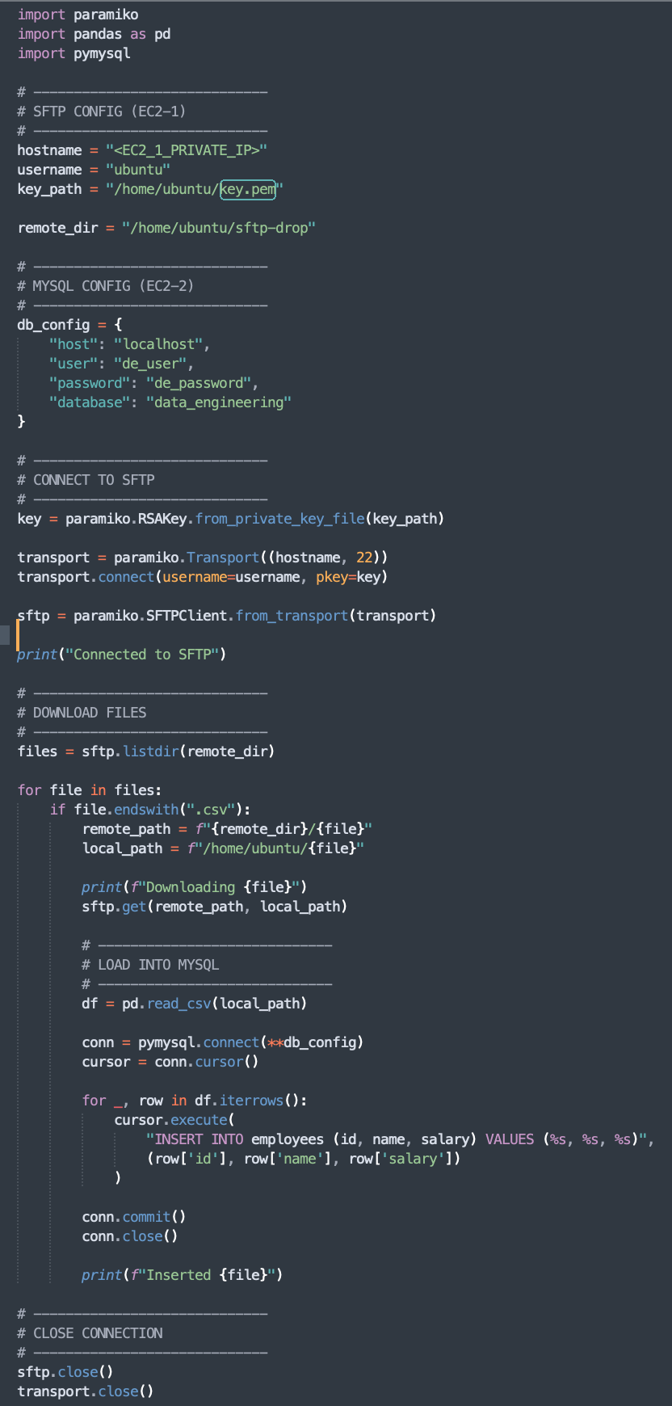
Create ingestion script (EC2-2)

Slide 14
Run pipeline
python3 ingest.py

Slide 15
Verify data: Very Important Step in Data Engineering
//login to ec2-1- sftp server
ssh -i ec2_sftp_keys.pem ubuntu@3.81.26.116
//login to mysql
sudo mysql
USE data_engineering;
SELECT * FROM employees;

Slide 16
Querying through MySQL tool(Mac)
Option 1: Tunneling ssh -i key.pem -L 3307:localhost:3306 ubuntu@<EC2_IP> -N
Then on your laptop: mysql -h 127.0.0.1 -P 3307 -u de_user –p
Option 2: Use Web-based DB tools
On EC2 type below commands:
sudo apt install php php-mysql -y
cd /var/www/html sudo wget https://www.adminer.org/latest.php -O adminer.php
Then, open in browser: http://<EC2_IP>/adminer.php(credentials in slide 11)

Slide 17
🧱 STEP-BY-STEP: CloudWatch Logging Integration

Slide 18
✅ Step 1: Install required libraries (EC2)
Below pip install line can be added in ec2 starter script, or run in ec2- server standalone:
pip3 install watchtower boto3 --break-system-packages
Boto3: watchtower uses boto3 internally
Shortcut to add region:
export AWS_DEFAULT_REGION=us-east-1
Watchtower: used for creating the logger in AWS
Alternatively, add below lines to ingest.py
import boto3
boto3.setup_default_session(region_name="us-east-1")
🧠 Why needed?
CloudWatch is region-specific → boto3 needs region

Slide 19
✅ Step 2: Add logging in your Python script
🔹 Create logger:
from datetime import datetime
import logging
timestamp = datetime.now().strftime("%Y%m%d_%H%M%S")
log_stream = f”employee_pipeline_{timestamp}"
log_group = "data_engineering"
logger = logging.getLogger(log_stream)
logger.setLevel(logging.INFO)
🔹 Add CloudWatch handler:
logger.addHandler(watchtower.CloudWatchLogHandler(log_group=log_group, stream_name=log_stream))
logger.info("Pipeline started")

Slide 20
✅ Step 3: Create IAM Role (CRITICAL)
🔹 Go to IAM → Create Role
Trusted entity type → AWS Service
Use Case → EC2
🔹 Attach policy: CloudWatchAgentServerPolicy
🔹 Name: ec2-cloudwatch-role

Slide 21
✅ Step 4: Attach IAM Role to EC2
Go to:
EC2 → Instance → Actions → Security → Modify IAM Role
Select: ec2-cloudwatch-role
🧠 Why needed?
boto3 needs credentials → IAM role provides temporary credentials

Slide 22
✅ Step 5: Run the pipeline and verify the logs
Run:
python3 ingest.py
🔹 Go to:
CloudWatch → Log groups
🔹 Select correct region:
US East (N. Virginia) → us-east-1
🔹 Find:
data_engineering
🔹 Inside:
pipeline_run → logs visible

Slide 23
CloudWatch → Alarm → SNS → Email Step A: Send logs from EC2 → CloudWatch
Add a logging error statement in python script: logger.error("TEST ERROR")

Slide 24
🔹 Step 2: Create Metric Filter
Go to: CloudWatch → Log groups → data_engineering_logs
Create metric filter
Pattern: %ERROR%
Metric namespace: ingestion_pipeline
Metric name: error_count
Value: 1
Note: Metric namespace is generated after the ” logger.error(“ERROR message/ any message”)” runs for the first time.

Slide 25
🔹 Step 3: Create Alarm
Go to: CloudWatch → Alarms → Create alarm
Then:
Select metric → Browse
Custom Namespaces → ingestion_pipeline → error_count

Slide 26
🔹 Step 3: Create SNS Topic
During alarm setup: Create topic: ingestion-alerts
Add Email Subscription
Protocol → Email
Enter your email
📩 Confirm email (CRITICAL)
# Can be done standalone also

Slide 27
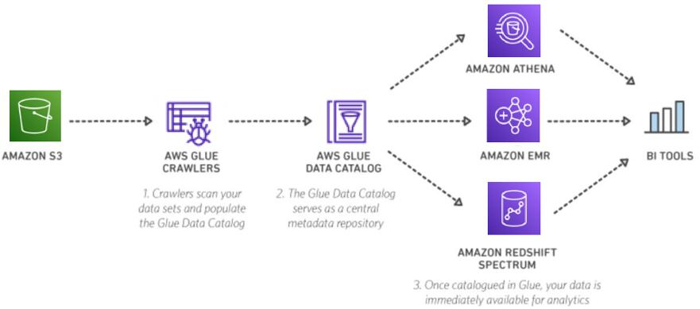
Final Target

Slide 28
S3 Data Lake Creation (Core Storage Layer)
What you did
Created S3 bucket: 👉 analytics-ingested
Designed partitioned storage format:
employees/ src_date=2026-04-09/ file.parquet src_date=2026-04-08/ file.parquet

Slide 29
Why this is important (VERY important concept)
🔹 Partitioning = performance + cost optimization
Without partition:
SELECT * FROM employees;
👉 scans all data
With partition:
SELECT * FROM employees WHERE src_date = '2026-04-09';
👉 scans only that folder
Key takeaway
S3 is not just storage → it is your data lake Folder structure = database partitioning

Slide 30
Glue Crawler (Metadata Layer)
Step 1:
Create an IAM role with below policies
AWSGlueServiceRole and AmazonS3ReadOnlyAccess
Permissions:
Read S3
Write metadata
Step 2:
Create a glue crawler with the role created.

Slide 31
Step 3:
✔ Choose Data source
S3 path → s3://analytics-ingested/employees/
Step 4:
Run the glue crawler manually.
Output:
Employees table is created automatically

Slide 32
What crawler actually does
When you run it:
Reads S3 files
Detects:
File format → Parquet
Schema → id, name, salary
Detects partition:
src_date=2026-04-09
Creates:
Table
Partition metadata
🧠 Important concept
Glue DOES NOT move data Glue only creates metadata (like schema registry)

Slide 33
Athena Query Layer (SQL on S3)
What happens internally
Athena:
Reads schema from Glue
Reads files from S3
Executes query
Result we see
Data displayed correctly
Partition column visible (src_date)
🧠 Key concept
Athena = serverless SQL engine on S3 You pay per data scanned

Slide 34
Lambda Automation (Event-driven orchestration)
Sample lambda function:
import boto3 glue = boto3.client('glue') def lambda_handler(event, context): glue.start_crawler(Name="s3-processed-crawler")

Slide 35
Automate the glue crawler call
Trigger configuration – Creates a trigger, so that whenever an object is put in “analytics-ingested/employees/*.parquet”, the lambda function will be triggered,
S3 → Lambda:
Bucket: analytics-ingested
Event: PUT
Prefix: employees/
Suffix: .parquet

Slide 36
Sample lambda code
import boto3
glue = boto3.client('glue')
def call_glue_crawler(event, context):
crawler_name = "s3-processed-crawler"
try:
status = glue.get_crawler(Name=crawler_name)['Crawler']['State']
if status == 'READY':
glue.start_crawler(Name=crawler_name)
print("Crawler started")
else:
print("Crawler already running")
except Exception as e:
print(f"Error: {str(e)}")
return {"statusCode": 200}

Slide 37
Flow
New parquet file uploaded ↓ S3 event generated ↓ Lambda triggered ↓ Glue crawler started
🧠 Key concept
Lambda = works as a connection between services (event-driven compute)

Slide 38
End-to-End Automated Flow
Full pipeline now:
SFTP ↓ EC2 (Python job) ↓ S3 (partitioned parquet) ↓ S3 event trigger ↓ Lambda ↓ Glue crawler ↓ Glue catalog updated ↓ Athena ready to query

Slide 39
Next Step
Multiple crawler runs
Every file triggers Lambda → crawler
Inefficient (but okay for now)
Next steps:
1. Diff between
Run only the Glue –partition adder instead of glue crawler vs Remove crawler → use partition projection (advanced)?
2. Run glue crawler only after the batch job(multiple files) is completed

