Slide 1
Intro to backend and nodejs
APPLESEEDS

Slide 2
/TABLE OF CONTENTS
/01
Server and client
/02
What is nodejs?
/03
/04
Nodejs vs browser
Using nodejs
APPLESEEDS
Server - client architecture, what is a server?
Runtime env
Download, run, get args
diffs

Slide 3
/01
Server and client
APPLESEEDS
INDEX.HTML

Slide 4
Server and client
APPLESEEDS
Most of the internet work with the same structure: client and servers.
Client - the machine make a request to get data and to show it to the user.
Server - the machine serving the client requests.

Slide 5
Server and client
APPLESEEDS
Until now we worked only on the client.
Working in the client, in web context, means that we work inside the browser:
We load html, css, js so the browser can run them.
We use browser api - fetch, requestAnimationFrame etc.
No more!

Slide 6
Server and client
APPLESEEDS
From now we work in the server side!
No more html, css and styling.
More - performance and db issues.
So what can we say about the difference between server side development and client side development?

Slide 7

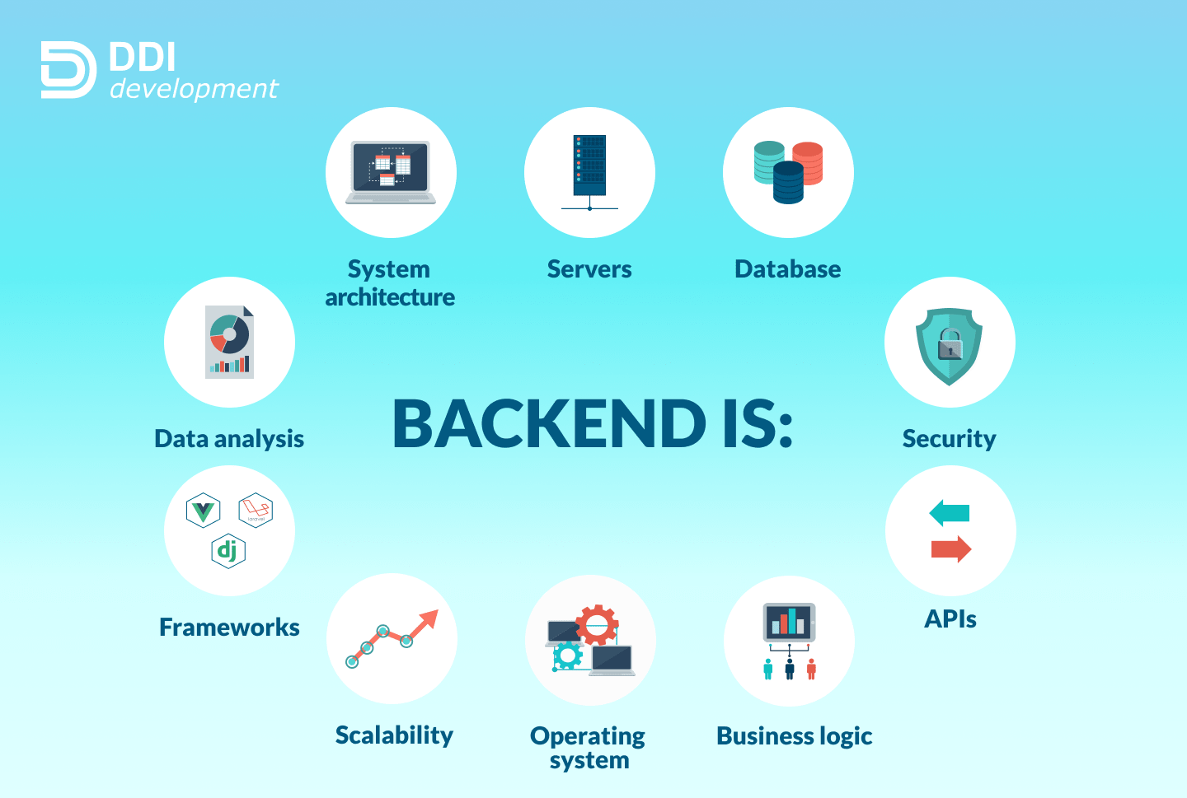
APPLESEEDS
INDEX.HTML

Slide 8
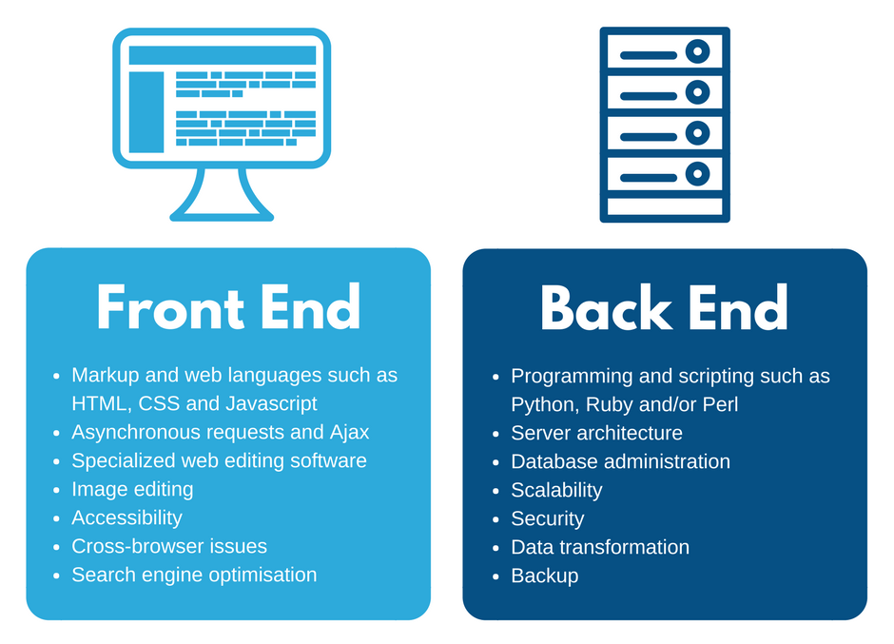
APPLESEEDS
INDEX.HTML

Slide 9
/02
What is nodejs?
APPLESEEDS
INDEX.HTML

Slide 10
What is nodejs?
APPLESEEDS
So what is nodejs?
Nodejs is a js runtime environment.
This basically means that it’s an environment where you can run js code.

Slide 11
What is nodejs?
APPLESEEDS
A guy called Ryan Dall created nodejs in 2009.
He took the V8 engine from chrome and detached it from the browser.
So now anyone can run JS in any environment and can build any type of application - not only front end based.

Slide 12
What is nodejs?
APPLESEEDS
Nodejs is free and open source.
Documentation - get used to it! We will read a lot of it.

Slide 13
/03
Using nodejs
APPLESEEDS
INDEX.HTML

Slide 14
Using nodejs
APPLESEEDS
If you haven't downloaded it yet: download
Using nodejs is straightforward: “node path/to/js/file/”
“node” is a command your terminal should know, after installing nodejs.

Slide 15
Using nodejs
APPLESEEDS
Basic usage: If we have the following file: App.js: console.log(‘hello world’);
We run it (if we are in the same directory): node ./App.js

Slide 16
Using nodejs
APPLESEEDS
80% of errors I saw are regarding the path and relative path.
So here is a small recap:
Using ‘./’ or ‘../’ is called relative path, because we are saying to the OS to go somewhere relative to the current directory.
“./” - relative to the directory i’m in
“../” - relative to the containing dir.

Slide 17
Using nodejs - passing cli args
APPLESEEDS
Nodejs can be used as more than just js engine - it can be a cli tool.
Lets say we want to build a cli calculator - we pass 2 numbers and operation, and the program will print the results.
For example: 2 + 4 // prints 6

Slide 18
Using nodejs - passing cli args
APPLESEEDS
First, we will create a file called calc.js, and run it like so: node ./calc.js 2 + 4
The second step is to get the arguments inside js, so we can use them.
Node gives us the “process.argv” array.

Slide 19
Using nodejs - passing cli args
APPLESEEDS
The first 2 args are not relevant:
The first will be the location of node itself.
The second is the location of the file.
So we can deconstruct like so: const [num1, operation, num2] = process.argv.slice(2)
Just remember that * has to be ‘*’

Slide 20
Using nodejs - passing cli args
APPLESEEDS
Once we have the arguments we can continue like it’s regular js.
Use switch case to diff between the options.

Slide 21
/04
Nodejs vs browser
APPLESEEDS
INDEX.HTML

Slide 22
Nodejs vs browser
APPLESEEDS
Most of the js you write in the client will work in the server, and vice versa.
Most - but not all. There are a lot of examples for client and server specific js.
For example:

Slide 23
Nodejs vs browser
APPLESEEDS
Browser api - only in the browser.
Geolocation
Audio
Commonjs - only in server
Process object, dirname - only in the server

Slide 24
Nodejs vs browser
APPLESEEDS
Don’t assume automatically that all your client code can be copied and pasted to your server!
And the other way around.

Slide 25
Thanks, and good luck!
Contact us:
Yishai
yishain@appleseeds.org.il
0524605642
Shadi
shhadys@appleseeds.org.il 0543113297
APPLESEEDS
INDEX.HTML

