Slide 1


On the precision loss in approximate homomorphic encryption Selected Areas in Cryptography (SAC) Fredericton, New Brunswick | August 2023
Anamaria Costache, Benjamin R. Curtis, Erin Hales, Sean Murphy, Tabitha Ogilvie, Rachel Player

Slide 2
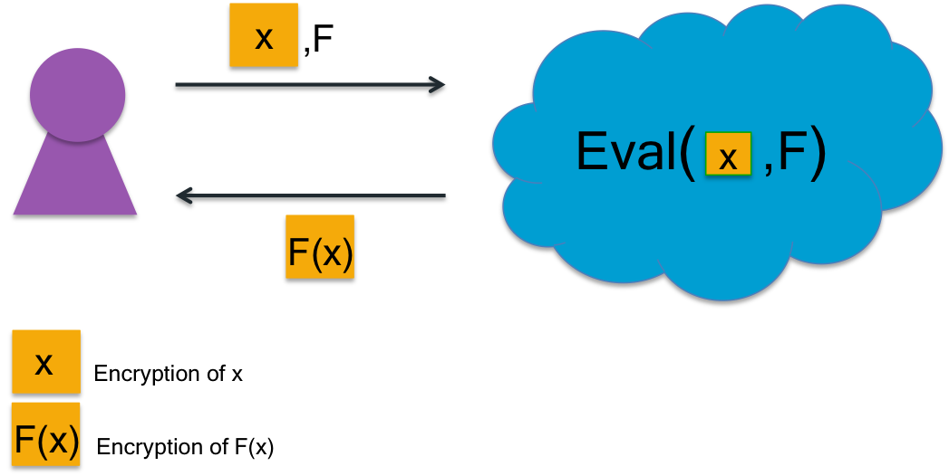
Homomorphic encryption (HE)

Slide 3
Homomorphic encryption (HE)
Somewhat homomorphic encryption:
F is a polynomial of at most some fixed degree

Slide 4
Homomorphic encryption (HE)
Somewhat homomorphic encryption:
F is a polynomial of at most some fixed degree
Approximate homomorphic encryption:
Decrypted result is approximately equal to F(x)

Slide 5
What is noise and why is it important?
All ciphertexts in HE schemes have inherent noise
Noise grows during homomorphic operations
If noise too large, decryption will fail
Understanding noise growth is essential to choose good parameters
Requiring large parameters is a major challenge in practical HE

Slide 6
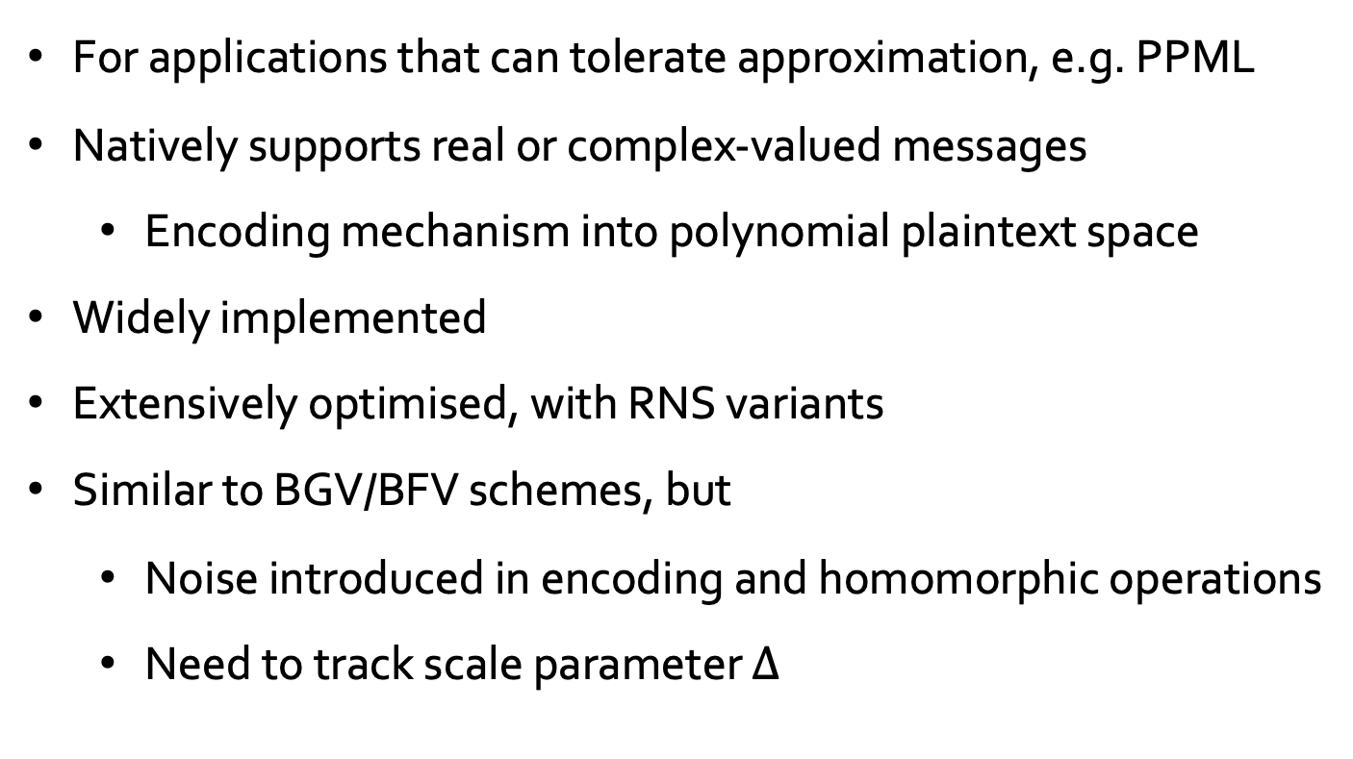
The CKKS approximate HE scheme
For applications that can tolerate approximation, e.g. PPML
Natively supports real or complex-valued messages
Encoding mechanism into polynomial plaintext space
Widely implemented
Extensively optimised, with RNS variants
Similar to BGV/BFV schemes, but
Noise introduced in encoding and homomorphic operations
Need to track scale parameter $∆$
J. H. Cheon, A. Kim, M. Kim, Y. Song. Homomorphic encryption for arithmetic of approximate numbers. Asiacrypt 2017.
J. H. Cheon, K. Han, A. Kim, M. Kim, Y. Song. A full RNS variant of approximate homomorphic encryption. SAC 2018.

Slide 7
Contributions of this work
New tighter bound on precision loss from encoding
Proof that bound is best possible
First average-case noise analysis for CKKS
For Textbook CKKS and RNS-CKKS
Evaluation compared to prior worst-case noise analyses and observed noise in implementations
For HEAAN v1.0 and FullRNS-HEAAN
HEAAN v1.0: https://github.com/snucrypto/HEAAN/releases/tag/1.0
FullRNS-HEAAN: https://github.com/KyoohyungHan/FullRNS-HEAAN

Slide 8
Worst-case approach for noise analysis
X
+
+
X
X

Slide 9
Worst-case approach for noise analysis
X
+
+
X
Bound on fresh
X

Slide 10
Worst-case approach for noise analysis
X
Bound after multiplication
+
+
X
Bound on fresh
X

Slide 11
Worst-case approach for noise analysis
X
Bound after multiplication
+
+
X
Bound on fresh
X

Slide 12
Worst-case approach for noise analysis
X
Bound after addition
Bound after multiplication
+
+
X
Bound on fresh
X

Slide 13
Worst-case approach for noise analysis
Bound on noise in output ciphertext
X
Choose correct parameters
Bound after addition
Bound after multiplication
+
+
X
Bound on fresh
X

Slide 14
Average-case approach for noise analysis
X
+
+
X
X

Slide 15
Average-case approach for noise analysis
X
+
+
X
Variance of fresh
X

Slide 16
Average-case approach for noise analysis
X
Variance after multiplication
+
+
X
Variance of fresh
X

Slide 17
Average-case approach for noise analysis
X
Variance after multiplication
+
+
X
Variance of fresh
X

Slide 18
Average-case approach for noise analysis
X
Variance after addition
Variance after multiplication
+
+
X
Variance of fresh
X

Slide 19
Average-case approach for noise analysis
Variance in output ciphertext
X
Variance after addition
Variance after multiplication
+
+
X
Variance of fresh
X

Slide 20
Average-case approach for noise analysis
Variance in output ciphertext
Bound on noise in
output ciphertext
X
Variance after addition
Variance after multiplication
+
+
X
Variance of fresh
X

Slide 21
Average-case approach for noise analysis
Variance in output ciphertext
Bound on noise in
output ciphertext
X
Choose correct
parameters
Variance after addition
Variance after multiplication
+
+
X
Variance of fresh
X

Slide 22
Prior work: TFHE
TFHE is a HE scheme with an average-case noise analysis
Noise is heuristically modelled as subgaussian
Heuristic was experimentally verified for gate bootstrapping
Every TFHE operation can be achieved by gate bootstrapping on a linear combination of ciphertexts
By linearity, all noises can be modelled in this way
Can the same approach work for CKKS?
I. Chillotti, N. Gama, M. Georgieva, M. Izabachène. TFHE: fast fully homomorphic encryption over the torus. J. of Cryptology, 2019.

Slide 23
An average-case approach for CKKS?
CKKS mult noise is the product of two input noises
The product of two Gaussians is not Gaussian
This suggests an average-case approach may be tricky

Slide 24
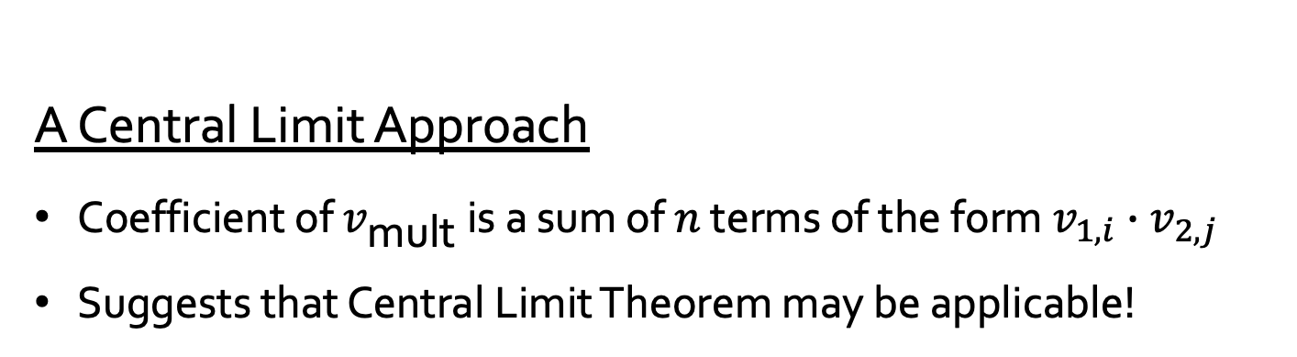
An average-case approach for CKKS?
CKKS mult noise is the product of two input noises
The product of two Gaussians is not Gaussian
This suggests an average-case approach may be tricky
A Central Limit Approach
Coefficient of $v_{\text{mult}}$ is a sum of $n$ terms of the form $v_{1,i}∙v_{2,j}$
Suggests that Central Limit Theorem may be applicable!

Slide 25

CLT approach for CKKS
Suppose $v_{1} \sim 𝒩(μ_{1}, ρ_{1}^{2}I_{N})$and $v_{2} \sim 𝒩(μ_{2},ρ_{2}^{2}I_{N})$
What is the distribution of $V=v_{1} v_{2}$?

Slide 26

CLT approach for CKKS
Suppose $v_{1} \sim 𝒩(μ_{1}, ρ_{1}^{2}I_{N})$and $v_{2} \sim 𝒩(μ_{2},ρ_{2}^{2}I_{N})$
What is the distribution of $V=v_{1} v_{2}$?
Theorem
$V$has mean $μ=μ_{1}μ_{2}$ and covariance $ρ^{2}I_{N}+S$
$ρ^{2}=Nρ_{1}^{2}$ $ρ_{2}^{2}+ρ_{1}^{2}{\left\|μ_{2}\right\|}_{2}^{2}$ + $ρ_{1}^{2}{\left\|μ_{1}\right\|}_{2}^{2}$
S is an off-diagonal matrix
Moreover, we can approximate $V_{i} \sim 𝒩(μ_{i},ρ^{2})$

Slide 27
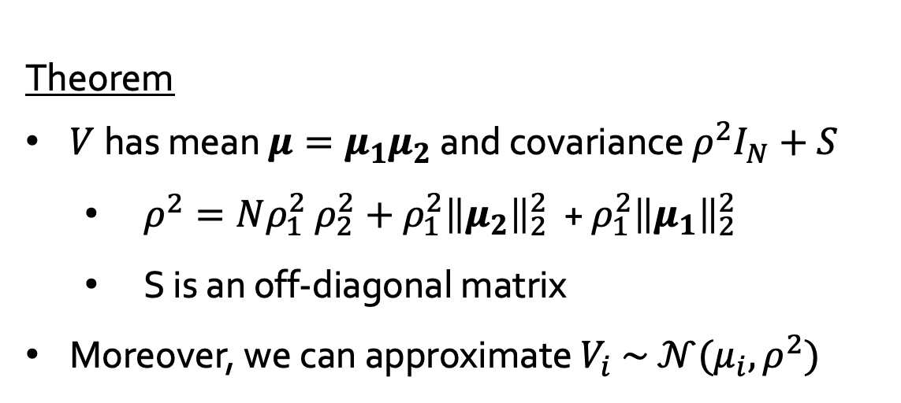
CLT approach for CKKS
Theorem
$V$has mean $μ=μ_{1}μ_{2}$ and covariance $ρ^{2}I_{N}+S$
$ρ^{2}=Nρ_{1}^{2}$ $ρ_{2}^{2}+ρ_{1}^{2}{\left\|μ_{2}\right\|}_{2}^{2}$ + $ρ_{1}^{2}{\left\|μ_{1}\right\|}_{2}^{2}$
S is an off-diagonal matrix
Moreover, we can approximate $V_{i} \sim 𝒩(μ_{i},ρ^{2})$

Slide 28
CLT approach for CKKS
Theorem
$V$has mean $μ=μ_{1}μ_{2}$ and covariance $ρ^{2}I_{N}+S$
$ρ^{2}=Nρ_{1}^{2}$ $ρ_{2}^{2}+ρ_{1}^{2}{\left\|μ_{2}\right\|}_{2}^{2}$ + $ρ_{1}^{2}{\left\|μ_{1}\right\|}_{2}^{2}$
S is an off-diagonal matrix
Moreover, we can approximate $V_{i} \sim 𝒩(μ_{i},ρ^{2})$
Heuristic: We can approximate $V \sim 𝒩(μ{, ρ}^{2}I_{N}+S)$

Slide 29
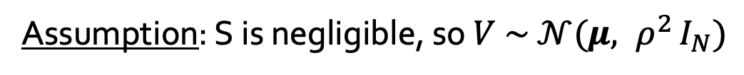
CLT approach for CKKS
Theorem
$V$has mean $μ=μ_{1}μ_{2}$ and covariance $ρ^{2}I_{N}+S$
$ρ^{2}=Nρ_{1}^{2}$ $ρ_{2}^{2}+ρ_{1}^{2}{\left\|μ_{2}\right\|}_{2}^{2}$ + $ρ_{1}^{2}{\left\|μ_{1}\right\|}_{2}^{2}$
S is an off-diagonal matrix
Moreover, we can approximate $V_{i} \sim 𝒩(μ_{i},ρ^{2})$
Heuristic: We can approximate $V \sim 𝒩(μ{, ρ}^{2}I_{N}+S)$
Assumption: S is negligible, so $V \sim 𝒩(μ{, ρ}^{2}I_{N})$

Slide 30
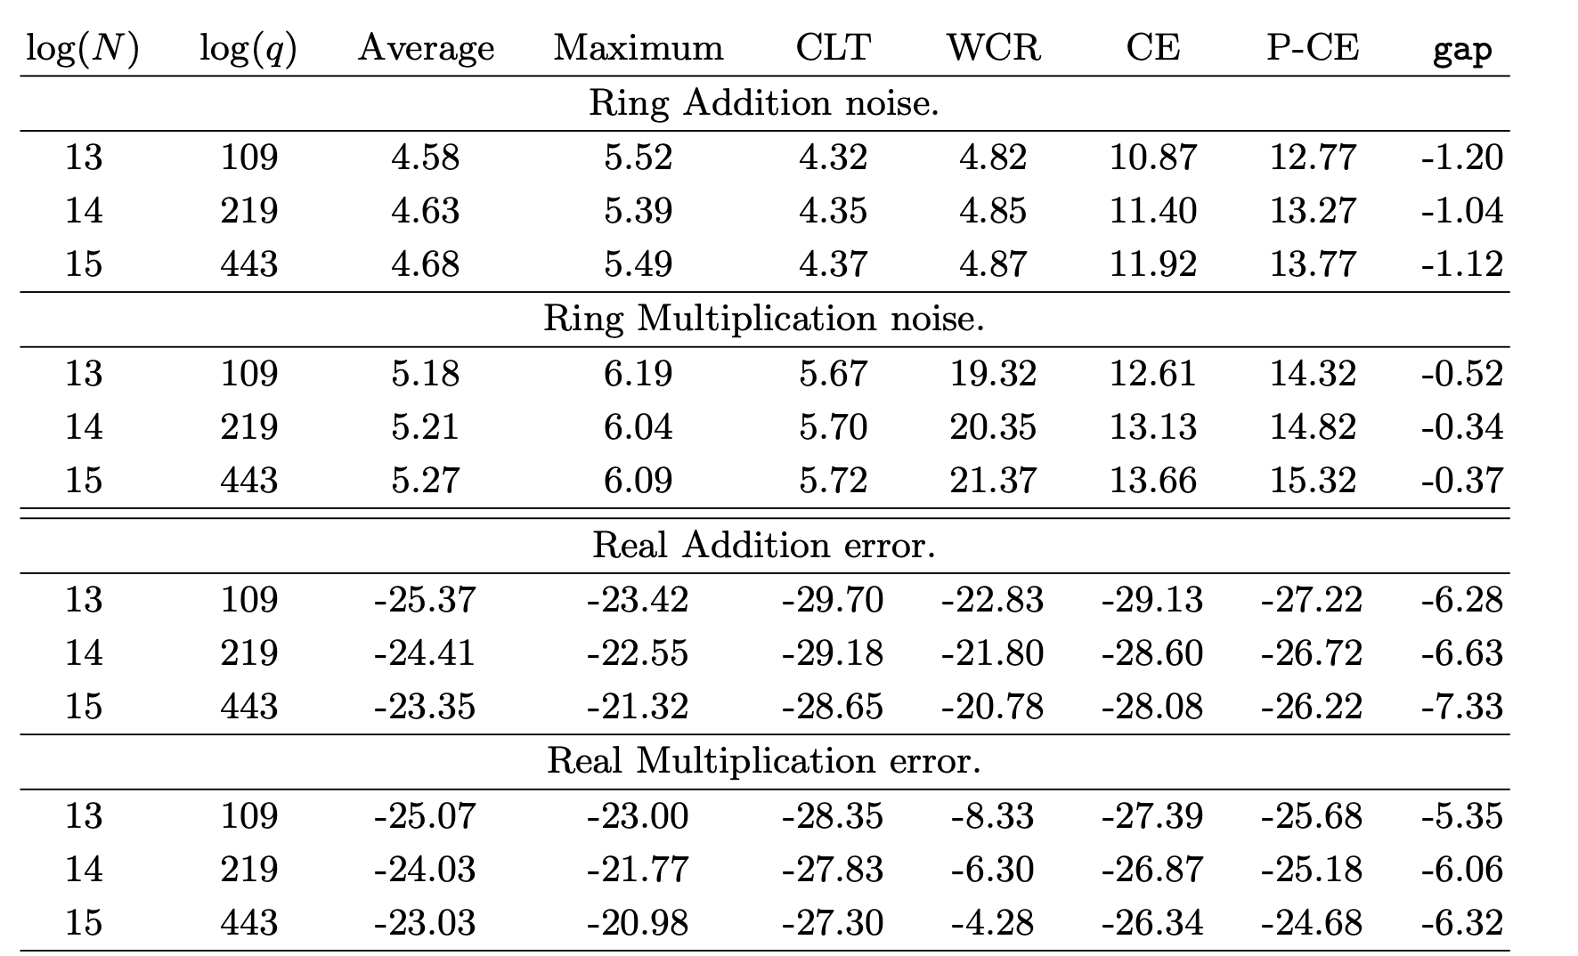
Experiments: Textbook CKKS, HEAAN v1.0
Comparison of noise analysis approaches with observed noise in HEAAN v1.0.

Slide 31
Experiments: Textbook CKKS, HEAAN v1.0
Comparison of noise analysis approaches with observed noise in HEAAN v1.0.

Slide 32
Experiments: Textbook CKKS, HEAAN v1.0
CLT approach can more closely model noise growth than prior worst-case approach
Comparison of noise analysis approaches with observed noise in HEAAN v1.0.

Slide 33
Experiments: Textbook CKKS, HEAAN v1.0
Comparison of noise analysis approaches with observed noise in HEAAN v1.0.

Slide 34
Experiments: Textbook CKKS, HEAAN v1.0
CLT approach can underestimate observed noise
Comparison of noise analysis approaches with observed noise in HEAAN v1.0.

Slide 35
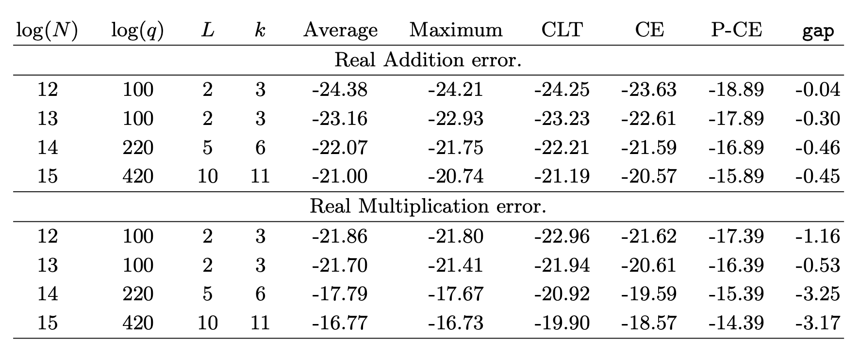
Experiments: RNS-CKKS, FullRNS-HEAAN
Comparison of noise analysis approaches with observed noise in FullRNS-HEAAN.

Slide 36
Experiments: RNS-CKKS, FullRNS-HEAAN
Comparison of noise analysis approaches with observed noise in FullRNS-HEAAN.

Slide 37
Experiments: RNS-CKKS, FullRNS-HEAAN
Again, CLT approach can underestimate observed noise
Comparison of noise analysis approaches with observed noise in FullRNS-HEAAN.

Slide 38
Experiments: RNS-CKKS, FullRNS-HEAAN
Comparison of noise analysis approaches with observed noise in FullRNS-HEAAN.

Slide 39
Experiments: RNS-CKKS, FullRNS-HEAAN
Jump in real data not captured in any of the noise analyses
Comparison of noise analysis approaches with observed noise in FullRNS-HEAAN.

Slide 40
Results
+ve: Our average-case approach
Can more closely model noise growth
Could refine starting point for manual parameter selection

Slide 41
Results
+ve: Our average-case approach
Can more closely model noise growth
Could refine starting point for manual parameter selection
-ve: Our average-case approach
Often underestimates practical noise
May not reflect all implementation choices
Requires heuristic assumptions that limit applicability

Slide 42
Future work
Refine average-case analysis to avoid heuristics
Tailor noise analyses to specific implementations
Incorporate noise analyses into compiler toolchains
Shown to be effective for BGV as in HElib
A. Costache, L. Nürnberger, R. Player. Optimisations and tradeoffs for HElib. CT-RSA 2023.

Slide 43
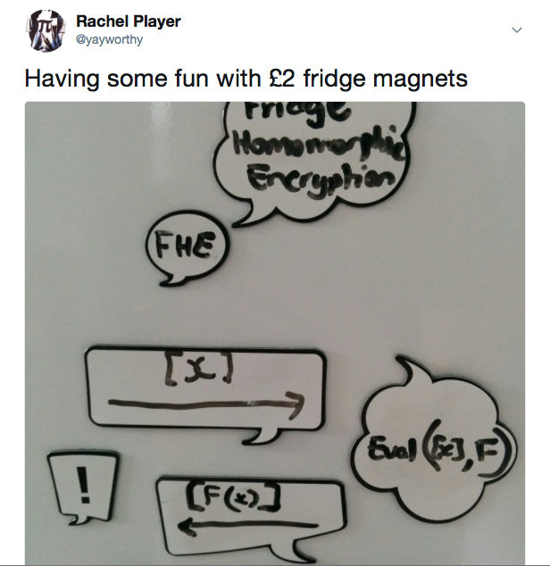
Thank you & questions!
rachel.player@rhul.ac.uk
Preprint:
eprint.iacr.org/2022/162
Code:
github.com/bencrts/CKKS_noise

