Slide 1


The Random Fault Model
Siemen Dhooghe & Svetla Nikova SAC 2023

Slide 2
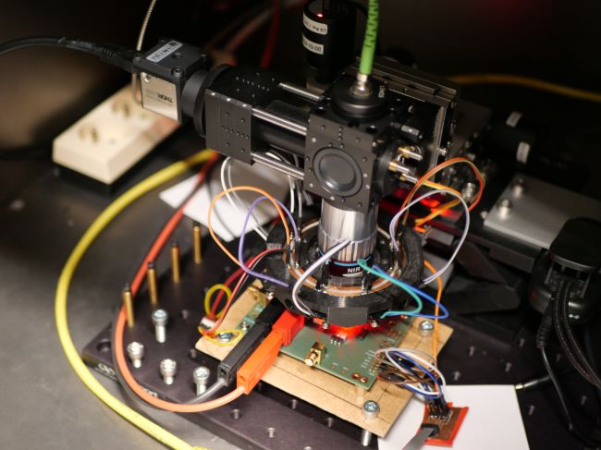
Fault Attacks & Adversary Models
Protection of embedded device’s against physical attacks
A need to algorithmically secure implementations
Platform-independent
Quantifiable security

Slide 3

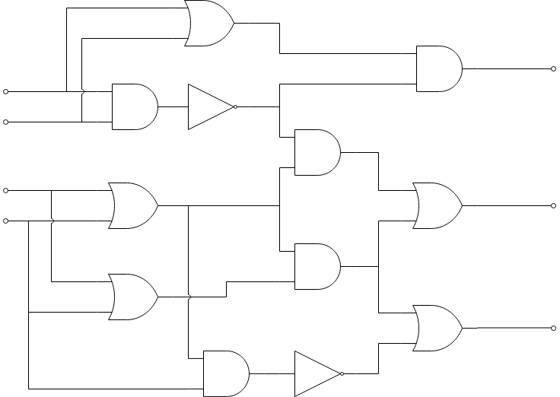
The Threshold Fault Model
Current most-used model
Allows for a theoretical analysis

Slide 4
The Threshold Fault Model
Not how real attacks work
Mismatch has real effects
Examples by Bartkewitz et al. in CHES 2022
Real modelling requires more details than what algorithms give

Slide 5



The Random Fault Model
$κ$ prob.
The new model
An adversary can target all gates/wires but each fault has a limited prob. to succeed
A little closer to practice
Not fully there
Still allows for theoretical analysis
$κ$ prob.
$κ$ prob.

Slide 6
Correctness and Privacy Models
Correctness: Advantage to get an incorrect ciphertext (not abort)
Can be related to DFA-like attacks
Privacy: Advantage to guess some secret only given whether the circuit aborts or not
Can be related SIFA-like attacks

Slide 7
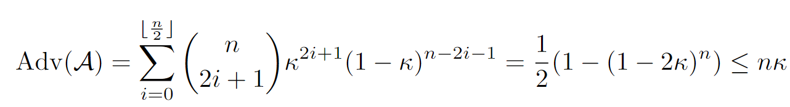

Results: Masking
For $n$ shares, the security decreases $n$ times

Slide 8
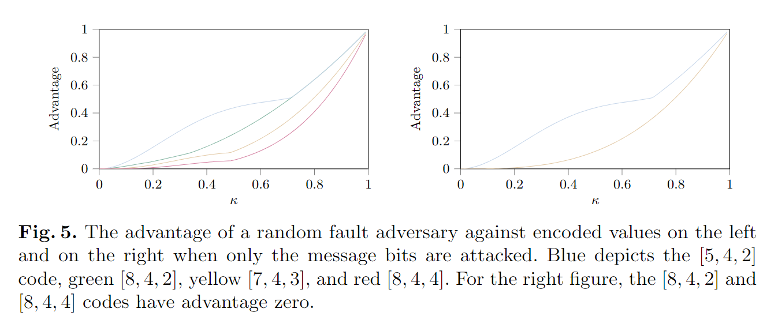
Results: Error Detection
For duplication, the security increases exponentially with the number of duplicates
For linear codes, we repeat Bartkewitz’s experiments

Slide 9
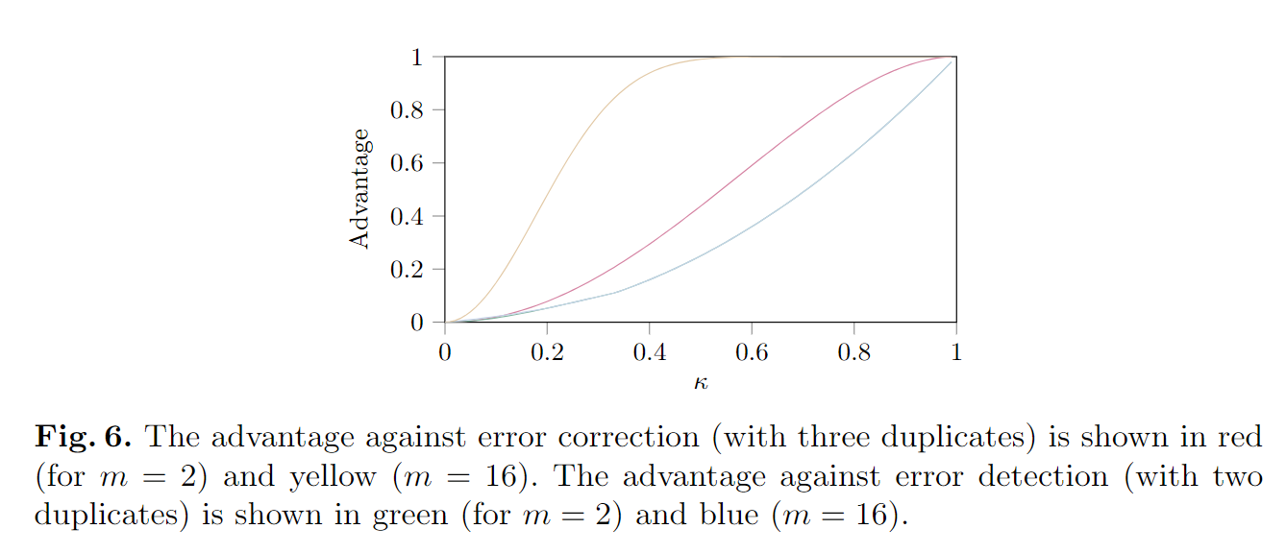
Results: Error Correction
The security of triplication is lower if the state size increases versus duplication

Slide 10
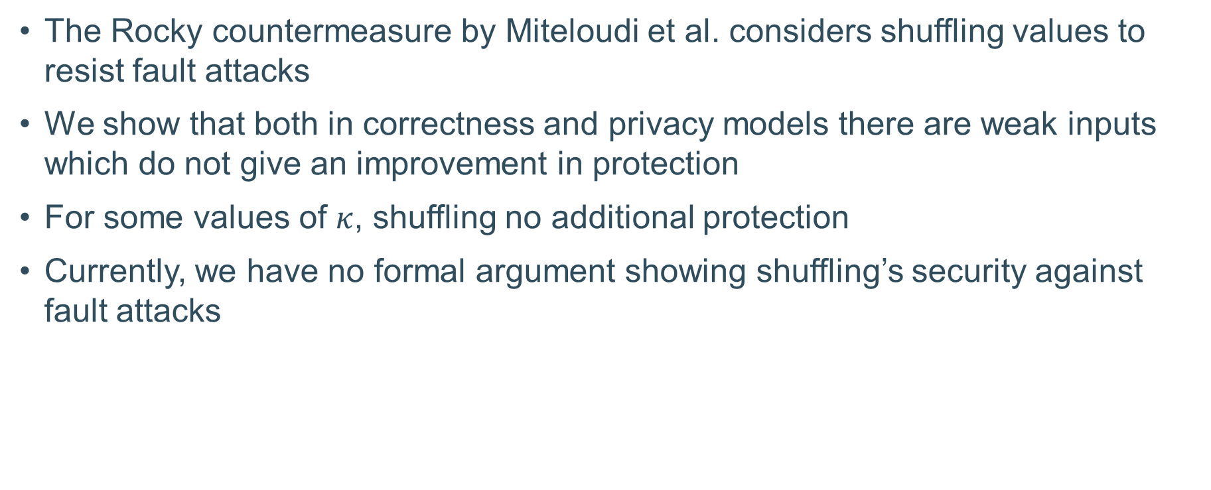
Results: Shuffling
The Rocky countermeasure by Miteloudi et al. considers shuffling values to resist fault attacks
We show that both in correctness and privacy models there are weak inputs which do not give an improvement in protection
For some values of $κ$, shuffling no additional protection
Currently, we have no formal argument showing shuffling’s security against fault attacks

Slide 11
Conclusions & Open Problems
The work also considered random probing
Showed that shuffling provides no significant protection in the random probing model
Several countermeasures are not yet studied (random probing or fault)
Multiplicative masking
Arithmetic masking
Prime field masking
Study combined security or the security of operations

Slide 12
Thank you!

