Slide 1
Deep Learning-Based Rotational-XOR Distinguishers for AND-RX Block Ciphers: Evaluations on Simeck and Simon
Amirhossein Ebrahimi¹, David Gerault², Paolo Palmieri¹
School of Computer Science & IT, University College Cork
Cryptography Research Centre, Technology Innovation Institute, Abu Dhabi, UAE

Slide 2
Outline
Background and Context
Preliminaries
Problem Statement and Objectives
Methodology
Results
Discussion and Implications
Future Work
Conclusion

Slide 3
Prior Work and Contextual Landscape
Simon & Simeck ciphers
First automated attacks of Simon and Simeck
Interpretation of neural network distinguishers
automated finding of good input differences
2013 - 2015
2016
2017 - 2018
2019
2021
2022
2022
Introducing the Rotational-Xor (RX) cryptanalysis
Gohr’s paper on Deep learning based cryptanalysis
rotational-xor cryptanalysis of simon-like
block ciphers

Slide 4
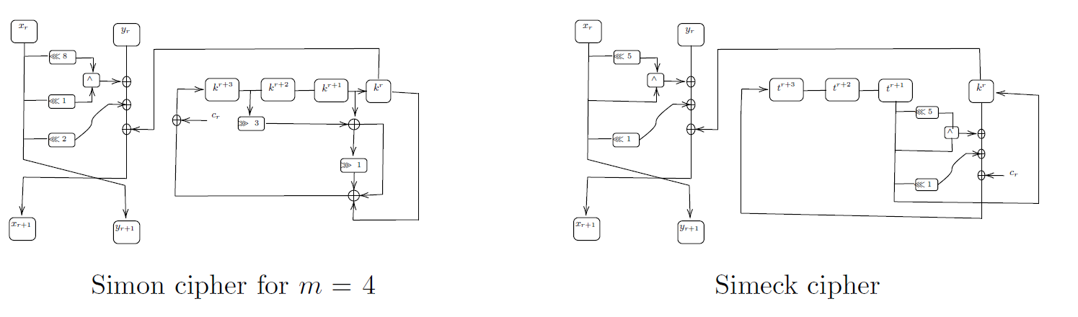

AND-RX Cipher (Simon-like)

Slide 5
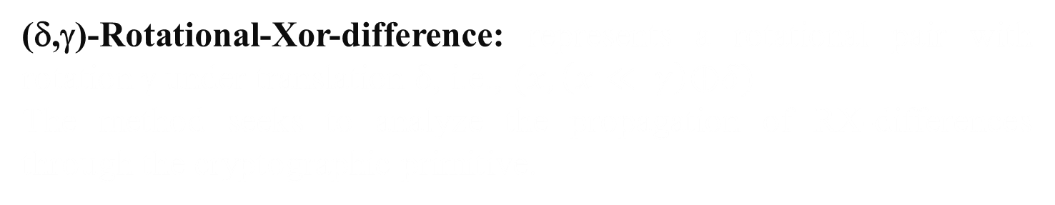
RX Cryptanalysis
Technique to analyze the security of symmetric algorithms
Focuses on rotational pairs of plaintext and ciphertext
Extension of rotational cryptanalysis to handle XOR operations with constants
(δ,γ)-Rotational-Xor-difference: represents a rotational pair with rotation γ under translation δ, i.e., $(x,\left(x≪ γ\right)⨁δ)$
The method seeks to analyze the propagation of RX-differences through the cryptographic primitive.

Slide 6
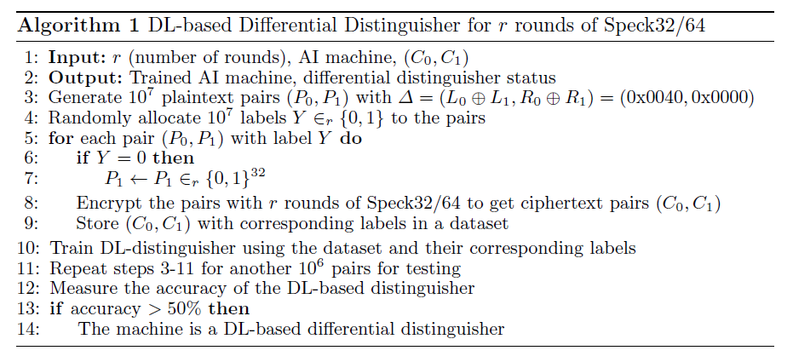
Deep Learning in Symmetric Cryptography
Gohr applied deep learning techniques for cryptanalysis, specifically for attacking the Speck cipher
Deep learning can outperform traditional counterparts in differential cryptanalysis

Slide 7
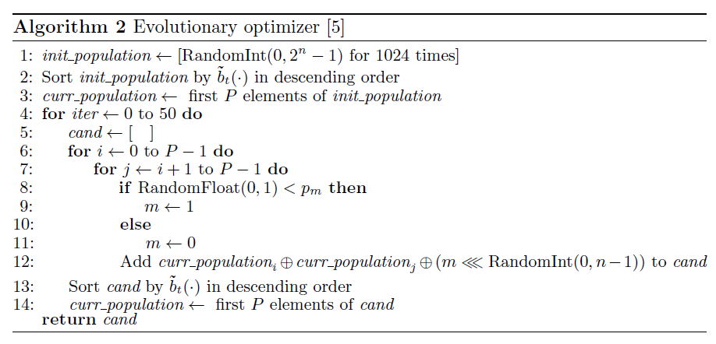
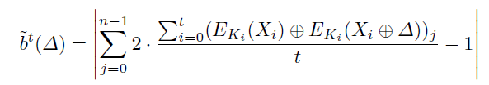
Deep Learning in Symmetric Cryptography (Cont.)
Bellini et al. presented an alternative approach for finding the best input difference that does not rely on neural networks

Slide 8
Challenges in RX Cryptanalysis
More parameters
Limitations of weak-key models
Unexplored potential of AI

Slide 9
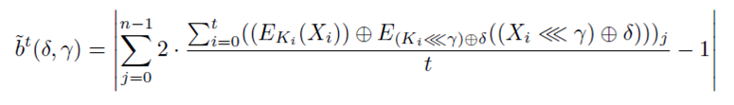
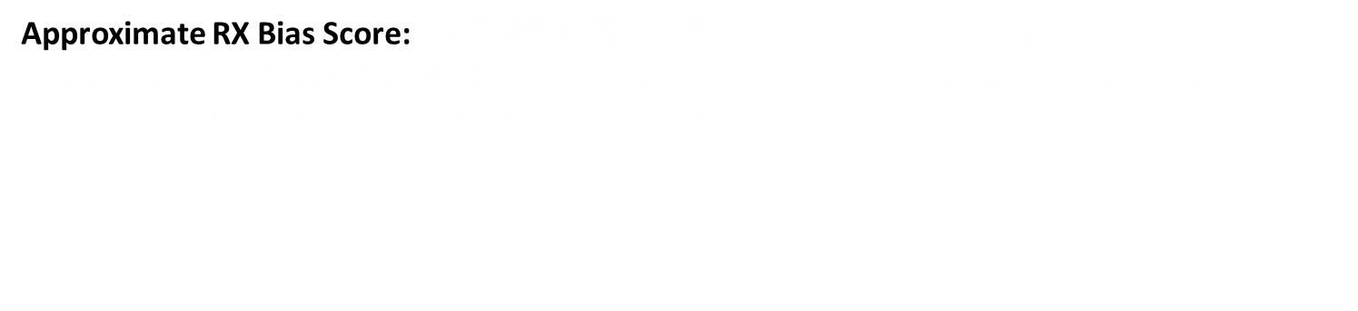
DL-based RX Distinguisher & Approximate RX Bias Score
DL-based RX Distinguisher: An AI machine is trained to distinguish rotational-XOR (RX) patterns in ciphertext pairs. The machine's accuracy is measured and if it's greater than or equal to 50%, it is designated as an RX distinguisher.
Approximate RX Bias Score: Let $E:𝔽_{2}^{n}×𝔽_{2}^{k}→𝔽_{2 }^{n}$ be a block cipher, then The Approximate RX Bias Score for $δ$, denoted by ${\tilde{b}}^{t}\left(δ,γ\right)$, is defined as the sum of the biases of each bit position $j$ in the output RX-difference, computed over $t$ samples.

Slide 10
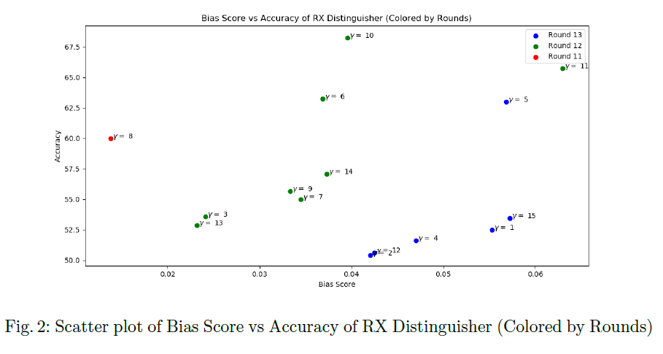
DL-based RX Distinguisher & Approximate RX Bias Score (Cont.)
We observed a positive correlation between bias score and the accuracy of the distinguisher, with some outliers due to variations in the cipher structure.

Slide 11
Evolutionary Optimization of Deep Learning RX Differential Distinguishers
Goal: To adapt the evolutionary-based search algorithm to explore a more extensive set of candidate RX pairs, accounting for the rotational offset γ and the XOR translation δ.
Search Strategy: First-time simultaneous search for optimal δ and γ parameters.
Methodology: The algorithm starts with a population of randomly generated input differences and corresponding rotational offsets. For each of them, an approximate RX bias score is computed. The algorithm iteratively refines this population, maintaining top performers.
Outcome: The algorithm returns a list of 32 input differences for each round and computes a weighted cumulative RX bias score.
Advancement: This approach allows for identifying effective RX distinguishers for full-key classes, a notable improvement over previous methods.

Slide 12
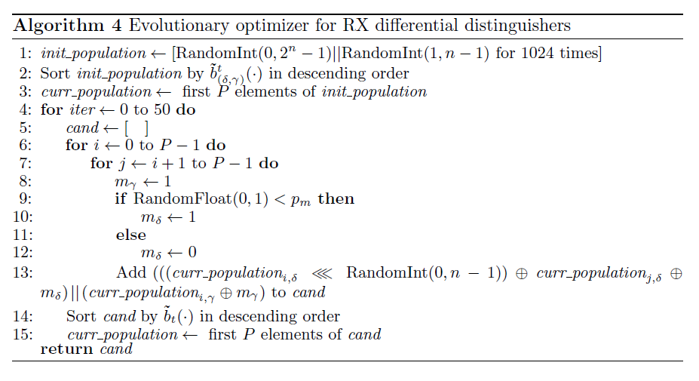
Evolutionary Optimization of Deep Learning RX Differential Distinguishers (Cont.)

Slide 13
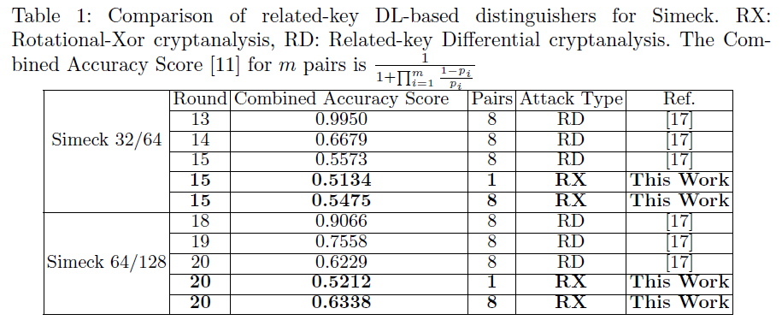
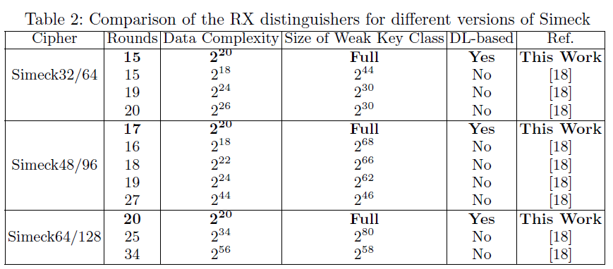
Results
17. Lu, J., Liu, G., Sun, B., Li, C., Liu, L.: Improved (related-key) differential-based neural
distinguishers for simon and simeck block ciphers. Cryptology ePrint Archive (2022)
18. Lu, J., Liu, Y., Ashur, T., Sun, B., Li, C.: Improved rotational-xor cryptanalysis of simon-like
block ciphers. IET Information Security 16(4), 282–300 (2022)

Slide 14
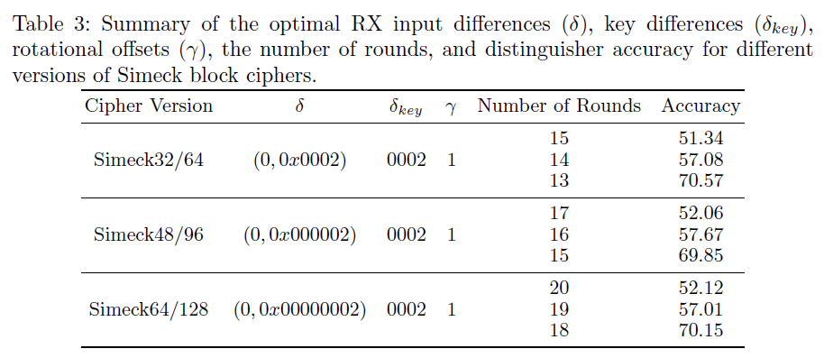
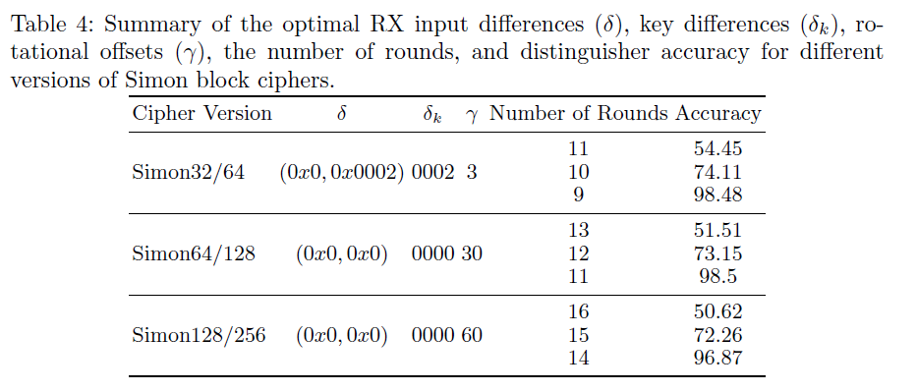
Results (Cont.)

Slide 15
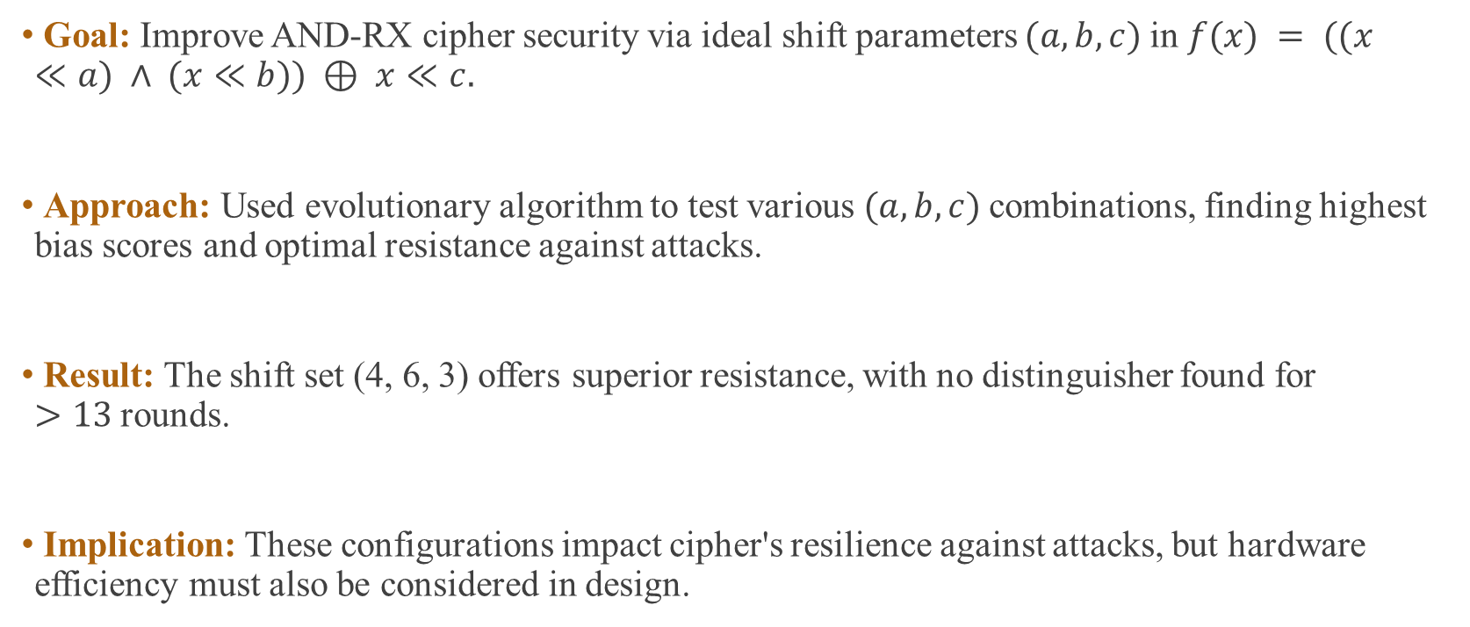
Impact of Diffusion Layer
Goal: Improve AND-RX cipher security via ideal shift parameters $(a, b, c)$in $f(x) = ((x≪a) ∧ (x≪b)) ⊕ x≪c.$
Approach: Used evolutionary algorithm to test various $(a, b, c)$combinations, finding highest bias scores and optimal resistance against attacks.
Result: The shift set (4, 6, 3) offers superior resistance, with no distinguisher found for $>13$rounds.
Implication: These configurations impact cipher's resilience against attacks, but hardware efficiency must also be considered in design.

Slide 16
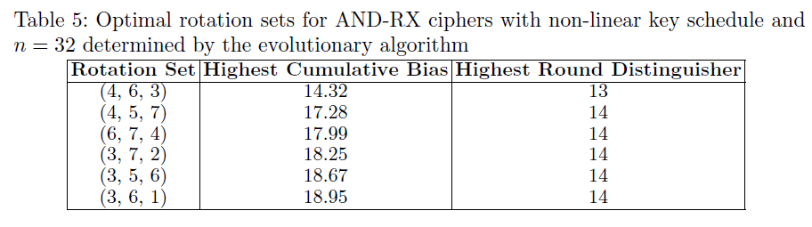
Impact of Diffusion Layer (Cont.)

Slide 17
Conclusion & Future works
Summary:
Explored deep learning's role in RX cryptanalysis of AND-RX ciphers, especially Simon and Simeck families.
Discovered related-key model distinguishers against conventional weak-key models.
Identified optimal RX input differences, key differences, and rotational offsets.
Presented a new method to optimize diffusion layers in AND-RX ciphers and identified several optimal rotation sets for Simeck-like ciphers.
Future Work:
Weak-key attack
Implementing key recovery attack

Slide 18
Thank you
Question ?

