Slide 1
30th Selected Areas in Cryptography
Traceable Ring Signatures from Group Actions: Logarithmic, Flexible, and Quantum Resistant
Reporter: Wei Wei
Authors: Wei Wei, Min Luo*, Zijian Bao, Cong Peng and Debiao He*
Wuhan University
2023-08-16

Slide 2








Motivation — Ring Signature
?
output
Hides the origin of a signature
Protect the privacy of signers

Slide 3

Motivation — Ring Signature
e-voting
e-coupon services

Slide 4
Motivation — Ring Signature
?
output
Unconditional anonymity

Slide 5
Motivation — Traceable Ring Signature
message
signature
Honest member
signature1
message1
message
signature
signature2
message2
message
signature
Dishonest
member
Vote twice for two candidates
Double-spend
How to construct a post-quantum secure traceable ring signature？

Slide 6
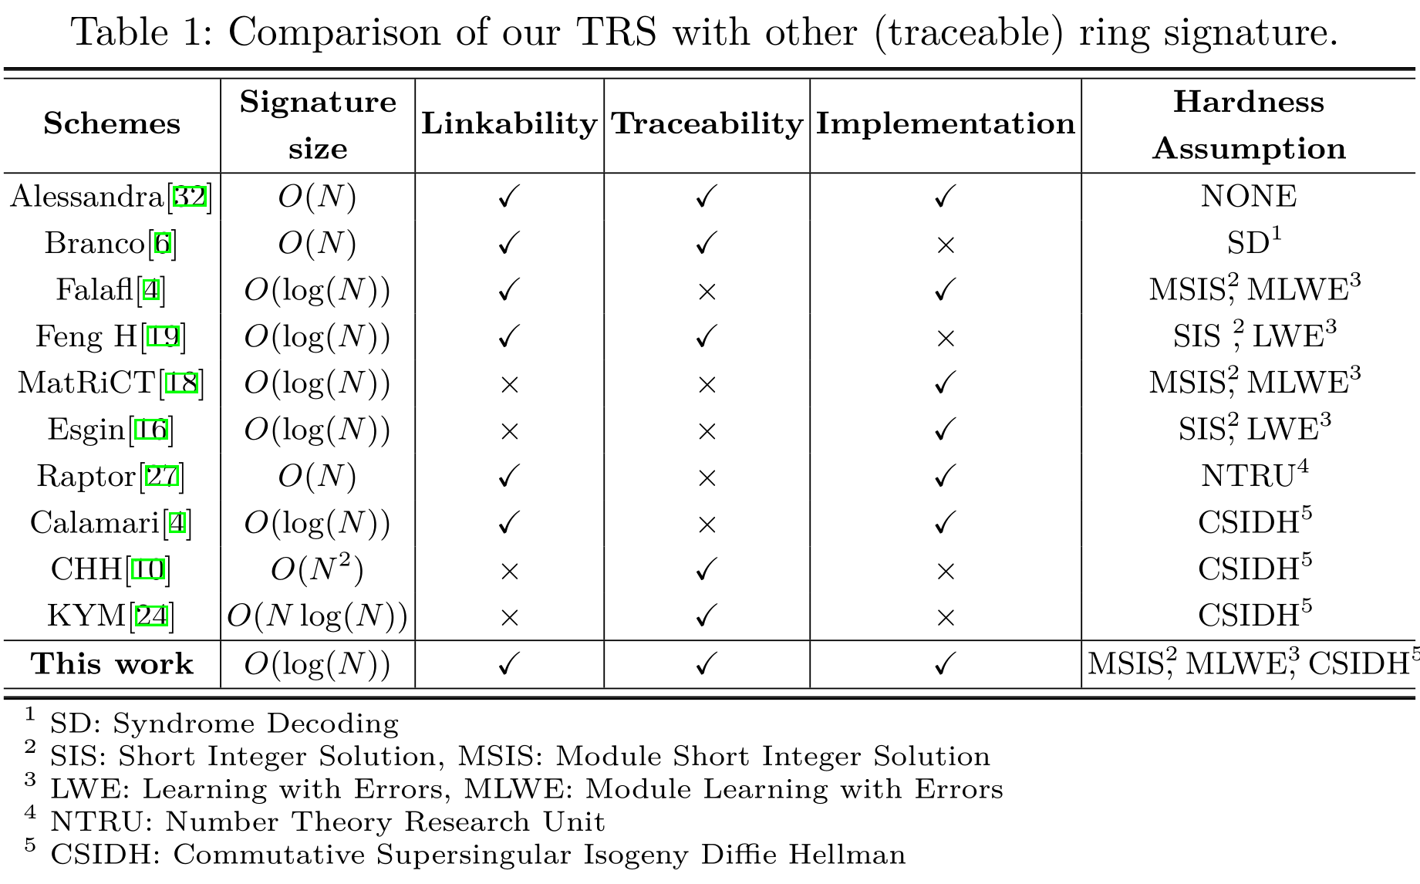
Motivation — Literature review
Lattice-based schemes
ring signature
traceable ring signature
unique ring signature
Isogeny-based schemes
linkable ring signature
accountable ring signature
revocable ring signature
Other post-quantum schemes
traceable ring signature
one-time traceable ring signature

Slide 7
Motivation — Literature review
[BKP2020]
construct an efficient (linkable) ring signature scheme and gave two concrete instances from isogenies and lattices
a general OR-proof, logarithmic signature size
[BKP2023]
construct an efficient dynamic group signature (accountable ring signature) from isogeny and lattice assumptions
add a proof of valid ciphertext to [BKP2020]’s OR-proof and proving full anonymity
Is this the construction for other signature schemes (traceable ring signature )?

Slide 8
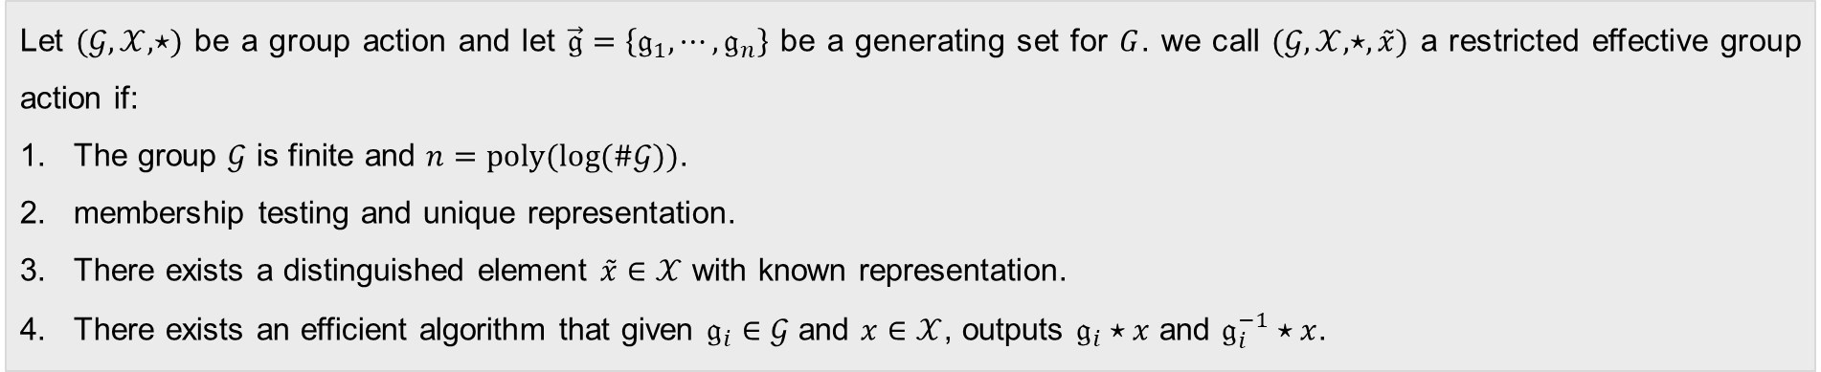
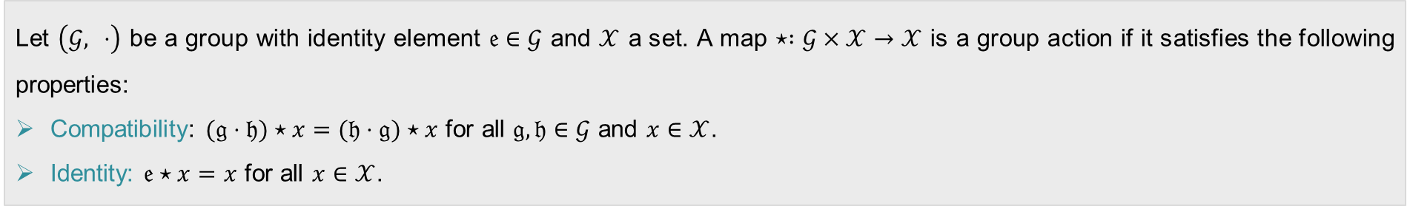
Background — Restricted Pair of Group Action
Group Action
Let $\left(𝒢, ⋅\right)$ be a group with identity element $𝔢∈𝒢$ and $𝒳$ a set. A map $⋆ :𝒢×𝒳→𝒳$ is a group action if it satisfies the following properties:
Compatibility: $(𝔤⋅𝔥)⋆x=(𝔥⋅𝔤)⋆x$ for all $𝔤,𝔥∈𝒢$ and $x∈𝒳$.
Identity: $𝔢⋆x=x$ for all $x∈𝒳$.
Restricted Effective Group Action
Let $(𝒢,𝒳,⋆)$ be a group action and let $\vec{𝔤}=\left\{𝔤_{1},⋯,𝔤_{n}\right\}$ be a generating set for $G$. we call $(𝒢,𝒳,⋆,\overset{˜}{x})$ a restricted effective group action if:
The group $𝒢$ is finite and $n=poly(log(\#𝒢))$.
membership testing and unique representation.
There exists a distinguished element $\overset{˜}{x}∈𝒳$ with known representation.
There exists an efficient algorithm that given $𝔤_{i}∈𝒢$ and $x∈𝒳$, outputs $𝔤_{i}⋆x$ and $𝔤_{i}^{−1}⋆x$.

Slide 9
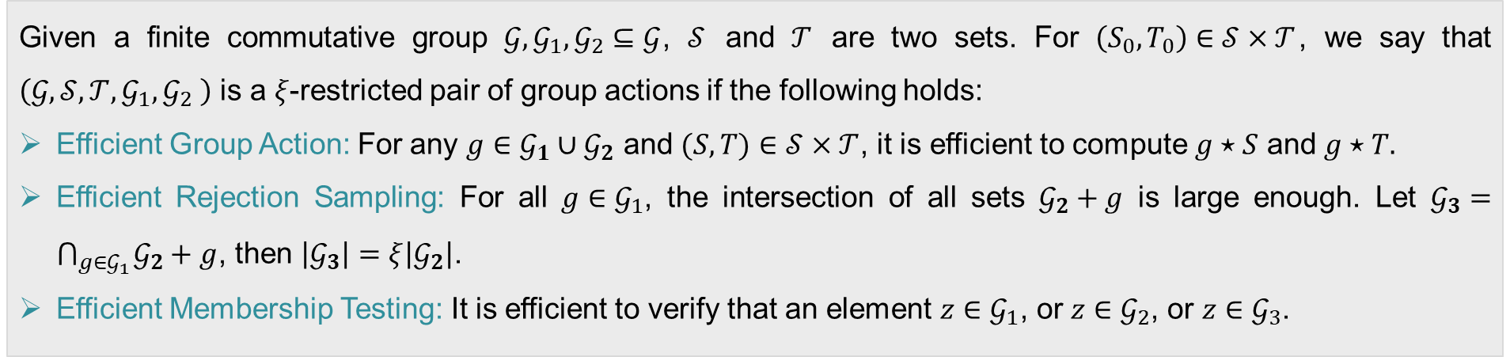
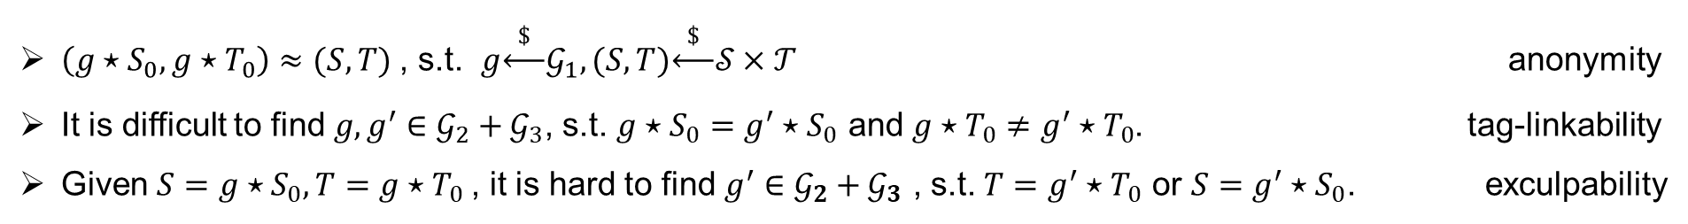
Background — Restricted Pair of Group Action
Restricted Pair of Effective Group Action
Given a finite commutative group $𝒢,𝒢_{1},𝒢_{2}⊆𝒢$, $𝒮$ and $𝒯$ are two sets. For $\left(S_{0},T_{0}\right)∈𝒮×𝒯$, we say that $\left(𝒢,𝒮,𝒯,𝒢_{1},𝒢_{2} \right)$ is a $ξ$-restricted pair of group actions if the following holds:
Efficient Group Action: For any $g∈𝒢_{1}∪𝒢_{2}$ and $(S,T)∈𝒮×𝒯$, it is efficient to compute $g⋆S$ and $g⋆T.$
Efficient Rejection Sampling: For all $g∈𝒢_{1}$, the intersection of all sets $𝒢_{2}+g$ is large enough. Let $𝒢_{3}=⋂_{g∈𝒢_{1}} 𝒢_{2}+g$, then $\left|𝒢_{3}\right|=ξ\left|𝒢_{2}\right|$.
Efficient Membership Testing: It is efficient to verify that an element $z∈𝒢_{1}$, or $z∈𝒢_{2}$, or $z∈𝒢_{3}$.
$\left(g⋆S_{0},g⋆T_{0}\right)≈(S,T)$, s.t. $g\underset{←}{ \$ }𝒢_{1},(S,T)\underset{←}{ \$ }𝒮×𝒯$ anonymity
It is difficult to find $g,g^{′}∈𝒢_{2}+𝒢_{3}$, s.t. $g⋆S_{0}=g^{′}⋆S_{0}$ and $g⋆T_{0}≠g^{′}⋆T_{0}$. tag-linkability
Given $S=g⋆S_{0},T=g⋆T_{0}$, it is hard to find $g^{′}∈𝒢_{2}+𝒢_{3}$ , s.t. $T=g^{′}⋆T_{0}$ or $S=g^{′}⋆S_{0}$. exculpability

Slide 10
Construction — Idea
We introduce tag sets to build traceable ring signatures → validity and traceability
A general traceable ring signature scheme is constructed based on OR sigma protocol and group action.
Each user generates a tag set based on message.
Traceability will be possible by checking whether each tag/vector in the two sets is equal.
Validity will be ensured by adding the tag set to OR-proof.
Logarithmic signature size under Isogeny-based and lattice-based Instantiation.

Slide 11
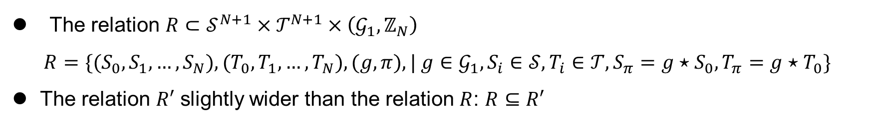


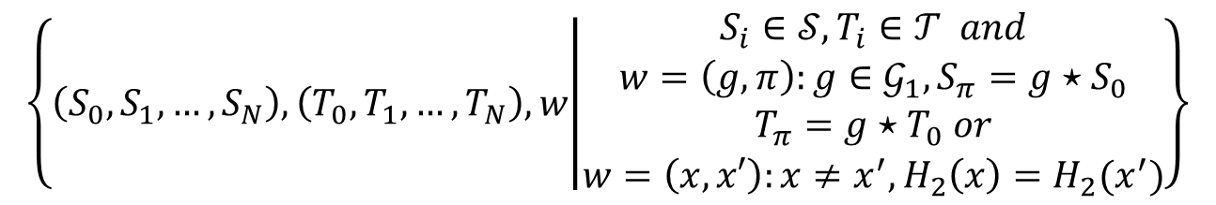
Construction — Definition of relation
The relation $R⊂𝒮^{N+1}×𝒯^{N+1}×\left(𝒢_{1},ℤ_{N}\right)$
$$R=\{(S_{0}, S_{1},…,S_{N}), (T_{0},T_{1},…,T_{N}),(g,π),| g∈𝒢_{1},S_{i}∈𝒮, T_{i}∈𝒯,S_{π}=g⋆S_{0}, T_{π}=g⋆T_{0}\}$$
The relation $R′$ slightly wider than the relation $R$: $R⊆R′$
$$\left\{\left(S_{0}, S_{1},…,S_{N}\right), \left(T_{0},T_{1},…,T_{N}\right),w | \begin{matrix}S_{i}∈𝒮, T_{i}∈𝒯 and \\ w=\left(g,π\right):g∈𝒢_{1},S_{π}=g⋆S_{0} \\ \begin{aligned}T_{π}=g⋆T_{0} or \\ w=\left(x,x′\right):x≠x^{′},H_{2}\left(x\right)=H_{2}(x^{′})\end{aligned}\end{matrix}\right\}$$
$$R$$
$$R′$$
Under $(R,R′)$, the OR sigma protocol is still useful as long as $\left(R,R^{′}\right)$ is sufficiently difficult.

Slide 12
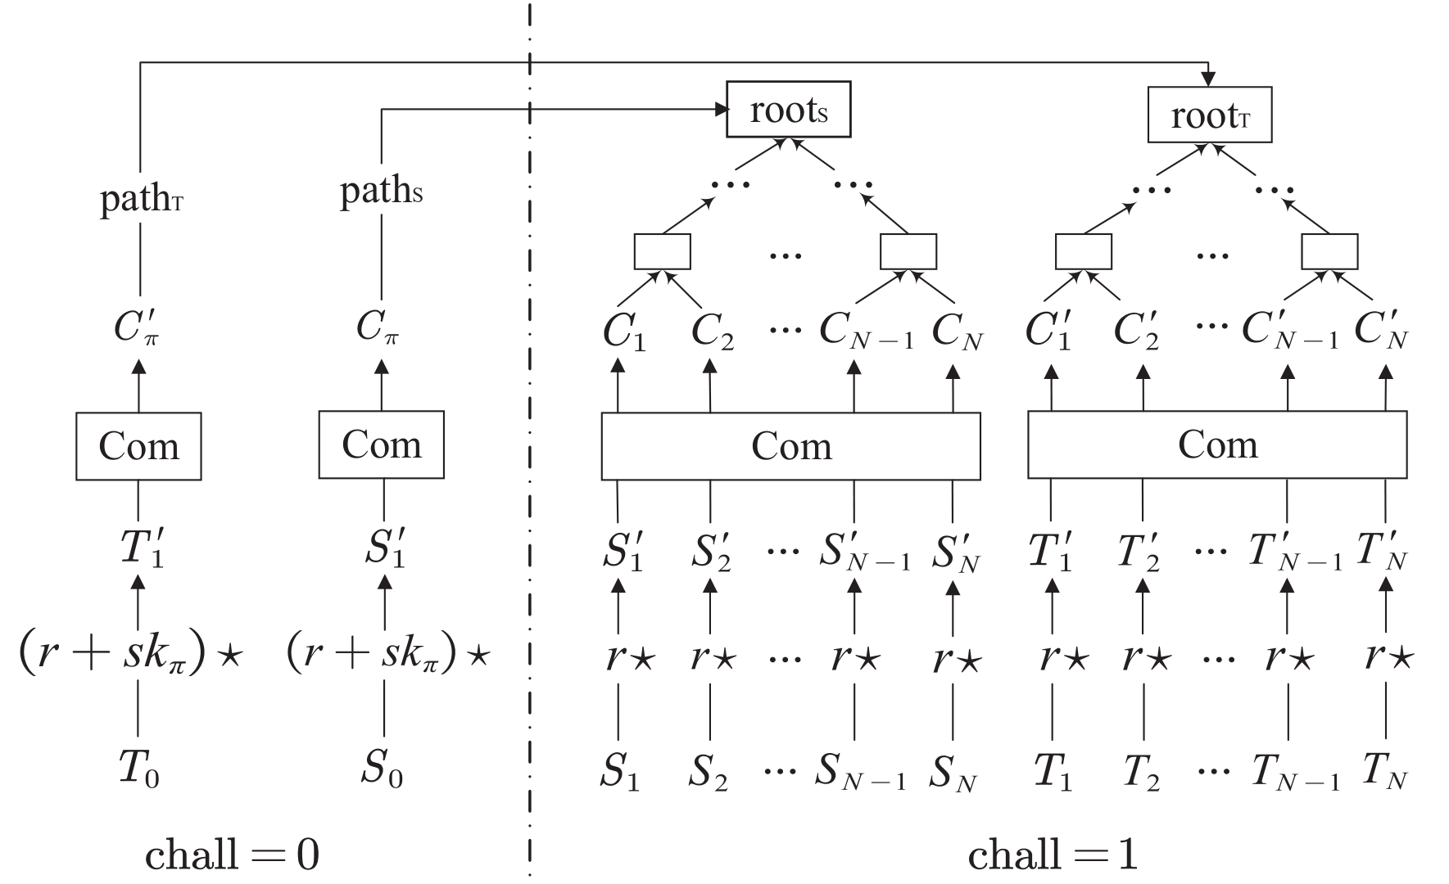

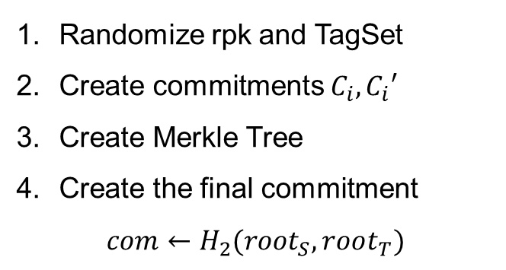
Construction — OR sigma protocol
Prover
com
Verifier
chall
rsp
3
Commitment
2
Randomize rpk and TagSet
Create commitments $C_{i},C_{i}′$
Create Merkle Tree
Create the final commitment
$$com←H_{2}(root_{S},root_{T})$$
1
Challenge
$$chall←\{0,1\}$$

Slide 13
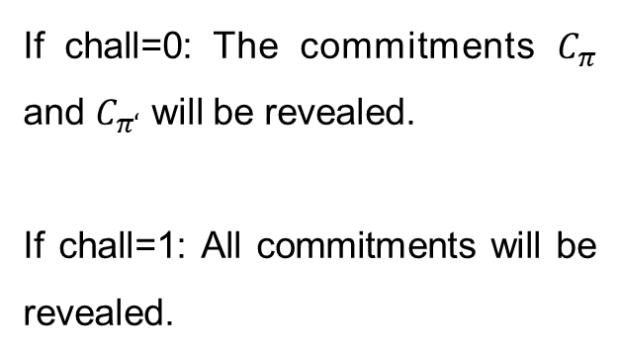
Construction — OR sigma protocol
Prover
com
Verifier
chall
rsp
Response
If chall=0: The commitments $C_{π}$ and $C_{π‘}$ will be revealed.
If chall=1: All commitments will be revealed.

Slide 14
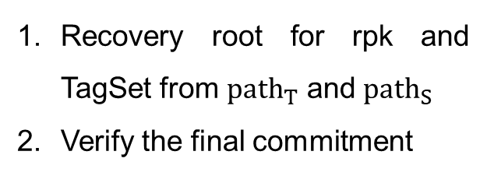
Construction — OR sigma protocol
Prover
com
Verifier
chall
rsp
Verification
If chall=0
Recovery root for rpk and TagSet from $path_{T}$ and $path_{S}$
Verify the final commitment
If chall=1
Recovery root from all commitments
Verify the final commitment

Slide 15
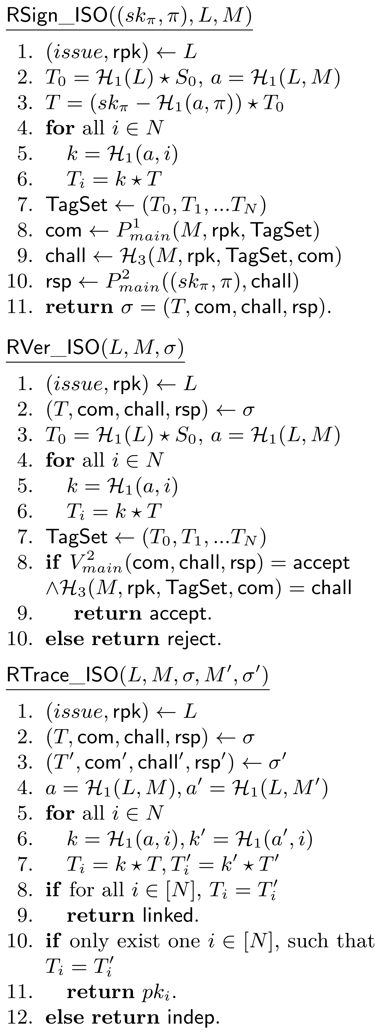


Construction — Isogeny-based TRS scheme
Generate Tag Set
Recover two Tag Sets
Add the tagSet to the OR-proof
Link /Trace two signatures
$H_{1}\left(a,π\right)⋆\left(\left({sk}_{π}−H_{1}\left(a,π\right)\right)⋆T_{0}\right)$= ${sk}_{π}⋆T_{0}=T_{π}$
Tracing the ring member $π$

Slide 16
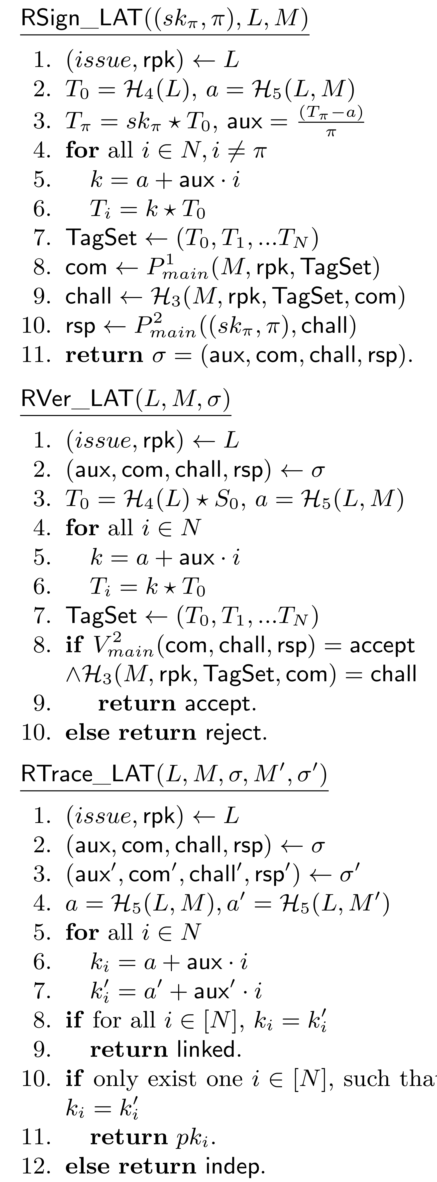
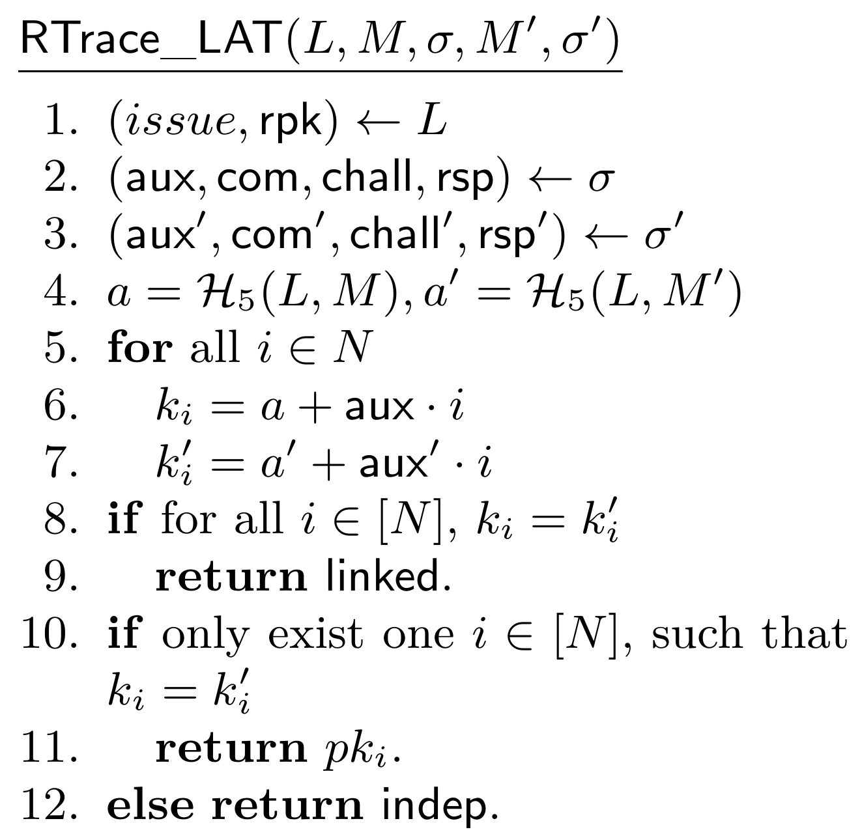


Construction — Lattice-based TRS scheme
Generate Tag Set
Recover two Tag Sets
Add the tagSet to the OR-proof
Link /Trace two signatures
$\left(a+\frac{T_{π}−a}{π}⋅π\right)$= $T_{π}$
Tracing the ring member $π$

Slide 17
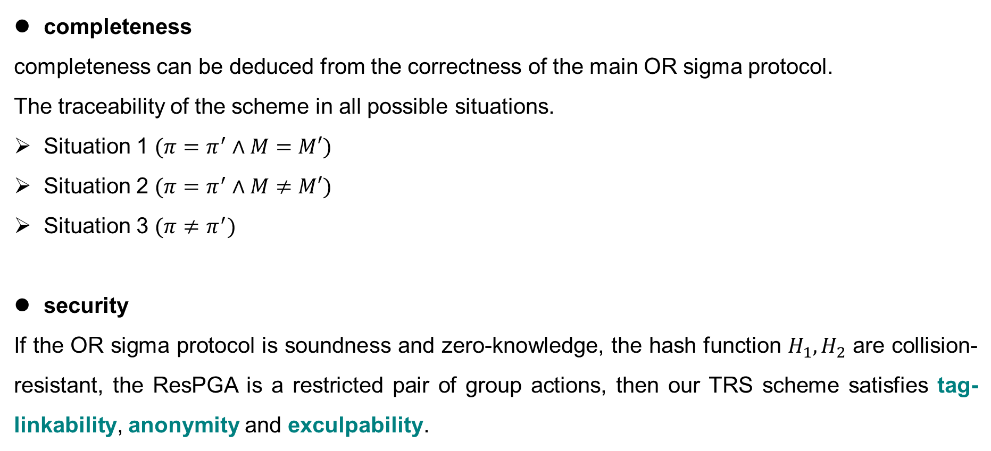
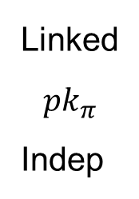
Analysis — Correctness
completeness
completeness can be deduced from the correctness of the main OR sigma protocol.
The traceability of the scheme in all possible situations.
Situation 1 $(π=π^{′}∧M=M′)$
Situation 2 $(π=π^{′}∧M≠M′)$
Situation 3 $(π≠π^{′})$
security
If the OR sigma protocol is soundness and zero-knowledge, the hash function $H_{1},H_{2}$ are collision-resistant, the ResPGA is a restricted pair of group actions, then our TRS scheme satisfies tag-linkability, anonymity and exculpability.
Linked
$$pk_{π}$$
Indep

Slide 18
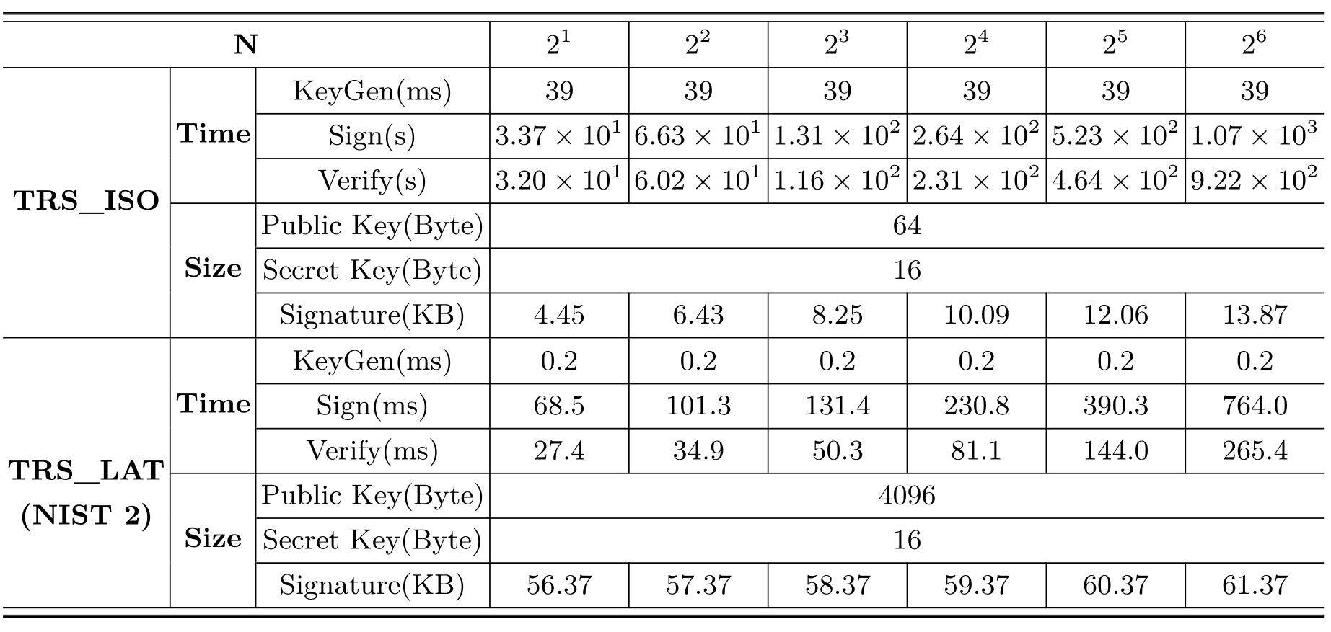
Analysis — Performance

Slide 19
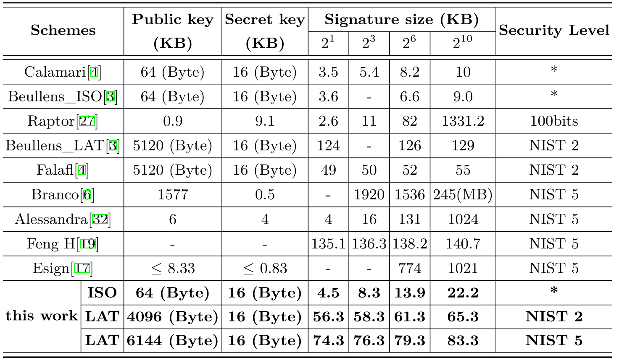
Analysis — Performance

Slide 20
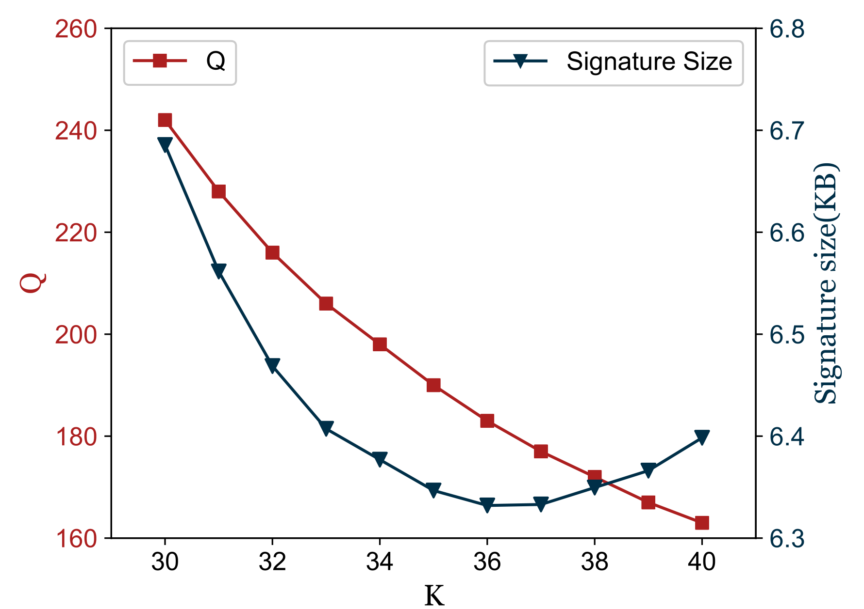
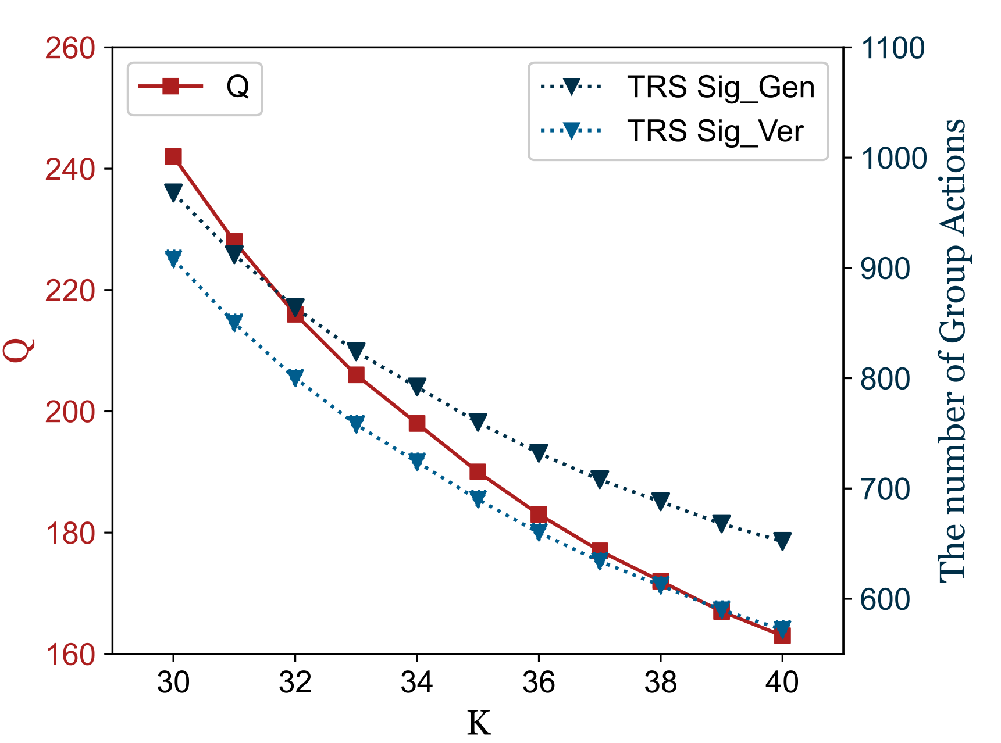
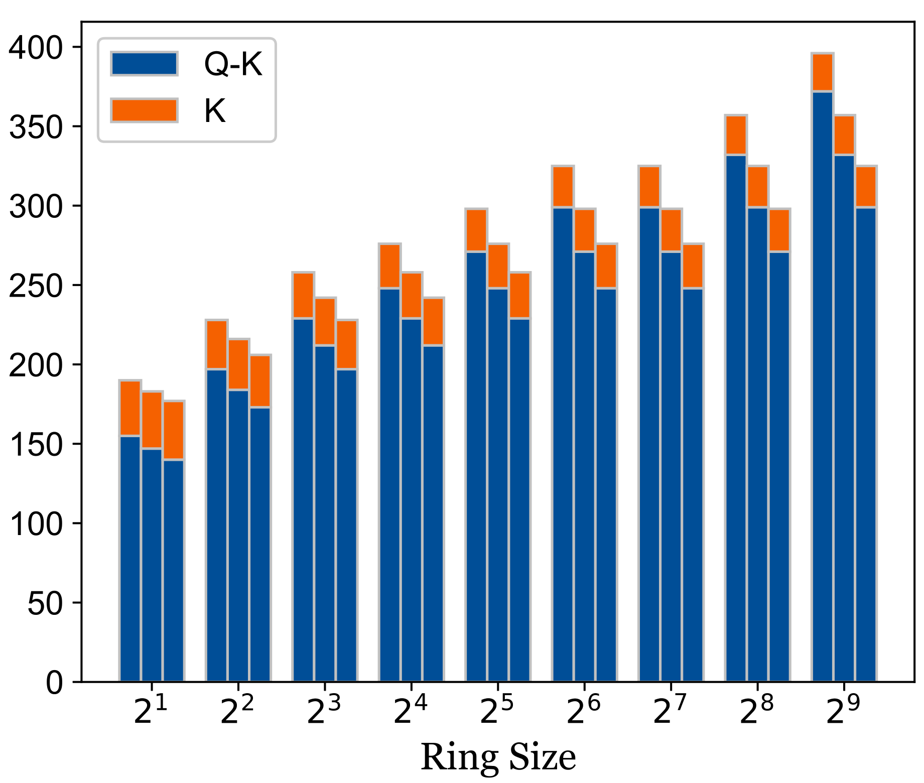
Analysis — Flexible
When $\left(\begin{aligned}Q \\ K\end{aligned}\right)>128$, the TRS scheme offers flexible customization of signature size and time for signature generation and verification.
The smaller the value of Q is, the less time it takes for signature generation and verification.
three optimal (Q,K) pairs under different ring sizes
the minimum signature size is obtained when K = 36

Slide 21
Conclusion
A general traceable ring signature scheme is constructed.
The first traceable ring signature scheme from isogeny is implemented.
The signature size is logarithmic, the signature size and signing time are flexible.
Futher topic:
Reducing the number of group actions to minimize computational costs and extending the technique to other signature schemes.

Slide 22
Thanks!
Q&A

