Slide 1


LOCATION DATA MANAGEMENT
EXPLORING USE CASES TO ENHANCE VALUE AND EFFICIENCY

Slide 2
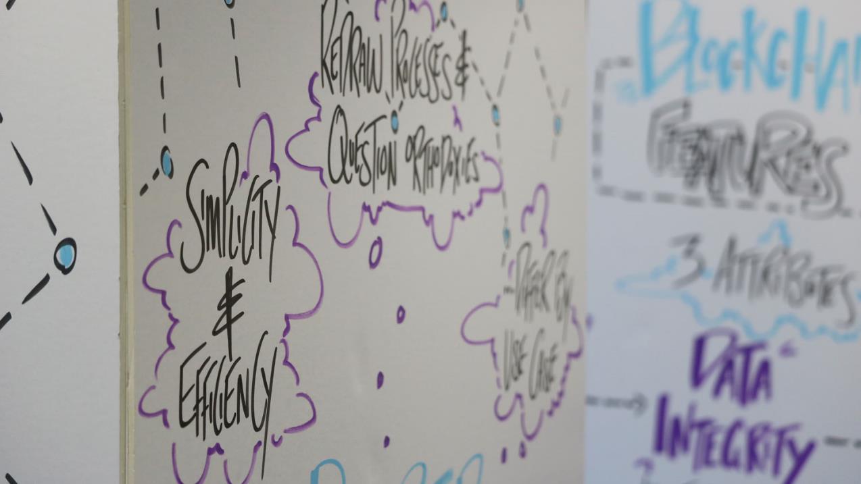
IDEATION PHASE ASE EVENT OBJECTIVES
Identify, define and prioritize a short list of DLT use cases for the Location Data Management process.
Select best use case from the short list and create high-level design of POC.
Determine the roadmap going forward and immediate key next steps.

Slide 3
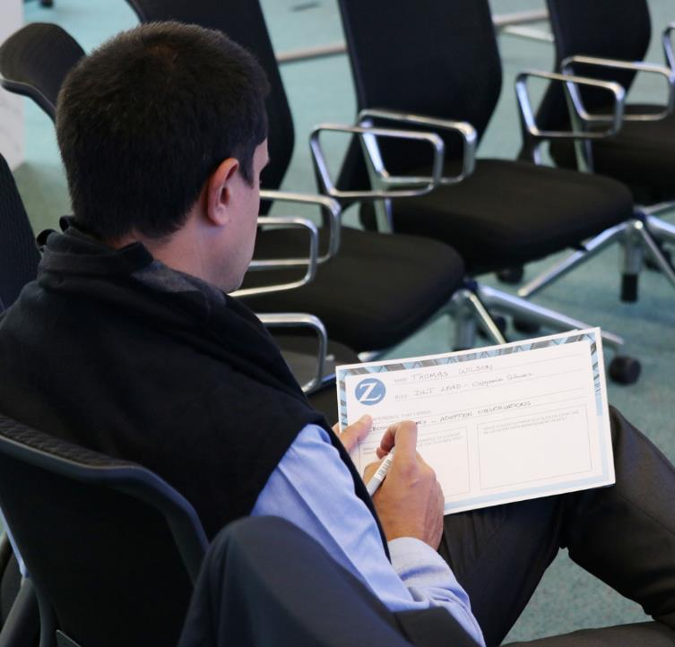
PARTICIPANTS
Susan Fallon
Claude Haueter
Stefan Fadler
Bart van den Broeck
Ertekin Aydemir
Tony Wainner
Armin Schäfer
Chong-Gu Ra
Michael Bischof
Franziska Klaus
Thomas Wilson
Hans-Peter Högger
Damien De Chillaz
Kevin Tran
Pierre Schuffenecker
Jouke Stuiver
Roman Banwhat

Slide 4
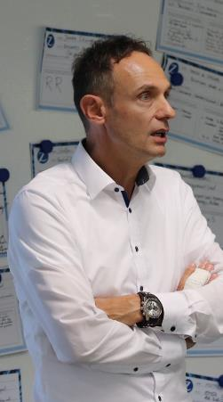
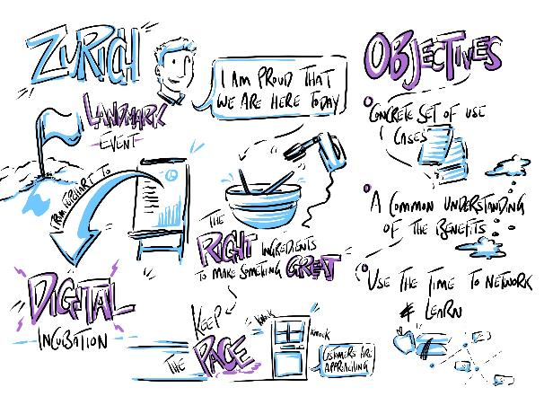
“I am excited to be here! For me and for commercial insurance this is a landmark event. When you think about where we started, we have come from three of us sat around a flipchart in Tony’s office to here, three months later…”
ARMIN SCHAEFER

Slide 5
“…We recognise that we are good at delivering big projects, but we know that we are still missing that gene to drive digital incubation and innovation. Following our meeting with Tony, we created a couple of slides, went to the Steering Committee, got approval for our plans and received some money. This is good evidence that the Steering Committee are keen to drive a digital agenda.
I want to start with a thank you to the business SMEs; thank you for freeing up your time for us to have these conversations and support us in this journey. There has been an enormous amount of engagement from the Business SMEs over the past couple of months. It is also fantastic to have a sponsor with us today too. There is a lot of experience in the room with us here this evening; we should leverage this for our benefit. I’m also very proud that we are here and that we are starting to make this happen.
The discussions so far have been engaging and challenging and they have created the perfect ingredients for a successful event and a successful incubation stage.”

Slide 6
…”We cannot understate how much of an important step we are taking. We want to reduce the distance to the customers using technology; this is going to be one example of how this could happen using the right technology levers.
We are aware that we don’t have any customers with us in the room and we know this is not ideal. We have had customers knocking on the door asking to add their views to this piece of work but in the second step we will bring the voices of the customers and the brokers to the table to drive towards a more detailed prototype or an incubation.
In terms of what we want to get out of today and tomorrow, it is absolutely key that when we walk out of here we have identified a concrete set of use cases that we see being viable to be taken to the next step (a prototype). Or, on the other hand, we must conclude that none of what we have seen will become a viable prototype. We should also achieve a common understanding of the benefits of these things. We should be able to rate and bundle them to take them into the next stage of ideation to make them happen.

Slide 7
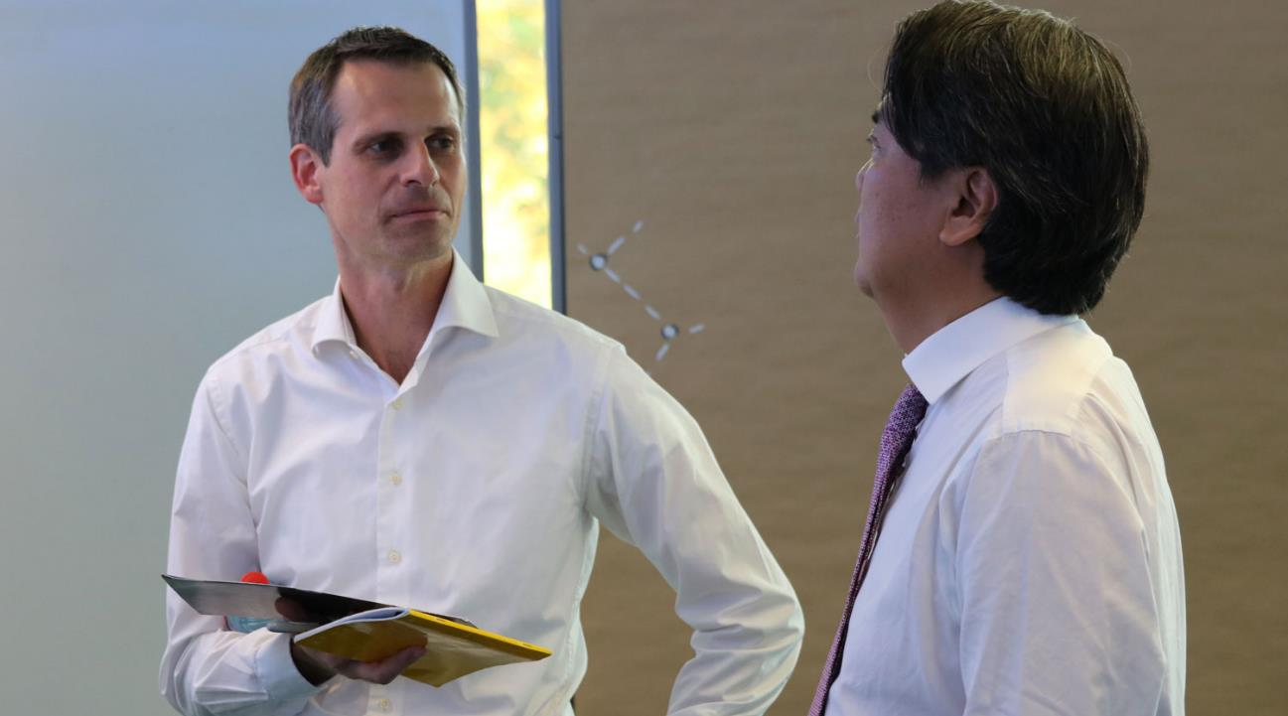
…”I would urge you to use this time to network, ask each other questions, free up your minds and learn from each other in order to have some fun – lets kick this off!””

Slide 8

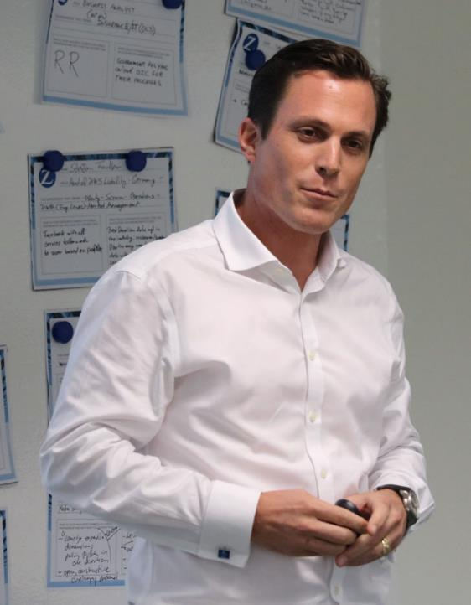
CURRENT AND FUTURE STATE OF DISTRIBUTED
LEGER TECHNOLOGIES IN INSURANCE
DAMIEN DE CHILLAZ

Slide 9
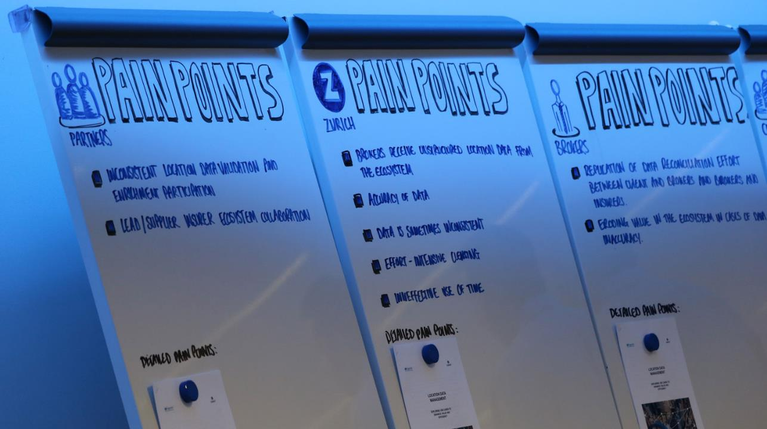
FLESHING OUT THE LOCATION DATA MANAGEMENT PAIN POINTS & BENEFITS

Slide 10
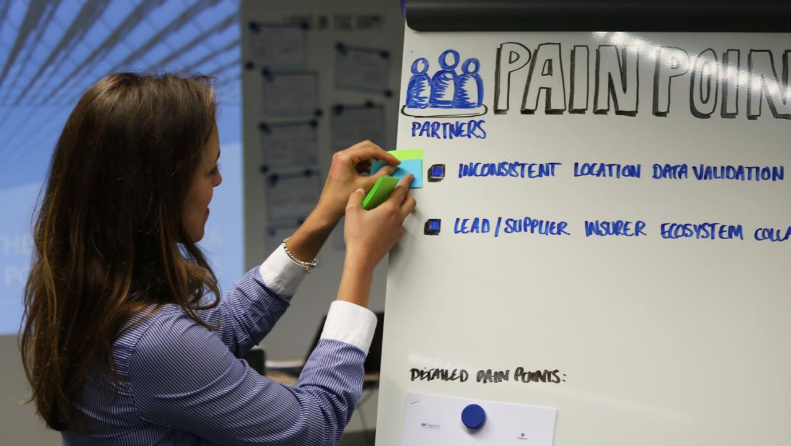
REPORT OUT

Slide 11
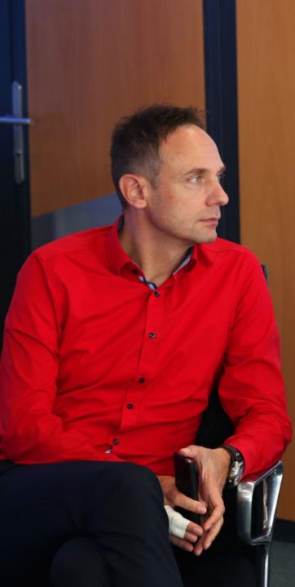
 |  |  | SHARED TRUTH | DATA INTEGRITY | PROCESS AUTOMATION
GROUP 1 | BENEFITS THAT ENHANCE A PROCESS | Standard data model
 |  | Faster straight through processing
 |  | Transparency
 |  | Reactivity
 |  | Aggregation
 |  | Loss Prevention
 | BENEFITS THAT ENHANCE THE TRANSFORMATION PROGRAMME | Potential to differentiate Zurich Insurance in the marketplace
 |  | Learning and enhancing technical skills (tools of innovation)
 |  | The ability to pioneer
 |  | Improved ease of use (internal and external customer experience)
 |  | Scalability (foundation proprietary model)
 |  | The added value of better data
 |  | More accurate pricing, reducing % of unknowns
 | ZURICH | Brokers receive unstructured location data from the ecosystem |  | Data Integrity
 |  | Accuracy of the data and completeness | Shared Truth
 |  | Data sometimes inconsistent | Shared Truth | Data Integrity
 |  | Effort intensive cleansing | Shared Truth |  | Process Automation
 |  | Ineffective use of time (broker delivers data late)
 | COMMON | No living view of location data | Shared Truth
 |  | Acceptance of standards different understanding, not self explanitory |  | Data Integrity | Process Automation
 |  | Duplication of effort through the ecosystem | Shared Truth |  | Process Automation
 |  | Control over public/private location data exposure | Shared Truth
 |  | Traceability to the last editor | Shared Truth | Data Integrity
 | PARTNERS | Inconsistent location data validation and enrichment participation | Shared Truth | Data Integrity | Process Automation
 |  | Delay due to back and forth (push back) | Shared Truth | Data Integrity | Process Automation
 |  | Lead/supplier insurer ecosystem collaboration

Slide 12
GROUP 2 | BENEFITS THAT ENHANCE A PROCESS | Standard data model |  | Data Integrity
 |  | Faster straight through processing | Shared Truth |  | Process Automation
 |  | Transparency | Shared Truth
 |  | Reactivity |  |  | Process Automation
 |  | Aggregation
 | BENEFITS THAT ENHANCE THE TRANSFOMATION PROGRAMME | Potential to differentiate Zurich Insurance in the marketplace | Shared Truth
 |  | Learning and enhancing technical skills (tools of innovation) |  |  | Process Automation
 |  | The ability to pioneer (industry market place) |  |  | Process Automation
 |  | Improved ease of use (internal and external customer experience) |  |  | Process Automation
 |  | Scalability (foundation proprietary model) |  |  | Process Automation
 |  | The added value of better data | Shared Truth
 |  | To enable new business models and new products for Zurich to better serve customers
 |  | To improve Zurich's financial results through monetisiation
 | BROKERS | Replication of data reconciliation effort between client and brokers, and brokers and insurers | Shared Truth
 |  | Eroding value in the ecosystem in cases of dat a inaccuracy |  | Data Integrity
 |  | Reducing manipulation of data | Shared Truth | Data Integrity
 |  | Opportunity: Faciolitating facilities (mixed facilities)
 | CUSTOMERS | Customers have problems linking insurer policy data with information they originally send | Shared Truth | Data Integrity
 |  | Multiple tools (their own and some from Zurich) do not integrate | Shared Truth |  | Process Automation
 |  | Reconciliation/linkage of coverage with brokers and insurers across their portfolio/requirements
 |  | Direct access to customer location data
 |  | Reducing manipulation of data | Shared Truth | Data Integrity
 |  | Cyber (preventative/proactive production scheduling, impact prevention) insurer driven.
 |  | Unknown location % reduction in portfolio
 |  | Identity of the building. Enrichment that drives customer value (Satellite/other) (Private/Public)

Slide 13
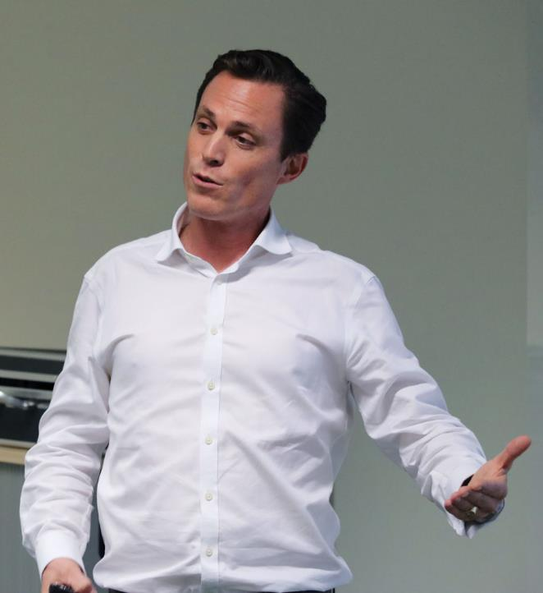
WHAT IS A USE CASE?
DAMIEN DE CHILLAZ

Slide 14
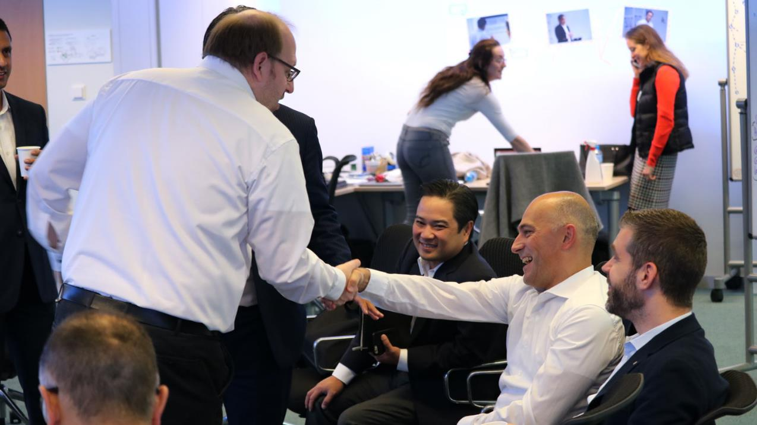
DAY TWO

Slide 15
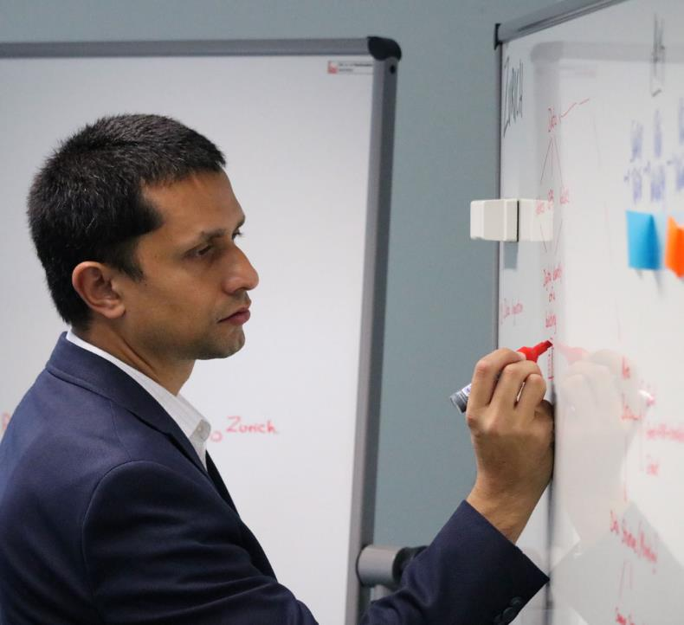
ADDING DETAIL AND PRIORITISING TO THE USE CASES

Slide 16
ADDING DETAIL TO OUR USE CASES
USE CASE TITLE: Structured “data in”
DETAILED DESCRIPTION:
Agreeing on closed system participants
Managing multiple sets of unstructured data
Easy validation [plausibility and completeness]
Customer interface that is smart
Unstructured feed of data
Structured data feed
Bring data in
Validation: automatic geo-coding
+ cleansing
Outcome: Data in the DLT and it’s shared
VALUE FOR STAKEHOLDER INVOLVED
WHAT PAIN POINTS DOES THIS ADDRESS?
Inconsistency of data
Delay
Ineffective use of time.
WHAT BENEFITS DOES THIS USE CASE DRIVE?
Data Integrity
Faster
Efficiency
Accessibility/self service
Real time
X
X
BROKERS
ZURICH
PARTNERS
THIRD PARTIES (FOR DATA VALIDATION)
X
CLIENTS
RISKS/CHALLENGES:
Customer behaviour
Simplify it
Incentivisation for client to use template
Broker (few to lose influence) layer influences contract between Broker → Customer, or Zurich → Customer, or Zurich → Broker → Customer.
ADDITIONAL CONSIDERATIONS
Use case 2 + 3 = natural progression
Offer geo-code tool where possible.
New data renewal/change data

Slide 17
ADDING DETAIL TO OUR USE CASES
USE CASE TITLE: Cleansing
DETAILED DESCRIPTION:
Cleansing → data completion, correction (Zurich, Customer), ideally automated, parts might be covered
Geo-coding
Allow ‘check’ during “data in” phase,
Outcome: digital building I.D.
STAKEHOLDERS INVOLVED
WHAT PAIN POINTS DOES THIS ADDRESS?
Efficiency (no delays)
Accuracy
WHAT BENEFITS DOES THIS USE CASE DRIVE?
More accurate pricing
X
ZURICH
BROKERS
X
X
PARTNERS
THIRD PARTIES (FOR DATA VALIDATION)
X
CLIENTS
RISKS/CHALLENGES:
Bulk upload exception
ADDITIONAL CONSIDERATIONS
Balance → how much to impose on customer to provide data → don’t scare/annoy them
Non-complete flag.

Slide 18
ADDING DETAIL TO OUR USE CASES
USE CASE TITLE: Consensus
DETAILED DESCRIPTION:
Digital data shared with ecosystem → agree OT
Agree → Certified on chain (unmutuable) disagree
Disagree → return to cleansing
STAKEHOLDERS INVOLVED
WHAT PAIN POINTS DOES THIS ADDRESS?
Recognition of own data
Less replication
WHAT BENEFITS DOES THIS USE CASE DRIVE?
One source
Trusted data
Ownership
Closer to client
One identity
X
X
BROKERS
ZURICH
X
PARTNERS
THIRD PARTIES (FOR DATA VALIDATION)
X
CLIENTS
RISKS/CHALLENGES:
Delay / deadline
Hesitation of client to agree/give consensus agreement
Disagree = exception case by case
ADDITIONAL CONSIDERATIONS

Slide 19
ADDING DETAIL TO OUR USE CASES
USE CASE TITLE: Updated Data Alerts
DETAILED DESCRIPTION:
Update: new data/change → causes alert → trigger (cleansing or consensus or change policy)
Alerts → need to be defined [need to know basis]
Former data remains (archive)
Out of scope:
Notification: trigger for the other processes
Consideration/action
Change policy or not?
Smart contract
STAKEHOLDERS INVOLVED
WHAT PAIN POINTS DOES THIS ADDRESS?
Inefficient use of time
Misunderstanding of data
No living view
WHAT BENEFITS DOES THIS USE CASE DRIVE?
Act proactively
Efficiency
Flexibility for customer
Living view/shared view
Real time
Agreement and understanding
Contract certainty of data.
X
X
BROKERS
ZURICH
X
PARTNERS
X
THIRD PARTIES (FOR DATA VALIDATION) (if cleansing)
X
CLIENTS
RISKS/CHALLENGES:
Hyper activity – too many too early reactions
ADDITIONAL CONSIDERATIONS
Any change is documented and time stamped
Writing rights for changes of data
No simultaneous change of data (check in → check out)

Slide 20
ADDING DETAIL TO OUR USE CASES
USE CASE TITLE: Market standard for Location data
DETAILED DESCRIPTION:
Open source
Being the standard platform for the ecosystem
Build an industry standard that works for the customer
Define the right amount of ‘standard’ attributes
STAKEHOLDERS INVOLVED
WHAT PAIN POINTS DOES THIS ADDRESS?
WHAT BENEFITS DOES THIS USE CASE DRIVE?
ZURICH
BROKERS
PARTNERS
THIRD PARTIES (FOR DATA VALIDATION) (if cleansing)
CLIENTS
RISKS/CHALLENGES:
ADDITIONAL CONSIDERATIONS
Customer centric approach
Go big → for whole industry
Or go small or selected group
What do we do next with or without stakeholders and with how many to start with?

Slide 21
ADDING DETAIL TO OUR USE CASES
USE CASE TITLE: Interface Insights (risk, value enhancing)
DETAILED DESCRIPTION:
Use feed for own services/systems
GUI (graphic user interface) “dashboard” allowance different _____ (headquarter, subsidiaries) -> value add, self risk assessment, add what already exists)
API (different per stakeholder)
Feed of “value add” – insights (risk warnings insights)
STAKEHOLDERS INVOLVED
WHAT PAIN POINTS DOES THIS ADDRESS?
Efficiency
Lack of understanding
WHAT BENEFITS DOES THIS USE CASE DRIVE?
Real time data availability
Benefit of a preparation add more 3rd party services
Full view of data for head quarter
Continue info/knowledge
X
X
BROKERS
ZURICH
X
X
PARTNERS
THIRD PARTIES (FOR DATA VALIDATION) (if cleansing)
Interface & access
X
CLIENTS
RISKS/CHALLENGES:
Info not of intent ___ assumption about what the customer wants and how
Complicated interface/user unfriendly
Exposure to more competition
ADDITIONAL CONSIDERATIONS
Value add -> tbd fee
Small customers = standard view large customer
Use what we have
Extra feed of data + consumption of data
Risks insights: additional risk view/ “zoom” in risk exposure per location

Slide 22
ADDING DETAIL TO OUR USE CASES
USE CASE TITLE: Change in Ecosystem
DETAILED DESCRIPTION:
Ecosystem includes multiple insurer → 1. steps within broader ecosystem map changing relationship changes in view/access right no need to delete data
2. Leaves ecosystem: data stays but no more update
Client leaves and comes back years later location ID continues to build during no years (e.g. about environment of location -> e.g. Earthquake risk)
STAKEHOLDERS INVOLVED
WHAT PAIN POINTS DOES THIS ADDRESS?
Start from scratch
When re-onboarding
WHAT BENEFITS DOES THIS USE CASE DRIVE?
Easy exchange of public data
Faster “re-onboarding”
X
X
BROKERS
ZURICH
X
THIRD PARTIES (FOR DATA VALIDATION) (if cleansing)
X
PARTNERS
Public data = owned by everyone the depending on your view
X
CLIENTS
RISKS/CHALLENGES:
Broker to have the richest view -> already the case today
Competitors have no interest in sharing data -> only with consensus of ecosystem
Info you receive = output od previous insurers
ADDITIONAL CONSIDERATIONS
In your portfolio -> you look at your customer
Not in portfolio -> you look at building
For more analytics utilize data available also competitors
The ledger not Zurich’s font ep the ecosystem with multiple insurers

Slide 23
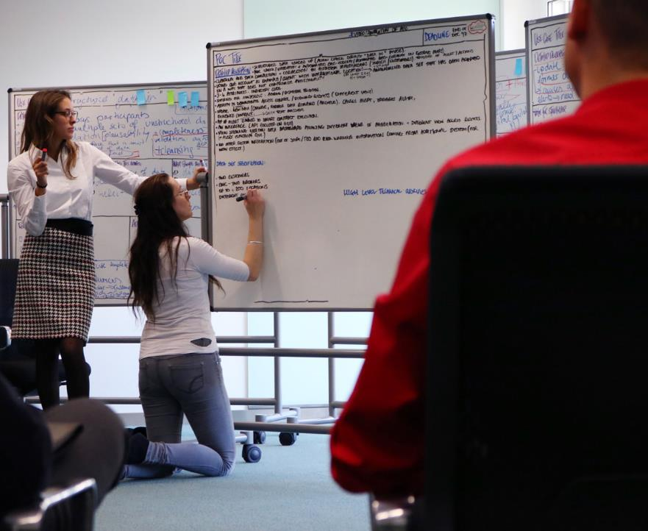

Slide 24
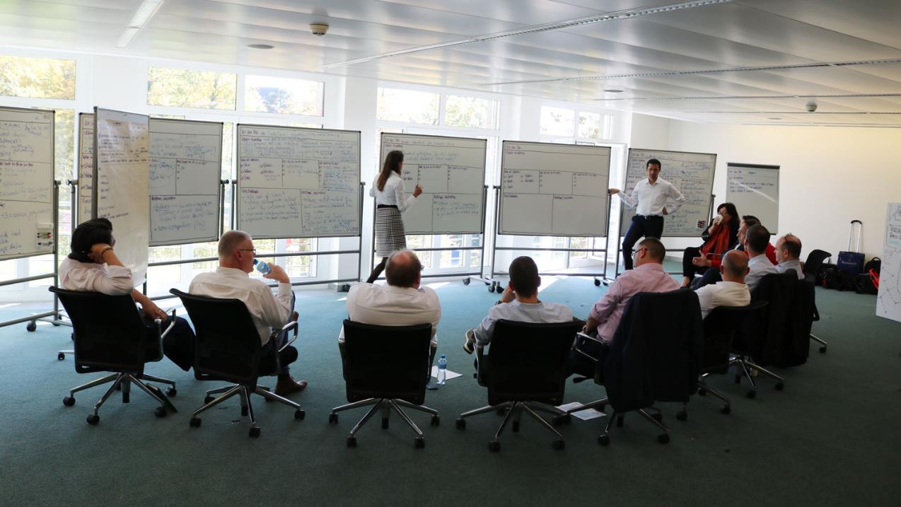

Slide 25
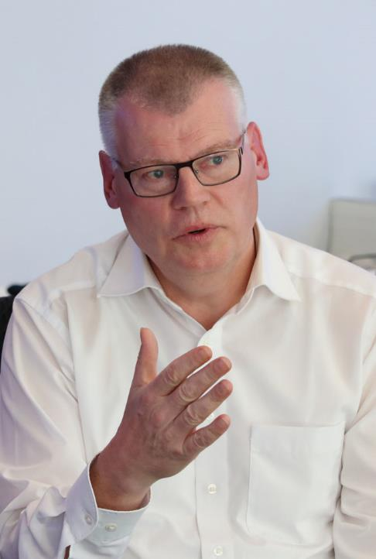
POCs

Slide 26
POC BLANK TEMPLATE
POC TITLE:
DEADLINE: End of Dec ‘17
DETAILED DESCRIPTION:
Structured data loaded up (checked during “data in” phase)
Pre check/validation and automated geo-coding (automated geo-coding in google maps)
Cleansing and data completion and correction by ecosystem stakeholders (Zurich/customers) triggered of alert/actions
Using one account as example/client with international locations -> + 3rd party anonymised data set that has been adapted in a way that does not compromise functionality
3-4 attributes – industry code
Sharing for consensus: agree/disagree trigger.
Ability to demonstrate access control/viewing rights (different views)
Update: 1 location new data/change, former data remains (archive. Causes alert, triggers alert, renewed contract.
Pop up alert cleared to smart contract execution
An interface (API focused on GUI)
View showing location data dashboard allowing different views of aggregation and different view access rights (+alert function GUI)
No other system integration (out of scope/ TBD add risk warning information coming from additional system (for wow effect)
DATA SET SPECIFICATION:
Two customers (customer name hidden)
One – two brokers
Up to c. 200 locations
Different continents (two different standards of addresses)
HIGH LEVEL TECHNICAL OVERVIEW:
Web GUI
Blockchain
Some API stub
Logins (username/password)
Full security compliance
No integration layer/no single sign on
Capgemini cloud
7-10 nodes on a blockchain
Hyperledger (but this is not fixed)
Easy access over the internet (online version)
Offline version
Desktop web device (no mobile)

Slide 27
POC BLANK TEMPLATE
TBC from Capgemini Team
Cost
Benefits
Outcomes
Ease of implementation/complexity
How we will deliver/approach (delivery) timeline
Likely delivery time

Slide 28
BIG LEVERS
BIG LEVERS
FTE reduction
3rd party India
Enhanced value to customer
Release of time
Closer to customers
Facilitation/easier process
Stay operational feasible
Facility case
How much faster?
Visibility = improvement for all
Try to test and learn/measure data extrapolate what the POC shows
? Cost today of location data management
Leakage management
Number o unknown data?
Issuance process and time effort remains

Slide 29
STAKEHOLDERS INVOLVED
STAKEHOLDERS INVOLVED
Zurich
Third Parties
Client
Customer
Brokers
Consider and answer at later stage
How to incentivise stakeholders to participate (→ running existing projects)
Opportunity to access new business.
NPS
ROI
Q
&
TOPI
NQ
NF
F

Slide 30
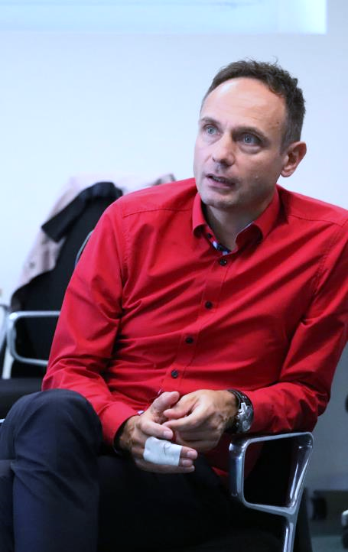
“I have found it very interesting to work with this many individuals with this many specialisms. I am very much looking forward to seeing what we come up with and how it will impact our future work. From what we have developed here, we know that we will expect some improvement from both a process and behavioural standpoint. The reality in Zurich is that we need to make information accessible to the client for free via a portal. This would enable us to actively influence our stakeholders. If this platform can steer the customer’s behaviour and provide more information more accurately, we will see great outcomes.
Currently, we know that we have about 50 accounts that are comfortable to handle. There are a large number of clients in location data management that we know will be easier to educate about the changes we intend to make. Smaller clients will be trickier, but this transformation will give us the opportunity to optimise current cases and give us the potential to access new business.
The past two days have been a great experience and we have had some very engaging discussions; there has been a good mix of different perspectives an experiences around the table. For me I’ve learnt a lot and I hope you can say that too. We have taken this topic a whole leap forward and although there is still a lot to be thought through and to be done, we now have a combined view and have identified what the potentials are.
Thank you to the Capgemini team for the set up that has contributed to a creative atmosphere. Thank you all for the discussion too; for is it is key that we shape this up and take the next week to do the work and bring it to the table so that we can start to engage the customer and brokers to explore this in more depth. I see the potential in this!”
CLOSING DOCUMENTATION

Slide 31
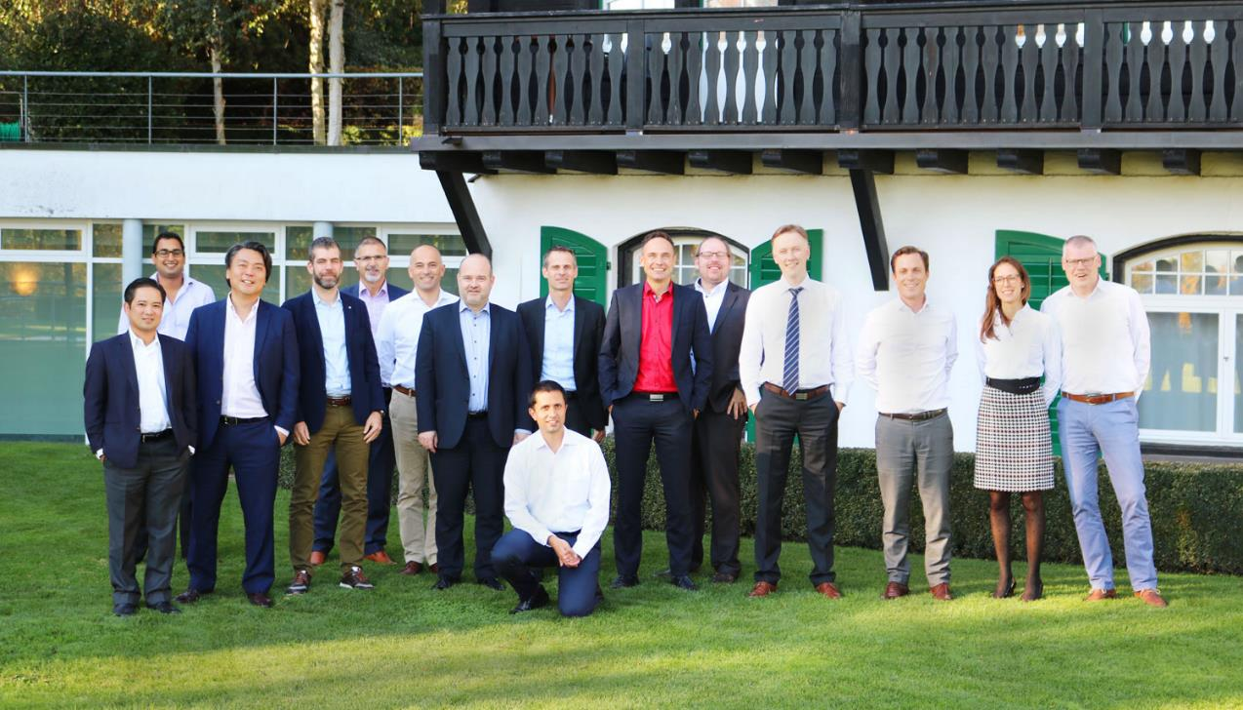
THANKYOU

