Slide 1
Continuous Architecture a vision
Sjaak Brinkkemper
January 2015

Slide 2

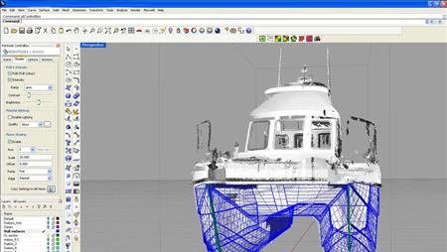
Observations in architecting
Traditional architecting disciplines have extensive documentation routines and practices
Architecture documentation is created during design and modified during redesign
When contemplating (re)design issues the architecture documentation is the central means for communication

Slide 3
Observations in software architecting
In the software industry there is no software architecture documentation available, only rudimentary sketches in out-dated hard to trace document snippets.
The software architect (tech lead, development manager):
Knows the complete architecture, but does not take time to document this.
Obtains status as the expert on the architecture
Is not willing to share this knowledge to maintain his status
Has communication difficulty
Other stakeholders dependent on the software architecture have severe difficulty in decision making.

Slide 4
Vision
All architectural decision making is performed on an up-to-date software architecture document
For which we need:
Automated updating
Simple models
Integrated models, code, reqs
Simple feedback communications with all stakeholders

Slide 5
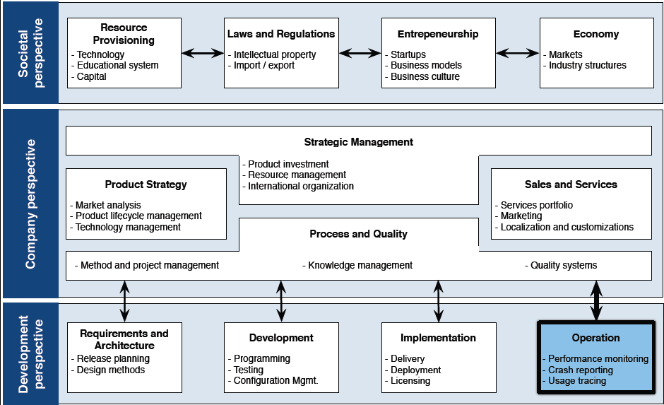
Research Framework for Software Production
Operation
Performance monitoring
Crash reporting
Usage tracing

Slide 6
Research Framework for Software Production
Scope of Continuous Architecting
Operation
Performance monitoring
Crash reporting
Usage tracing

Slide 7
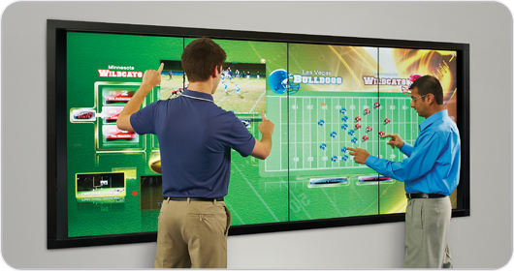
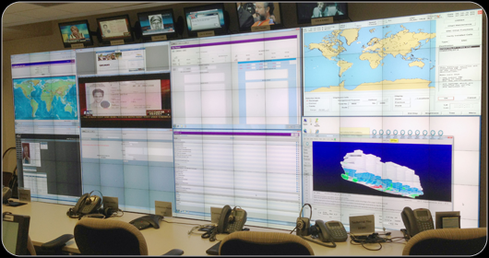
Requirements and Architecting on a Video Wall

Slide 8
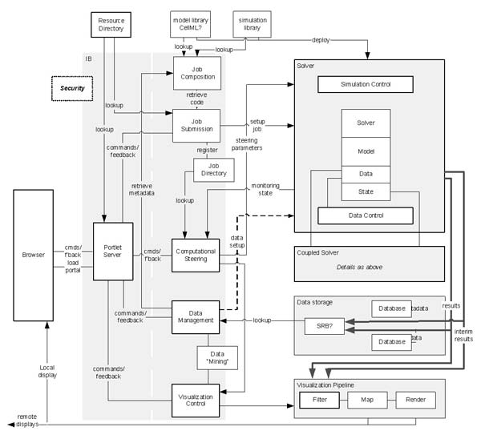
Descriptive: current architecture

Slide 9
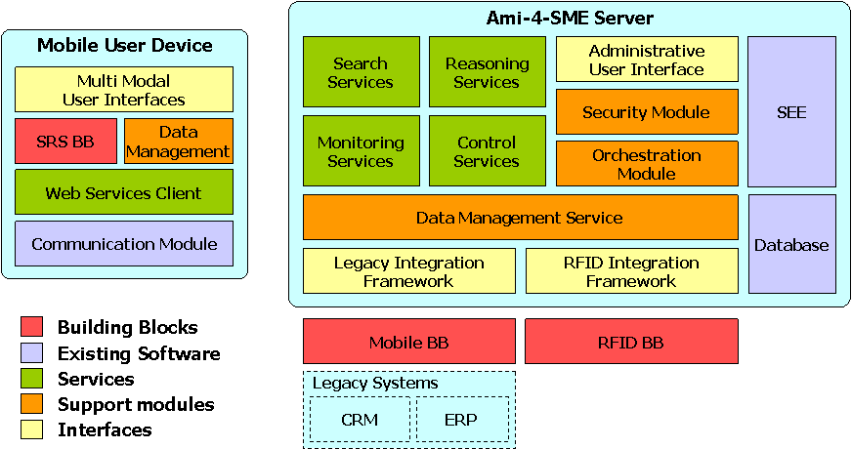
Prescriptive: Decision on Module allocation

Slide 10
Firefox architecture
Front-end
Localization
Gecko (layout engine)
MathML
JavaScript
Vector Graphics (SVG)
Document Object Model
Quality Assurance
MailNews
User Interface Language (XUL)
XULRunner
DocShell
Toolkit
Semantic Data Interchange (RDF)
Security
Cross Platform Components (XPCOM)
Mac OS X Development
Binary Plugins (including NPAPI)
Networking (Necko)
Exchange Language Binding (XBL)

Slide 11
Objectives
Simple visualizations of functional and technical viewpoints of software products
Technology agnostic
Always up-to-date; auto updating
Requirements impact analysis and visualization (functional and quality reqs)
Video wall as interaction means
Analysis, simulation, intelligence, mining
Interoperability, stakeholder feedback
Positioning defects, crappy code, work assignment
Release positioning, variability
Research program in software production

Slide 12
Four uses for architecture documentation
Education
Introducing people to the system
New members of the team
External analysts or evaluators
New architect
Primary vehicle for communication among stakeholders
Especially architect to developers
Especially architect to future architect!
Basis for construction
Architecture tells implementers what to implement.
Each module has interfaces that must be provided and uses interfaces from other modules.
Documentation can serve as a receptacle for registering and communicating unresolved issues.
Basis for system analysis
Architecture documentation serves as the basis for architecture evaluation, as-is and to-be

Slide 13
Notations
Informal notations
Views are depicted (often graphically) using general-purpose diagramming and editing tools (e.g. Powerpoint)
The semantics of the description are characterized in natural language
They cannot be formally analyzed
Semiformal notations
Standardized notation that prescribes graphical elements and rules of construction
Lacks a complete semantic treatment of the meaning of those elements
Rudimentary analysis can be applied based on rules for the notation
UML is a semiformal notation in this sense.
Formal notations
Views are described in a notation that has a precise (usually mathematically based) semantics.
Formal analysis of both syntax and semantics is possible.
Architecture description languages (ADLs)
Support automation through associated tools.
Usage is rare.

Slide 14
Functional Architectures
A functional architecture is an architectural model from a usage perspective
So the functional architecture should resemble the enterprise functions of the customer organisation or user context
Names of modules should resemble the names of enterprise functions
Flows in functional architecture resemble the interactions in the customer domain
Standard functional architecture is called Reference Architecture

Slide 15
Functional Architecture for ERP product
Bussiness Planning
Product Innovation
BusinessPlan
Product Information
Master Planning
Sales Forecast
Master Plan
Sales Order Ready for Assembly
PO/ Contracts/ Inquiries
Material Plan
Customer Request
Pur-
chase
Requirements Planning
Assem-
bly
Sales
Subcontracting
Material Plan
Invoiced Sales Order
Production
Progress
Packing and shipping order
Production
Orders/ schedules
FAS Order
Warehousing
Received Goods
Picking List
Picking List
Shipment order
Receipt &
Goods
Component
Manufact.
Assembly
Packing &
Shipping

Slide 16
Usage of the Functional architecture
Structure for processes in Software Product Management: Functional Architecture Framework (FAF)?
Consider practical issues like:
Roadmap: How to manage the product vision for future, subsequent releases?
Reqs gathering: How to register incoming requirements from customers and prospects?
Development mgmt: How to assign work to development teams?
Reqs organizing: How to manage large volumes of requirements in a distributed company?

Slide 17
Reality vs. Product
Function
Module
Processes
Features

Slide 18
User working scope
Example: Event Ticketing
booking
event request
Pay- ment
Ticket sales
Acqui- sition
payee interaction
ticket types
ticketing contract
banking details
event details
Contract management
terms of services
options
customer details
Legal
Merchandising
Customer Relationship Management

Slide 19
Notation of FAs
Module or sub-module: business function consisting of a set of continuous processes
Color is used for categorization
All words start with Capital
Flow: transfer of data between modules
all lower case
Scenario: continuous process
as overlay on EFD
Payment
ticket

Slide 20
Functional architecture
On-line Event Ticketing
Module
booking
event request
Pay- ment
Ticket sales
Acqui- sition
payee interaction
ticket types
ticketing contract
banking details
event details
Contract management
terms of services
options
customer details
Product scope
Information flow

Slide 21
FA on module level: Ticket sales
Visitor management
Event registration
event details
visitor details
Ticket selection
templates
package structures
payment details
Type management
ticket types
final ticket
booking
Pre-payment arrangement
ticket overview
Event reporting
reports
Ticket sales
Module scope
Sub-module

Slide 22
FA of Contract management
final contract
Sub-module
Contract baseline
contract version
ticket types
event details
Event administration
payee interaction
terms of services
option details
options
Options handling
Contract management
Module scope

Slide 23
Scenario
Visitor management
Event registration
event details
visitor details
Ticket selection
templates
package structures
payment details
Type management
ticket types
final ticket
booking
Pre-payment arrangement
ticket overview
Event reporting
reports
Ticket sales
Scenario
Sub-module

Slide 24
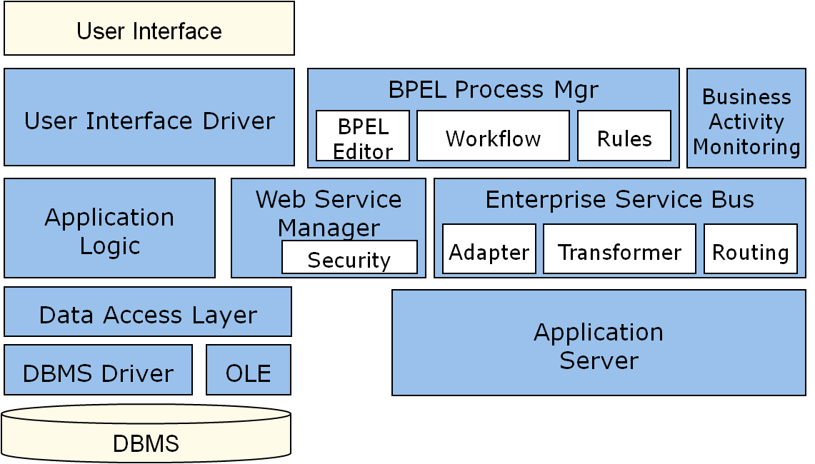
FA of Technical systems
FAs can also be provided for technical systems
Example:

Slide 25
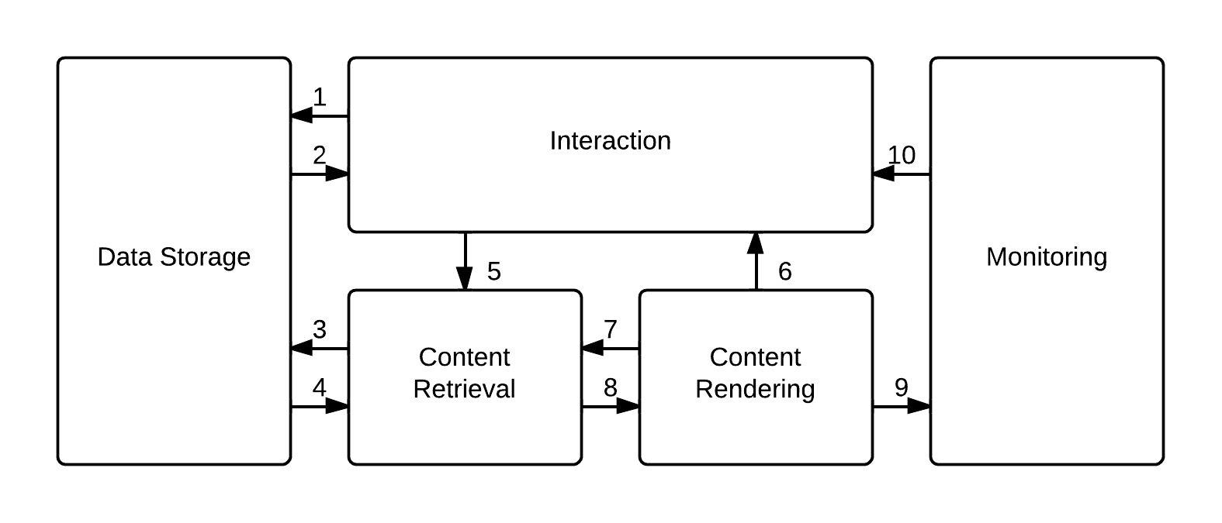
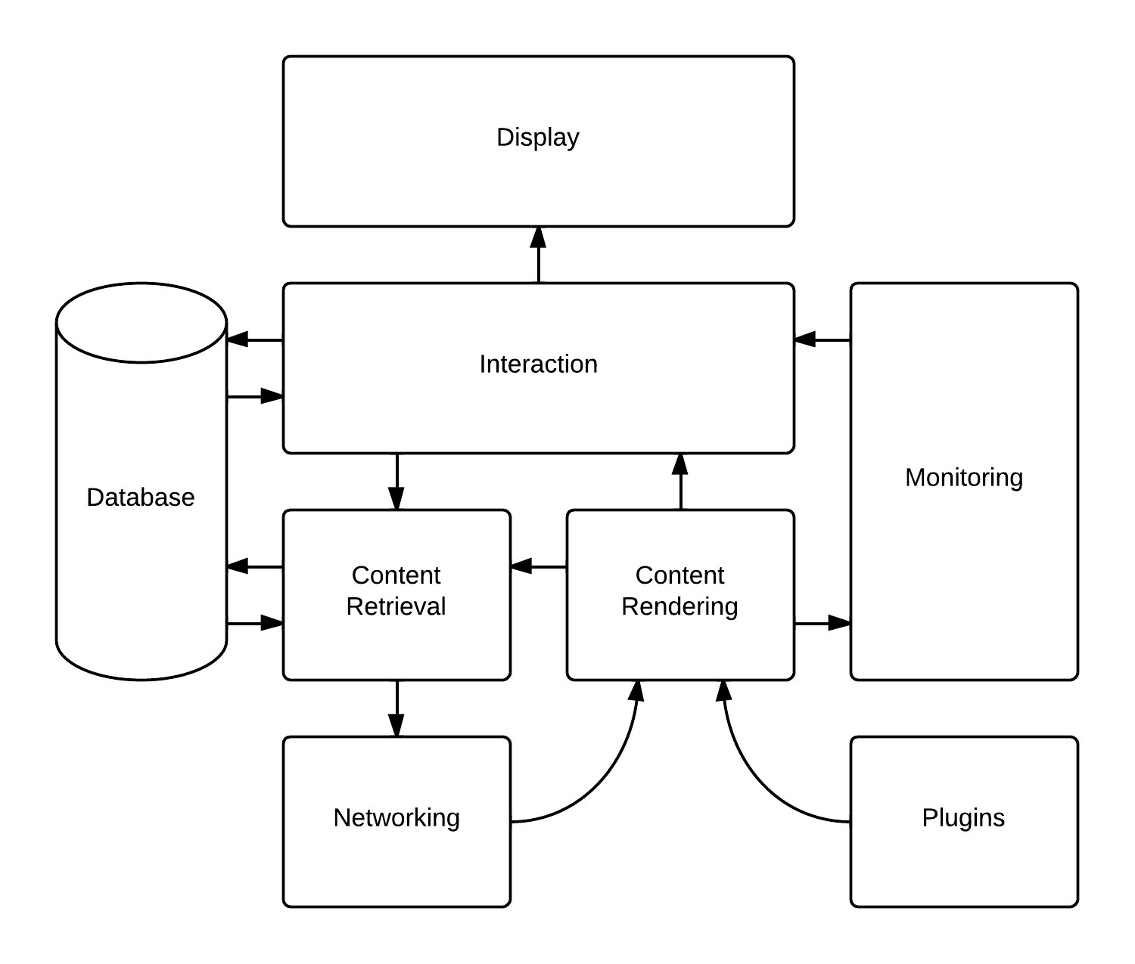
Case study: FA of a Chrome
Technical Architecture
Functional architecture
1. data storage requests
2. data storage data
3. request or store command
4. data receiving
5. user command
6 requested website data
7. additional data request
8. website data
9. check for correct behavior
10. error and security reports
Information flows

Slide 26
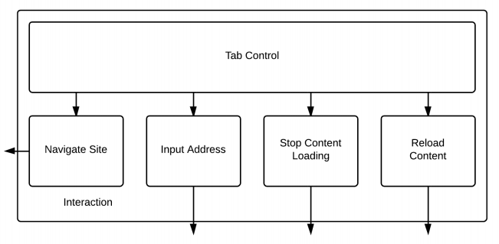
Modular decomposition

Slide 27
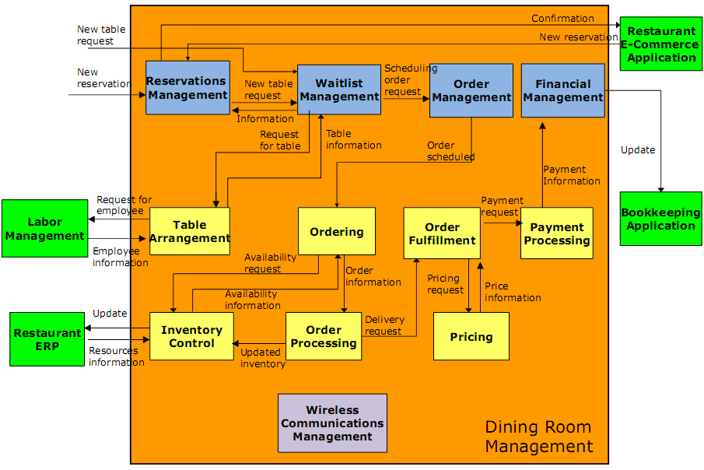
FA Restaurant Management
Notes:
Specify external to/from internal interactions
This step is related to the second step, where we had to identify the interactions between the product and external products. At this point we need to perform further analysis, to identify which of the modules will need to be interfaced with the external product for each request-feedback flow. It is possible that we may discover new modules at this stage which we had ignored in the previous steps. Also, for the sake of certain interaction we may need to add more interactions also amongst the internal modules of the product.
In figure 8 we can see the final FAD of the Dining Room Management application. All interactions from the external third party applications to the product's modules and vice versa are modeled in this step. The functions are triggered either by a new table request, which corresponds to a request of a customer who visits the restaurant without reservation, or by a new reservation request, which can be performed either by a customer directly or through a related e-commerce application.

Slide 28
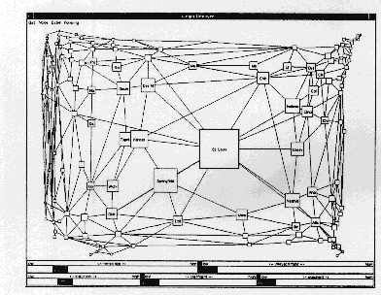
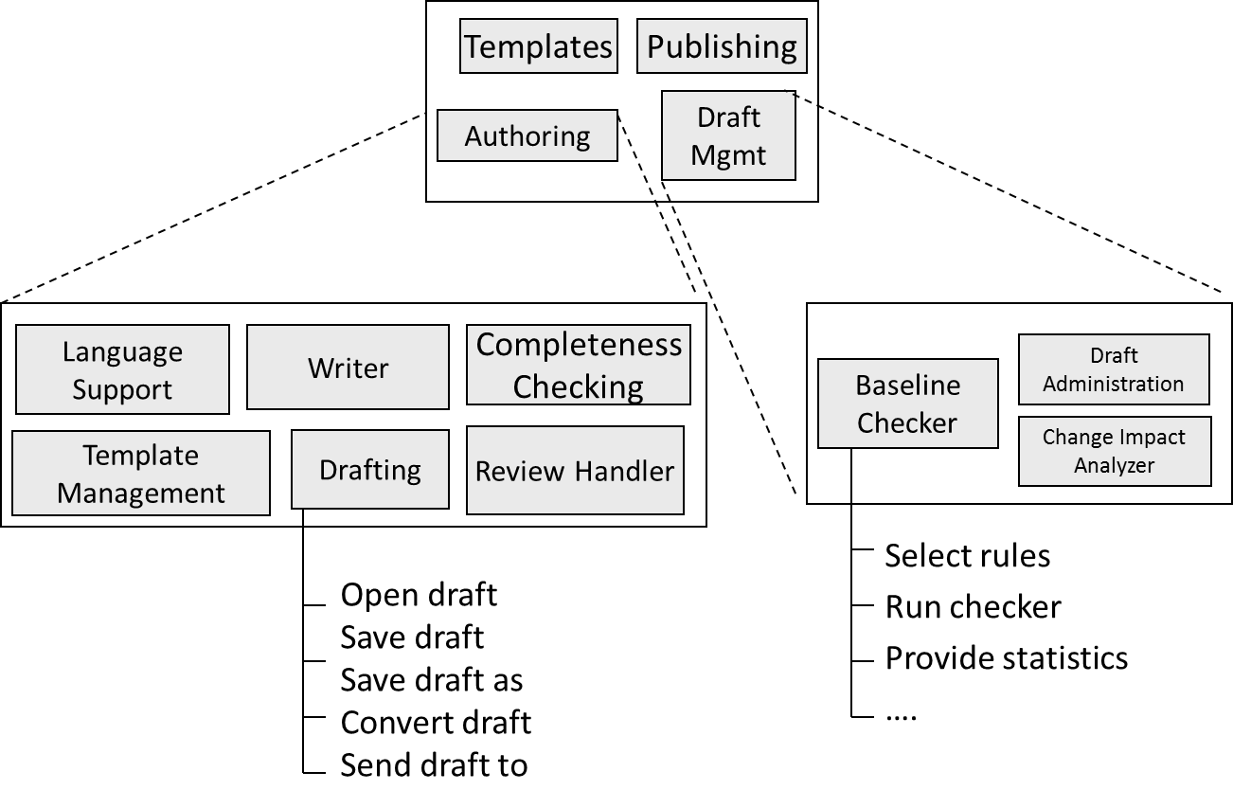
Notational variants of FA diagrams
Module
Natural
Boxed
Pillar
Hierarchy
Fish-eye
Flows
Named flows
Unnamed flows
Numbered
No flows

Slide 29
Pillar view FA
Sales
Service
Planning
Manufacturing
Distribution
E-Sales
Apropos
Order
Promising
PDM
Designer
SalesPlus
E-Service
Planner
MES
RoutePro
SalesPoint
E-Service
Remote
Demand
Planner
Scheduler
TransPro
Configuration
Service
Scheduler
TQM
BidPro
Enterprise Professional
ERP
Collaboration
Business Intelligence
Portal
Notes:
Project?
Distribution Solution is built on top of iBaan ERP Warehousing

Slide 30
Positioning
Control
Flow of execution progress

Slide 31
Reality vs. Product
Function
Module
Processes
Features

Slide 32
Functional Decomposition
The modules in a functional architecture are modelled in 2 or 3 layers
At the lowest level the module consists of features
Definition: Feature is a discrete unit of unique and attractive functionality of a product that delivers measurable benefit to customers
The lowest level modules are elaborated in a feature model
M1
M2
M3
Mn
M11
M12
Mn1
Mn2
M13
Mn3
Mn4
F1
F2
F3
F4

Slide 33
FA example: Authoring application
Module
Sub-module
Features

Slide 34
Functions and Processes
Enterprise function:
Definition: An enterprise function is a collection of coherent processes, continuously performed within an enterprise and supporting its mission
Examples: Corporate Planning, Human Resource Management, Supplier Contract Management, Shop Floor Control
Naming standards:
Nouns: Planning in stead of Plan
Precise, determining words known in the business domain
Name is Capitalized
Process
Definition: A process is an activity of which the execution can be described in terms of needed and delivered data and of which the start and end can be determined.”
A process is the WHAT a company does and not HOW it is being done.
Examples: Receive order, Register complaint, Print invoice, Select basic configuration
Functions are modeled in the Functional Architecture
Processes are modeled in a Feature Model

Slide 35
Feature models
Writer
Template Mgmt
Drafting
Review Handler
Open draft
Saving
File exchange
Save draft
Save draft as
Convert draft
Send draft to

Slide 36
Documenting behavior
Behavior documentation complements each views by describing how architecture elements in that view interact with each other.
Behavior documentation enables reasoning about
a system’s potential to deadlock
a system’s ability to complete a task in the desired amount of time
maximum memory consumption
and more
Behavior has its own section in our view template’s element catalog.

Slide 37
Notations for documenting behavior
Trace-oriented languages
Traces are sequences of activities or interactions that describe the system’s response to a specific stimulus when the system is in a specific state.
A trace describes a particular sequence of activities or interactions between structural elements of the system.
Examples
Scenarios on functional architectures
use cases
sequence diagrams
communication diagrams
activity diagrams
message sequence charts

Slide 38
Identification of interfaces
Sales Order Request Definition
Assembly Scheduling
Sales Order to
be Fulfilled
CUSTOMER
Sales Order Fulfillment
Fulfilled Sales Order
Production Order
Control
Pick
Control (Prod.)
Production Operation
Control
Receipt
Control (Prod.)
Pick Control (Sales)
Packing
Control
Shipping
Control
Assembly
Packing
Shipping

Slide 39
6
2
1
3
4
5

Slide 40
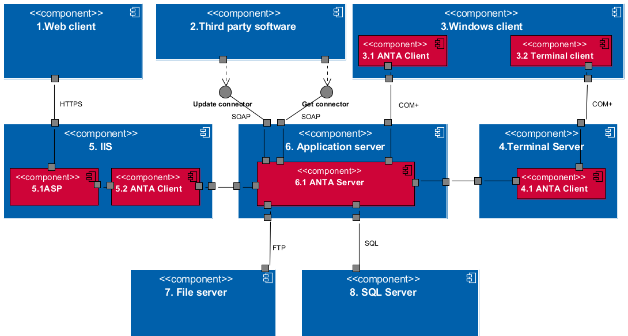
6
5
1
2
4
3

Slide 41
Reciprocal Twin Peaks model
Lucassen et al., submitted for review

Slide 42
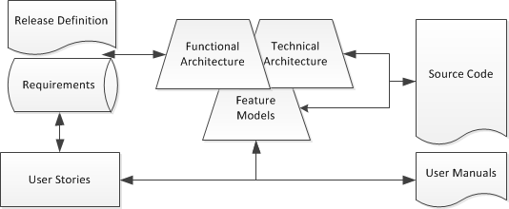
Continuous Architecting

Slide 43
Domains of DA
Requirements Management
Software Architecture
Software Engineering

Slide 44
Impact forecasting

Slide 45
User Story Modeling

Slide 46
User Story Modeling - Relationship
User story template:
"As a <role>, I want <goal/desire> so that <benefit>“
As an Organizer I am able to withdraw payments immediately to maximize cash flow
As the Event Ticketer, I am able to dictate a minimum withdraw amount to maximize cash flow
As a user I am able to add a video fragment to an event
As a user I am able to order search results
As a user I am able to delete an event (which I added)

Slide 47
Architecture Auto-updating from source code

Slide 48
Synchronization of Feature models and User manuals

Slide 49
Generating Feature Models from User Manuals
User manuals (help texts):
Describes processes by listing features in free form text
Strong structure: user, module, feature
Typically most complete documentation of product.
Example challenges to construct a Feature Model:
What information can be extracted from free form text?
What ratio of the application does a user manual cover
What manual structure is optimal to synchronize with the Feature Model?
What should be the role of the source code in this process

Slide 50
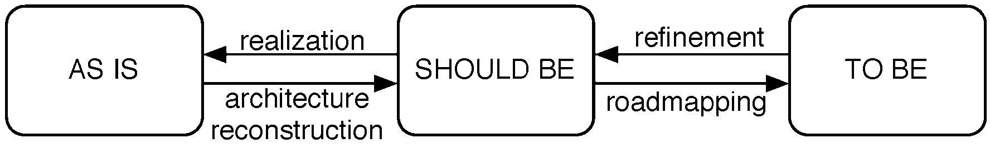
Incremental Architecting
Inc-1
Inc-3
As is
To be
Inc-2
Inc-5
Inc-4

Slide 51
Other uses for the Video Wall
Architecting
Social network analysis
Software ecosystems
Argumentation
Data visualization
Gaming
Interaction technology
Animation and simulation

Slide 52
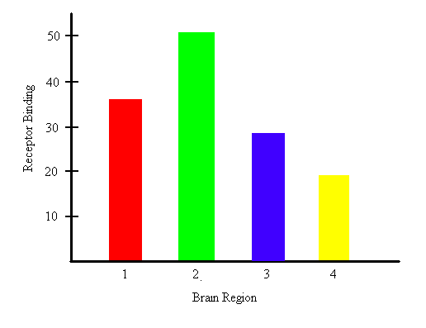
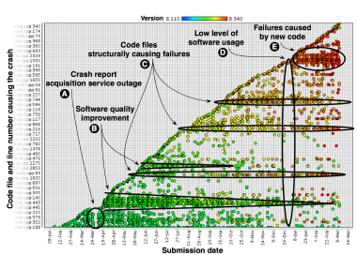
And if we enhance CA to Delivery and Feedback
Continuous Operations (SOM)
Executables
Ecosystems Monitoring
Delivery
Feedback

Slide 53
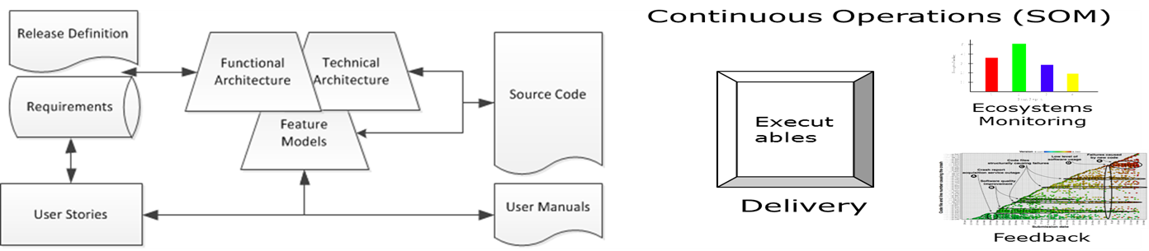
And even further to Continuous Software Production
Operation
Performance monitoring
Crash reporting
Usage tracing

Slide 54
Papers
Sjaak Brinkkemper, Stella Pachidi: Functional Architecture Modeling for the Software Product Industry. ECSA 2010: 198-213
Wilbert Seele, Shaheen Syed, Sjaak Brinkkemper: The Functional Architecture Modeling Method Applied on Web Browsers. WICSA 2014: 171-174
This is an active research topics of our team. More papers to follow.

