Slide 1


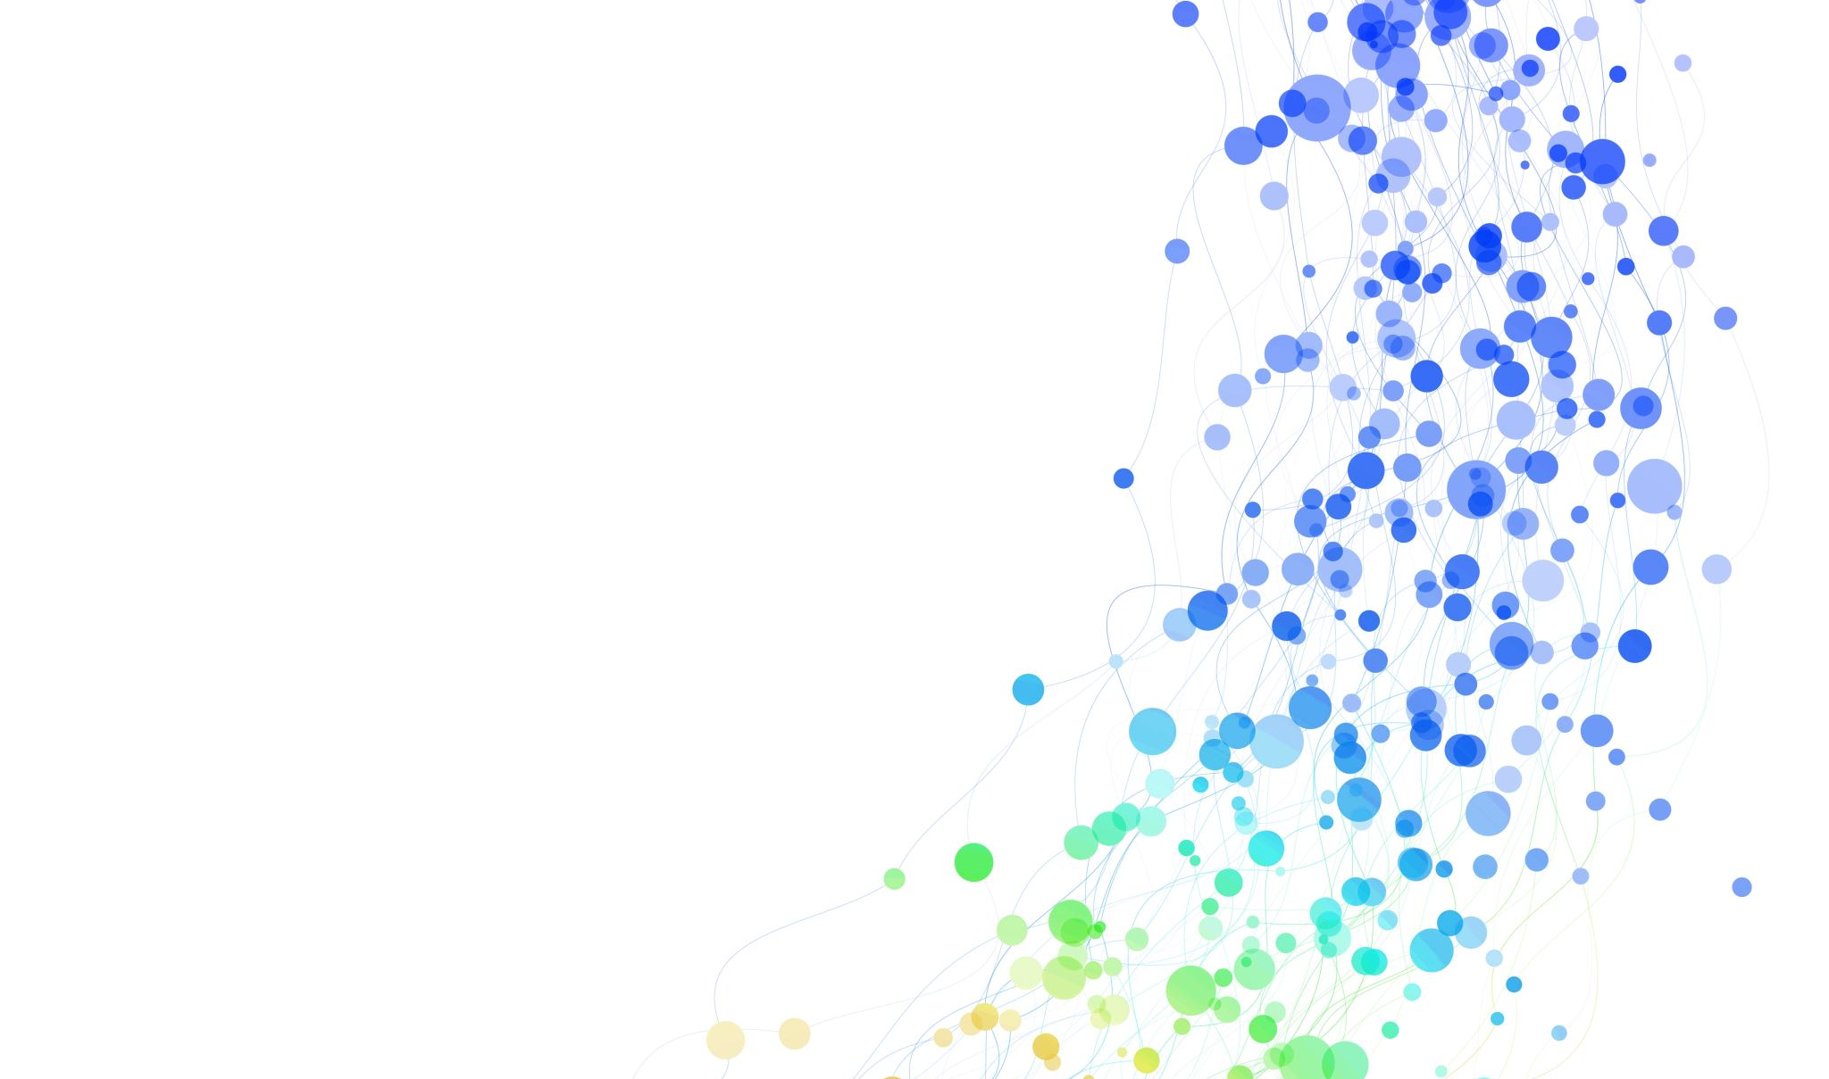



DIFFERENT PROPOSALS FOR THE IMPLEMENTATION OF SUPERCONDUCTING
DIODE TYPE SYSTEMS.

Slide 2
Type I
Fall in the resistivity for dierent temperatures and dierent materials.
From left to right: Gilles Holst, Gerrit Jan Flim and Heike Onnes
Shielding of the magnetic field of the superconductor sample (perfect diamagnetic behavior χm = −1)

Slide 3
Periodic table of the superconductors elements

Slide 4
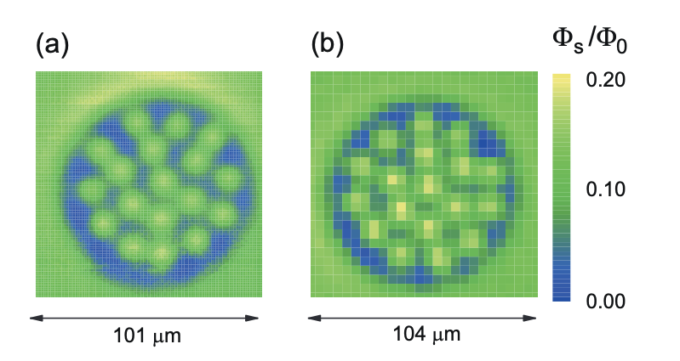
IntroducTION
Physica C: Superconductivity and its Applications
Volume 581, 15 February 2021, 1353818
Type II
Orden parameter for a superconductor disk with H = 1.1.
Magnetization and vorticity behavior for the case 3, we took the value of parameter deformation τ = 0.3, τ = 0.5 and τ = 0.8, all with value κ = 1 and size L = 8.
Physica C: Superconductivity and its Applications
Volume 554, 15 November 2018, Pages 8-14
Sequence (Left-Right) of the state of the vortices for case 3 (Up) and case 4(Down) configuration Fig.3.1(c-d), for the same value of the applied Field. We see the influuence that the deformation parameter has on the configuration of the vortices and the variation of the magnetization
June 2019, Journal of Applied Physics 125(22):223906

Slide 5
Solid State Communications
Volume 306, February 2020, 113799
Schematic view of the studied system: a strip of length L and width w; the width of the electrodes is a, through which a uniform dc current density Ja is injected in presence of an external magnetic field H.
Figure 10.4: (Color online) Snapshots of the logarithm of the order parameter, ln|ψ| for L = 24ξ,36ξ,48ξ at Ja = 1.74 with a number of PLine = 3,3,5 phase split lines respectively at zero magnetic field.

Slide 6
Scalar potential (V) obtained in the sample from applied currents J for different values of the external magnetic field (H). The value of the bridge width corresponds to d= 0.27 ξ(0).
A schematic representation of the sample: In green, the superconductor sample, in red and blue the metallic electrodes. The dimensions of the sample are: c=ξ(0), b = 3.2ξ(0), R = 0.6ξ (0), while the side length a is varied throughout this work. The radial defect can be expressed with the function $r(\theta) = R + r_0\sin(\omega_0 \theta)$, with parameters $r_0 = 0.1 \, \xi(0)$ and $\omega_0= 45/\xi(0)$, and $\theta$ is measured from the center of the semicircle

Slide 7
Cooper pair density ($|\psi|^{2}$) and phase difference on the superconducting device with J=0mA and d=0.4ξ(0) , as a function of the external applied magnetic field H.
Magnitude of the first critical (First Shapiro step) currents with opposite polarization as a function of the applied magnetic field. (b) Efficiency factor γ (H ) as a function of the applied magnetic field H, for a fixed value of d = 0.27 ξ(0).

Slide 8
Diode efficiency $\gamma_{d}H$ as a function of the Ginzburg–Landau parameter $\kappa$, for fixed external magnetic field values H [1.0,\, 1.4] (in steps of $0.1$), in a mesoscopic superconducting wedge acting as a potential diode. As the H increases, the $\gamma_(d)H dedecreases, and for sufficiently large values of H the diode effect vanishes, i.e., $\gammad)Hfor all K
SciPost Phys. Core 9, 006 (2026), published 4 February 2026
(a) Schematic representation of the superconducting meso-wedge geometry. The dimensions of the external numerical mesh are A=30ξ(0), B=C=15ξ(0). (b) Real three-dimensional superconducting sample with meso-wedge geometry and its projection of $n$-layers for the superconducting meso-wedge sample. The inclusion of external/transport currents J-in x-direction- is given by the lateral faces $\partial \Omega_{i}$, $i=1,2$, the external magnetic field (${ \mathbf{H}=\bf H_{z}}$) is in the $\hat{z}$-direction.

Slide 9
Cooper pair density $|\psi|^2$ for different values of the external magnetic field H Panel (a): $\mathbf{H} = 1.1$, and panel (b): H= 1.3. The Ginzburg–Landau parameter (GLP) is set to K= 2.0$. The density is projected for two selected layers of the superconducting meso-wedge: $n = 1$, and $n = 7$. The color bar indicates the intensity of $|\psi|^{2}$ in each region of the superconducting meso-wedge geometry.

Slide 10
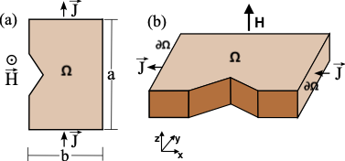
Voltage V as a function of the external current J for a fixed external magnetic field H=1.0 and different Ginzburg–Landau parameters K= 1.0,2.0,3.0,4.0, considering both current polarities J>0 and J<0, for the sample presented in Fig. \ref{Layout} (a-b). The values of the critical currents have been indicated with arrows for each of the K values, for both polarities.
Physica B: Condensed Matter
Volume 720, 1 January 2026, 417960
Voltage V as a function of the external current J for a fixed Ginzburg-Landau parameter K=1.0 and different fixed values of the external magnetic field H= 1.0,1.1,1.2,1.3, considering both current polarities (J>0$ and J<0), for the sample presented in Fig. \ref{Layout} (a-b). The first critical currents have been indicated for each of the applied external fields and both polarities used.

Slide 11
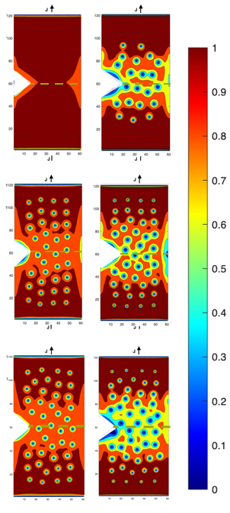
Cooper pair density $|\psi|^2$ for different values of Ginzburg-Landau parameter $\kappa=1.0,3.0,4.0$, for a fixed external magnetic field $\mathbf{H}=1.0$. Panel (a): $\kappa=1.0$, $\mathbf{J}>0$, $\mathbf{J}<0$ en inverse polarity, panel (b): $\kappa=3.0$, for both polarities of external currents and panel (c): $\kappa=4.0$, $\mathbf{J}>0$, $\mathbf{J}<0$. The density is projected for one selected layer of the superconducting meso-sample
Cooper pair density $|\psi|^2$ for different values of Ginzburg-Landau parameter $\kappa=1.0,2.0,3.0,4.0$, for a fixed external magnetic field $\mathbf{H}=1.0$. Panel (a): $\kappa=1.0$, $\mathbf{J}>0$, $\mathbf{J}<0$, panel (b): $\kappa=3.0$, for both polarities of external currents and panel (c): $\kappa=4.0$, $\mathbf{J}>0$, $\mathbf{J}<0$. The density is projected for one selected layer of the superconducting meso-sample.

Slide 12
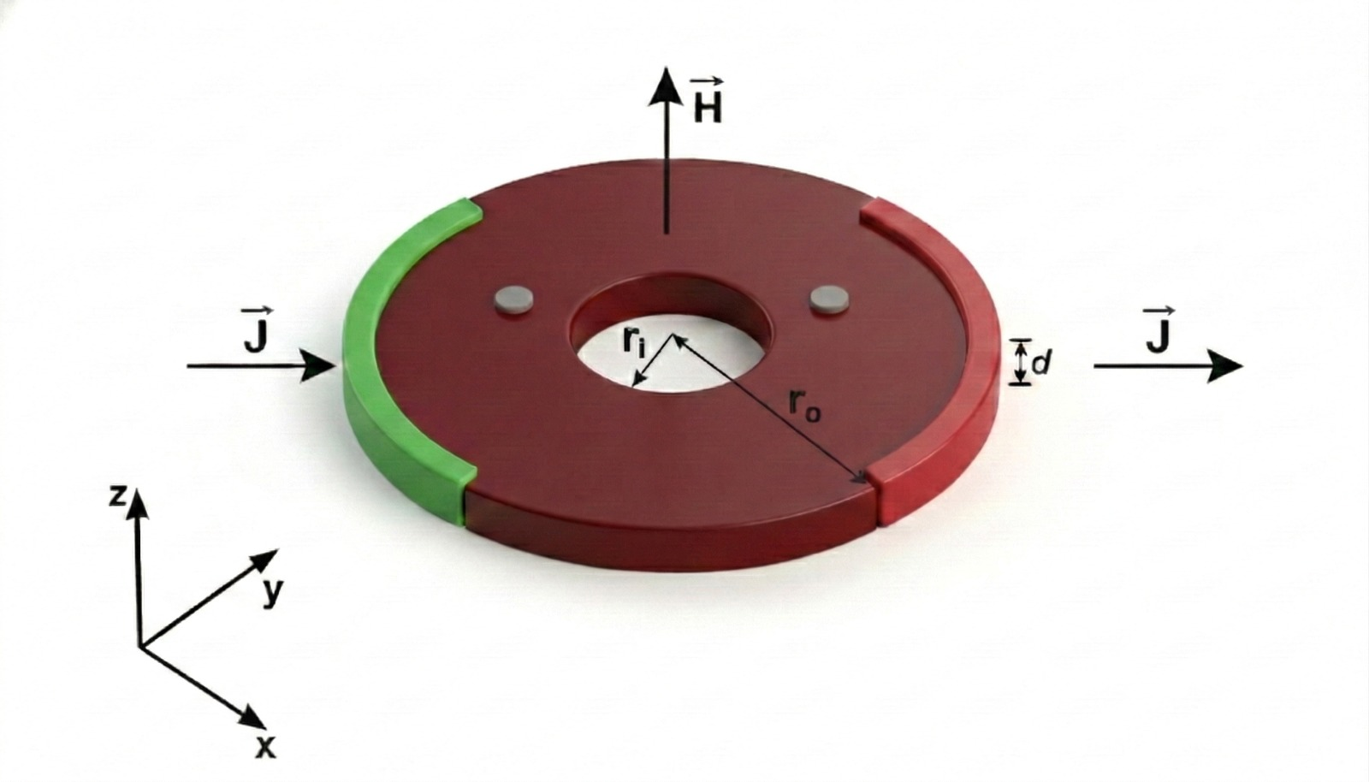
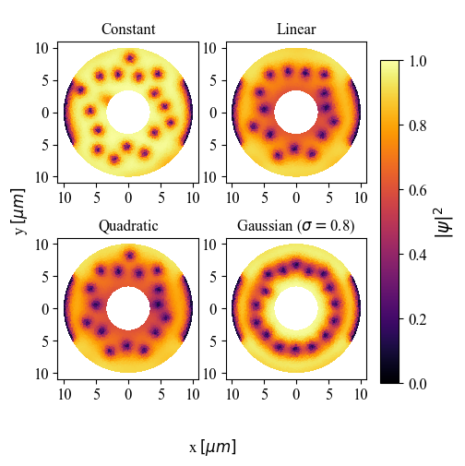
Schematic view of the simulated circular superconducting plate with $r_0=9.95 \mu m$, $r_i=3.45 \mu m$ and $d=0.1\mu m$. The green and red regions represent the current source and drain, respectively with size $sd\approx 20.98\mu m$. Probe points (in gray) for the simulations, are also indicated. $\mathbf{J}$ and $\mathbf{H}$ are the external applied current and magnetic field, respectively.
Cooper pair density $|\psi|^2$ of the superconducting order parameter for an applied magnetic field $H=0.2mT$ and different temperature gradients (linear, quadratic and gaussian) that have a reduction $\Delta \epsilon = 0.6$

Slide 13
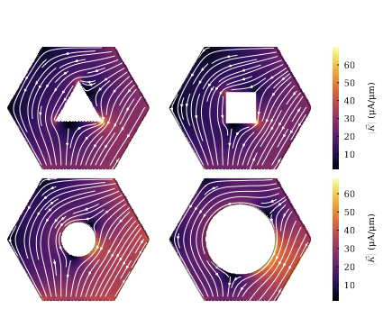
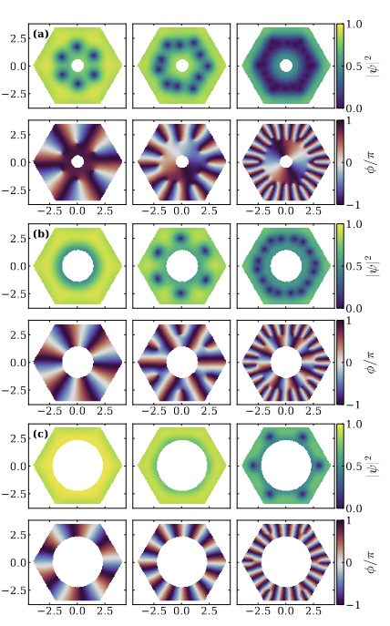
Schematic 3D view of the simulated hexagonal superconducting film with side length $L = 8\,\xi$ ($4\ \mu\text{m}$) and thickness $d = 0.2\,\xi$ ($0.1\ \mu\text{m}$). The central defect takes different geometries (circle and regular polygons), all scaled to the same reference area corresponding to a circle of radius $r = 2\,\xi$ ($1\ \mu\text{m}$). Blue and brown regions denote source and drain contacts, with probe points for voltage measurement.
Current–density distribution for different defect geometries. Top: triangular and square defects.
Bottom: circular defects with radii $R/\xi = 2.0$ ($1\,\mu\mathrm{m}$) and $R/\xi = 4.0$ ($2\,\mu\mathrm{m}$). Additionally, in the two lower panels, the current streamlines are observed, for two different values of the radius of the internal circular fault.
Order parameter magnitude (top row) and phase (bottom row) for defects of radius $r = 1.20\,\xi$ (a), $r = 2.90\,\xi$ (b), and $r = 4.60\,\xi$ (c)~$\mu$m under different applied magnetic fields. From left to right, the columns correspond to increasing field values of 0.55, 0.85, and 1.5 \textcolor{blue}{(in units of $H_{c2}$)
Physica Scripta, 2026, 103.

Slide 14
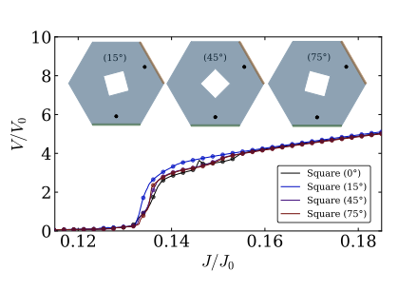
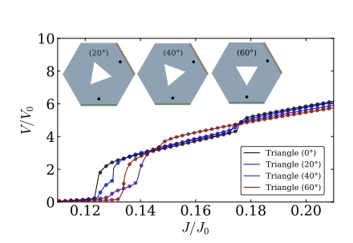
$V/V_0$ as a function of $J/J_0$ for a triangular defect under in-plane rotations by an angle $\theta$.
$V/V_0$ as a function of $J/J_0$ for a square defect under in-plane rotations by an angle $\theta$.

Slide 15
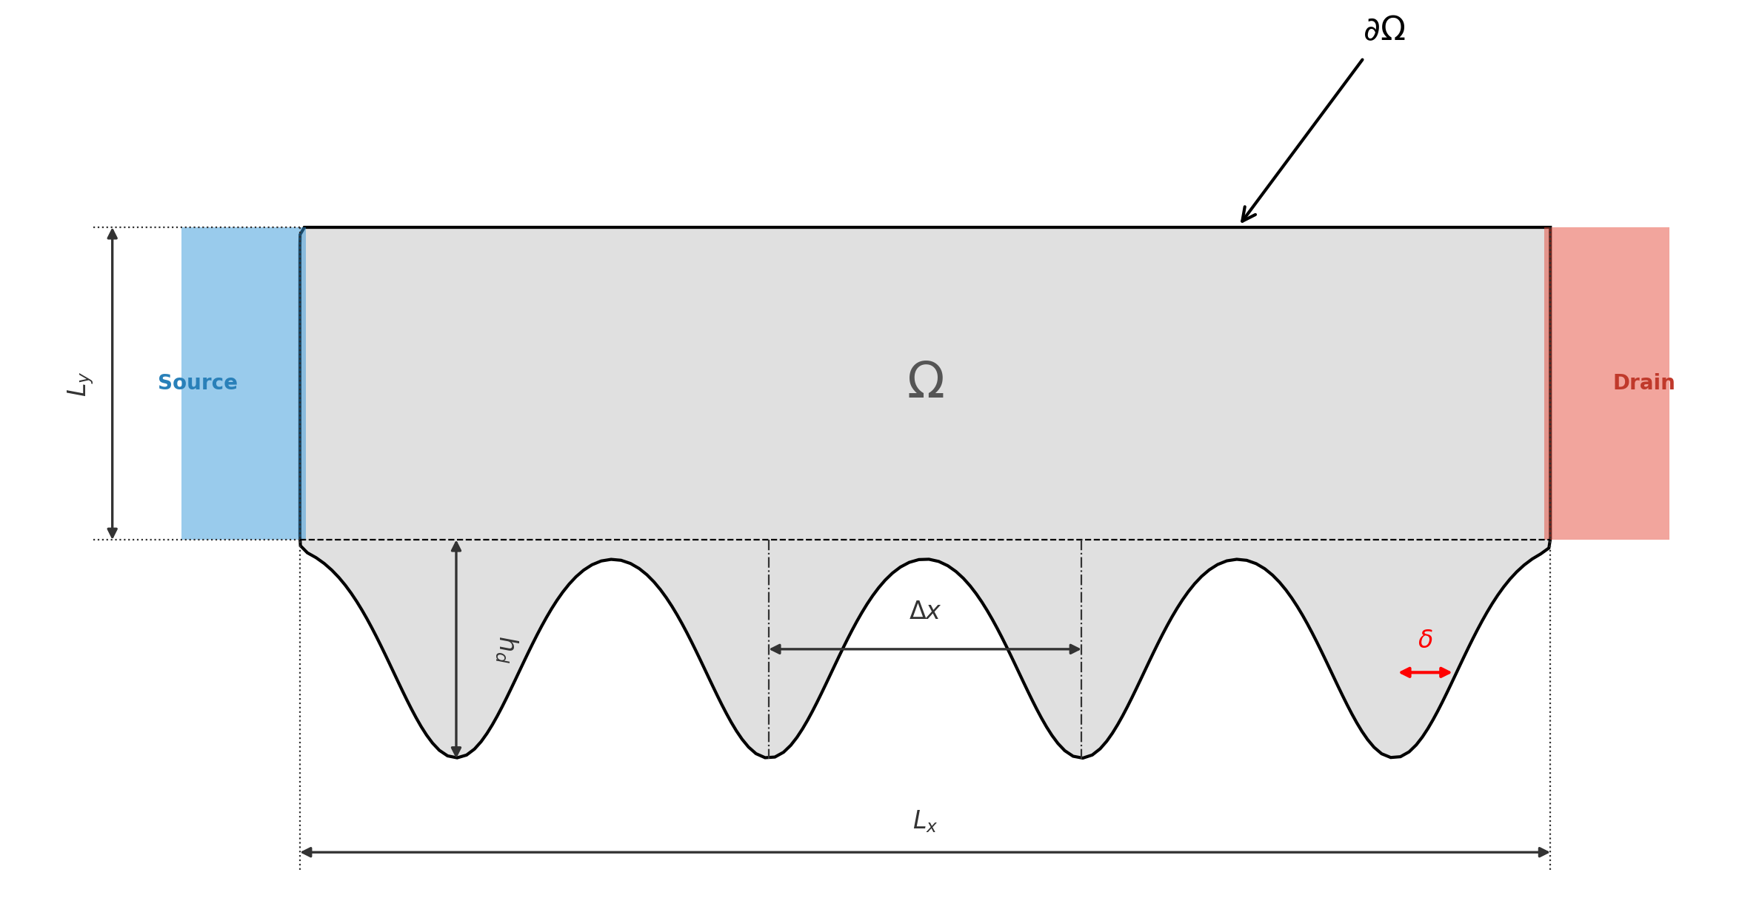
Spatial distribution of (a) the supercurrent density and (b) the superconducting order parameter for Device 1 (κ = 3) exposed to a static magnetic field of H = 0.1 mT. The matrices contrast the evolution of the mixed state, ev- idencing the asymmetry in vortex nucleation and the cur- rent crowding phenomenon upon reversing the polarity of the transport current.
3D schematic representation of the asymmetric comb- shaped superconducting device geometry. The superconduct- ing domain (Ω, gray) is bounded by its boundary (∂Ω). The source (blue) and drain (red) terminals are indicated. An ap- plied external magnetic field, H⃗ , and a uniformly applied cur- rent density, J⃗, are denoted by vectors. The magnetic field H⃗ is applied at a distance d from the source terminal. The main dimensions are the total length Lx (20 μm), the strip height Ly (5.0 μm), and the thickness Lz (0.1 μm). The lower pro- file features Gaussian indentations (teeth) with a maximum depth hd (3.5 μm), inter-tooth separation ∆x, and a geomet- ric parameter δ.

Slide 16
Spatial distribution of (a) the supercurrent density and (b) the superconducting order parameter for Device 2 (a) (κ = 3) exposed to a static magnetic field of H = 0.5 mT.

Slide 17
THE END

