Slide 1

Yelp Restaurant Photo Classification
Nov, 2 – Data Mining, Nanyang Technological University
Yang Fan – Michele Barbera – Jan-Eric Egenolf - Christian Dallago

Slide 2



The Team
Yang Fan, Master Student from NTU, BSc in Electrical and Electronic Engineering
Michele Barbera, Exchange student from Lyngby (Denmark), BSc Engineering Management
Jan-Eric Egenolf, Exchange student from Munich (Germany), BSc Mathematics
Christian Dallago, Exchange student from Munich (Germany), BSc Computer Science and Engineering

Slide 3
Roadmap
Challenge Selection
Data Cleaning Process, Preprocessing
Skeletonize
Problem Statement Understanding
Food vs. No Food Classification
Facilitation of Data Processing, Feature Creation
Contour Finding
etc...
Model Creation
Normalization
Duplicate-Cleaning
Postprocessing
multiclass-multilabel
labels vs. not-label
SVM
model ensembling/ model selection
label correlations

Slide 4

The Challenge – Yelp Restaurant Photo Classification
Task: to predict attribute labels for restaurants using user submitted photos
Input: A food image
Output: Business Attributes:
0: good_for_lunch
1: good_for_dinner
2: takes_reservations
3: outdoor_seating
4: restaurant_is_expensive
5: has_alcohol
6: has_table_service
7: ambience_is_classy
8: good_for_kids
A multi-label classification problem

Slide 5
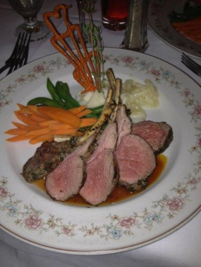
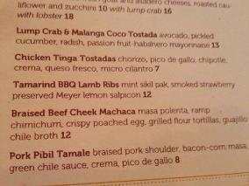

The Challenge – Ideal Model training
Labels (9)
Data (~ 240000)
Labels (9)
Data (~ 240000)
0
0
1
1
Business IDs
(2000)
2
2
1
3
3
4
4
2
5
5
6
6
7
7
8
8
TRAIN

Slide 6
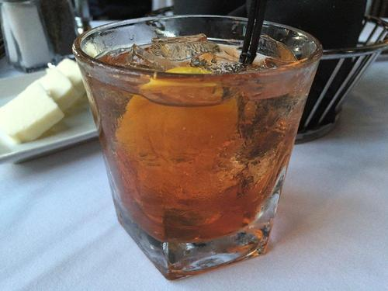
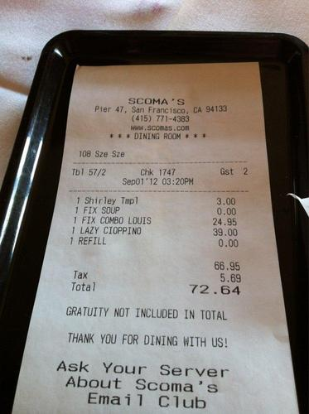
The Challenge – Ideal Predictions
GOAL
Labels (9)
Business IDs (2000)
Data (~240000)
Labels (9)
0
Business IDs (2000)
0
1
1
1
1
2
2
2
2
3
3
4
4
INFERRED
GIVEN
PREDICTED

Slide 7
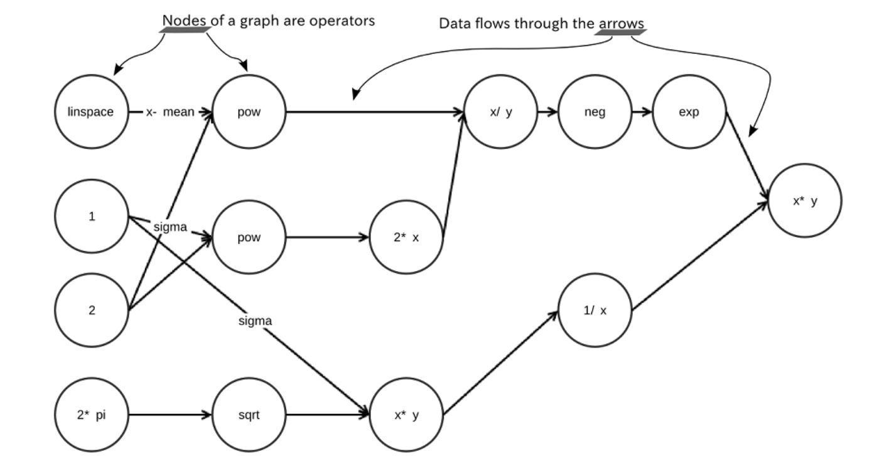
TensorFlow
TensorFlow™ is an open source software library for numerical computation using data flow graphs.
Nodes: mathematical operations
graph edges: multidimensional data arrays (tensors) communicated between them
Architecture :
Underlining computation : C++
Interface : Python

Slide 8
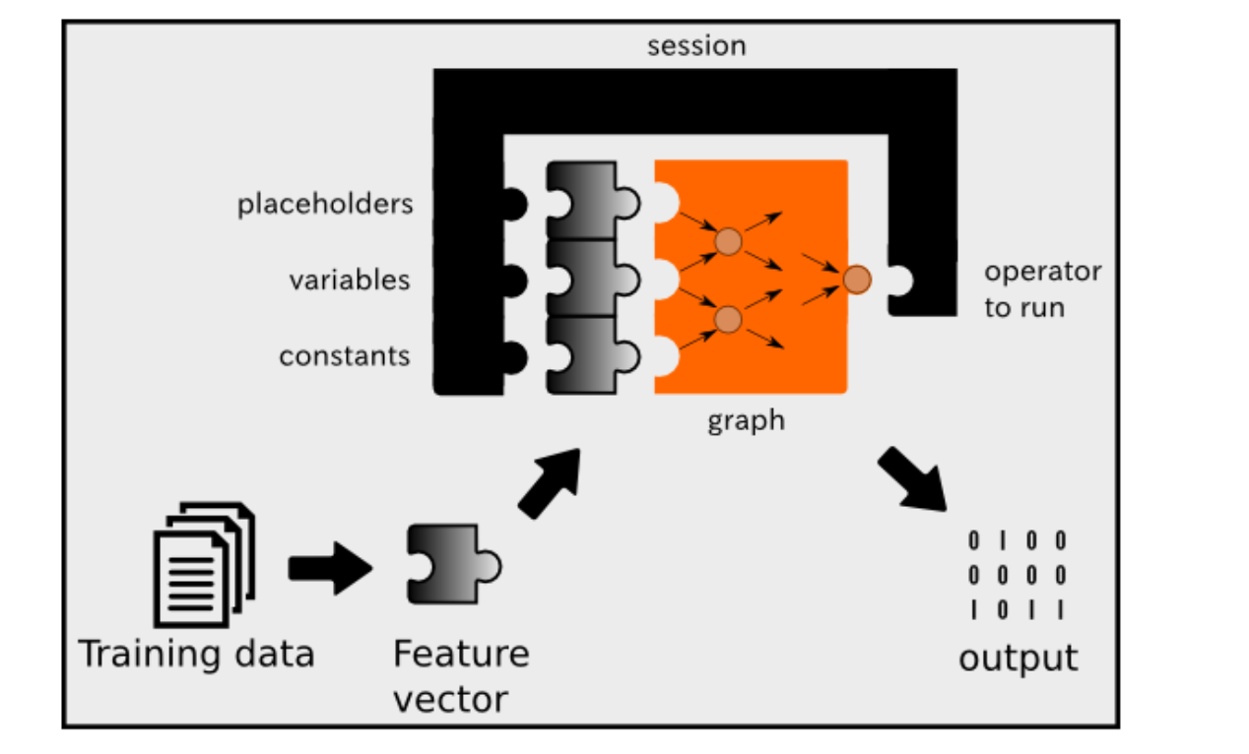
Deep Learning with TensorFlow
Placeholders:
A place where input is expected
Variables
A modifiable tensor
Constants
A constant tensor
Session
An interface to run tensorflow operations

