Slide 1
Progress report 20160916

Slide 2
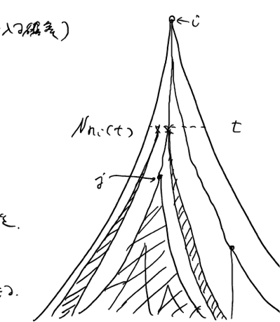
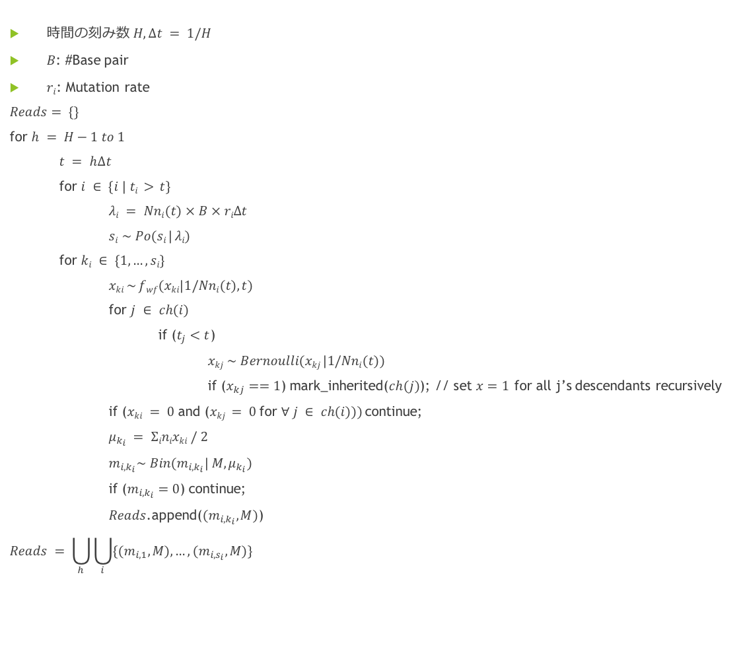
Read simulation
時間の刻み数 $H, Δt = 1/H$
$B$: #Base pair
$ri$: Mutation rate
$Reads$ $= \{\}$
for $h = H−1 to 1$
$t = h∆t$
for $i ∈ \{i | ti > t\}$
$λi = Nni(t) × B × riΔt$
$si \sim Po(si | λi)$
for $ki ∈ \{1, …, si\}$
$xki \sim fwf(xki|1/Nni(t), t)$
for $j ∈ ch(i)$
if ($t_{j}<t$)
$xkj \sim Bernoulli(xkj |1/Nni(t))$
if ($x_{kj}==1$) mark_inherited($ch(j)$); // set $x=1$ for all j’s descendants recursively
if ($xki = 0$and ($xkj = 0$for $∀ j ∈ ch(i)))$continue;
$μ_{k_{i}} = Σinixki / 2$
$m_{i,k_{i}}\sim Bin(m_{i,k_{i}}| M,μ_{k_{i}})$
if ($m_{i,k_{i}}=0$) continue;
$Reads$.append($(m_{i,k_{i}},M)$)
$$Reads = \bigcup_{h}{\bigcup_{i}{\{{(m}_{i,1},M),…,(m_{i,s_{i}},M)\} }}$$

Slide 3
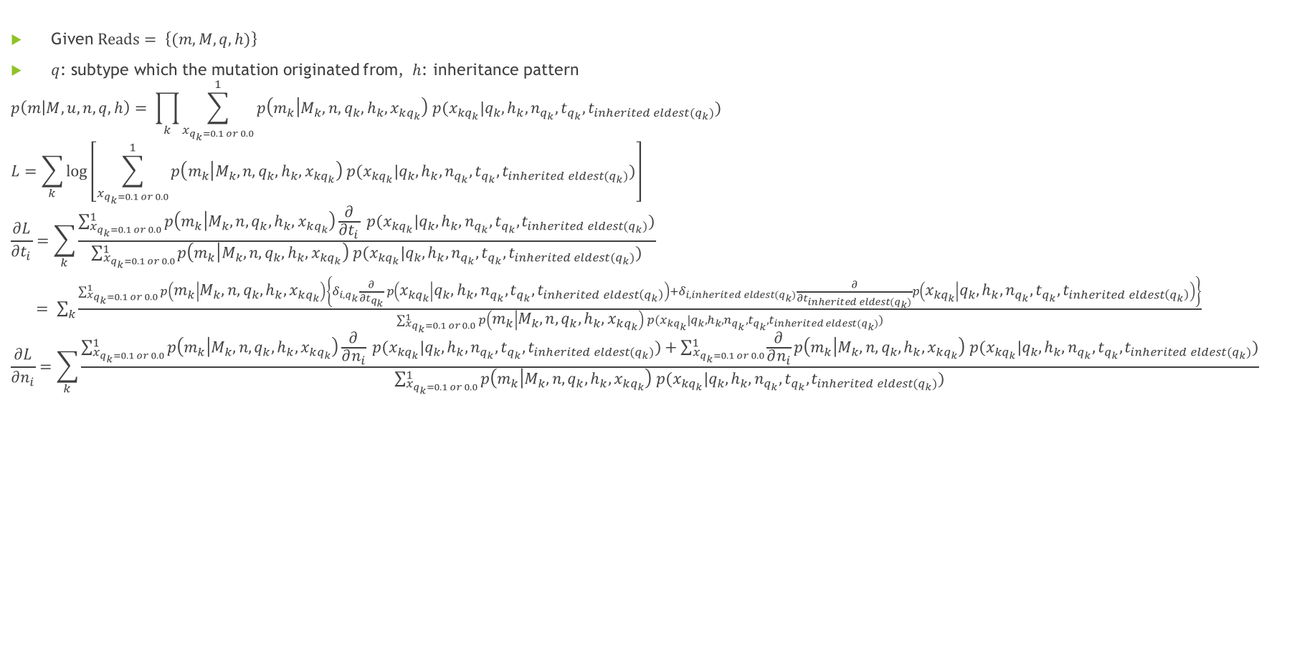
ML estimation of t and n
Given $Reads= \left\{(m,M,q,h)\right\}$
$q$: subtype which the mutation originated from, $h$: inheritance pattern
$$p\left(m | M,u,n,q,h\right)= \prod_{k}{\sum_{x_{q_{k}=0.1 or 0.0}}^{1}{p\left(m_{k} | M_{k},n,q_{k},h_{k},x_{kq_{k}}\right) p(x_{{kq}_{k}}|q_{k},h_{k},n_{q_{k}},t_{q_{k}},t_{inherited eldest(q_{k})})}}$$
$$L=\sum_{k}{\log\left[\sum_{x_{q_{k}=0.1 or 0.0}}^{1}{p\left(m_{k} | M_{k},n,q_{k},h_{k},x_{kq_{k}}\right) p(x_{{kq}_{k}}|q_{k},h_{k},n_{q_{k}},t_{q_{k}},t_{inherited eldest(q_{k})})}\right]}$$
$$\frac{∂L}{∂t_{i}}=\sum_{k}{\frac{\sum_{x_{q_{k}=0.1 or 0.0}}^{1}{p\left(m_{k} | M_{k},n,q_{k},h_{k},x_{kq_{k}}\right)\frac{∂}{∂t_{i}} p(x_{{kq}_{k}}|q_{k},h_{k},n_{q_{k}},t_{q_{k}},t_{inherited eldest(q_{k})})}}{\sum_{x_{q_{k}=0.1 or 0.0}}^{1}{p\left(m_{k} | M_{k},n,q_{k},h_{k},x_{kq_{k}}\right) p(x_{{kq}_{k}}|q_{k},h_{k},n_{q_{k}},t_{q_{k}},t_{inherited eldest(q_{k})})}}}$$
$= \sum_{k}{\frac{\sum_{x_{q_{k}=0.1 or 0.0}}^{1}{p\left(m_{k} | M_{k},n,q_{k},h_{k},x_{kq_{k}}\right)\left\{δ_{i,q_{k}}\frac{∂}{∂t_{q_{k}}} p\left(x_{{kq}_{k}} | q_{k},h_{k},n_{q_{k}},t_{q_{k}},t_{inherited eldest\left(q_{k}\right)}\right)+δ_{i,inherited eldest(q_{k})}\frac{∂}{∂t_{inherited eldest(q_{k})}}p\left(x_{{kq}_{k}} | q_{k},h_{k},n_{q_{k}},t_{q_{k}},t_{inherited eldest\left(q_{k}\right)}\right)\right\}}}{\sum_{x_{q_{k}=0.1 or 0.0}}^{1}{p\left(m_{k} | M_{k},n,q_{k},h_{k},x_{kq_{k}}\right) p(x_{{kq}_{k}}|q_{k},h_{k},n_{q_{k}},t_{q_{k}},t_{inherited eldest(q_{k})})}}}$
$$\frac{∂L}{∂n_{i}}=\sum_{k}{\frac{\sum_{x_{q_{k}=0.1 or 0.0}}^{1}{p\left(m_{k} | M_{k},n,q_{k},h_{k},x_{kq_{k}}\right)\frac{∂}{∂n_{i}} p(x_{{kq}_{k}}|q_{k},h_{k},n_{q_{k}},t_{q_{k}},t_{inherited eldest(q_{k})})}+\sum_{x_{q_{k}=0.1 or 0.0}}^{1}{\frac{∂}{∂n_{i}}p\left(m_{k} | M_{k},n,q_{k},h_{k},x_{kq_{k}}\right) p(x_{{kq}_{k}}|q_{k},h_{k},n_{q_{k}},t_{q_{k}},t_{inherited eldest(q_{k})})}}{\sum_{x_{q_{k}=0.1 or 0.0}}^{1}{p\left(m_{k} | M_{k},n,q_{k},h_{k},x_{kq_{k}}\right) p(x_{{kq}_{k}}|q_{k},h_{k},n_{q_{k}},t_{q_{k}},t_{inherited eldest(q_{k})})}}}$$
Notes:
パラメータの依存関係をはっきりさせる
何で時間を測っているのか? (mutation rateで?)
単位、無次元化
でないと、現実のデータにあてはめられない

Slide 4
Results

Slide 5

Conclusions
$n$は、小さな$Bでも$精度良く推定できる。
$B=3.0×{10}^{9}$程度(whole-genome sequencing)程度あれば、$t$も推定できる。
$t$の推定精度が、$B=1.5×{10}^{10}, 3.0×{10}^{10}\left(bp\right)$で落ちているのは、read simulationの際に、計算時間の制約のために$B=7.5×{10}^{9},1.5×{10}^{10}, 3.0×{10}^{10}\left(bp\right)$ で$t<0.1$の領域でのリード生成をカットしており、正しい変異アレル頻度分布を与えられていないためである可能性がある。
Notes:
B=3.0x10^9とかは、rやNを決めた上でのこと。
また、単位、パラメータ依存関係を考えられていない。

