Slide 1
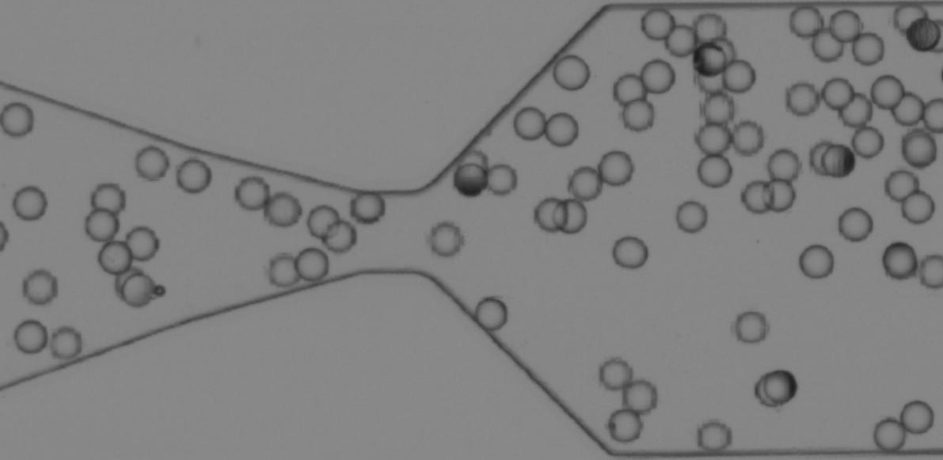

Monodisperse clogging - 3D cells

Slide 2
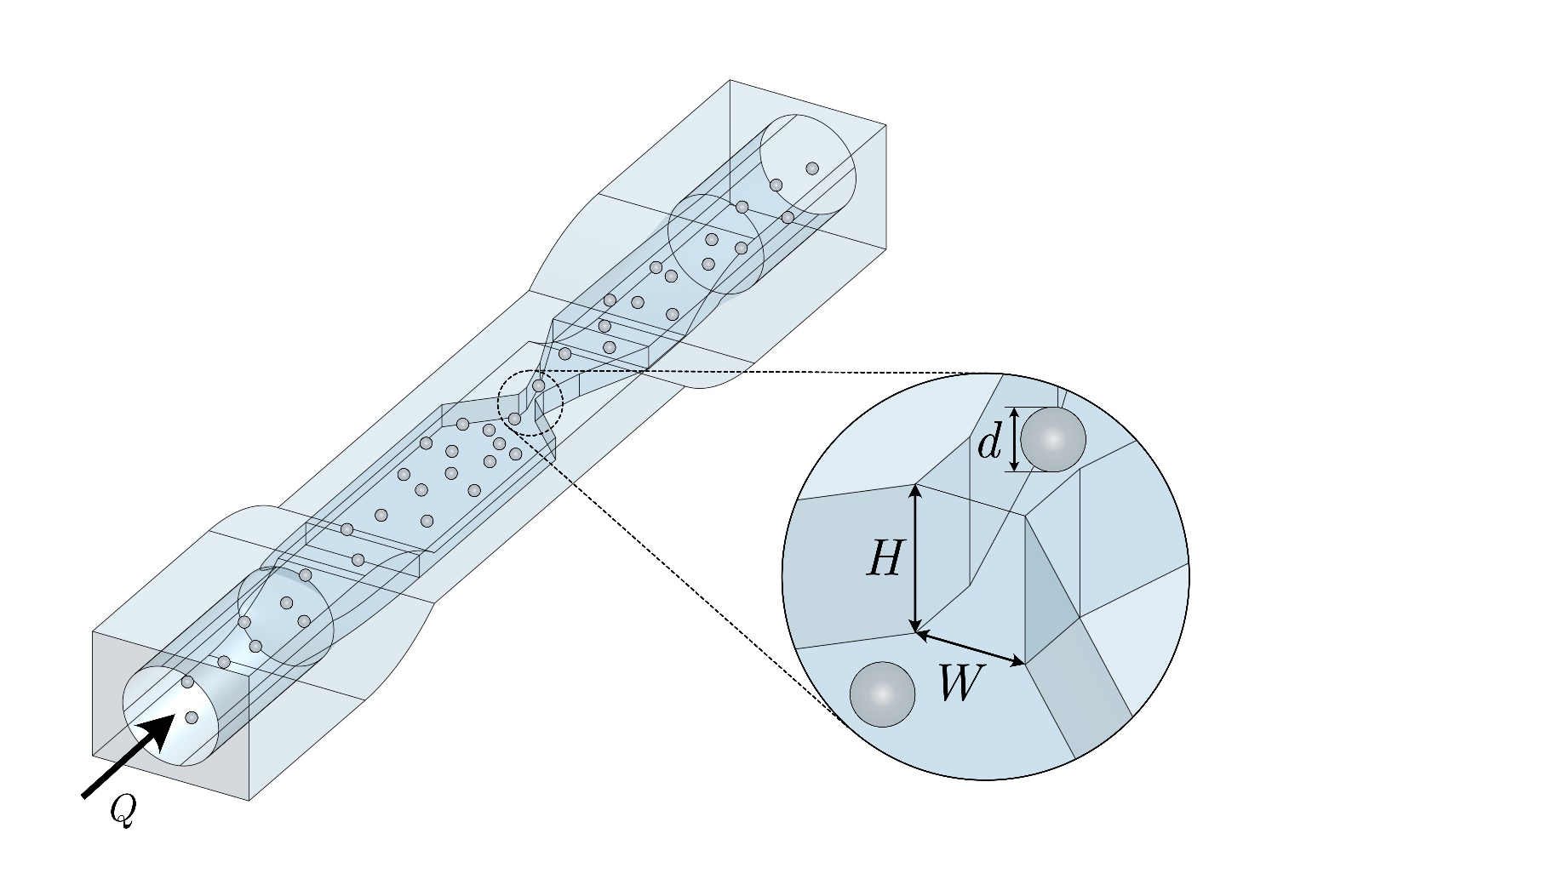
Experimental Set-Up
$$W/d =\left[1.7, 2.7\right]$$
$$H/d =\left[2.6, 3.1, 3.6, 4.1, 4.6\right]$$
$$φ=φ_{c}$$

Slide 3
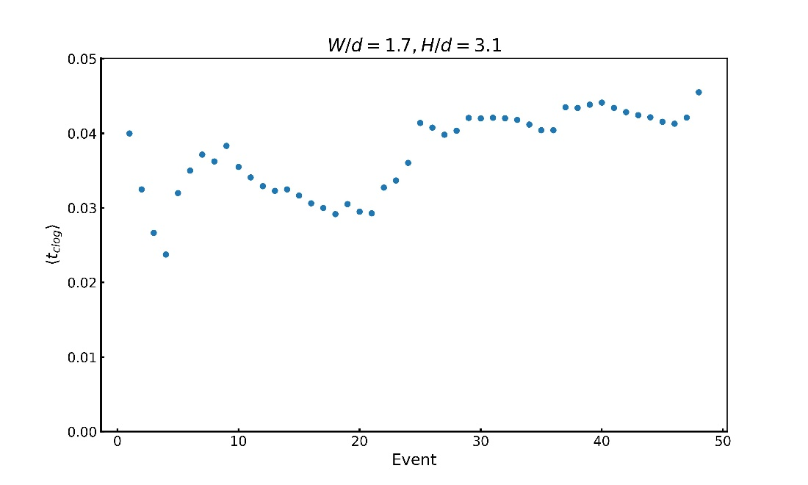
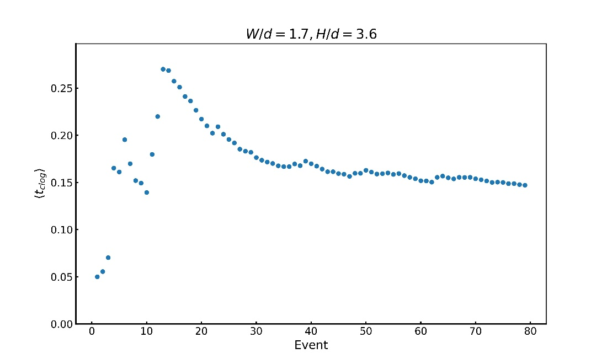
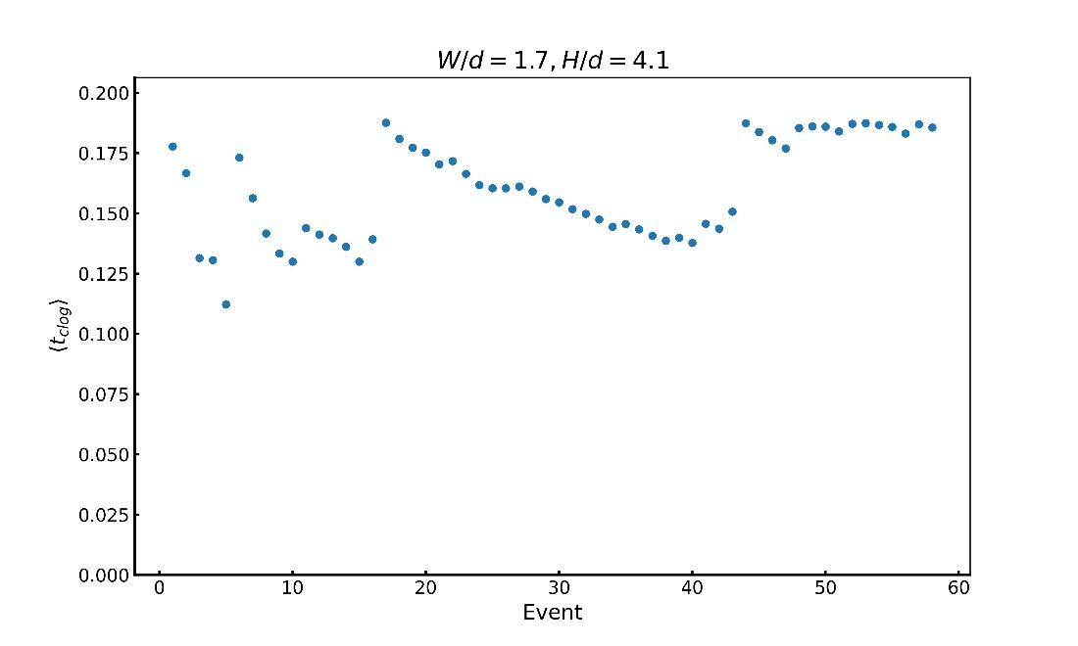
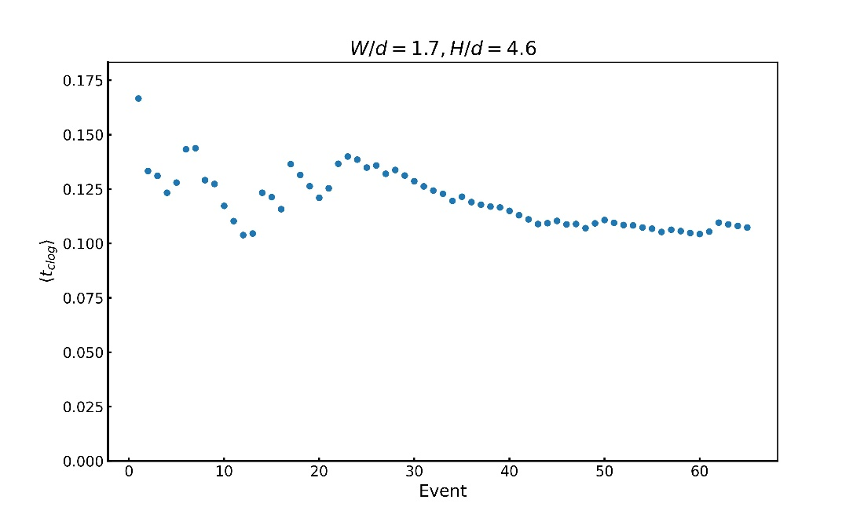
Evolution of $\left\langle t_{clog} \right\rangle$ (Temporary and Permanent)

Slide 4
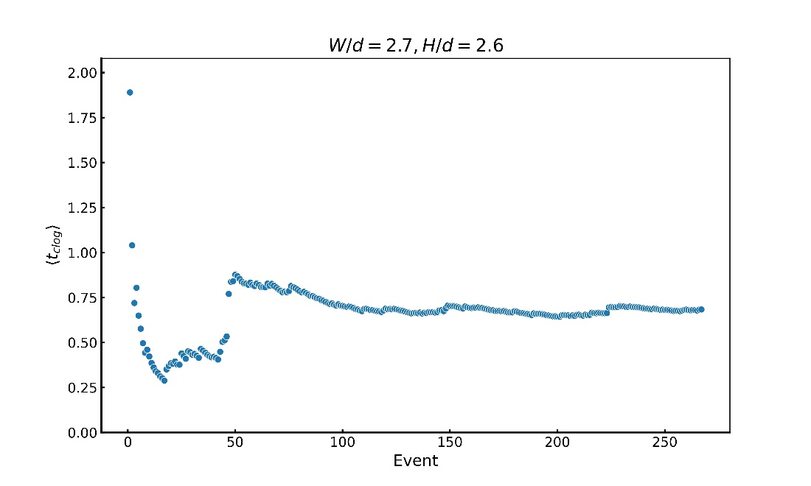
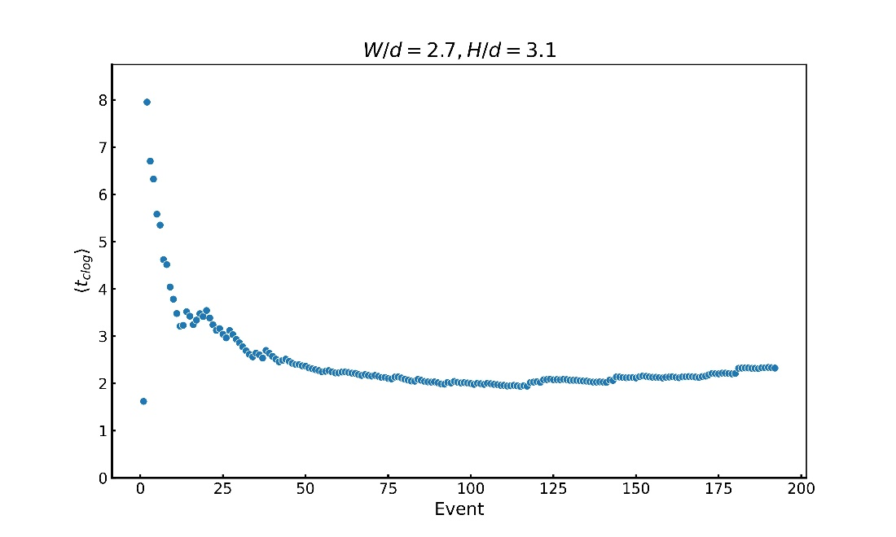
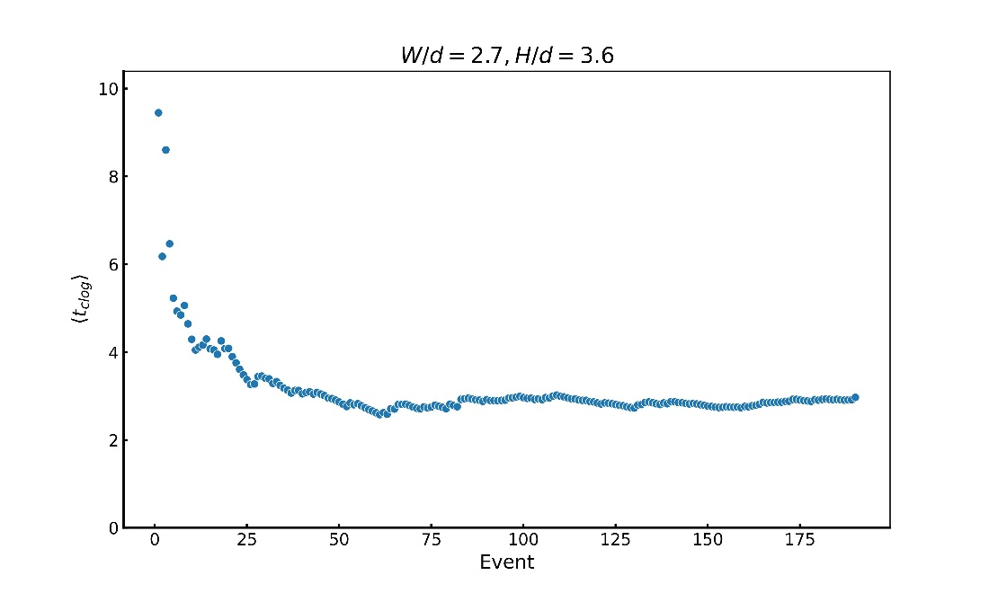
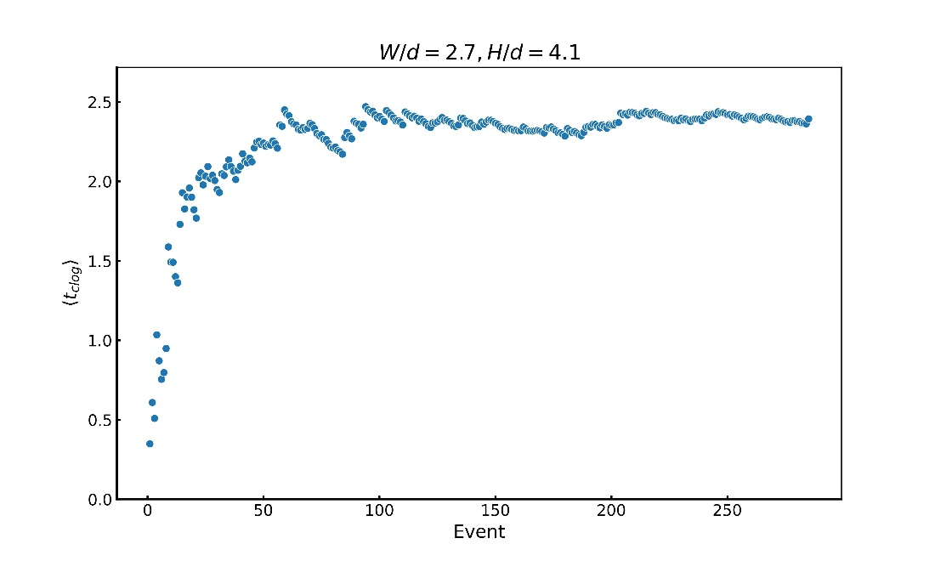
Evolution of $\left\langle t_{clog} \right\rangle$ contd.

Slide 5
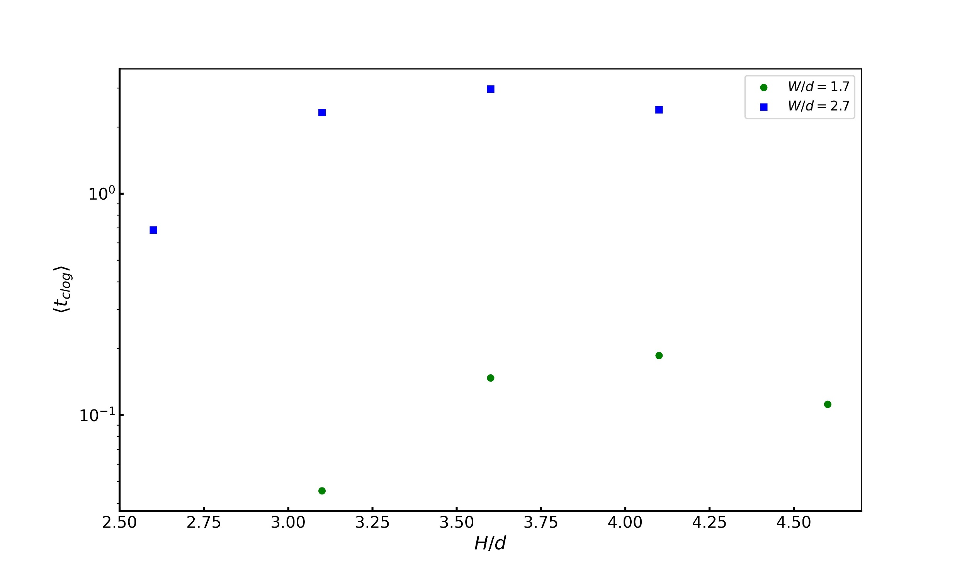
Evolution of $\left\langle t_{clog} \right\rangle$ as a function of height

Slide 6
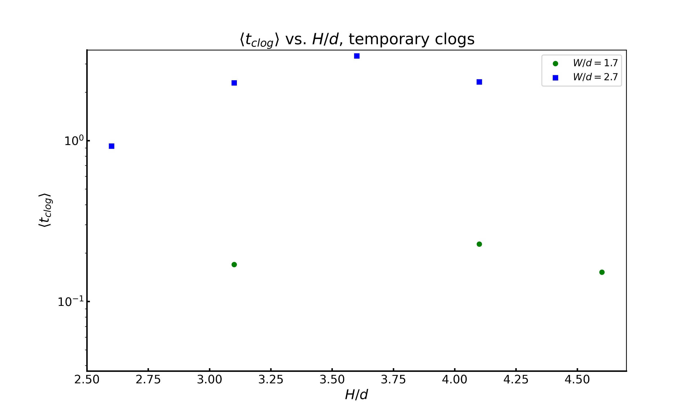
Evolution of $\left\langle t_{clog} \right\rangle$ as a function of height, temporary clogs

Slide 7
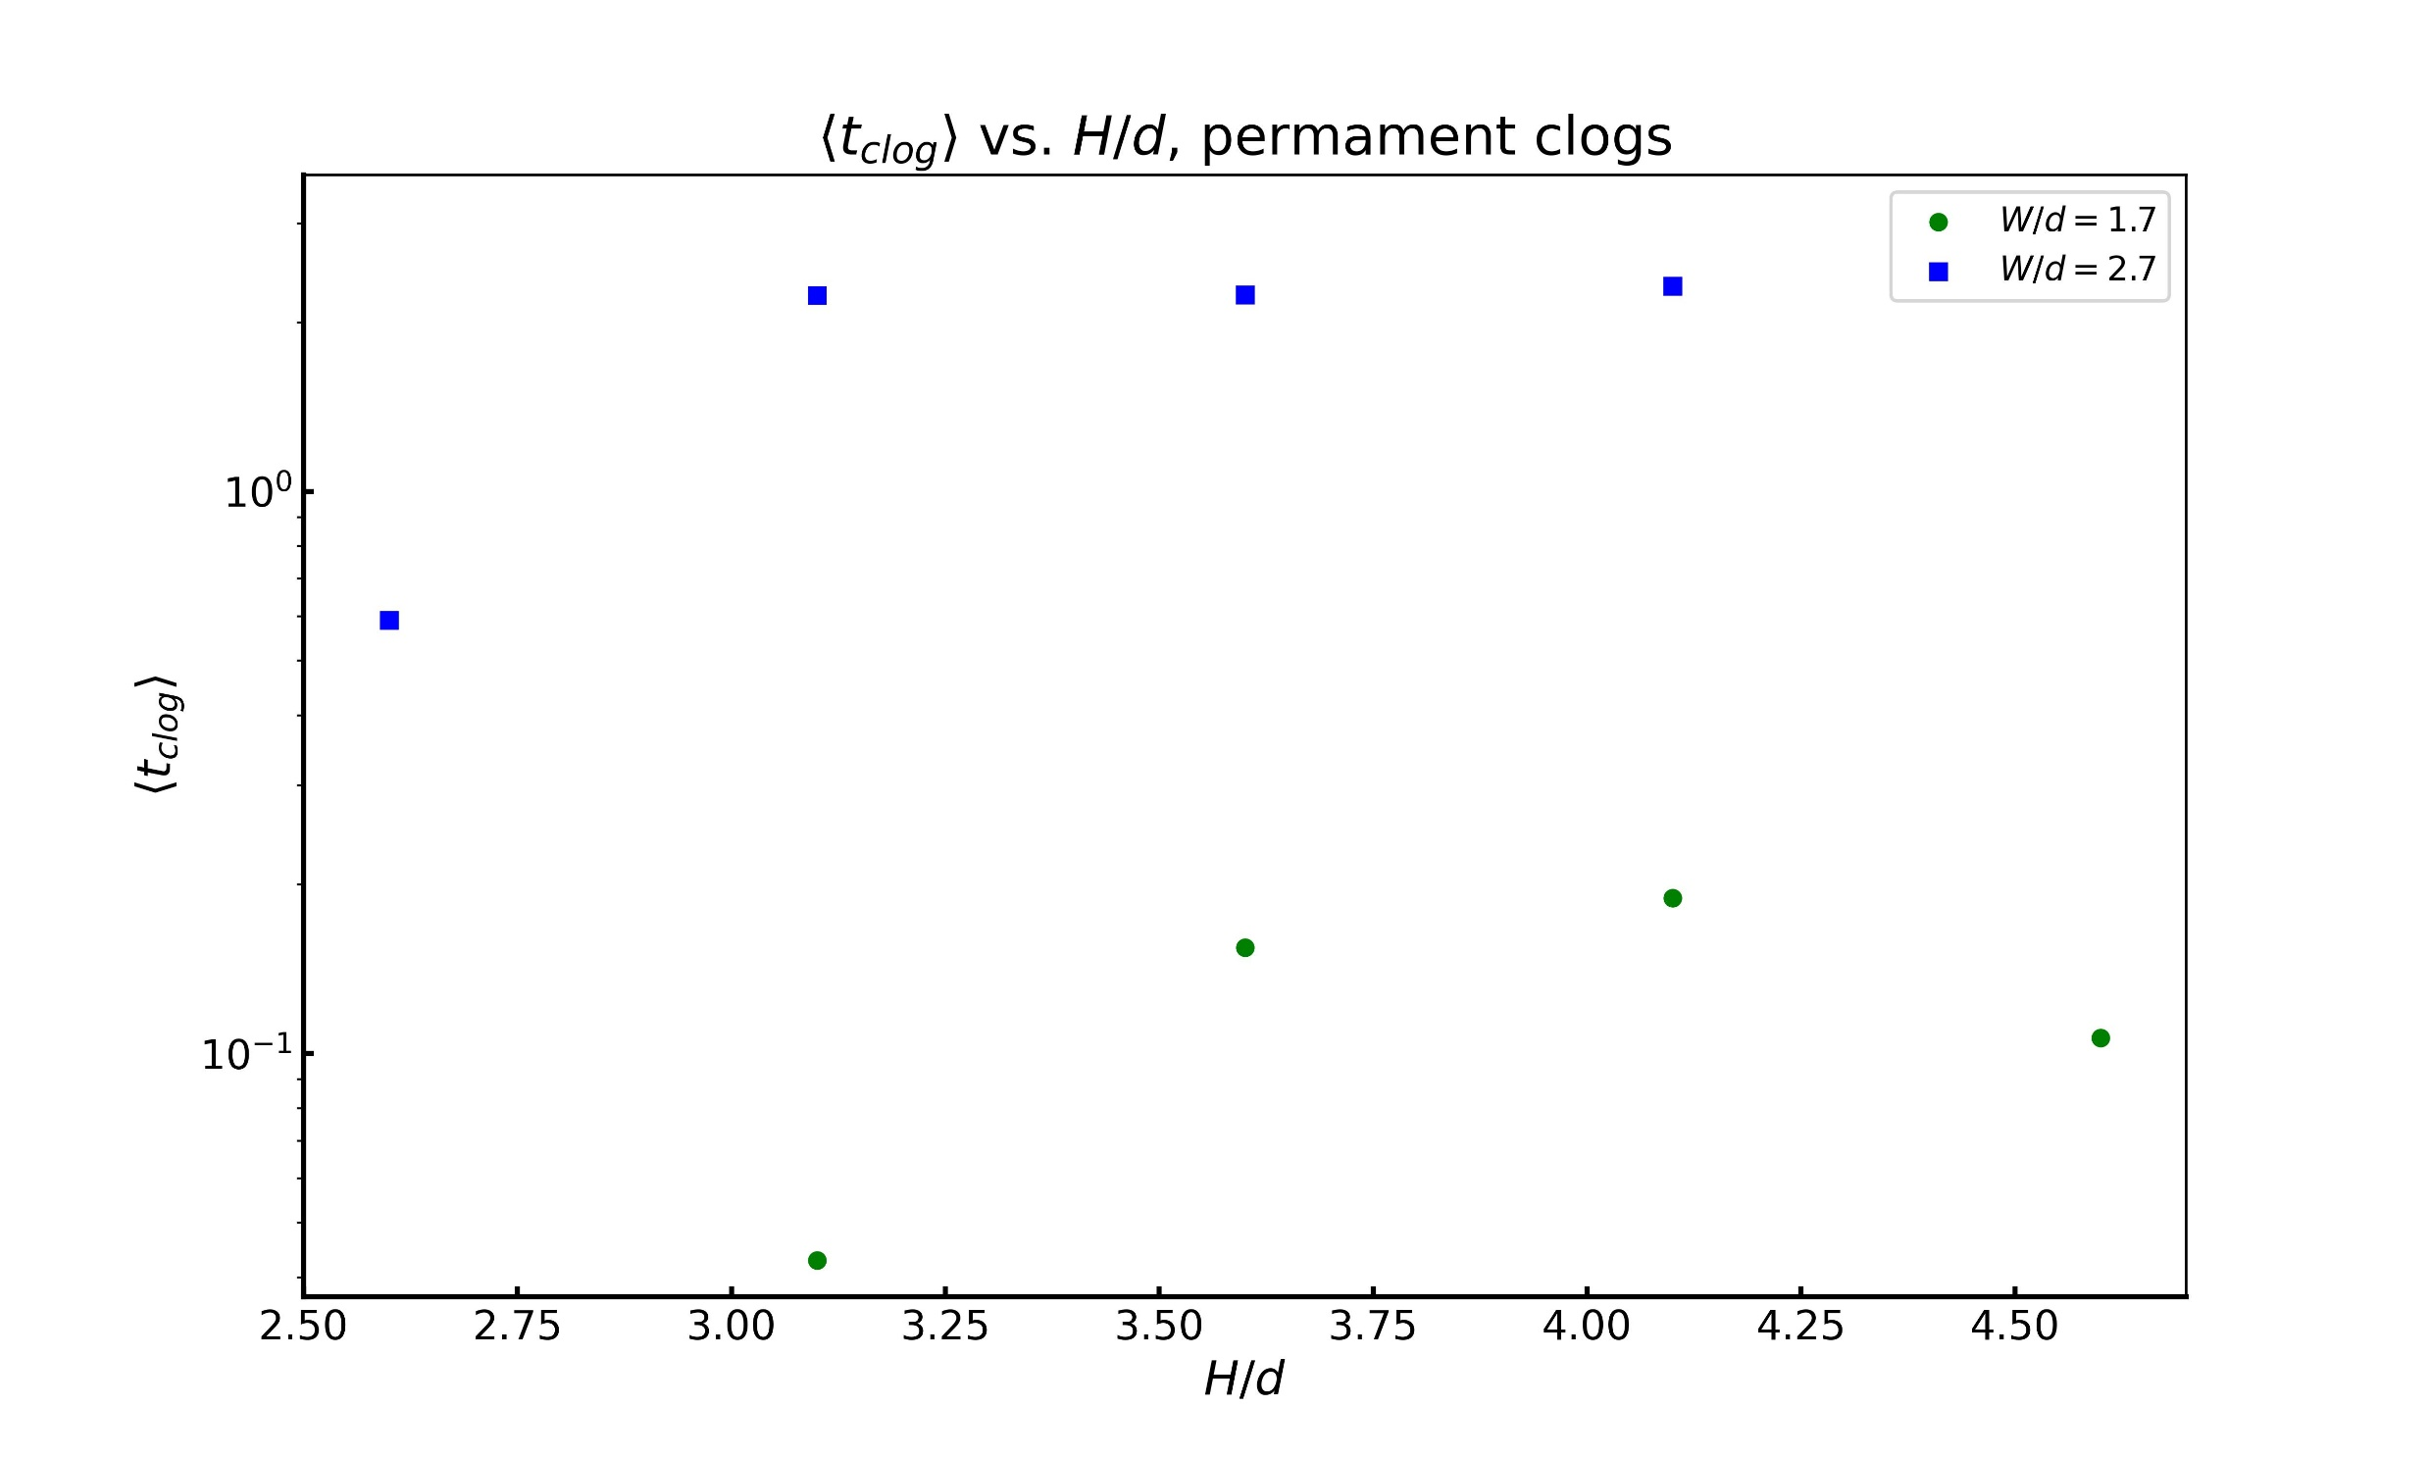
Evolution of $\left\langle t_{clog} \right\rangle$ as a function of height, permanent clogs

Slide 8
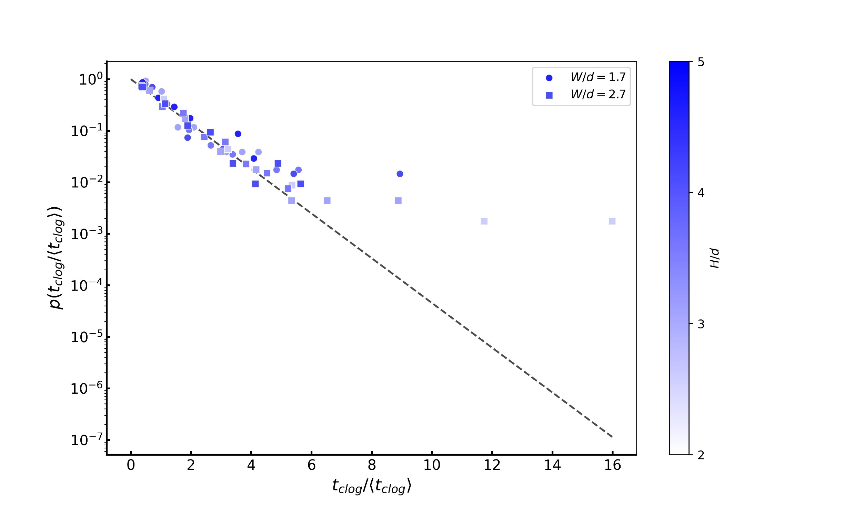
Probability Distribution Function, all clogs

Slide 9
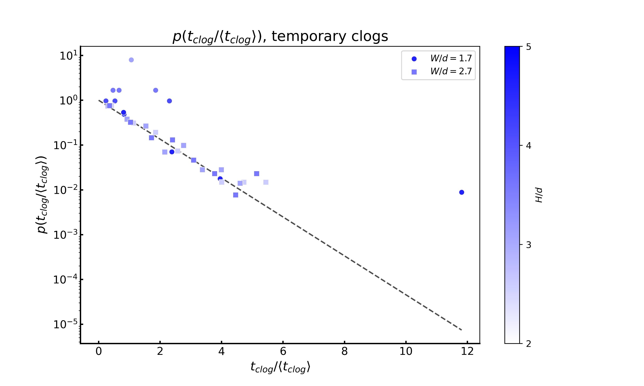
Probability Distribution Function, temporary clogs

Slide 10
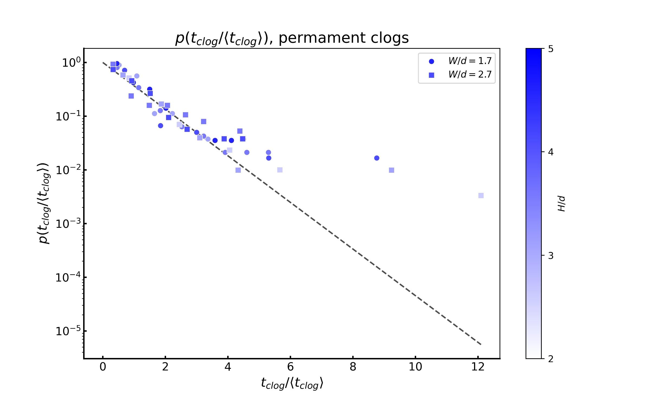
Probability Distribution Function, permanent clogs

Slide 11
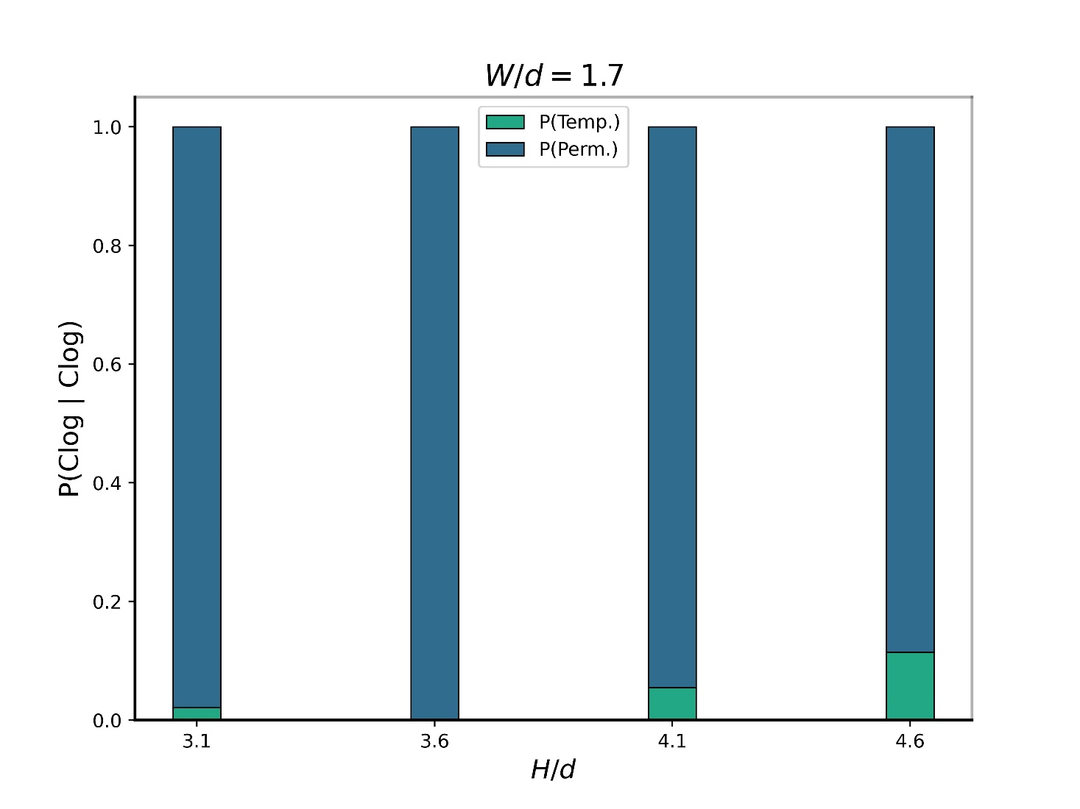
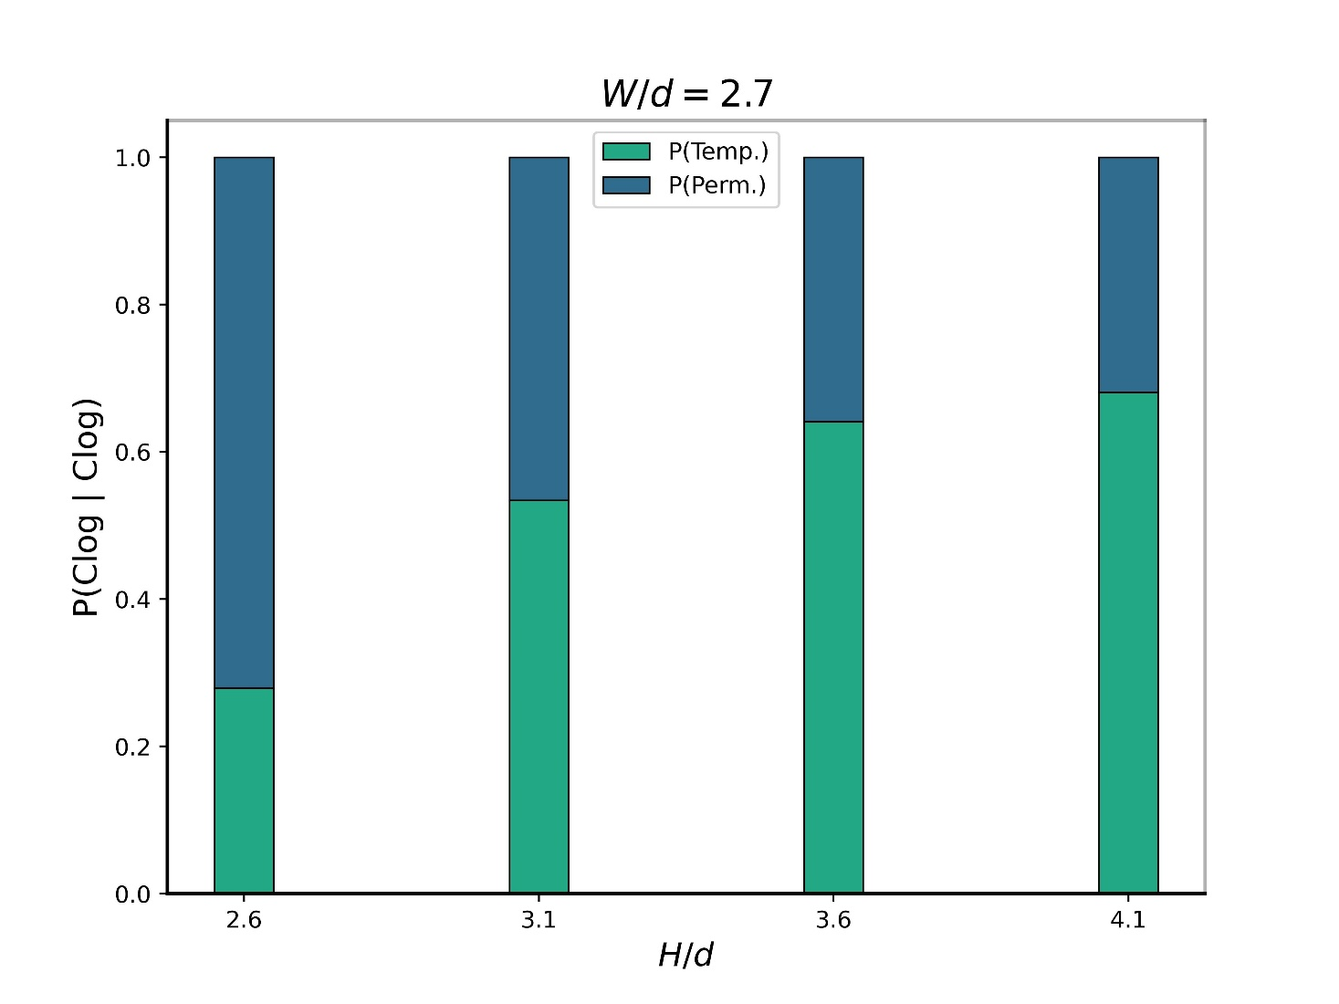
Intermittence

Slide 12
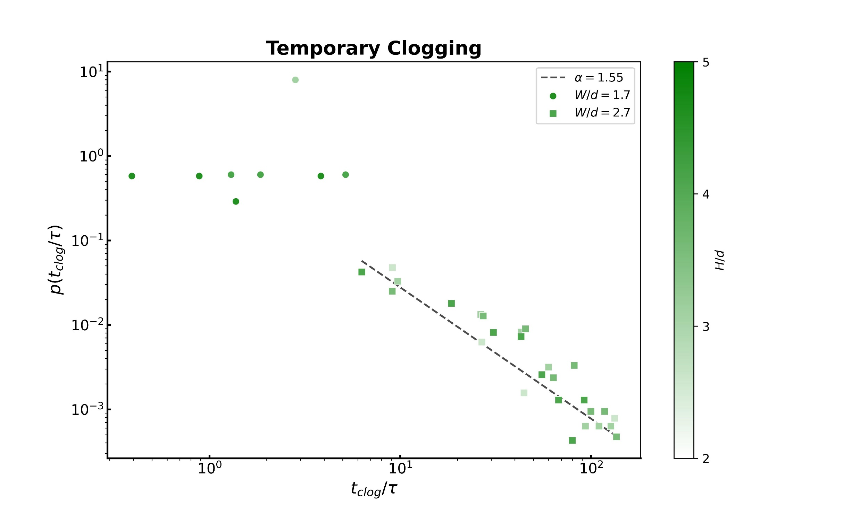
Temporary clogs – Re-scaled by Stokes time

Slide 13
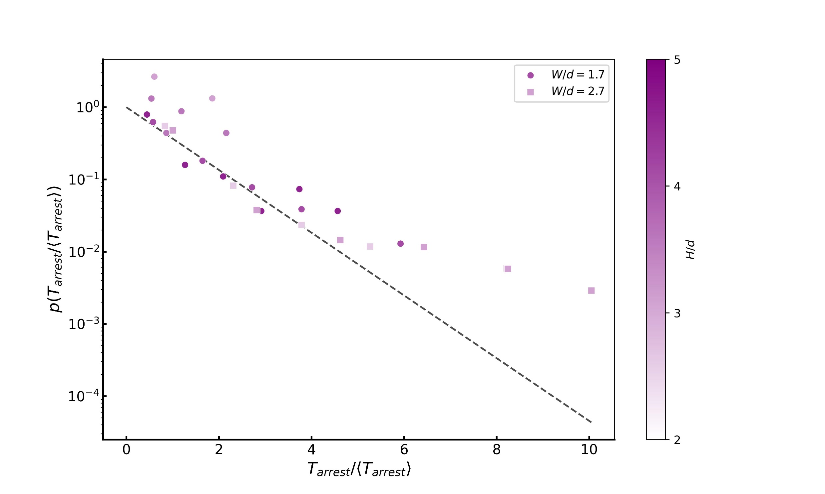
Arrest times for temporary clogs

Slide 14
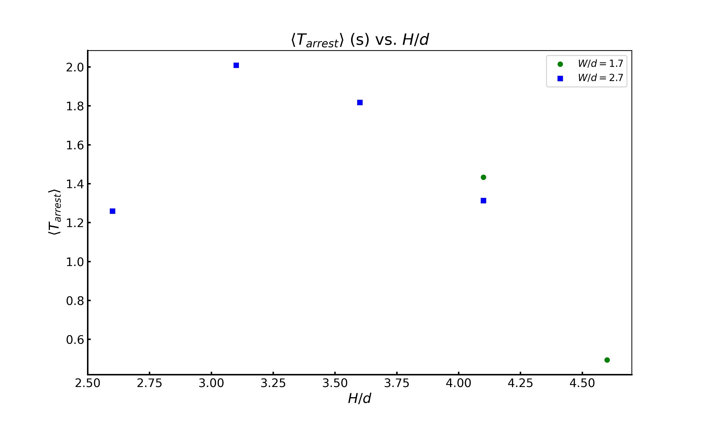
Arrest times vs. H/d

