Slide 1
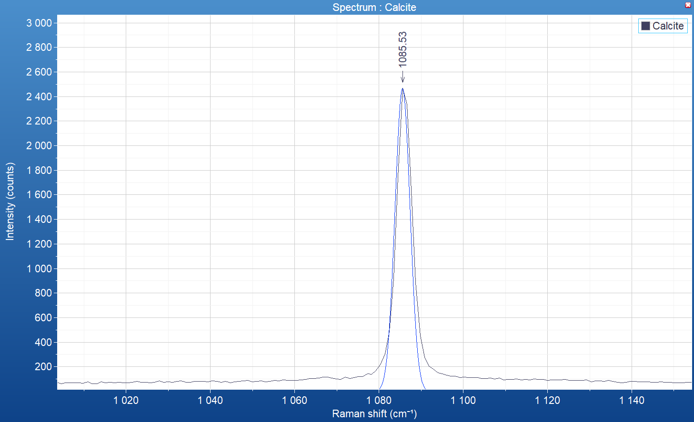
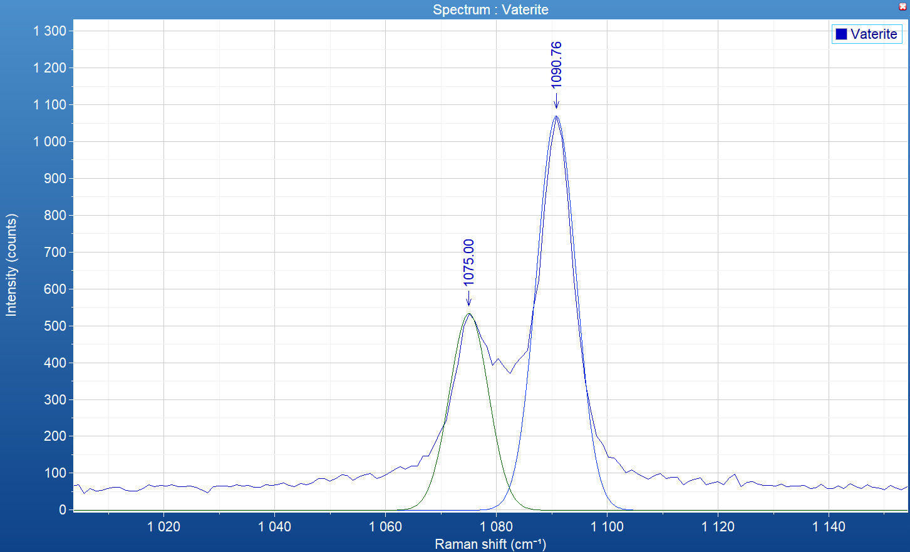
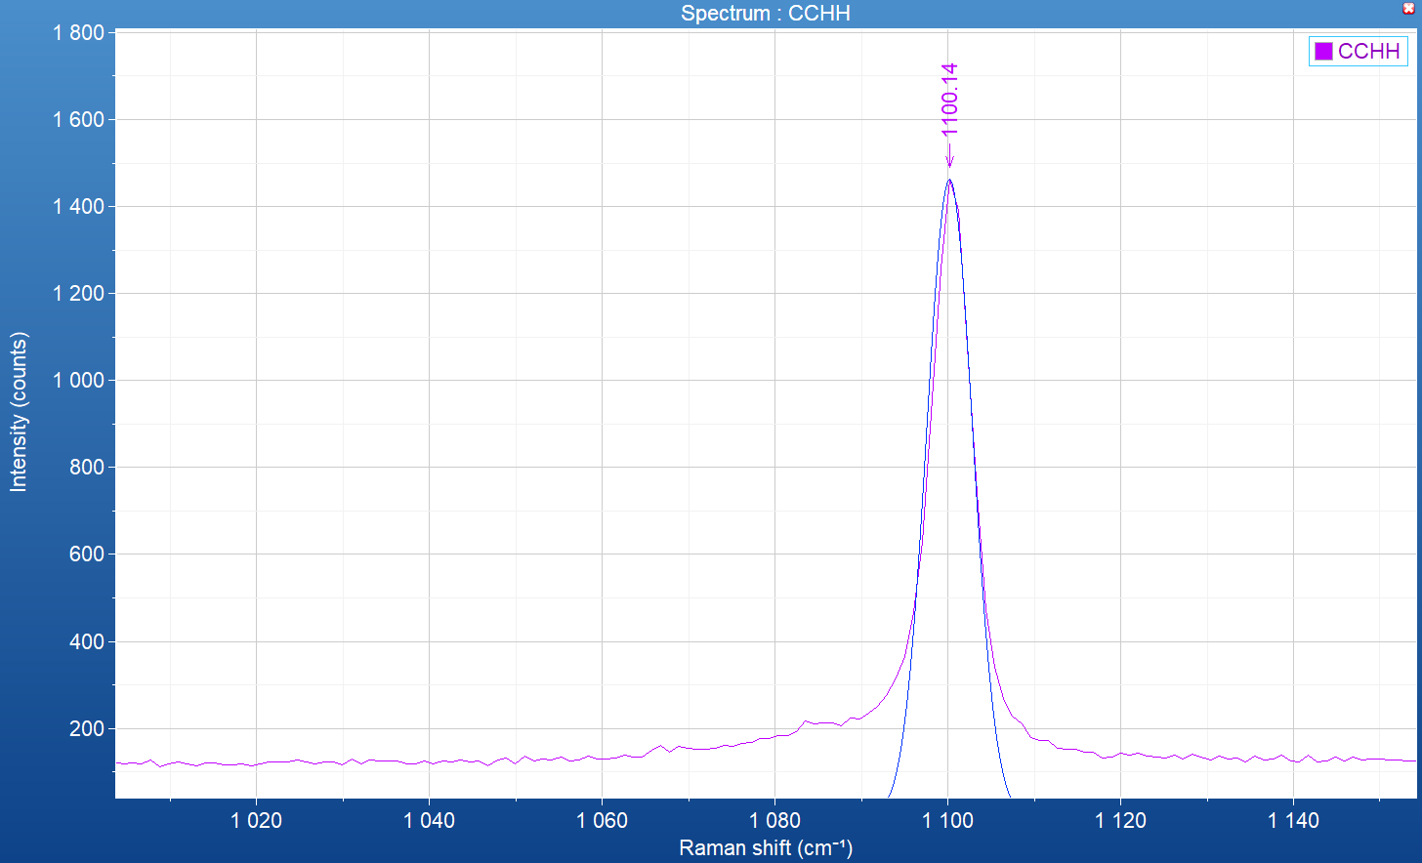
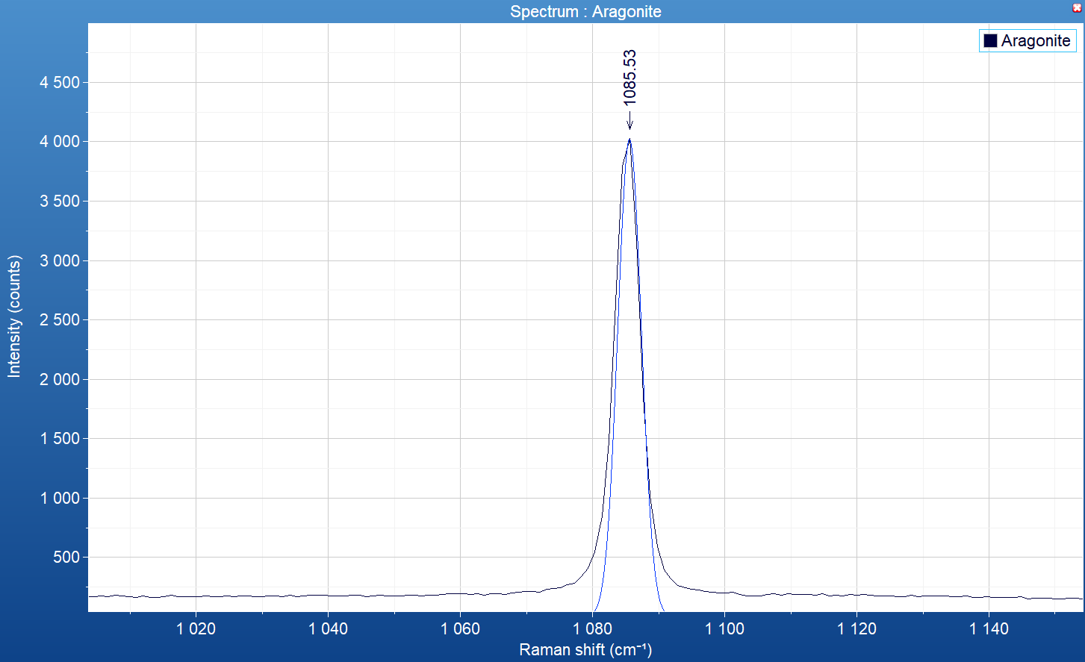
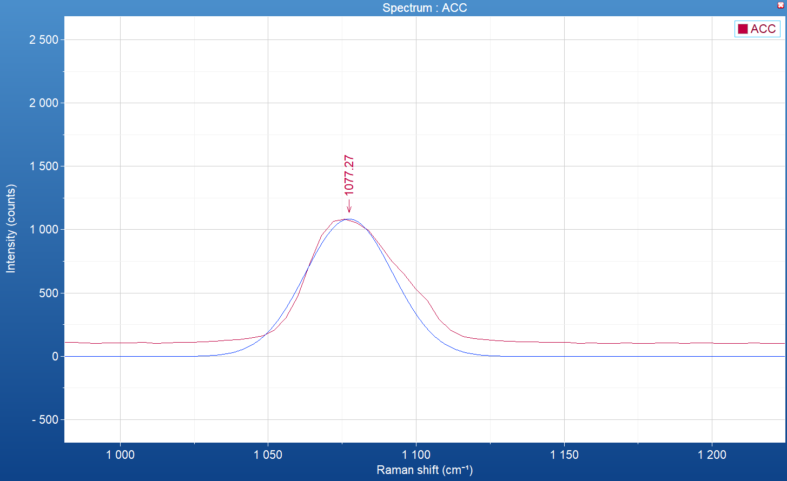
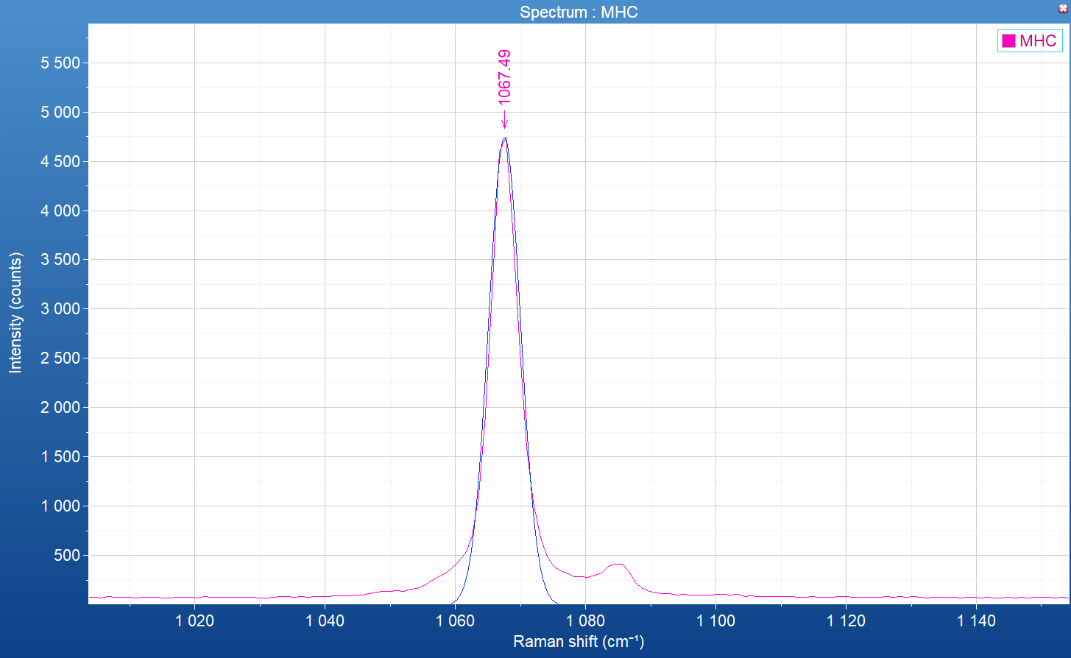
Modèle Carbonates
Résultat Raman spontané – échantillon synthétique ou géologique
sample | Calcite geologic | Aragonite geologic | Vaterite synthetic | ACC synthetic | CCHH synthetic | MHC synthetic
Nu (cm⁻¹) | 1085.5 | 1085.5 | 1075, (1080,) 1090.8 | 1077 | 1100.1 | 1067.5
FWHM (cm⁻¹) | 4.2 | 4.2 | 8.2, (?), 8.3 | 35 | 6.3 | 5.8
Vaterite synthetic
CCHH synthetic
Calcite geologic
Aragonite geologic
ACC synthetic
MHC synthetic

Slide 2
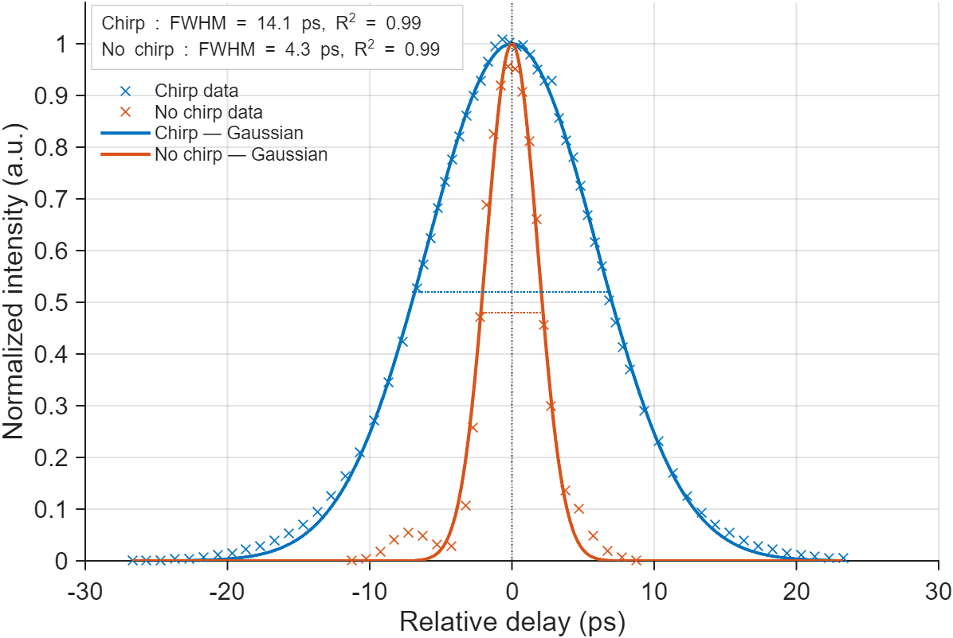
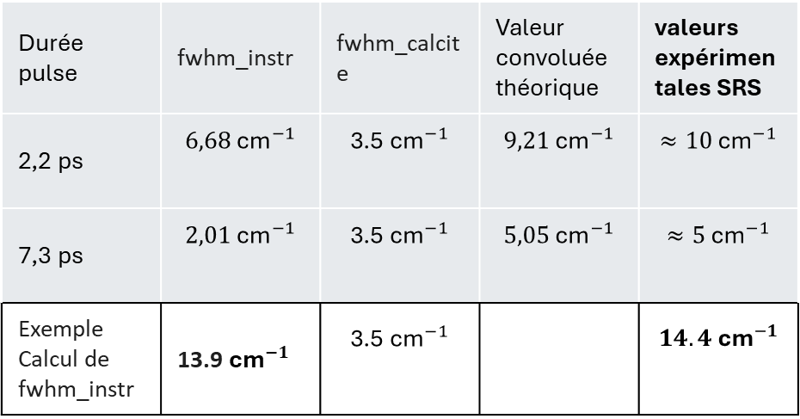
Modèle Carbonates
Résultat Raman spontané – échantillon synthétique ou géologique
sample | Calcite geologic | Aragonite geologic | Vaterite synthetic | ACC synthetic | CCHH synthetic | MHC synthetic
Nu (cm⁻¹) | 1085.5 | 1085.5 | 1075, (1080,) 1090.8 | 1077 | 1100.1 | 1067.5
FWHM (cm⁻¹) | 3.5 (4.2 avant déconvolution) | 3.5 (4.2 avant déconvolution) | 8.2, (?), 8.3 | 35 | 6.3 | 5.8
Durée pulse | fwhm_instr | fwhm_calcite | Valeur convoluée théorique | valeurs expérimentales SRS
2,2 ps | $$6,68{\text{ cm}}^{−1}$$ | $$\text{3.5}{\text{ cm}}^{−1}$$ | $$9,21{\text{ cm}}^{−1}$$ | $$≈10{\text{ cm}}^{−1}$$
7,3 ps | $$2,01{\text{ cm}}^{−1}$$ | $$\text{3.5}{\text{ cm}}^{−1}$$ | $$5,05{\text{ cm}}^{−1}$$ | $$≈5{\text{ cm}}^{−1}$$
Exemple Calcul de fwhm_instr | 13.9${\text{cm}}^{−1}$ | $$\text{3.5}{\text{ cm}}^{−1}$$ |  | $$14.4{\text{ cm}}^{−1}$$
Spectral Resolutions (Hole50m, 100x Objective, FWHM) for the 2 main gratings:
- Grating 1800 g/mm: 585.25 nm 1.66cm-1 (<2.3 cm-1) / 837.76 nm= 0.65 cm-1 (<1.1 cm-1)

Slide 3
Modèle Carbonates
Paramètres | Calcite | Aragonite | Vaterite | ACC | CCHH | MHC
Nu (cm⁻¹) | 1085.5¹ 1085.9³ | 1085.5¹ 1086² 1084³ | [1075, (1080,) 1090.8]¹ [1073.8, 1080, 1089.5] ³ | 1077¹ 1075² 1073⁴ 1085⁵ | 1100.1¹ 1097² | 1067.5¹
FWHM (cm⁻¹) | 3.5¹ | 3.5 ^{1,6} | [8.2, (8 aussi?), 8.3]¹ | 35¹ 30⁴ | 6.3¹ | 5.8¹
nu_LB (cm⁻¹) | 1084.5 | 1084 | 1073 | 1073,1070(coral) | 1097 | 1066
nu_UB (cm⁻¹) | 1086.5 | 1086.5 | 1093 | 1082 | 1102 | 1070
FWHM_LB (cm⁻¹) | 1 | 1 | 3 | 20 | 3 | 3
FWHM_UB (cm⁻¹) | 5 | 5 | 10 | 40 | 10 | 10
¹Résultats raman spontané – synthétique ou géologique (cal et ara)
²Dicko, Hamadou, et al. "3D Calcium carbonate polymorphs imaging with stimulated Raman scattering in biominerals." Faraday Discussions 261 (2025): 286-297. – biogénique (corail)
³Colas, C. (2022). Bio-inspired synthetic crystals (Doctoral dissertation, Université Paris-Saclay).
⁴Duboisset et al., « Amorphous-to-Crystal Transition in the Layer-by-Layer Growth of Bivalve Shell Prisms ». – biogenique (huitre)
⁵Lia Addadi et al “Taking Advantage of Disorder: Amorphous Calcium Carbonate and Its Roles in Biomineralization” – biogenique (juvenil huitre, oursin)
⁶ Farfan et al (2021)“Crystallographic and chemical signatures in coral skeletal aragonite” (National Museum of Natural History, Washington, DC, USA) – corail

Slide 4
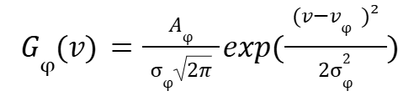


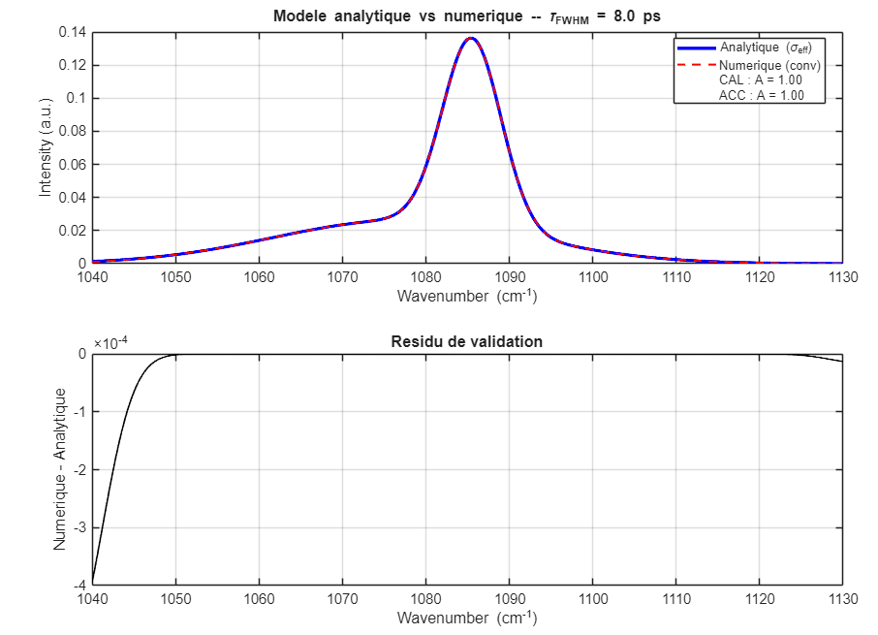
Modèle Carbonates – Réponse instrumentale
Modèle gaussien pour chaque phase :
Convolué avec
Modèle gaussien de la réponse instrumentale :
➔ Analytiquement :
En comparaison avec l’anlyse numérique utilisant la fonction conv() :

Slide 5
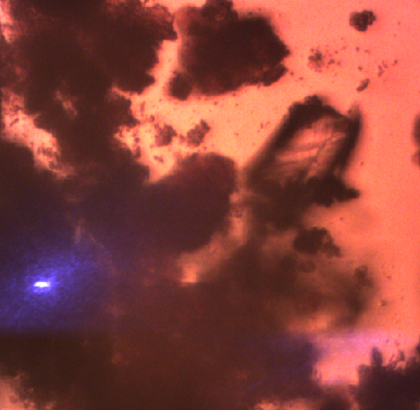
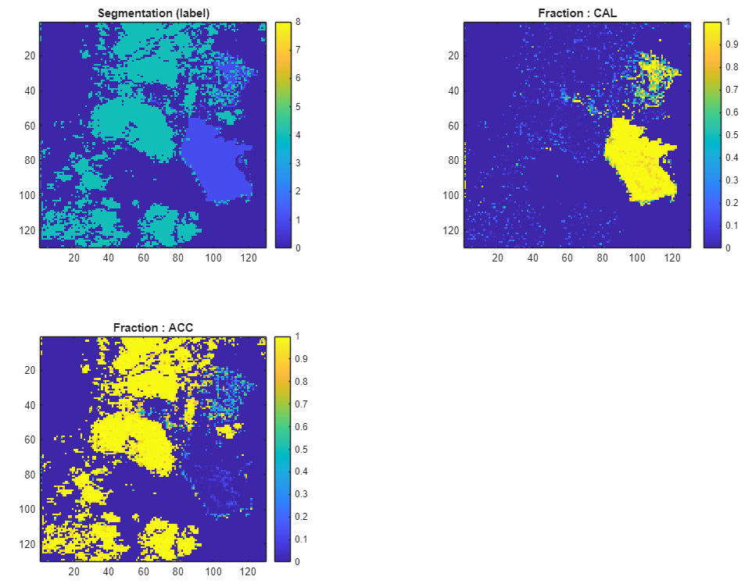
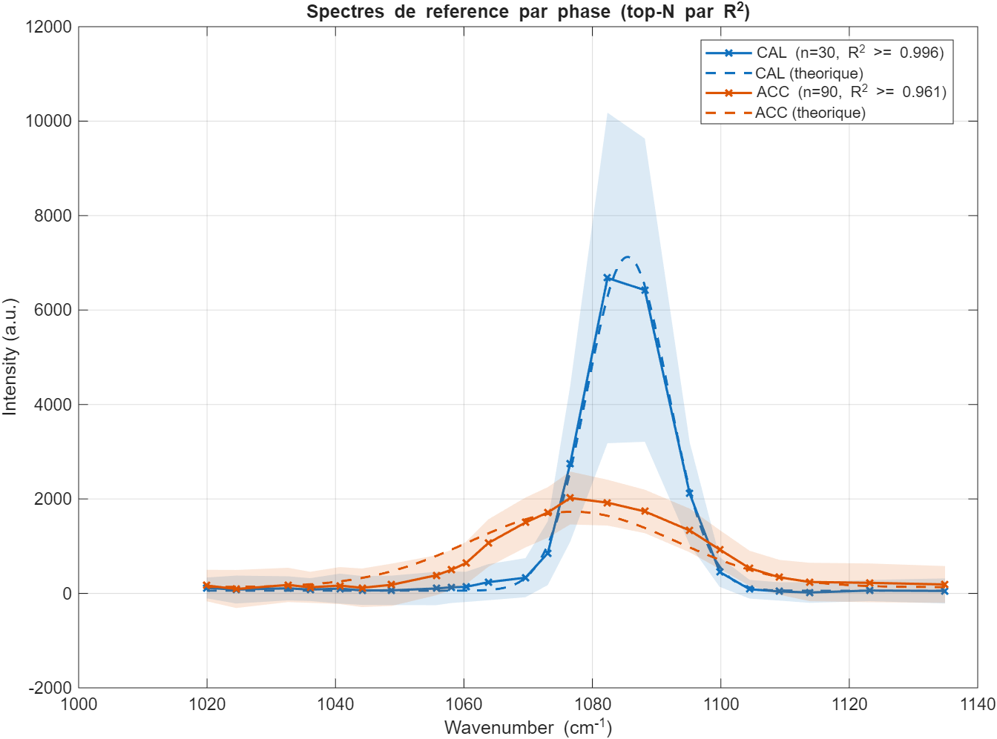
2ps - 260708 ACC_Cal – lsqcurvefit Map
Phase 1 : CAL
A_mean = 3691.1 +/- 1833.8
nu = 1085.3015 +/- 0.3722 cm^-1
FWHM = 1.6533 +/- 1.0651 cm^-1
Phase 4 : ACC
A_mean = 714.78 +/- 162
nu = 1081.0182 +/- 0.9139 cm^-1
FWHM = 28.2891 +/- 2.0484 cm^-1
Aacc/Acal>0.3

Slide 6
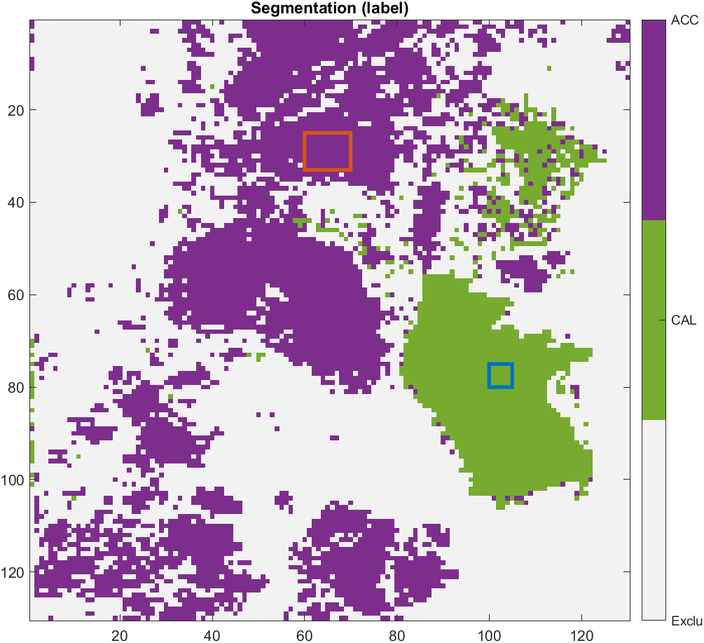
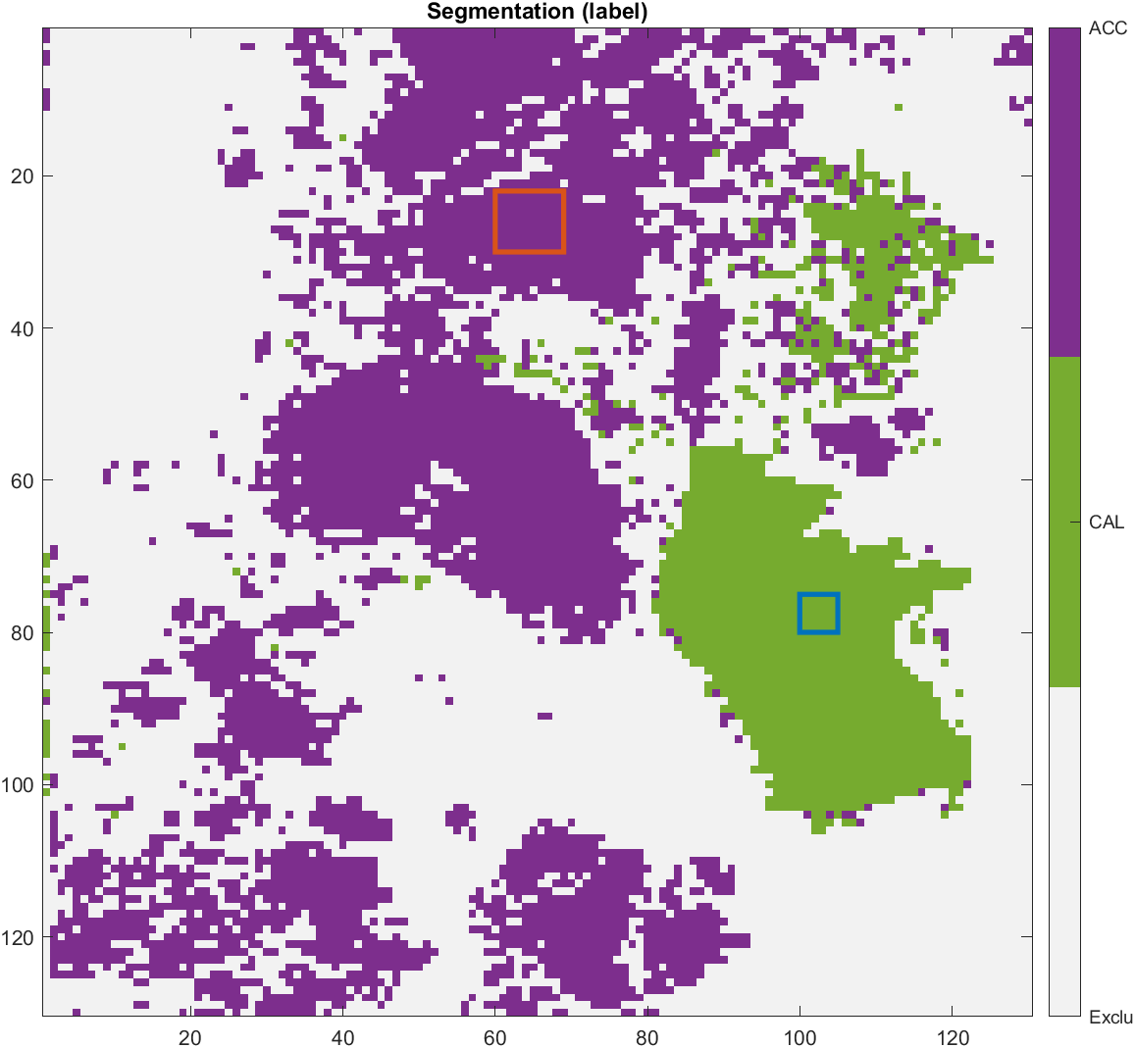
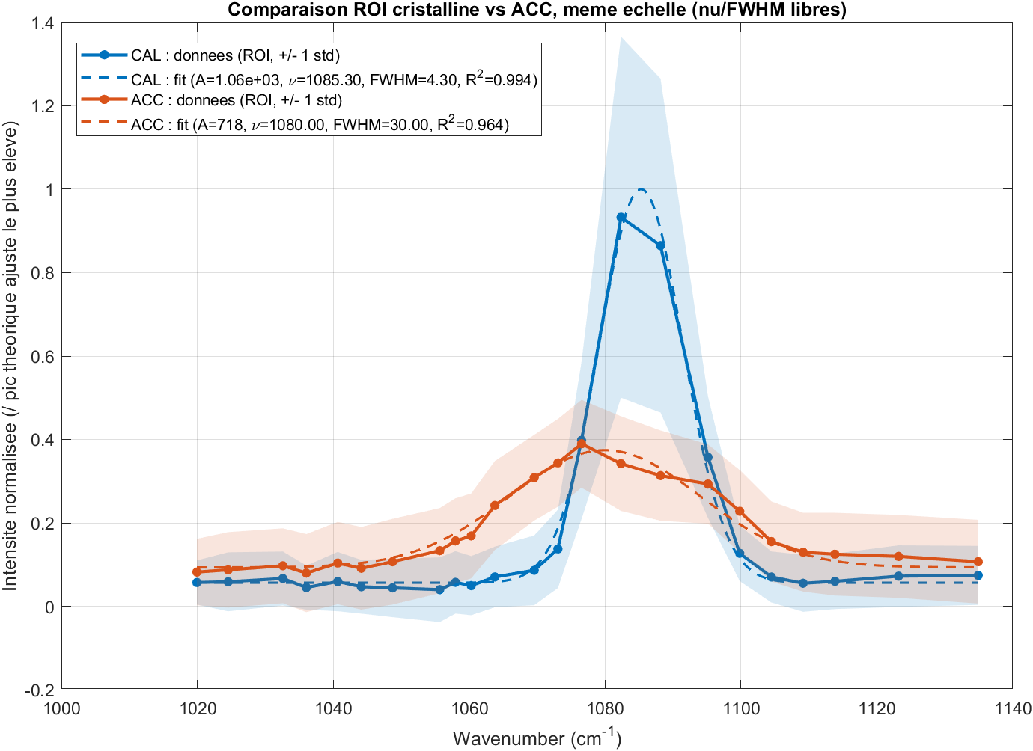
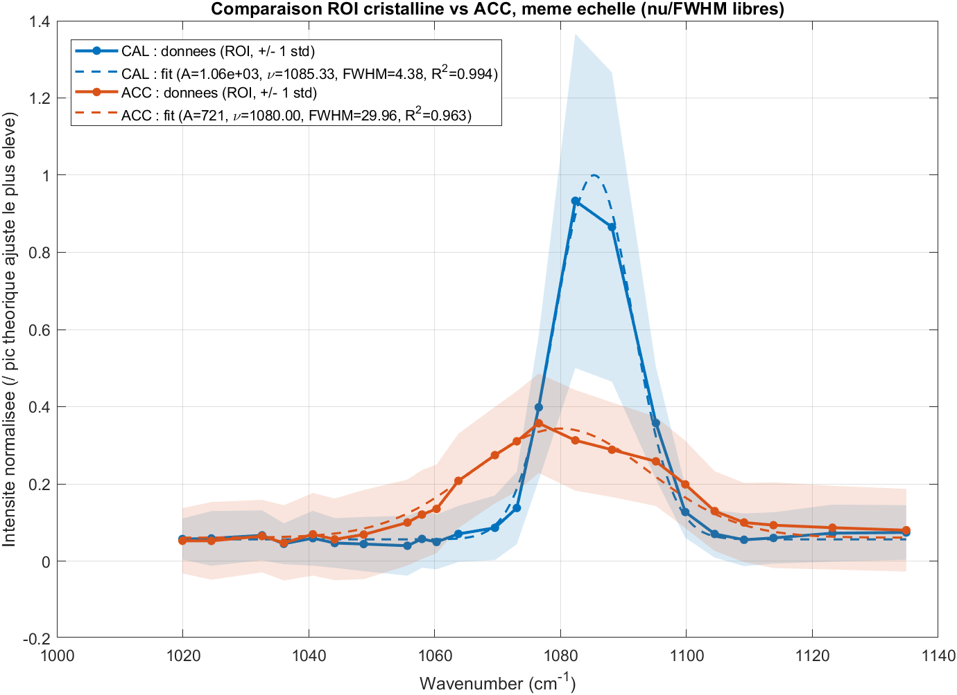
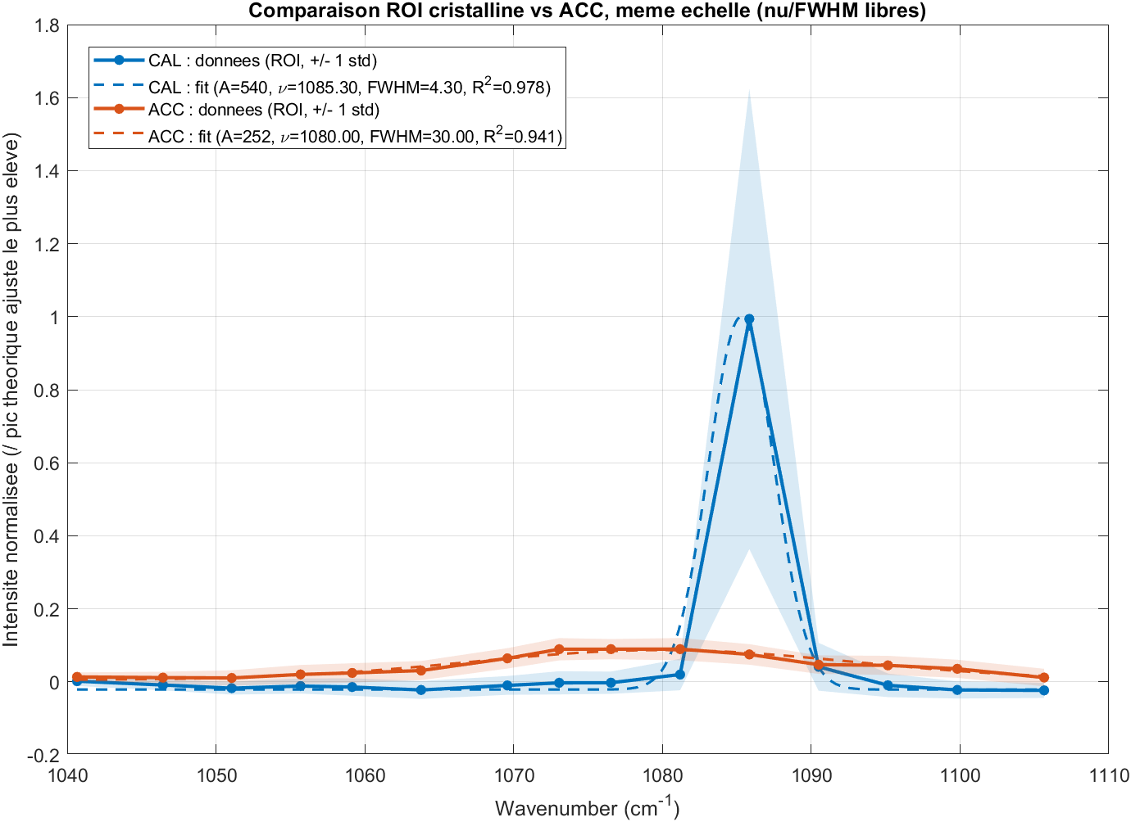
2ps - 260708 ACC_Cal – Map

Slide 7
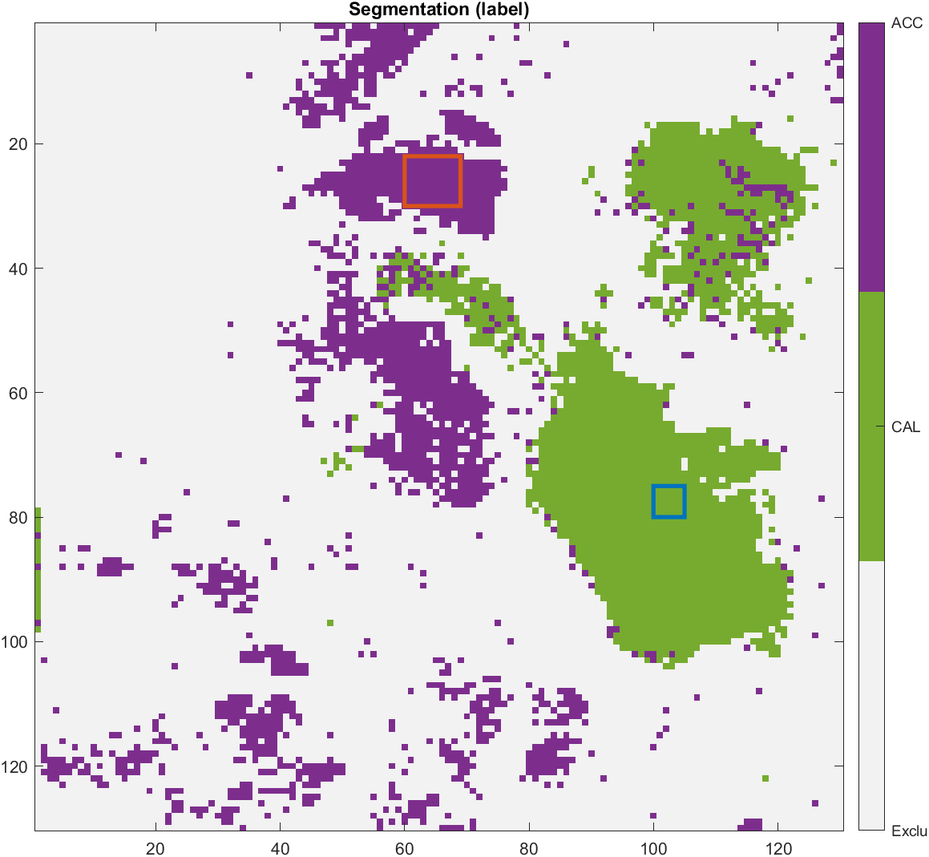
7ps - 260708 ACC_Cal – Map

Slide 8
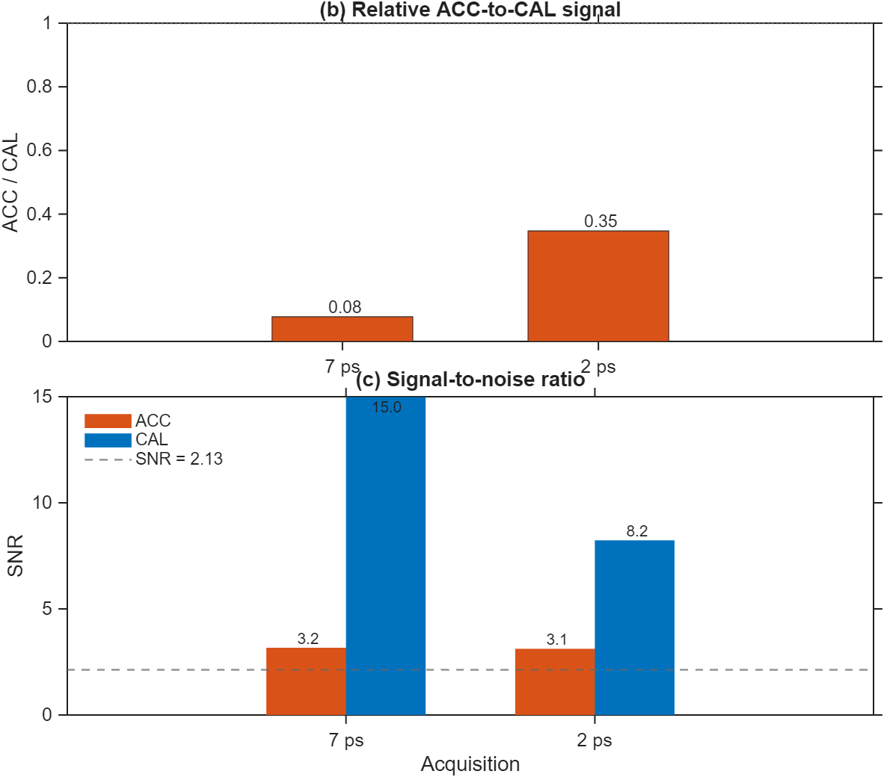
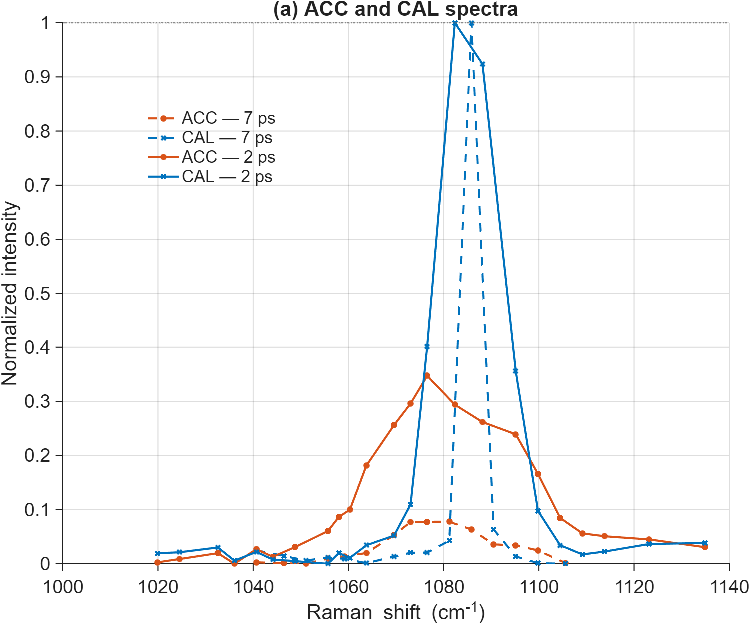
2ps vs 7ps - 260708 ACC_Cal synt

Slide 9
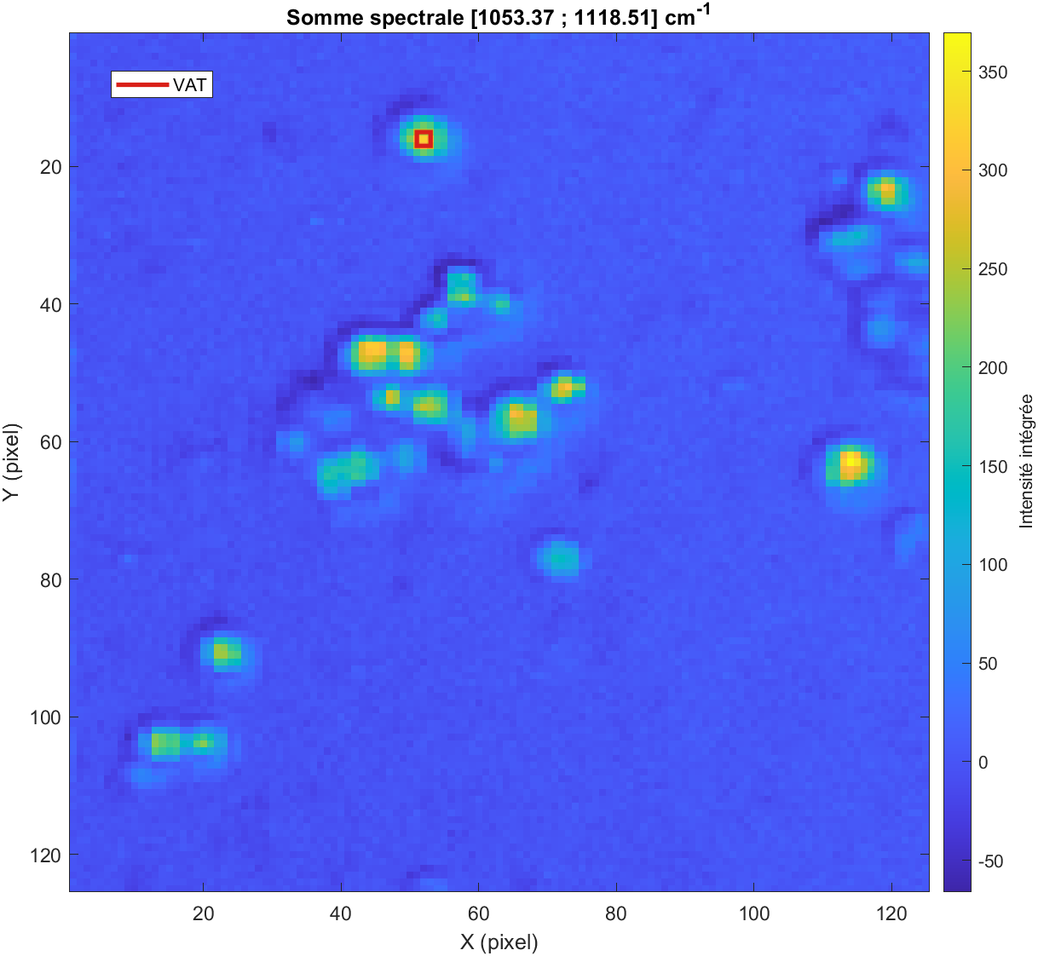
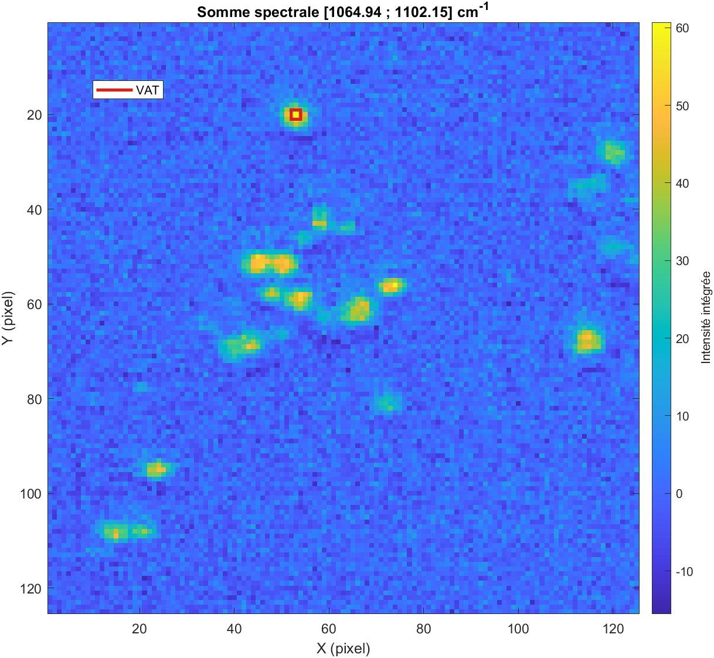
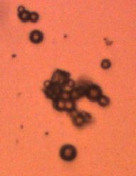
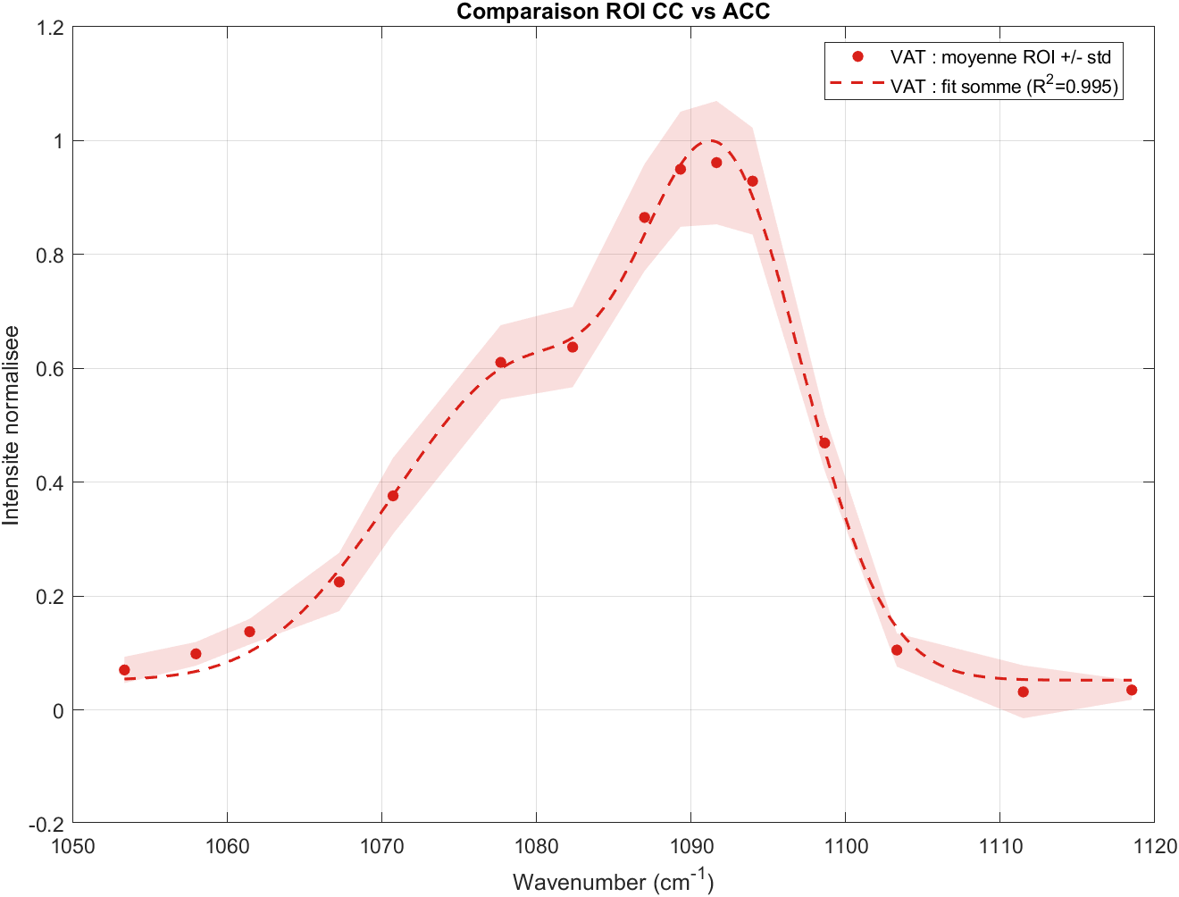
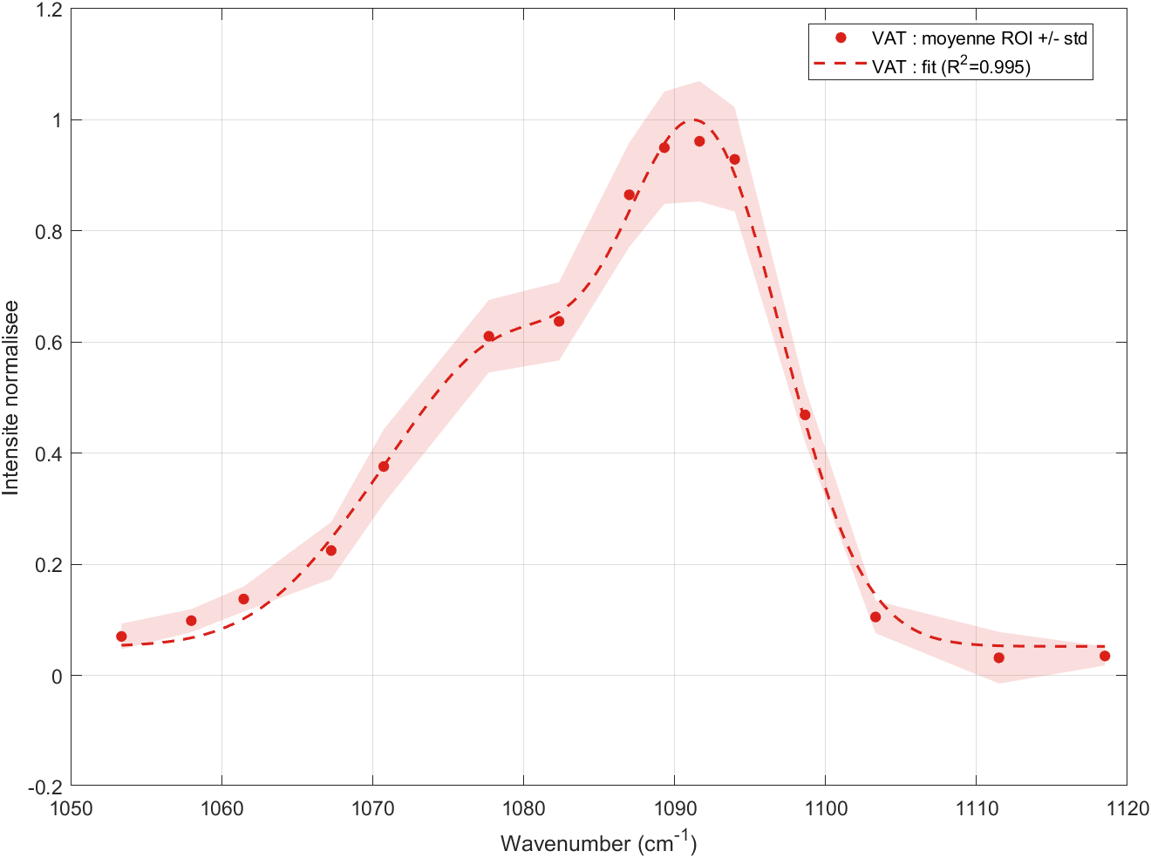
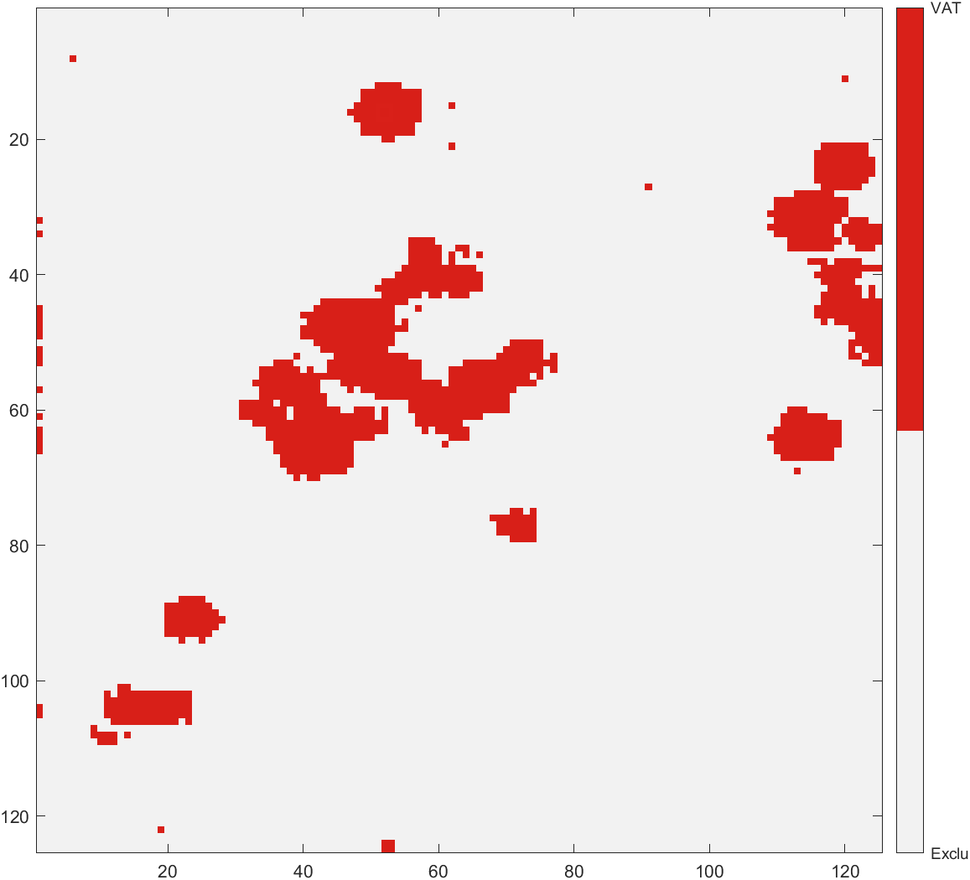
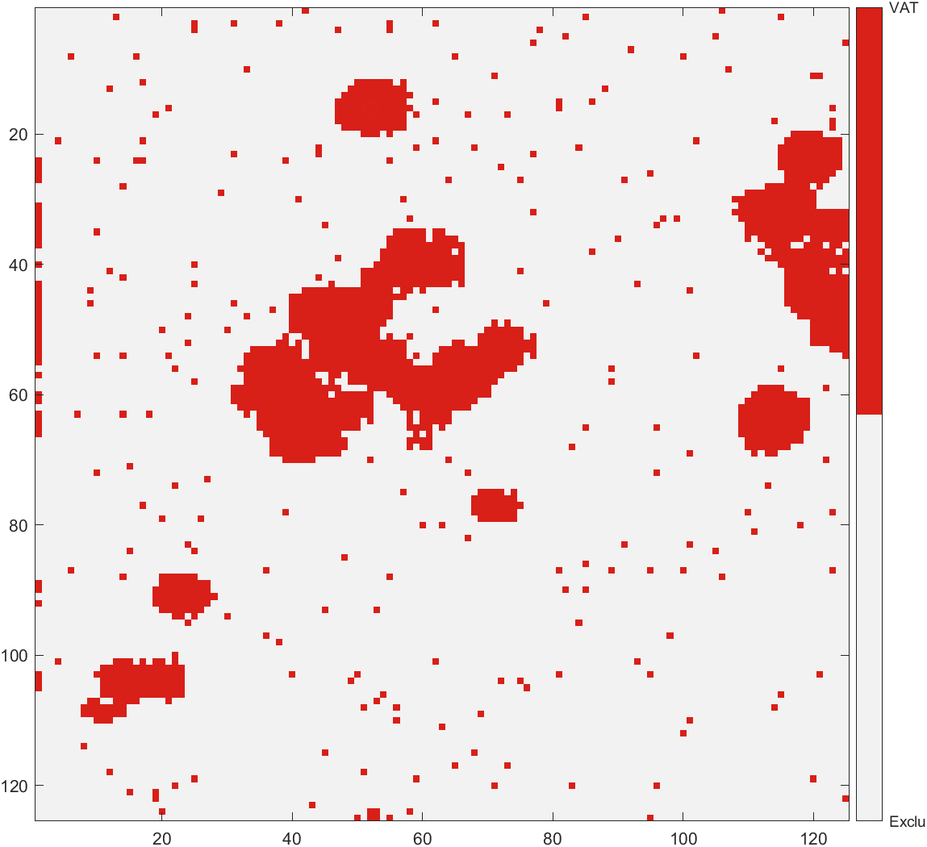
2ps 260527 Vatérite
Phase VAT : A_fit = 8050.1
  - Raie 1 : nu = 1073.8006 cm^-1
  - Raie 2 : nu = 1080.2310 cm^-1
  - Raie 3 : nu = 1091.7282 cm^-1
  - FWHM 1 : FWHM = 10.0000 cm^-1
  - FWHM 2 : FWHM = 3.0289 cm^-1
  - FWHM 3 : FWHM = 5.5216 cm^-1

Slide 10
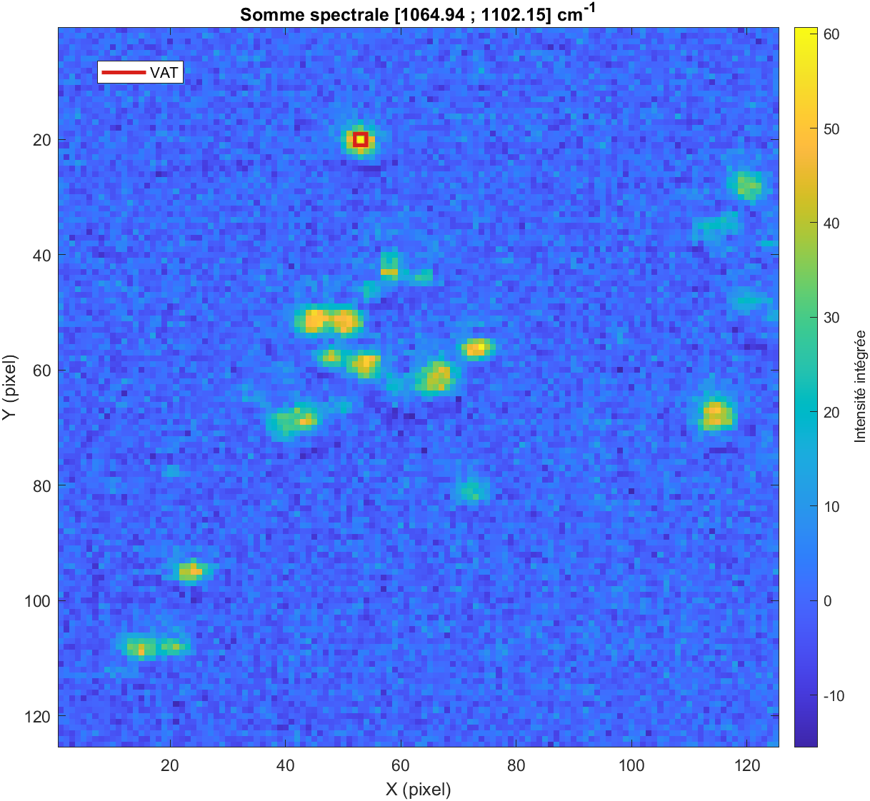
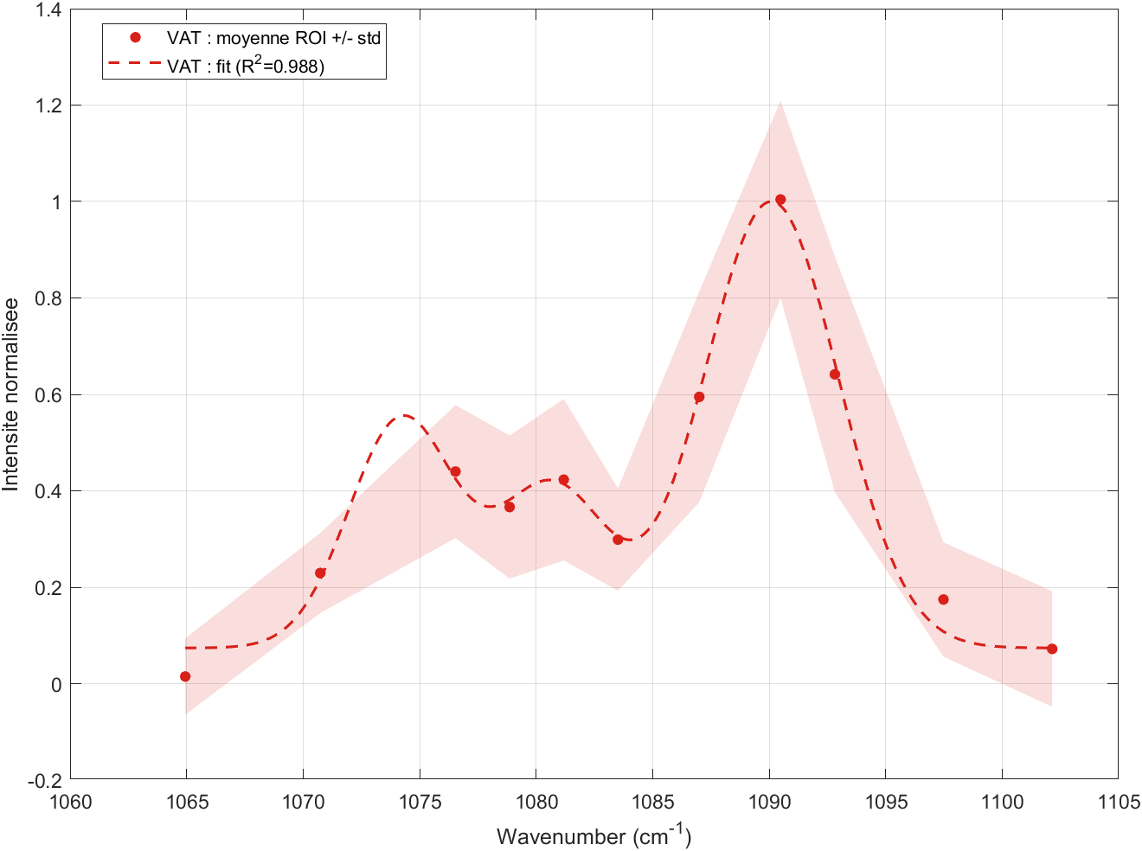
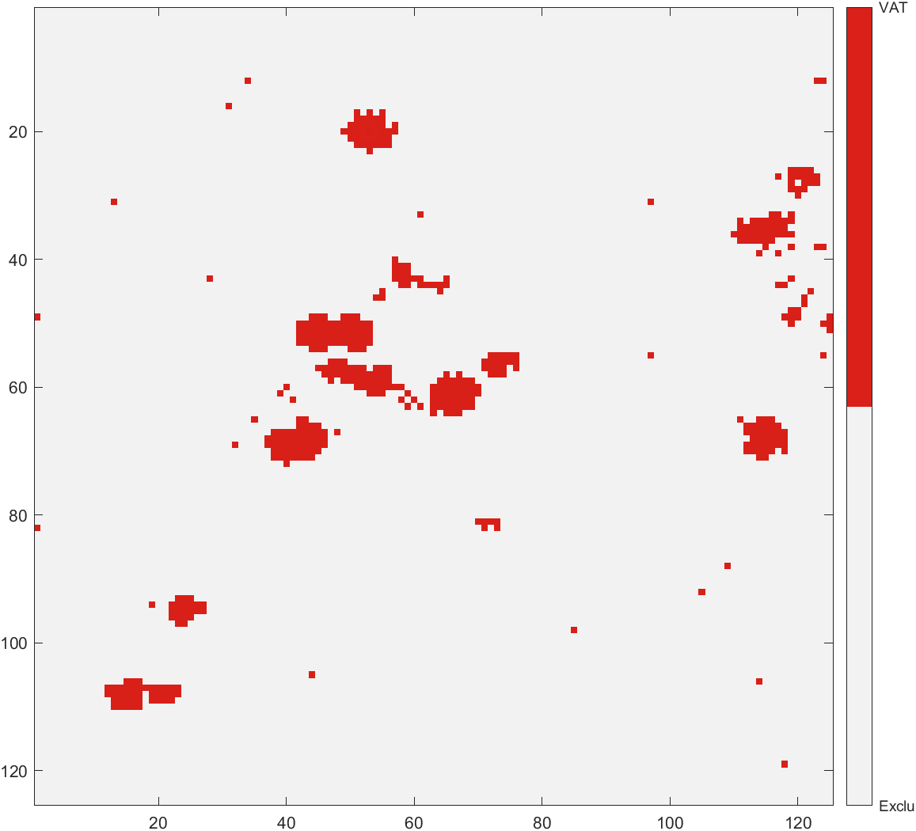
7ps 260527 Vatérite
Phase VAT : A_fit = 1071.1
  - Raie 1 : nu = 1074.2124 cm^-1
  - Raie 2 : nu = 1080.6756 cm^-1
  - Raie 3 : nu = 1090.0957 cm^-1
  - FWHM 1 : FWHM = 3.1743 cm^-1
  - FWHM 2 : FWHM = 3.6489 cm^-1
  - FWHM 3 : FWHM = 5.2779 cm^-1

Slide 11
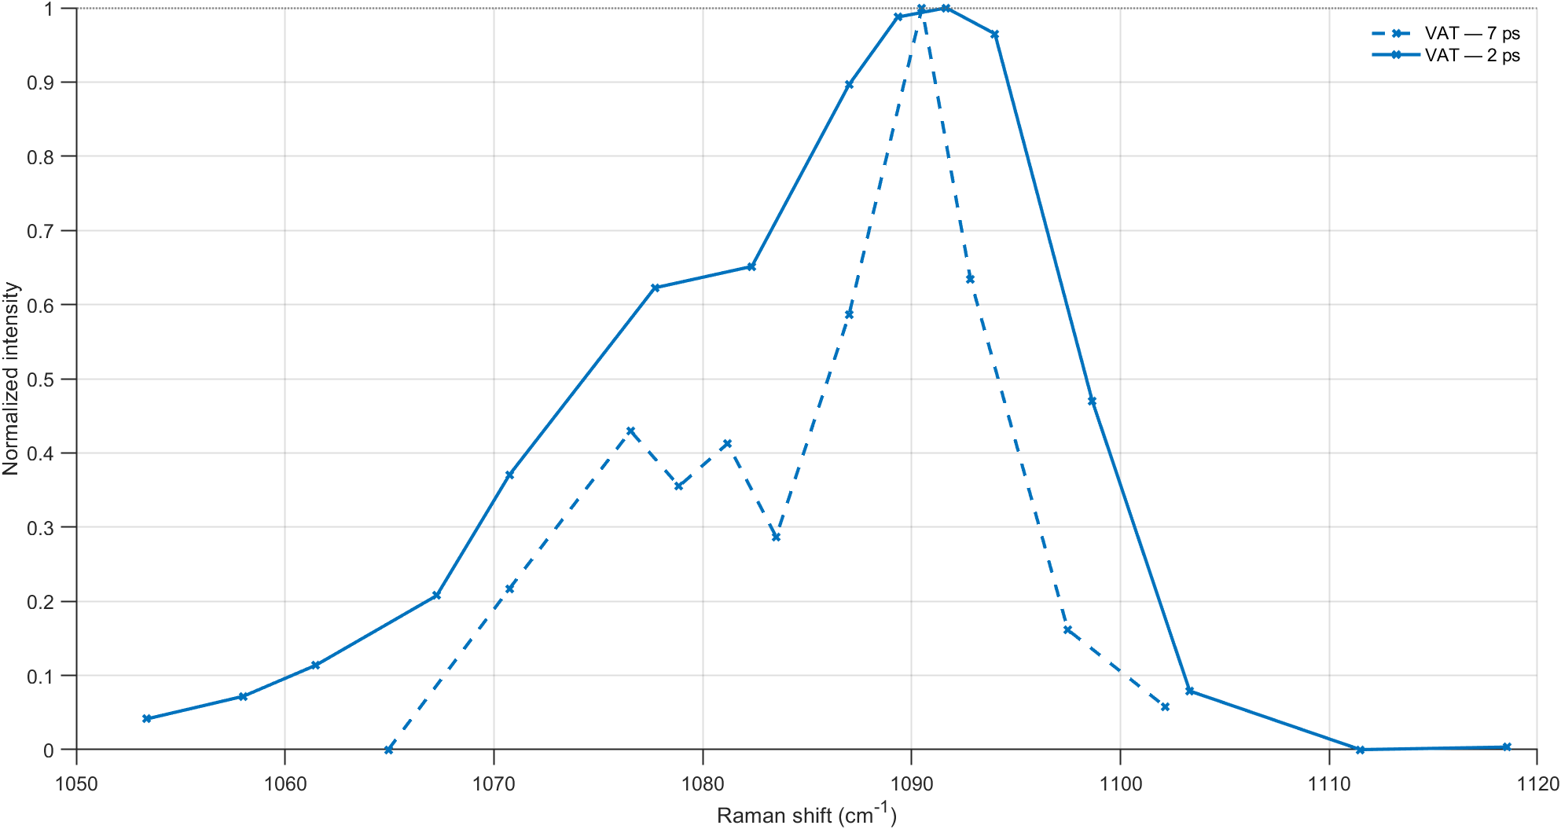
2ps vs 7ps 260527 Vatérite

Slide 12
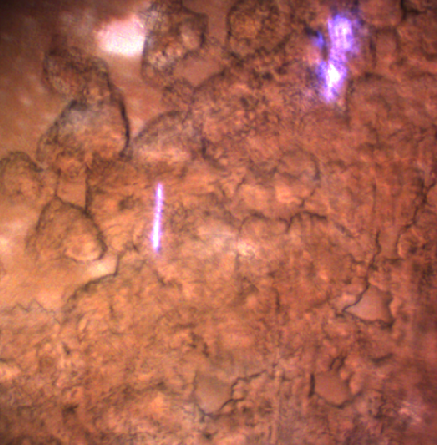
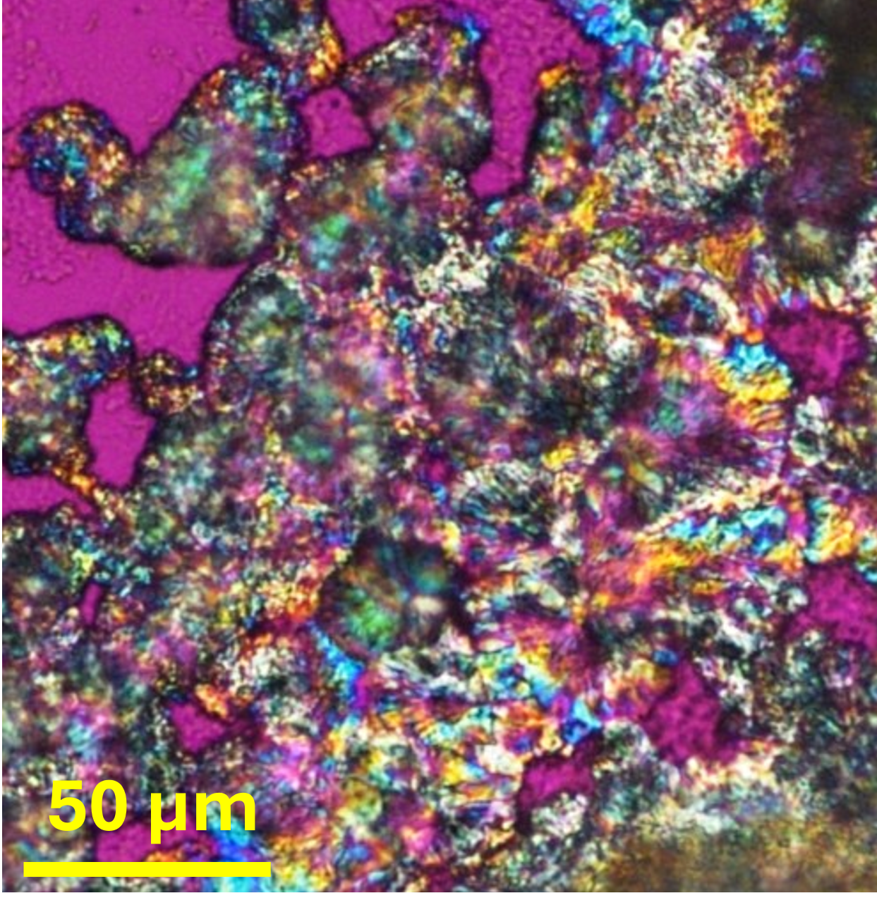
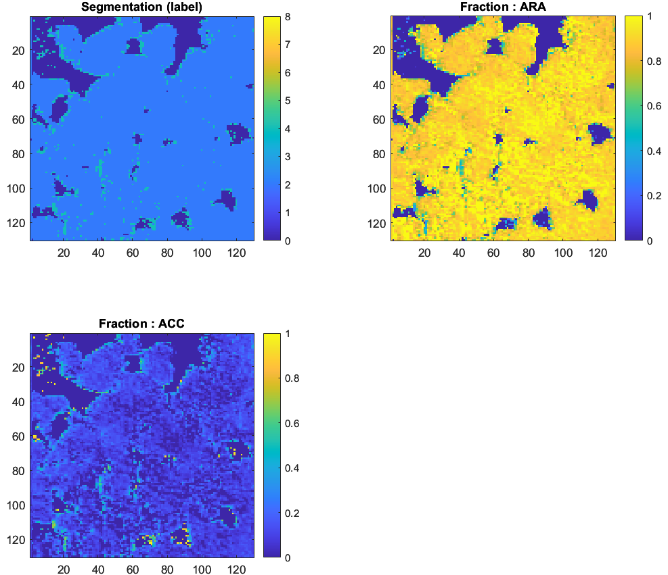
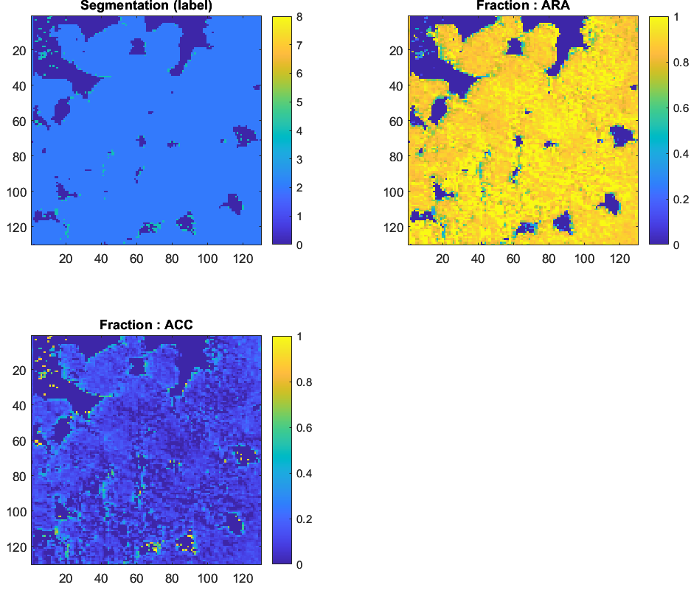
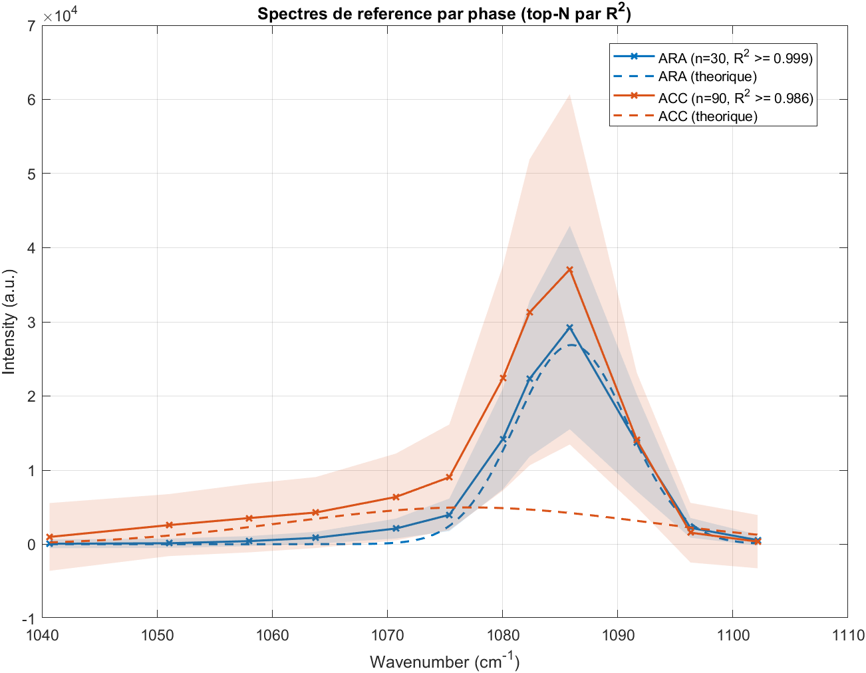
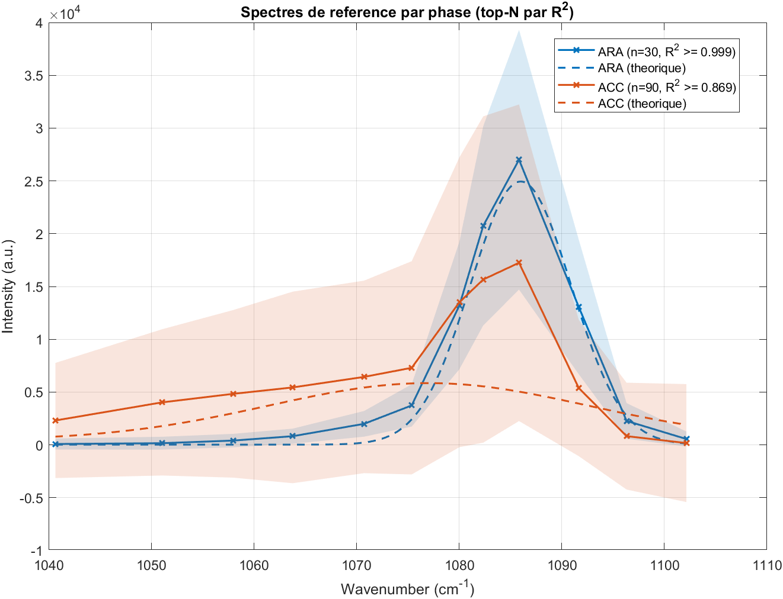
Corals 260715 2ps (#4 stressed)
Aacc/Acal>1
Aacc/Acal>0.3
  ARA : Phase ara : A_mean = 11615 +/- 5235.2
  Phase acc : A_mean = 1673.2 +/- 908
  nu = 1085.9181 +/- 0.1665 cm^-1
  FWHM_deconvolve = 1.1279 +/- 0.3712 cm^-1
  Mean = 0.82211;Std = 18.902
  ACC : Phase ara : A_mean = 4316.2 +/- 2845.1
  Phase acc : A_mean = 2218.1 +/- 1386.1
  nu = 1073.7361 +/- 2.2470 cm^-1
  FWHM_deconvolve = 31.3916 +/- 6.8866 cm^-1
  Mean = -1.0486;Std = 43.549
Aacc/Acal>0.3
Aacc/Aara>0.3
Aacc/Aara>1

Slide 13
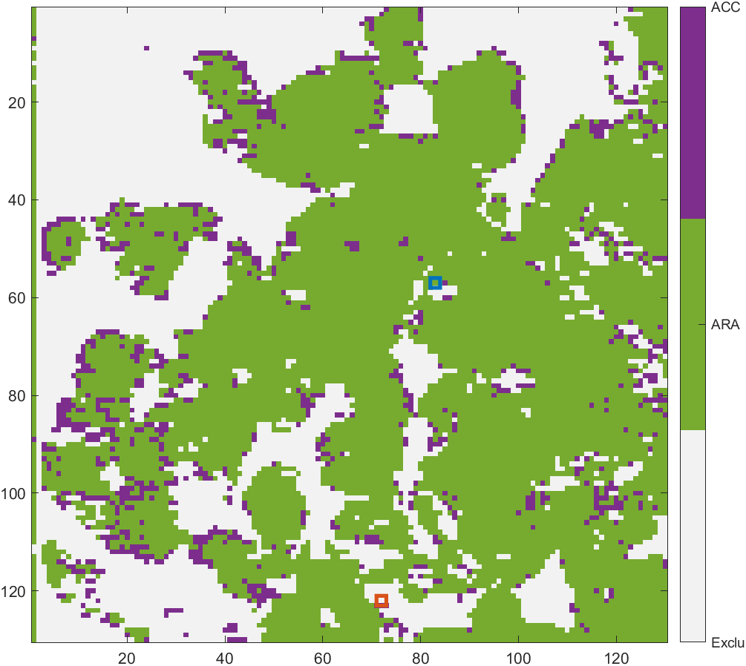
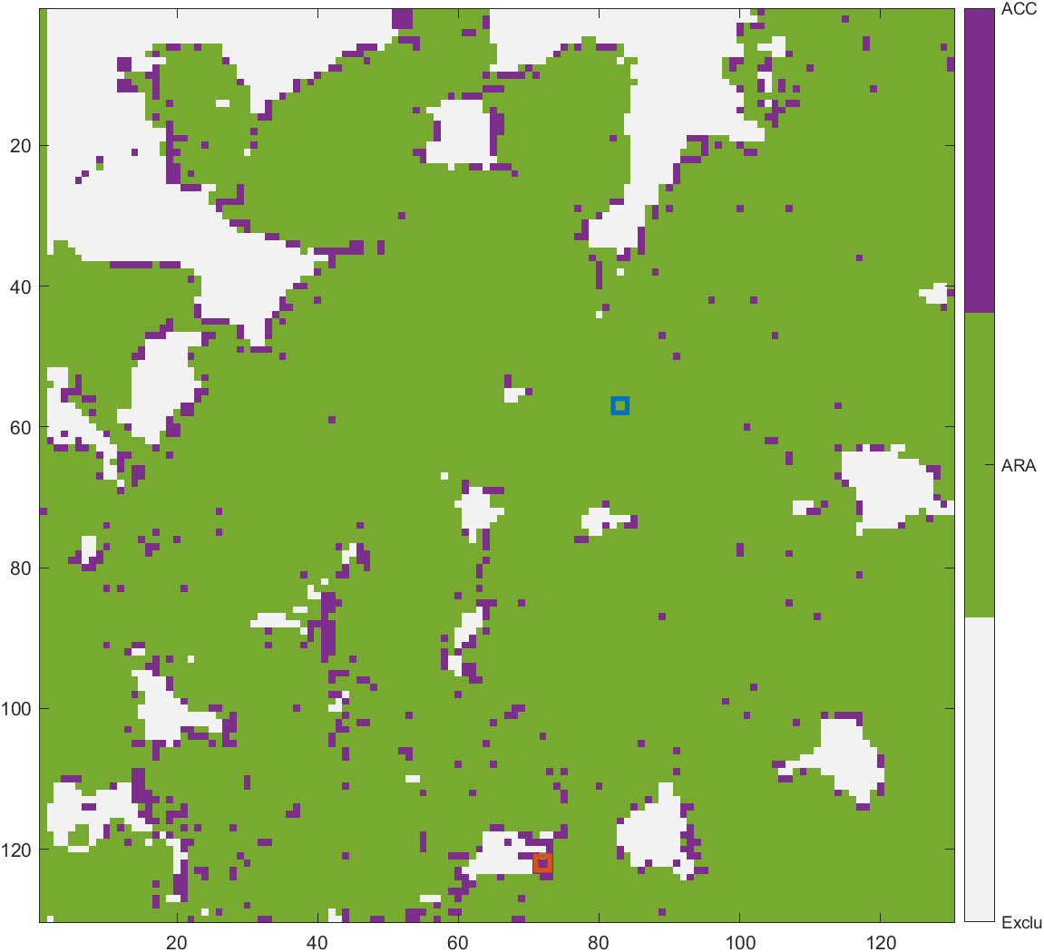
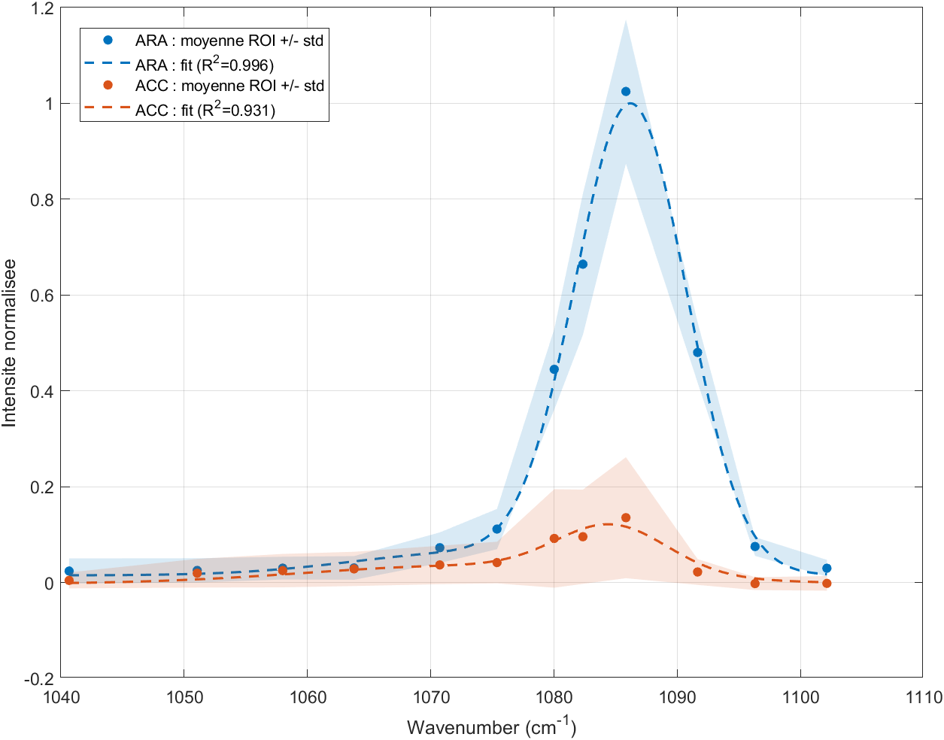
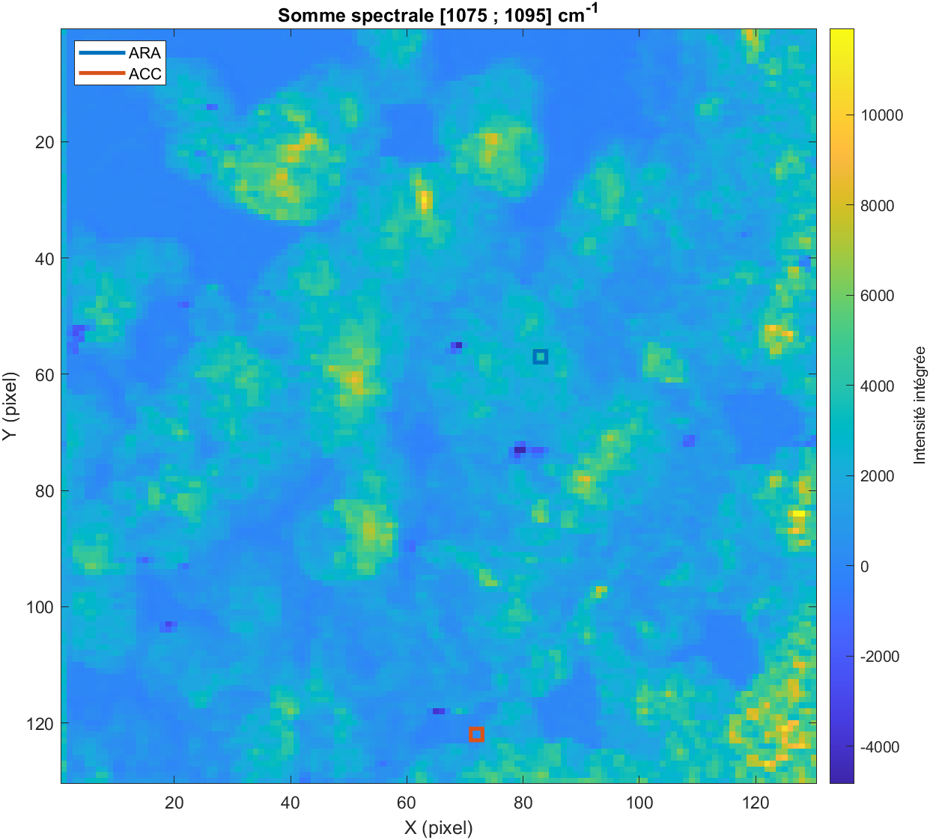
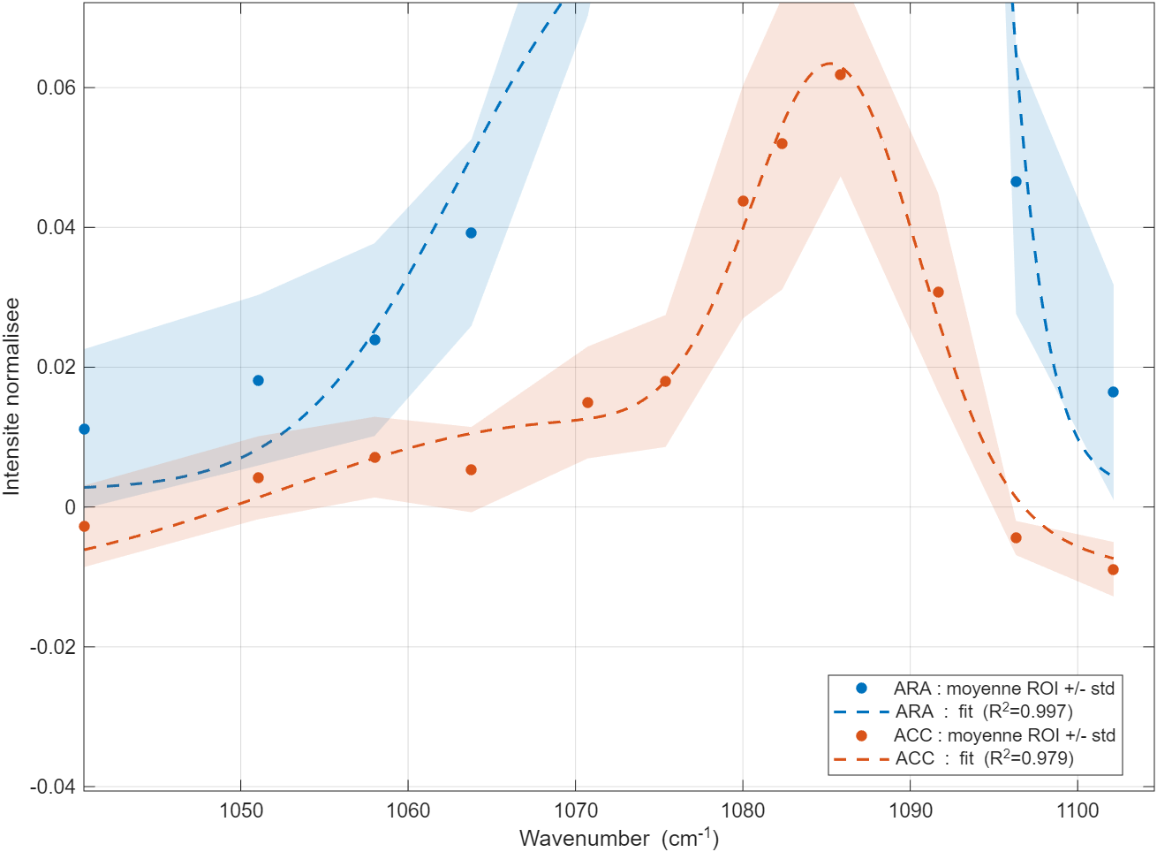
Corals 260715 2ps (#4 stressed)
7ps
Spectre ACC :
ARA : A_fit = 12139
ACC : A_fit = 13594
ARA : nu = 1084.7373 cm^-1
ACC : nu = 1073.0000 cm^-1
ARA : FWHM = 1.0000 cm^-1
ACC : FWHM = 29.1308 cm^-1

Slide 14
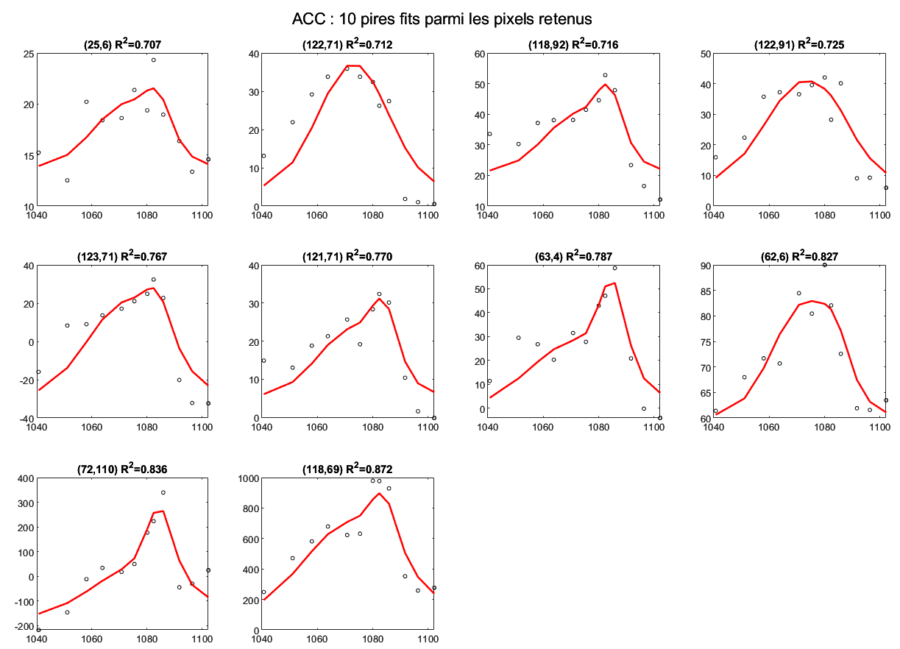
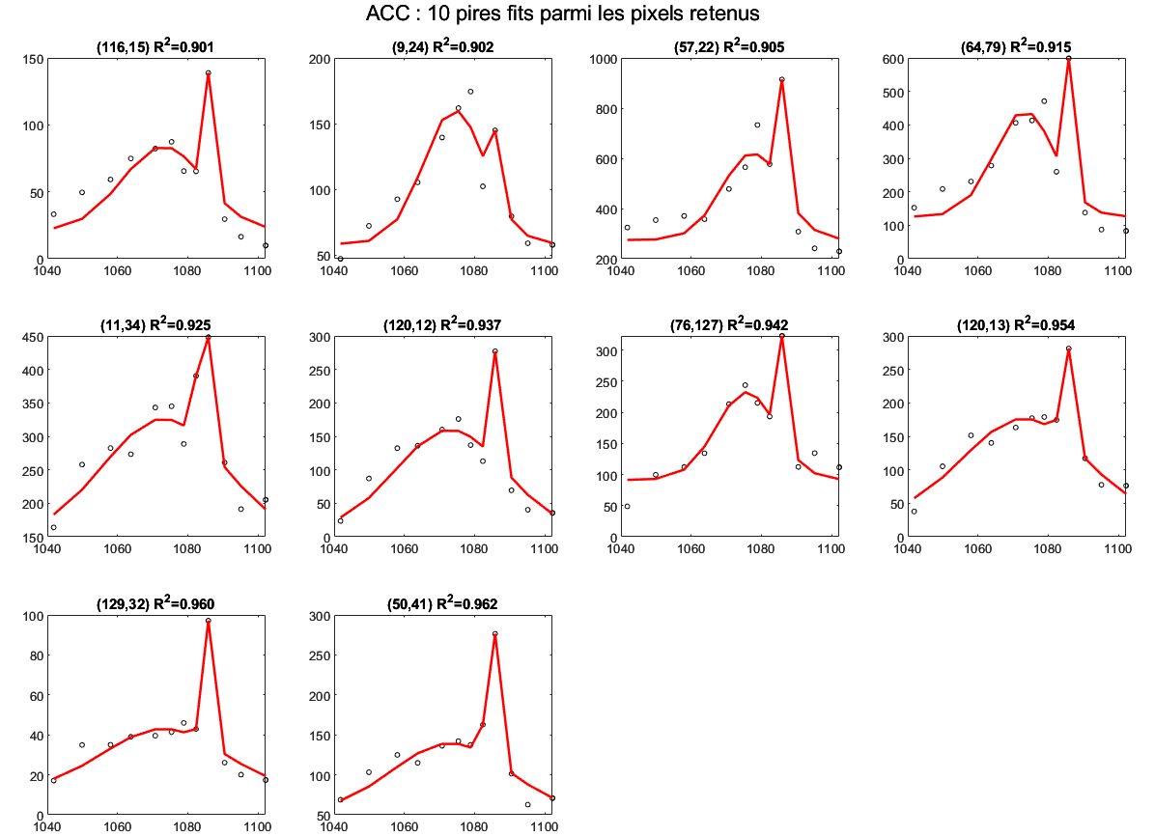
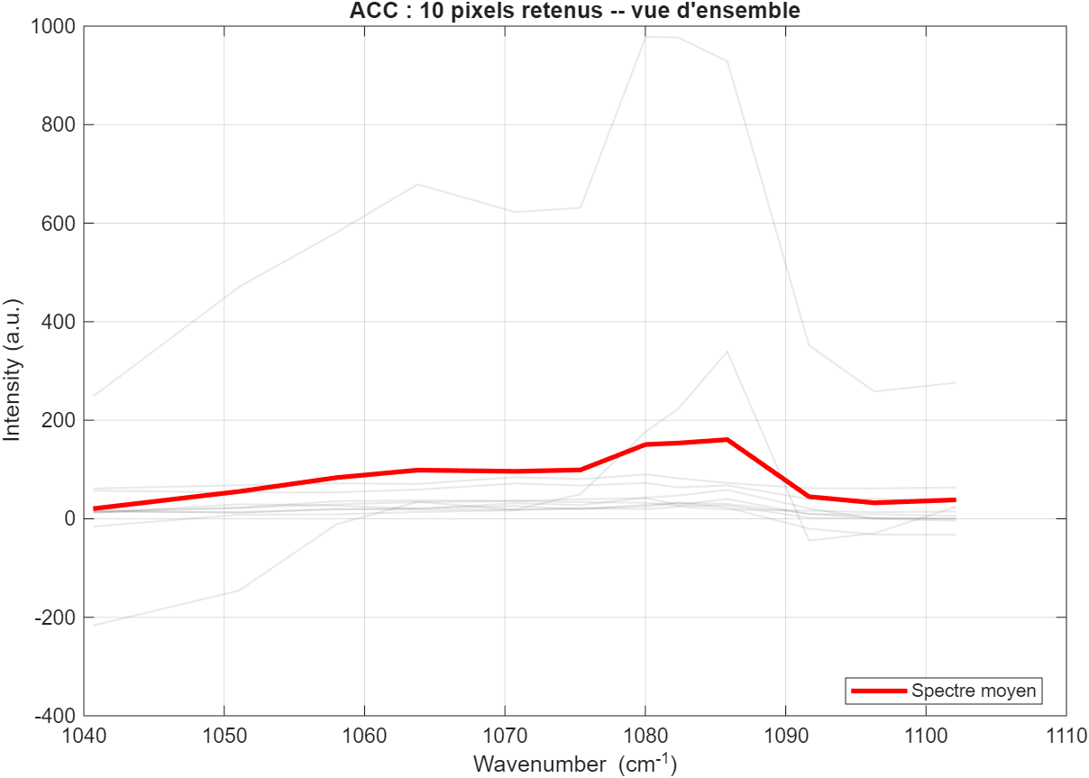
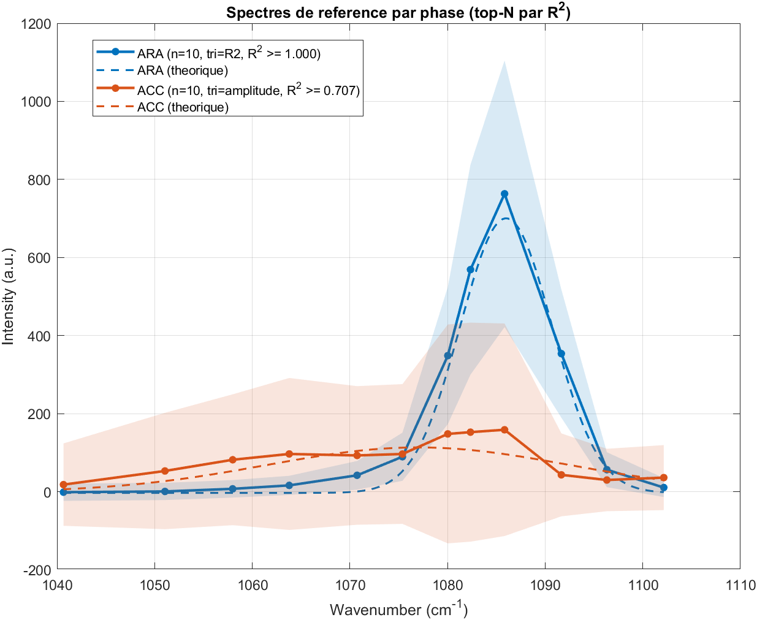
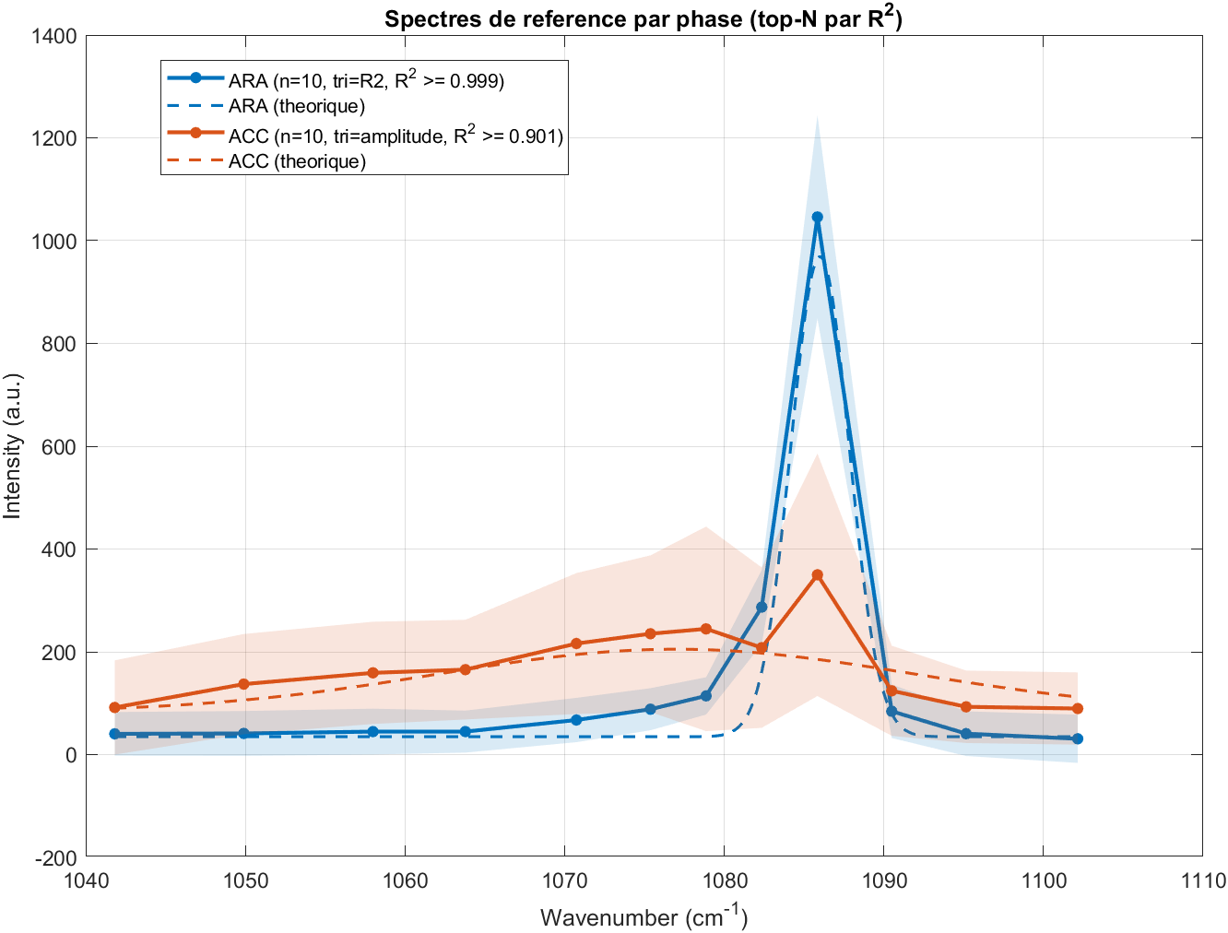
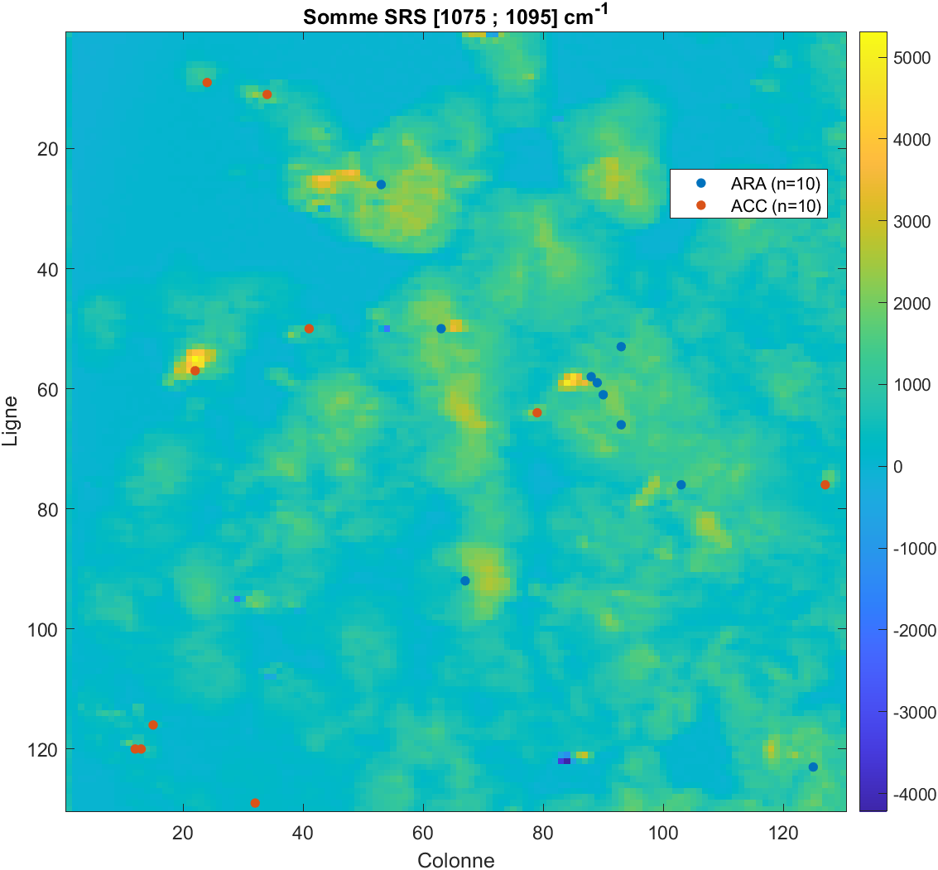
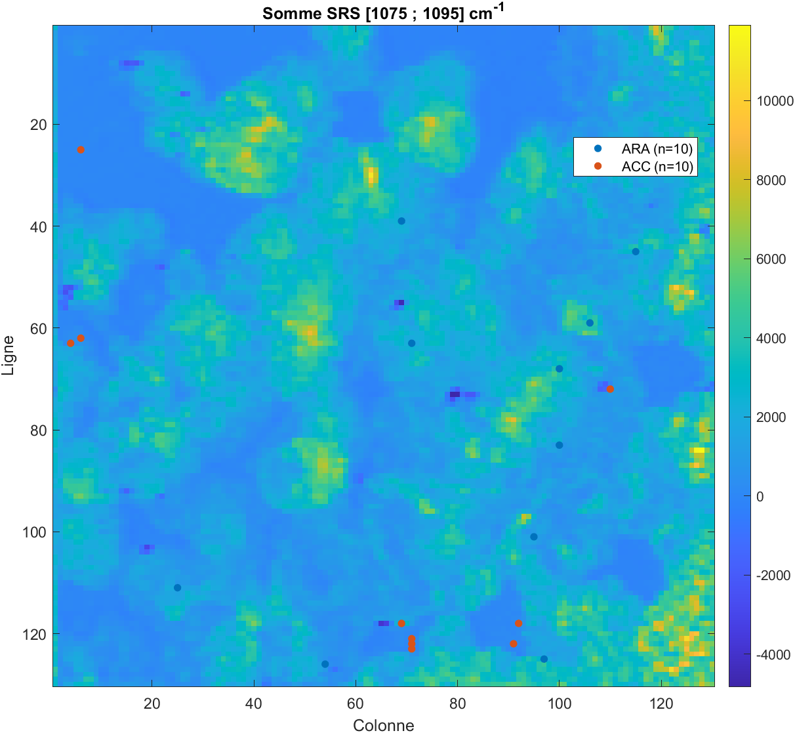
Corals 260715 2ps (#4 stressed)
ACC
ARA: A_mean = 702.68 +/- 1229
ACC:A_mean = 4453 +/- 8549.8
nu = 1073.5428 +/- 1.7166 cm^-1
FWHM= 31.8237 +/- 6.0136 cm^-1
ARA
ARA : A_mean = 8311 +/- 3747.4
ACC: A_mean = 1346.2 +/- 966.64
nu = 1086.0169 +/- 0.1741 cm^-1 FWHM= 1.4299 +/- 0.8107 cm^-1

Slide 15
Corals 260715 7ps (#4 stressed)
ACC
ARA: A_mean = 648.98 +/- 422.52
ACC:A_mean = 4568.9 +/- 2423.2
nu = 1073.8552 +/- 1.5147 cm^-1
FWHM= 30.2458 +/- 9.4385 cm^-1
ARA
ARA : A_mean = 4275 +/- 794.18
ACC: A_mean = 1464.6 +/- 604.63
nu = 1085.4458 +/- 0.2423 cm^-1
FWHM= 3.1194 +/- 0.9295 cm^-1

Slide 16


Corals 260715 2ps (stressed)
Aacc/Acal>0.3

Slide 17


Corals 260715 7ps (#4 stressed)
Aacc/Acal>0.3
Aacc/Acal>1
Aacc/Acal>1

Slide 18




Corals 260715 7ps (#4 stressed)
FWHM instrumentale 2.4980 cm^-1
Phase 2 : ARA
Amplitude des phases :
Phase 2 : A_mean = 4275 +/- 794.21
Phase 4 : A_mean = 1464.7 +/- 604.59
nu = 1085.4458 +/- 0.2422 cm^-1
FWHM= 3.1193 +/- 0.9294 cm^-1
Phase 4 : ACC
Phase 2 : A_mean = 86.662 +/- 68.817
Phase 4 : A_mean = 4145.5 +/- 1814.5
nu = 1070.4489 +/- 0.6355 cm^-1
FWHM = 34.4327 +/- 4.8101 cm^-1

Slide 19




Corals 260713 2ps(#4 stressed)
Aacc/Acal>1
Aacc/Acal>0.3
  ARA : Phase ara : A_mean = 11615 +/- 5235.2
  Phase acc : A_mean = 1673.2 +/- 908
  nu = 1085.9181 +/- 0.1665 cm^-1
  FWHM_deconvolve = 1.1279 +/- 0.3712 cm^-1
  Mean = 0.82211;Std = 18.902
  ACC : Phase ara : A_mean = 4316.2 +/- 2845.1
  Phase acc : A_mean = 2218.1 +/- 1386.1
  nu = 1073.7361 +/- 2.2470 cm^-1
  FWHM_deconvolve = 31.3916 +/- 6.8866 cm^-1
  Mean = -1.0486;Std = 43.549
Aacc/Acal>0.3
50 µm
Aacc/Acal>0.3
Aacc/Acal>1

Slide 20





Corals 260713 7ps(#4 stressed)
Aacc/Acal>0.3
params.R2_min_final = 0.7;
params.threshold_sigma_final = 5;
params.min_points_above_noise = 1;
params.alpha_dominance = 2;
params.methode_ref_spectra = 'amplitude';

Slide 21





Corals 260713 2ps(#4 stressed)
Aacc/Acal>0.3
2ps vs 7ps
params.R2_min_final = 0.7;
params.threshold_sigma_final = 5;
params.min_points_above_noise = 1;
params.alpha_dominance = 2;
params.methode_ref_spectra = 'amplitude';

