Slide 1
Meeting 15/10/26
Modèle
  Convolution Carbonate*Instrument
  Carbonate
2) Expérimentale
a) fit sur A
b) ACC
c) Vatérite
d) Coral
e) Set up schéma

Slide 2
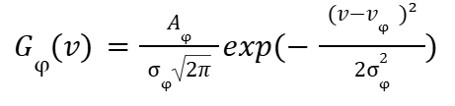





Modèle Analytique – Réponse instrumentale
Modèle gaussien pour chaque phase :
Convolué avec
Modèle gaussien de la réponse instrumentale :
➔ Analytiquement, on obtient :
avec
➔

Slide 3
Modèle Carbonates
Résultat Raman spontané – échantillon synthétique ou géologique
sample | Calcite geologic | Aragonite geologic | Vaterite synthetic | ACC synthetic | CCHH synthetic | MHC synthetic
Nu (cm⁻¹) | 1085.5 | 1085.5 | 1075, (1080,) 1090.8 | 1077 | 1100.1 | 1067.5
FWHM (cm⁻¹) | 4.2 | 4.2 | 8.2, (?), 8.3 | 35 | 6.3 | 5.8
FWHM_déconvolué* (cm-1) | 3.5 | 3.5 | 7.9,(?),8.0 | 35 | 5.9 | 5.3
(*) déconvolué par la résolution théorique maximale du raman spontané :
Paramètres :
- grating : 1800 (500nm)
- Laser : 532nm_Edge
- objectif x20
Spectral Resolutions (Hole50m, 100x Objective, FWHM) :
- Grating 1800 g/mm: 585.25 nm 1.66cm-1 (<2.3 cm-1*)

Slide 4
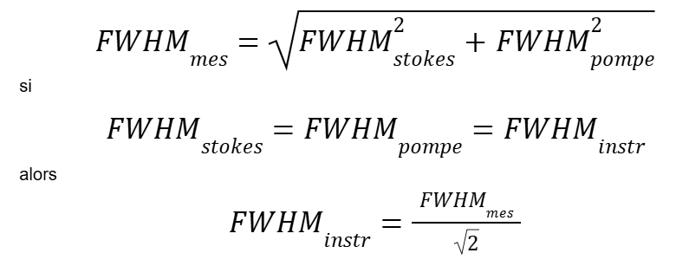
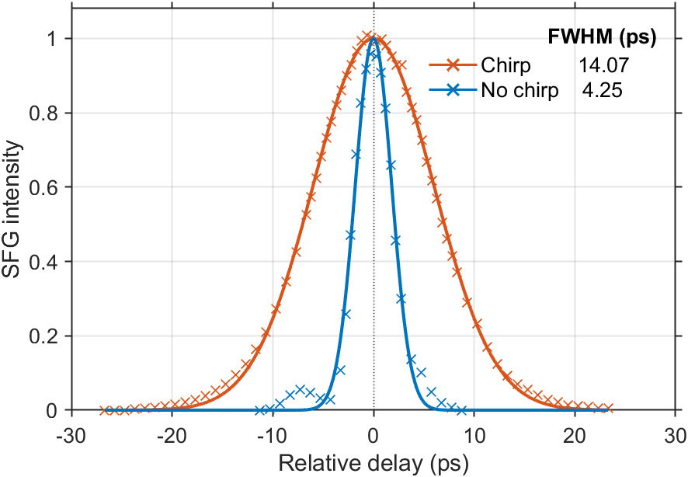
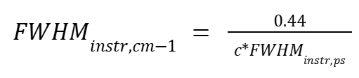

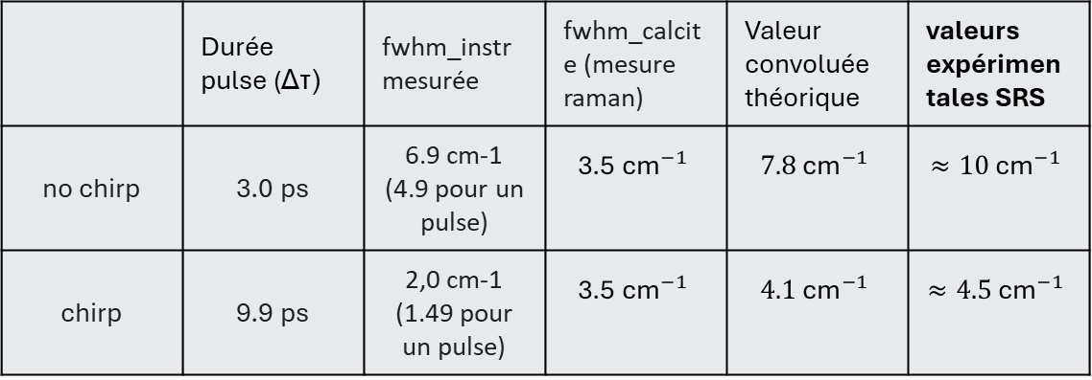
Chirp – Calcul de FWHM_instr
Cas calcite synthétique
moyen
 | Durée pulse (Δτ) | fwhm_instr mesurée | fwhm_calcite (mesure raman) | Valeur convoluée théorique | valeurs expérimentales SRS
no chirp | 3.0 ps | 6.9 cm-1 (4.9 pour un pulse) | $$\text{3.5}{\text{ cm}}^{−1}$$ | $$7.8{\text{ cm}}^{−1}$$ | $$≈10{\text{ cm}}^{−1}$$
chirp | 9.9 ps | 2,0 cm-1 (1.49 pour un pulse) | $$\text{3.5}{\text{ cm}}^{−1}$$ | $$4.1{\text{ cm}}^{−1}$$ | $$≈4.5{\text{ cm}}^{−1}$$
Fig. Observed Sum Frequence Generation (SFG) between Stokes and pump beam with and without chirp. Full Widths at Half Maximum (FWHM) were calculated from the Gaussian fitting function.
Pour une gaussienne limité par la TF.

Slide 5
Modèle Carbonates
Paramètres | Calcite | Aragonite | Vaterite | ACC | CCHH | MHC
Nu (cm⁻¹) | 1085.5¹ 1085.9³ | 1085.5¹ 1086² 1084³ | [1075, (1080,) 1090.8]¹ [1073.8, 1080, 1089.5] ³ | 1077¹ 1075² 1073⁴ 1085⁵ | 1100.1¹ 1097² | 1067.5¹
FWHM_déconvolué (cm-1) | 3.5¹ | 3.5 ^{1,6} | [7.9, (8 aussi?), 8]¹ | 35¹ 30⁴ | 5.9¹ | 5.3¹
nu_LB (cm⁻¹) | 1084.5 | 1084 | 1073 | 1073,1070(corail) | 1097 | 1066
nu_UB (cm⁻¹) | 1086.5 | 1086.5 | 1093 | 1082 | 1102 | 1070
FWHM_LB (cm⁻¹) | 1 | 1 | 3 | 20 | 3 | 3
FWHM_UB (cm⁻¹) | 4 | 4 | 10 | 40 | 10 | 10
¹Résultats raman spontané – synthétique ou géologique (cal et ara)
²Dicko, Hamadou, et al. "3D Calcium carbonate polymorphs imaging with stimulated Raman scattering in biominerals." Faraday Discussions 261 (2025): 286-297. – biogénique (corail)
³Colas, C. (2022). Bio-inspired synthetic crystals (Doctoral dissertation, Université Paris-Saclay).
⁴Duboisset et al., « Amorphous-to-Crystal Transition in the Layer-by-Layer Growth of Bivalve Shell Prisms ». – biogenique (huitre)
⁵Lia Addadi et al “Taking Advantage of Disorder: Amorphous Calcium Carbonate and Its Roles in Biomineralization” – biogenique (juvenil huitre, oursin)
⁶ Farfan et al (2021)“Crystallographic and chemical signatures in coral skeletal aragonite” (National Museum of Natural History, Washington, DC, USA) – corail

Slide 6
Pourquoi ?
- bruit ?
- illumination non homogène ?
- erreur modèle ?
Expérimentale – Fit sur A
Ratio A(cc/acc) | Synthetic 260708 1 | Synthetic 260708 2 | Synthetic 260708 3 (see nxt slide) | Coral - 260715 (small ROI) | Coral - 260715 (big ROI)
2ps | 1.00 | 0.86 | 0.86 | 2.94 | 5.86
7ps | 2.41 | 1.20 | 0.76 | 1.14 | 1.23

Slide 7
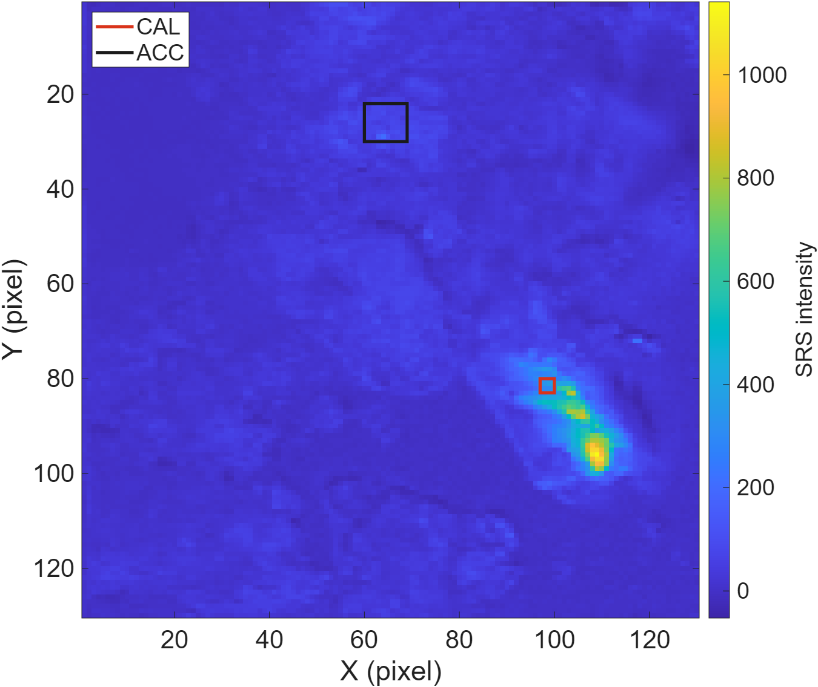
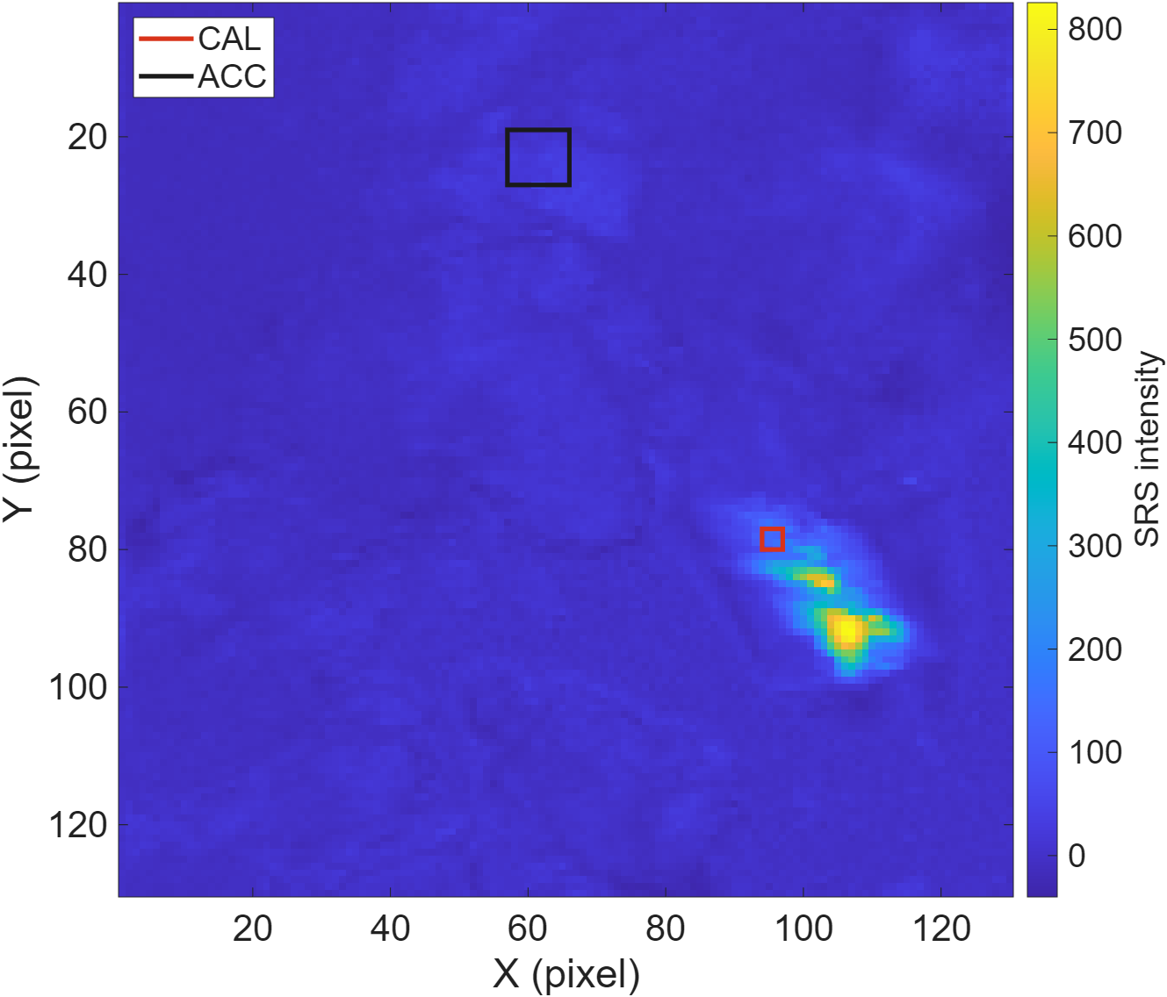


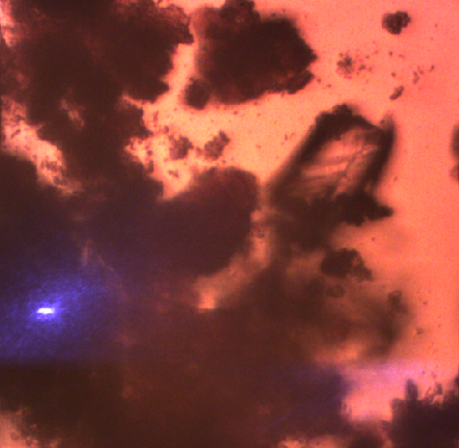
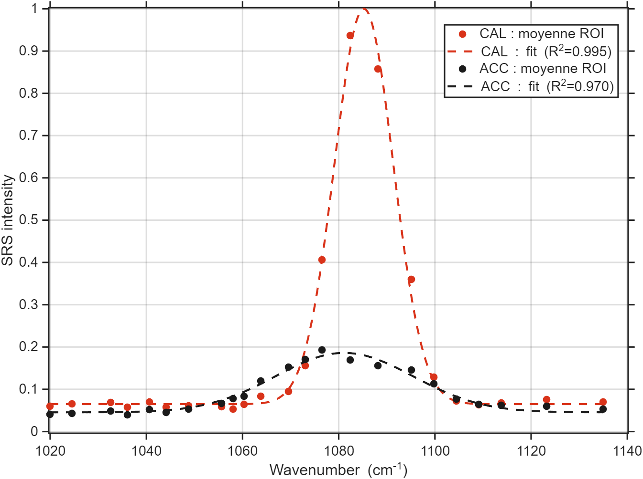
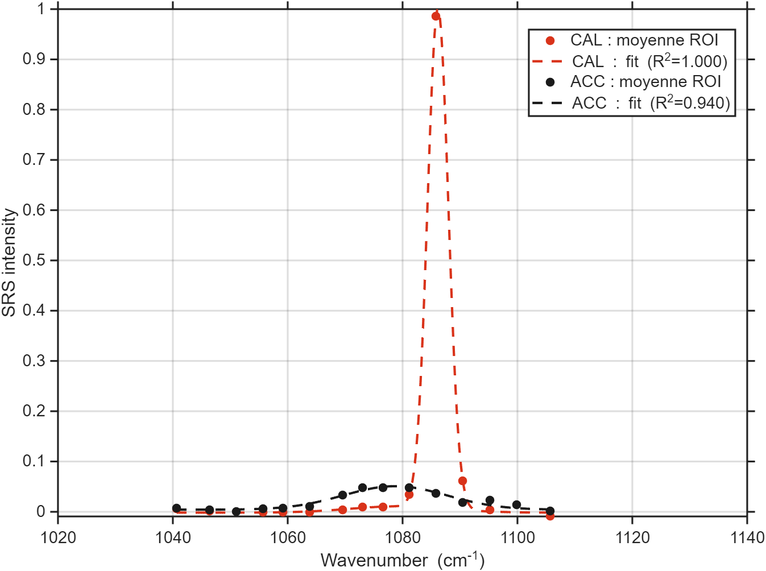
2ps vs 7ps - 260708 ACC_Cal synt
2ps
7ps
10 µm
10 µm
10 µm

Slide 8
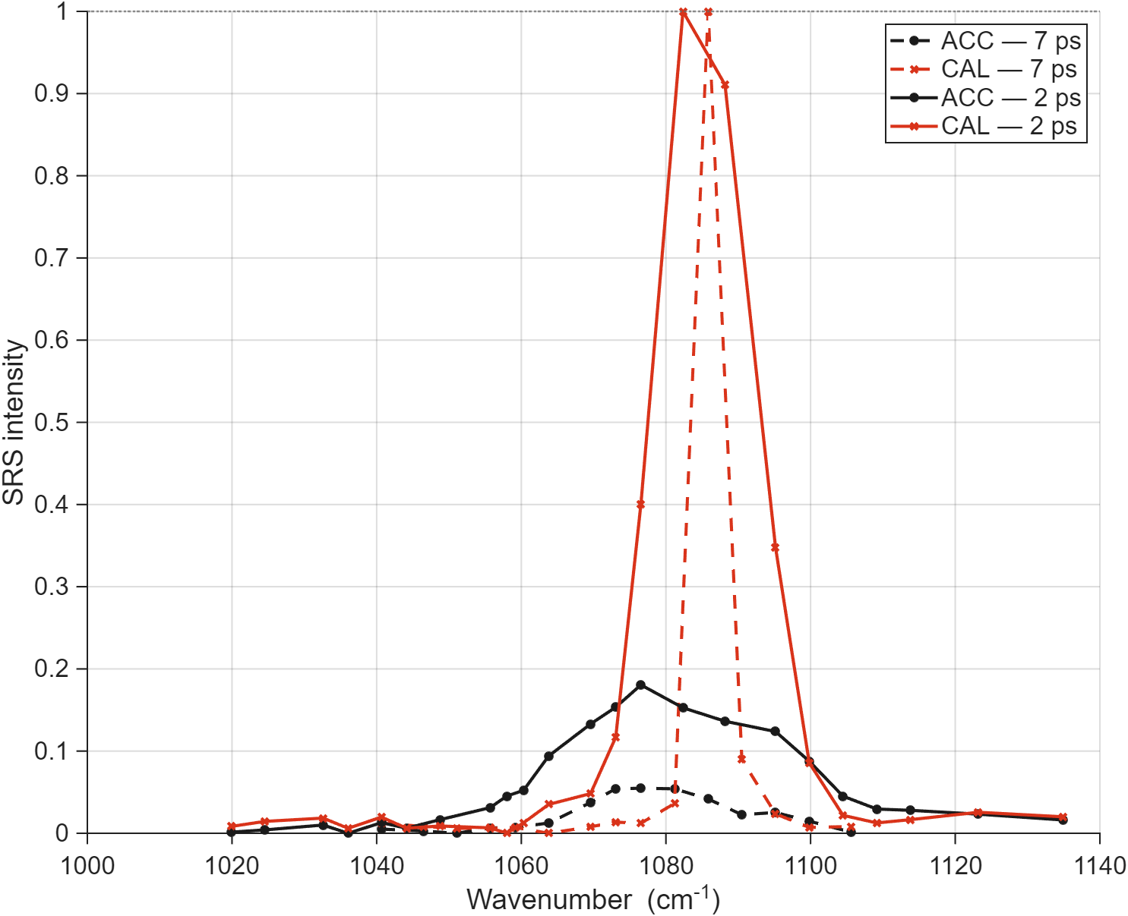
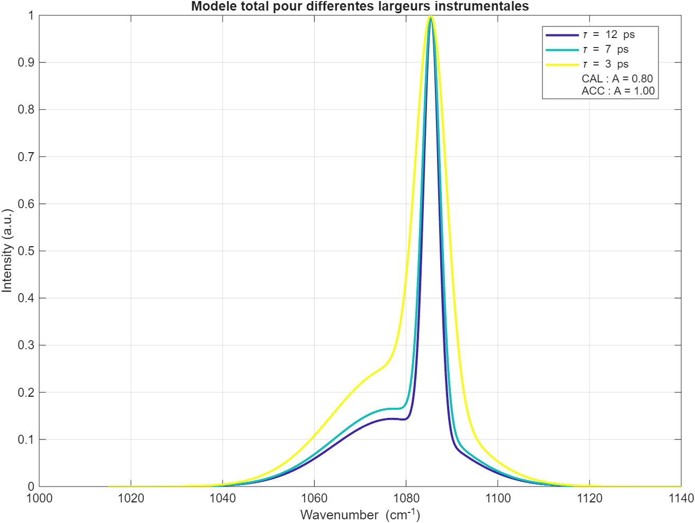
2ps vs 7ps - 260708 ACC_Cal synt
260708 ROI | A | Nu (cm-1) | FWHM_phase (cm-1)
2ps CAL | 33862 | 1085.2 | 5.4
2ps ACC | 61552 | 1081.2 | 31.1
7ps CAL | 9263 | 1086.3 | 3.3
7ps ACC | 12761 | 1078.8 | 22.4
7ps
x 0.55
x 0.55
x 0.73
10 µm
10 µm

Slide 9
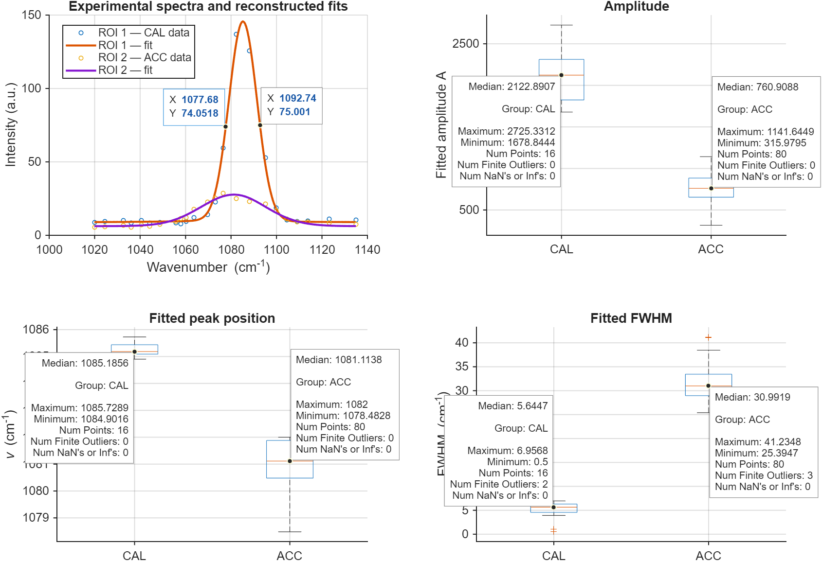
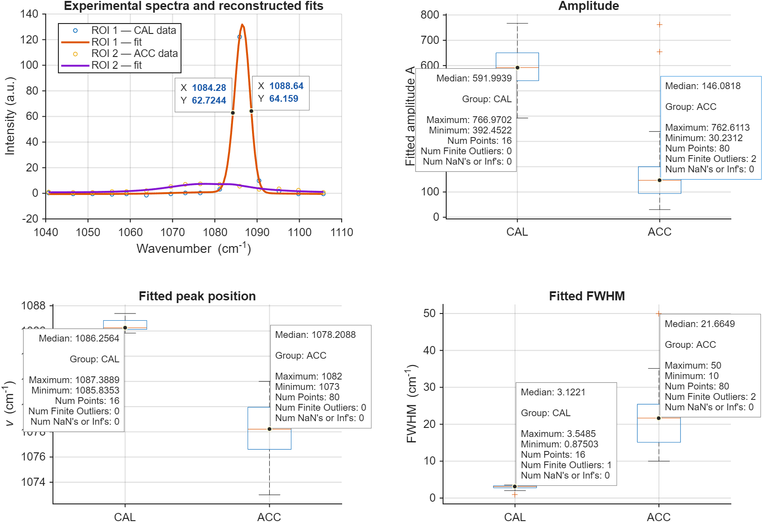
2ps vs 7ps - 260708 ACC_Cal synt
260708 ROI | A | Nu (cm-1) | FWHM_phase (cm-1)
2ps CAL | 33862 | 1085.2 | 5.4
2ps ACC | 61552 | 1081.2 | 31.1
7ps CAL | 9263 | 1086.3 | 3.3
7ps ACC | 12761 | 1078.8 | 22.4
7ps
x 0.55
x 0.73
2ps
7ps
10 µm
10 µm
2,8
4.1

Slide 10

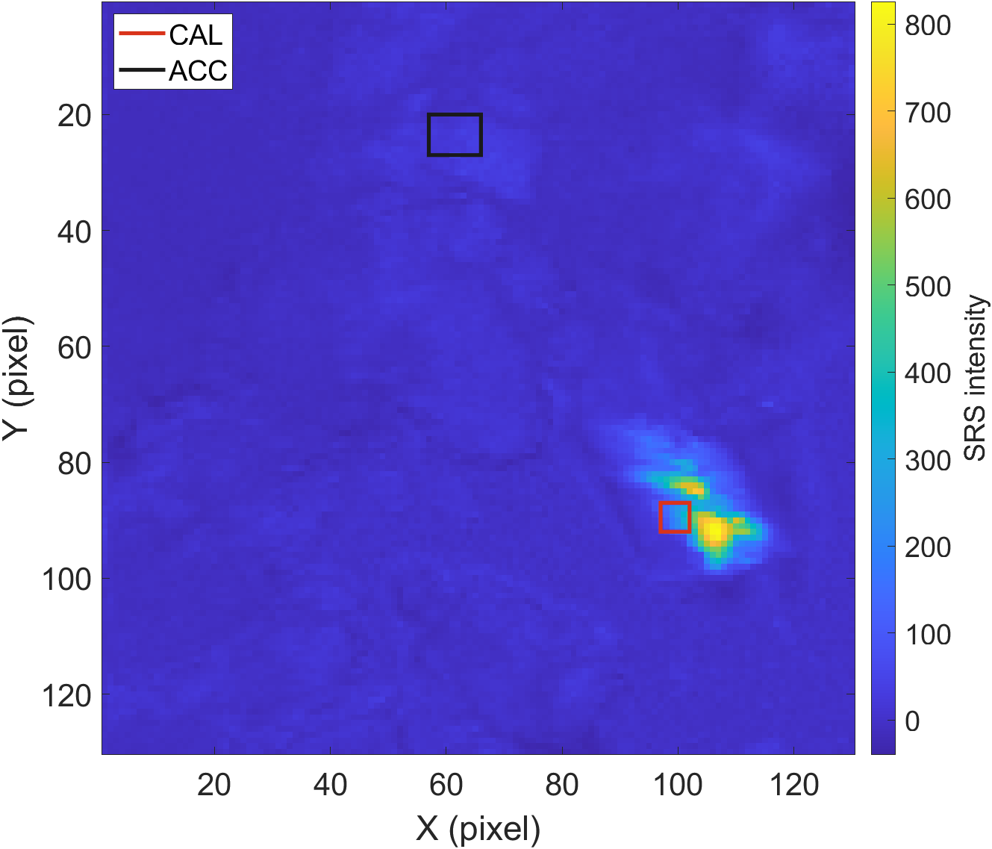
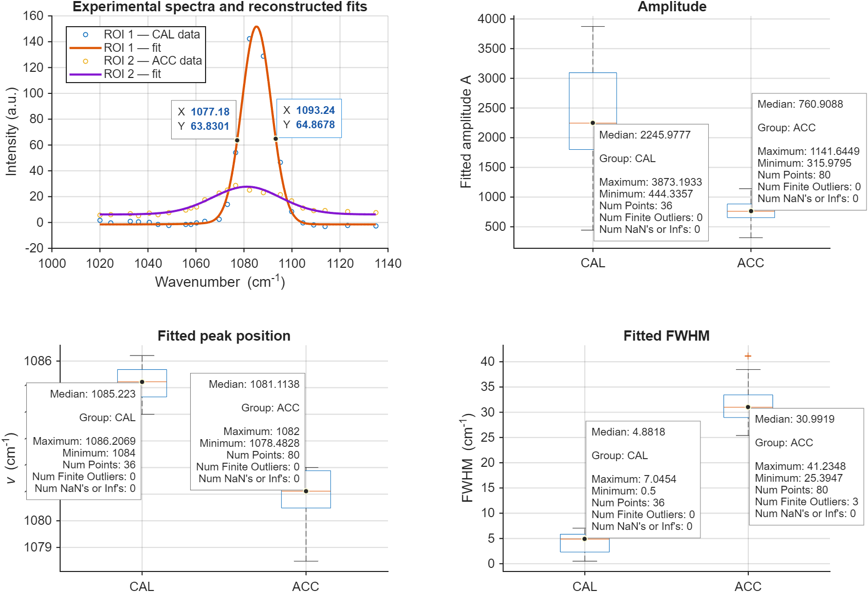
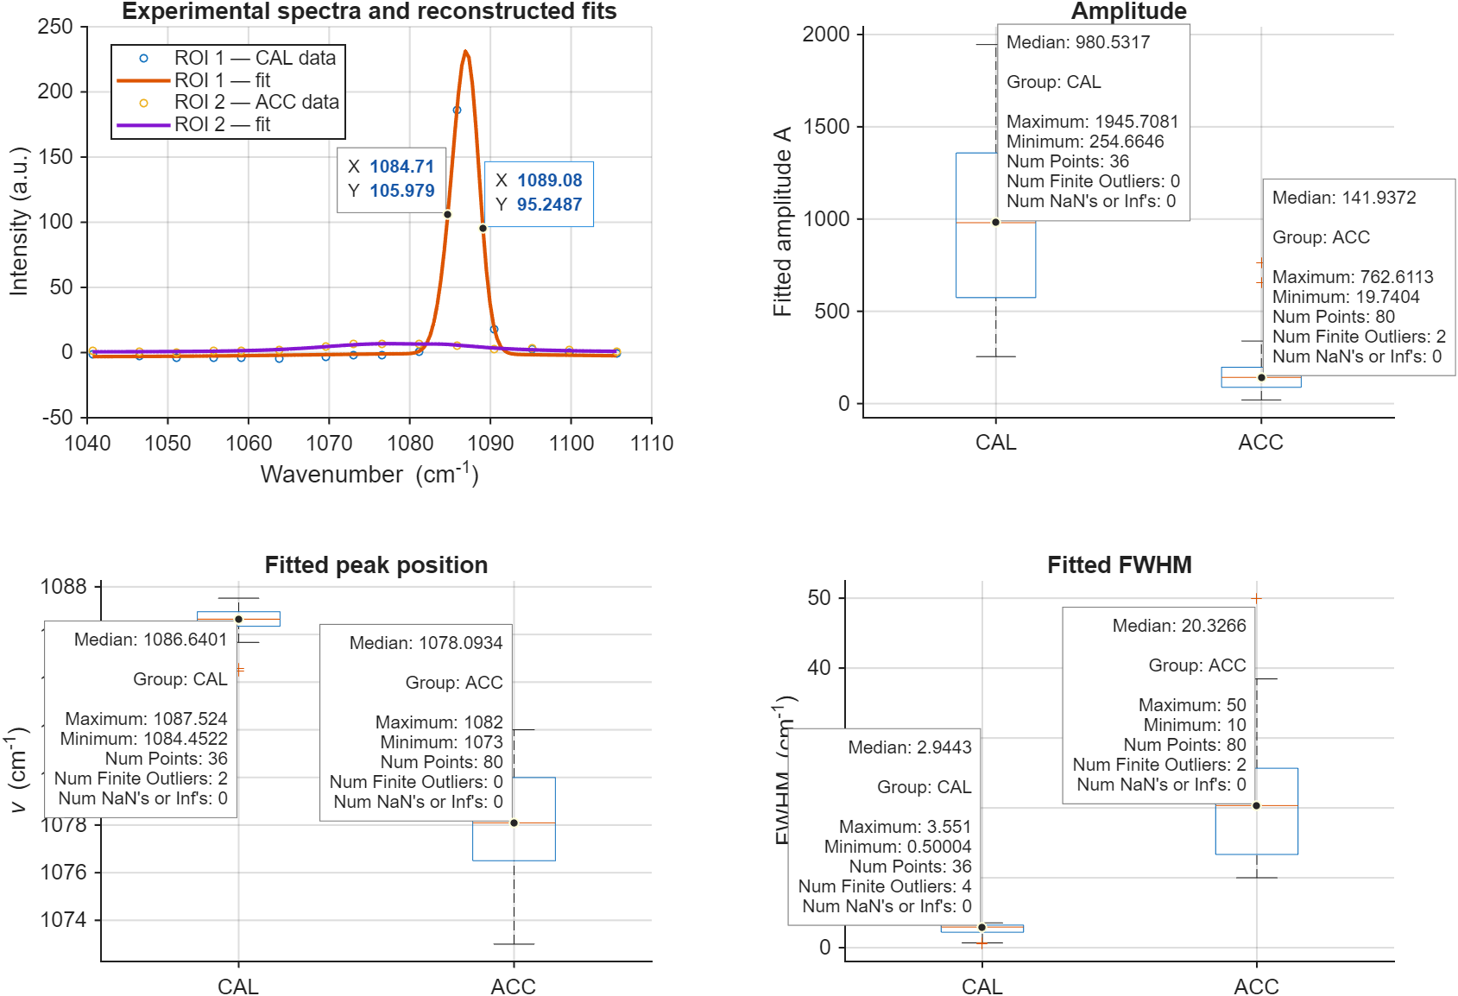
2ps vs 7ps - 260708 ACC_Cal synt
2ps - Fwhm_instr = 13.5 (14 mesuré)
params.roi1 = [90 95 100 105];
params.roi2 = [23 30 60 69];
7ps - Fwhm_instr = 2.8 (4.4 mesuré)
2ps
7ps
2ps
7ps
10 µm
2,9
7
10 µm

Slide 11
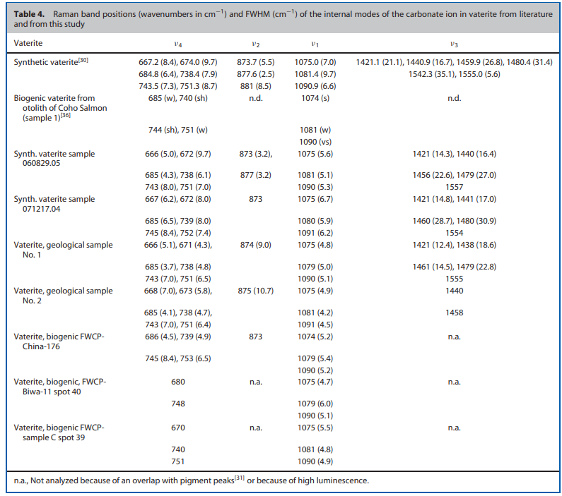
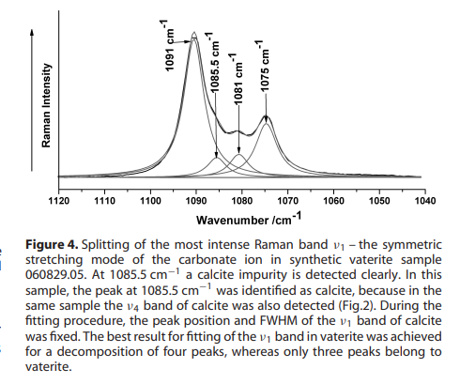
Littérature Vatérite
Wehrmeister, U., et al. (2010). Raman spectroscopy of synthetic, geological and biological vaterite: a Raman spectroscopic study. Journal of Raman Spectroscopy

Slide 12
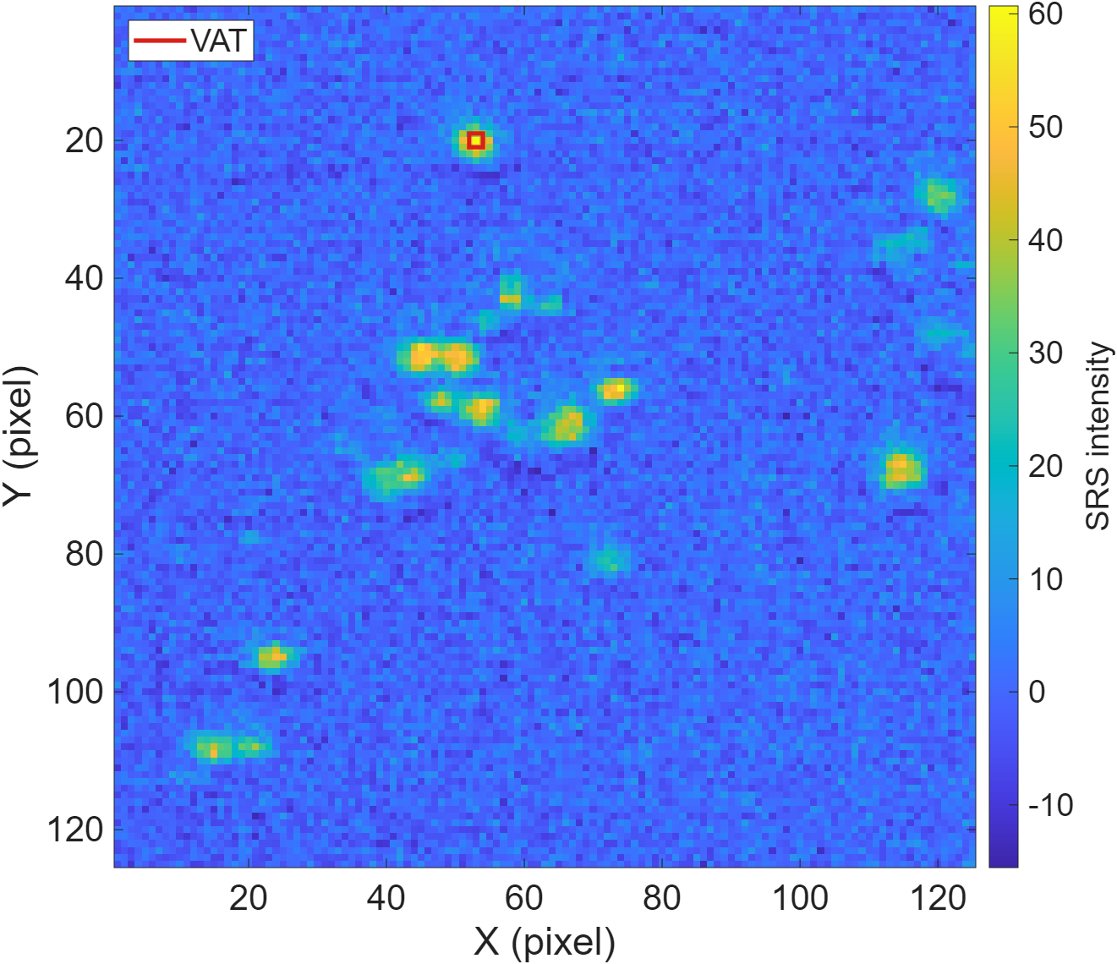
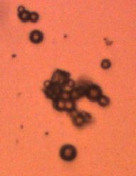
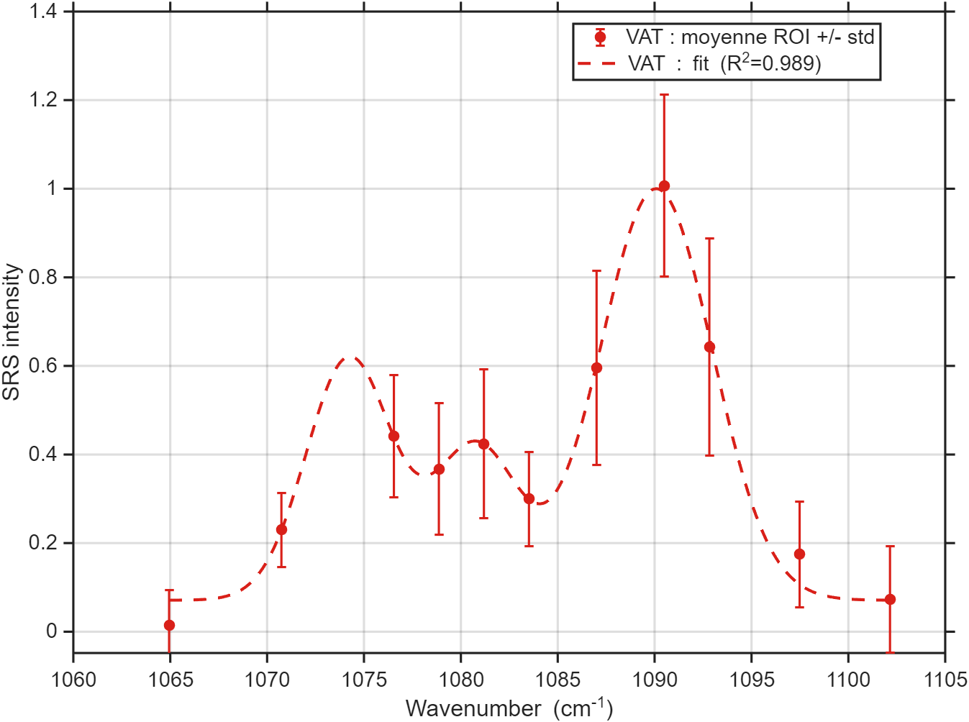
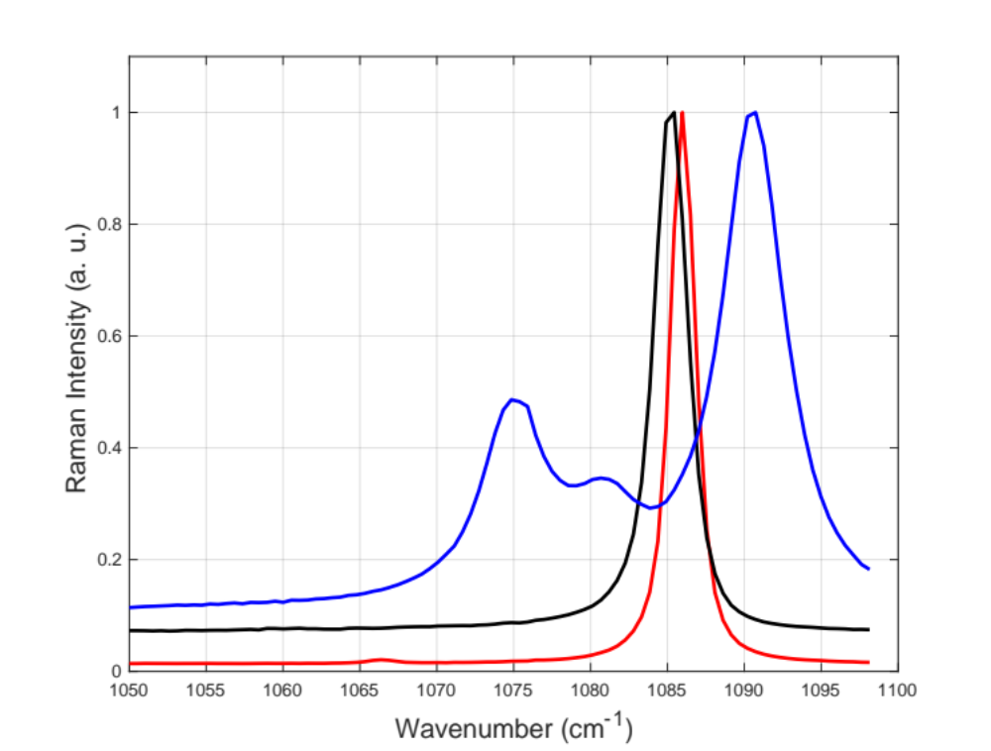
7ps 260527 Vatérite
Ratio_model = [0.45 0.28 1];
Résultat du fit :
Phase VAT : A_fit = 1099
  - Raie 1 : nu = 1074.23 cm^-1
  - Raie 2 : nu = 1080.78 cm^-1
  - Raie 3 : nu = 1090.09 cm^-1
  - FWHM 1 : FWHM = 3.04 cm^-1
  - FWHM 2 : FWHM = 2.85 cm^-1
  - FWHM 3 : FWHM = 5.34 cm^-1
Synthetic samples made by Clémentine
0.5
0.35

Slide 13
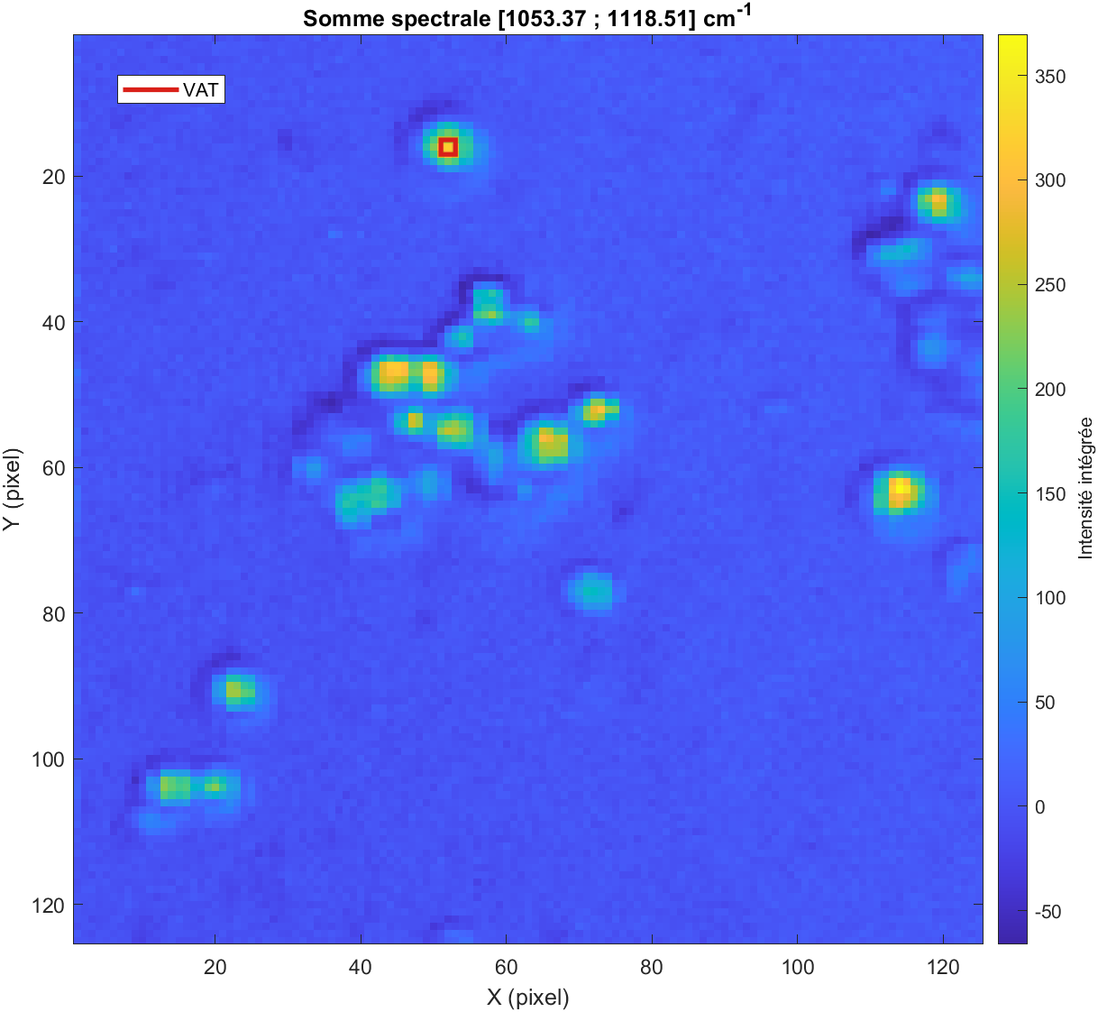
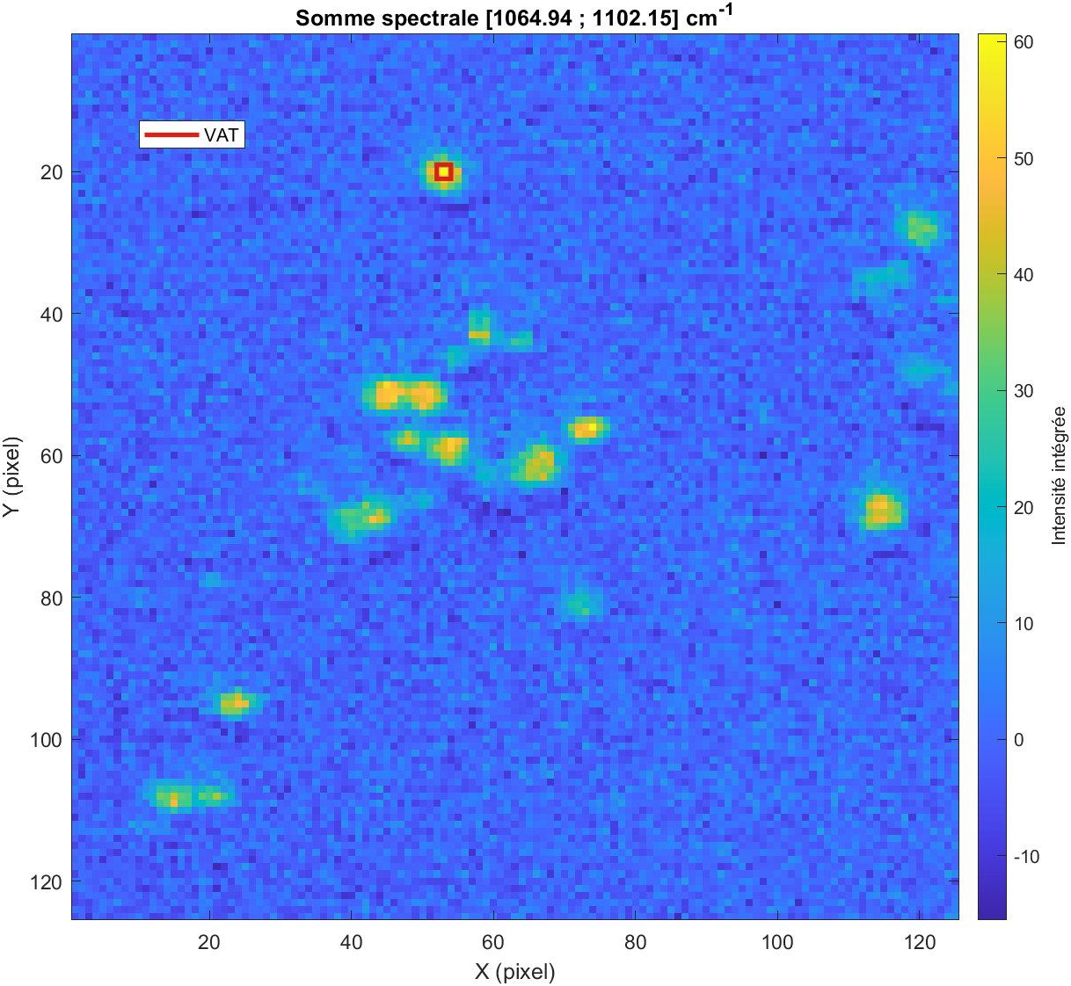
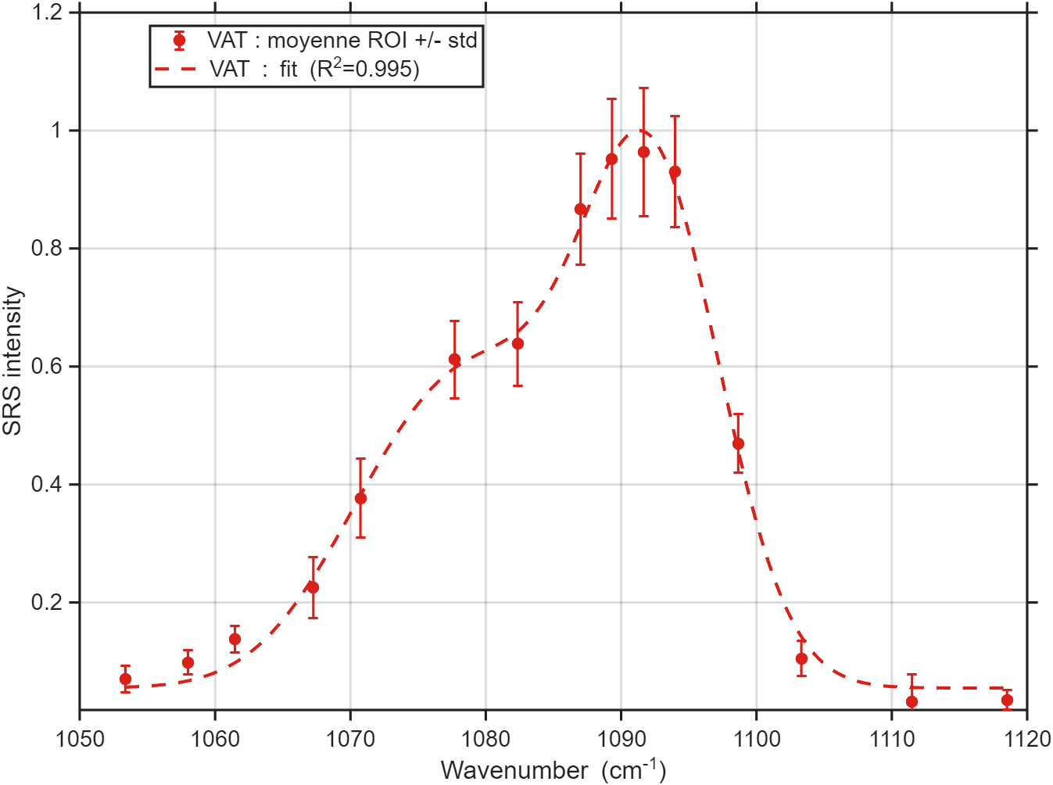
2ps 260527 Vatérite
Ratio_model = Ratio_model = [0.45 0.28 1];
Résultat du fit :
Phase VAT : A_fit = 8050.1
  - Raie 1 : nu = 1073.8006 cm^-1
  - Raie 2 : nu = 1080.2310 cm^-1
  - Raie 3 : nu = 1091.7282 cm^-1
  - FWHM 1 : FWHM = 10.0000 cm^-1
  - FWHM 2 : FWHM = 3.0289 cm^-1
  - FWHM 3 : FWHM = 5.5216 cm^-1

Slide 14
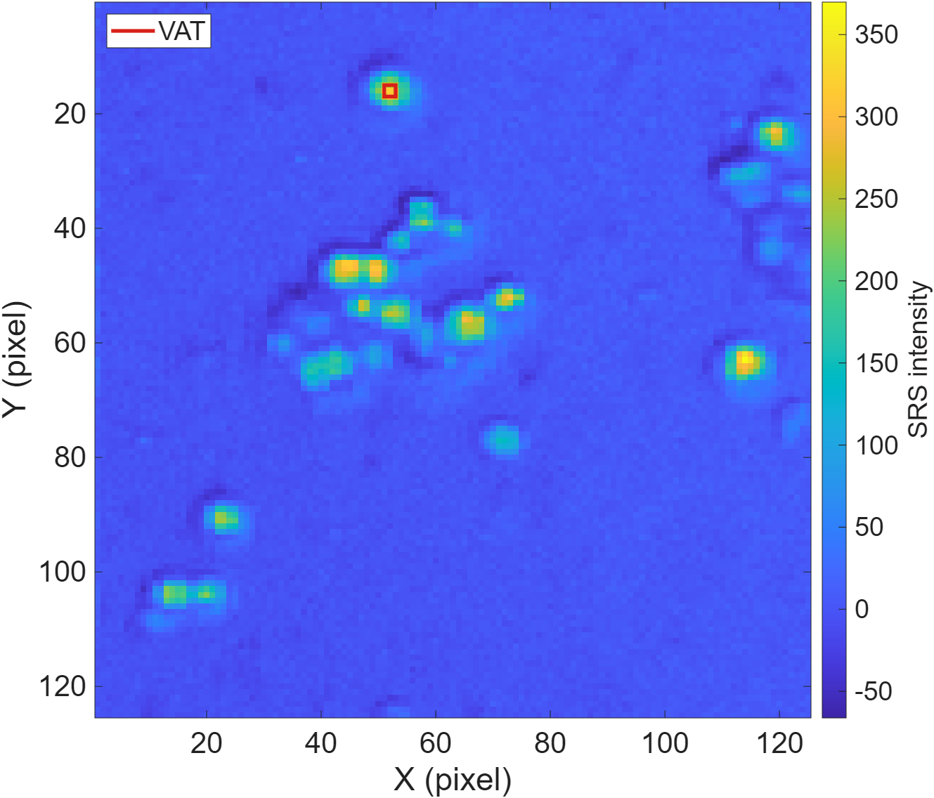
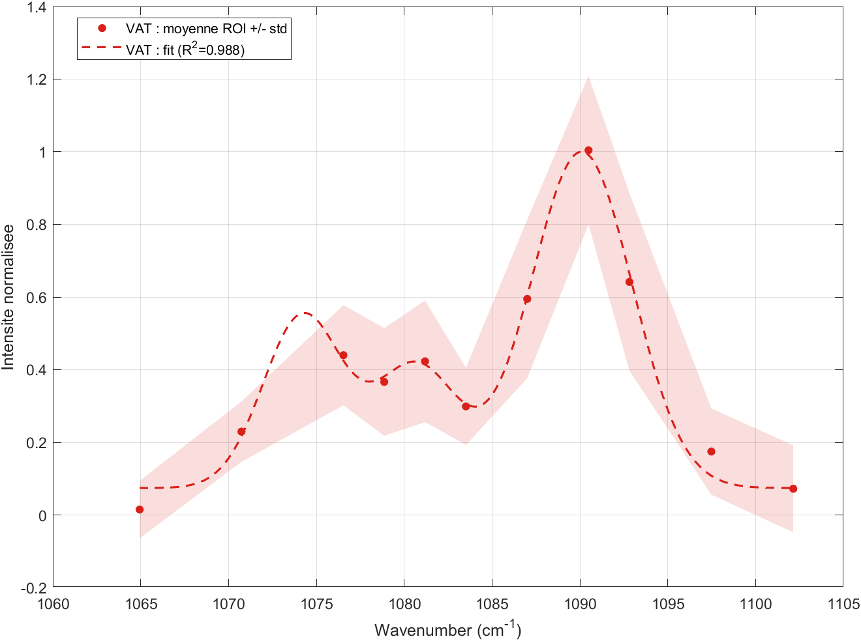
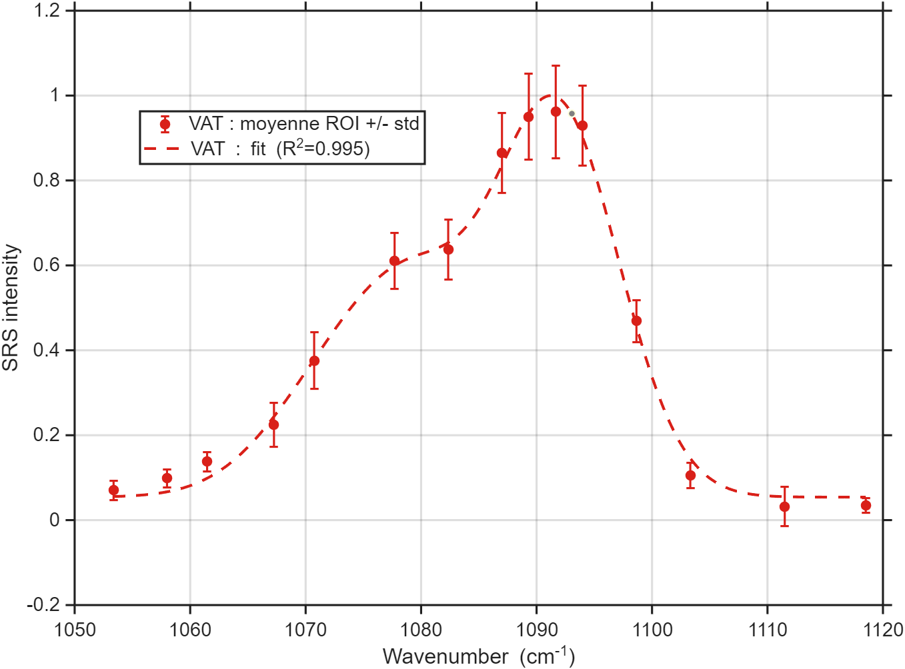
2 vs 7ps 260527 Vatérite
7ps
2ps
10 µm
10 µm
10 µm
Nb points 125²
scan range 50 µm
2ps
7ps
1 pix = 400 nm²

Slide 15
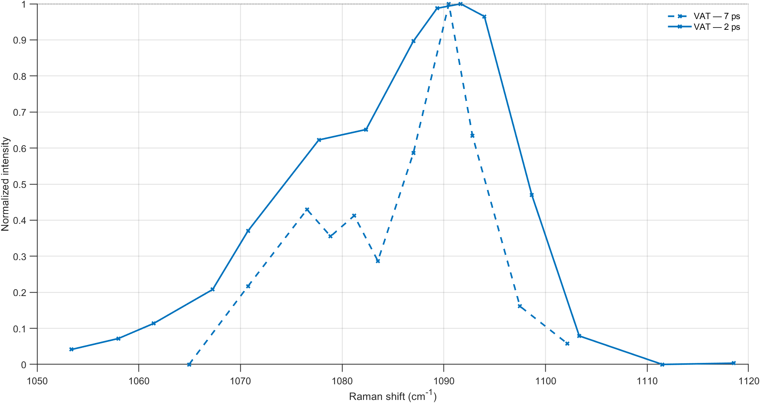
2ps vs 7ps 260527 Vatérite

Slide 16
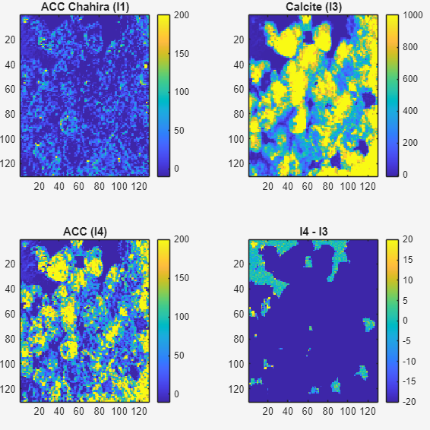
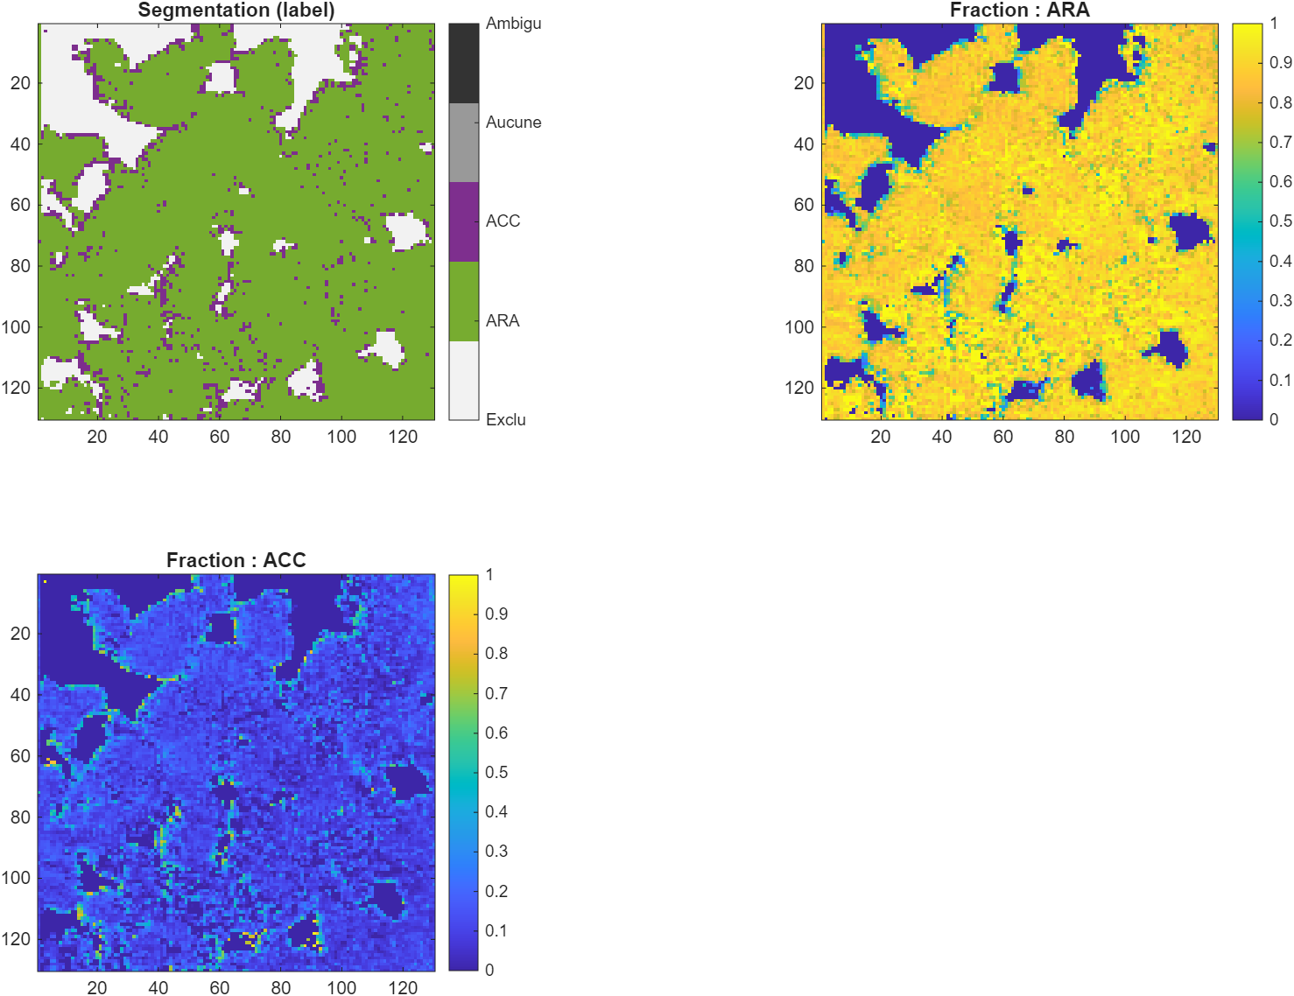
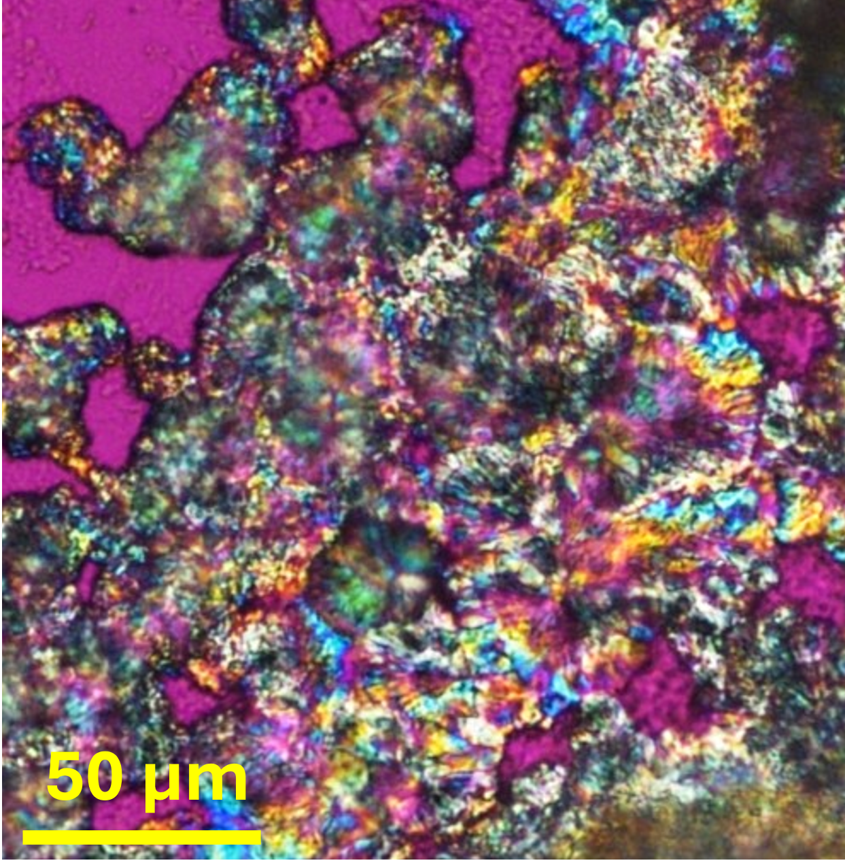
Corals 260715 2ps (#4 stressed)
R2_min= 0.7;
threshold_sigma= 4;
min_points_above_threshold = 2;
ACC if A(ACC)> Γ A(ARA) :
Γ = 0.3
Γ = 1

Slide 17
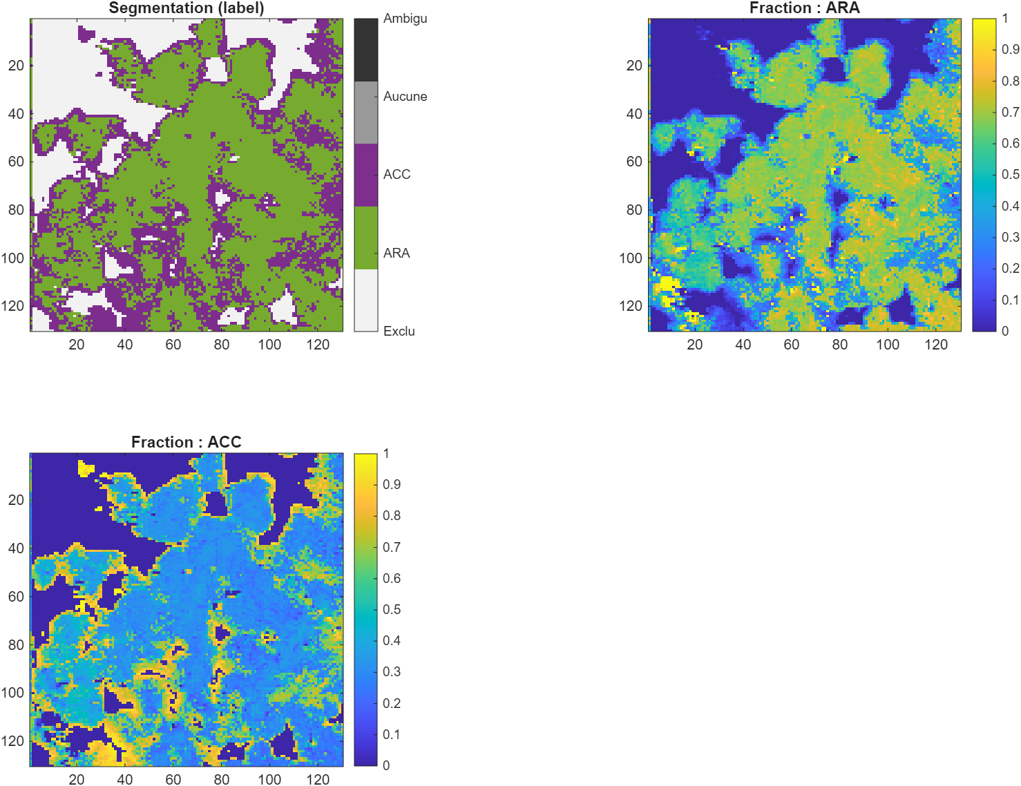
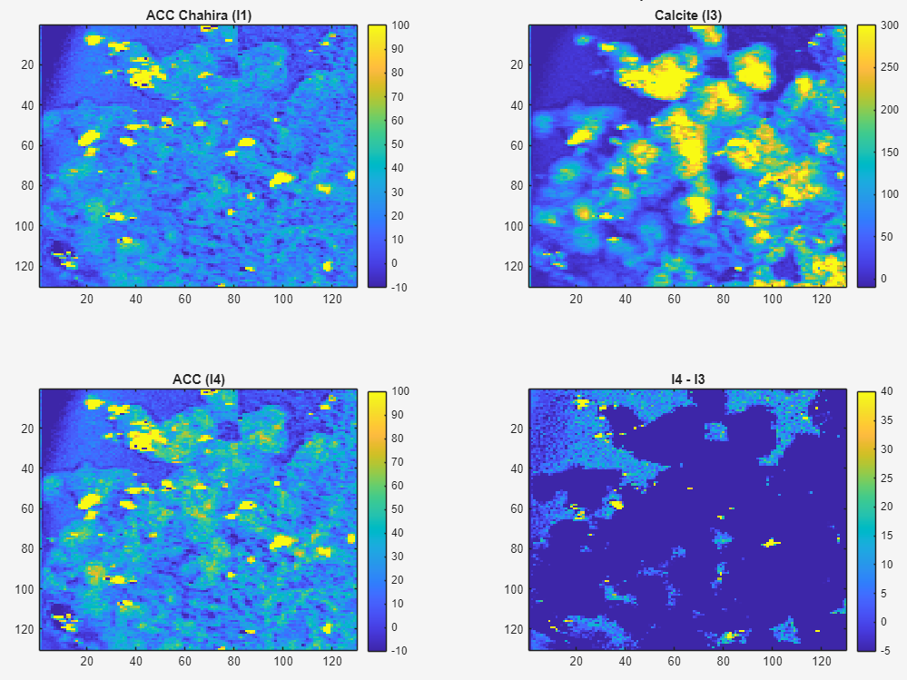
Corals 260715 7ps (#4 stressed)
R2_min= 0.6;
threshold_sigma= 5;
min_points_above_threshold = 1;
ACC if A(ACC)> Γ A(ARA) :
Γ = 1
Γ = 1

Slide 18
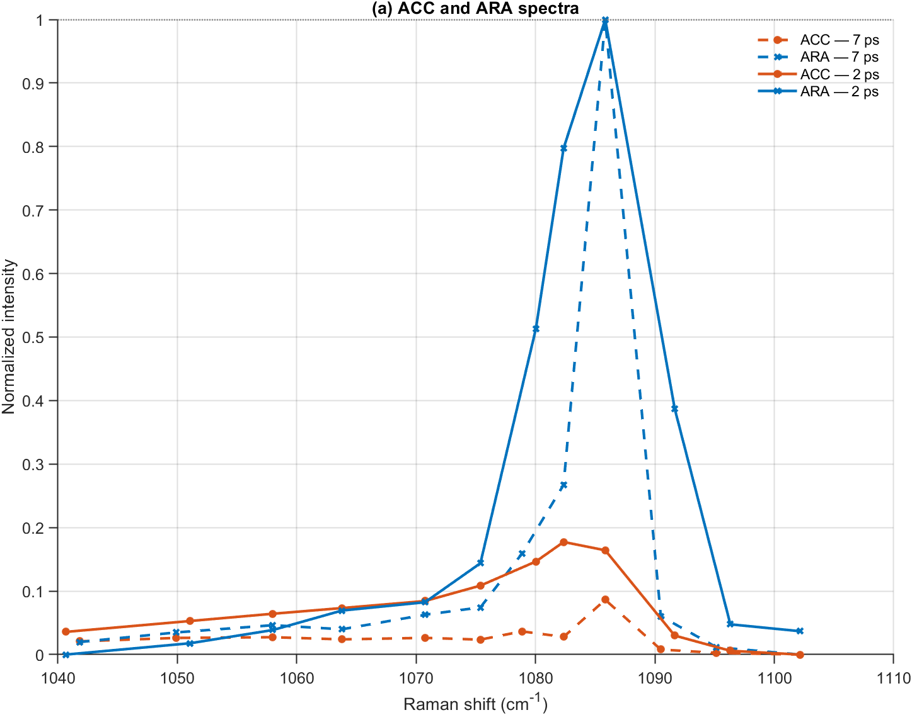
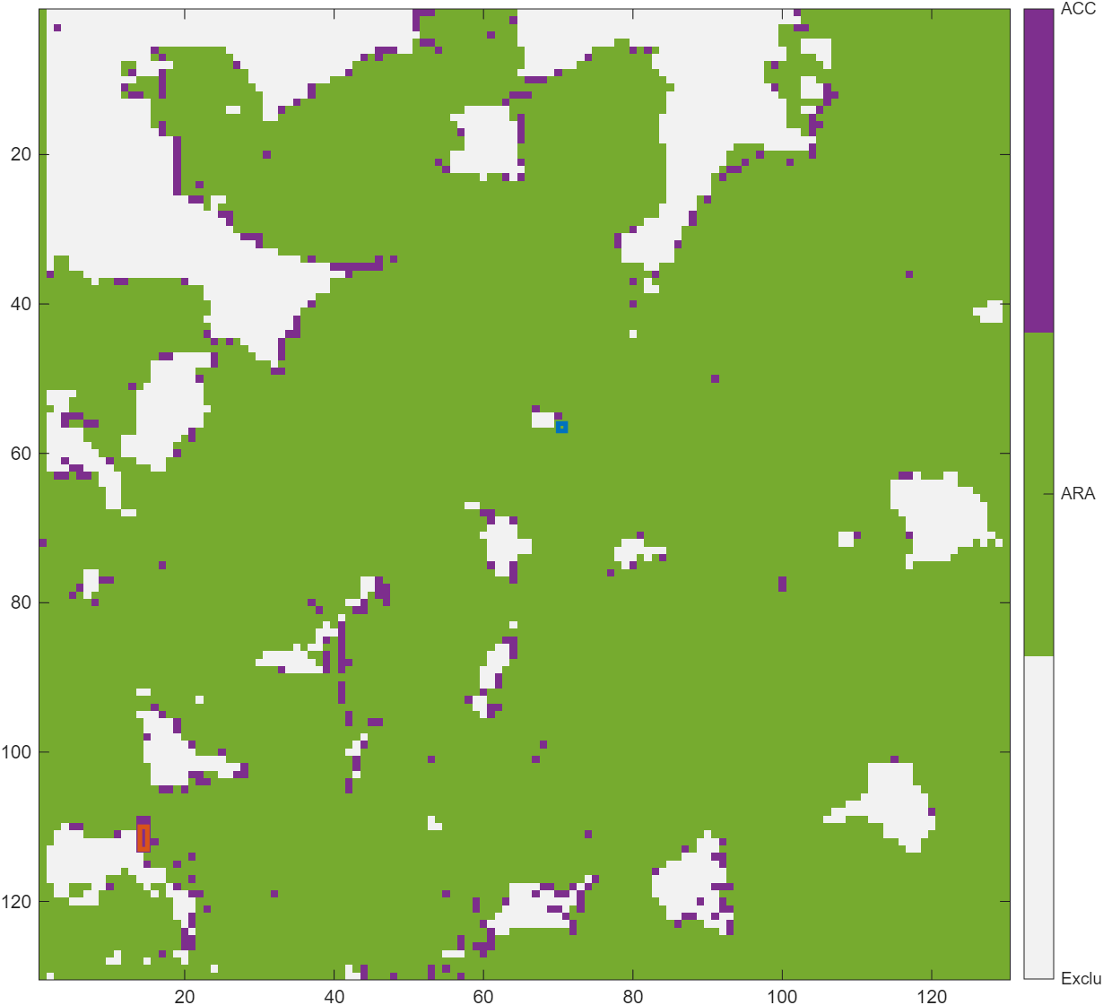
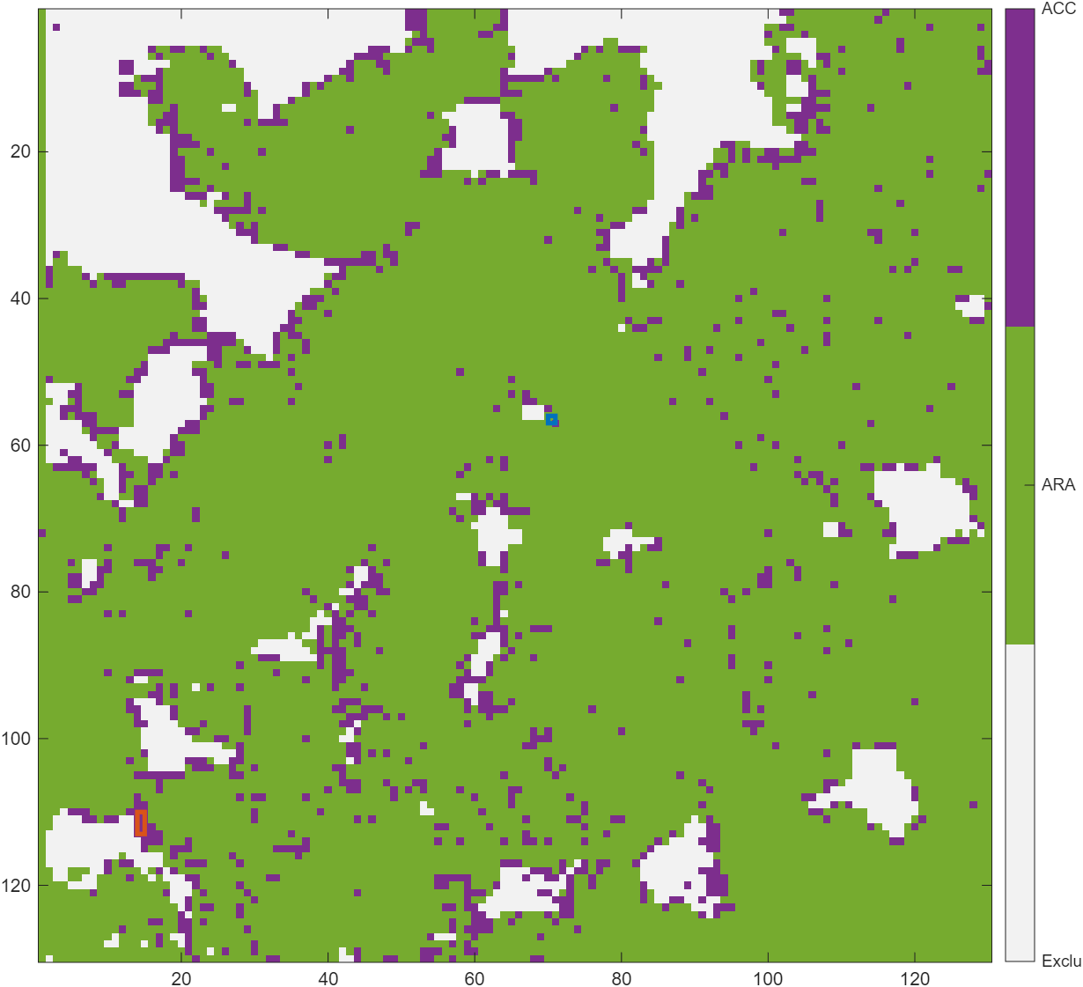
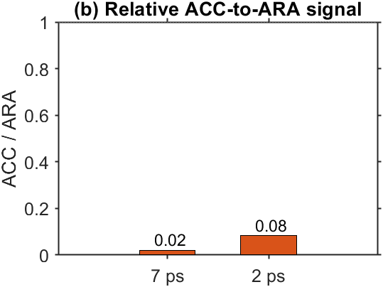
Corals 260715 2ps vs 7ps (#4 stressed)
R2_min= 0.7;
threshold_sigma= 4;
min_points_above_threshold = 2;
ACC if A(ACC)> Γ A(ARA) :
Γ = 1
Γ = 0.3
260715 ROI | A | nu | FWHM_phase
2ps ARA | 8311 +/- 3747.4 | 1086.02 +/- 0.17 | 1.43 +/- 0.81
2ps ACC | 2823.2 +/- 2918.7 | 1073.11 +/- 0.36 | 33.92 +/- 6.33
7ps ARA | 4275 +/- 794.18 | 1085.45 +/- 0.24 | 3.12 +/- 0.93
7ps ACC | 3741.6 +/- 2693.2 | 1073.83 +/- 1.53 | 32.04 +/- 8.97

Slide 19
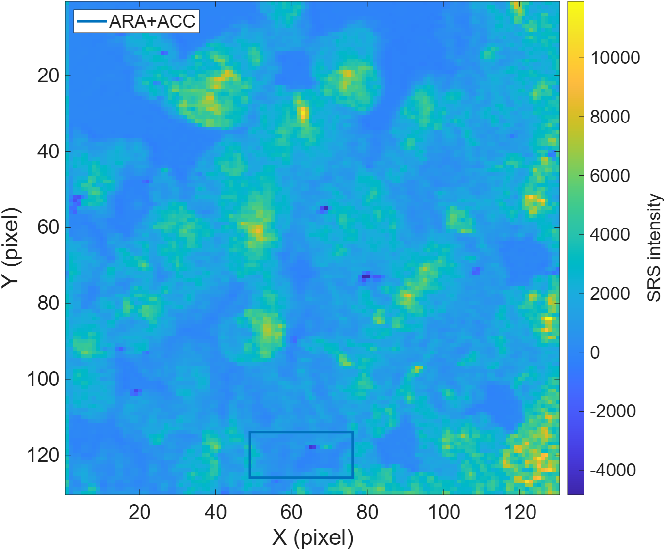
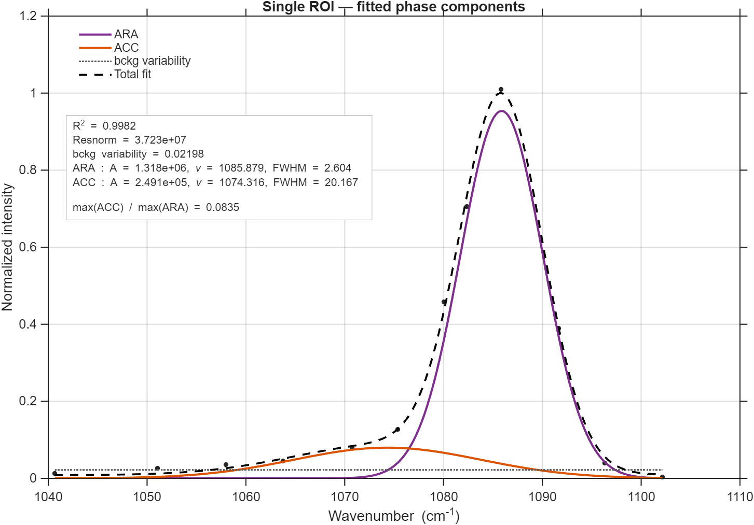
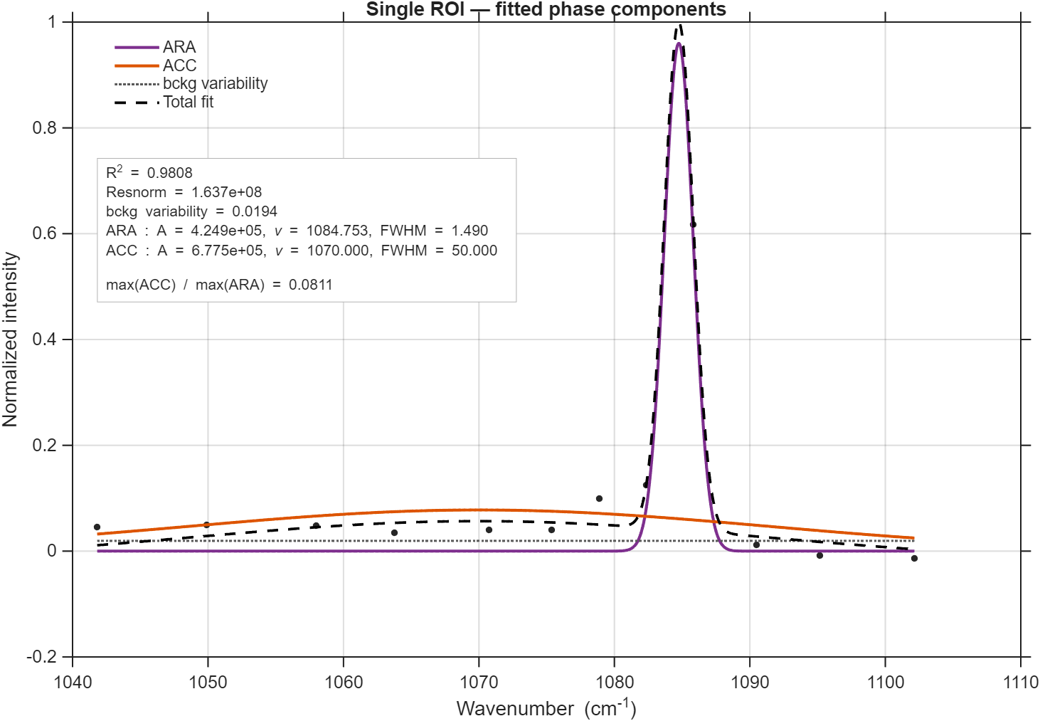
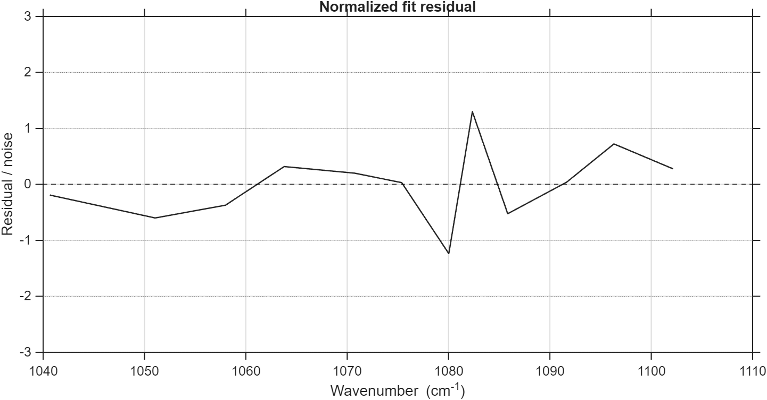
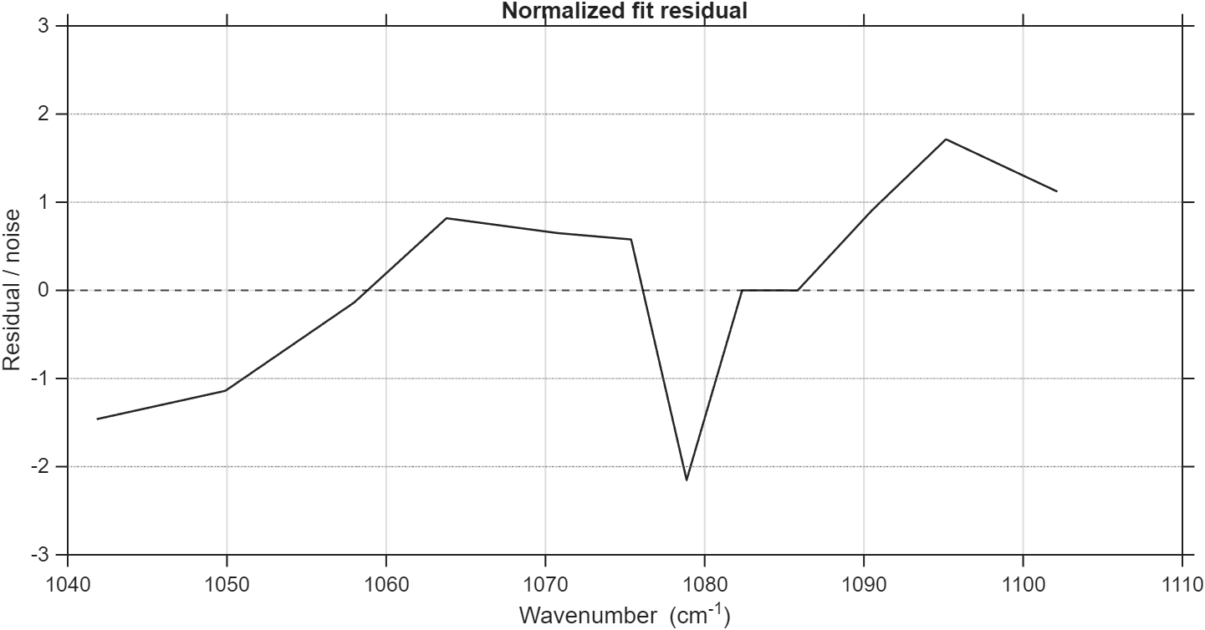
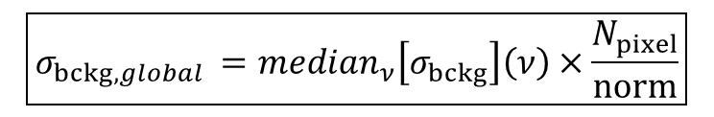
Corals 260715 2ps vs 7ps (#4 stressed)
Réalisé sur la somme des pixels :
2ps
7ps
Stats sur [min(wn) 1076] :
2ps :
RMS residual = 0.506
Max residual = 0.745
min experimental = 416.64
background fit = -470.884175
min fit = -324.167943
max fit = 128446.667684
7 ps :
RMS residual = 0.970
Max residual = 1.475
min experimental = -2214.30
background fit = 1071.426001
min fit = 2024.255660
max fit = 100911.778329
$$\boxed{σ_{bckg,global }={median}_{ν}\left[σ_{bckg}\right]\left(ν\right)×\frac{N_{pixel}}{norm}}$$
Bckg variability :

Slide 20
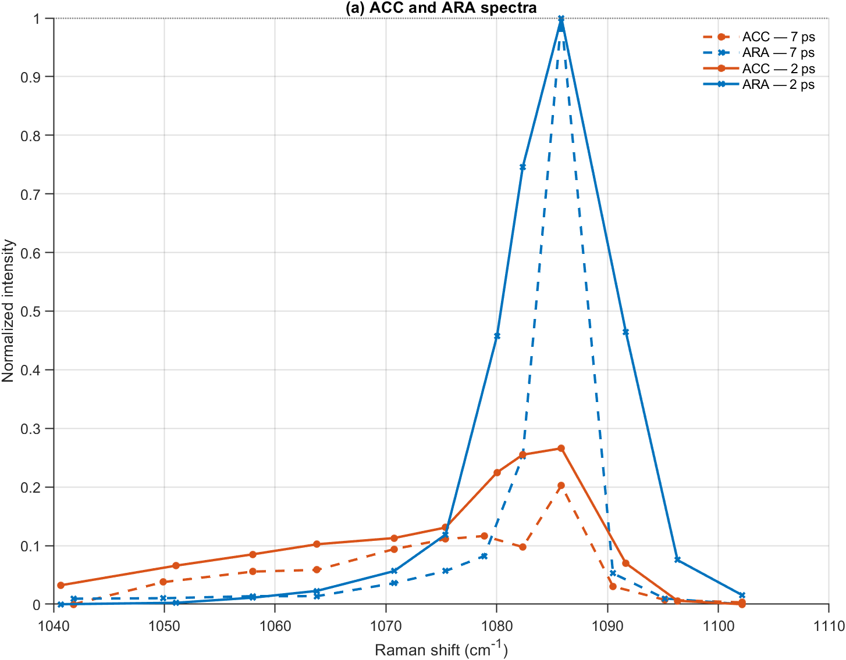
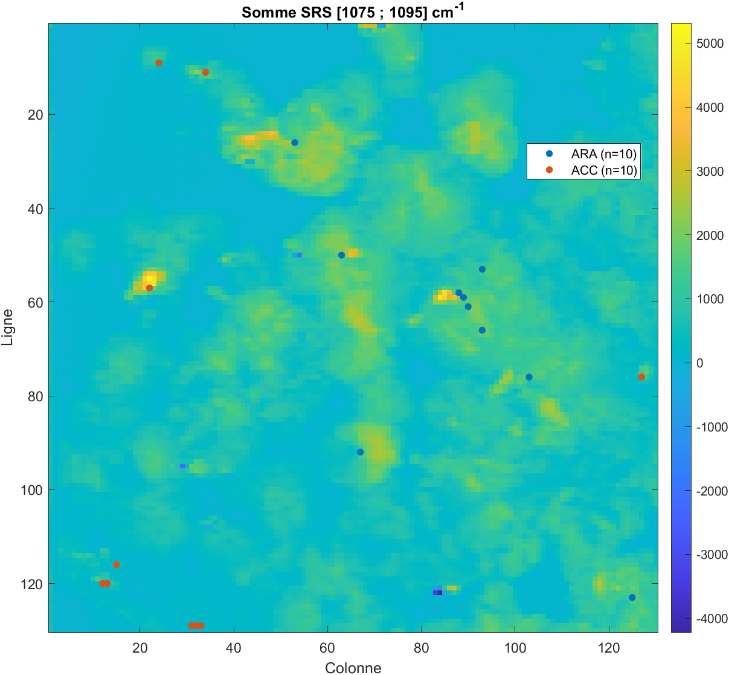
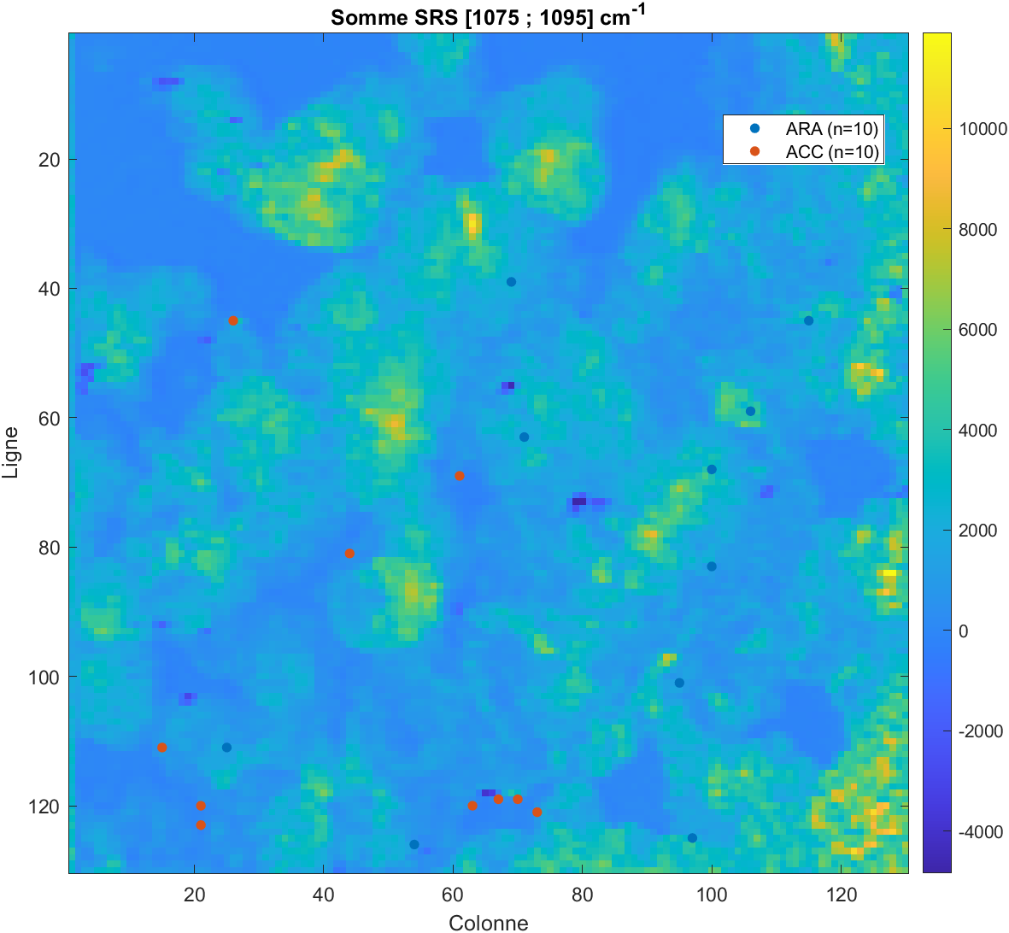
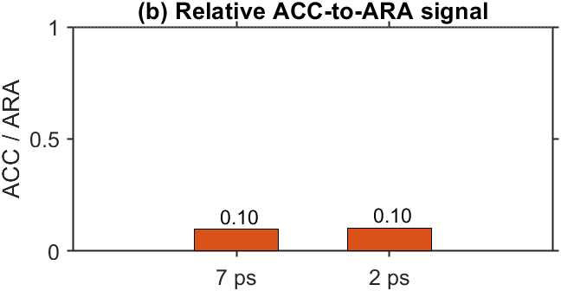
Coral 260715 2ps vs 7ps (#4 stressed)
7ps
2ps
260715 | A | nu | FWHM_phase | FWHM_instr | N_pix
2ps ARA | 8311 +/- 3747.4 | 1086.02 +/- 0.17 | 1.43 +/- 0.81 | 10.53 | 10
2ps ACC | 2823.2 +/- 2918.7 | 1073.11 +/- 0.36 | 33.92 +/- 6.33 | 10.53 | 10
7ps ARA | 4275 +/- 794.18 | 1085.45 +/- 0.24 | 3.12 +/- 0.93 | 2.50 | 10
7ps ACC | 3741.6 +/- 2693.2 | 1073.83 +/- 1.53 | 32.04 +/- 8.97 | 2.50 | 10

Slide 21
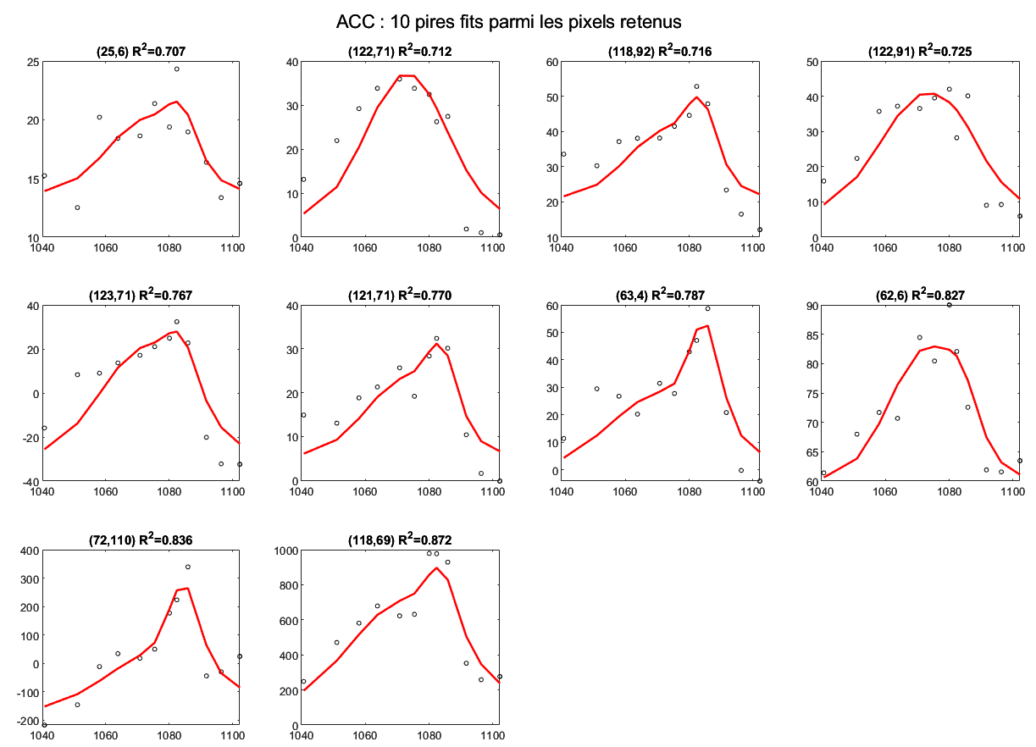






Corals 260715 2ps (#4 stressed)
ACC
ARA: A_mean = 702.68 +/- 1229
ACC:A_mean = 4453 +/- 8549.8
nu = 1073.5428 +/- 1.7166 cm^-1
FWHM= 31.8237 +/- 6.0136 cm^-1
ARA
ARA : A_mean = 8311 +/- 3747.4
ACC: A_mean = 1346.2 +/- 966.64
nu = 1086.0169 +/- 0.1741 cm^-1 FWHM= 1.4299 +/- 0.8107 cm^-1

Slide 22
Corals 260715 7ps (#4 stressed)
ACC
ARA: A_mean = 648.98 +/- 422.52
ACC:A_mean = 4568.9 +/- 2423.2
nu = 1073.8552 +/- 1.5147 cm^-1
FWHM= 30.2458 +/- 9.4385 cm^-1
ARA
ARA : A_mean = 4275 +/- 794.18
ACC: A_mean = 1464.6 +/- 604.63
nu = 1085.4458 +/- 0.2423 cm^-1
FWHM= 3.1194 +/- 0.9295 cm^-1

Slide 23




Corals 260715 7ps (#4 stressed)
FWHM instrumentale 2.4980 cm^-1
Phase 2 : ARA
Amplitude des phases :
Phase 2 : A_mean = 4275 +/- 794.21
Phase 4 : A_mean = 1464.7 +/- 604.59
nu = 1085.4458 +/- 0.2422 cm^-1
FWHM= 3.1193 +/- 0.9294 cm^-1
Phase 4 : ACC
Phase 2 : A_mean = 86.662 +/- 68.817
Phase 4 : A_mean = 4145.5 +/- 1814.5
nu = 1070.4489 +/- 0.6355 cm^-1
FWHM = 34.4327 +/- 4.8101 cm^-1

Slide 24





Corals 260713 2ps vs 7ps (#4 stressed)

Slide 25

SET UP
(a)
(b)

