Slide 1
I) Données Chahira
II) Chirp analysis
1- Calcite
2- Vatérite
3- ACC

Slide 2
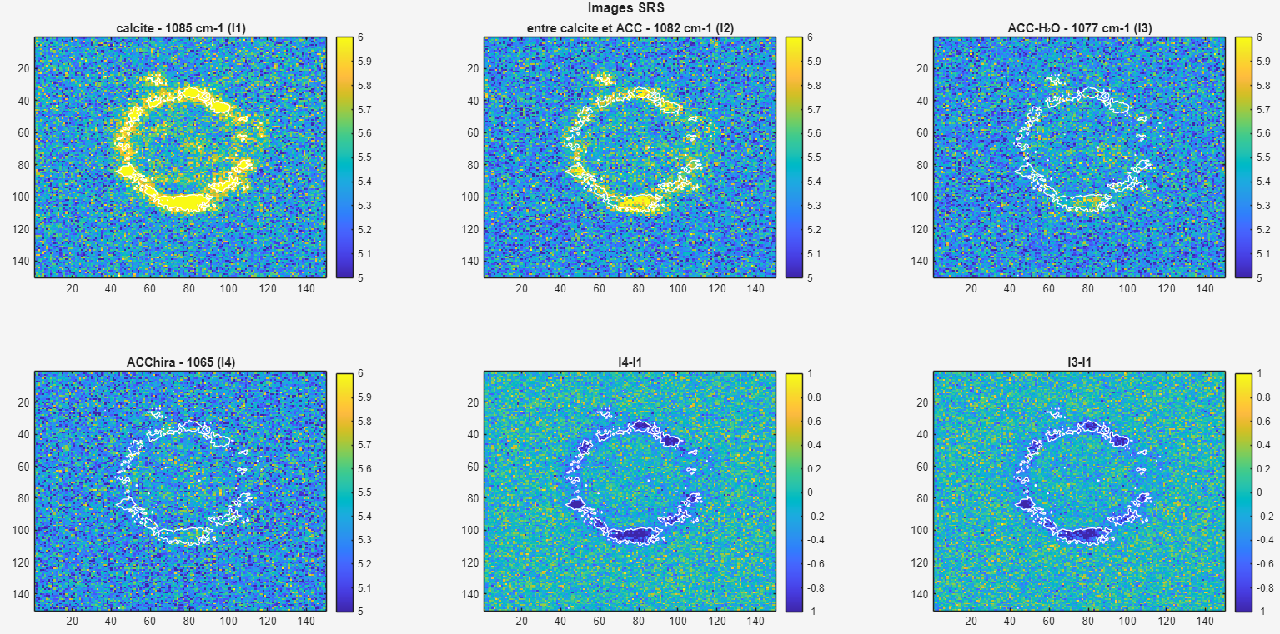

Slide 3
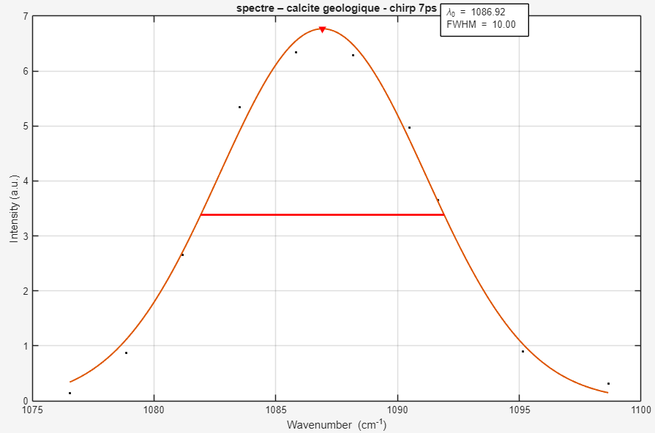
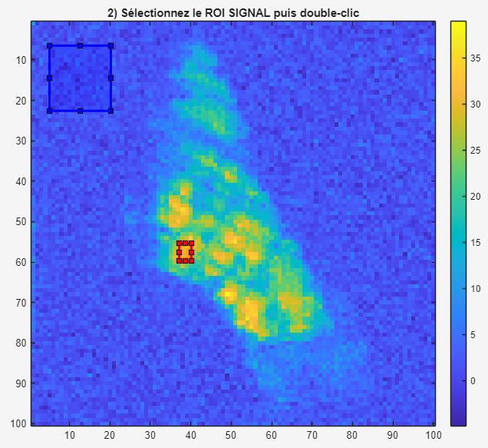
7 ps chirp on calcite - 260522
POWER METER POSITION | Stokes | Pump
INPUT (software) | 220 mW | 300 mW
OUTPUT Laser (before CHRIRP) | 510 mW | 510 mW
After CHIRP | 240 mW | 230 mW
After sample | 4 mW | 3.5 mW
Psignal ~ 18
Pnoise ~ 3
🡺 SNR ~ 6
Wavelength = [927,927.4,927.8,927.2,926.4,926.8,927.6,928,926.1,926.7]

Slide 4
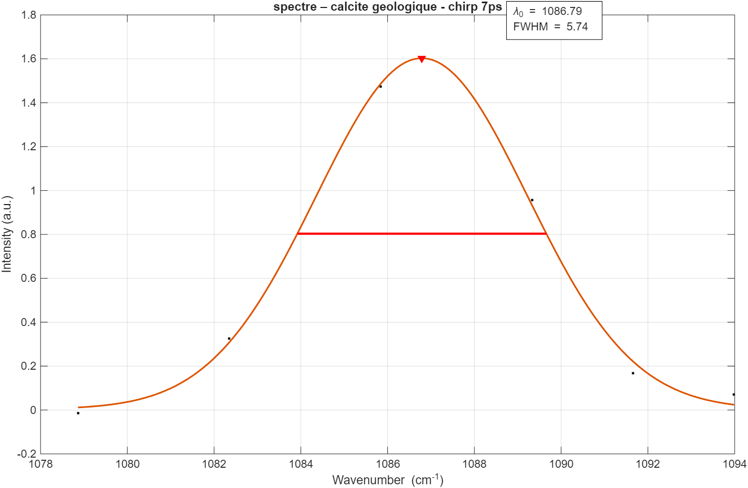
7 ps chirp on calcite - 260529
Wavelength = [927.2,927.8,926.5,926.9,927.5,926.7]

Slide 5
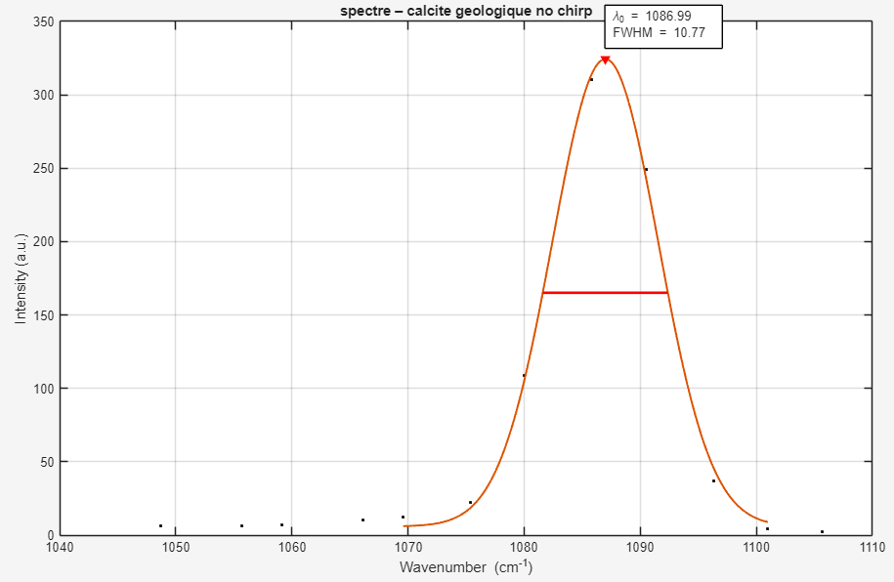
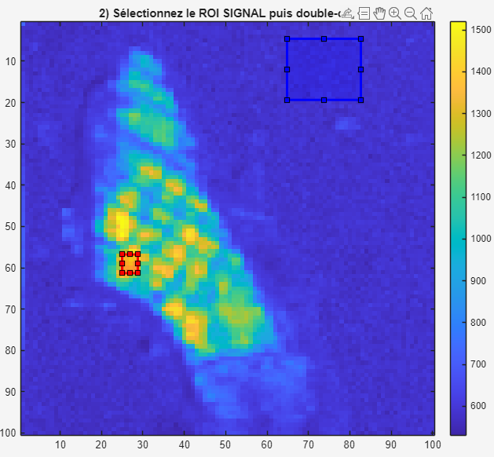
2 ps chirp on calcite - 260522
POWER METER POSITION | Stokes | Pump
INPUT (software) | 220 mW | 300 mW
OUTPUT Laser | 510 mW | 510 mW
After sample | 16 mW | 20 mW
SNR ~ 40
Wavelength = [927.2,927.7,928.1,928.6,928.9,929.5,929.8,930.4,926.8,926.3,925.9,925.5,932,932.9,935]

Slide 6
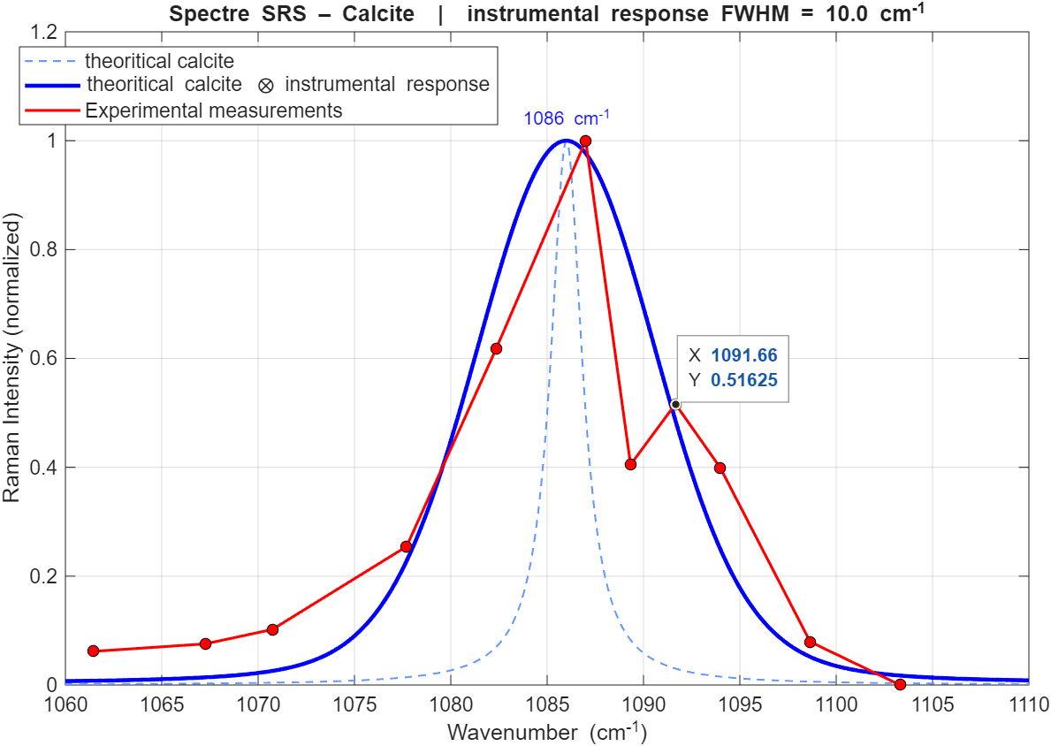
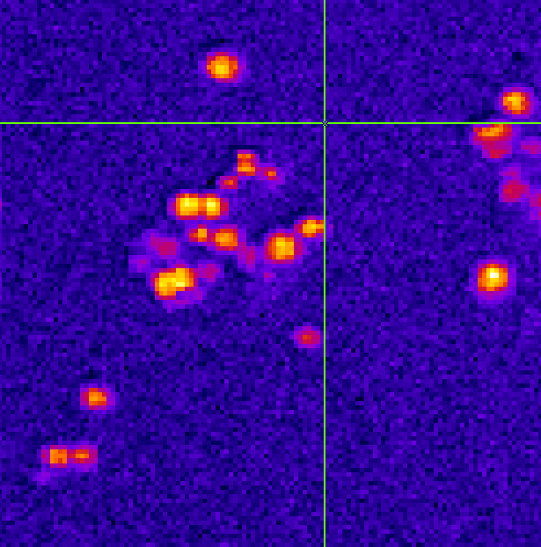
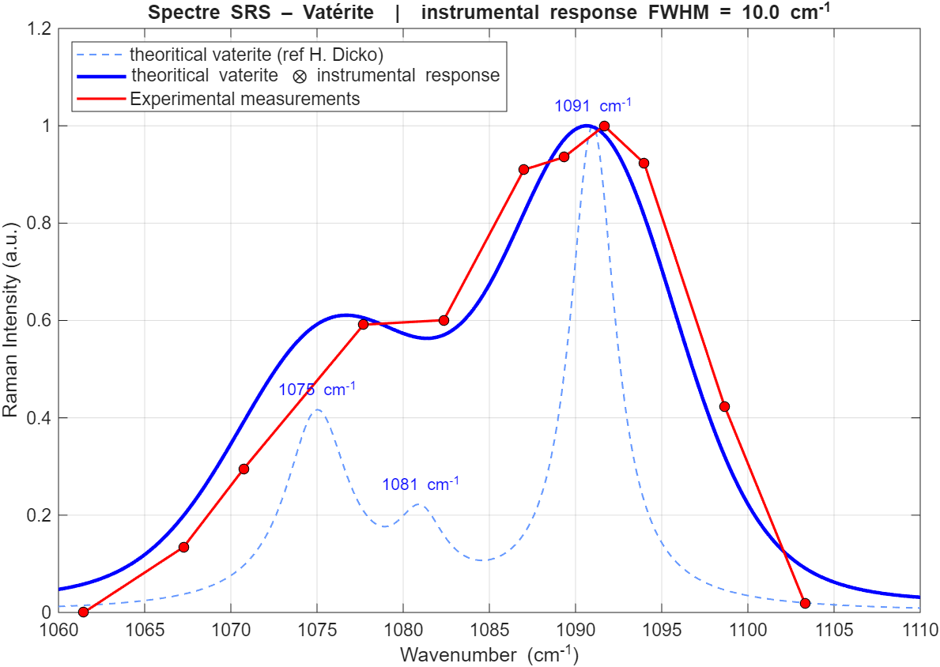
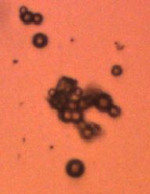
2 ps chirp on vatérite - 260527
Power max 150²
Nb points 125²
PixelRep 100 NbACC 5
scan range 50 µm
Wavelength = [926.7,927.1,927.5,927.9,928.5,928.8,929.3,929.6,930,926.9,926.1,926.5,925.7,925,924.4]
Calcite
Vatérite
maybe calcite

Slide 7
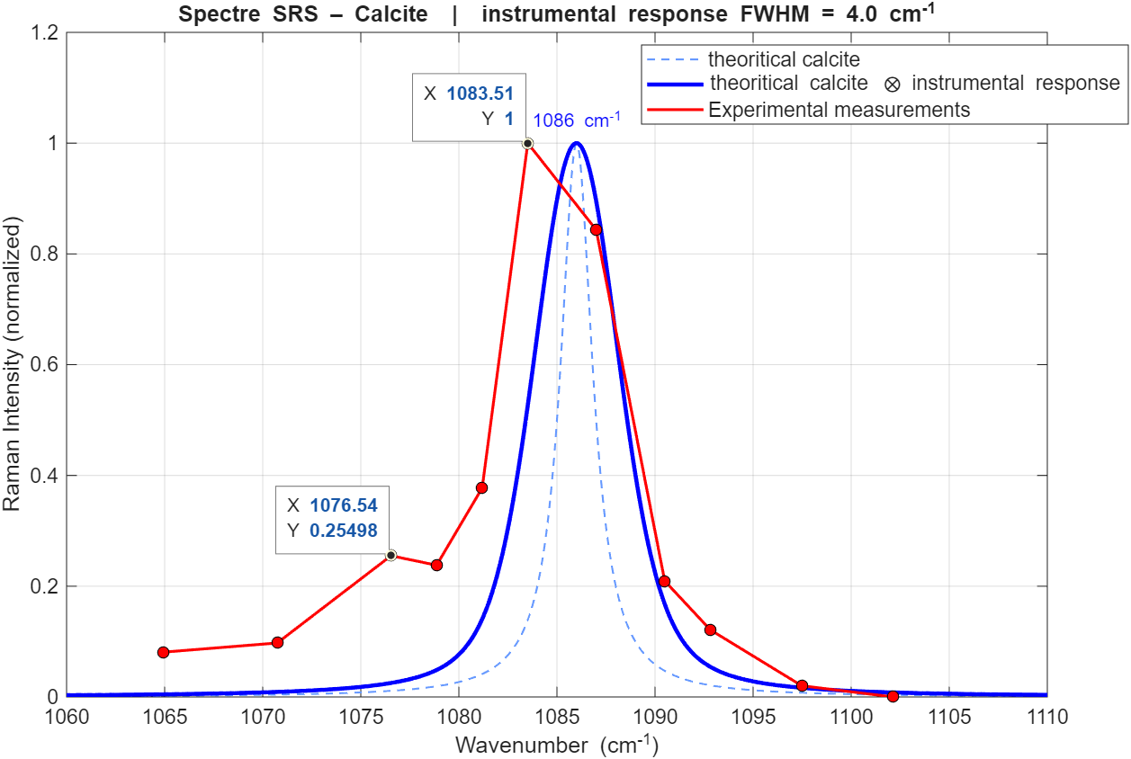
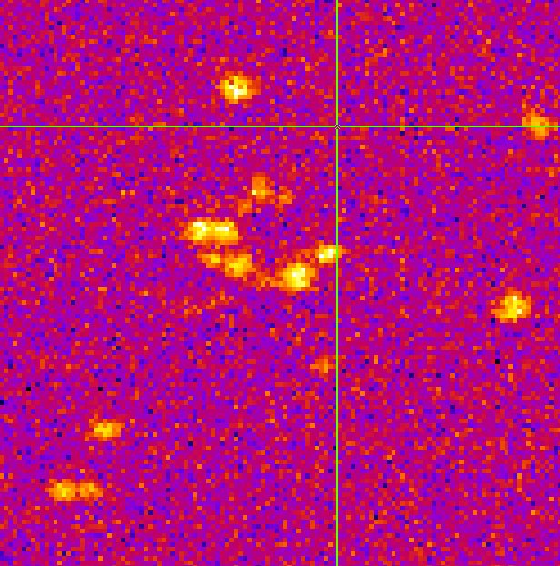
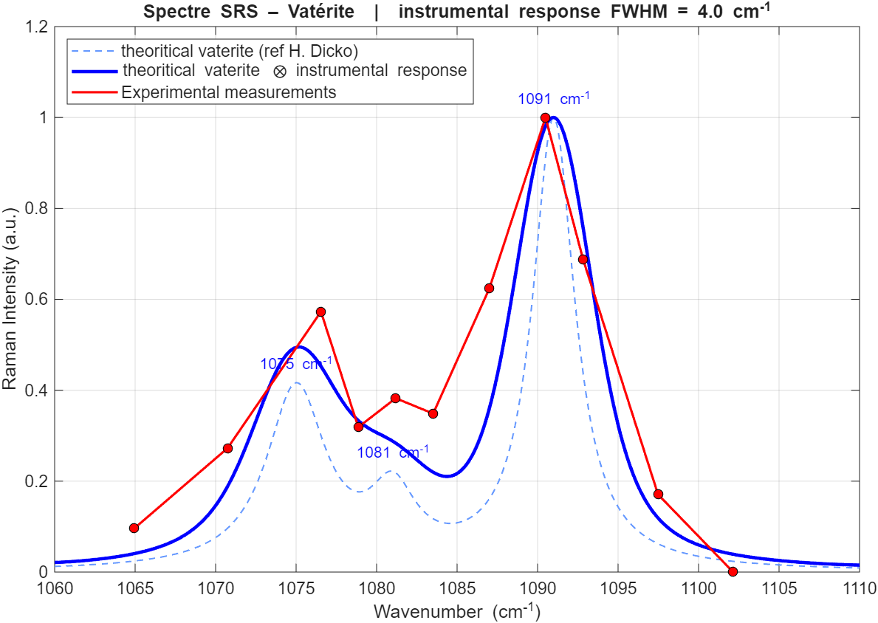
7 ps chirp on vatérite - 260527
Wavelength = [926.6,927.1,927.6,928,928.5,929,927.8,927.4,926.8,926.2,925.8]
Power max (400 pump/370 stokes)
Nb points 125²
PixelRep 150 NbACC 12
scan range 50 µm
Delay (fs) = [-5000,1000,8500,14000, 21000, 27000,10000, 5000 , -3000,-9000,-16500,-5000] ~+6000 par 0.5 nm
Commentaire :
diminution du signal observer sur la ligne détection retard pour 928.5 puis 929
Même endroit que précédemment
Calcite
Vatérite

Slide 8
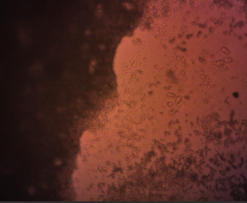
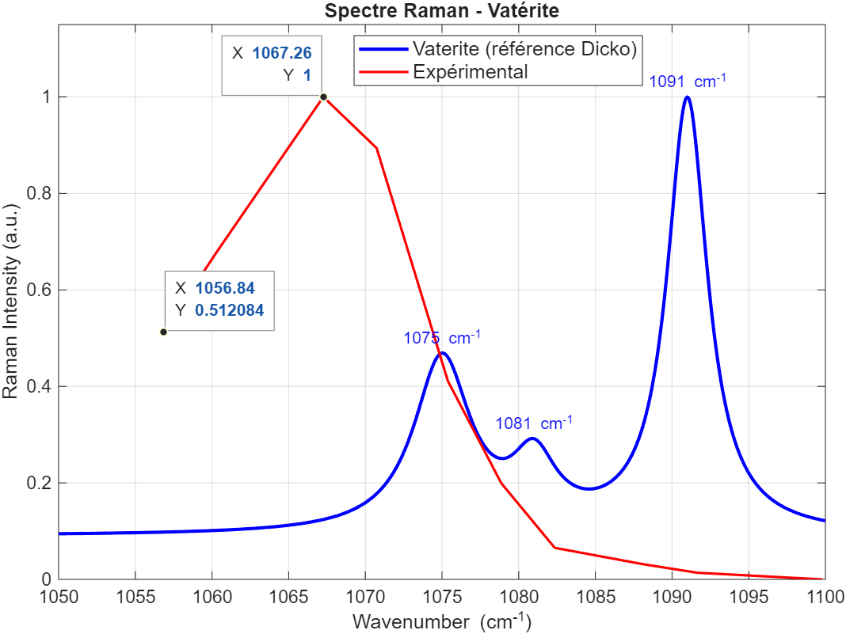
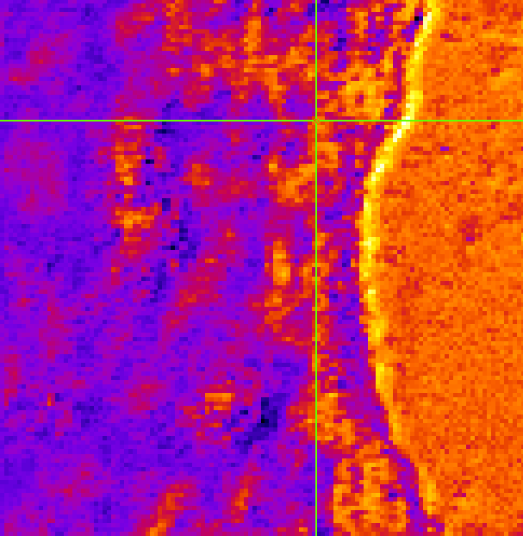
2 ps chirp on ACC- 260527
Power 250²
Nb points 125²
PixelRep 100 NbACC 5
scan range 50 µm
Wavelength = [928.1,928.5,928.8,929.4,929.7,930.3,931.1,932,927.8,927.5,927,926.7,926,925]

Slide 9
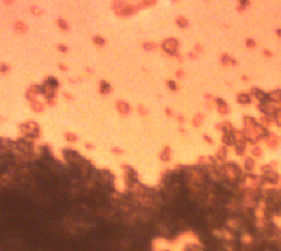
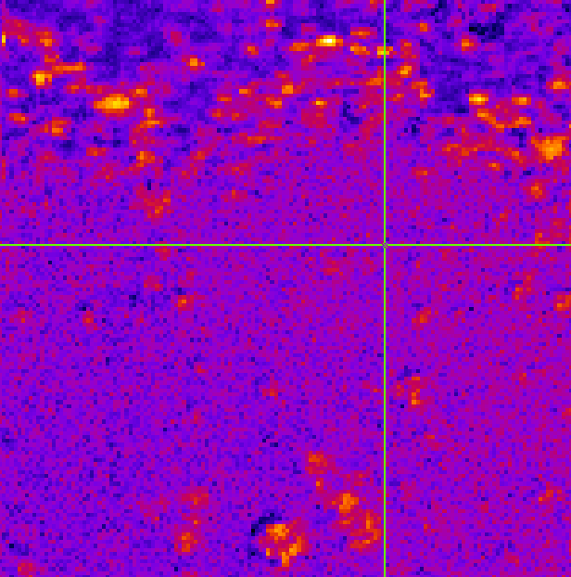
2 ps chirp on ACC- 260528
Power 250²
Nb points 150²
PixelRep 100 NbACC 5
scan range 50 µm
Wavelength = [928.4,928.8,929.1,929.6,929.9,930.3,930.8,931.2,931.4,932,928,927.6,927.3,926.7,926,925.5]
Calcite ?

Slide 10

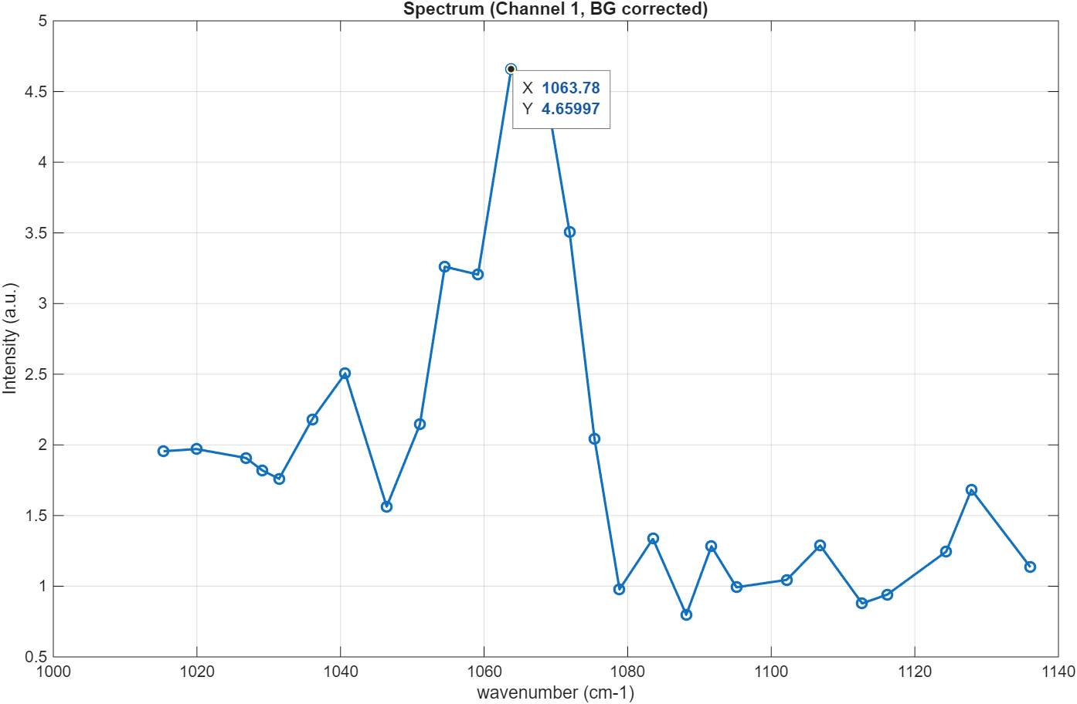
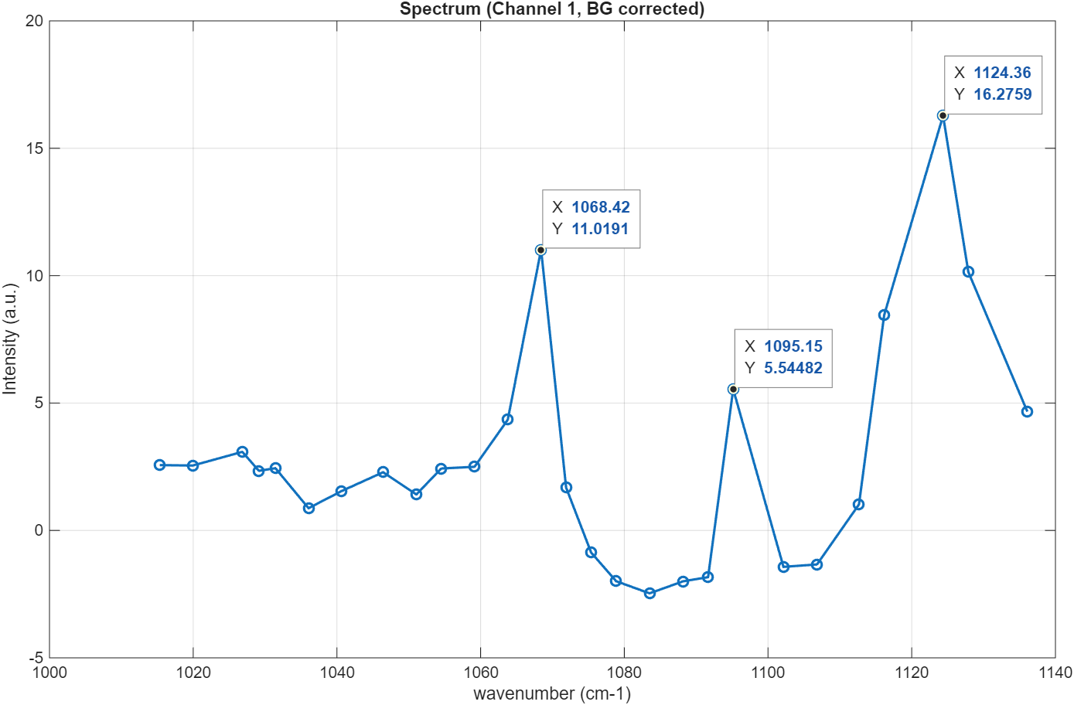
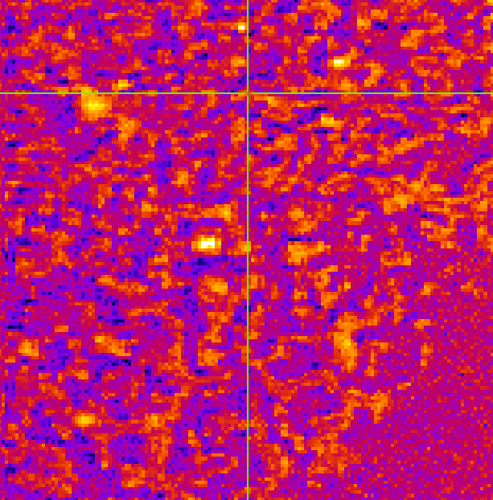
2 ps chirp on ACC- 260529
Power 300²
Nb points 150²
PixelRep 100 NbACC 5
scan range 50 µm
Wavelength = [928.7,928.1,927.8,927.4,927,926.7,925.8,926.4,925.4,924.9,924.6,923.9,928.4,929.1,929.5,929.9,930.2,930.6,931.1,931.5,931.9,932.1,932.3,932.9,933.3,923.6,922.9]
928.4

Slide 11
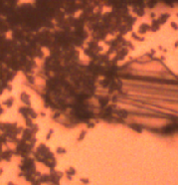
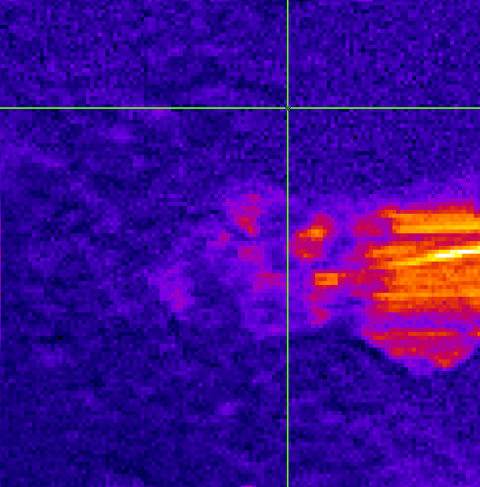
7 ps chirp on ACC- 260602
Power 350 OPO,300 Signal
Nb points 125²
PixelRep 150 NbACC 10
scan range 50 µm
Wavelength = [929.1,928.8,928.4,927.9,927.5,927.2,926.7,926.4,926,925.6,925.2,924.5,923.9,923,926.8,928.6,929.4,929.7,930.2,931.1,932.1,932.9,934.2,934.9]
Remarque : diminution du signal au détecteur sur les dernières mesures (2/3?)
927.2 - calcite

Slide 12
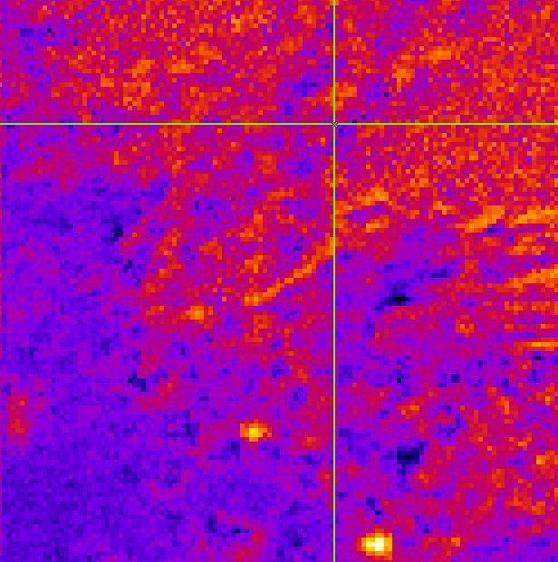
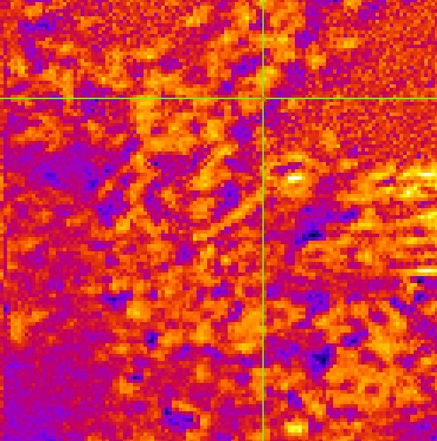
2 ps chirp on ACC- 260602
Power 150²
Nb points 125²
PixelRep 100 NbACC 5
scan range 50 µm
Wavelength = [929.2,928.8,928.3,927.8,927.5,927.1,926.7,926.3,925.9,925.5,924.9,923.9,923,924.5,929.1,929.4,929.7,930.4,]
923.9 – CCHH ?
929.1 – ACC

Slide 13
2 ps chirp on ACC- 260603
Power 150²
Nb points 125²
PixelRep 100 NbACC 5
scan range 50 µm
Wavelength = [927.2,927.6,928,928.3,928.7,929.3,929.7,930.2,931,929.2,927,926.5,925.9,925

Slide 14
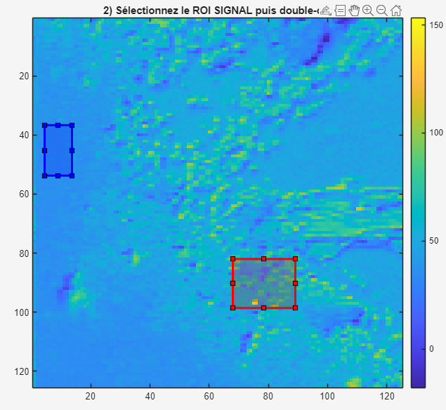
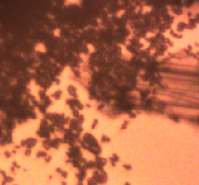
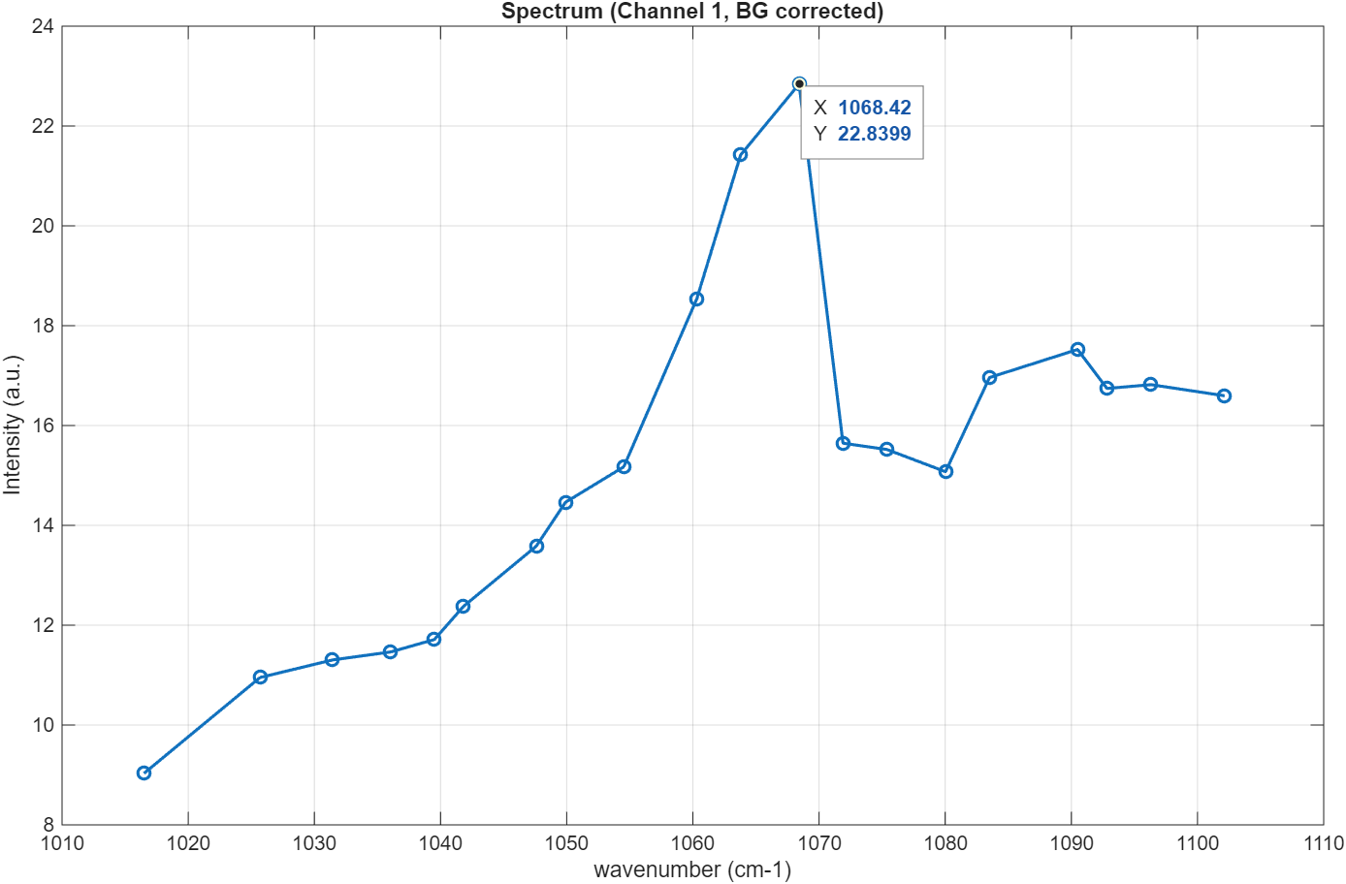
2 ps chirp on ACC- 260603 bis
Power 200²
Nb points 125²
PixelRep 100 NbACC 5
scan range 50 µm
Wavelength = [929.1,929.4,929.9,930.3,930.5,931,931.2,931.5,931.9,932.4,933.2,928.7,928.1,927.7,927.4,926.8,926.6,926.3,925.8,928.4]
ACC zone

Slide 15
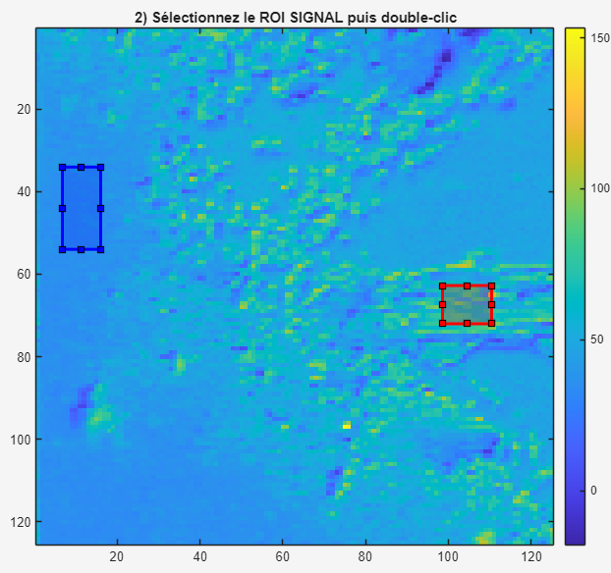
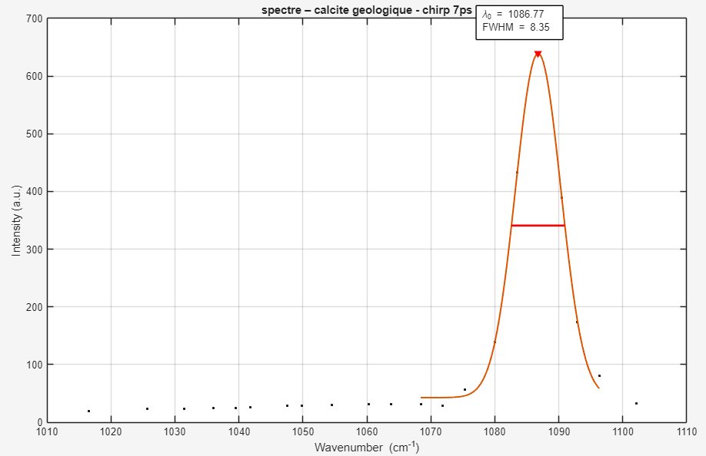
2 ps chirp on ACC- 260603 bis
Power 200²
Nb points 125²
PixelRep 100 NbACC 5
scan range 50 µm
Wavelength = [929.1,929.4,929.9,930.3,930.5,931,931.2,931.5,931.9,932.4,933.2,928.7,928.1,927.7,927.4,926.8,926.6,926.3,925.8,928.4]

Slide 16
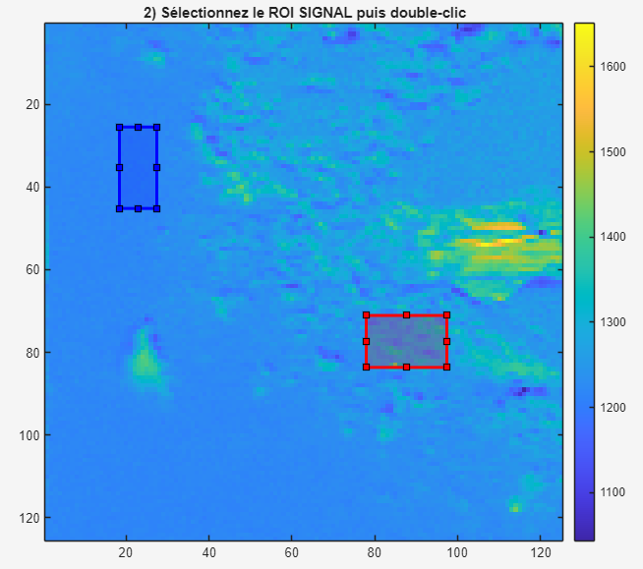
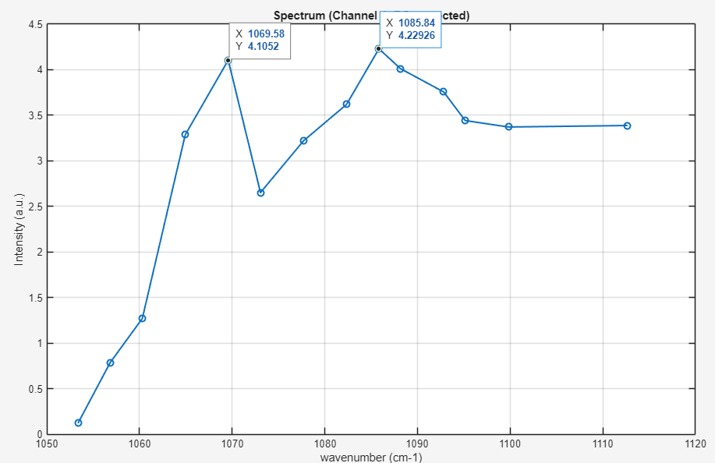
7 ps chirp on ACC- 260603 bis
Power 350,300
Nb points 125²
PixelRep 150 NbACC 10
scan range 50 µm
Wavelength = [929,929.7,930,929.4,927,927.5,927.9,928.3,928.6,929.4,927.2,926.6,926.4,926,924.9]
Rq : en gras, PMT allumé
ACC zone

Slide 17
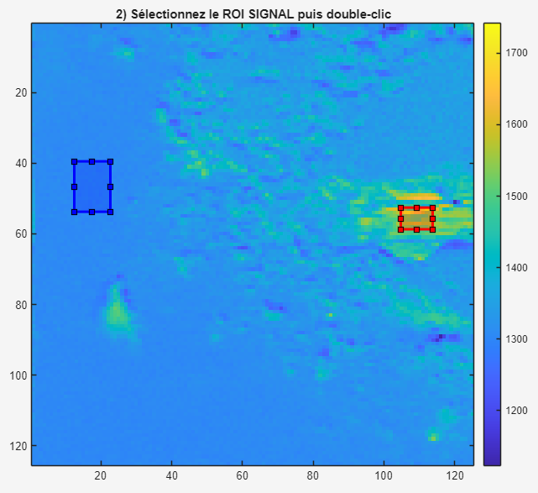
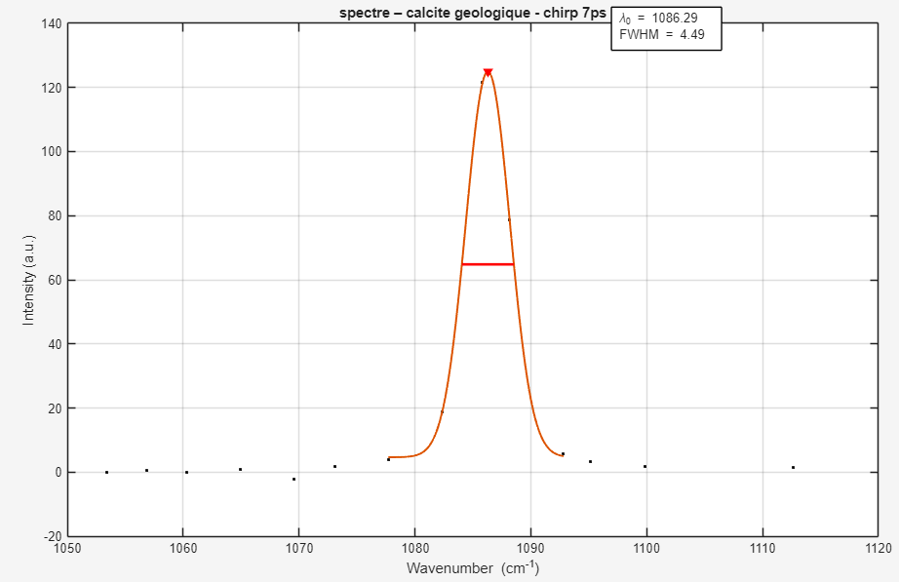

7 ps chirp on ACC- 260603 bis
Power 350,300
Nb points 125²
PixelRep 150 NbACC 10
scan range 50 µm
Wavelength = [929,929.7,930,929.4,927,927.5,927.9,928.3,928.6,929.4,927.2,926.6,926.4,926,924.9]
Rq : en gras, PMT allumé

Slide 18
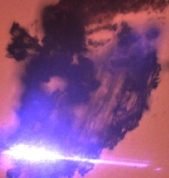
7 ps chirp on ACC- 260623
Power 300,300
Nb points 100²
PixelRep 100 NbACC 10
scan range 100 µm
Wavelength = [928.5,928.8,929.2,929.6,930,928.3,928,927.6,927.2,926.9,926.6,927.5]

Slide 19
2 ps chirp on ACC- 260623
Power 200²
Nb points 100²
PixelRep 100 NbACC 10
scan range 100 µm
Wavelength = [928.9,928.6,928.3,928,927.6,927.2,926.8,926.5,925.9,925,924,929.3,929.7,930,930.4,931.1,]

Slide 20
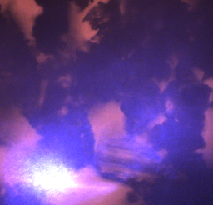
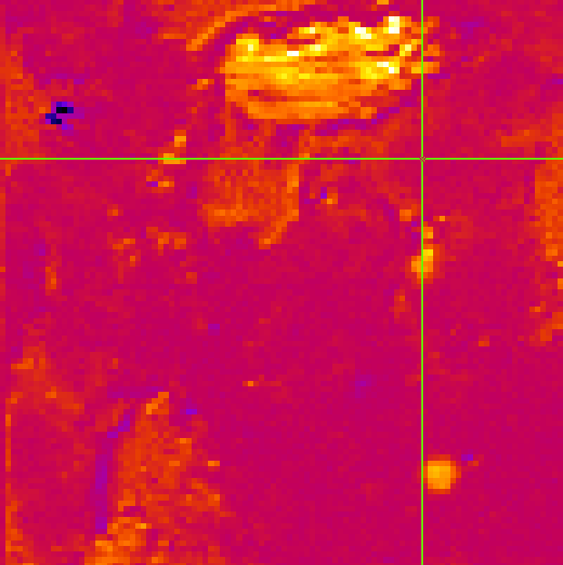
2 ps chirp on ACC- 260624 bis
Power 200²
Nb points 100²
PixelRep 100 NbACC 10
scan range 100 µm
Wavelength=[928.6,928.2,927.8,927.4,926.9,926.6,926.3,925.8,925,923.9,923,929.1,929.5,929.9,930.5,930.8,931.1,931.3,931.7,932.1,932.4,933,934]
➔ Meilleur signal que précédent
929.1

Slide 21
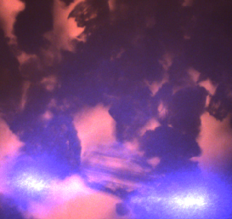
7 ps chirp on ACC- 260624 bis
Power 350²
Nb points 100²
PixelRep 120 NbACC 15
scan range 100 µm
Wavelength=[929.4,928.6,928.3,927.8,927.4,926.9,926.6,926.1,925.5,929.2,929.7,930.2,928.9]
➔ Meilleur signal que précédent

Slide 22
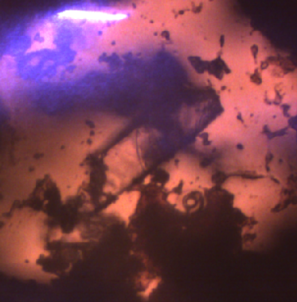
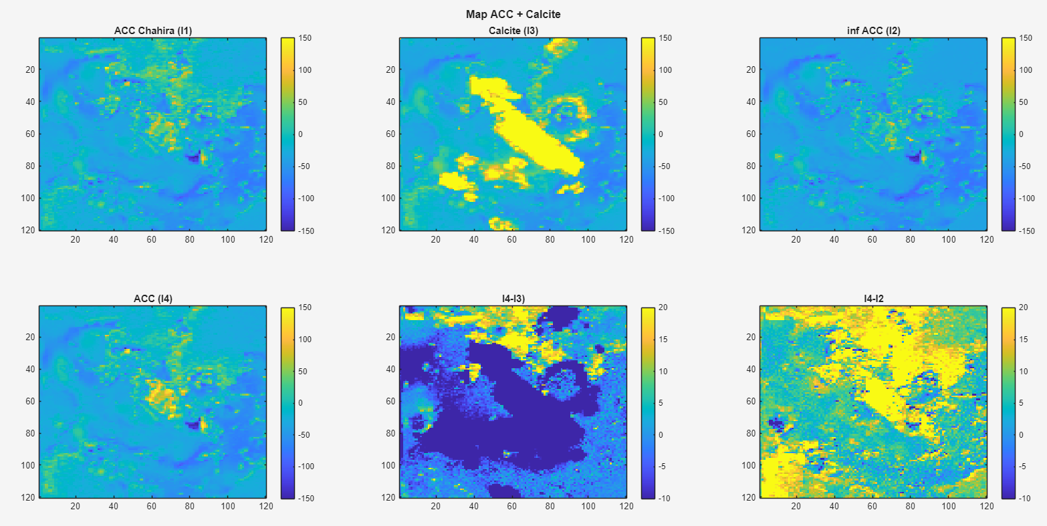
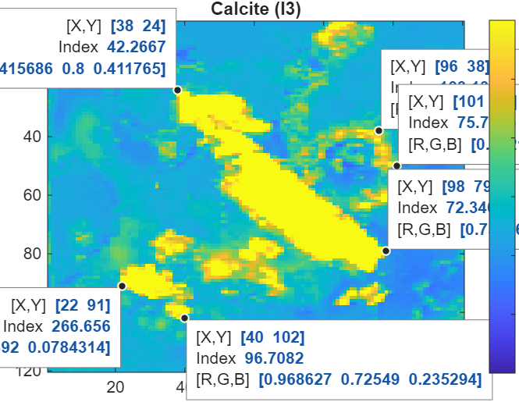
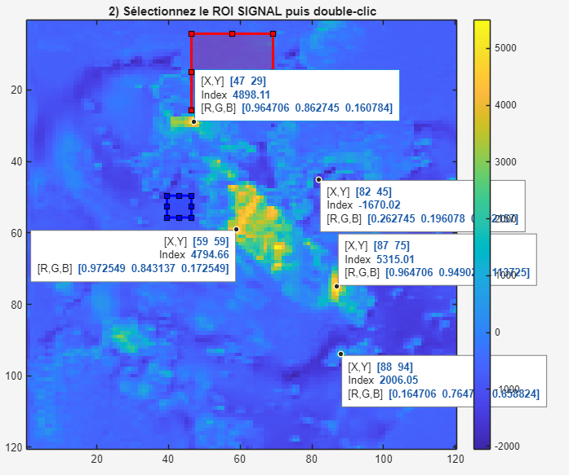
2 ps chirp on ACC + cal- 260626
Power 300
Nb points 120²
PixelRep 80 NbACC 5
scan range 100 µm
Wavelength=[929.2,928.8,928.5,928.2,927.7,927.4,926.9,926.6,926.2,925.7,925,924.1,929.1,929.5,929.8,930.2,930.5,931,931.8,932.9]
➔ Meilleur signal que précédent

Slide 23
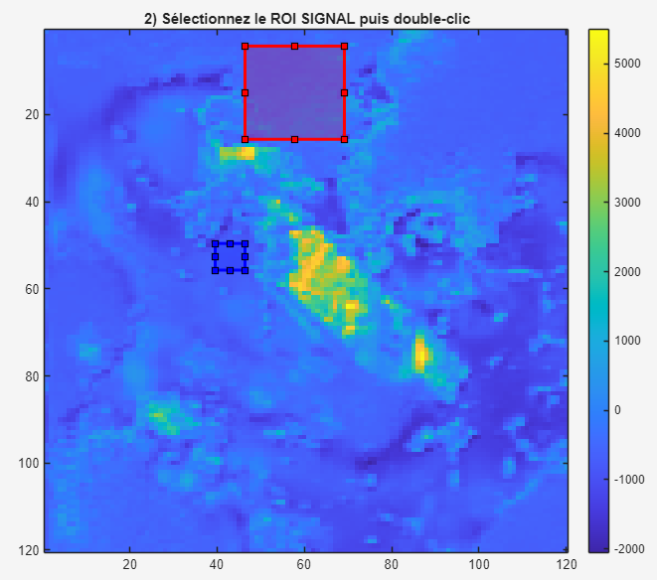
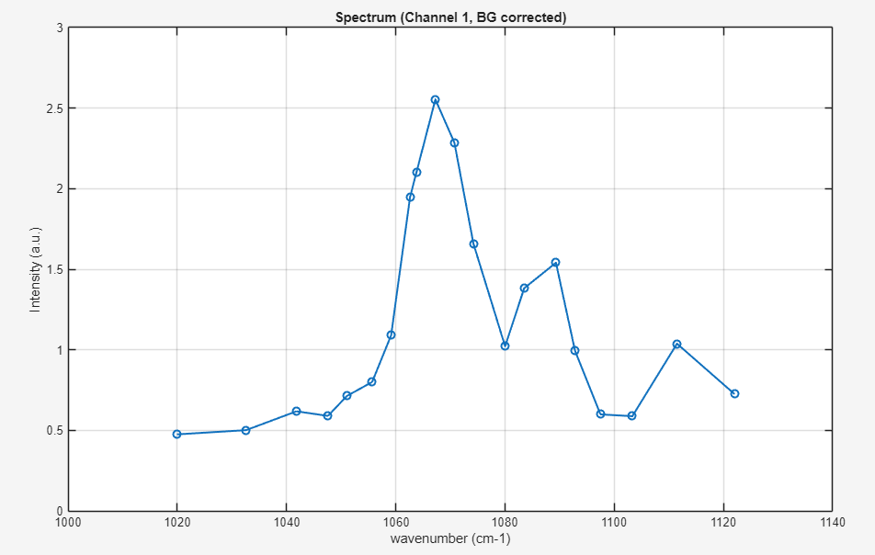
2 ps chirp on ACC + cal- 260626
Power 300
Nb points 120²
PixelRep 80 NbACC 5
scan range 100 µm
Wavelength=[929.2,928.8,928.5,928.2,927.7,927.4,926.9,926.6,926.2,925.7,925,924.1,929.1,929.5,929.8,930.2,930.5,931,931.8,932.9]
➔ Meilleur signal que précédent

Slide 24
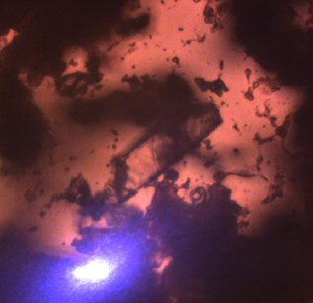
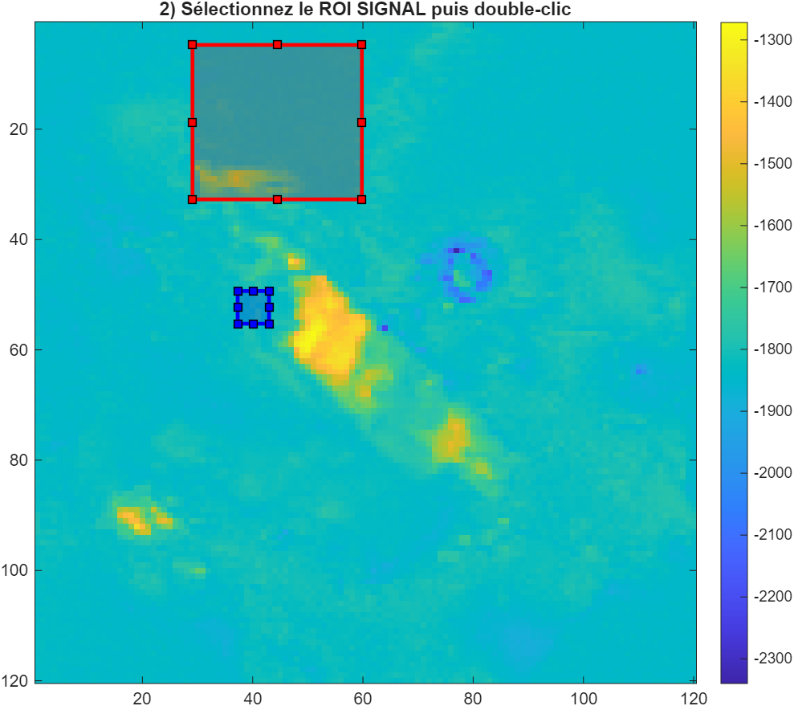
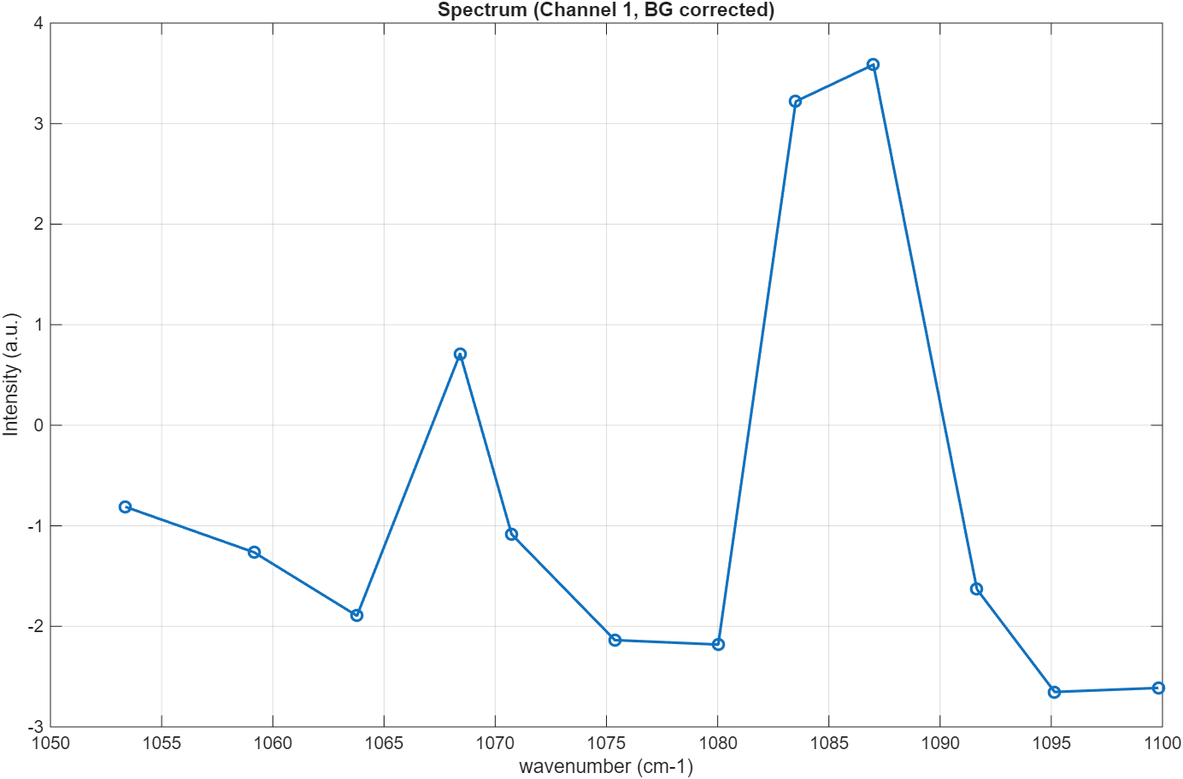
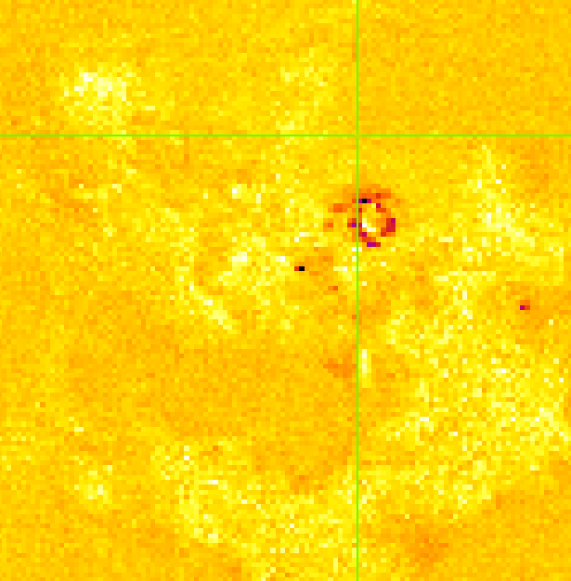
7 ps chirp on ACC + cal- 260626
Power 350²
Nb points 120²
PixelRep 150 NbACC 10
scan range 100 µm
Wavelength=[929.1,928.7,928.5,928.1,927.7,927.4,926.7,926.4,926,929.5,930,927.1]
➔ Meilleur signal que précédent
929.1

Slide 25
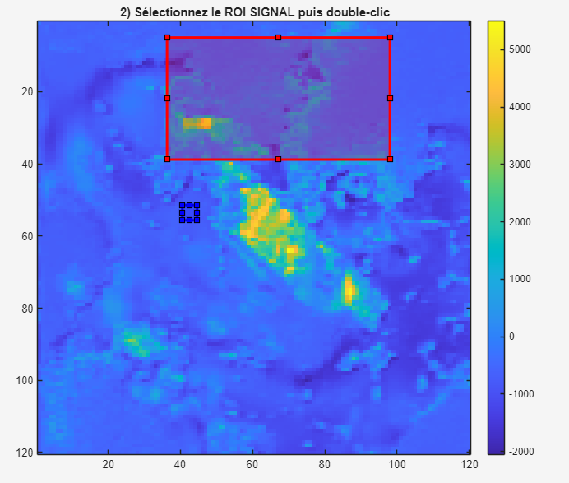
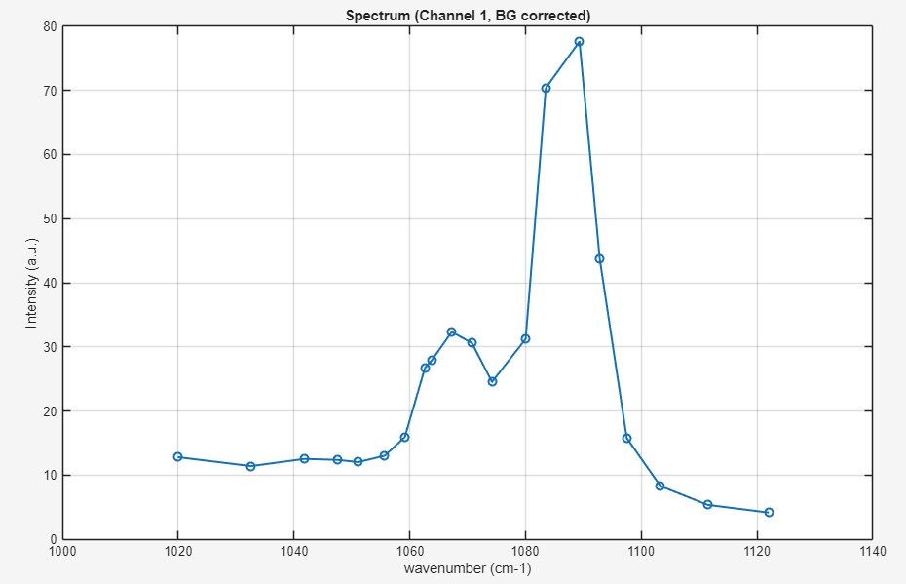
2 ps chirp on ACC + cal- 260626
Power 300
Nb points 120²
PixelRep 80 NbACC 5
scan range 100 µm
Wavelength=[929.2,928.8,928.5,928.2,927.7,927.4,926.9,926.6,926.2,925.7,925,924.1,929.1,929.5,929.8,930.2,930.5,931,931.8,932.9]
➔ Meilleur signal que précédent

Slide 26


2 ps chirp on ACC + cal- 260626
Power 300
Nb points 120²
PixelRep 80 NbACC 5
scan range 100 µm
Wavelength=[929.2,928.8,928.5,928.2,927.7,927.4,926.9,926.6,926.2,925.7,925,924.1,929.1,929.5,929.8,930.2,930.5,931,931.8,932.9]
➔ Meilleur signal que précédent

Slide 27

7 ps chirp on ACC + cal- 260626
Power 350²
Nb points 120²
PixelRep 150 NbACC 10
scan range 100 µm
Wavelength=[929.1,928.7,928.5,928.1,927.7,927.4,926.7,926.4,926,929.5,930,927.1]
➔ Meilleur signal que précédent
929.1

Slide 28


7 ps chirp on ACC + cal- 260626
Power 350²
Nb points 120²
PixelRep 150 NbACC 10
scan range 100 µm
Wavelength=[929.1,928.7,928.5,928.1,927.7,927.4,926.7,926.4,926,929.5,930,927.1]
➔ Meilleur signal que précédent
929.1

Slide 29




2ps 7 ps
x_bg=4.068975e+01; y_bg=5.070873e+01; width_bg=3.870968e+00; height_bg=4.554080e+00;
x_sig=4.478843e+01; y_sig=1.752372e+00; width_sig=6.011385e+01; height_sig=2.823529e+01;

Slide 30




2ps 7 ps
x_bg=2.953226e+01; y_bg=2.748292e+01; width_bg=4.098672e+00; height_bg=4.554080e+00;
x_sig=7.962713e+01; y_sig=2.429507e+01; width_sig=2.003795e+01; height_sig=1.275142e+01;

Slide 31




2ps 7 ps
x_bg=2.839374e+01; y_bg=2.611670e+01; width_bg=4.781784e+00; height_bg=6.375712e+00;
x_sig=4.752087e+01; y_sig=1.700854e+01; width_sig=5.305503e+01; height_sig=1.958254e+01;
I_{ara}/I_{acc}~2
I_{ara}/I_{acc}~2,9

Slide 32





2ps 7 ps
x_bg=1.154364e+01; y_bg=1.199905e+01; width_bg=4.781784e+00; height_bg=4.781784e+00;
x_sig=5.799526e+01; y_sig=1.951328e+01; width_sig=5.692600e+00; height_sig=4.326376e+00;

Slide 33




2ps 7 ps
x_bg=1.063074e+02; y_bg=7.401275e+01; width_bg=6.288952e+00; height_bg=6.968839e+00;
x_sig=3.797875e+01; y_sig=3.814448e+00; width_sig=3.093484e+01; height_sig=4.436261e+01;
I_{ara}/I_{acc}~2,8
I_{ara}/I_{acc}~6,8

Slide 34




2ps 7 ps
x_bg=9.852657e+01; y_bg=1.001205e+02; width_bg=6.831120e+00; height_bg=5.692600e+00;
x_sig=1.023975e+02; y_sig=2.207780e+00; width_sig=1.685009e+01; height_sig=1.958254e+01;

Slide 35


2ps 7 ps
x_bg=1.063074e+02; y_bg=7.401275e+01; width_bg=6.288952e+00; height_bg=6.968839e+00;
x_sig=3.797875e+01; y_sig=3.814448e+00; width_sig=3.093484e+01; height_sig=4.436261e+01;

Slide 36





2ps 7 ps
x_bg=1.063074e+02; y_bg=7.401275e+01; width_bg=6.288952e+00; height_bg=6.968839e+00;
x_sig=3.797875e+01; y_sig=3.814448e+00; width_sig=3.093484e+01; height_sig=4.436261e+01;
Décalage du pic, présence d’ACC ?
Recalage du pic par rapport au 2ps fais sens si l’on détecte moins d’ACC en 7ps

Slide 37




260708 ACC
Wavelength=[928.5,928.8,929.2,929.6,929.9,930.3,930.8,931.2,931.5,931.8,932.1,932.6,932.9,928.3,927.8,927.5,927.1,926.6,926.1,925.6,925,924.5,923.9,
Power 200 mW
Nb pts 130²
Pixrep 100
Nbacc 5

Slide 38



260708 ACC_Cal 2 ps
Wavelength=[927,927.5,928,928.3,928.6,929.1,929.4,929.6,929.8,930.4,930.8,931.1,931.5,931.8,932.5,932.9,933.9,935,926.8,926.4,926,925.6,925.2,924.8,924,923
Power 200 mW
Nb pts 130²
Pixrep 100
Nbacc 3

Slide 39



260708 ACC_Cal 7 ps
Wavelength=[928.6,929.1,929.5,929.8,930.2,930.6,931.1,928,927.6,927.2,926.8,926.4,926,925.5,928.3]
Power 350 mW
Nb pts 130²
Pixrep 130
Nbacc 5

Slide 40




2ps 7 ps
x_bg=7.438046e+01; y_bg=9.090797e+01; width_bg=9.127135e+00; height_bg=9.373814e+00;
x_sig=1.047220e+02; y_sig=9.066129e+01; width_sig=8.387097e+00; height_sig=9.867173e+00;

Slide 41




2ps 7 ps
x_bg=7.536717e+01; y_bg=9.115465e+01; width_bg=1.036053e+01; height_bg=1.159393e+01;
x_sig=5.686622e+01; y_sig=2.257780e+01; width_sig=1.529412e+01; height_sig=9.373814e+00;

Slide 42




2ps 7 ps
x_bg=1.121224e+02; y_bg=1.175493e+02; width_bg=4.193548e+00; height_bg=4.440228e+00;
x_sig=6.278653e+01; y_sig=6.377324e+01; width_sig=3.552182e+01; height_sig=1.850095e+01;

Slide 43




2ps 7 ps
ROI BACKGROUND : x=73, y=91, largeur=6, hauteur=7
ROI SIGNAL : x=61, y=22, largeur=8, hauteur=9
ROI SIGNAL : x=97, y=78, largeur=8, hauteur=9

Slide 44


2ps
ROI BACKGROUND : x=73, y=91, largeur=6, hauteur=7
ROI SIGNAL : x=61, y=22, largeur=8, hauteur=9
ROI SIGNAL : x=97, y=78, largeur=8, hauteur=9
Si l’on regarde la somme des deux ROIS : Modèle correspond bien aux mesures pour
A(ACC)=2.5
A(Cal)=9
➔ A(ACC)/A(Cal) ~0.28
FWHM instrument = 14.5 cm-1
Sur de la calcite pure pour déterminer FWHM(instr) = 14.5 cm-1
Supérieur à précédemment.

