Slide 1
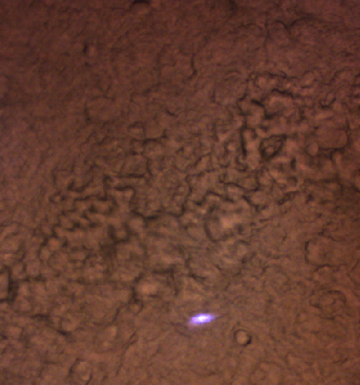
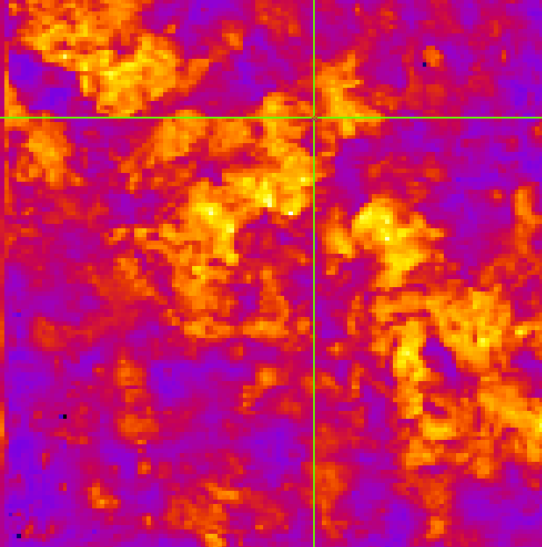
260701 coral_7ps #1 stressed
Power 300 mW
Nb pts 130²
Pixrep 100
Nbacc 5
Wavelength = [927.5,927.1,926.8,926.4,925.9,925.5,924.5,924.1,923.5,925,927.4,927.7,928.1,928.5,928.7,929.1,929.4,929.9,930.4,930.8,931.1,
927.1

Slide 2
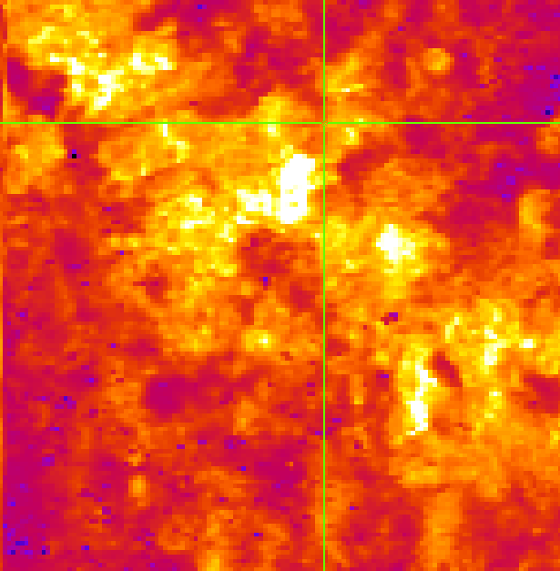
260701 coral_2ps #1 stressed
Power 200 mW
Nb pts 130²
Pixrep 100
Nbacc 5
Wavelength = [927.1,927.6,928,928.5,928.8,929.3,929.6,929.9,930.4,931.1,926.7,926.3,925.8,925.4,924.9,924.5,924.1,923.5,]
927.1

Slide 3
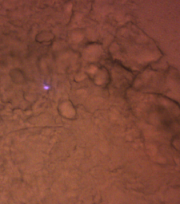
260702 coral_2ps #1 stressed
Power 200 mW
Nb pts 120²
Pixrep 120
Nbacc 10
Wavelength = [928.6,928.9,929.4,929.9,930.3,931,932.1,928.4,928.1,927.6,927.2,926.7,926.3,925.8,925.2]
927.1

Slide 4
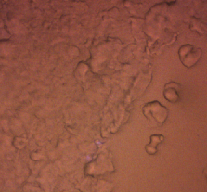
260702 coral_7ps_bis #1 stressed
Power 350 mW
Nb pts 120²
Pixrep 150
Nbacc 3
Wavelength=[927.1,927.4,928.5,928.2,928.8,929.1,929.4,929.6,930,926.8,926.4,926,927.8,928.3,925,]
927.1

Slide 5
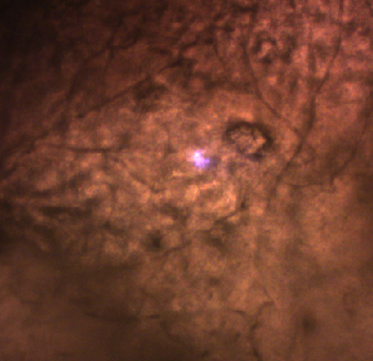
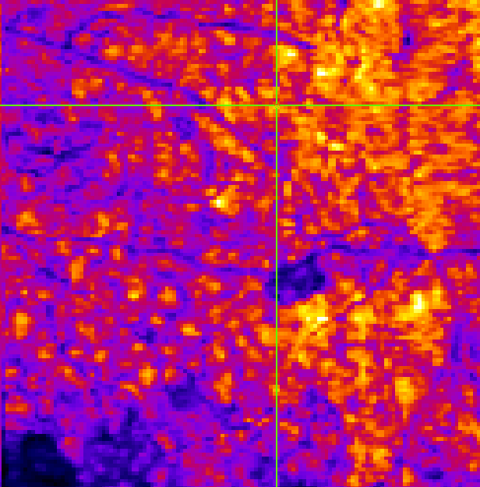
260702 coral_2ps [#3 tissues]
Power 150 mW
Nb pts 130
Pixrep 120
Nbacc 3
Wavelength=[926.9,927.2,927.5,927.8,928.3,928.6,929.1,929.4,929.6,930,930.4,930.8,931.1,931.5,931.9,932.9,926.7,926.4,926,925.6,924.9]]
927.2

Slide 6
260702 coral_7ps [#3 tissues]
Power 350 mW
Nb pts 130
Pixrep 150
Nbacc 5
Wavelength=[926.9,927.2,927.5,928.4,928.6,928.9,929.2,929.6,929.9,930.2,930.8,931,931.3,926.6,926.1,925
L’intensité après chirp diminue à partir de 930.5 nm
Manip après 931 nm, peut être désalignement.
 | 931 | 931.3 | 926.6 | 925 | 924
Puissance PM (a.u.) | 18.5 | 15.3 | 20 (ou plus) | 17,3 | 6

Slide 7
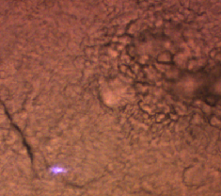
260706 coral_2ps test [#3 tissues]
Power 150 mW
Nb pts 150²
Pixrep 100
Nbacc 10
Wavelength=[928.5,929.1,929.6,928.1,927.5,927,926.9,926.6,926.2,925.8,925,924.5,923,924,]
927.2

Slide 8
260706 coral_2ps test_bis [#3 tissues]
Power 150 mW
Nb pts 150²
Pixrep 100
Nbacc 10
Wavelength=[927,928,928.5,928.9,929.4,929.9,930.4,927.2
927.2

Slide 9
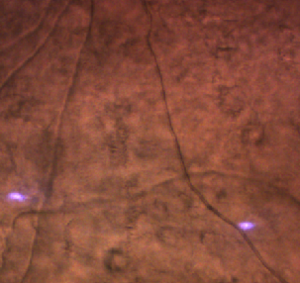
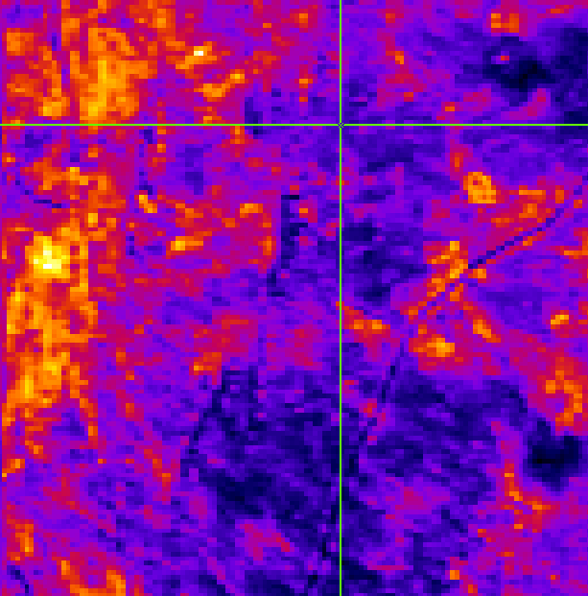
260706 coral_2ps test_ter [#3 tissues]
Power 150 mW
Nb pts 150²
Pixrep 100
Nbacc 10
Wavelength=[927,927.6,928.3,928.6,929.1,929.4,929.9
927.6

Slide 10
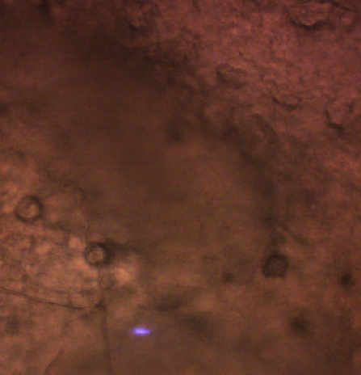
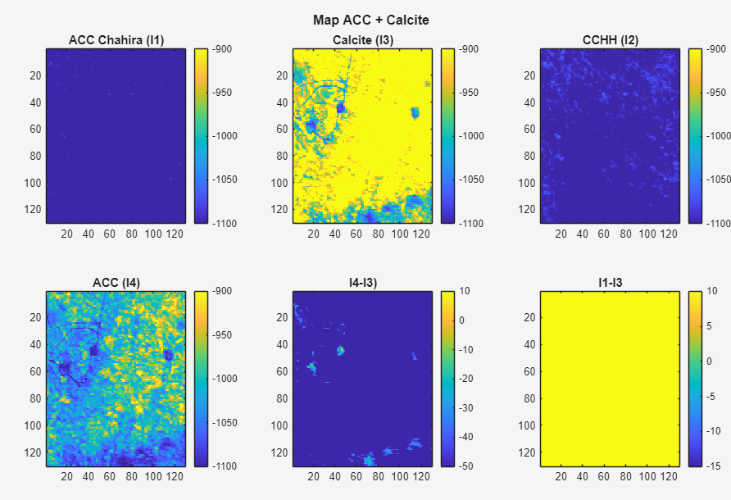
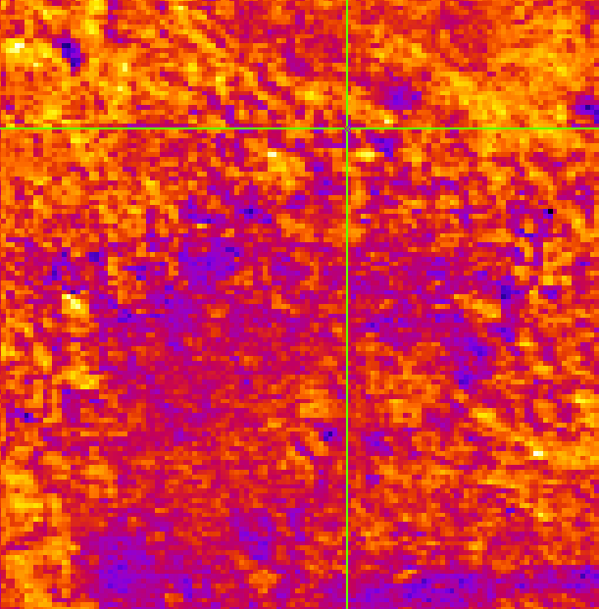
260706 coral_2ps test quater #3 tissues
Wavelength = [928.9,928.6,928.1,927.3,
Power 150 mW
Nb pts 130²
Pixrep 100
Nbacc 10
928.9

Slide 11
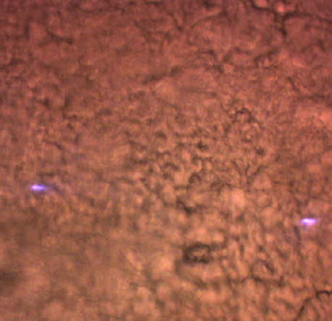
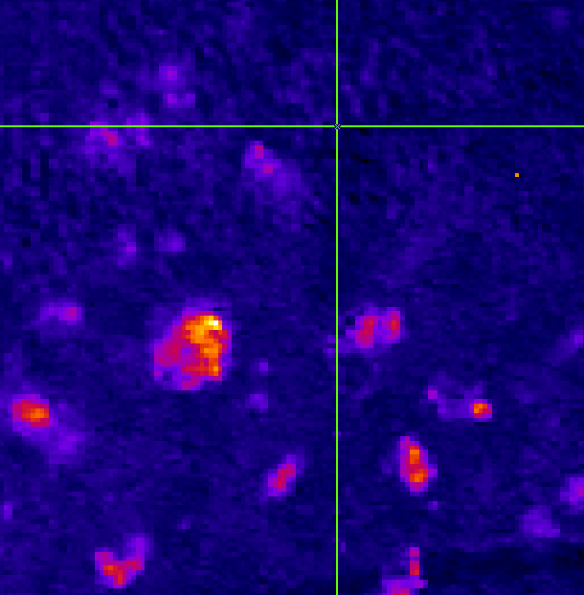
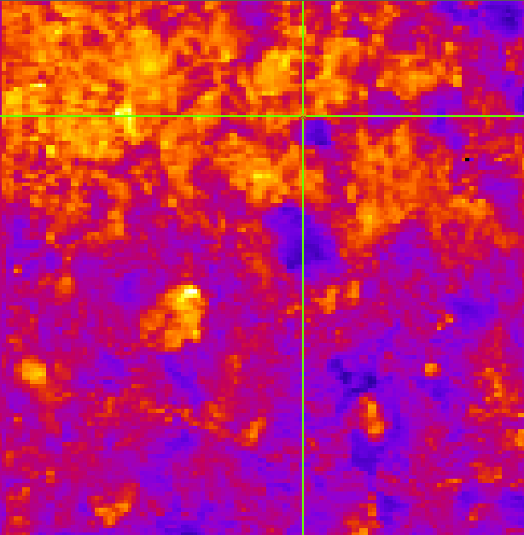
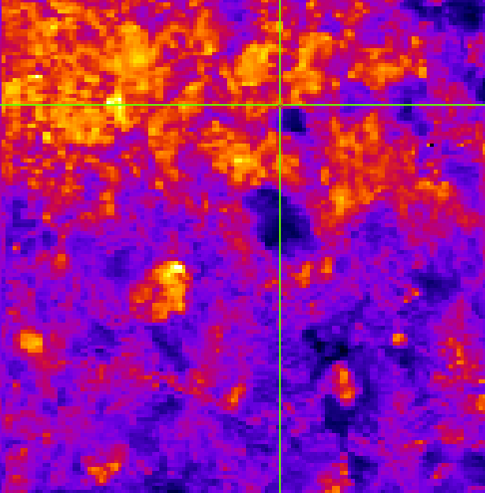
260706 coral_2ps test quinq #3 tissues
Wavelength=[929.1,928.7,928.4,928.1,927.4,926.9,926.5,926,925.5,925,924.5,924,923,927.8,929.7,930.2,931.1]
Power 150 mW
Nb pts 130²
Pixrep 100
Nbacc 10
928.7
927.4 ?

Slide 12
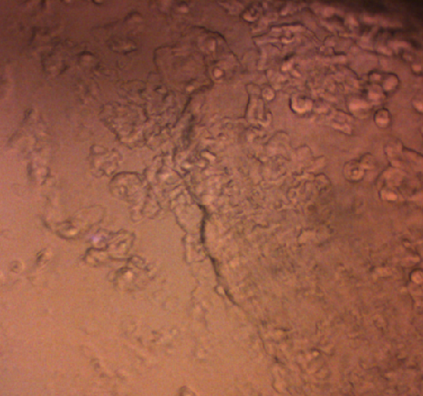
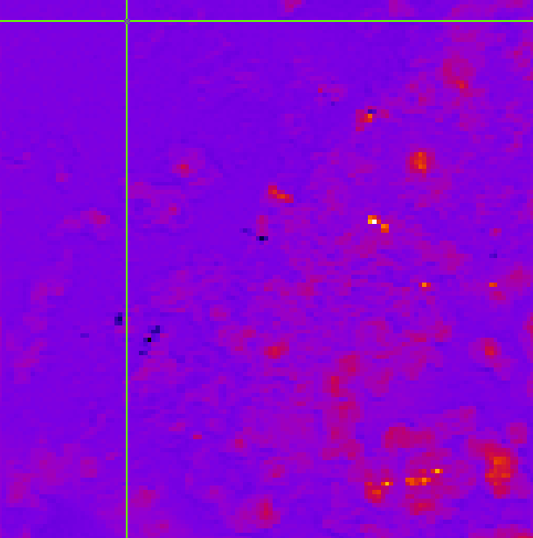
260707 coral_2ps test #4 stressed
Wavelength=[928.6,928.1,927.6,927.2,926.7,926.4,926,925.6,925,929,929.4,929.7,930.1,930.5,931,931.9,]
Power 150 mW
Nb pts 130²
Pixrep 100
Nbacc 10
927.2

Slide 13
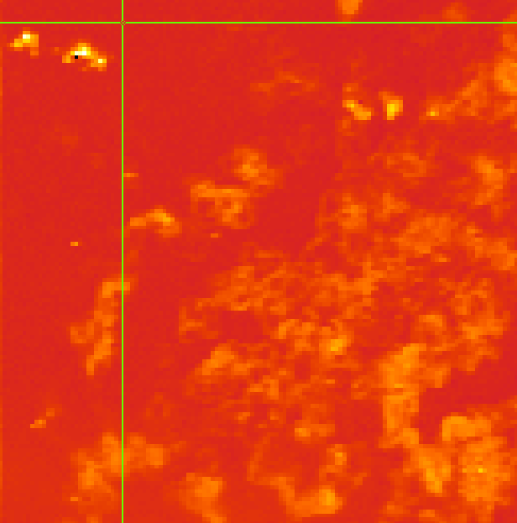
260707 coral_7ps test #4 stressed
Wavelength=[927.2,927.5,927.9,928.3,928.8,929.2,929.4,929.7,930.2,930.8,
Power 300 mW
Nb pts 130²
Pixrep 100
Nbacc 10
927.2

Slide 14
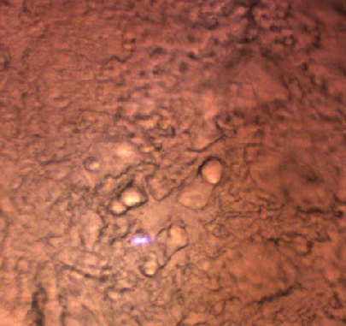
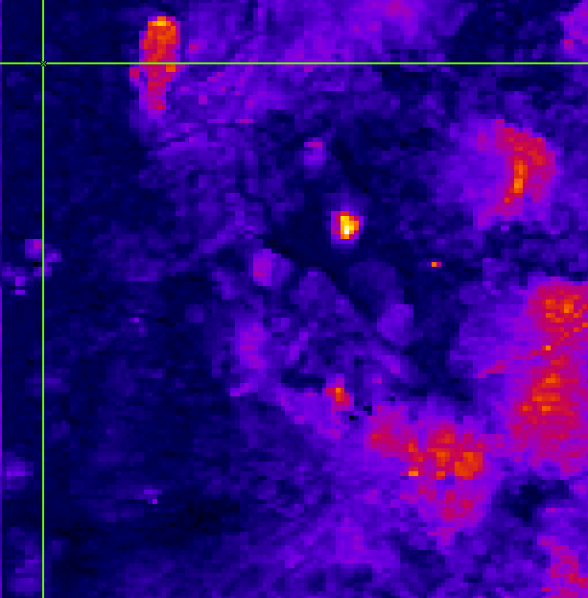
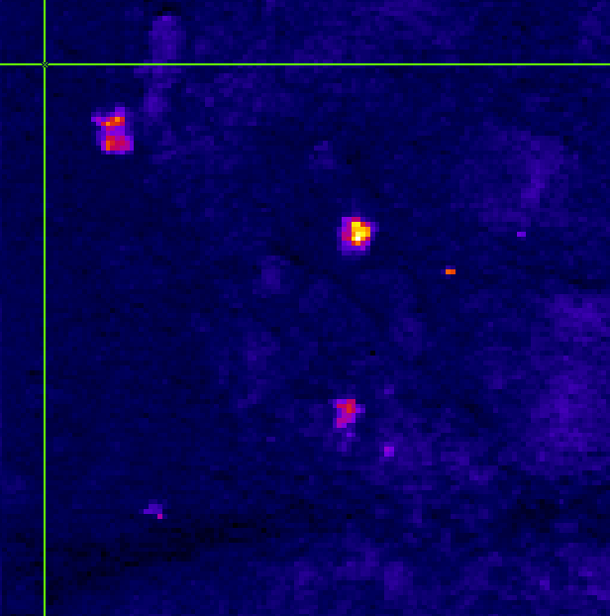
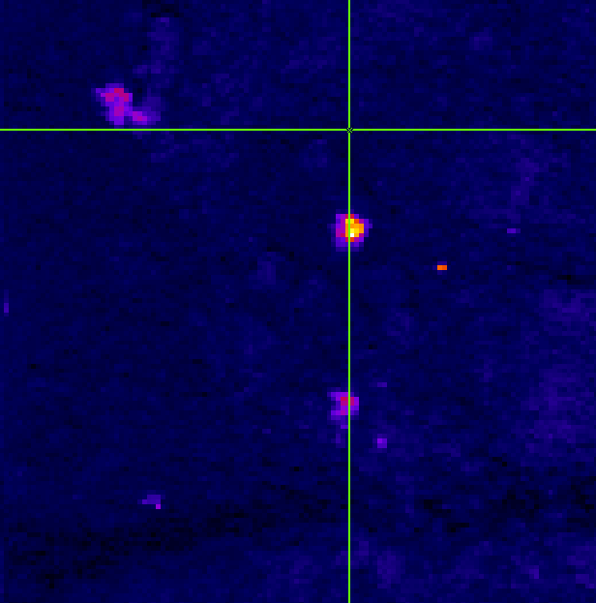
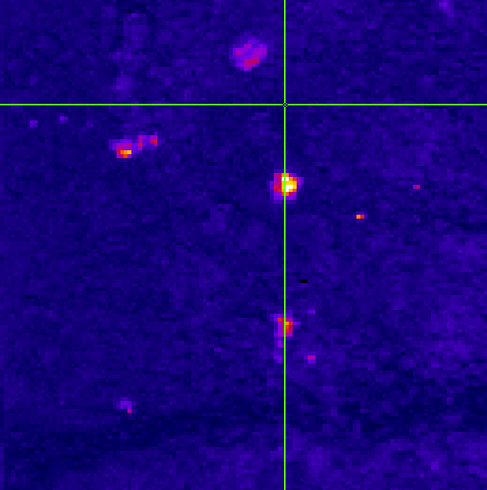
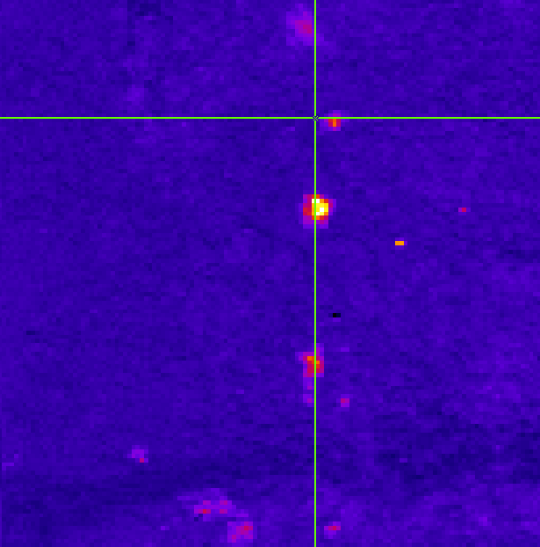
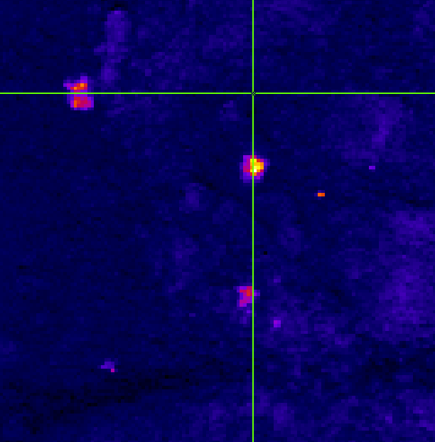
260708 coral_2ps test #4 stressed
Wavelength=[927.2,927.6,928.5,928.8,929.2,929.5
Power 100 mW
Nb pts 130²
Pixrep 100
Nbacc 3
927.2
928.8
929.5
928.5
929.2

Slide 15
260708 ACC
Wavelength=[928.5,928.8,929.2,929.6,929.9,930.3,930.8,931.2,931.5,931.8,932.1,932.6,932.9,928.3,927.8,927.5,927.1,926.6,926.1,925.6,925,924.5,923.9,
Power 200 mW
Nb pts 130²
Pixrep 100
Nbacc 5

Slide 16
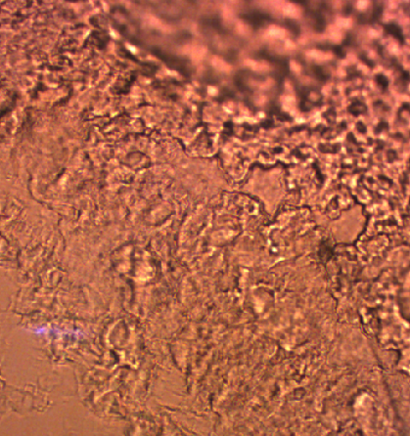
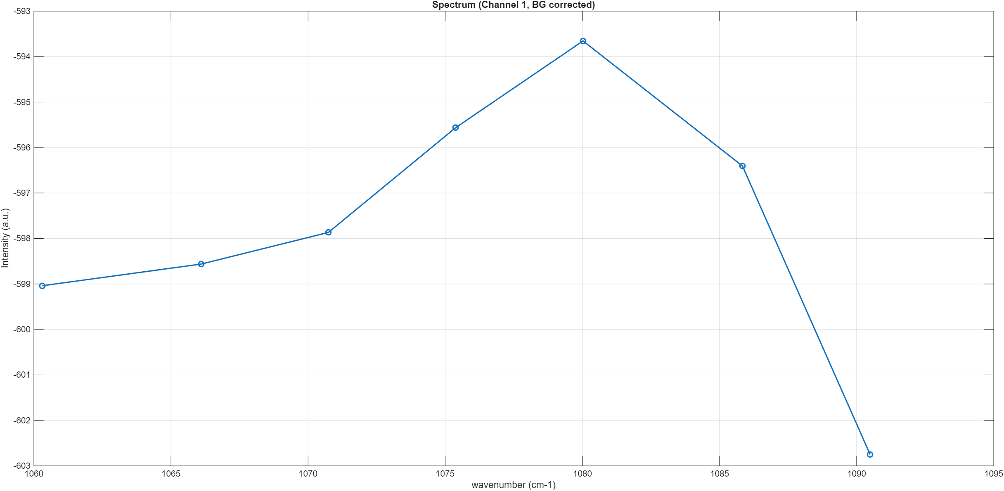
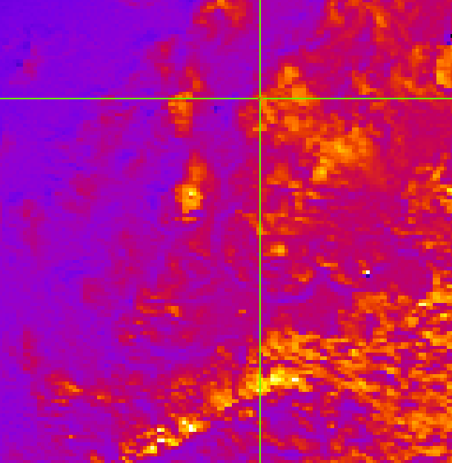
260710 coral_2ps #4 stressed
Wavelength=[928.1,928.5,928.9,929.4,927.7,927.2,926.8
Power 100 mW
Nb pts 130²
Pixrep 100
Nbacc 5
927.2

Slide 17
260710 coral_2ps_bis #4 stressed
Wavelength=[928.3,928.6,929.2,928,927.6,927.2,926.9,
Power 100 mW
Nb pts 130²
Pixrep 100
Nbacc 5
927.2

Slide 18
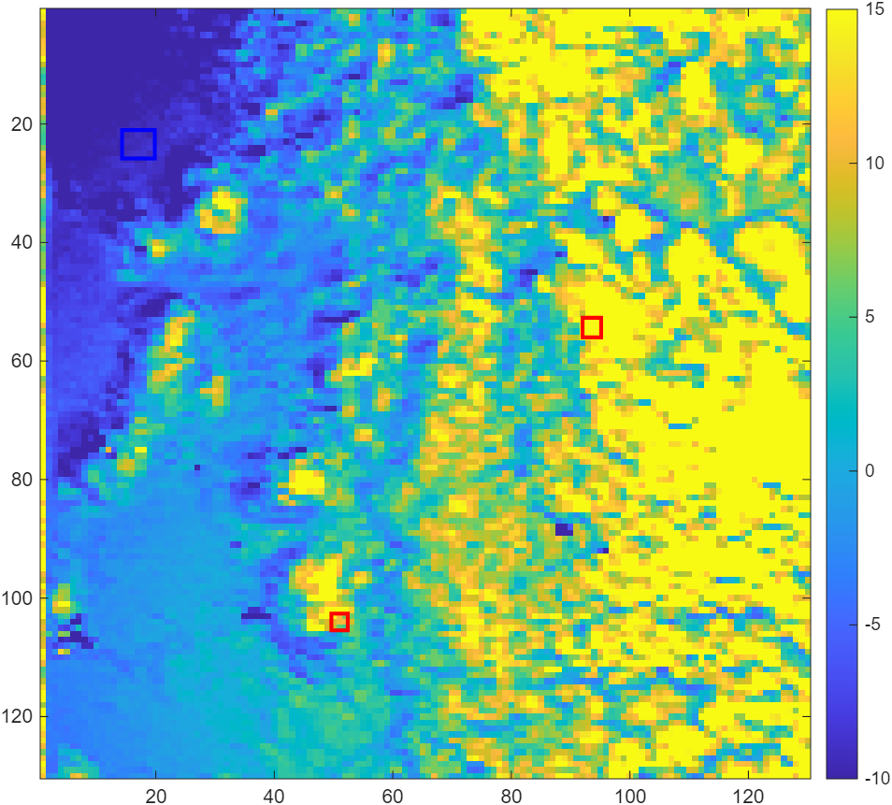
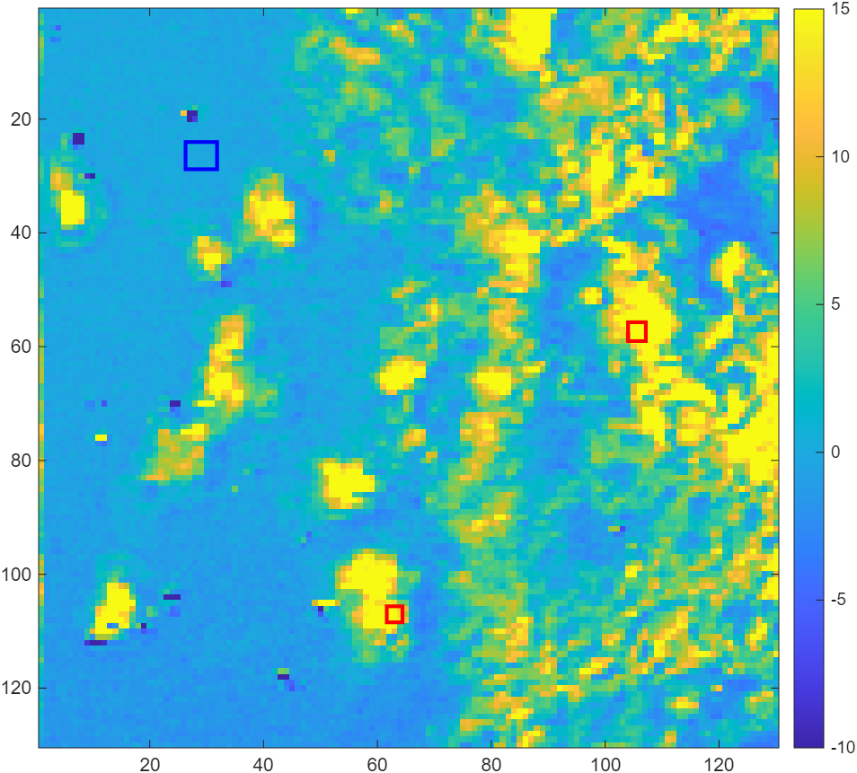
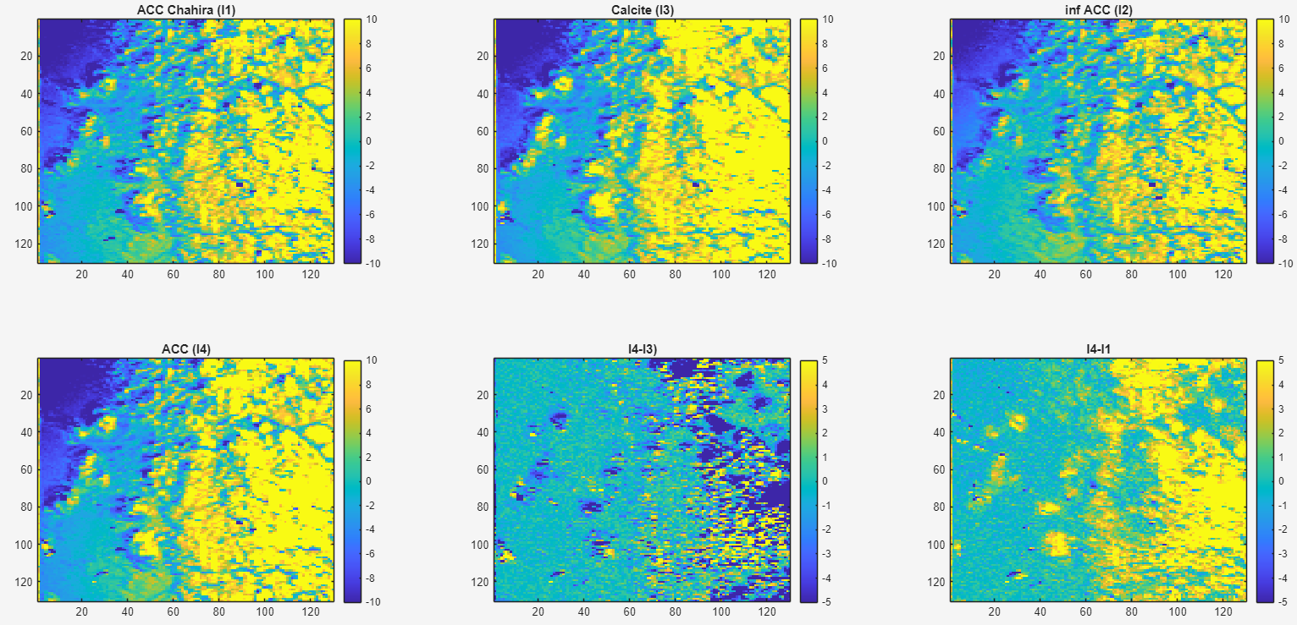
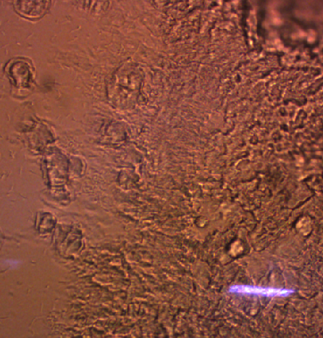
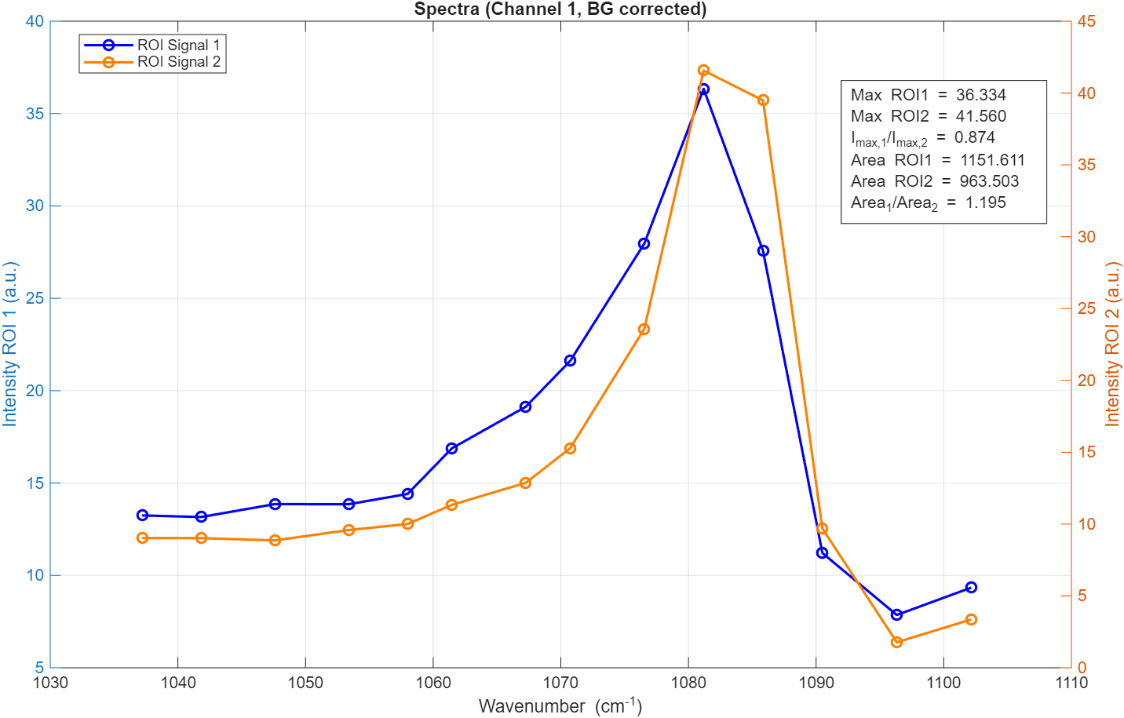
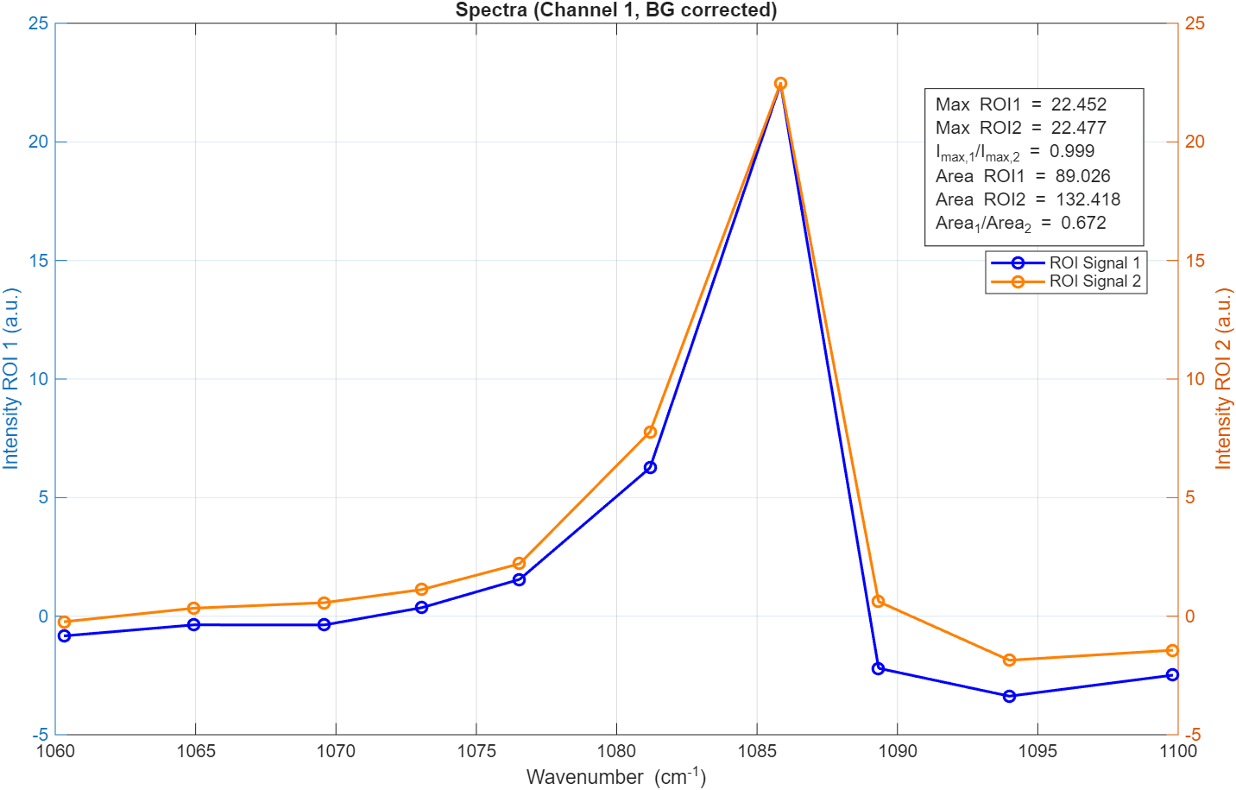
260710 coral_2ps_ter #4 stressed
Wavelength=[927.2,927.6,928,928.5,928.8,929.3,929.6,930,930.5,931,931.4,926.8,926.3,925.8
Power 100 mW
Nb pts 130²
Pixrep 100
Nbacc 5
x_bg=1.431020e+01; y_bg=2.103116e+01; width_bg=5.524079e+00; height_bg=4.787535e+00;
x_sig1=4.963919e+01; y_sig1=1.026220e+02; width_sig1=2.756044e+00; height_sig1=2.816934e+00;
x_sig2=9.201558e+01; y_sig2=5.270255e+01; width_sig2=3.130312e+00; height_sig2=3.314448e+00;

Slide 19
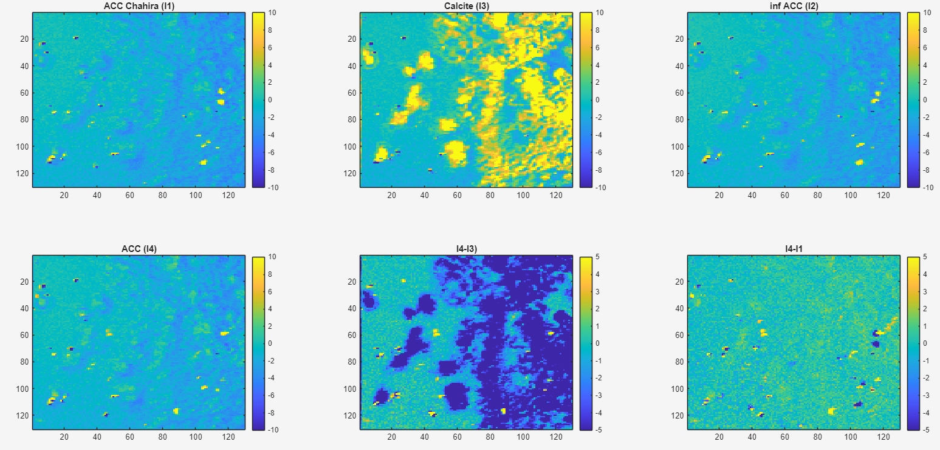
260710 coral_7ps_ter #4 stressed
Wavelength=[927.2,928,928.3,928.6,929,929.4,926.9,926.5,926,927.6]
Power 300 mW
Nb pts 130²
Pixrep 100
Nbacc 7
x_bg=1.431020e+01; y_bg=2.103116e+01; width_bg=5.524079e+00; height_bg=4.787535e+00;
x_sig1=4.963919e+01; y_sig1=1.026220e+02; width_sig1=2.756044e+00; height_sig1=2.816934e+00;
x_sig2=9.201558e+01; y_sig2=5.270255e+01; width_sig2=3.130312e+00; height_sig2=3.314448e+00;

Slide 20
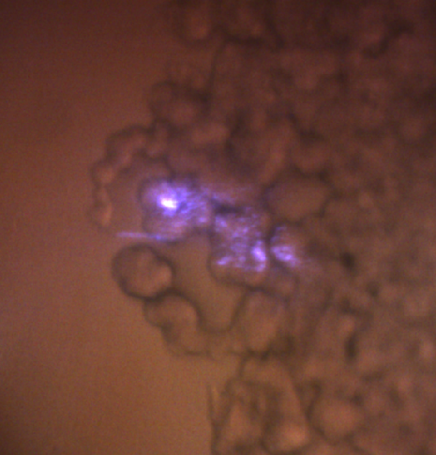
260713 coral_2ps #4 stressed
Wavelength=[928.9,928.5,928.1,927.6,927.2,926.7,926.3
Power 150 mW
Nb pts 130²
Pixrep 100
Nbacc 7

Slide 21
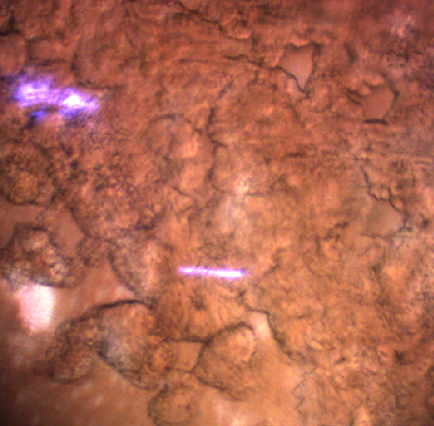

Slide 22
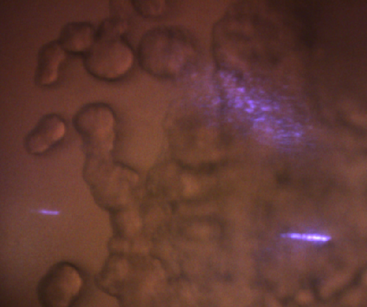
260713 coral_2ps bis #4 stressed
Wavelength=[928.2,928.6,929.1,927.7,927.3,926.7,926.4,926.9,926.1,
Power 150 mW
Nb pts 130²
Pixrep 100
Nbacc 7

Slide 23
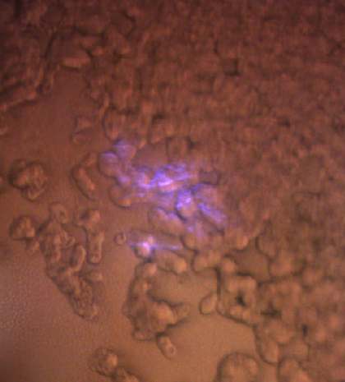
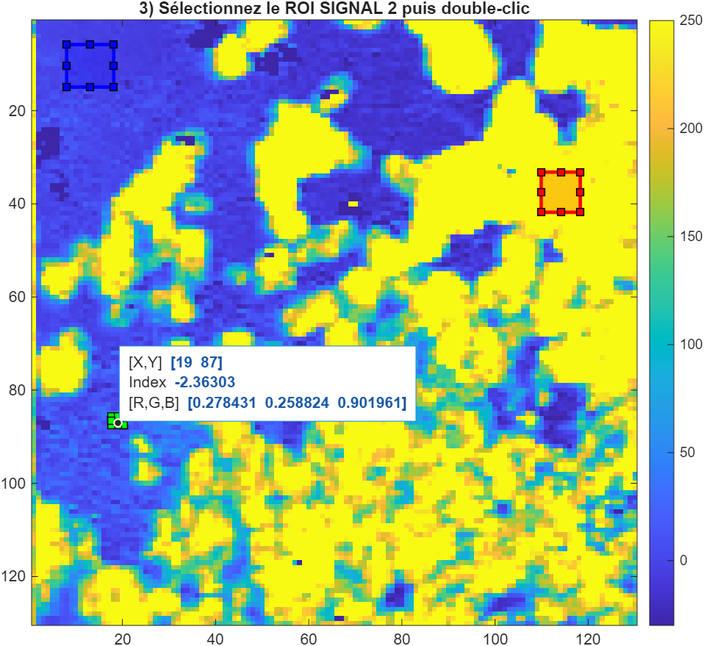
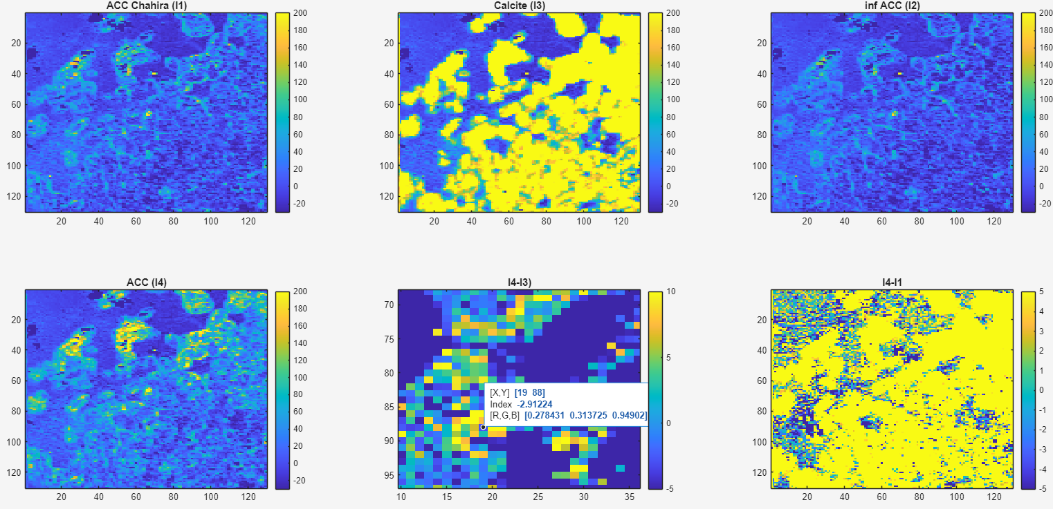
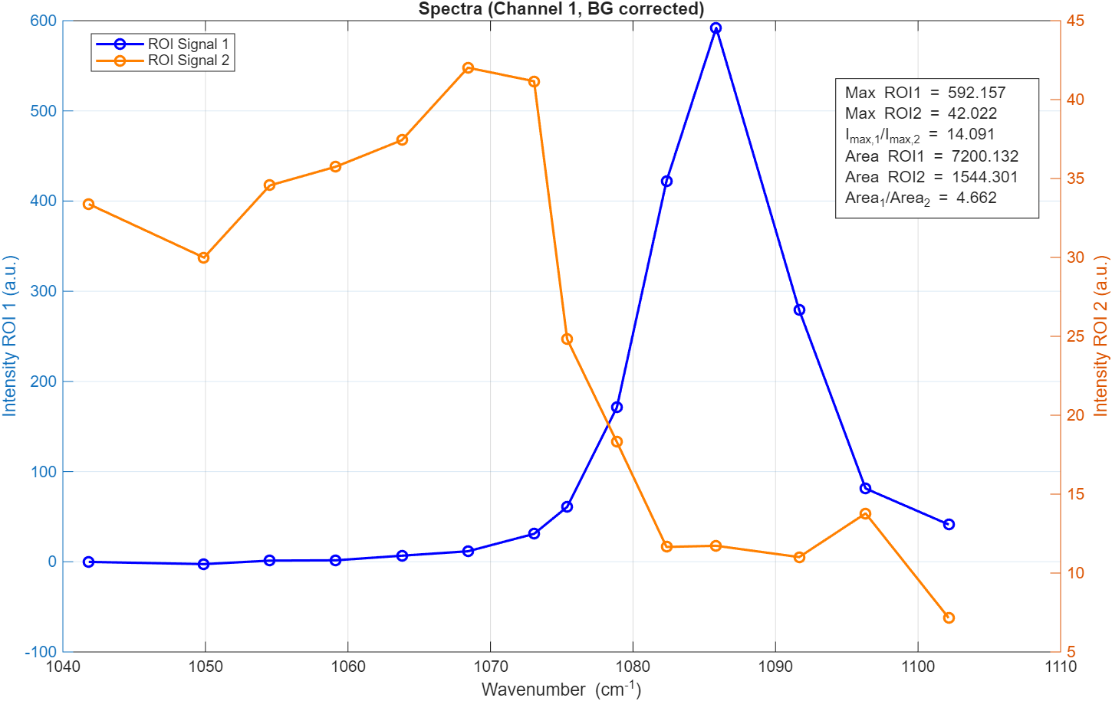
260713 coral_2ps ter #4 stressed
Wavelength=[928.3,928.7,929.1,929.5,929.9,930.3,931,928.1,927.8,927.5,927.2,926.7,926.3,925.8]
Power 150 mW
Nb pts 130²
Pixrep 100
Nbacc 10
x_bg=8.023719e+00; y_bg=5.803605e+00; width_bg=1.011385e+01; height_bg=9.127135e+00;
x_sig1=1.099023e+02; y_sig1=3.318501e+01; width_sig1=8.387097e+00; height_sig1=8.633776e+00;
x_sig2=1.762585e+01; y_sig2=8.562121e+01; width_sig2=2.746270e+00; height_sig2=1.821783e+00;

Slide 24
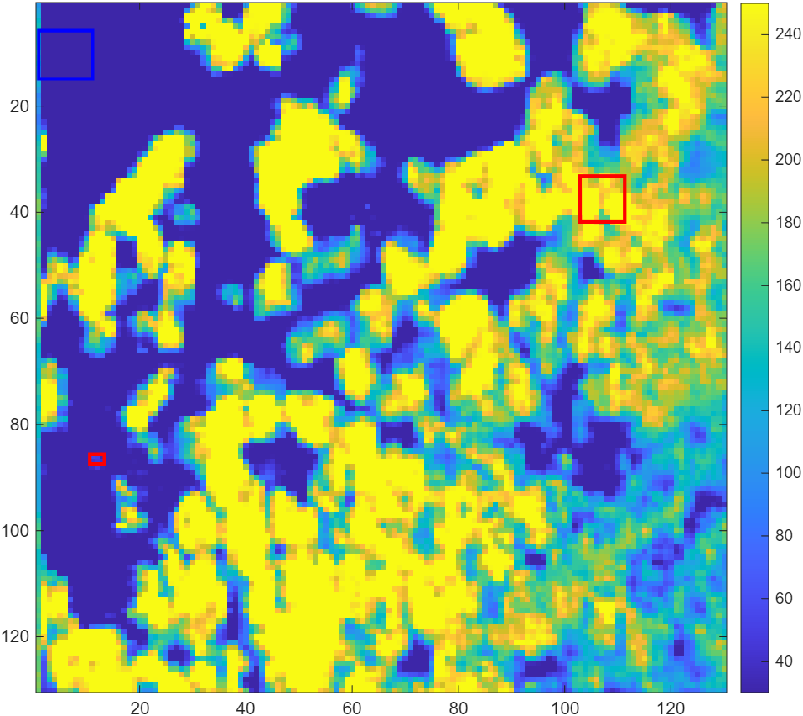
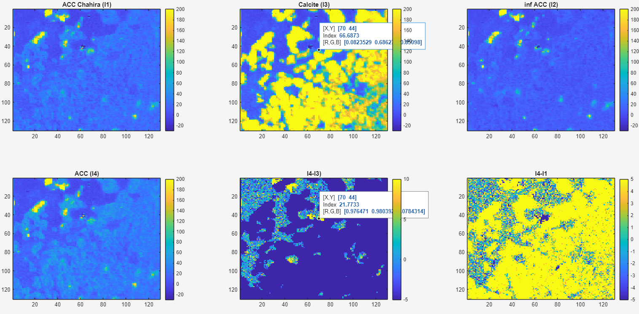
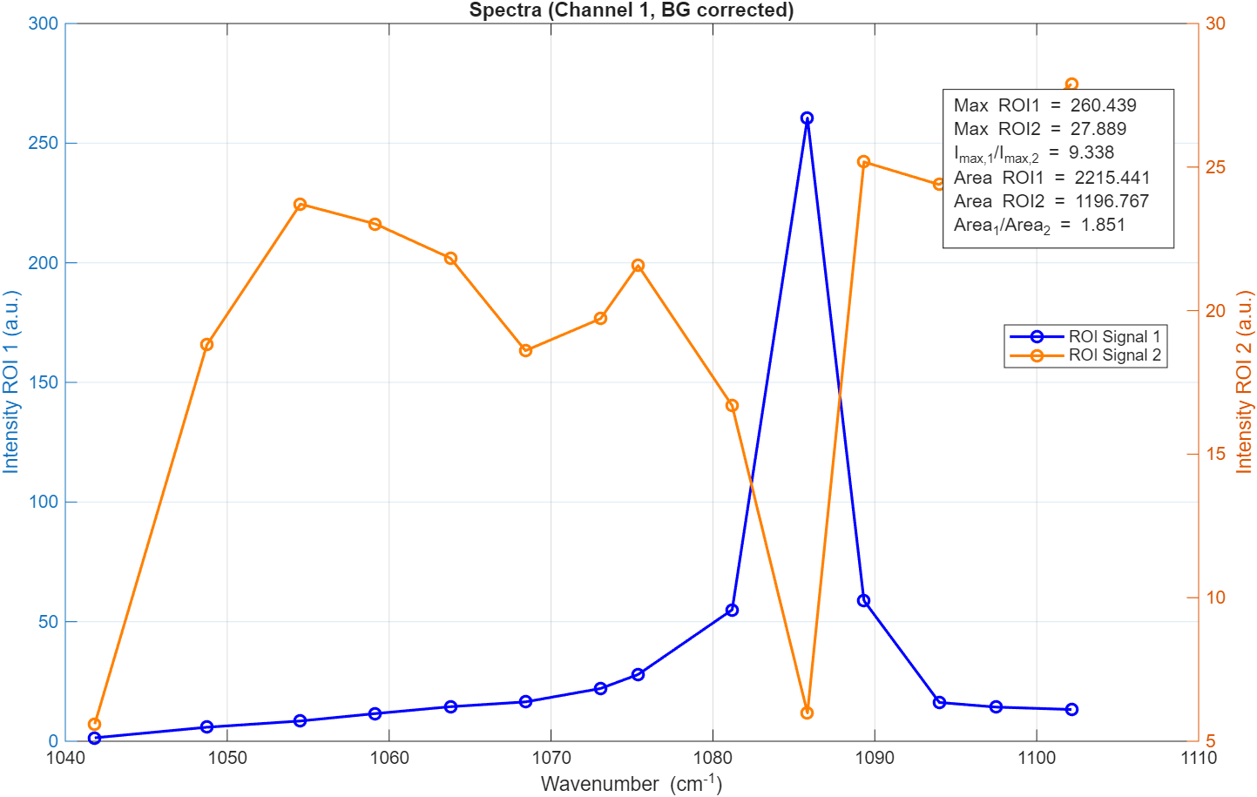
260713 coral_7ps ter #4 stressed
Wavelength=[927.2,927.6,928.1,928.3,928.7,929.1,929.5,929.9,930.4,931,926.9,926.5,926.2,925.8]
Power 400 mW
Nb pts 130²
Pixrep 100
Nbacc 10
x_bg=8.023719e+00; y_bg=5.803605e+00; width_bg=1.011385e+01; height_bg=9.127135e+00;
x_sig1=1.099023e+02; y_sig1=3.318501e+01; width_sig1=8.387097e+00; height_sig1=8.633776e+00;
x_sig2=1.762585e+01; y_sig2=8.562121e+01; width_sig2=2.746270e+00; height_sig2=1.821783e+00;

Slide 25
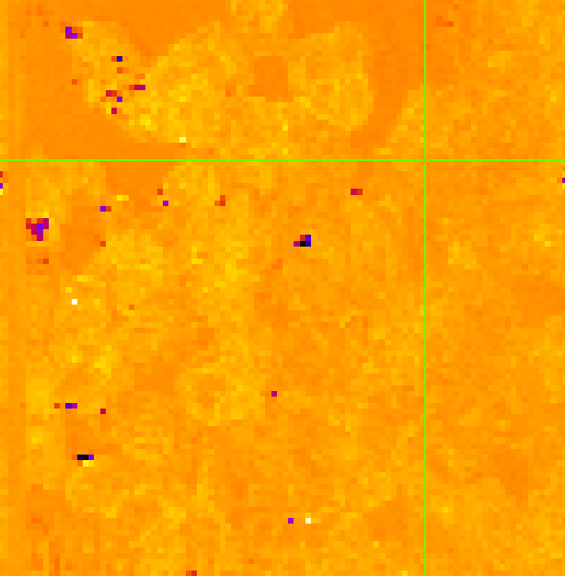
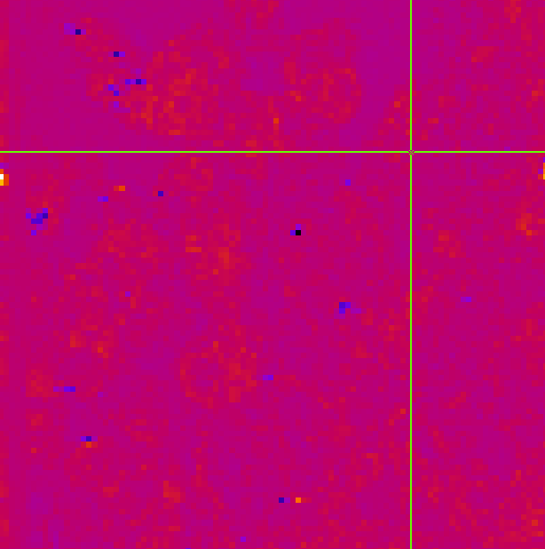
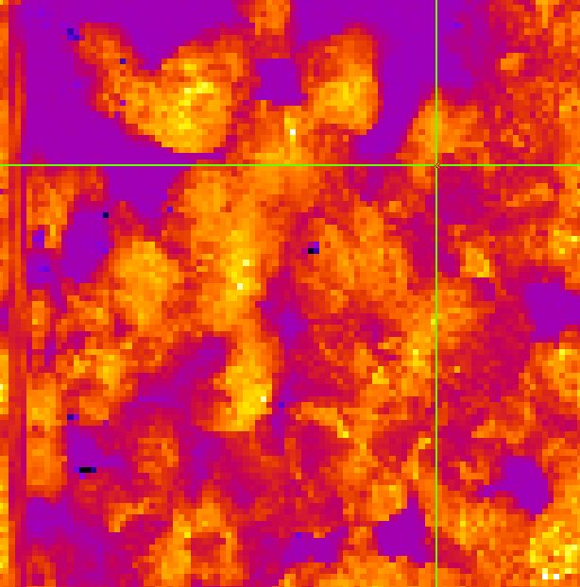

260715 coral_2ps #4 stressed
0 um
2 um
Wavelength=[927.2,927.5,927.7,928.1,928.5,929.1,929.6,930.2,931.1,926.7926.3,925.8]
928.5
nm
Power 150
Nb pts 130²
Pixrep 100
Nbacc 10
927.2 nm

Slide 26
260715 coral_7ps #4 stressed
Wavelength=[927.8,927.2,928.1,928.5,929.1,929.6,930.3,931,927.5,926.8,926.4,925.8]
Power 350 mW
Nb pts 130²
Pixrep 130
Nbacc 10

Slide 27

260717 coral_7ps #4 stressed
Wavelength=[927.2,928.1,928.5,928.9,929.5,929.9,930.4,930.9,927.5,926.9,926.7,926.3,925.8,928]
Power (a.u.) = [?, 14.3, 13.4, 13.4,12.9,12.5,11.5,9.2,14.3,14.7,14.8,14.4,14.7,13.7] +/-0.3
Power 400,300 mW
Nb pts 130²
Pixrep 100 (6.76s)
Nbacc 10

Slide 28
260717 coral_2ps #4 stressed
Wavelength=[927.4,927.7,928.3,928.7,929.1,929.6,929.9,930.4,930.6,931,]
Power 200 mW
Nb pts 130²
Pixrep 100 (6.76s)
Nbacc 10

Slide 29


260717 coral_2ps_bis #4 stressed
Wavelength=[927.2,927.8,928.1,928.6,928.9,929.2,929.6,929.9,930.3,930.8,931.2,927.5,927,926.7,926.3,925.8]
927.5
Power 150 mW
Nb pts 150
Pixrep 100 (9s)
Nbacc 7

Slide 30


260717 coral_7ps_bis #4 stressed
Wavelength=[927,927.7,928.1,928.5,929.1,929.9,931,927.3,926.8,926.4,]
927.5
Power 400,330 mW
Nb pts 150
Pixrep 100 (9s)
Nbacc 7
50 µm

