Slide 1
Meeting 15/10/26
Modèle
  Convolution Carbonate*Instrument
  Carbonate
2) Expérimentale
a) fit sur A
b) ACC
c) Vatérite
d) Coral
e) Set up schéma

Slide 2
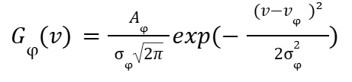





Modèle Analytique – Réponse instrumentale
Modèle gaussien pour chaque phase :
Convolué avec
Modèle gaussien de la réponse instrumentale :
➔ Analytiquement, on obtient :
avec
➔

Slide 3
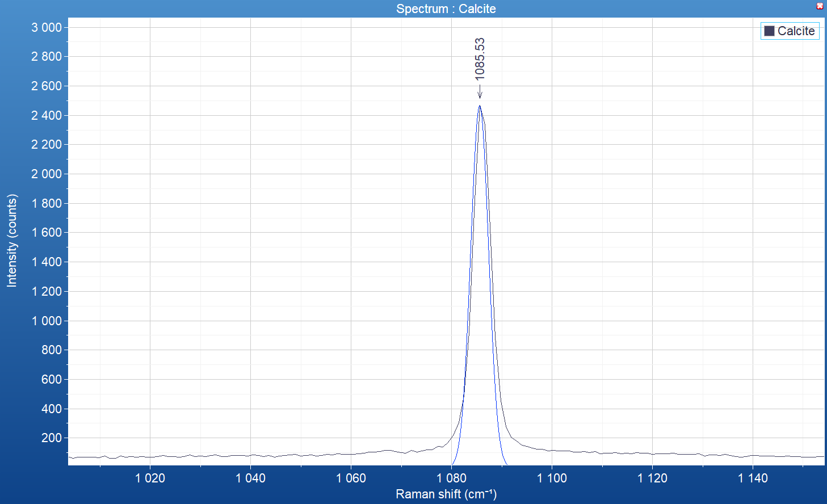
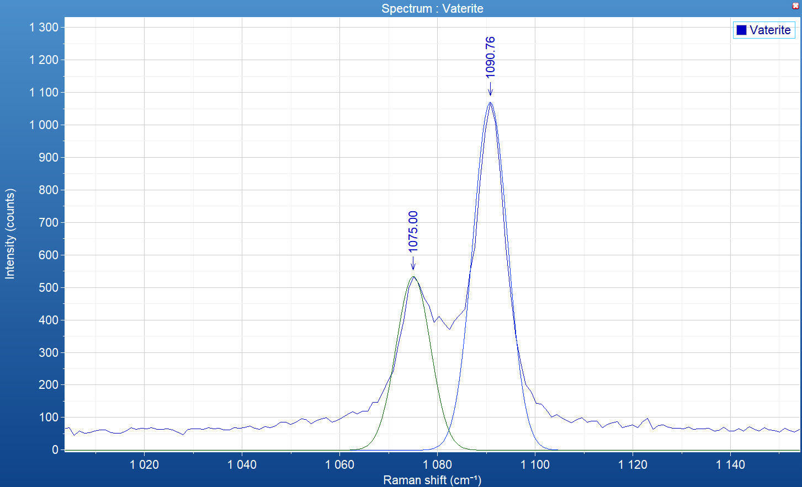
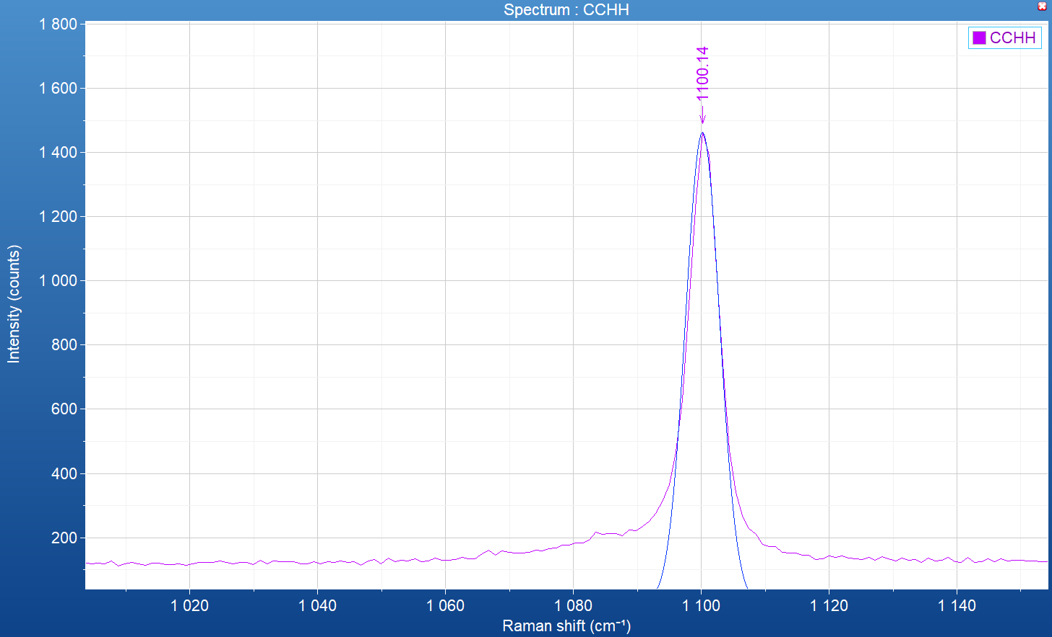
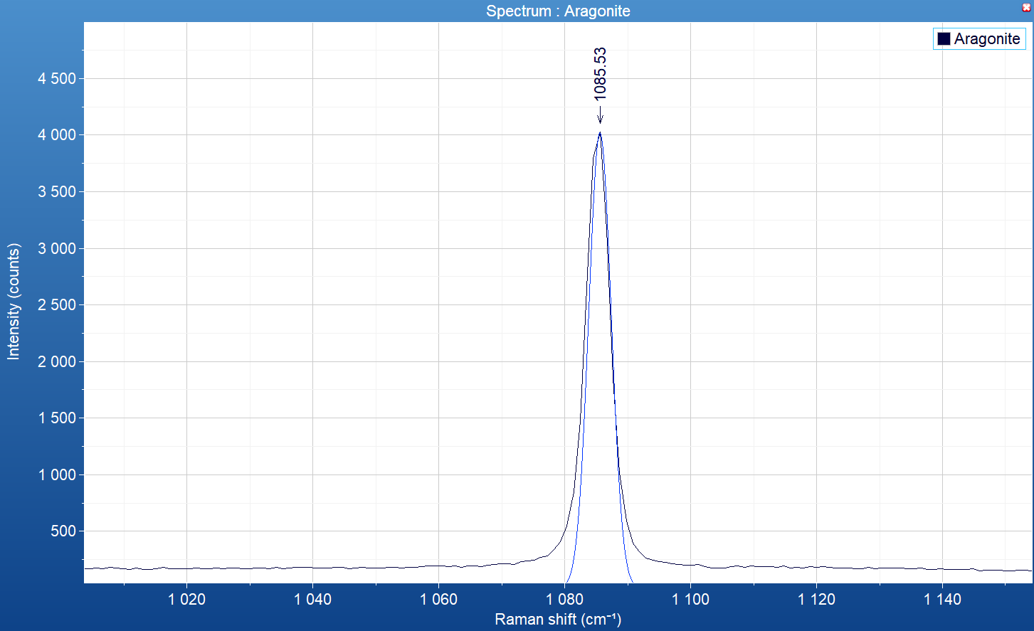
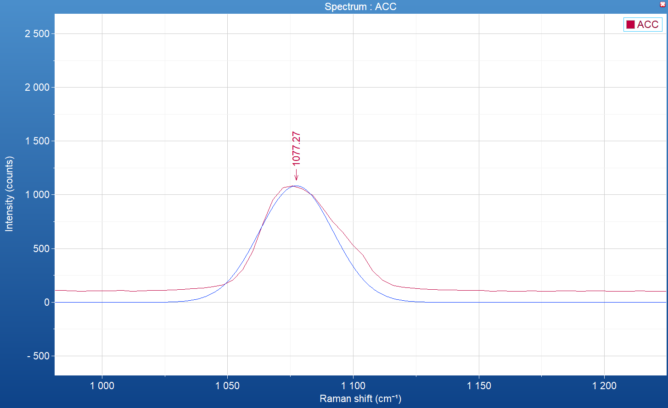
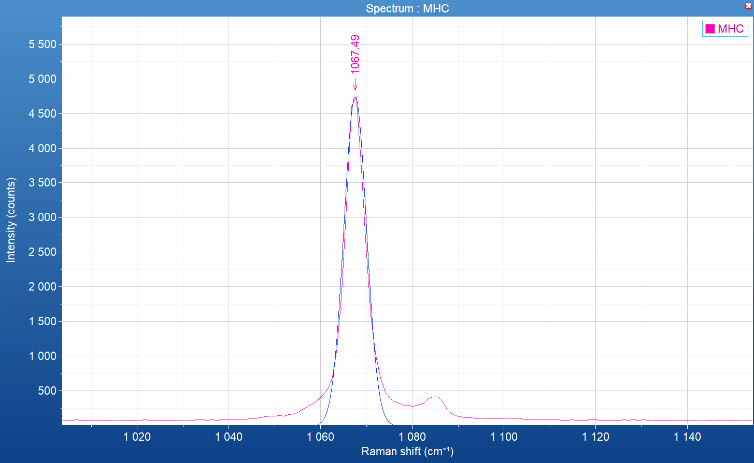
Résultat Raman spontané – échantillon synthétique ou géologique
sample | Calcite geologic | Aragonite geologic | Vaterite synthetic | ACC synthetic | CCHH synthetic | MHC synthetic
Nu (cm⁻¹) | 1085.5 | 1085.5 | 1075, (1080,) 1090.8 | 1077 | 1100.1 | 1067.5
FWHM (cm⁻¹) | 4.2 | 4.2 | 8.2, (?), 8.3 | 35 | 6.3 | 5.8
FWHM_déconvolué* (cm-1) | 3.5 | 3.5 | 7.9,(?),8.0 | 35 | 5.9 | 5.3
Vaterite synthetic
CCHH synthetic
Calcite geologic
(*) déconvolué par la résolution théorique maximale du raman spontané :
Paramètres :
- grating : 1800 (500nm)
- Laser : 532nm_Edge
- objectif x20
Spectral Resolutions (Hole50m, 100x Objective, FWHM) :
- Grating 1800 g/mm: 585.25 nm 1.66cm-1 (<2.3 cm-1*)
Aragonite geologic
ACC synthetic
MHC synthetic

Slide 4
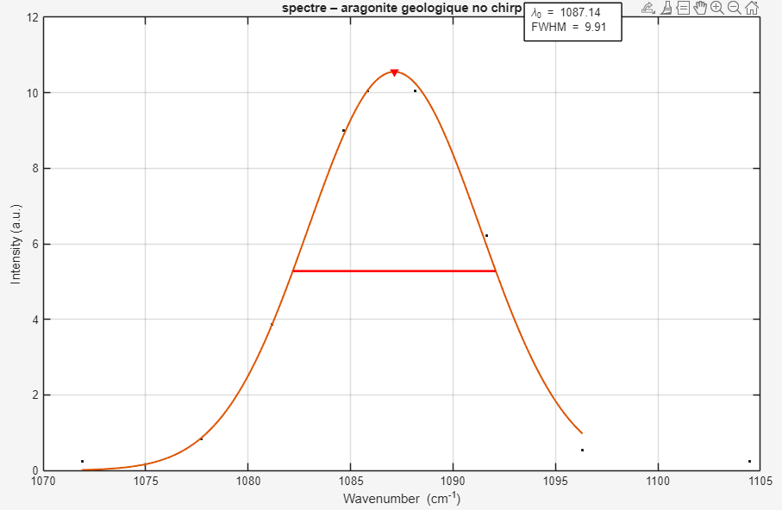
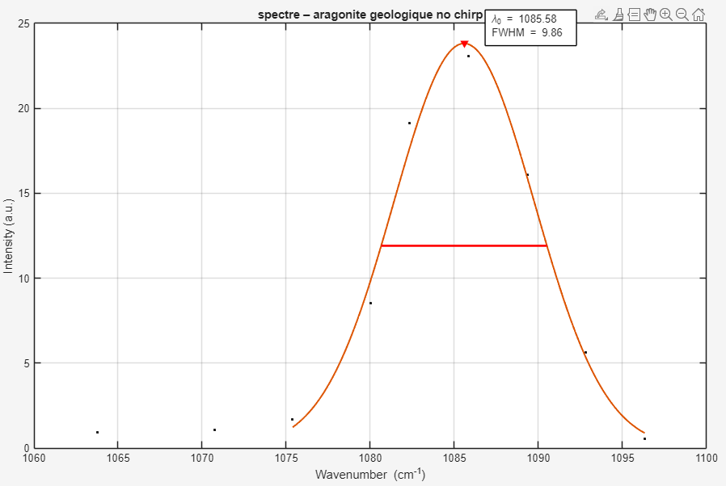
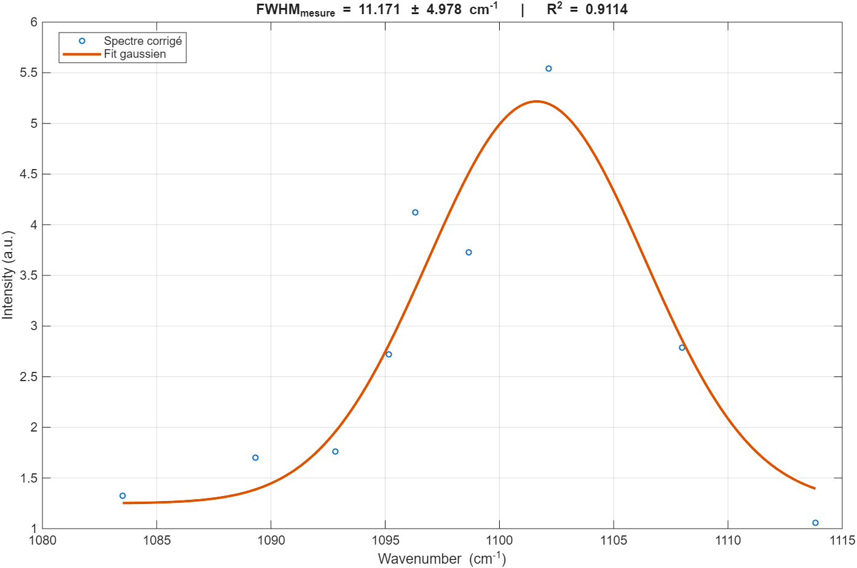
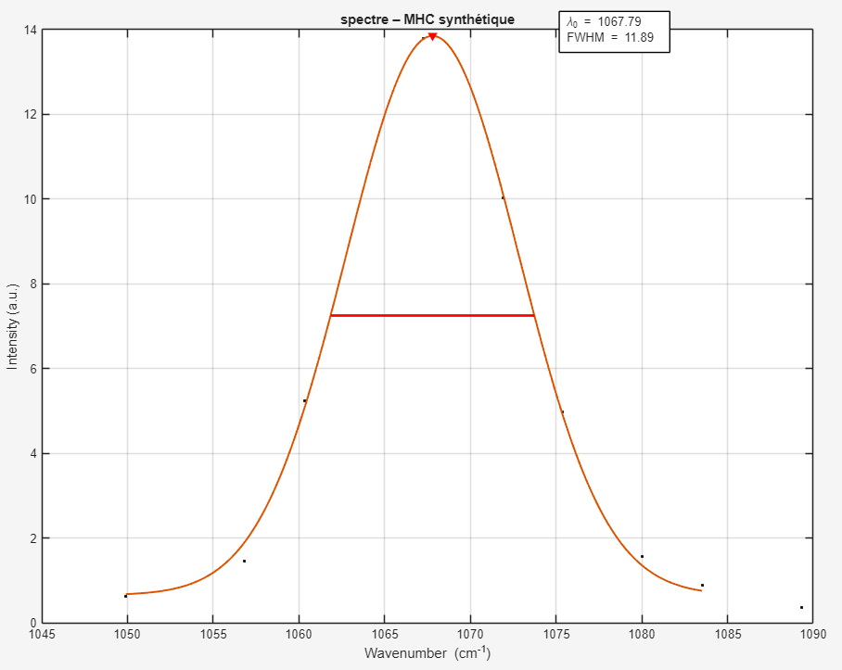
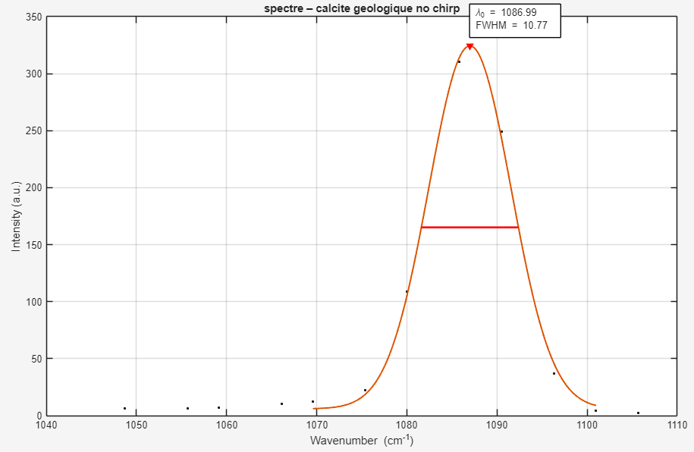
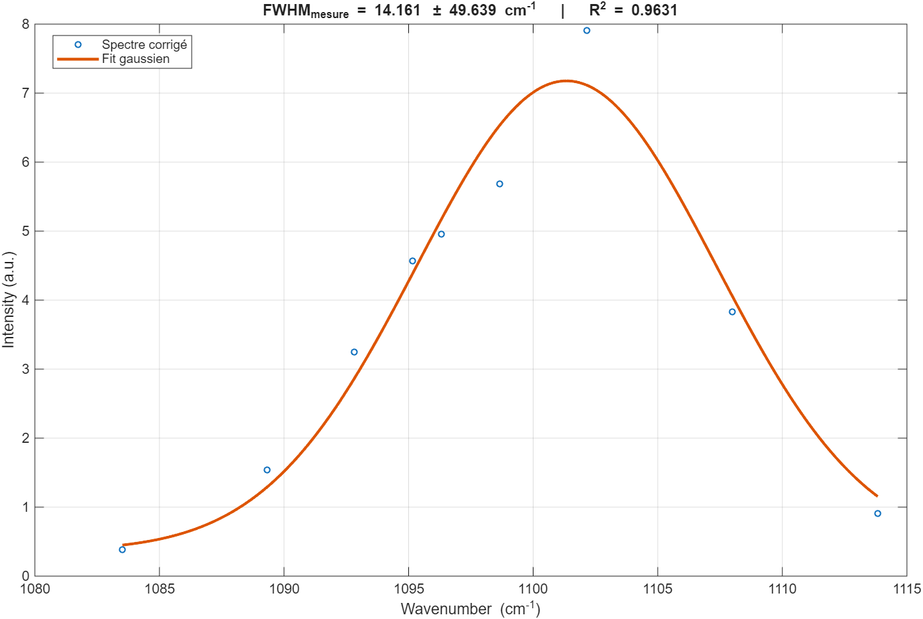
Résultat Raman spontané – échantillon synthétique ou géologique
sample | Calcite geologic | Aragonite geologic | Vaterite synthetic | ACC synthetic | CCHH synthetic | MHC synthetic
Nu (cm⁻¹) | 1085.5 | 1085.5 | 1075, (1080,) 1090.8 | 1077 | 1100.1 | 1067.5
FWHM_déconvolué* (cm-1) | 3.5 | 3.5 | 7.9,(?),8.0 | 35 | 5.9 | 5.3
FWHM_mes (2ps) | 9.9,10.7 | 9.9 |  |  | [11.2,14.2] | 11.9
FWHM_instr (2ps) | 9.3,10.2 | 9.3 |  |  | [9.5,12.9] | 10.6
Calcite geologic
CCHH synthetic
MHC synthetic
Aragonite geologic

Slide 5
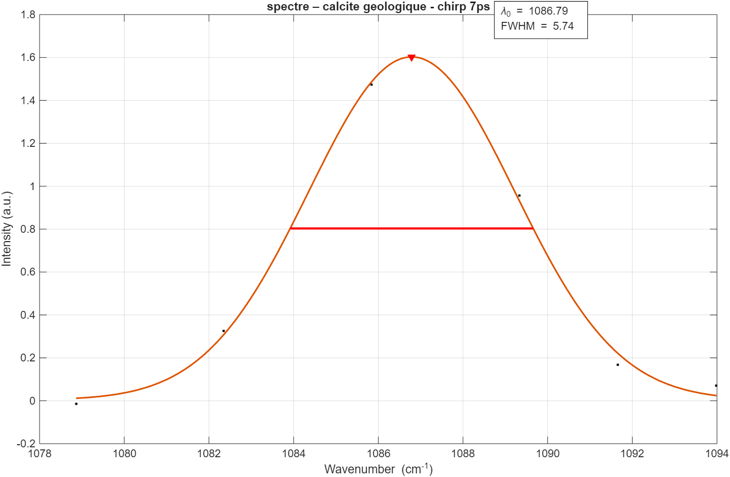
Résultat Raman spontané – échantillon synthétique ou géologique
sample | Calcite geologic | Aragonite geologic | Vaterite synthetic | ACC synthetic | CCHH synthetic | MHC synthetic
Nu (cm⁻¹) | 1085.5 | 1085.5 | 1075, (1080,) 1090.8 | 1077 | 1100.1 | 1067.5
FWHM_déconvolué* (cm-1) | 3.5 | 3.5 | 7.9,(?),8.0 | 35 | 5.9 | 5.3
FWHM_mes (7ps) | 5.7
FWHM_instr (7ps) | 4.5
Calcite geologic
CCHH synthetic
MHC synthetic
Aragonite geologic

Slide 6
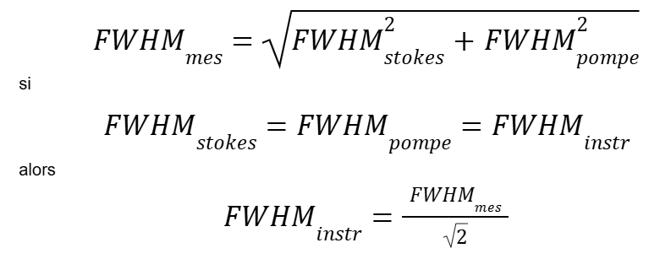
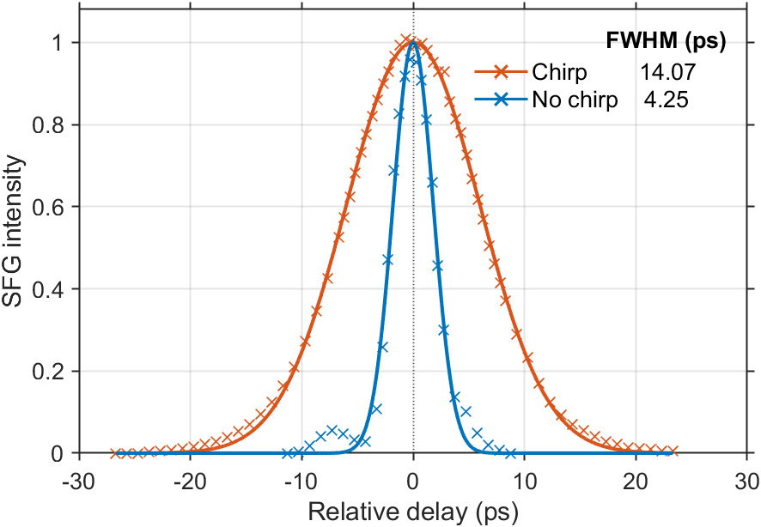
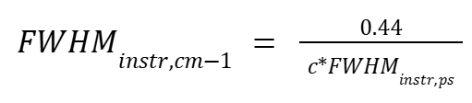

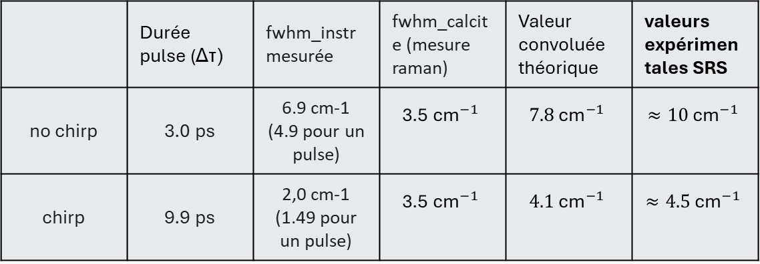
Chirp – Calcul de FWHM_instr
Cas calcite synthétique
moyen
 | Durée pulse (Δτ) | fwhm_instr mesurée | fwhm_calcite (mesure raman) | Valeur convoluée théorique | valeurs expérimentales SRS
no chirp | 3.0 ps | 6.9 cm-1 (4.9 pour un pulse) | $$\text{3.5}{\text{ cm}}^{−1}$$ | $$7.8{\text{ cm}}^{−1}$$ | $$≈10{\text{ cm}}^{−1}$$
chirp | 9.9 ps | 2,0 cm-1 (1.49 pour un pulse) | $$\text{3.5}{\text{ cm}}^{−1}$$ | $$4.1{\text{ cm}}^{−1}$$ | $$≈4.5{\text{ cm}}^{−1}$$
Fig. Observed Sum Frequence Generation (SFG) between Stokes and pump beam with and without chirp. Full Widths at Half Maximum (FWHM) were calculated from the Gaussian fitting function.
Pour une gaussienne limité par la TF.
Claudius Riek, Daniele BridaOpt. and al Lett. (2016)

Slide 7
Modèle Carbonates
Paramètres | Calcite | Aragonite | Vaterite | ACC | CCHH | MHC
Nu (cm⁻¹) | 1085.5¹ 1085.9³ | 1085.5¹ 1086² 1084³ | [1075, (1080,) 1090.8]¹ [1073.8, 1080, 1089.5] ³ | 1077¹ 1075² 1073⁴ 1085⁵ | 1100.1¹ 1097² | 1067.5¹
FWHM_déconvolué (cm-1) | 3.5¹ | 3.5 ^{1,6} | [7.9, (8 aussi?), 8]¹ | 35¹ 30⁴ | 5.9¹ | 5.3¹
nu_LB (cm⁻¹) | 1084.5 | 1084 | 1073 | 1073,1070(corail) | 1097 | 1066
nu_UB (cm⁻¹) | 1086.5 | 1086.5 | 1093 | 1082 | 1102 | 1070
FWHM_LB (cm⁻¹) | 1 | 1 | 3 | 20 | 3 | 3
FWHM_UB (cm⁻¹) | 10 | 6 | 10 | 40 | 10 | 10
¹Résultats raman spontané – synthétique ou géologique (cal et ara)
²Dicko, Hamadou, et al. "3D Calcium carbonate polymorphs imaging with stimulated Raman scattering in biominerals." Faraday Discussions 261 (2025): 286-297. – biogénique (corail)
³Colas, C. (2022). Bio-inspired synthetic crystals (Doctoral dissertation, Université Paris-Saclay).
⁴Duboisset et al., « Amorphous-to-Crystal Transition in the Layer-by-Layer Growth of Bivalve Shell Prisms ». – biogenique (huitre)
⁵Lia Addadi et al “Taking Advantage of Disorder: Amorphous Calcium Carbonate and Its Roles in Biomineralization” – biogenique (juvenil huitre, oursin)
⁶ Farfan et al (2021)“Crystallographic and chemical signatures in coral skeletal aragonite” (National Museum of Natural History, Washington, DC, USA) – corail

Slide 8
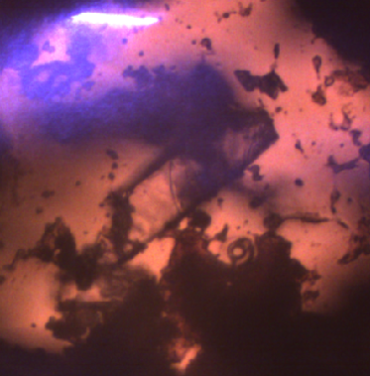
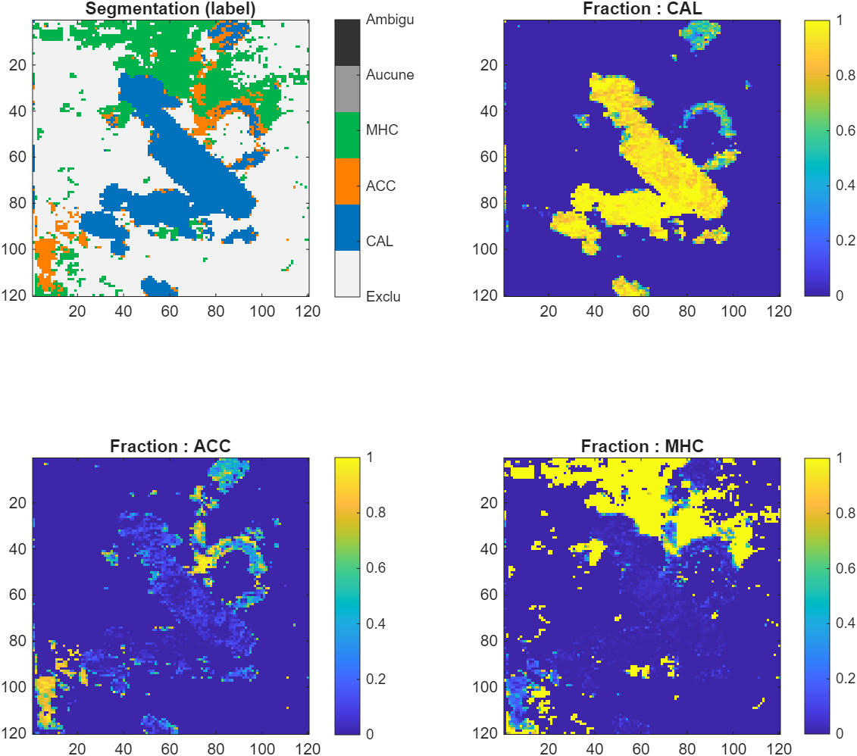
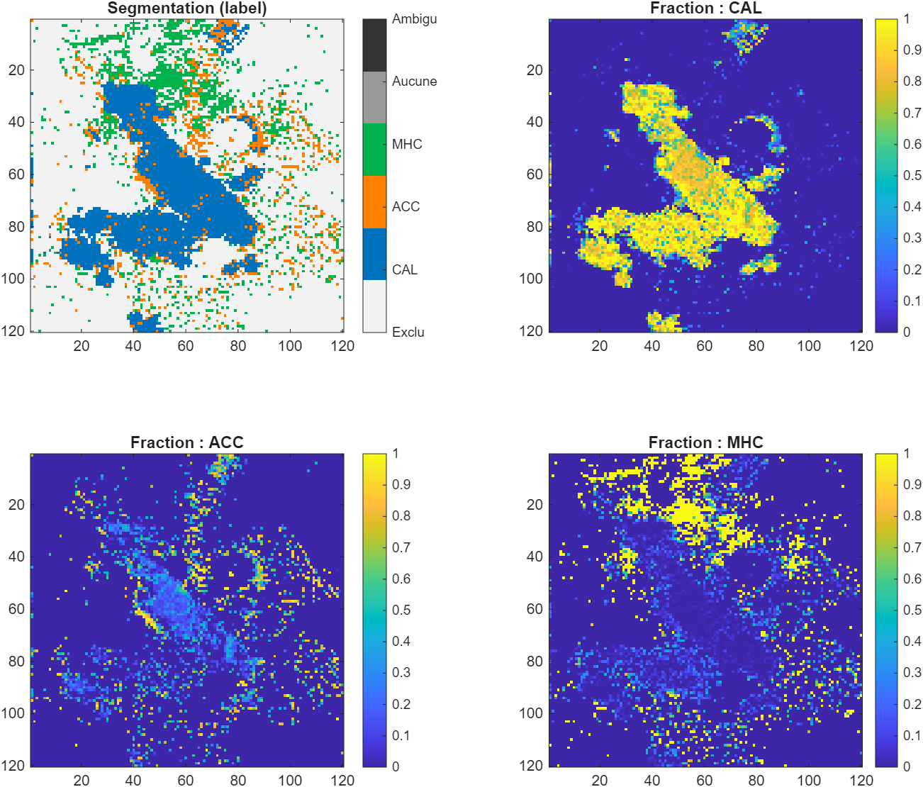
ACC + cal 260626
2 ps
7 ps
Wavelength=[929.2,928.8,928.5,928.2,927.7,927.4,926.9,926.6,926.2,925.7,925,924.1,929.1,929.5,929.8,930.2,930.5,931,931.8,932.9]
Power 300
Nb points 120²
PixelRep 80 NbACC 5
scan range 100 µm
Power 350²
Nb points 120²
PixelRep 150 NbACC 10
scan range 100 µm
Wavelength=[929.1,928.7,928.5,928.1,927.7,927.4,926.7,926.4,926,929.5,930,927.1]

Slide 9
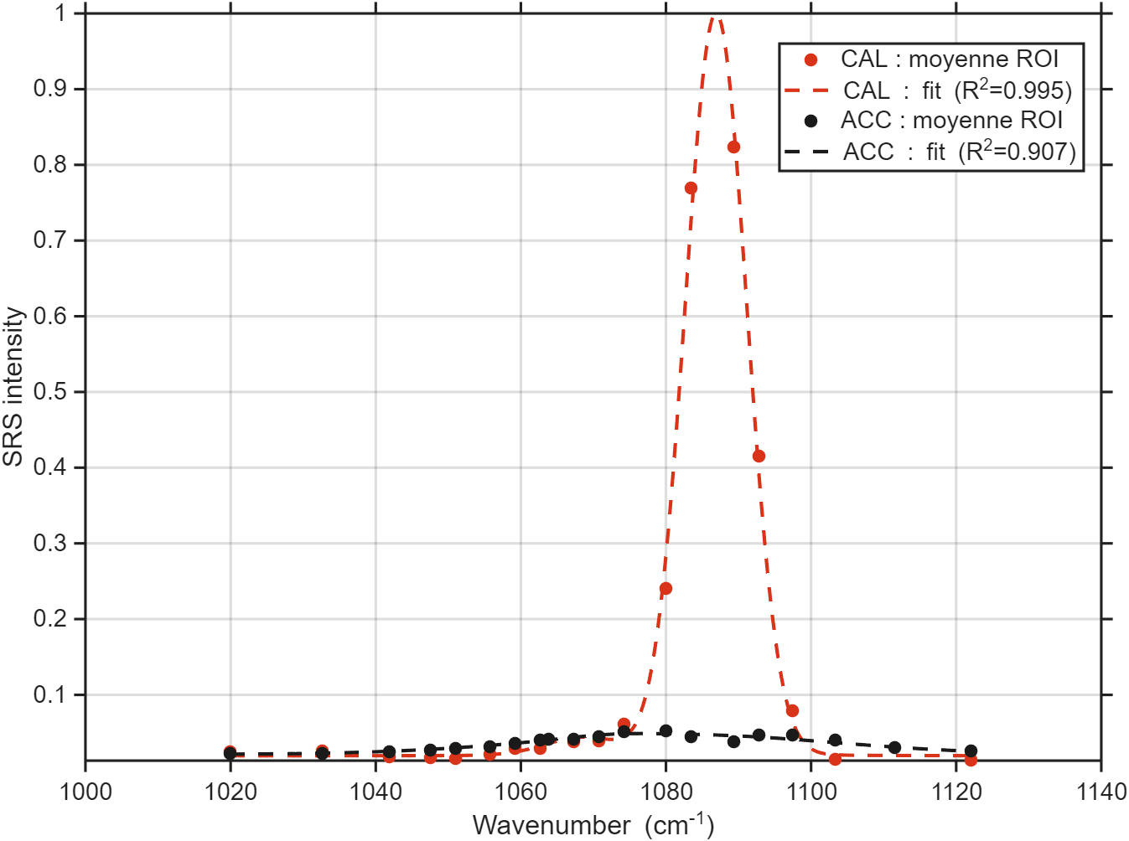
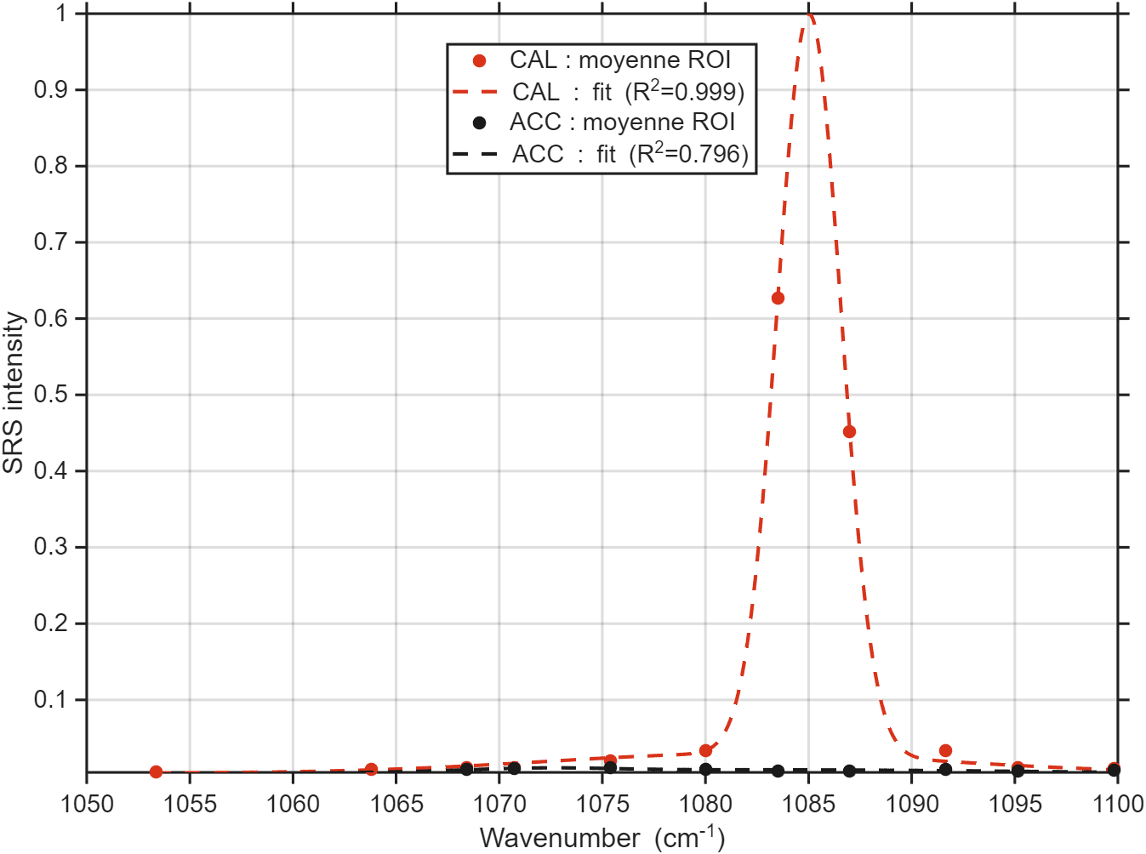
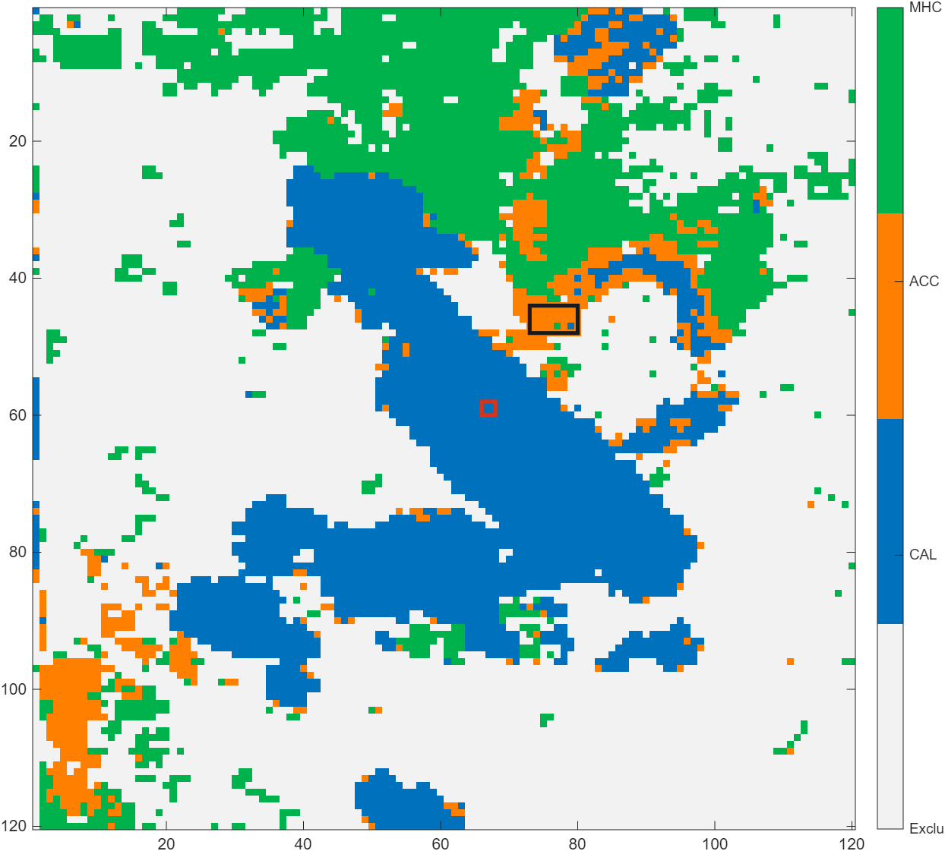
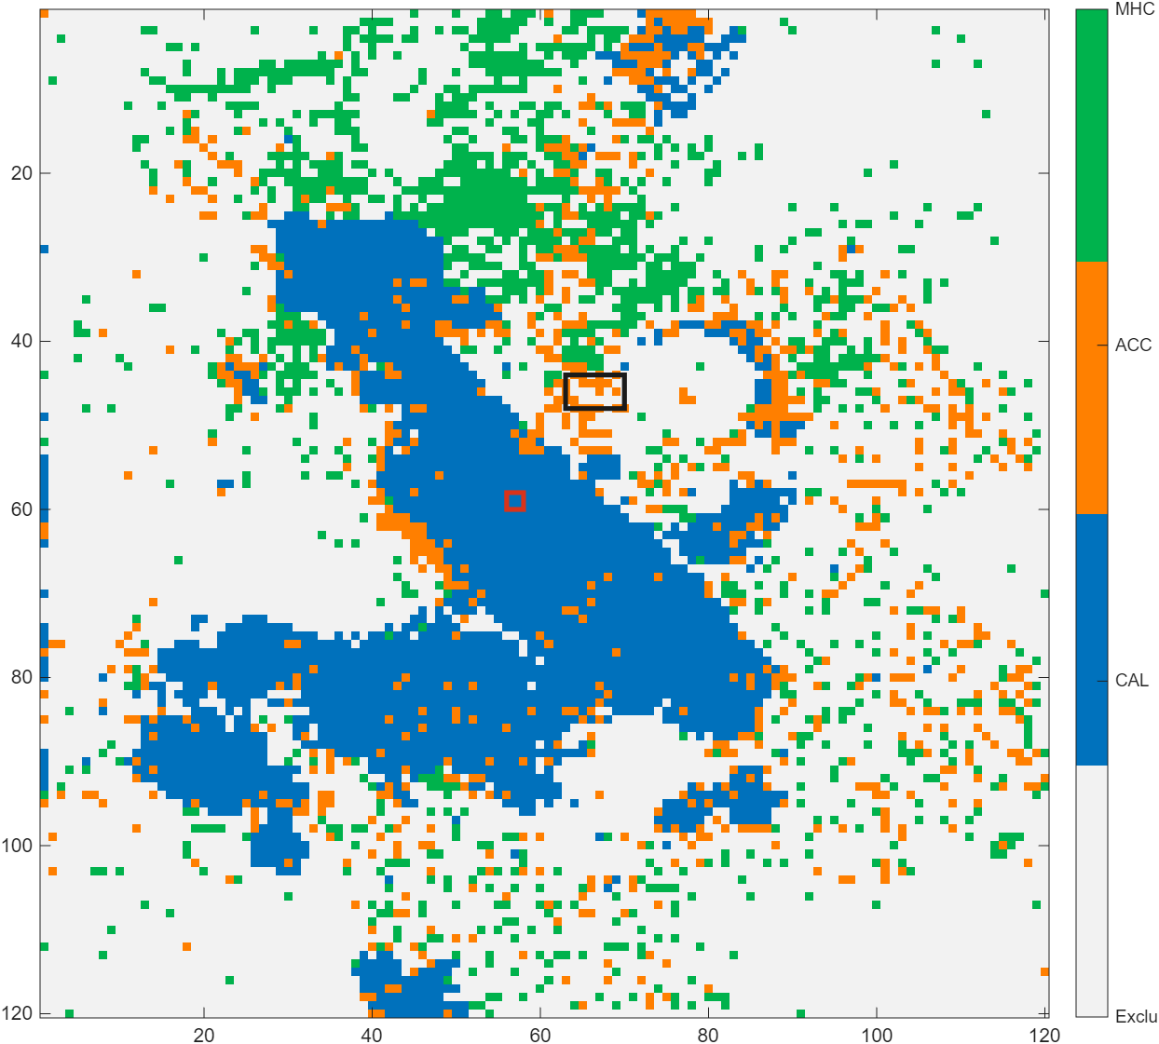
ACC + cal 260626
2 ps
7 ps
params.roi1 = [58+params.shift_row 60+params.shift_row...
66+params.shift_col 68+params.shift_col]; params.roi2 = [44+params.shift_row 48+params.shift_row...
73+params.shift_col 80+params.shift_col];

Slide 10
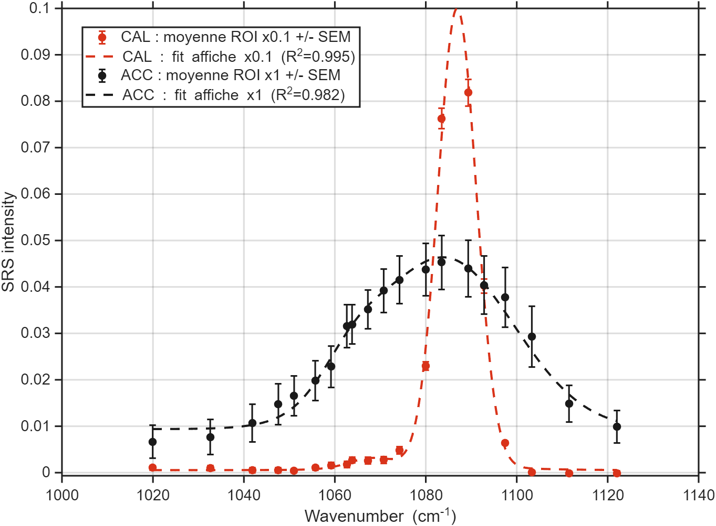
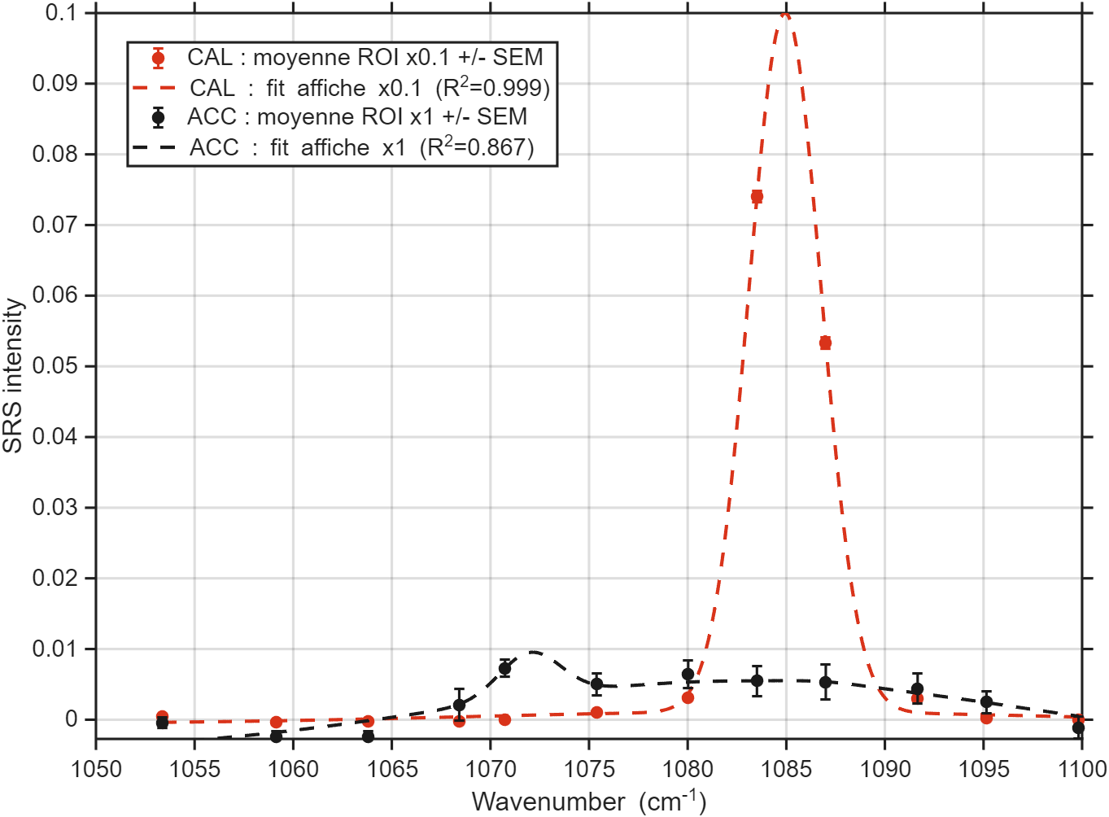
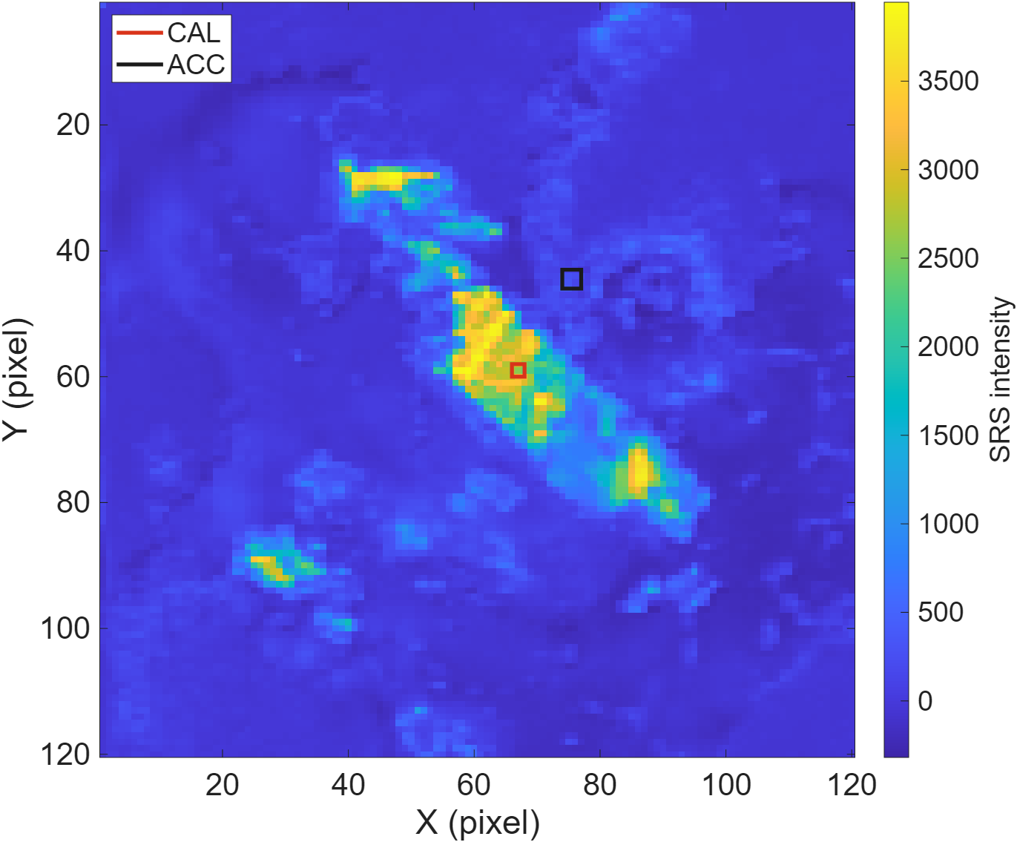

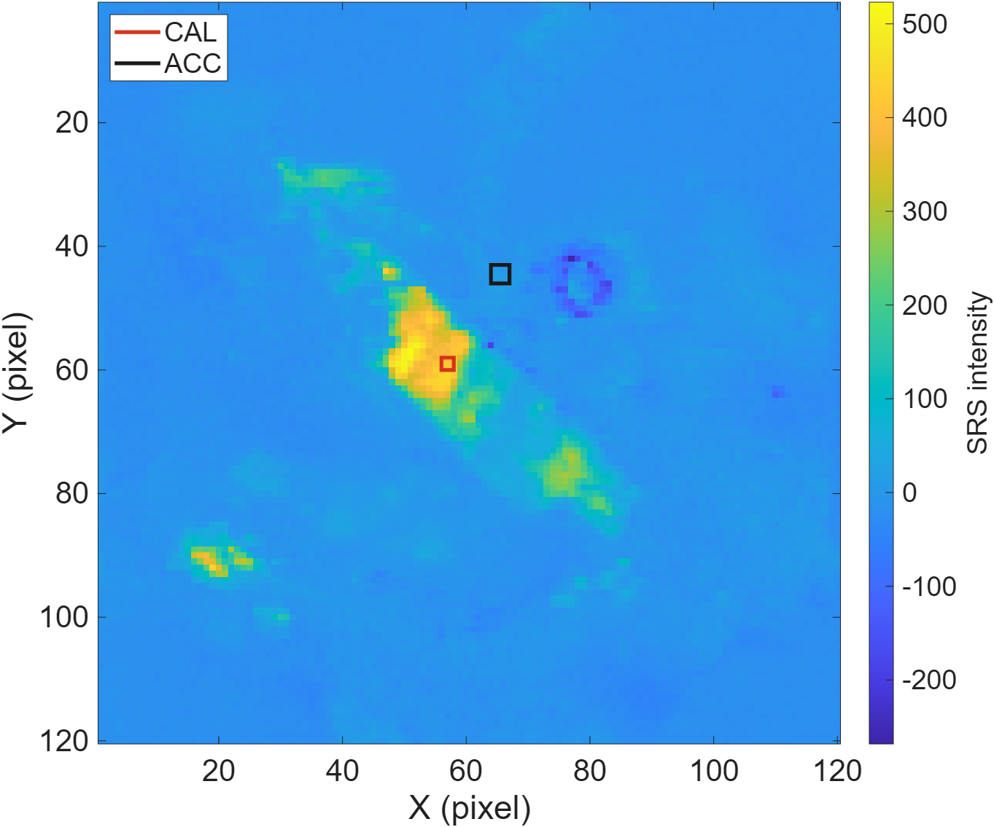
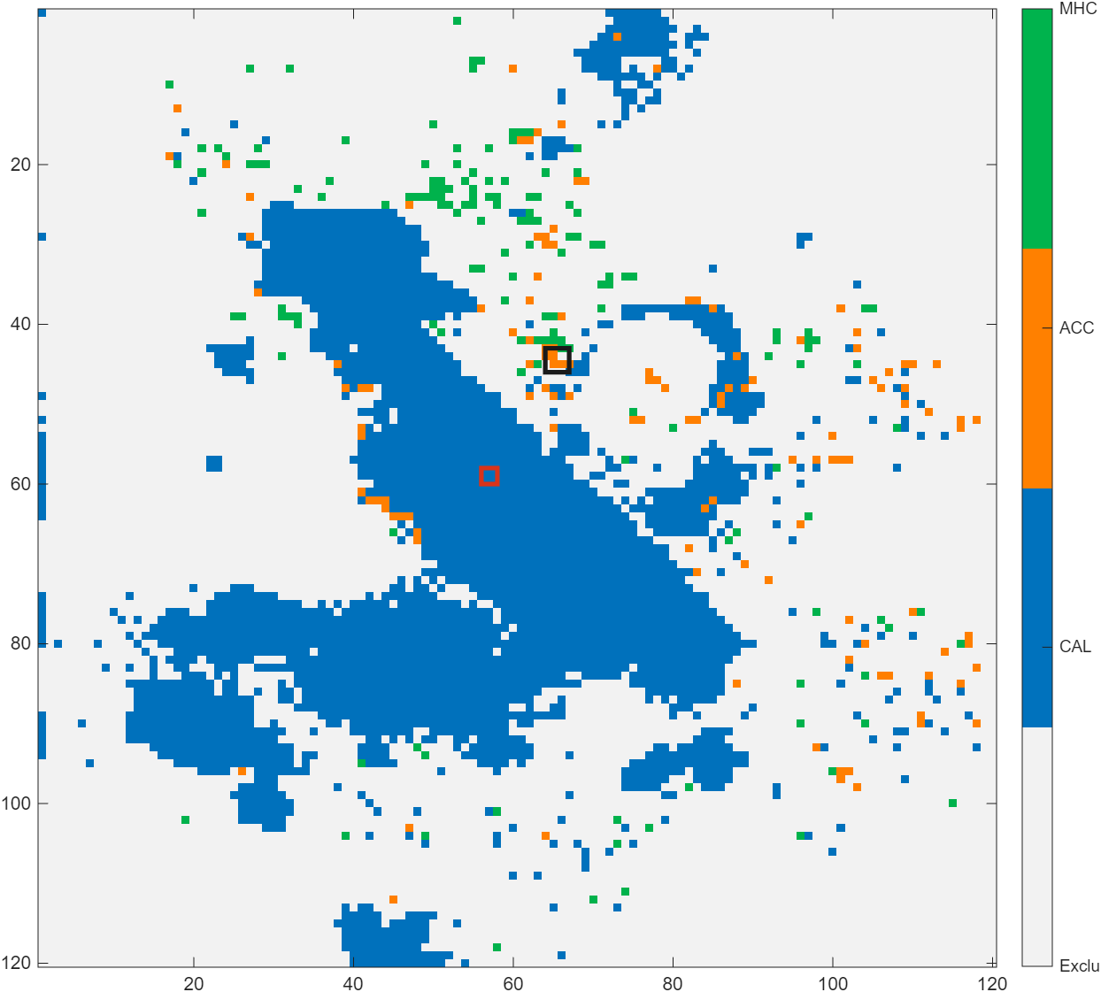
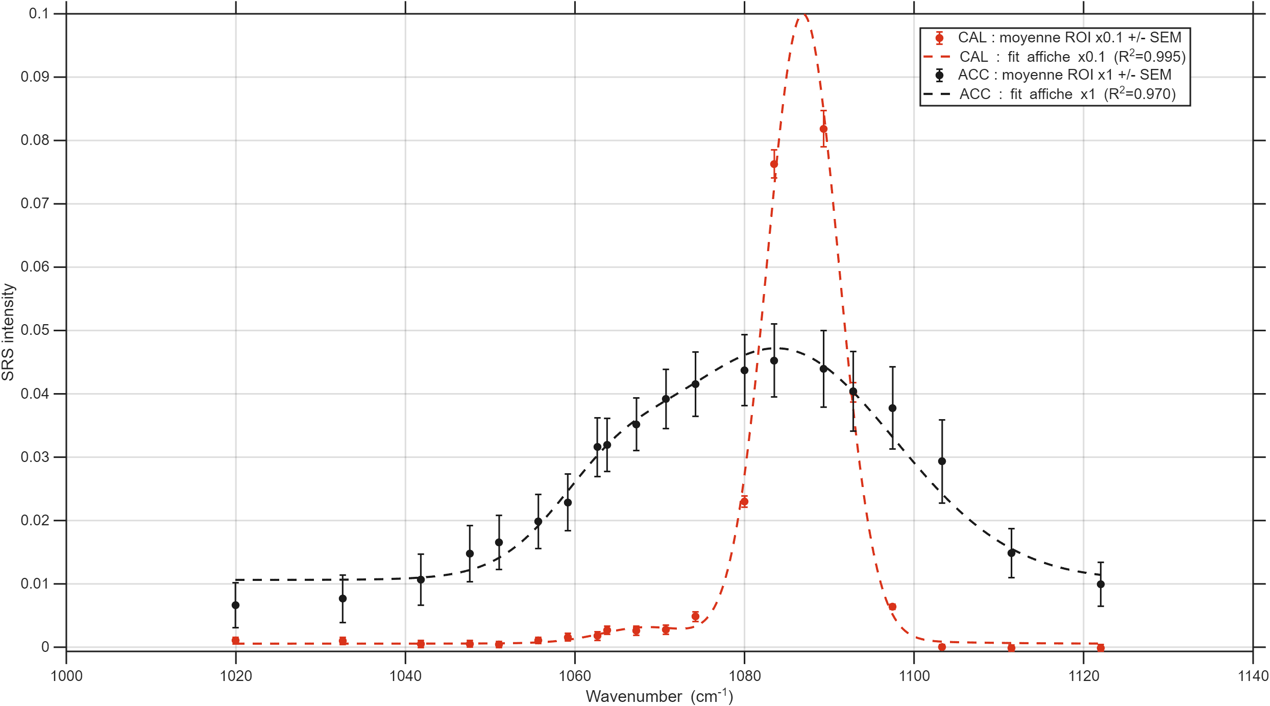
ACC + cal 260626
X 0.1
X 0.1
2 ps
7 ps
fwhm_instr_2ps = 9.3
fwhm_instr_7ps = 2.5
X 1
X 1
params.roi1 = [58+params.shift_row 60+params.shift_row...
66+params.shift_col 68+params.shift_col];
params.roi2 = [43+params.shift_row 46+params.shift_row...
74+params.shift_col 77+params.shift_col];
Si l’on fixe FWHM_2ps = 31 cm-1
260626 ROI | A | Nu (cm-1) | FWHM_phase (cm-1)
2ps CAL | 117960 | 1086.9 | 3.5 (fixé)
2ps ACC | 36580 | 1083.0 | 42.7
7ps CAL | 12703 | 1085.0 | 3.5 (fixé)
7ps ACC | 1572 | 1082.9 | 31 (fixé)

Slide 11
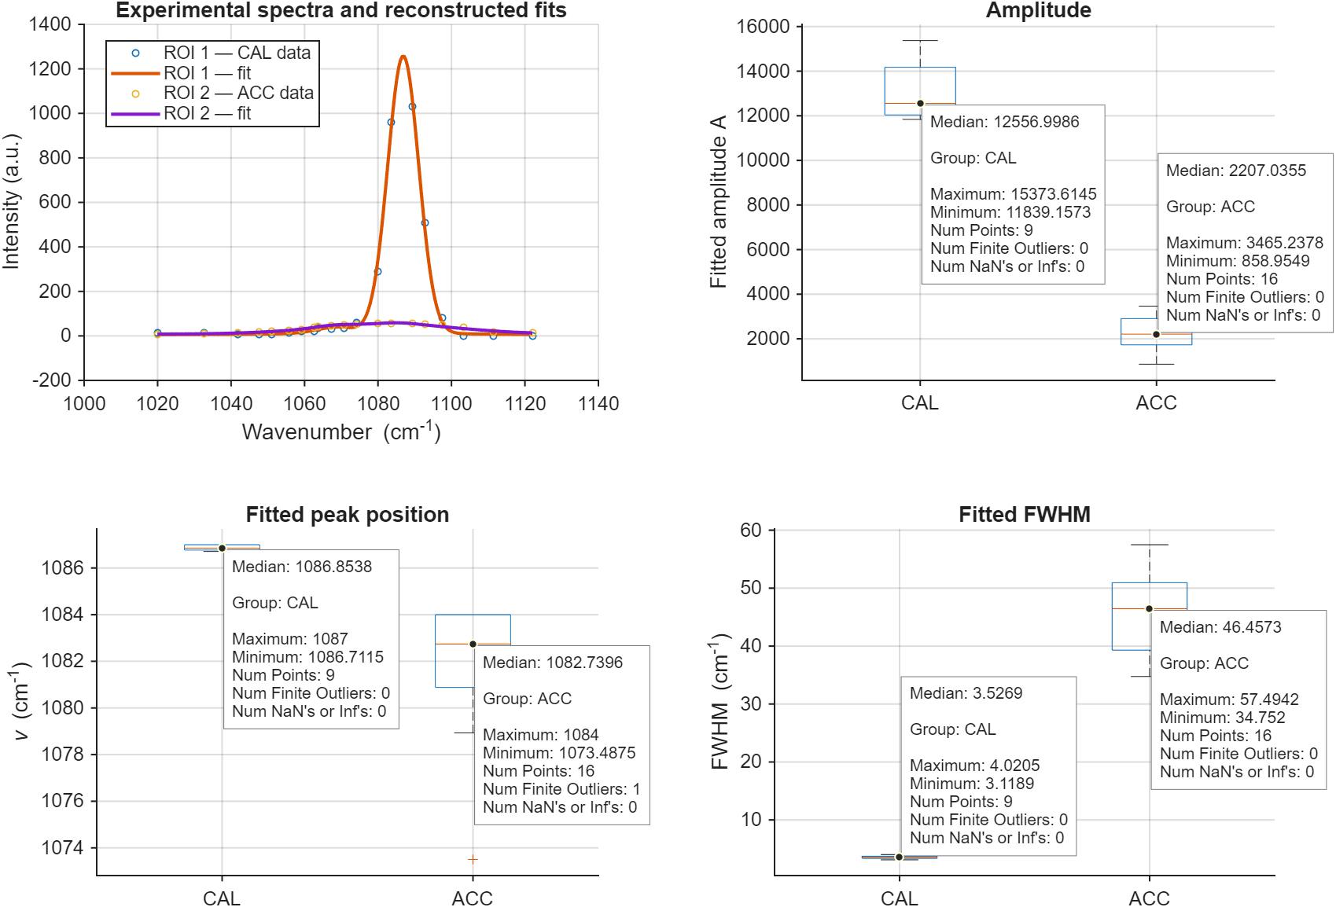
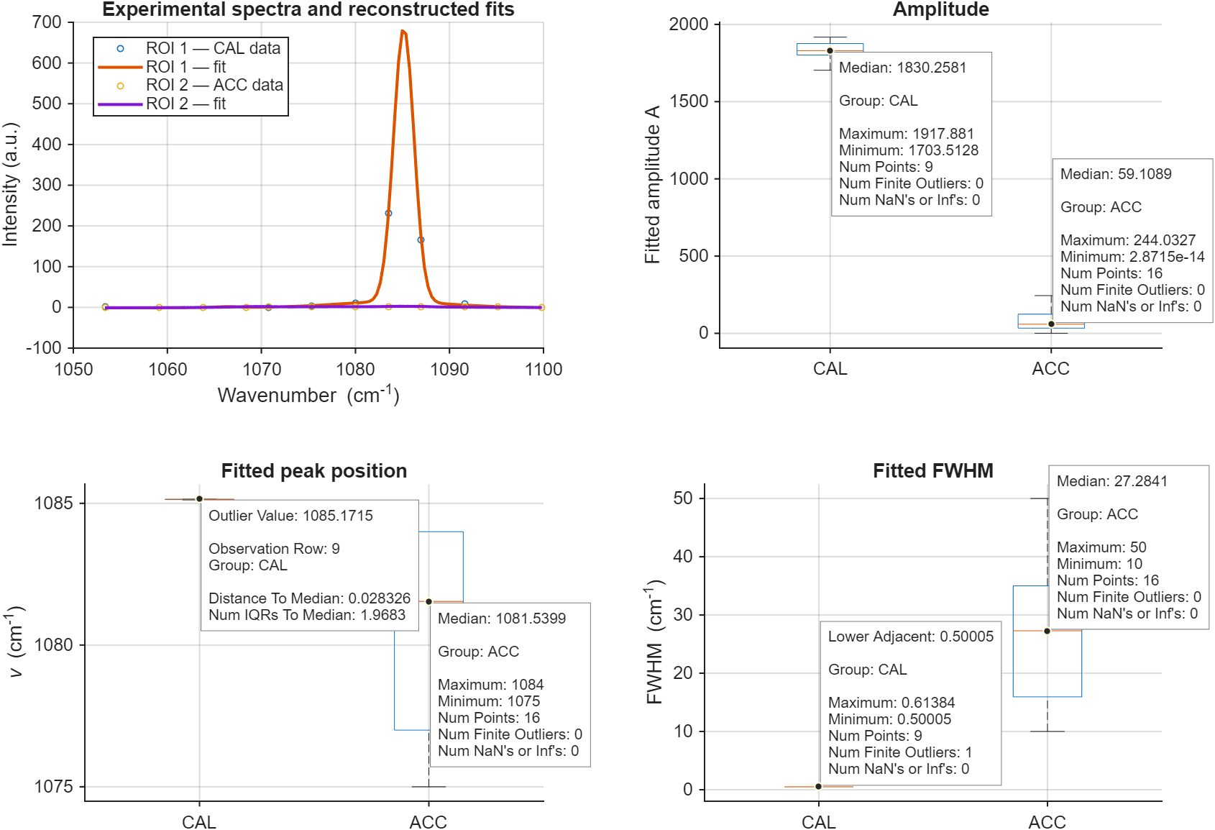
ACC + cal 260626
2 ps
7 ps

Slide 12
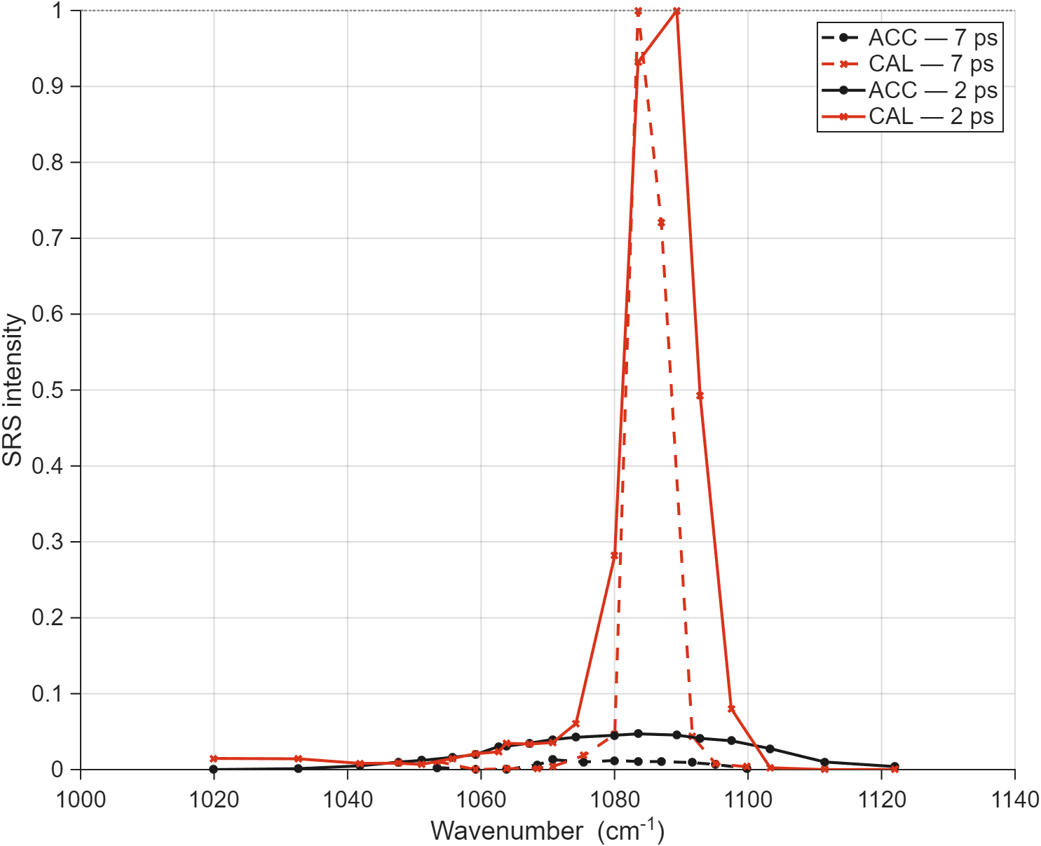
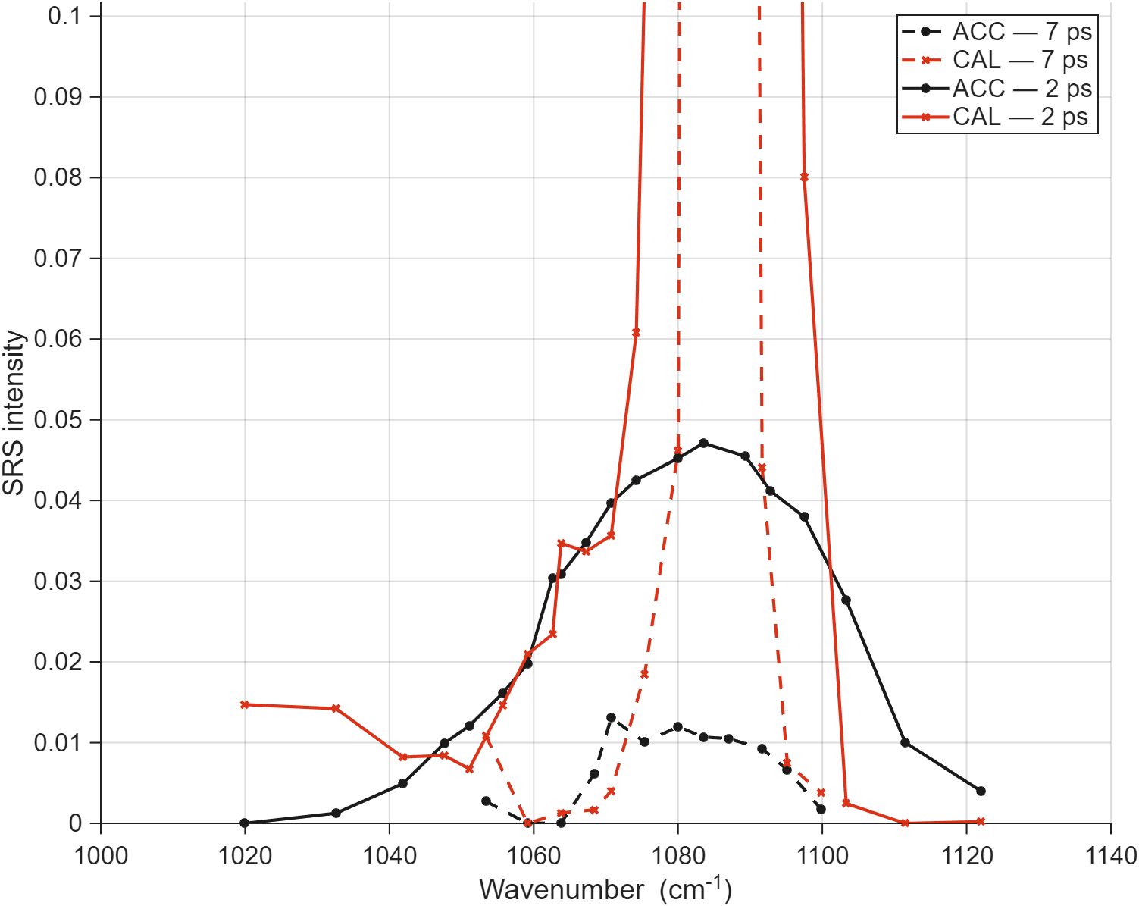
2 ps vs 7 ps

Slide 13
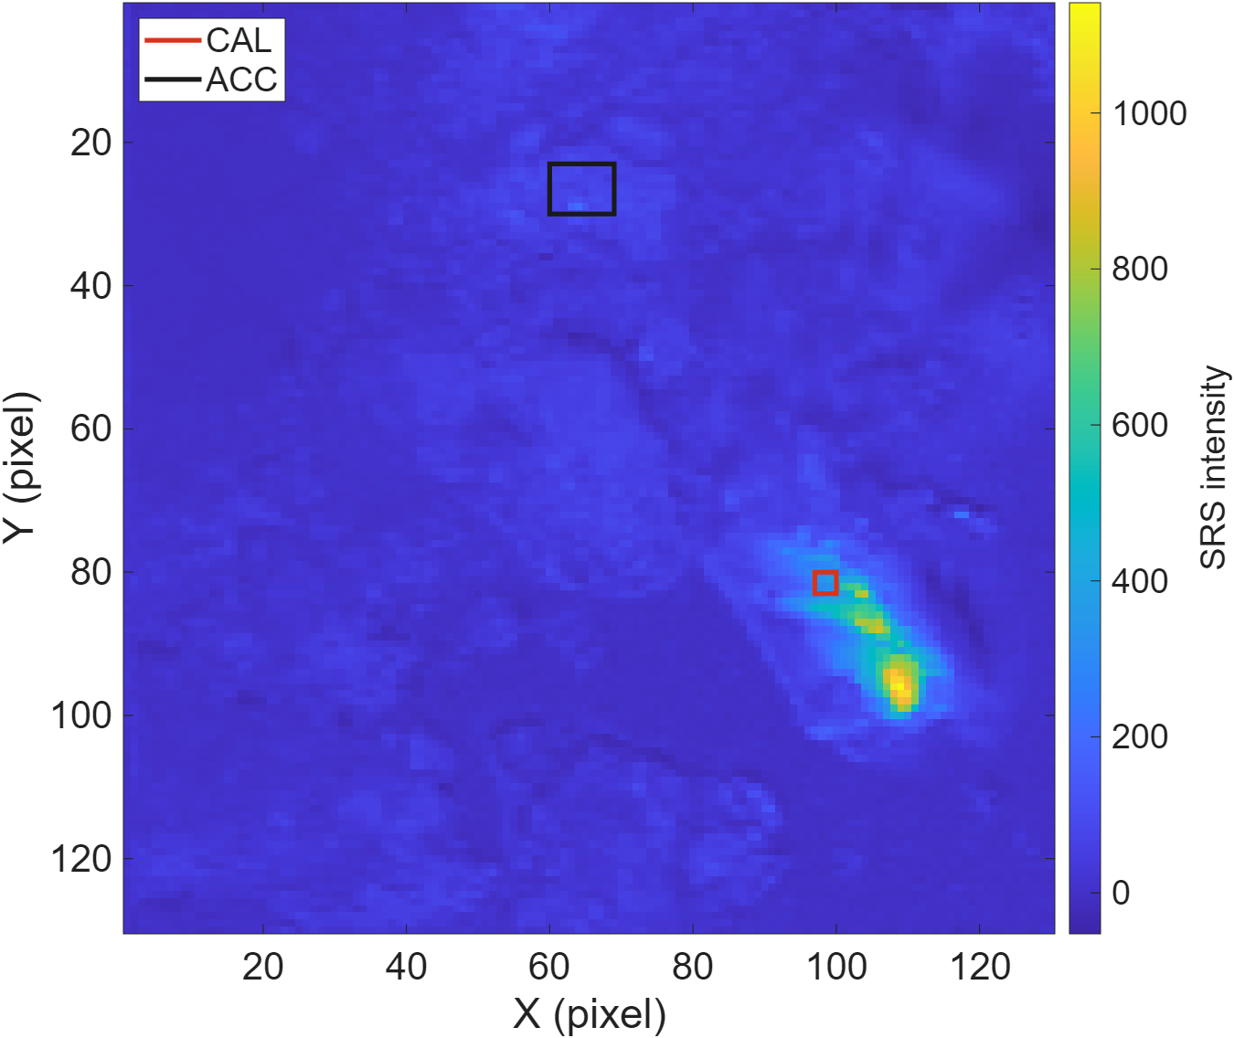
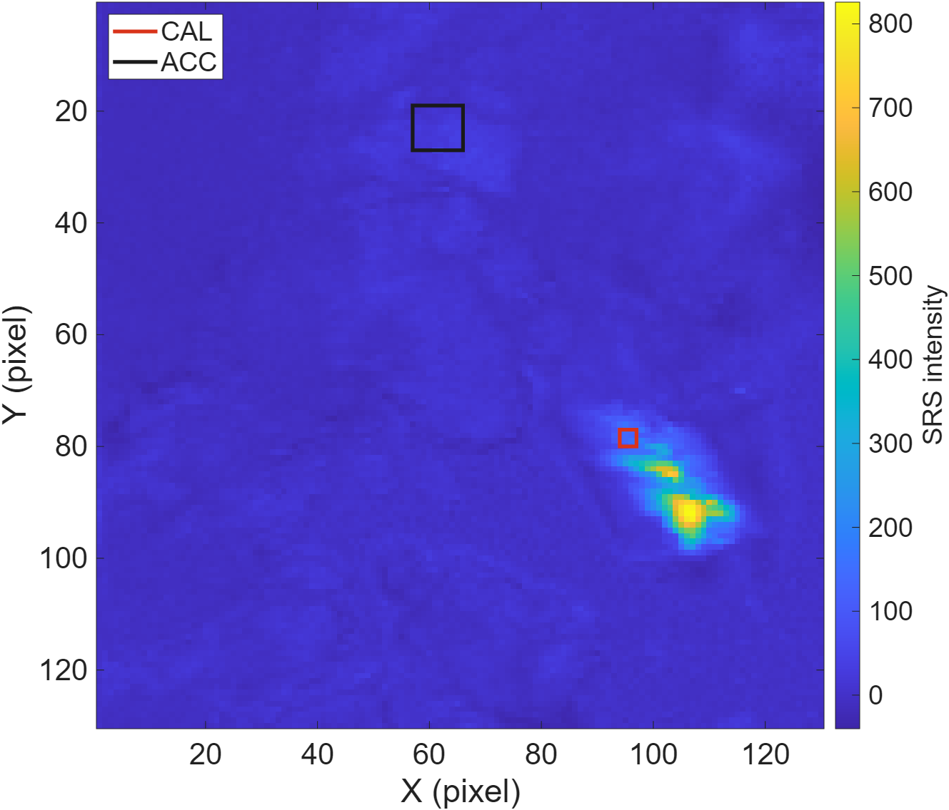
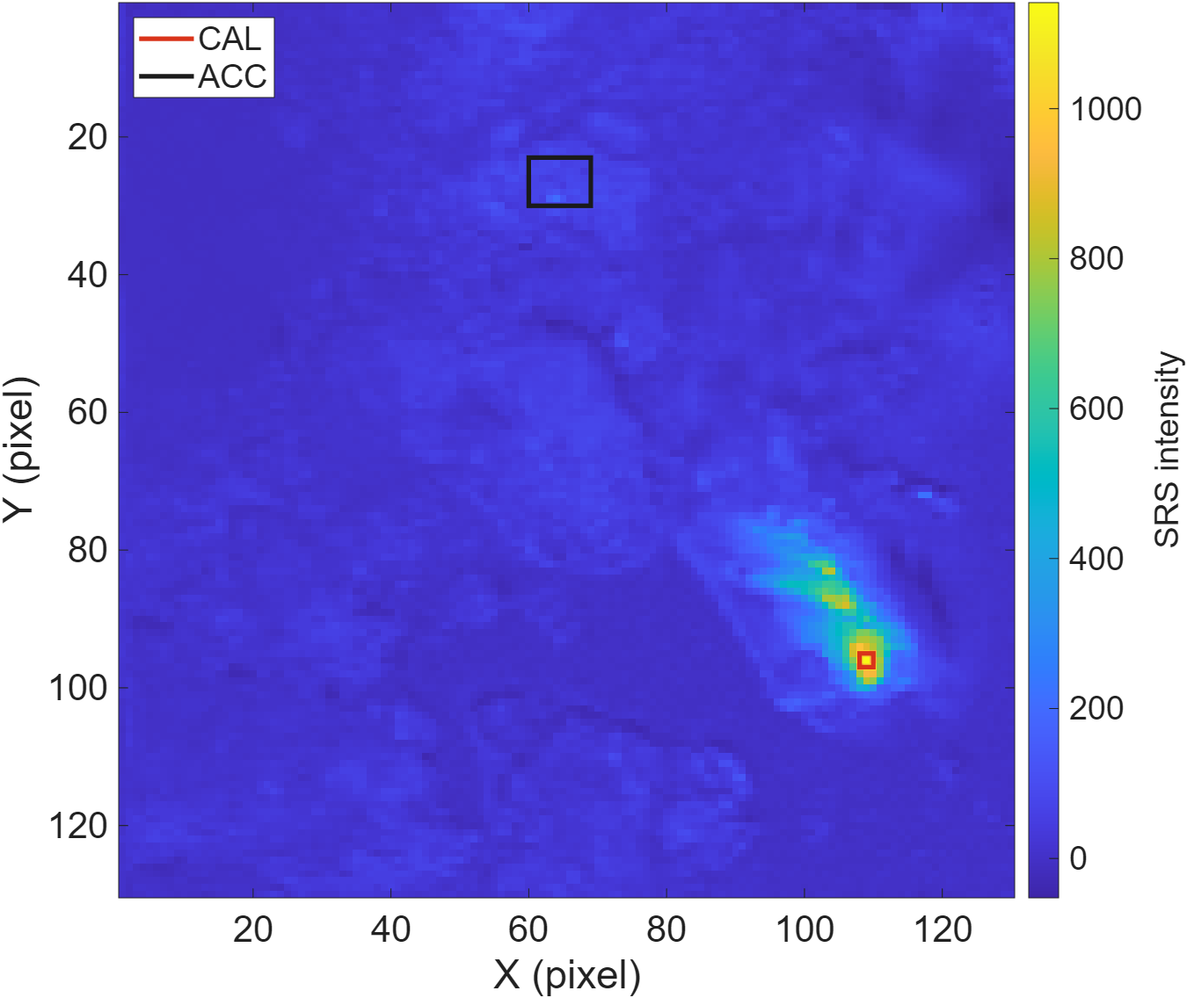
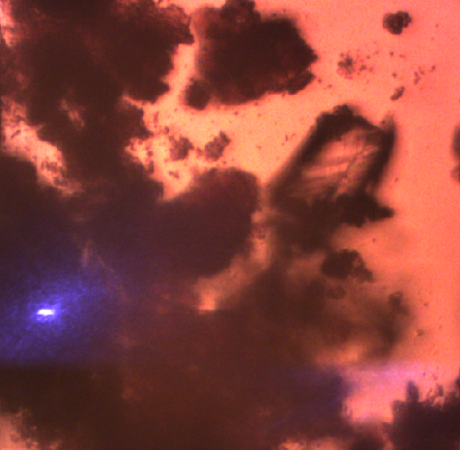
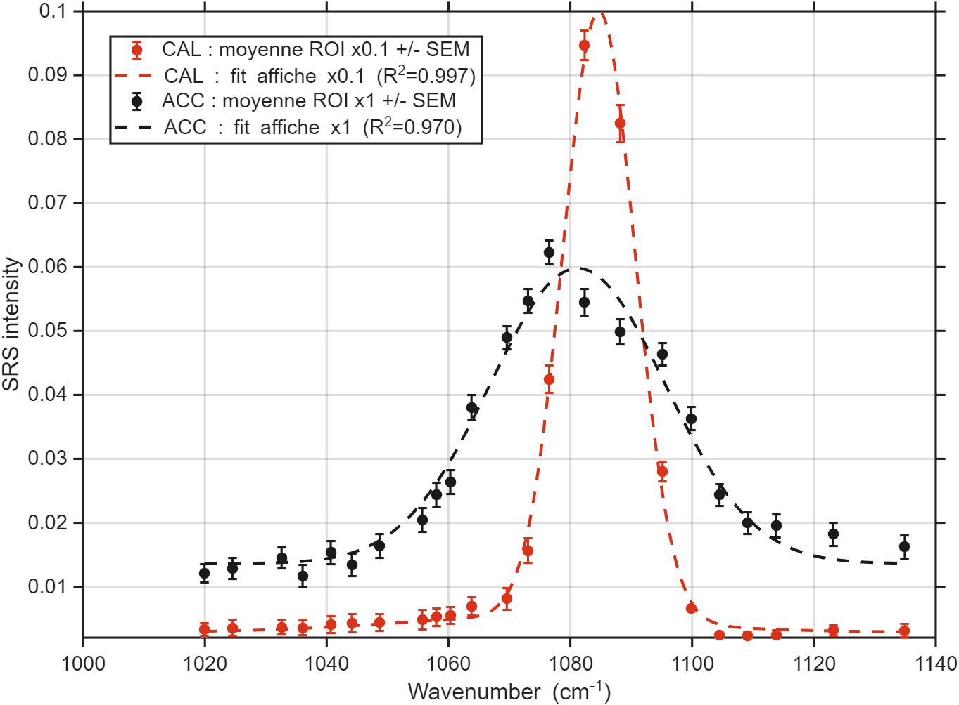
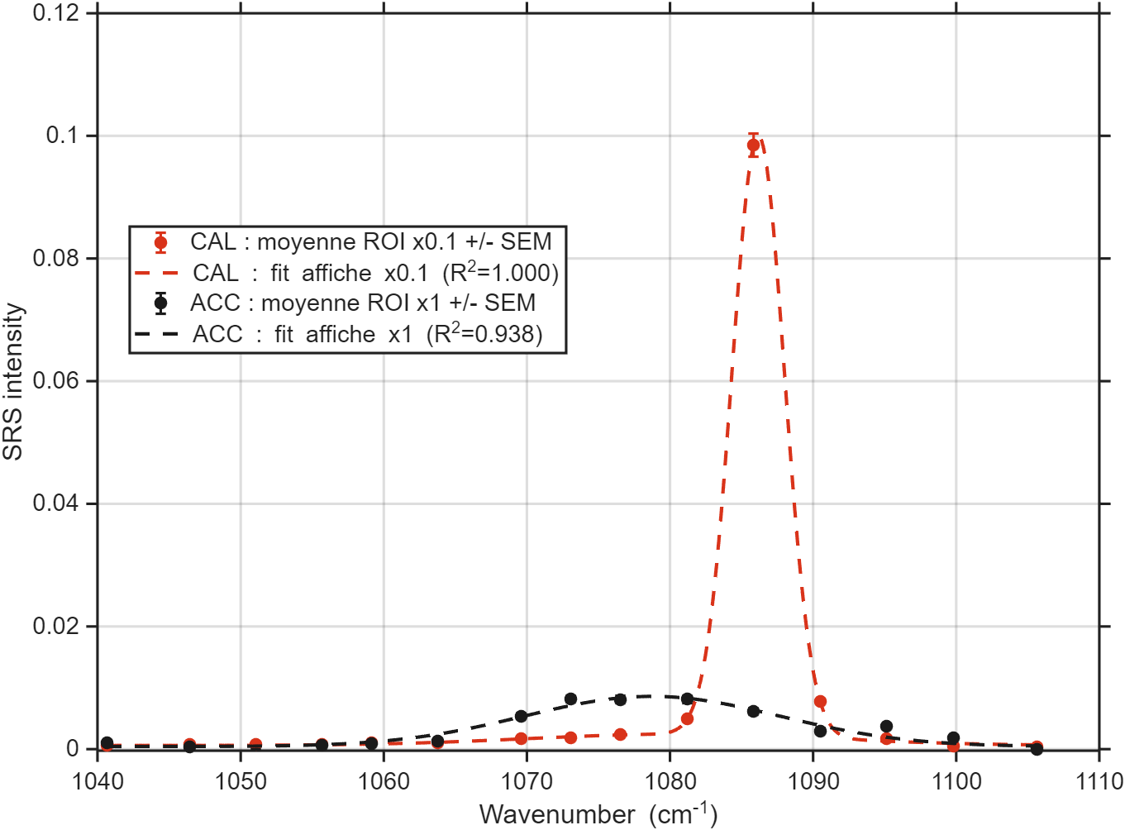
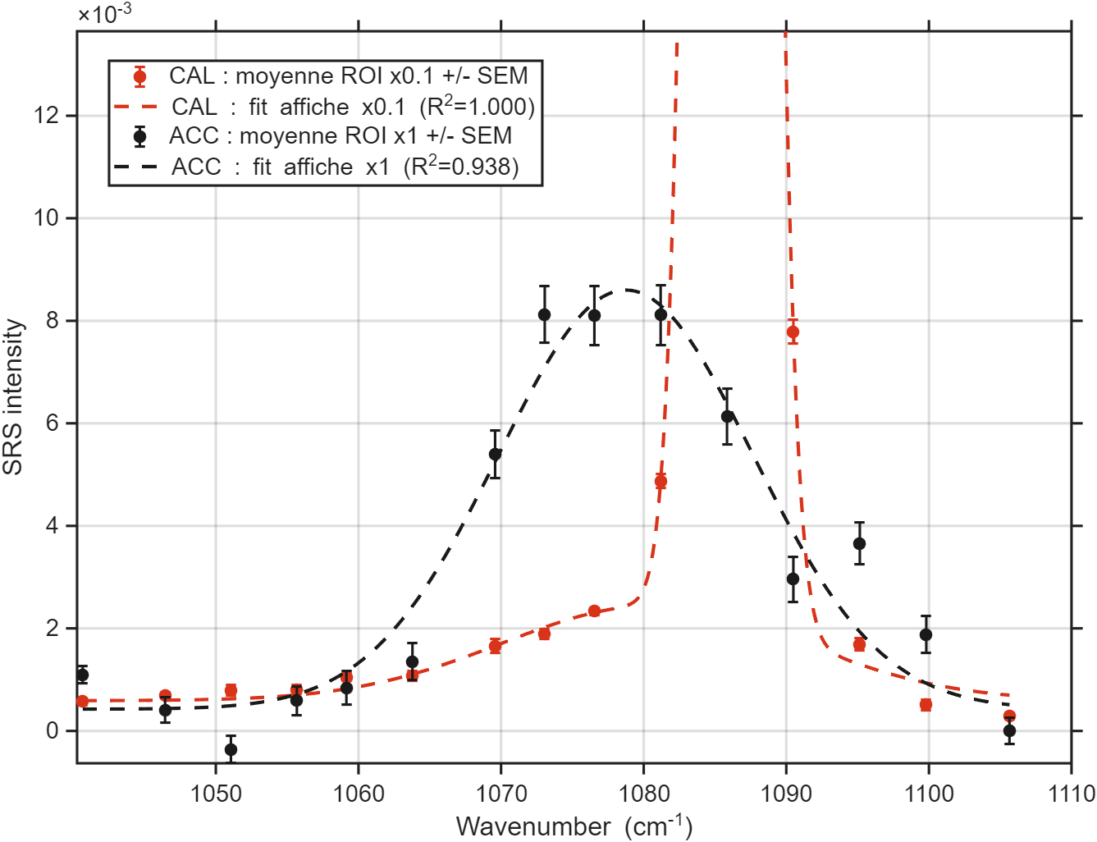
2ps
7ps
260708 ACC_Cal synt
10 µm
10 µm
10 µm
fwhm_instr_2ps = 13.8
fwhm_instr_7ps = 2.9
260708 ROI | A | Nu (cm-1) | FWHM_phase (cm-1)
2ps CAL | 58678 | 1084.7 | 2.2
2ps ACC | 61555 | 1081.2 | 31.0
7ps CAL | 27962 | 1086.2 | 3.2
7ps ACC | 10120 | 1078.7 | 20.8

Slide 14

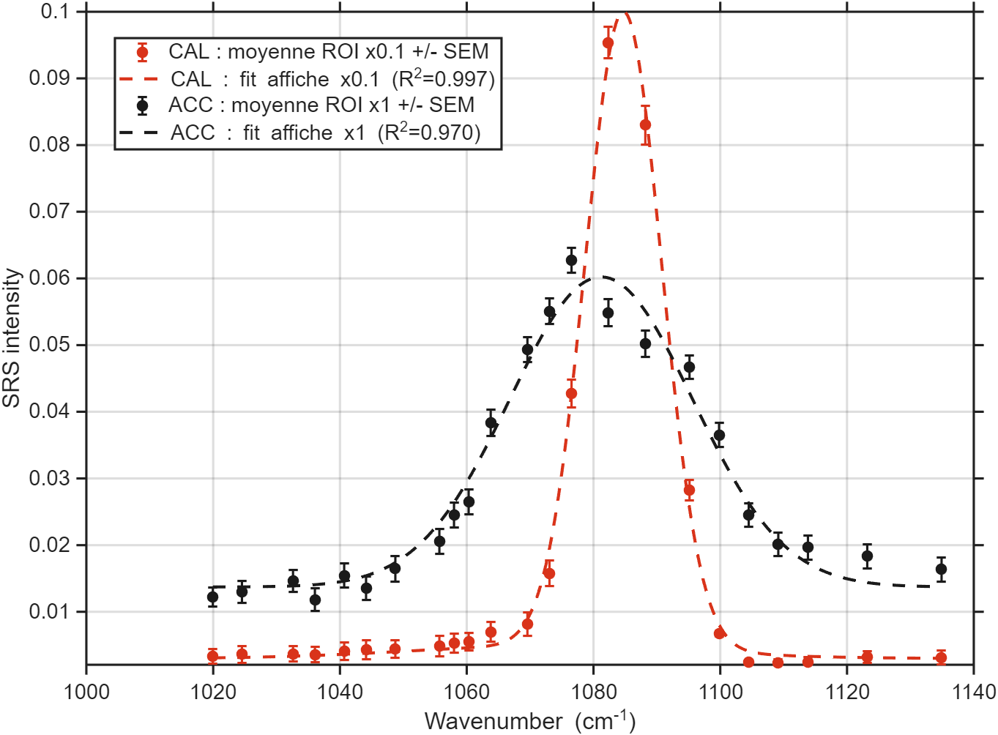
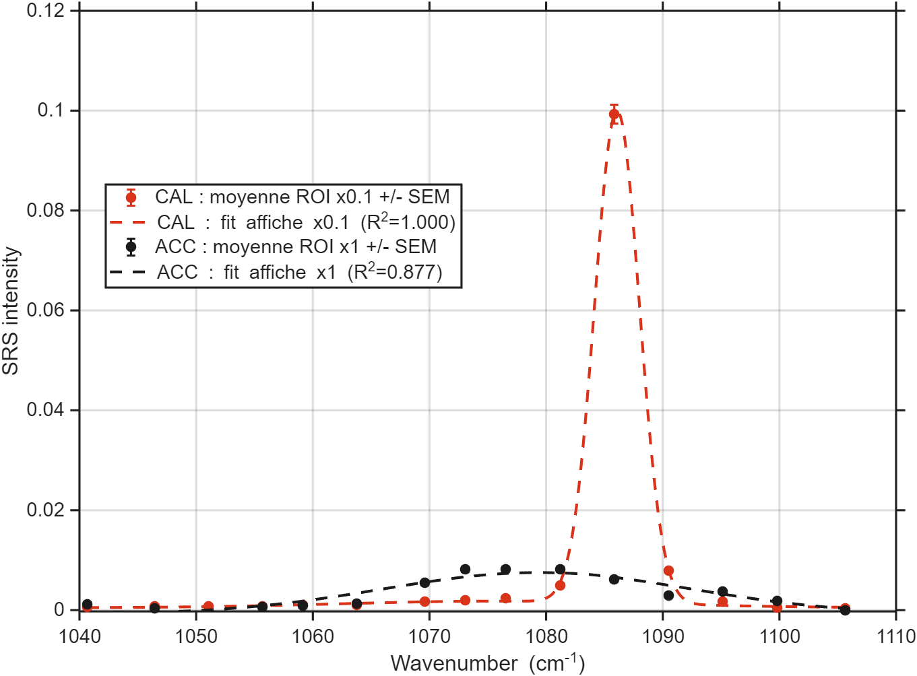
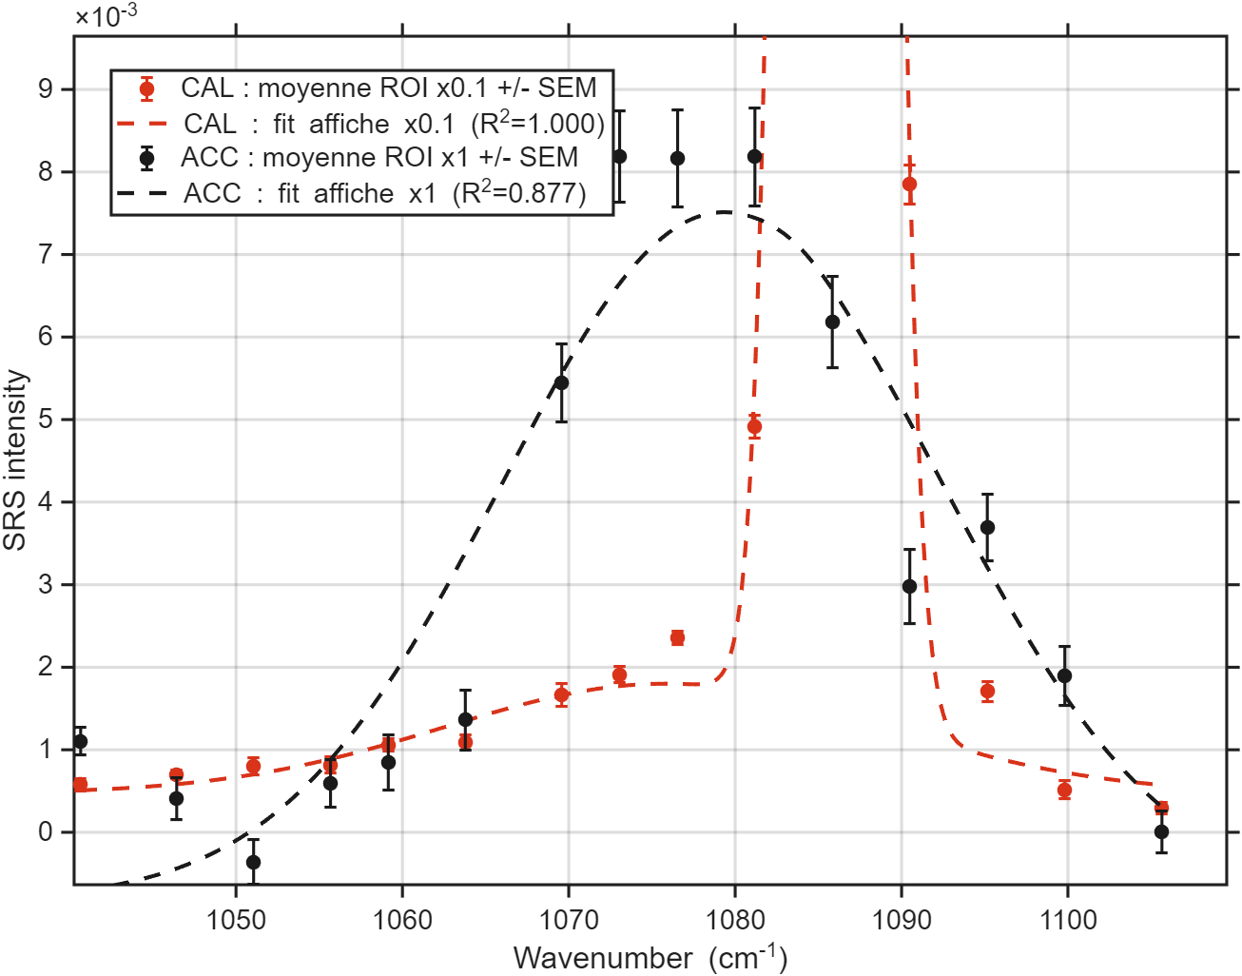
2ps
7ps
260708 ACC_Cal synt
10 µm
10 µm
10 µm
fwhm_instr_2ps = 13.8
fwhm_instr_7ps = 2.9
260708 ROI | A | Nu (cm-1) | FWHM_phase (cm-1)
2ps CAL | 59549 | 1084.7 | 3.5
2ps ACC | 61554 | 1081.2 | 31.0
7ps CAL | 29285 | 1086.1 | 3.5
7ps ACC | 15150 | 1079.2 | 31

Slide 15
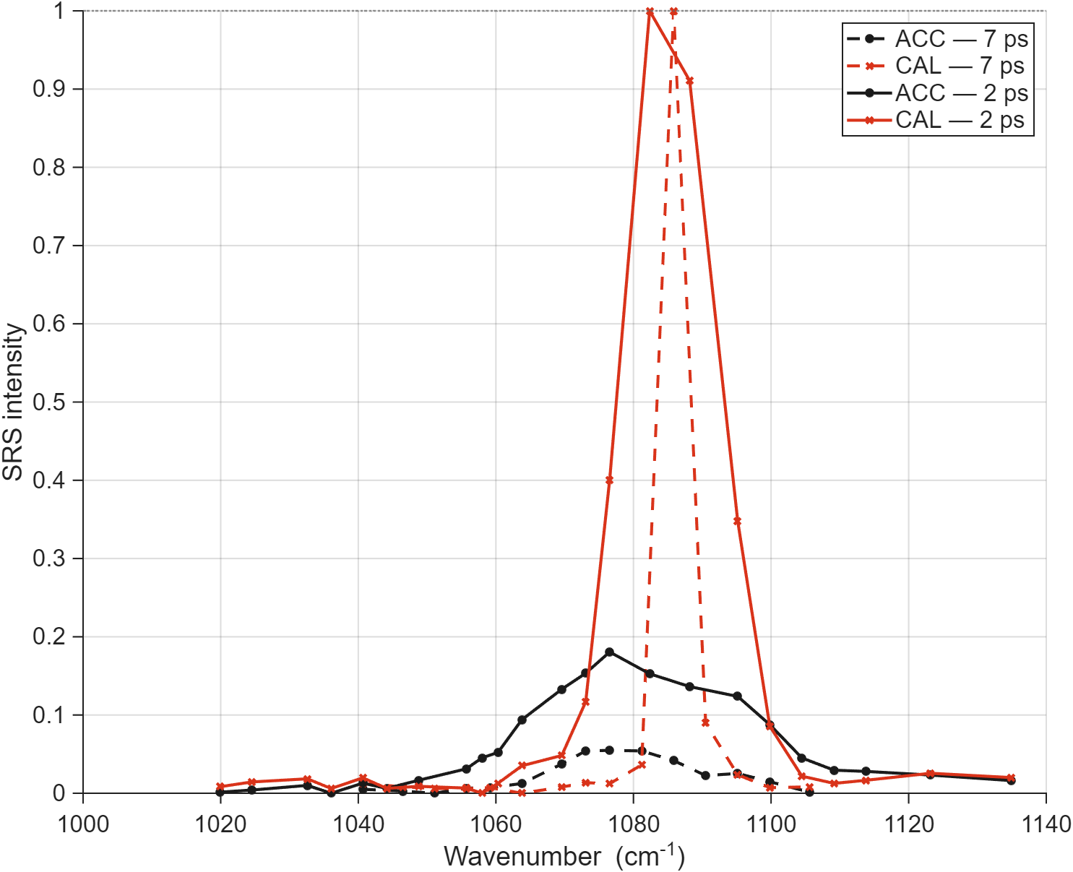
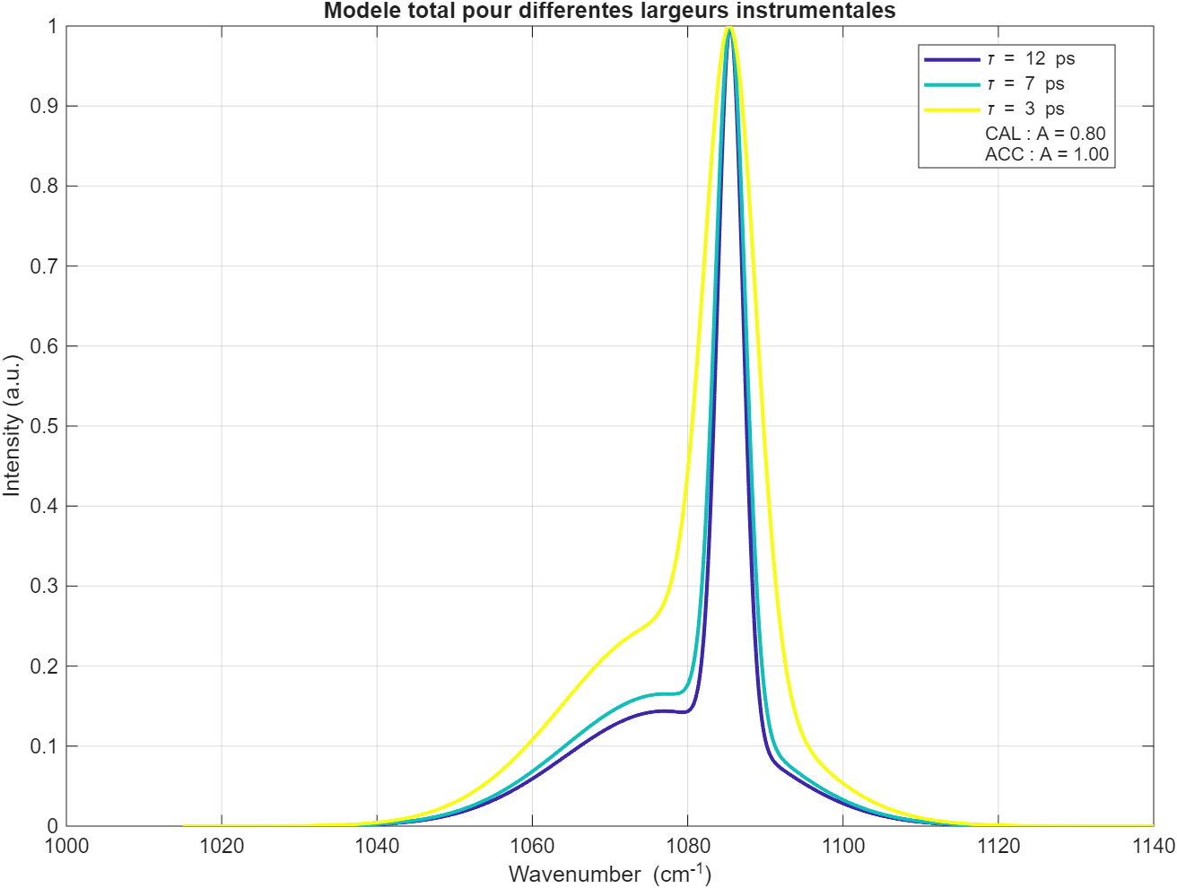
2ps vs 7ps - 260708 ACC_Cal synt
260708 ROI | A | Nu (cm-1) | FWHM_phase (cm-1)
2ps CAL | 33862 | 1085.2 | 3.7
2ps ACC | 61552 | 1081.2 | 30.8
7ps CAL | 9263 | 1086.3 | 3.3
7ps ACC | 12761 | 1078.8 | 22.4
7ps
x 0.55
x 0.55
x 0.73
10 µm
10 µm
SNR

Slide 16
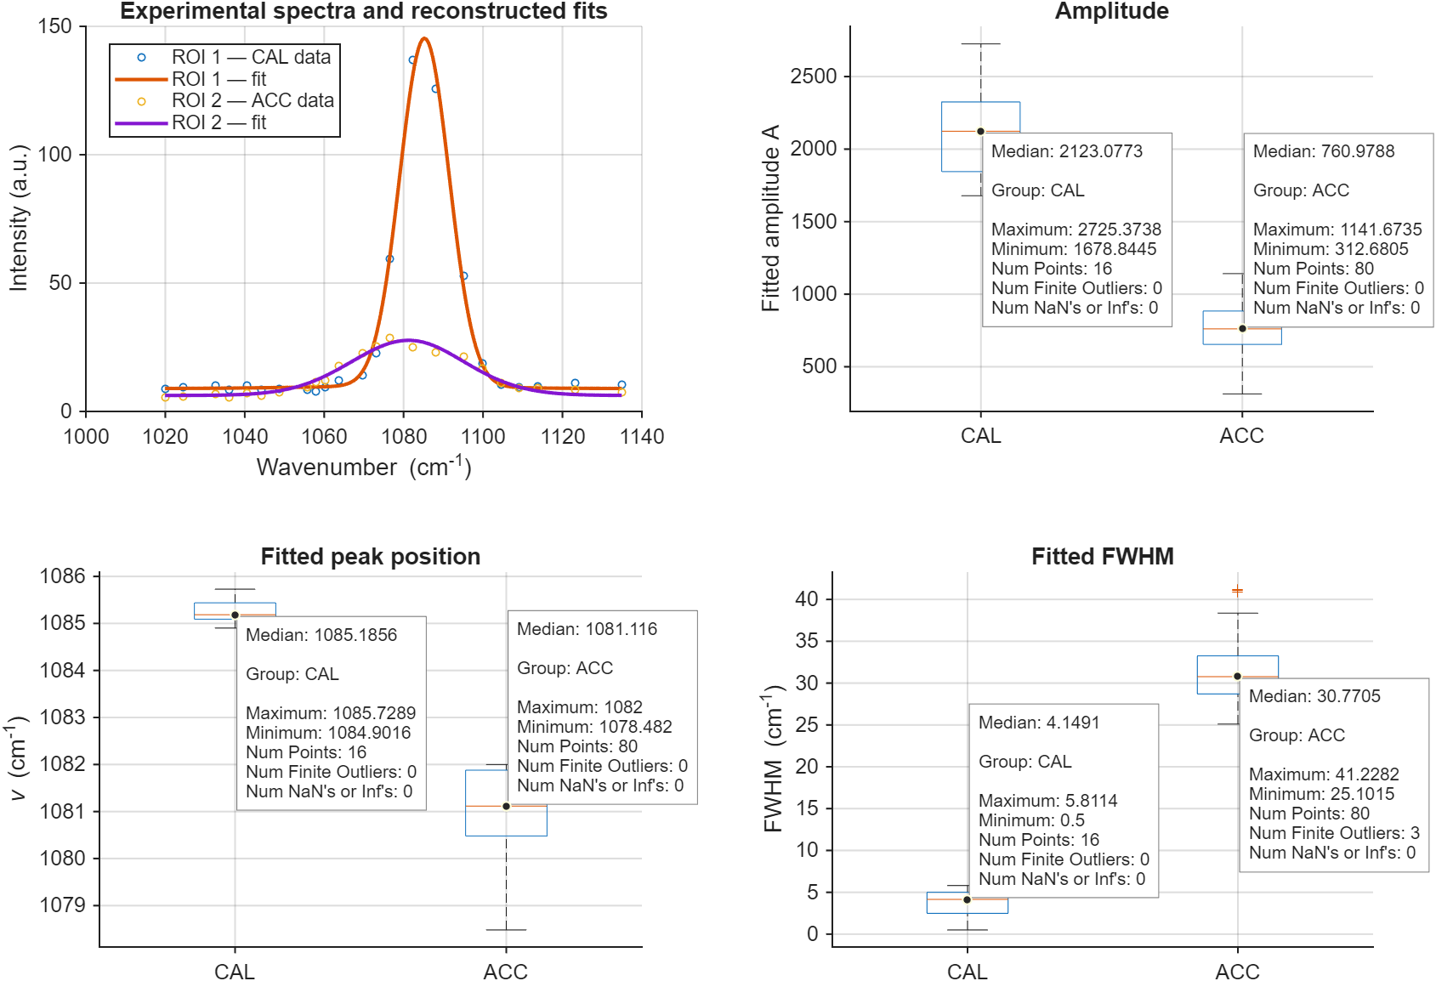
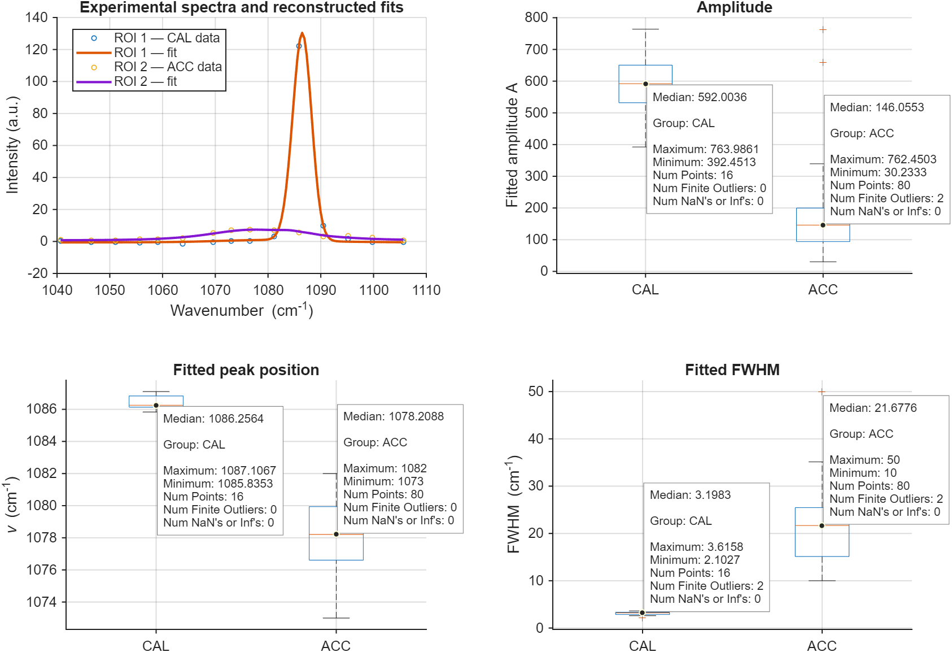
2ps vs 7ps - 260708 ACC_Cal synt
260708 ROI | A | Nu (cm-1) | FWHM_phase (cm-1)
2ps CAL | 33862 | 1085.2 | 3.7
2ps ACC | 61552 | 1081.2 | 30.8
7ps CAL | 9263 | 1086.3 | 3.3
7ps ACC | 12761 | 1078.8 | 22.4
7ps
x 0.55
x 0.73
2ps - Fwhm_instr = 13.5 (14 mesuré)
10 µm
7ps - Fwhm_instr = 2.8 (4.4 mesuré)
10 µm

Slide 17

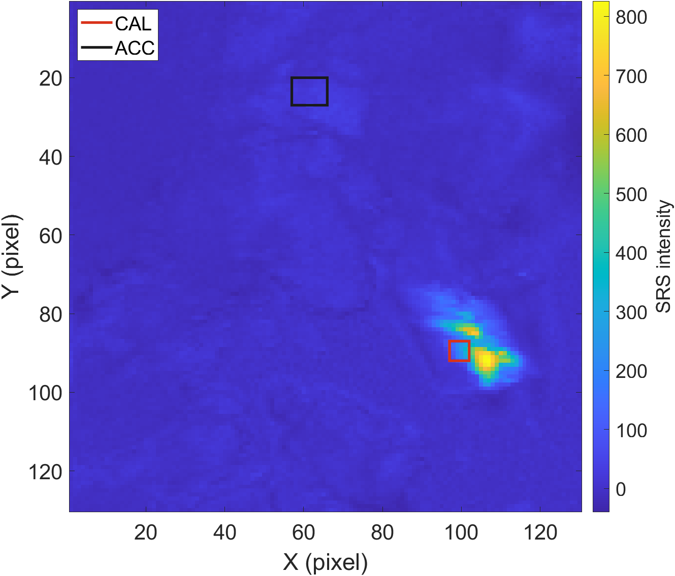


2ps vs 7ps - 260708 ACC_Cal synt
2ps - Fwhm_instr = 13.6 (14 mesuré)
params.roi1 = [90 95 100 105];
params.roi2 = [23 30 60 69];
7ps - Fwhm_instr = 2.8 (4.4 mesuré)
2ps
7ps
2ps
7ps
10 µm
2,9
7
10 µm

Slide 18


Littérature Vatérite
Wehrmeister, U., et al. (2010). Raman spectroscopy of synthetic, geological and biological vaterite: a Raman spectroscopic study. Journal of Raman Spectroscopy

Slide 19




7ps 260527 Vatérite
Ratio_model = [0.45 0.28 1];
Résultat du fit :
Phase VAT : A_fit = 1099
  - Raie 1 : nu = 1074.23 cm^-1
  - Raie 2 : nu = 1080.78 cm^-1
  - Raie 3 : nu = 1090.09 cm^-1
  - FWHM 1 : FWHM = 3.04 cm^-1
  - FWHM 2 : FWHM = 2.85 cm^-1
  - FWHM 3 : FWHM = 5.34 cm^-1
Synthetic samples made by Clémentine
0.5
0.35

Slide 20



2ps 260527 Vatérite
Ratio_model = Ratio_model = [0.45 0.28 1];
Résultat du fit :
Phase VAT : A_fit = 8050.1
  - Raie 1 : nu = 1073.8006 cm^-1
  - Raie 2 : nu = 1080.2310 cm^-1
  - Raie 3 : nu = 1091.7282 cm^-1
  - FWHM 1 : FWHM = 10.0000 cm^-1
  - FWHM 2 : FWHM = 3.0289 cm^-1
  - FWHM 3 : FWHM = 5.5216 cm^-1

Slide 21



2 vs 7ps 260527 Vatérite
7ps
2ps
10 µm
10 µm
10 µm
Nb points 125²
scan range 50 µm
2ps
7ps
1 pix = 400 nm²

Slide 22

2ps vs 7ps 260527 Vatérite

Slide 23



Corals 260715 2ps (#4 stressed)
R2_min= 0.7;
threshold_sigma= 4;
min_points_above_threshold = 2;
ACC if A(ACC)> Γ A(ARA) :
Γ = 0.3
Γ = 1

Slide 24


Corals 260715 7ps (#4 stressed)
R2_min= 0.6;
threshold_sigma= 5;
min_points_above_threshold = 1;
ACC if A(ACC)> Γ A(ARA) :
Γ = 1
Γ = 1

Slide 25




Corals 260715 2ps vs 7ps (#4 stressed)
Réalisé sur la somme des pixels :
2ps
7ps
260715 | A | nu | FWHM_phase | FWHM_instr | N_pix
2ps ARA | 8311 +/- 3747.4 | 1086.02 +/- 0.17 | 1.43 +/- 0.81 | 10.53 | 10
2ps ACC | 2823.2 +/- 2918.7 | 1073.11 +/- 0.36 | 33.92 +/- 6.33 | 10.53 | 10
7ps ARA | 4275 +/- 794.18 | 1085.45 +/- 0.24 | 3.12 +/- 0.93 | 2.50 | 10
7ps ACC | 3741.6 +/- 2693.2 | 1073.83 +/- 1.53 | 32.04 +/- 8.97 | 2.50 | 10
$$\boxed{σ_{bckg,global }={median}_{ν}\left[σ_{bckg}\right]\left(ν\right)×\frac{N_{pixel}}{norm}}$$
Bckg variability :

Slide 26




Corals 260715 2ps vs 7ps (#4 stressed)
R2_min= 0.7;
threshold_sigma= 4;
min_points_above_threshold = 2;
ACC if A(ACC)> Γ A(ARA) :
Γ = 1
Γ = 0.3
260715 ROI | A | nu | FWHM_phase
2ps ARA | 8311 +/- 3747.4 | 1086.02 +/- 0.17 | 1.43 +/- 0.81
2ps ACC | 2823.2 +/- 2918.7 | 1073.11 +/- 0.36 | 33.92 +/- 6.33
7ps ARA | 4275 +/- 794.18 | 1085.45 +/- 0.24 | 3.12 +/- 0.93
7ps ACC | 3741.6 +/- 2693.2 | 1073.83 +/- 1.53 | 32.04 +/- 8.97

Slide 27

SET UP
(a)
(b)

Slide 28



Calcul FOV – objectif x20
Paramètres mires :
Thorlabs · Resolution Test Targets
groupe 6, résolution 1 : 64 lp/mm
largeur de 5 lignes = 67 pixels
1 pix = 1.2 µm
Paramètres acquisition :
FOV_X = FOV_Y = 10
Calib X = Calib Y = 0.1
Pix = 300²
FOV = 10² ⬄ FOV = 360 µm²
~ 80 pixels
100 180
191
- = 67 pixels
124
Dwell time = 20µs
Dwell time = 100 µs

Slide 29

Fréquences parasites

Slide 30


Puissance fonction de Lambda

Slide 31



Test scan sur calcite

