Slide 1
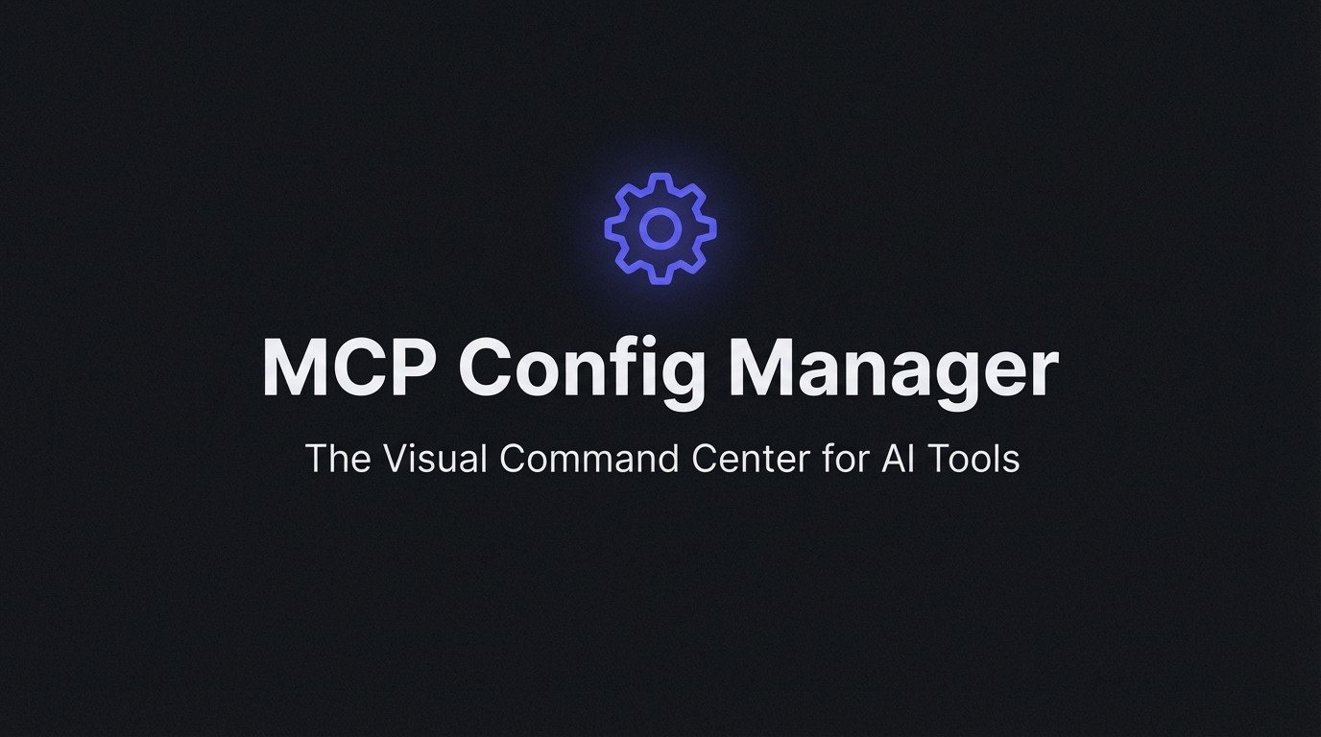

Slide 2
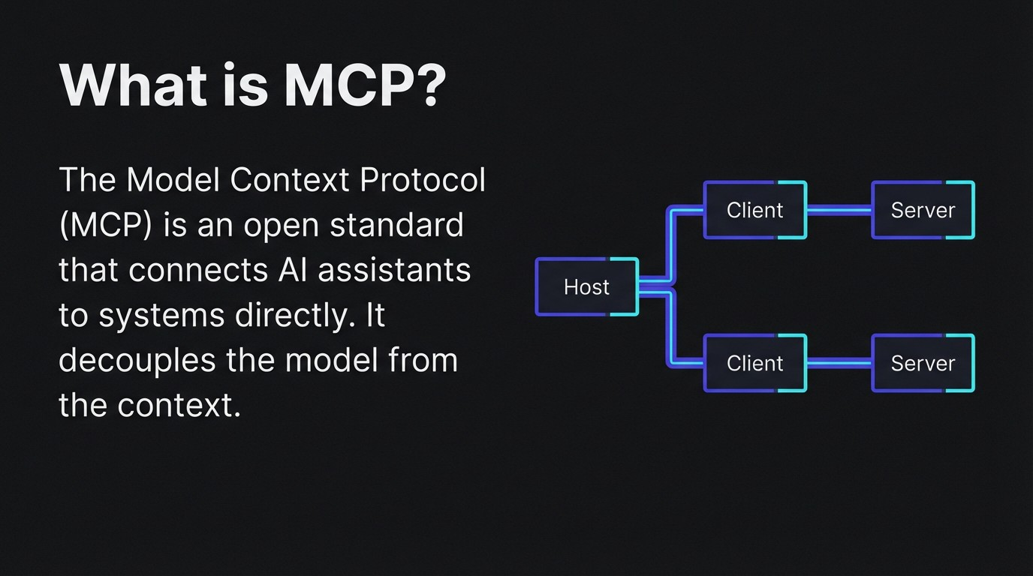

Slide 3
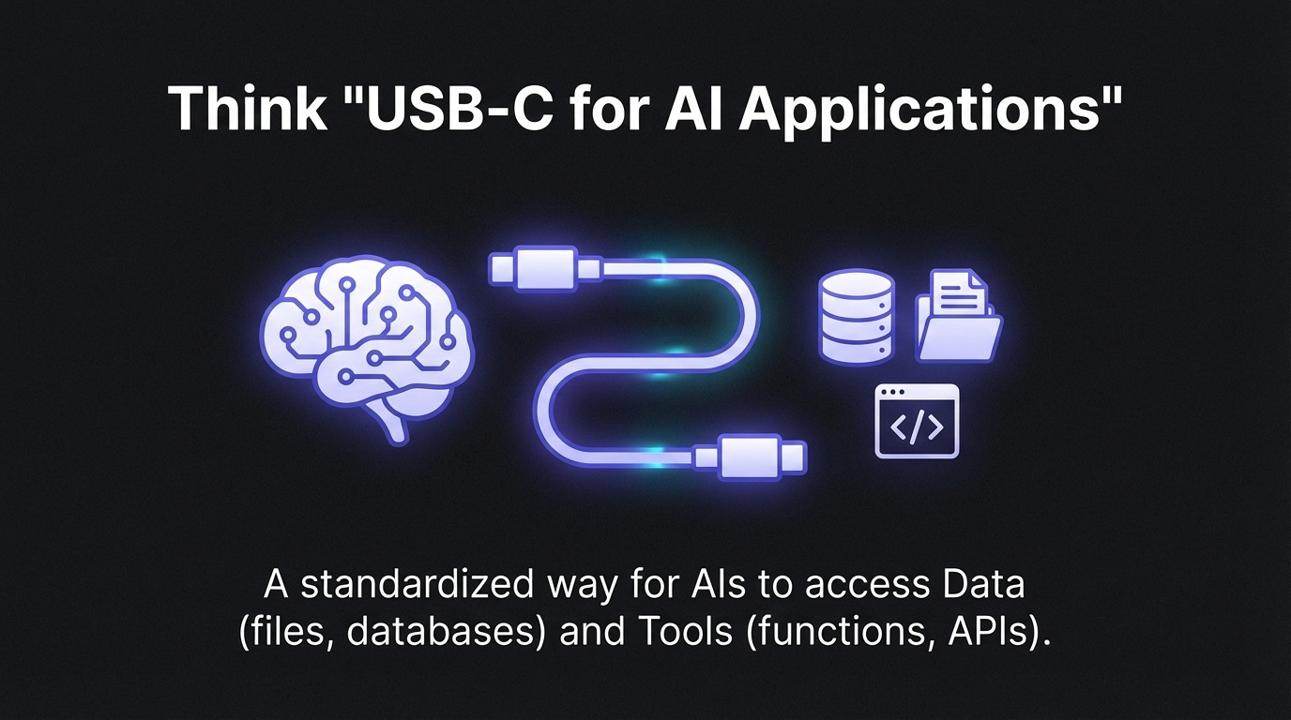

Slide 4
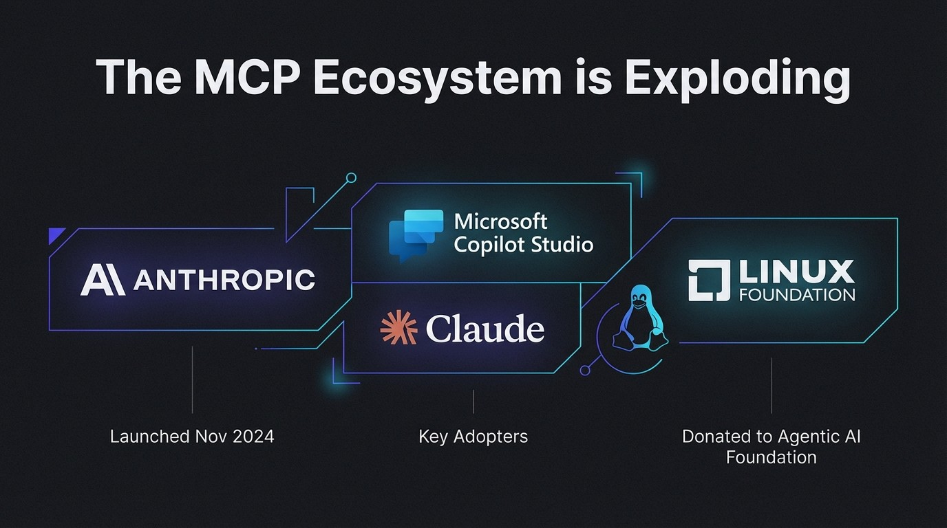

Slide 5
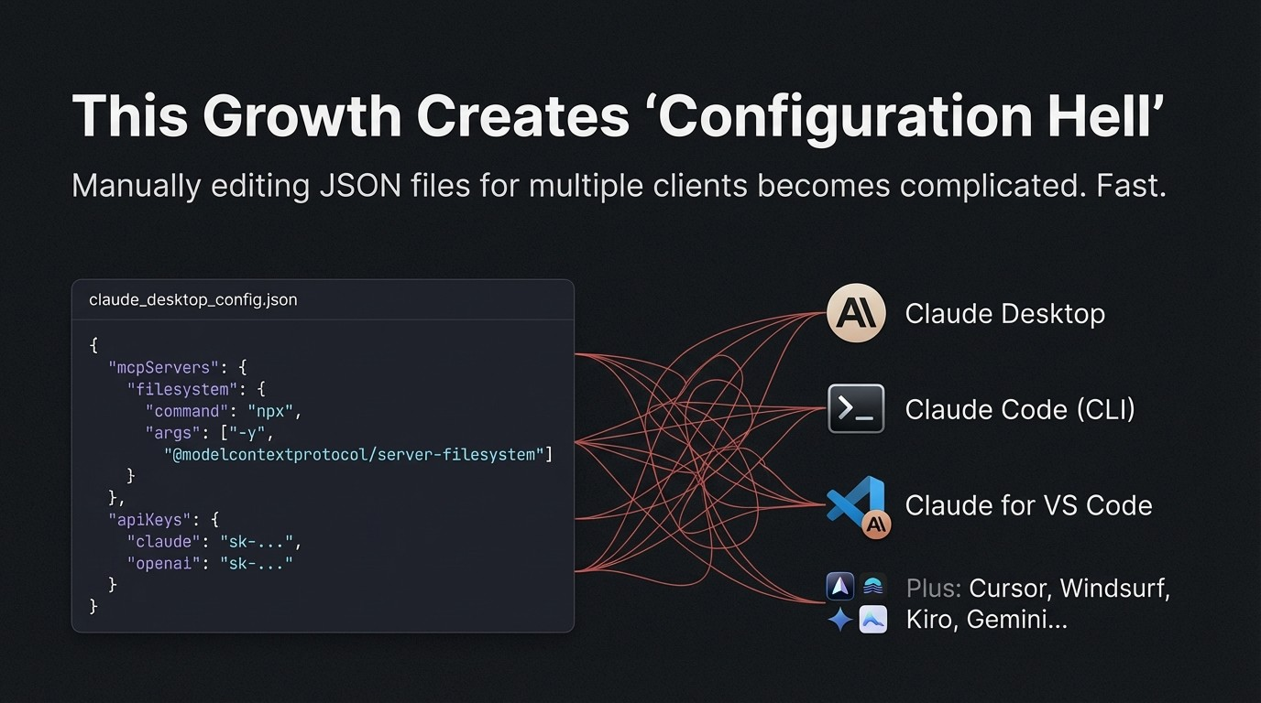

Slide 6
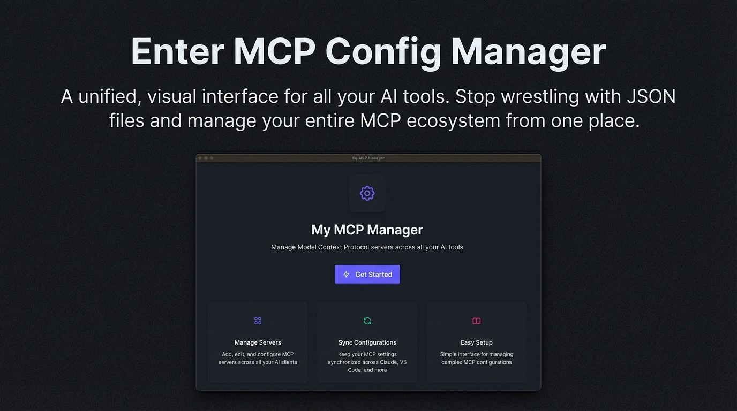

Slide 7
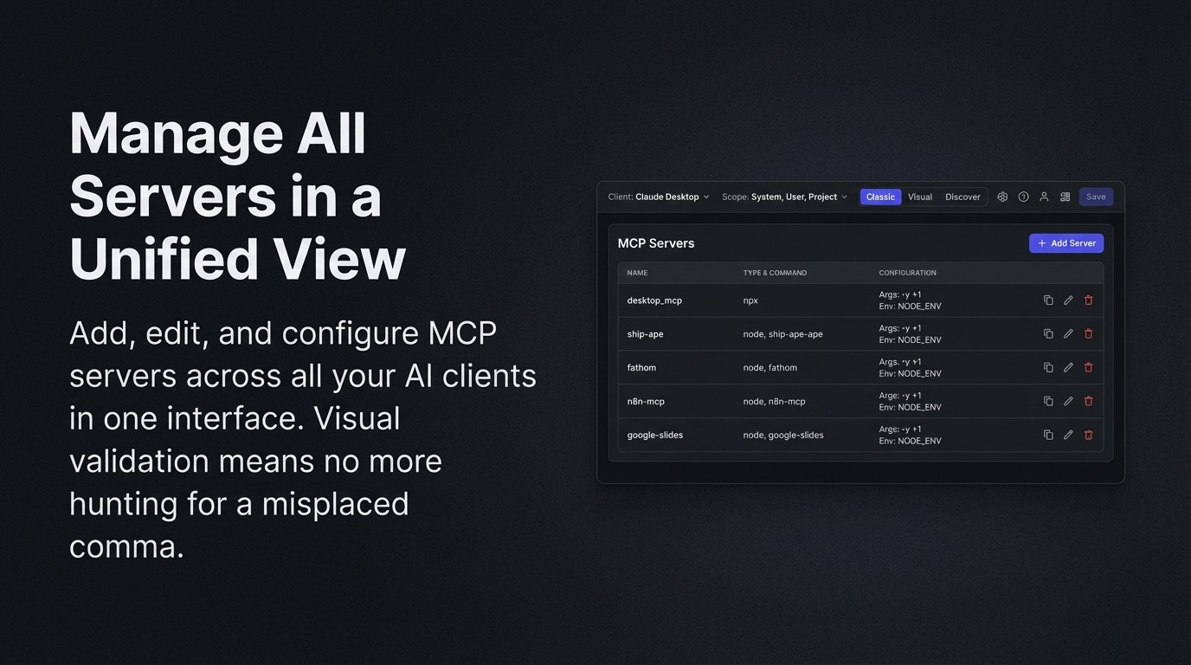

Slide 8

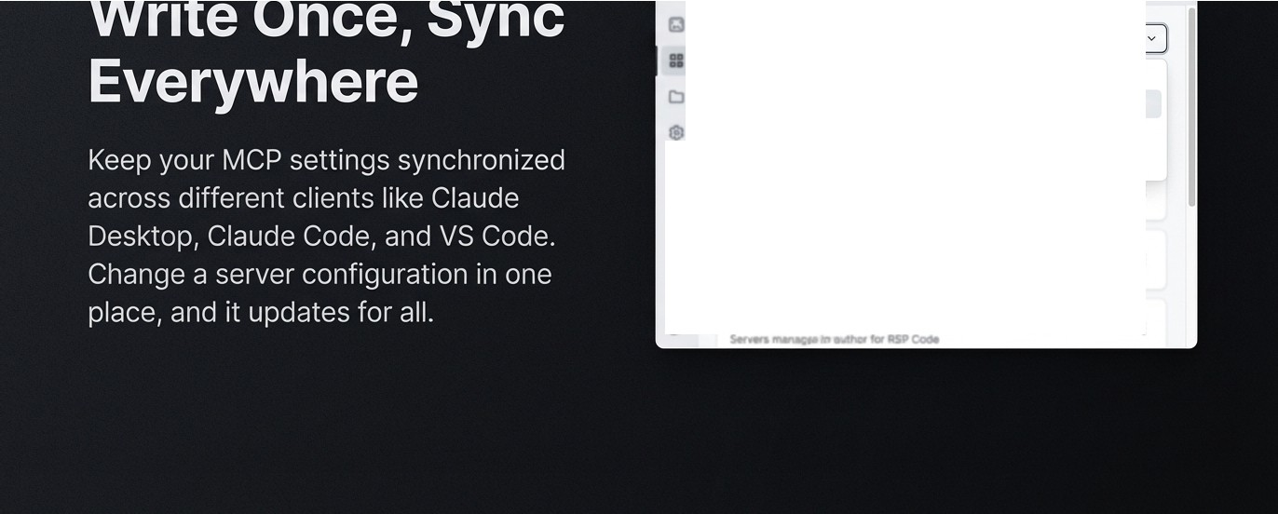
Server Catalog (
server:;)
Client: [ Select a client
Q Search...
Scope. System User
Installed Clients
Claude Desktop ✓
Project
Claude Code ✓
VS Code✓
0 OpenAI
t.otcr_...n _,.ro,aiw:s.�u,p,
••
•
CJ files_mq,
s.-..
•
•
Q)
0
fllN..Jnc:p
•
•

Slide 9
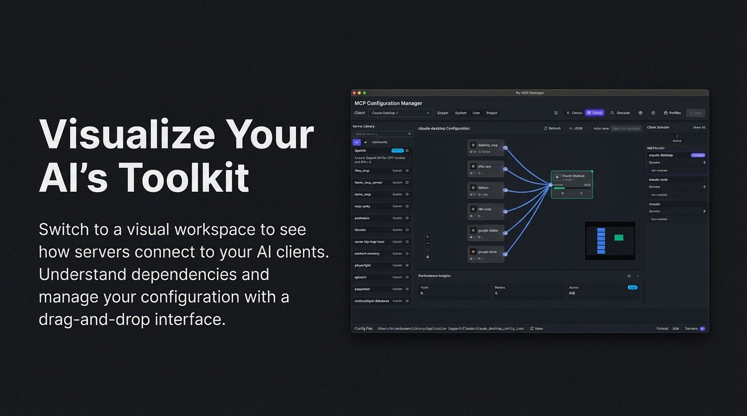

Slide 10
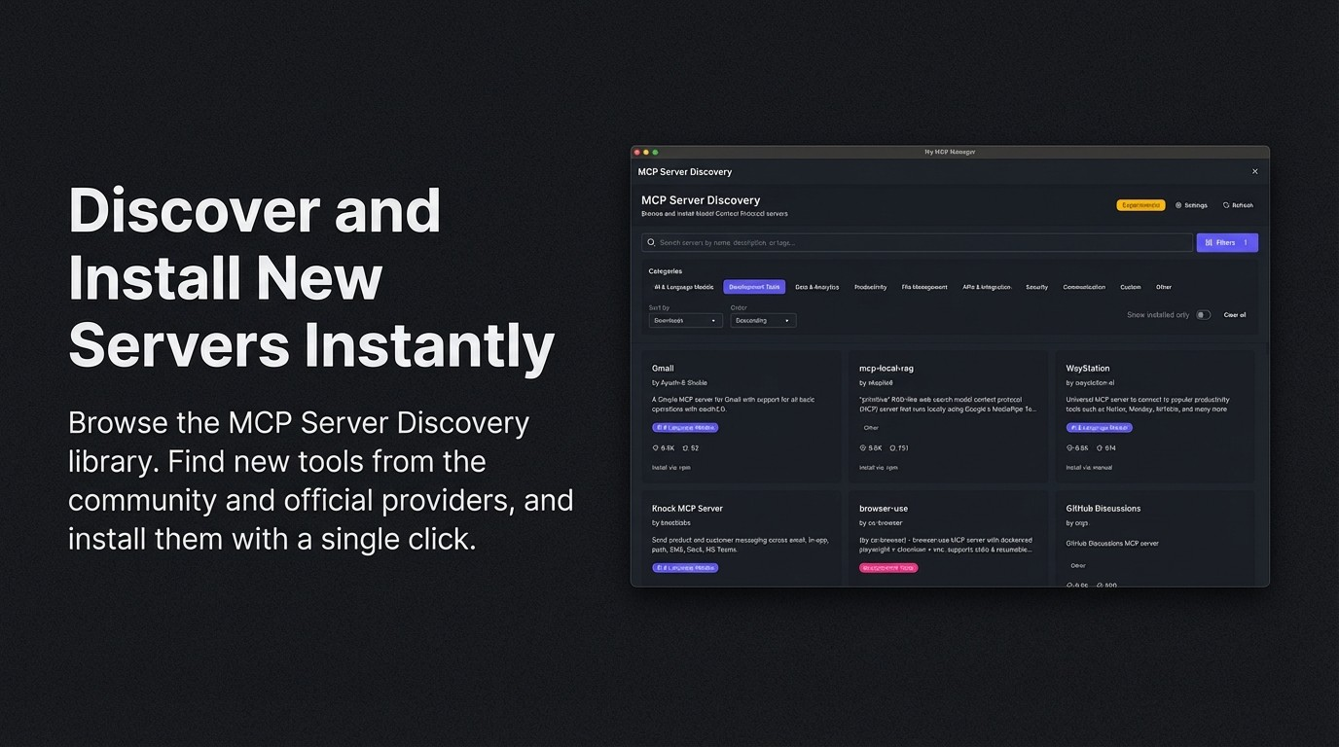

Slide 11
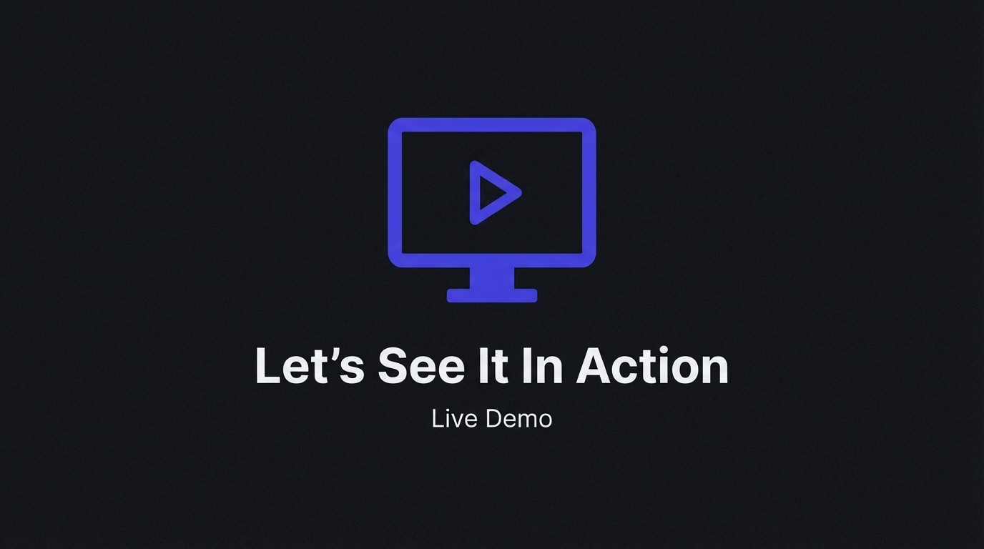

Slide 12
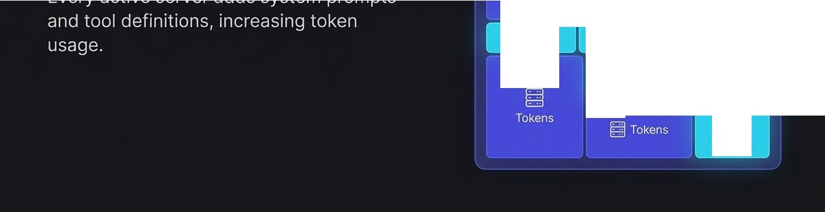
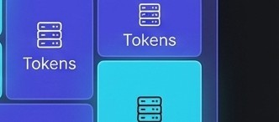
Beyond Configuration:
Context Window
The Context TheContomy
-
BJ Tokens
....
--
-
la Tokens
Bl
Tokens
Tokens

Slide 13
The Hidden Cost
0
of Context
0
Performance Insights
With multiple active servers, token
0
Tools
Tokens
usage can climb rapidly. Too many
75
20,212
•
servers leads to slower inference,
0
higher costs, and potentially lower-quality responses.

Slide 14
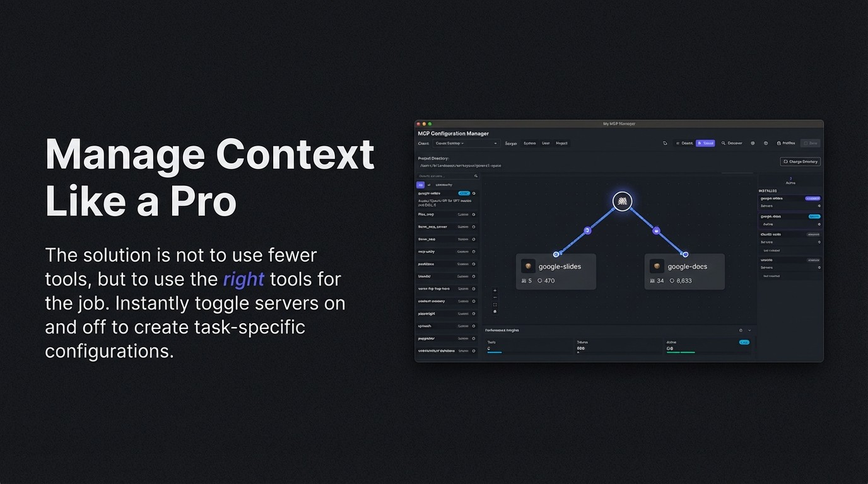

Slide 15
A Tale of Two Agents
We use different Al agents and server configurations for different phases of development. The MCP Config Manager makes switching between these contexts seamless.
Planning
Building

Slide 16
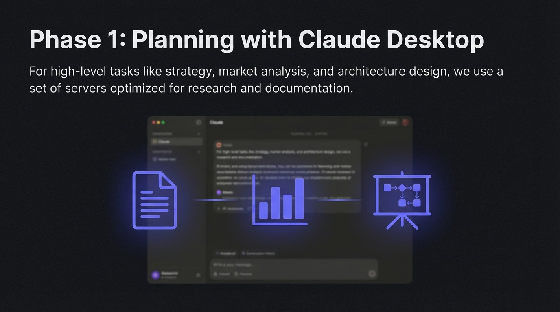

Slide 17
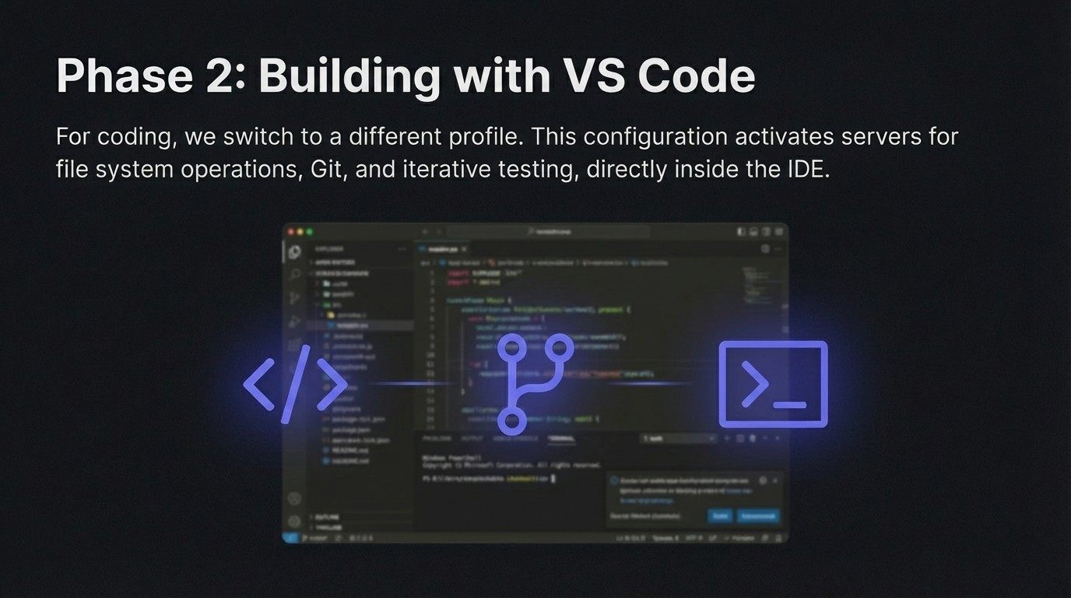

Slide 18
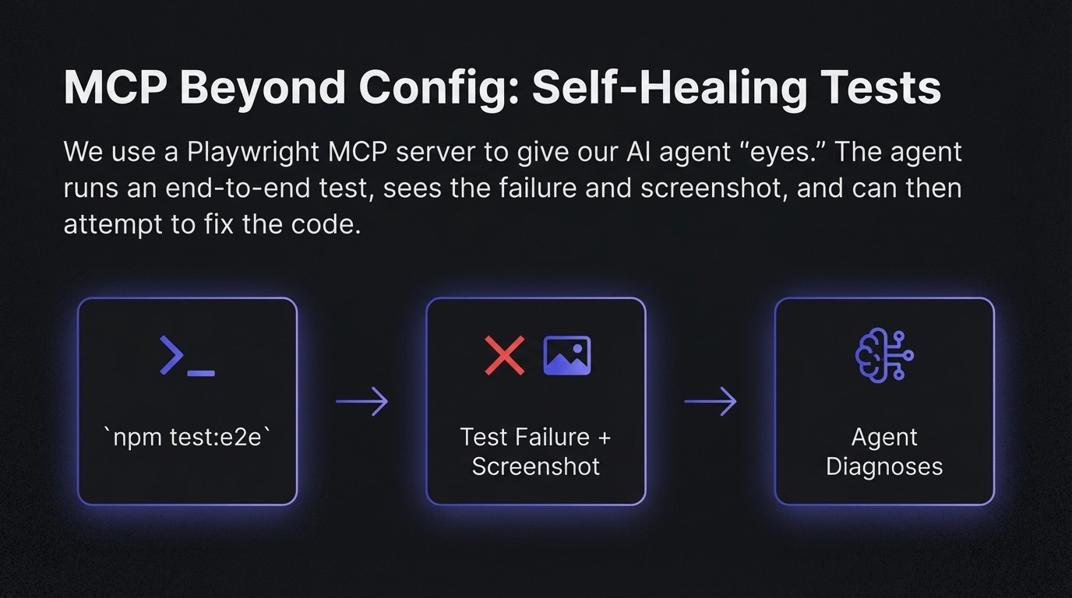

Slide 19
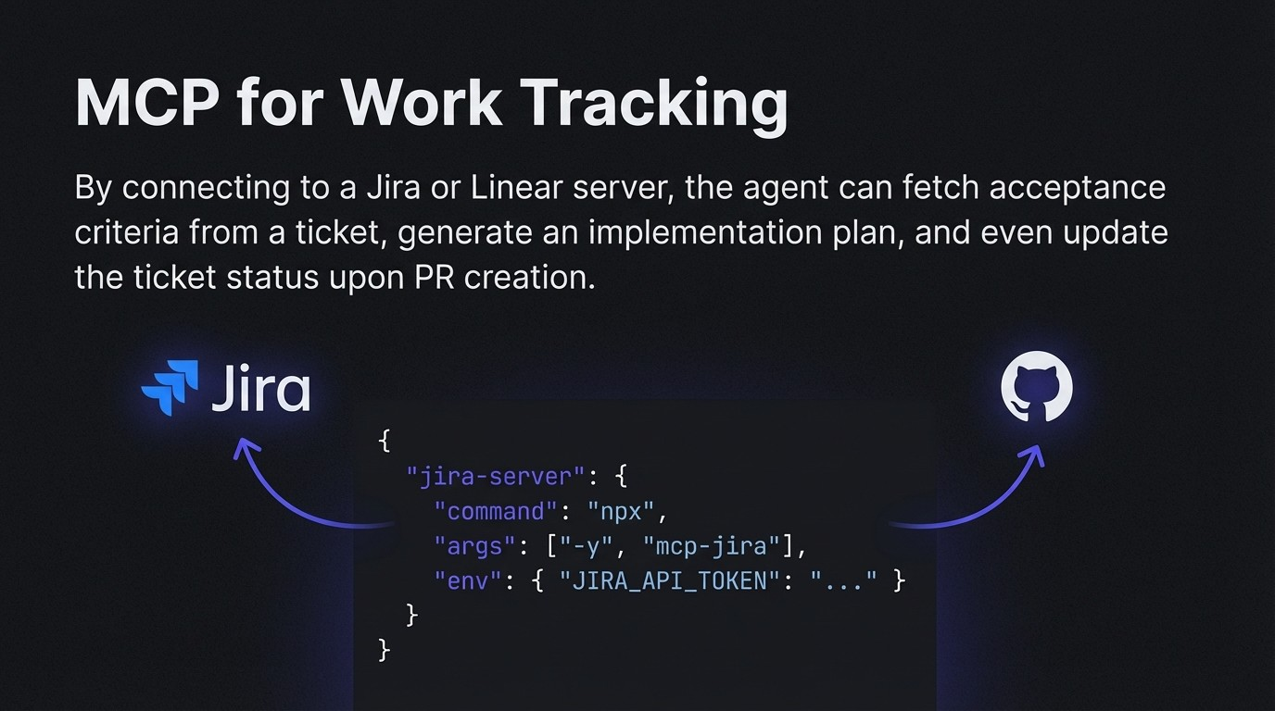

Slide 20
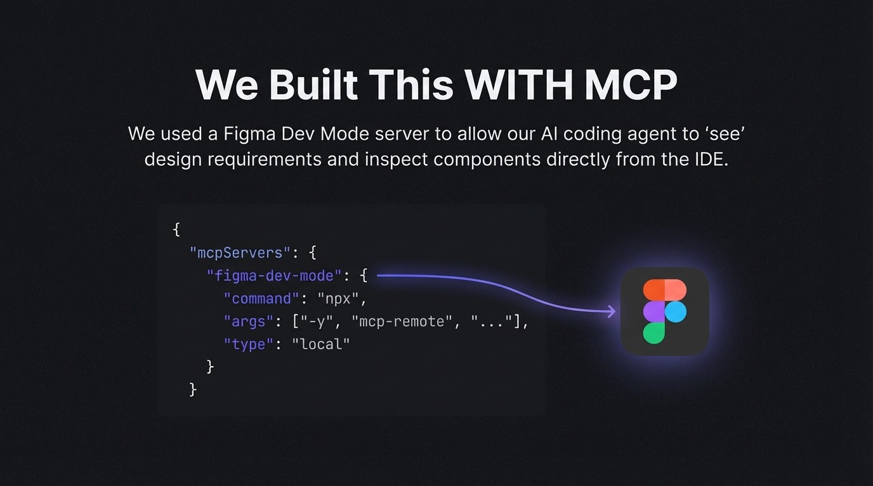

Slide 21
