Slide 1
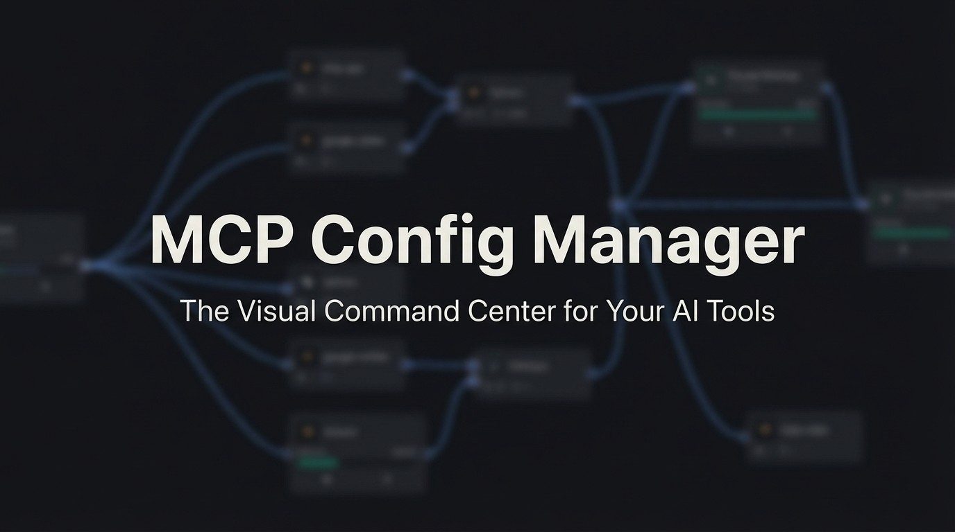

Slide 2
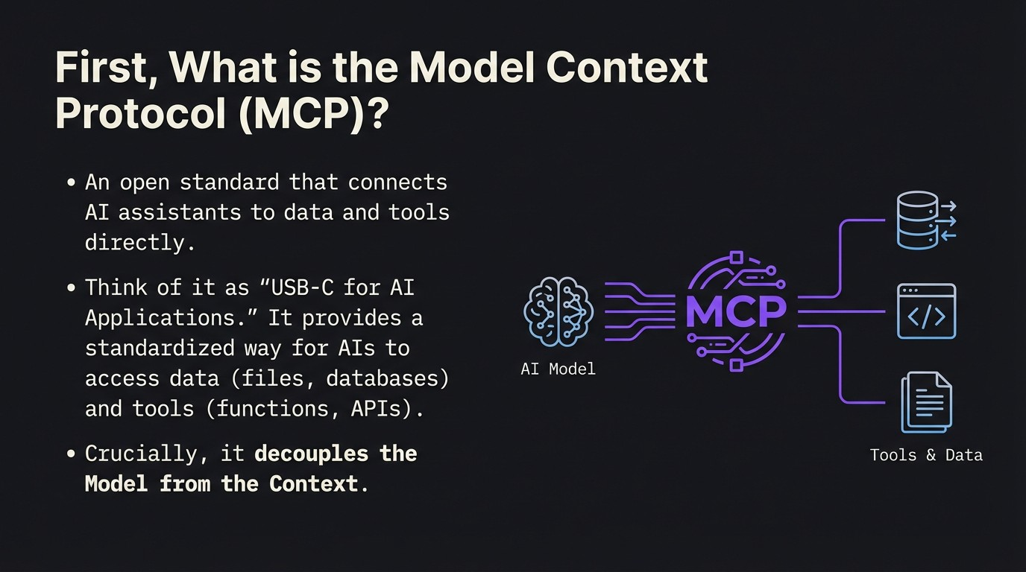

Slide 3
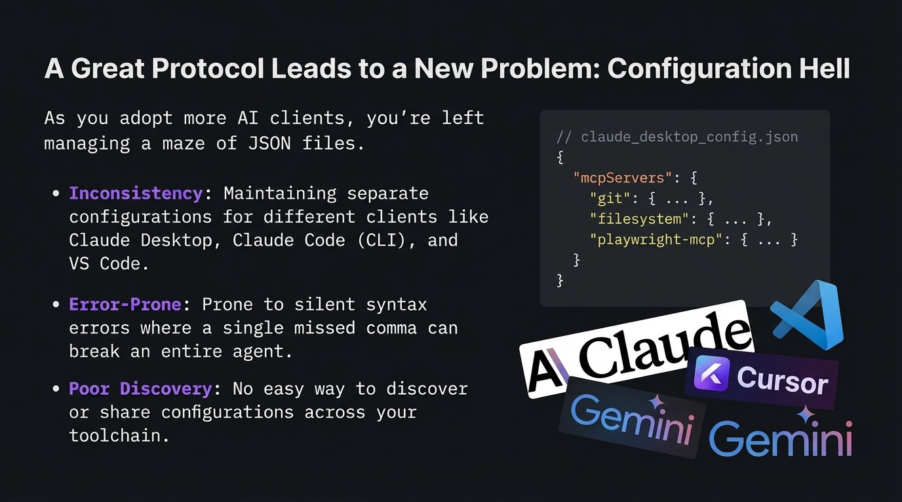

Slide 4
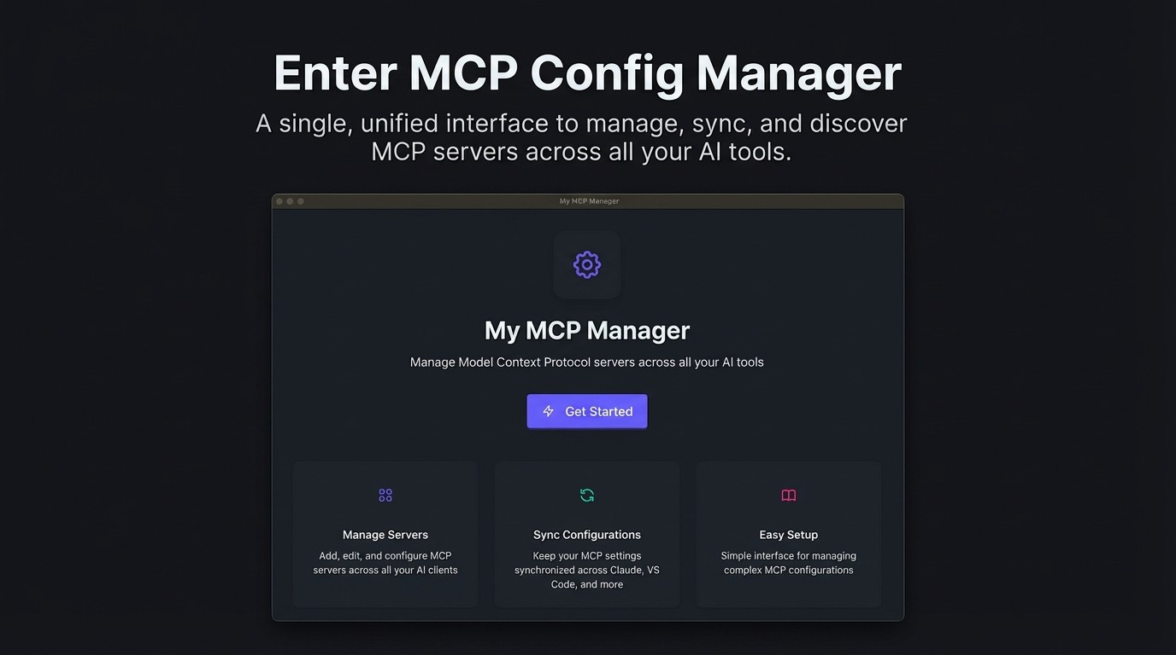

Slide 5
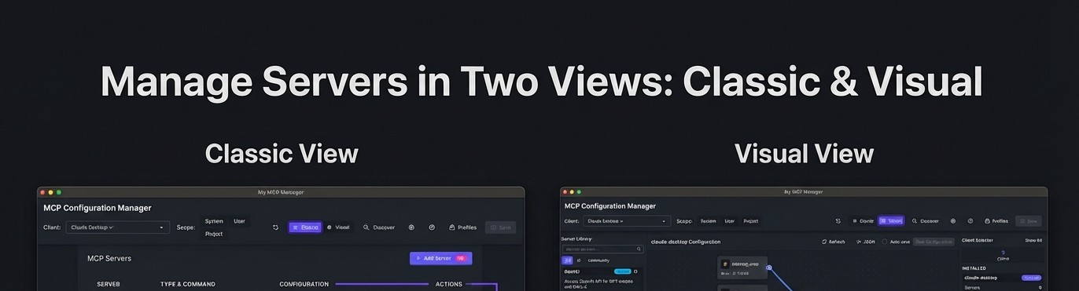
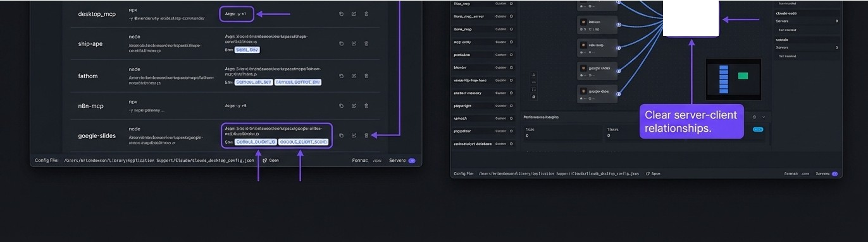
-
..
?:::-:��
-
L.
.

Slide 6
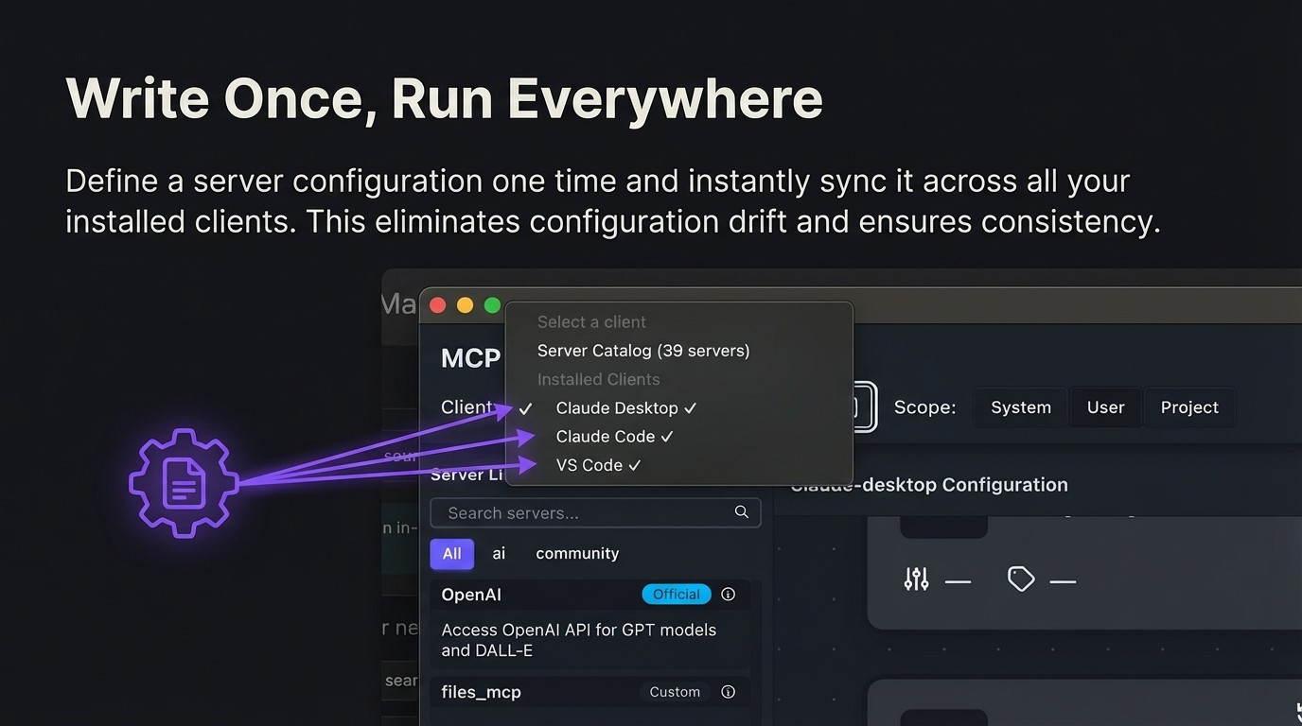

Slide 7
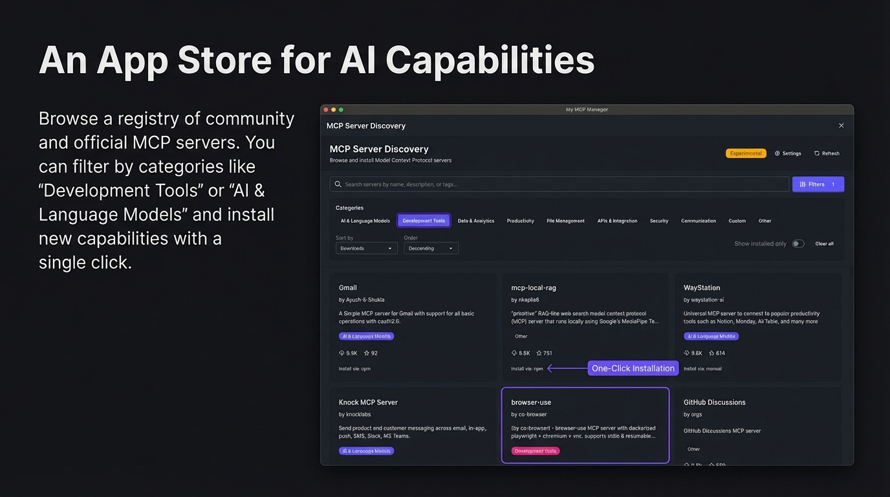

Slide 8
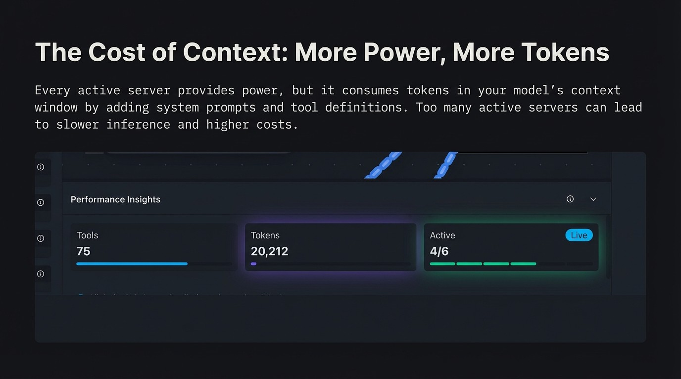

Slide 9
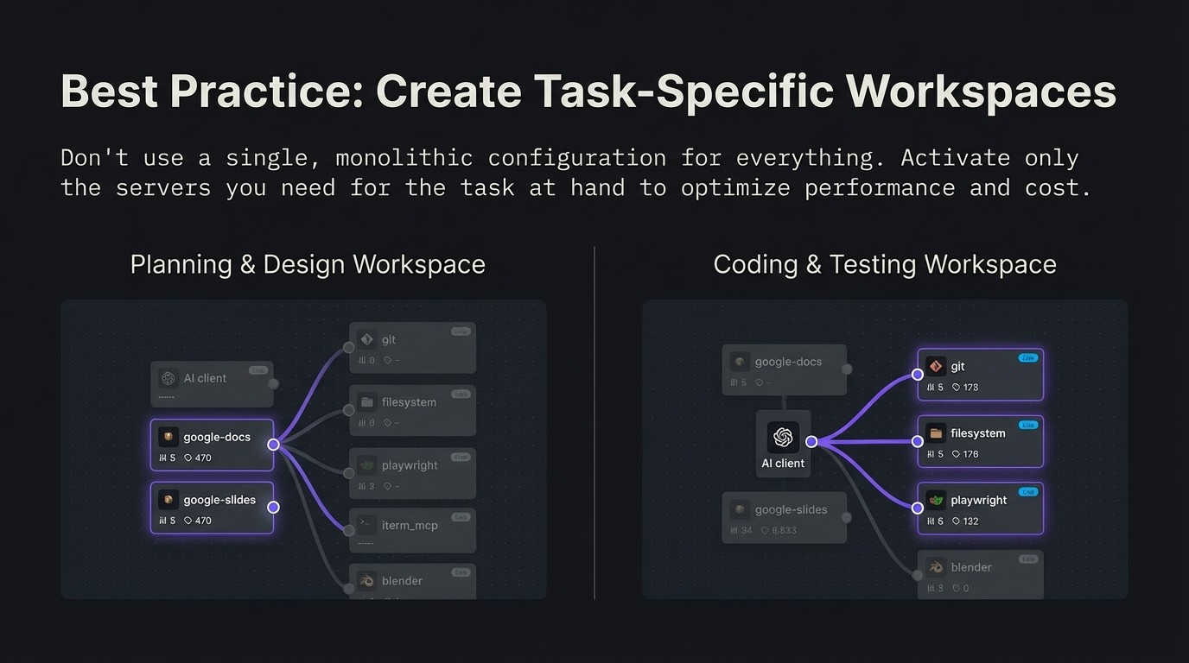

Slide 10
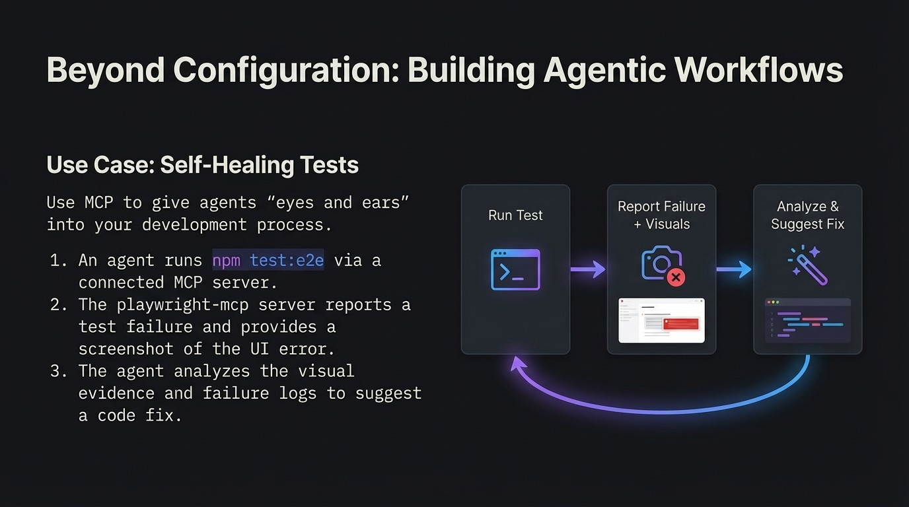

Slide 11
We Practice What We Preach
MCP Config Manager was built from the ground up using the very tools and protocols it manages.
For example, we used the 'figma-dev-mode' MCP server to allow the AI coding agent to 'see' design requirements directly and translate them into code.
// .mcp.json (Actual Project Config)
{
"mcpServers ¹¹: {
' figma-dev-mode : {
1 11
¹¹command'¹:
11_{npx}11,
''aigs'': [''-y'¹,
''mcp-remote'',
II...Il
,
f
¹¹type¹¹: ¹¹local¹¹
}
}
}

Slide 12
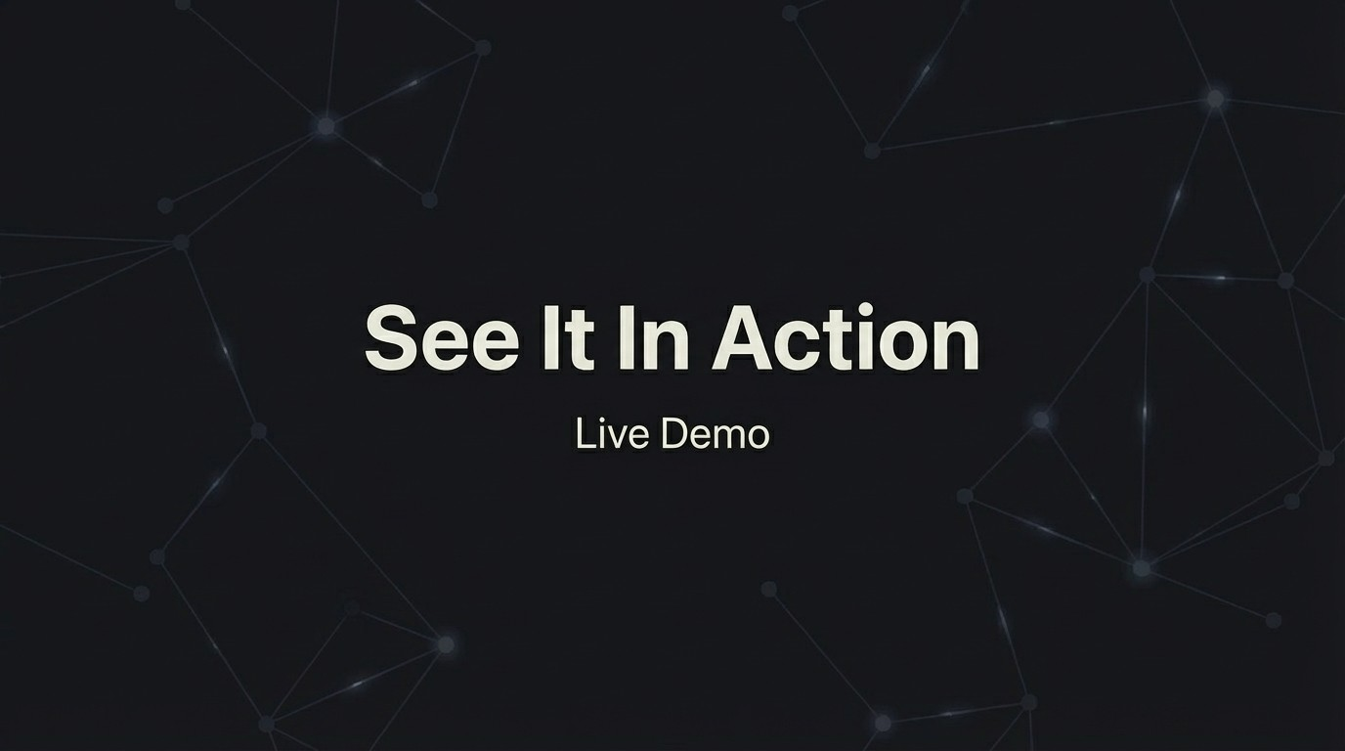

Slide 13
