Slide 1
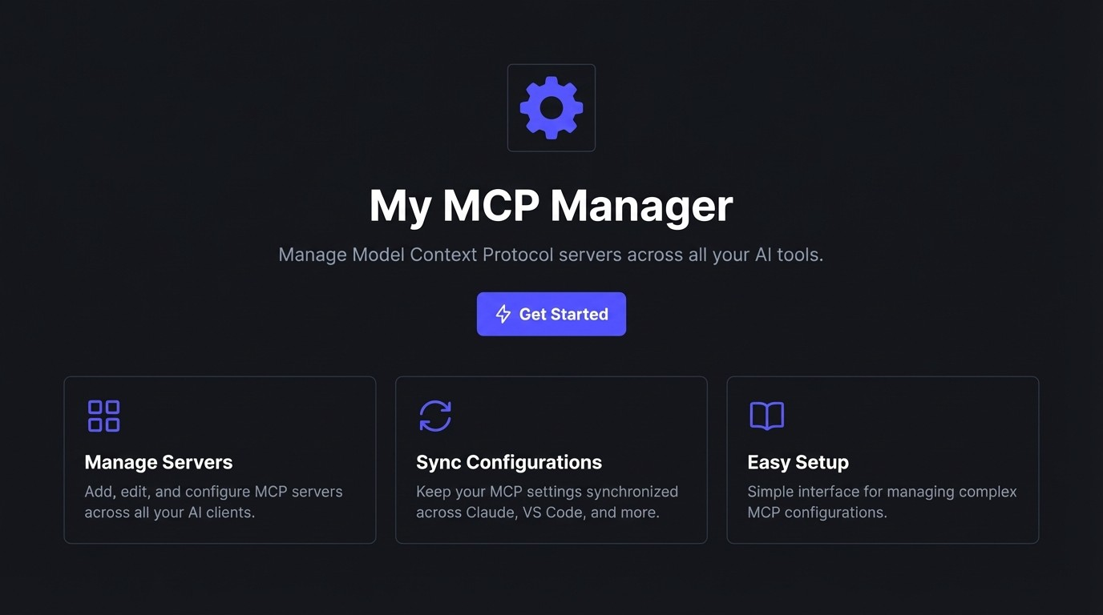

Slide 2
What is the Model Context Protocol (MCP)?
An open standard that connects Al assistants to systems directly. It decouples the model from the context.
Think ''USB-C for Al Applications.''
A standardized way for Als to access:
� Data (files, databases)
� Tools (functions, APis)

Slide 3
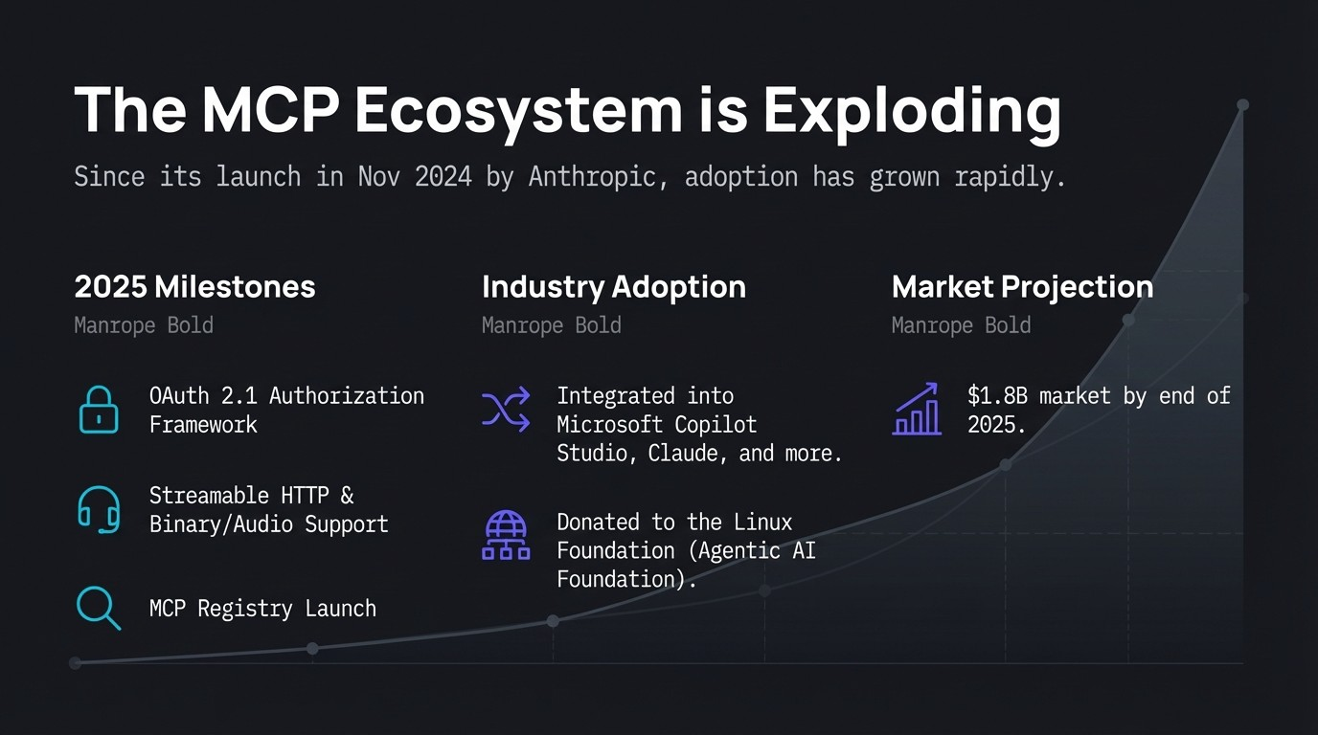

Slide 4
This Growth Creates 'Configuration Hell'
// claude_desktop_config.json
{
"mcpServers" : {
llgitll: {
¹¹command¹¹:
¹¹npx¹¹
,
¹¹args¹¹:
[ -y 1
11 11
¹¹mcp-git¹¹
] I
¹¹type¹¹:
¹¹local¹¹
,
¹¹description¹¹
:
11
11
•••
}
}
}
As you adopt more AI tools, you have to manage more configuration files.
One file down, six to go...

Slide 5
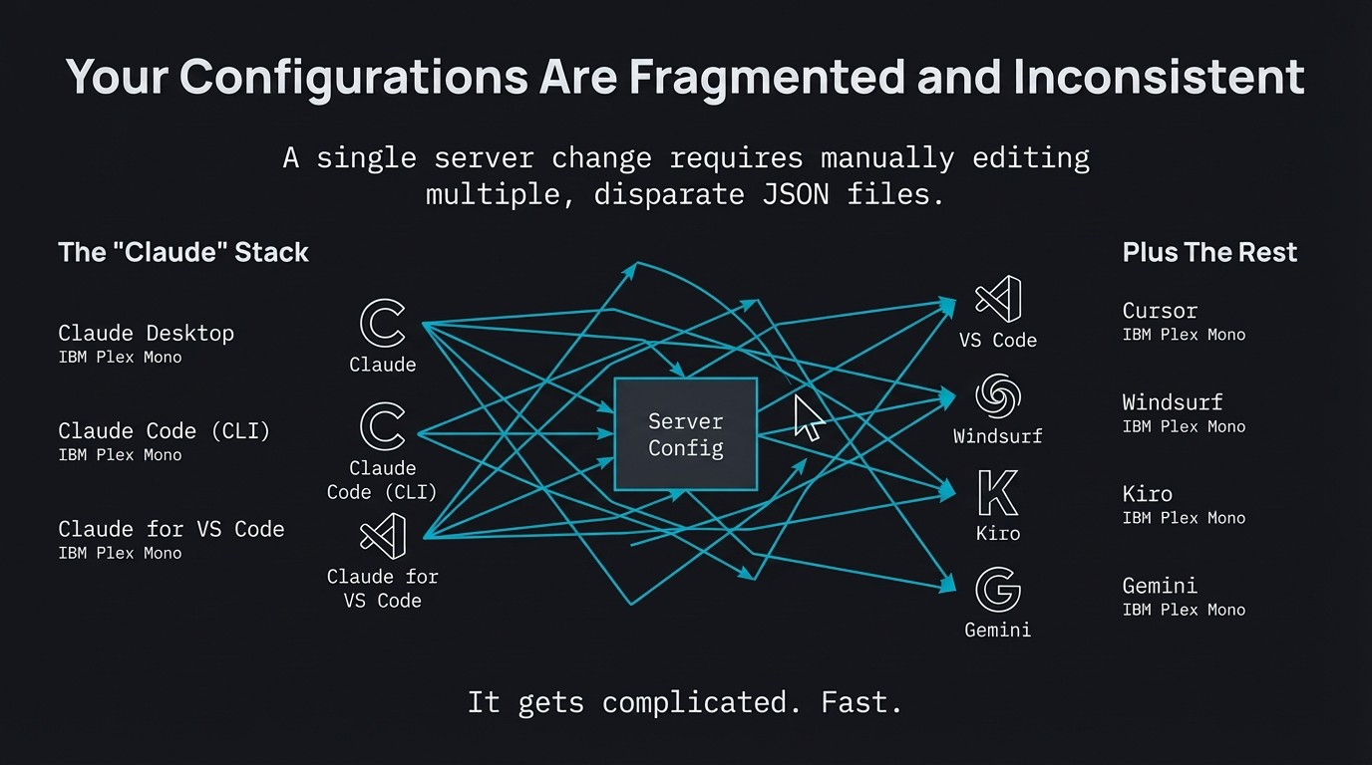

Slide 6
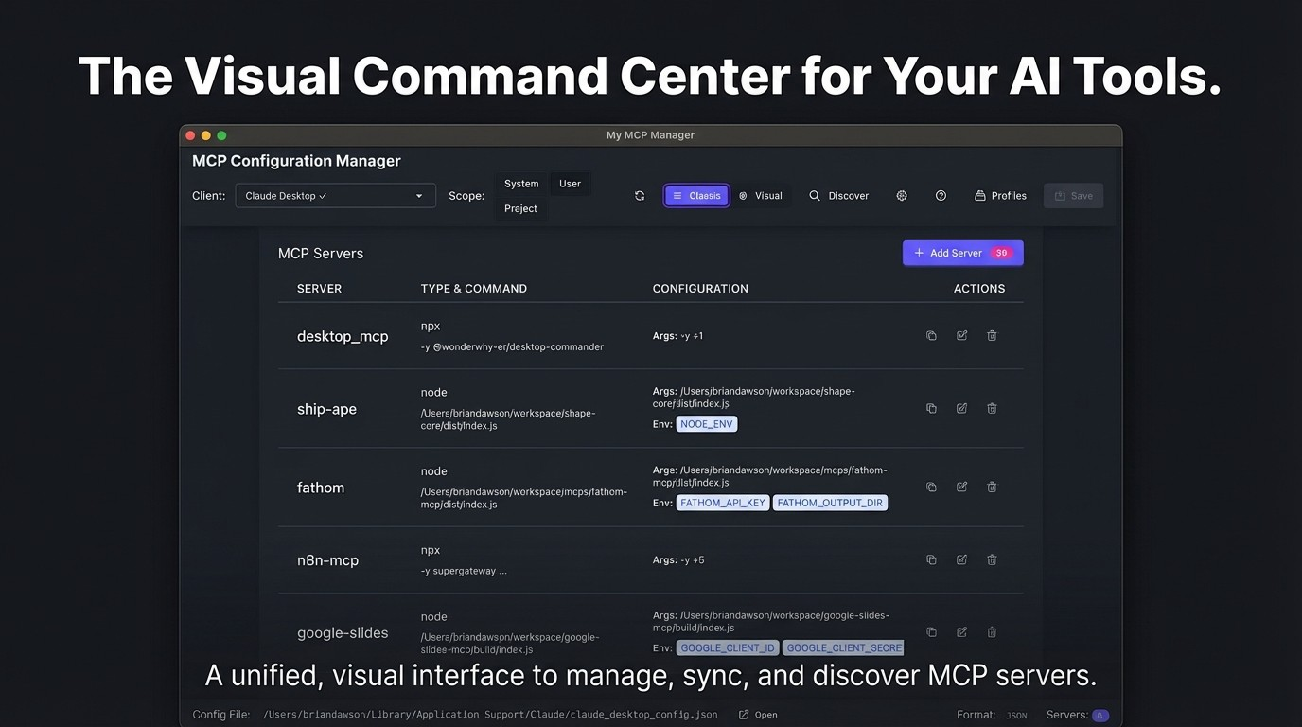

Slide 7
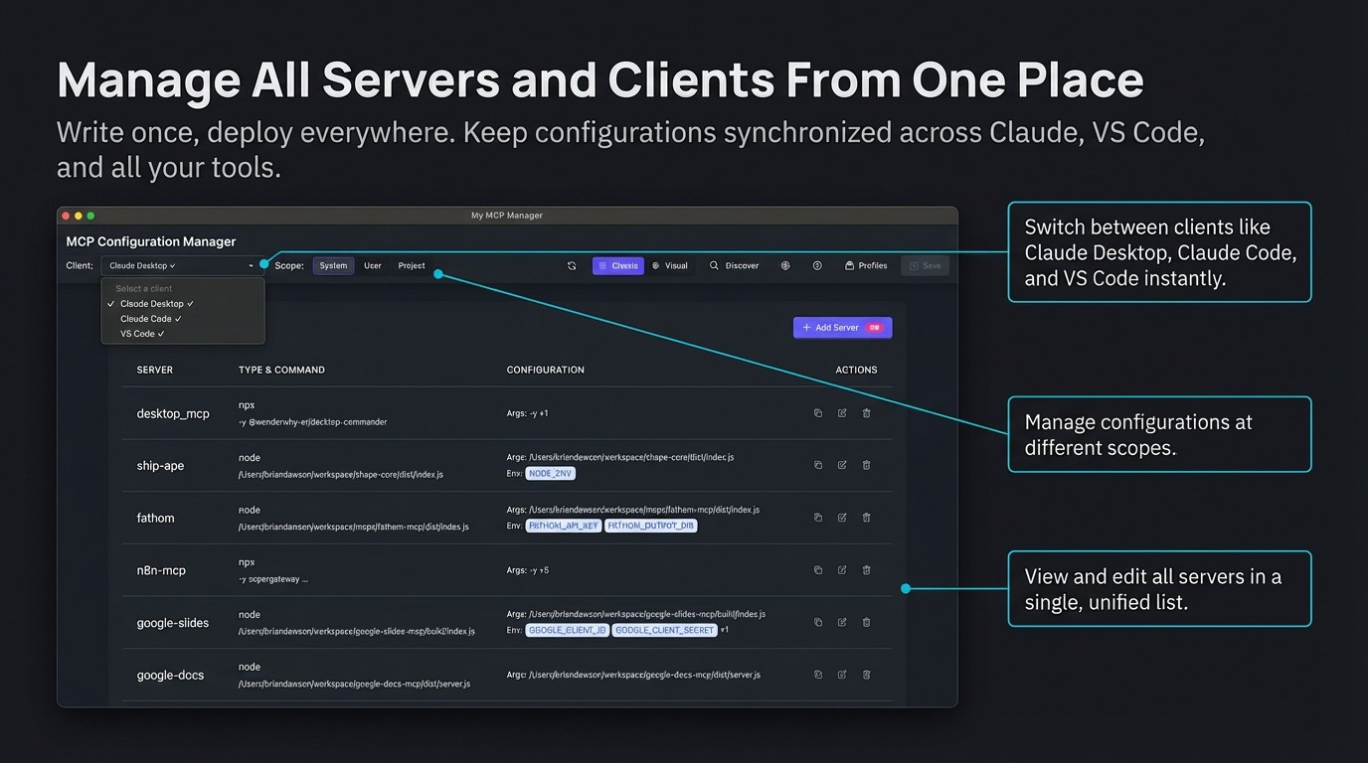

Slide 8
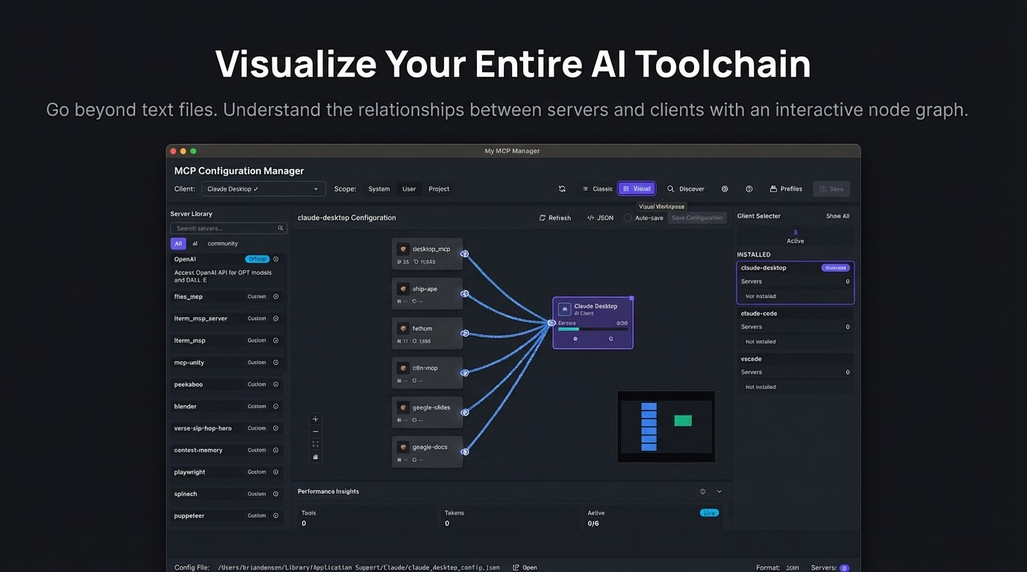

Slide 9
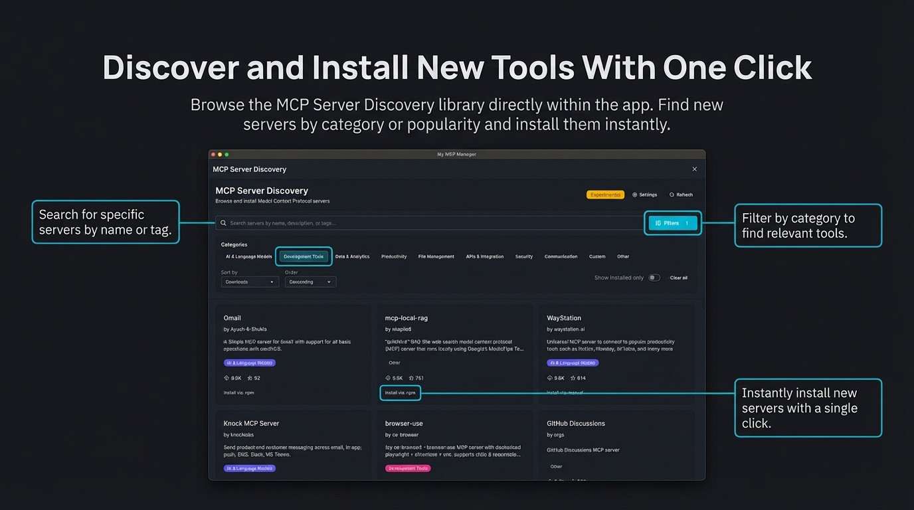

Slide 10
Master the 'Context Economy'
The Problem
Performance Insights
0
Every active server consumes your
model's context window with
system prompts and tool definitions.
Too many servers lead to slower
Tools
Tokens
Active
Live
inference and higher costs.
75
20,212
4/6
--·---
The Solution
The Config Manager provides live performance insights, helping you make informed decisions.

Slide 11
Instantly Tailor Your Al for Any Task
Create different server profiles for different phases of development to optimize context usage.
Phase 1: Planning � IBM Plex Mono Regular - Active Servers: 'google-slides' ' google-docs ' ' Jira-server ' ' ₋ ' Client: Claude Desktop |  | ' ' ' ' ' ' ' ' ' ' ' ' ' ' ' ' ' ' ' ' ' ' ' ' ' ' ' ' ' ' ' ' ' ' ' ' ' ' ' ' ' ' ' ' ' ' ' ' ' ' _{r ml google-slides} ' ' ' ' ' ' ' ' ' ' ' ' ' ' " •-,·• ' ' ' ' ' I ' % ' ' ' ' ' ' ' _{i} 1K Tokens: 470 Version: 2.1.0 ' ' ' ' ' ' ' ' ' ' ' ' ' ' ' ' ' ' ' ' ' ' ' ' ' ' ' ' .\ ' ' ' ' ' ' ' ' ' ' ' ' ' ' ' ' ' ,., ' ' .. ' ' ,.', ' ₋ ' ' . ' ' ' ' ' ' ' ', ' ····-·-·- ----- ' ' ' ' ' ' ' .,,.' ^{I '} ' ' google-docs ••-----�_{, Claude Desktop} ' ' ' ' ' ' ' ' ' , ' ' ^{I Ill Tokens: 34} Versi����1:,� . . . . ;I . . ' ' _{'-··· -----} J ' ' ' ' ' ' ' ' ' ' ' ' ' I ' ' ' ' ' ' ' ' ' ' ' ' ' ' ' ' ' ' ' ' ' _{l}' ' ,.I,. ' ' ' ' ' ' ' ' ' ' ' ' ' ' ' ' ' ' ' ' ' ' ' ' ' � jira-server _{•·-"} . ' . ' ' ' ' ' ' ' ' ' ' ' ' Ill Tokens: 103 Version: 2.10 ' ' ' ' ' ' ' ' ' ' ' ' ' ' ' ' ' ' ' ' ' ' ' ' ' ' ' ' ' ' ' ' ' ' ' ' ' ' ' ' ' ' ' ' ' ' ' ' ' ' ' ' ' ' ' ' ' ' ' ' ' ' ' ' . ' ' ' ' . '
Phase 2: Building 7: IBM Plex Mono Regular Active Servers: ' git-mcp' 'filesystem-mcp', ' playwright-mcp' Client: VS Code
'

Slide 12
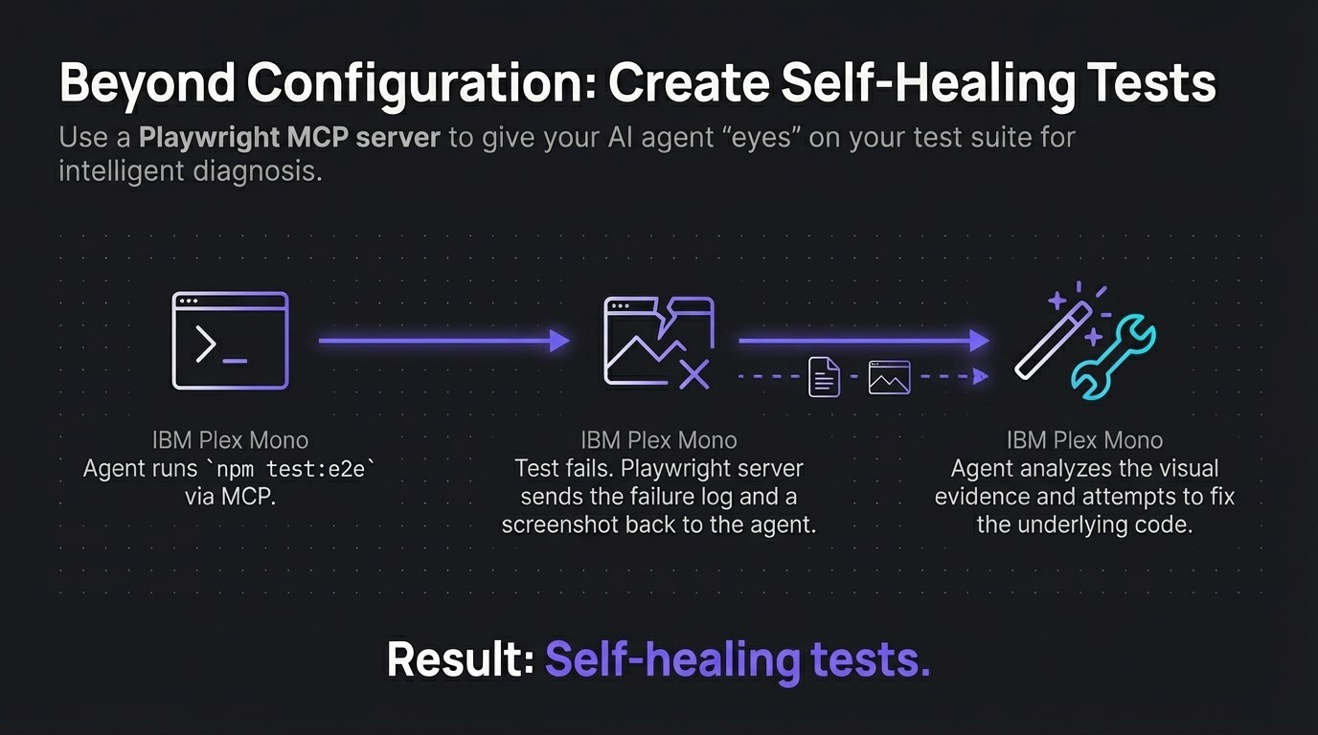

Slide 13
We Built This *With* MCP
We practiced what we preach. This project was built using the very same MCP server architecture it helps you manage.
// .mcp.json (Actual Project Config)
{
"mcpSeivers": {
"figma-dev-mode":
{
"command":
"npx",
"args": ["-y", "mcp-remote",
" ... "]
l
l
l
Key Tool Used:
A'
figma-dev-mode' MCP server.
Benefit:
This allowed our Al coding agent to 'see' design requirements directly, •
inspect components, and write code to match the design spec. •

Slide 14
