Slide 1
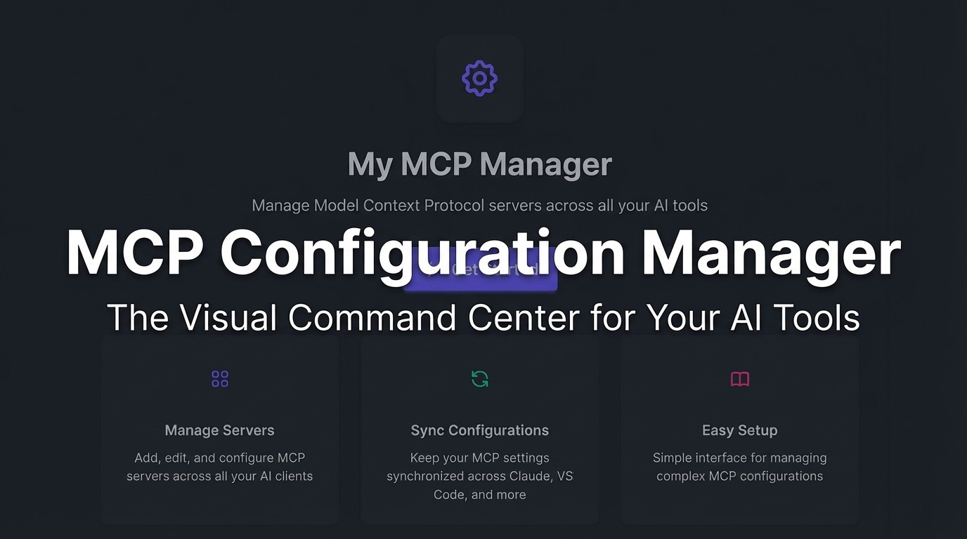

Slide 2
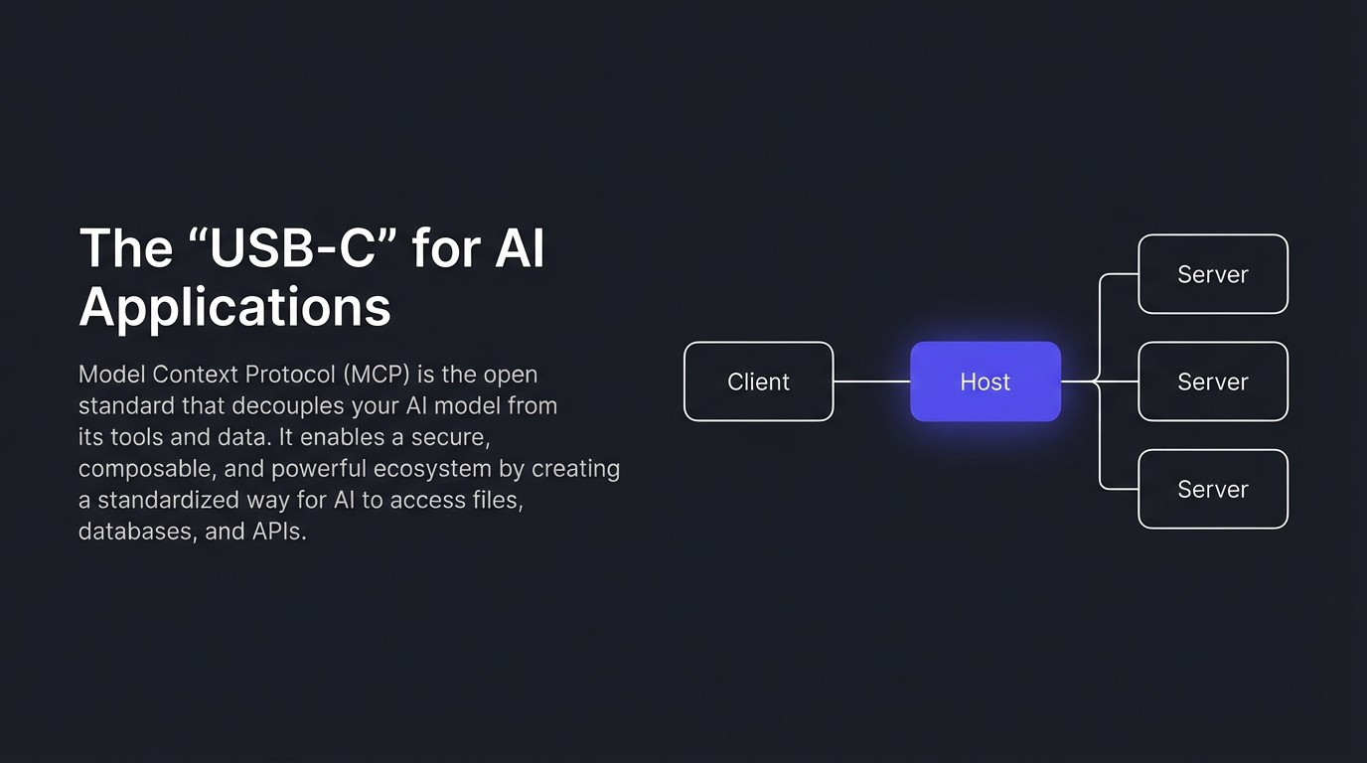

Slide 3
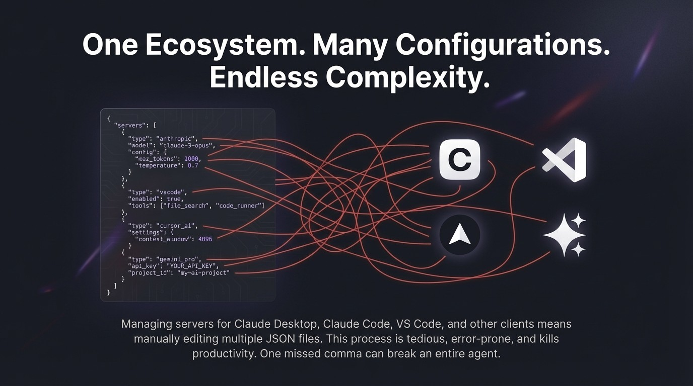

Slide 4
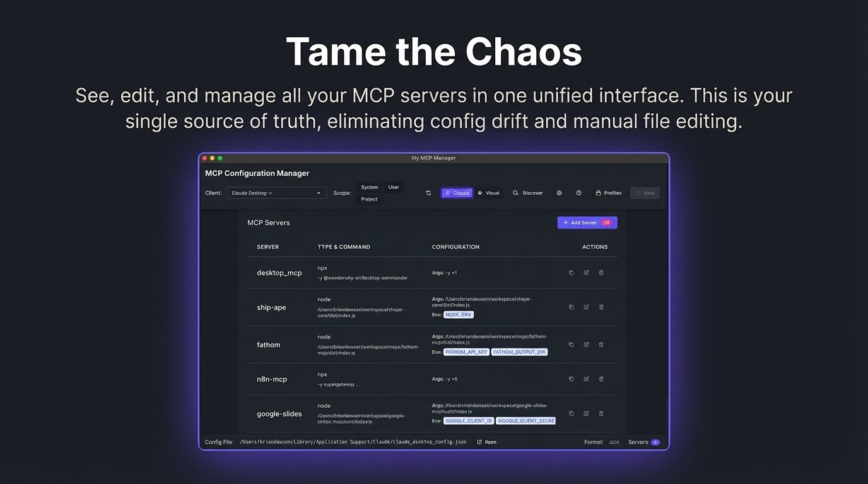

Slide 5
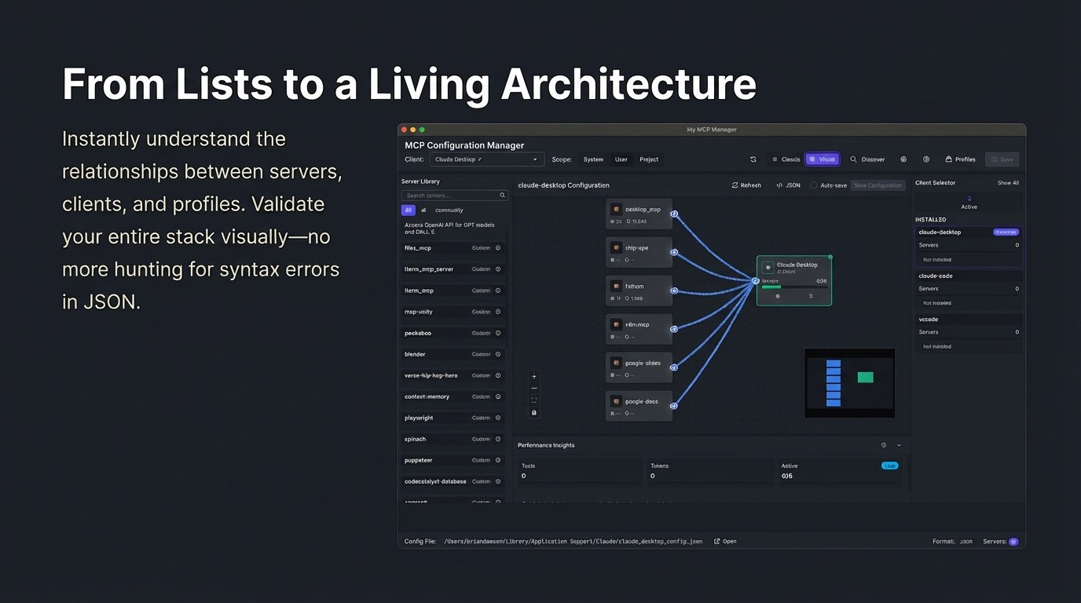

Slide 6
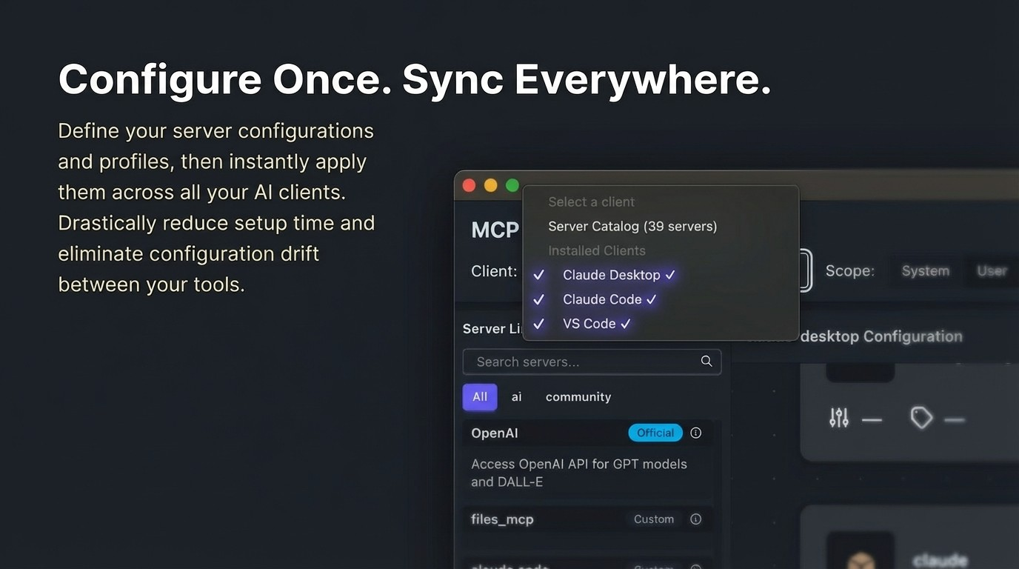

Slide 7
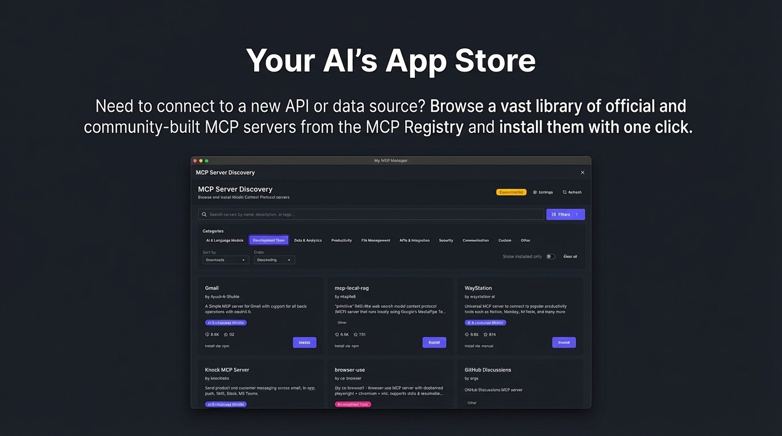

Slide 8
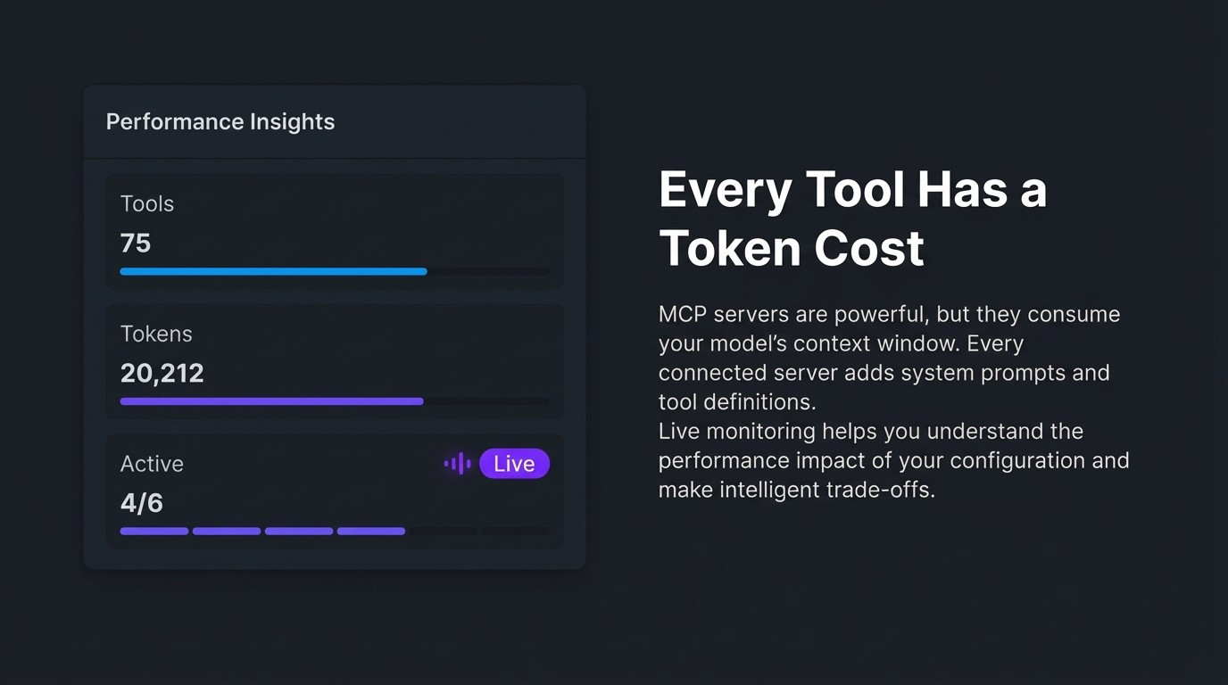

Slide 9
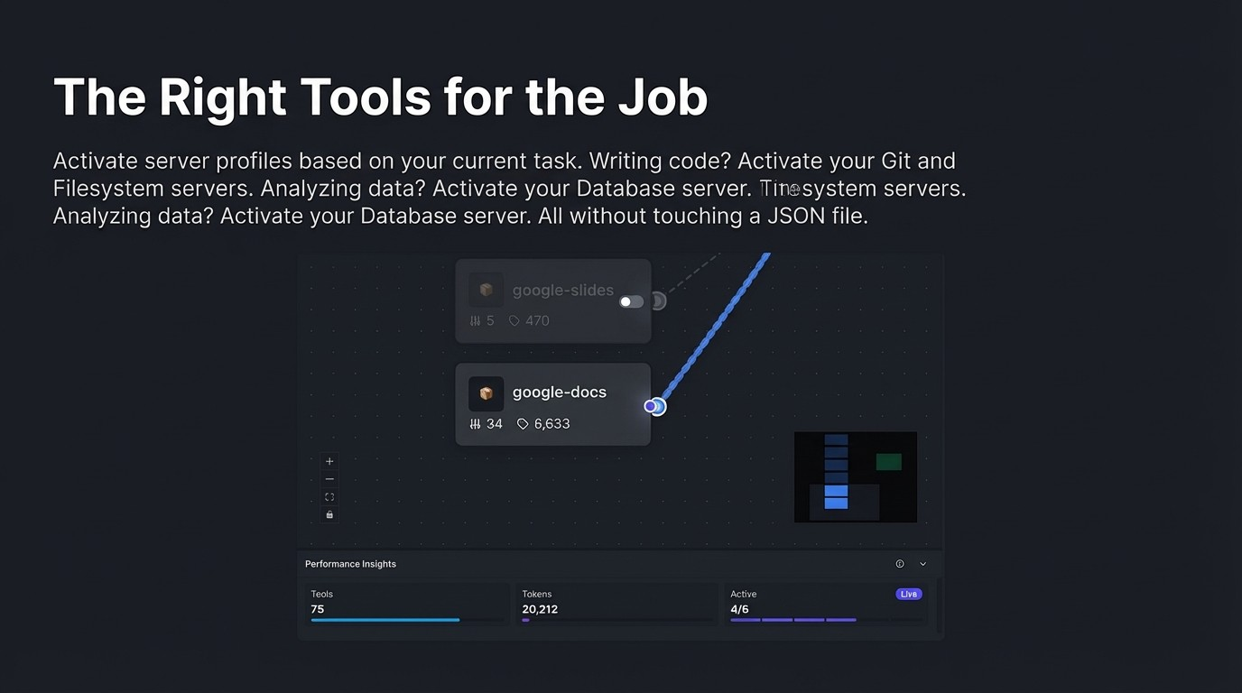

Slide 10
Supercharge the Entire Development Lifecycle
Use MCP to connect your entire toolchain. Let your agent read acceptance
criteria from a Jira ticket, diagnose a failed Playwright test by viewing the results and screenshot, or inspect a design in Figma.

Slide 11
,
,
// Actual Project Config
{
We Practice What We Preach
"mcpServers": {
"figma-dev-mode":{
The MCP Config Manager was built from the
"command": "npx",
"args": ["-y", "mcp-remote", "..."l'
ground up using Al agents powered by MCP
"type": "local"
servers. We used a figma-dev-mode server to
allow our Al coding assistant to "see" design
}
}
requirements directly, alongside Filesystem
}
and Git servers for context.
Get started at: github.com/itsocialist/mcp-config-manager

