Slide 1
MCP Config Manager
The Visual Command Center for Al Tools
Manage Servers
Sync Configurations
Easy Setup

Slide 2
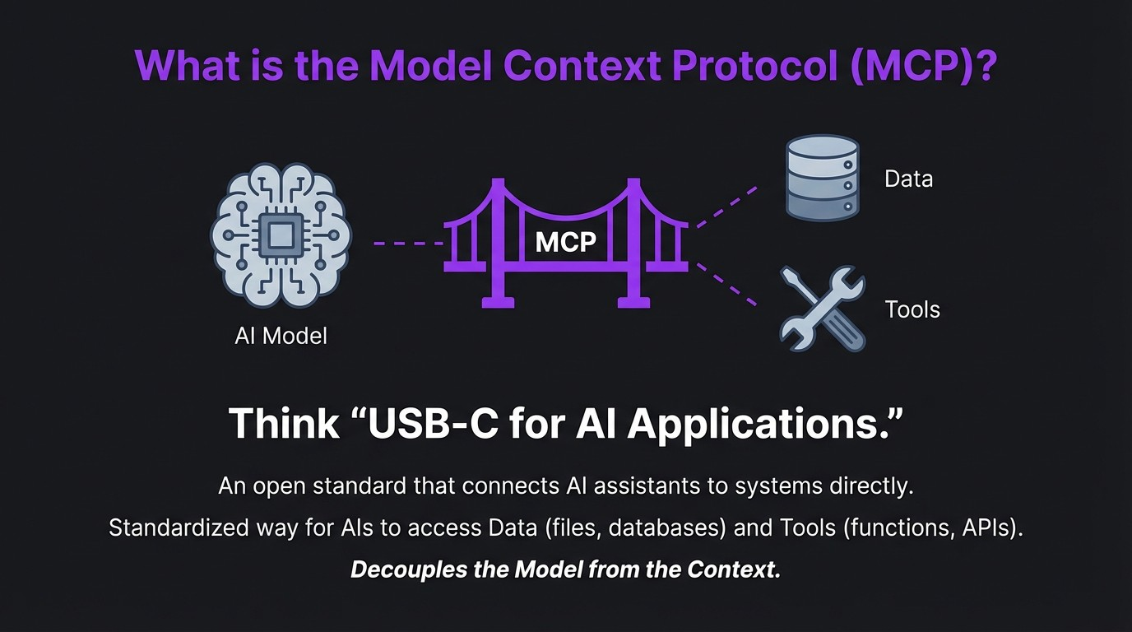

Slide 3
The MCP Ecosystem is Exploding.
Since its launch in November 2024, adoption has skyrocketed.
2025 Mi;estones Industry Adoption
OAuth 2.1 Authorization Framework
Integrated into Microsoft Copilot
(Security
Qi)
Studio, Claude, and more.
Streamable HTTP & Binary/Audio
Donated to the Linux Foundation
Support
0
(Agentic Al Foundation).
MCP Registry Launch (Discovery
,)
Projection: $1.8B market by end of 2025.

Slide 4
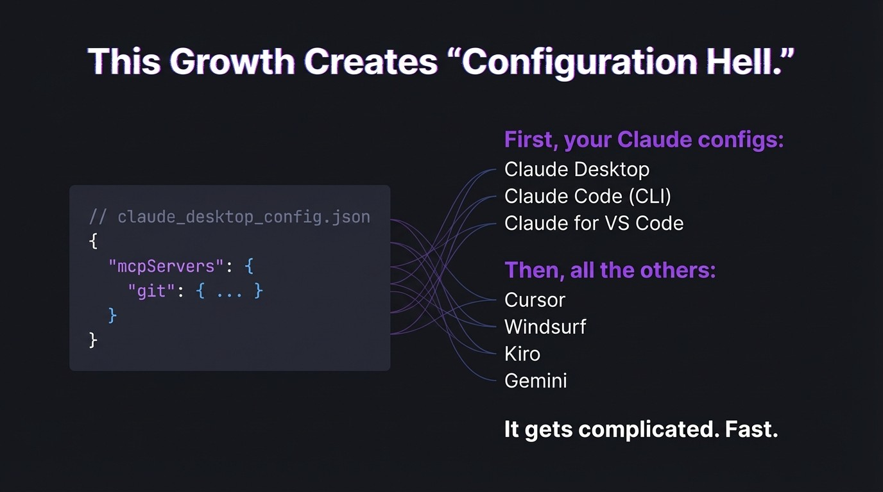

Slide 5
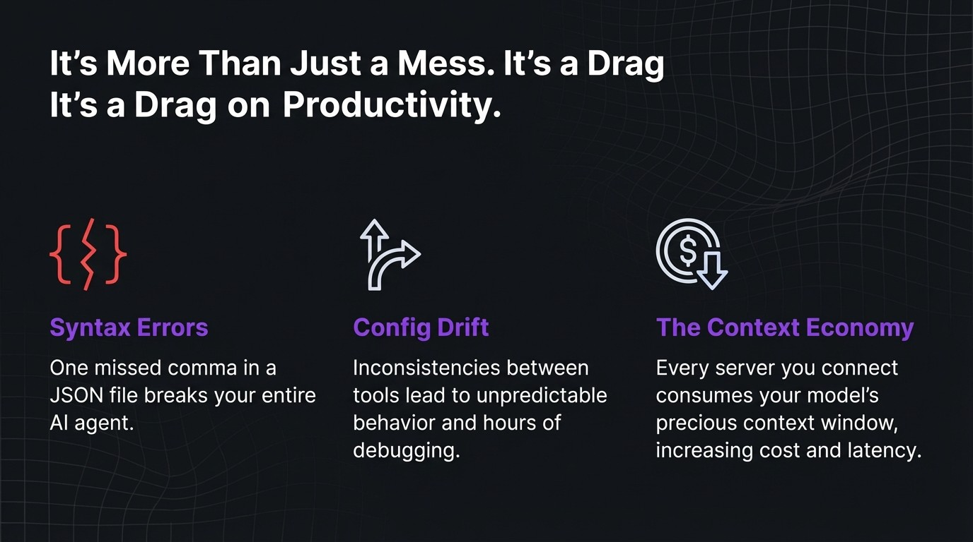

Slide 6
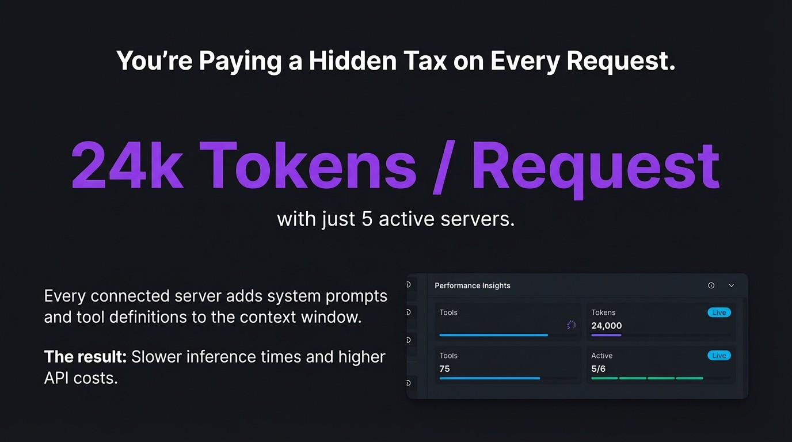

Slide 7
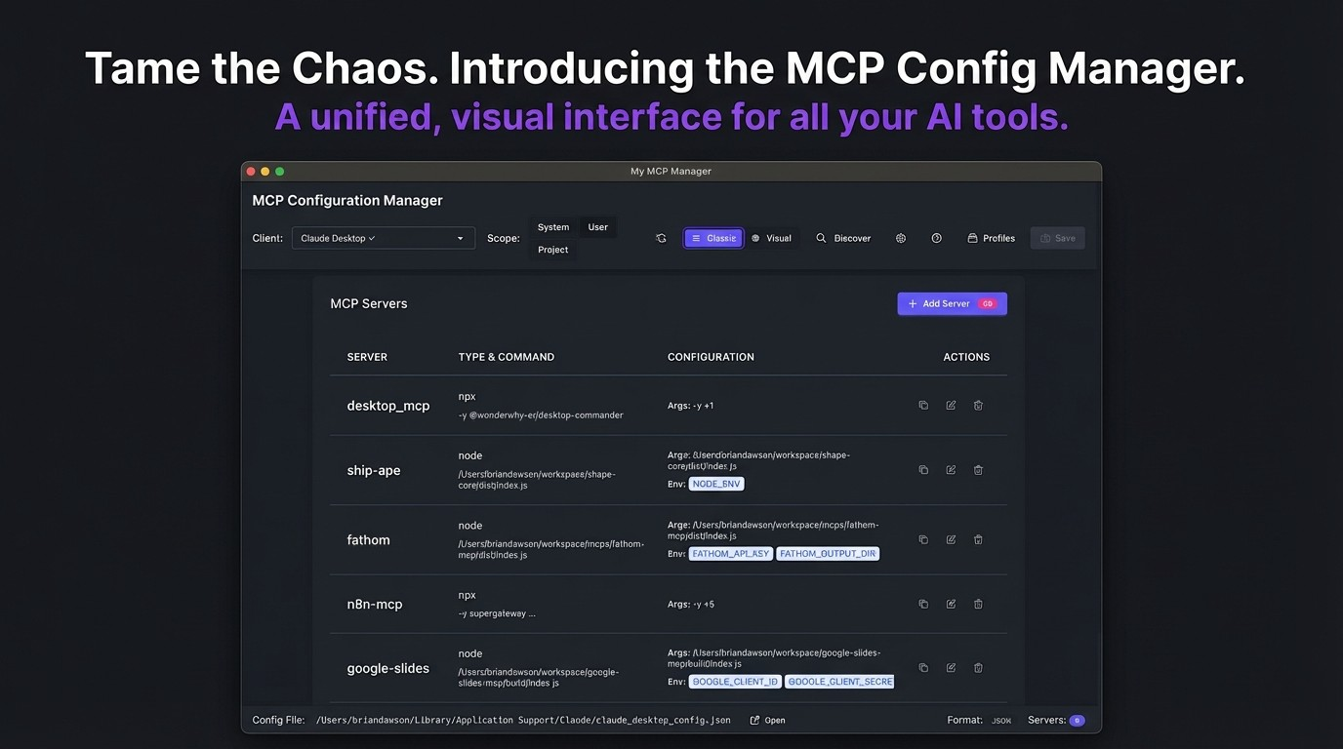

Slide 8
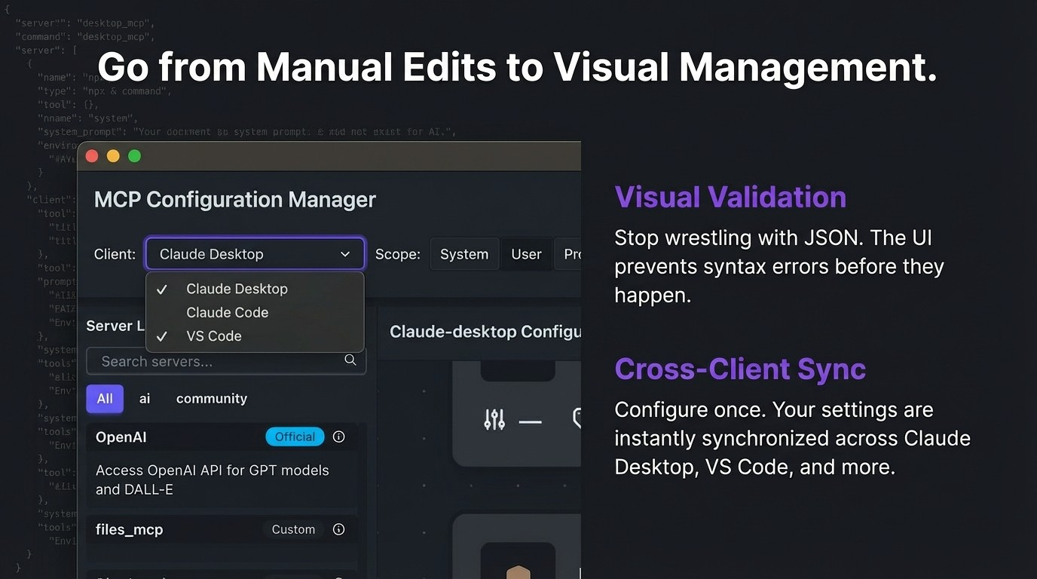

Slide 9
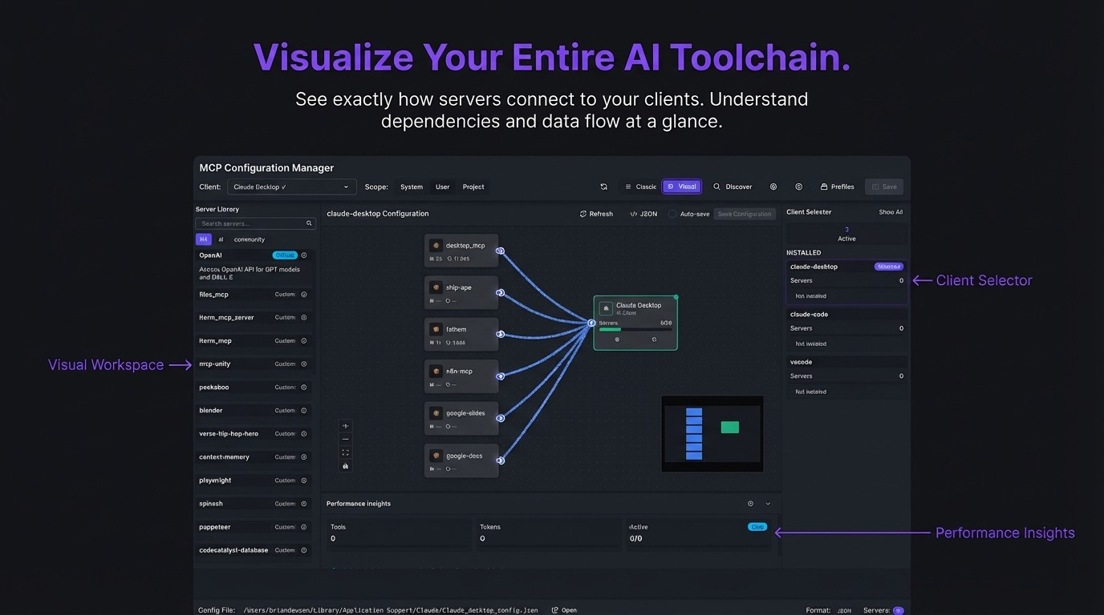

Slide 10
,,h.,e
Ac
l!D
---

Slide 11
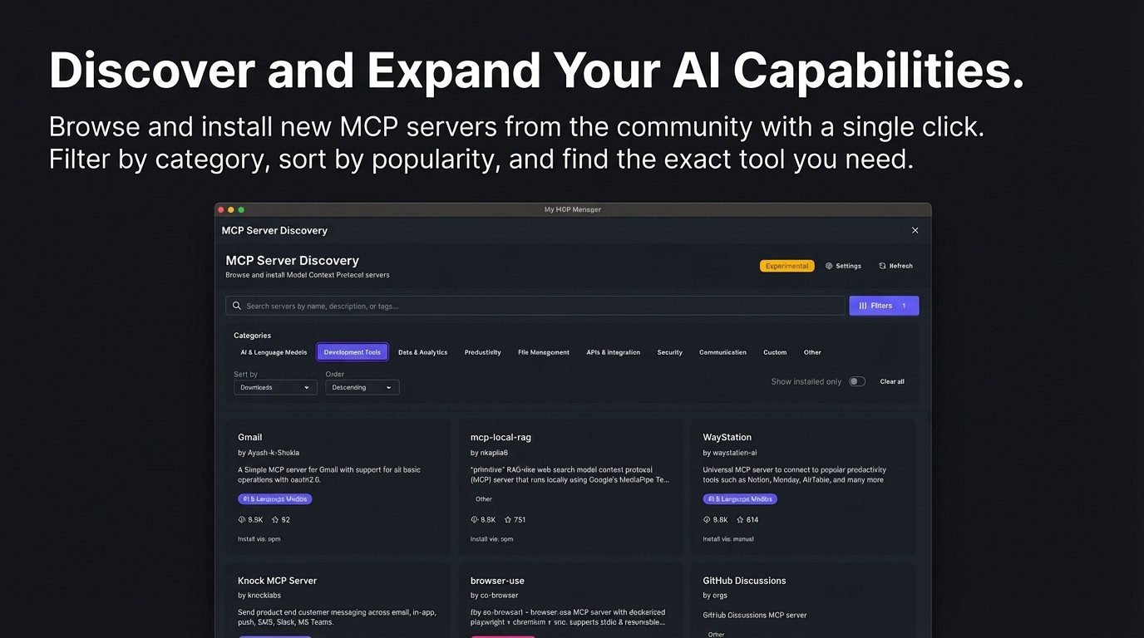

Slide 12
Built WITH MCP.
We practiced what we preach. This project was built using the very tools we're presenting.
Example Use Case:
We used a Figma Dev Mode server to allow our Al coding agent to 'see' design requirements directly in the IDE.
// .mcp.json (Actual Project Config) { "mcpServers":{
"figma-dev-mode":{
"command": "npx",
"args":
"type":
[ "-y", "mcp- remote",
"local"
1l1
II
• • •
I
}
}
}

Slide 13
