Slide 1

MCP Conﬁg Manager
The Visual Command Center for AI Tools
Simplifying the Model Context Protocol Ecosystem
Made with Google Antigravity
🌙 /☀

Slide 2
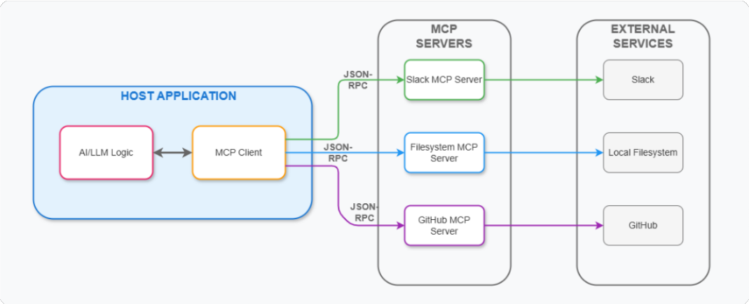
What is MCP?
The Model Context Protocol (MCP) is an open standard that connects AI assistants to systems directly.

Slide 3
What is MCP?
The Model Context Protocol (MCP) is an open standard that connects AI assistants to systems directly.
Think "USB-C for AI Applications"

Slide 4
What is MCP?
The Model Context Protocol (MCP) is an open standard that connects AI assistants to systems directly.
Think "USB-C for AI Applications"
Standardized way for AIs to access Data (ﬁles, databases) and Tools (functions, APIs).

Slide 5
What is MCP?
The Model Context Protocol (MCP) is an open standard that connects AI assistants to systems directly.
Think "USB-C for AI Applications"
Standardized way for AIs to access Data (ﬁles, databases) and Tools (functions, APIs).
Decouples the Model from the Context.

Slide 6
State of MCP
Since its launch in Nov 2024 by Anthropic, the ecosystem has exploded.

Slide 7
State of MCP
Since its launch in Nov 2024 by Anthropic, the ecosystem has exploded.
2025 Milestones:
OAuth 2.1 Authorization Framework (Security 🔒)
Streamable HTTP & Binary/Audio Support 🎧
MCP Registry Launch (Discovery 🔍)

Slide 8
State of MCP
Since its launch in Nov 2024 by Anthropic, the ecosystem has exploded.
2025 Milestones:
OAuth 2.1 Authorization Framework (Security 🔒)
Streamable HTTP & Binary/Audio Support 🎧
MCP Registry Launch (Discovery 🔍)
Adoption:
Integrated into Microsoft Copilot Studio, Claude, and more.
Donated to the Linux Foundation (Agentic AI Foundation).

Slide 9
State of MCP
Since its launch in Nov 2024 by Anthropic, the ecosystem has exploded.
2025 Milestones:
OAuth 2.1 Authorization Framework (Security 🔒)
Streamable HTTP & Binary/Audio Support 🎧
MCP Registry Launch (Discovery 🔍)
Adoption:
Integrated into Microsoft Copilot Studio, Claude, and more.
Donated to the Linux Foundation (Agentic AI Foundation).
Projection: $1.8B market by end of 2025.

Slide 10
Why Do We Need a Manager?
The "Conﬁguration Hell"
// claude_desktop_config.json
{
"mcpServers": { "git": { ... }
}
}
One ﬁle down, 6 to go...

Slide 11
Why Do We Need a Manager?
The "Conﬁguration Hell"
3 Different Claude Conﬁgs:
Claude Desktop
// claude_desktop_config.json
{
"mcpServers": { "git": { ... }
}
}
Claude Code (CLI)
Claude for VS Code
One ﬁle down, 6 to go...

Slide 12
Why Do We Need a Manager?
The "Conﬁguration Hell"
3 Different Claude Conﬁgs:
Claude Desktop
// claude_desktop_config.json
{
"mcpServers": { "git": { ... }
}
}
Claude Code (CLI)
Claude for VS Code
Plus The Rest:
Cursor, Windsurf, Kiro
One ﬁle down, 6 to go...
Antigravity, Gemini

Slide 13
Why Do We Need a Manager?
The "Conﬁguration Hell"
3 Different Claude Conﬁgs:
Claude Desktop
// claude_desktop_config.json
{
"mcpServers": { "git": { ... }
}
}
Claude Code (CLI)
Claude for VS Code
Plus The Rest:
Cursor, Windsurf, Kiro
One ﬁle down, 6 to go...
Antigravity, Gemini
It Gets Complicated. Fast.

Slide 14
Enter MCP Conﬁg Manager
A uniﬁed, visual interface for your AI tools.

Slide 15
Enter MCP Conﬁg Manager
A uniﬁed, visual interface for your AI tools.
Visual Validation: No more JSON syntax errors.

Slide 16
Enter MCP Conﬁg Manager
A uniﬁed, visual interface for your AI tools.
Visual Validation: No more JSON syntax errors.
Cross-Client Sync: Write once, update Claude & VS Code.

Slide 17
Enter MCP Conﬁg Manager
A uniﬁed, visual interface for your AI tools.
Visual Validation: No more JSON syntax errors.
Cross-Client Sync: Write once, update Claude & VS Code.
Server Library: Discover & install with one click.

Slide 18
Enter MCP Conﬁg Manager
A uniﬁed, visual interface for your AI tools.
Visual Validation: No more JSON syntax errors.
Cross-Client Sync: Write once, update Claude & VS Code.
Server Library: Discover & install with one click.
Live Monitoring: See real-time checks and status.

Slide 19
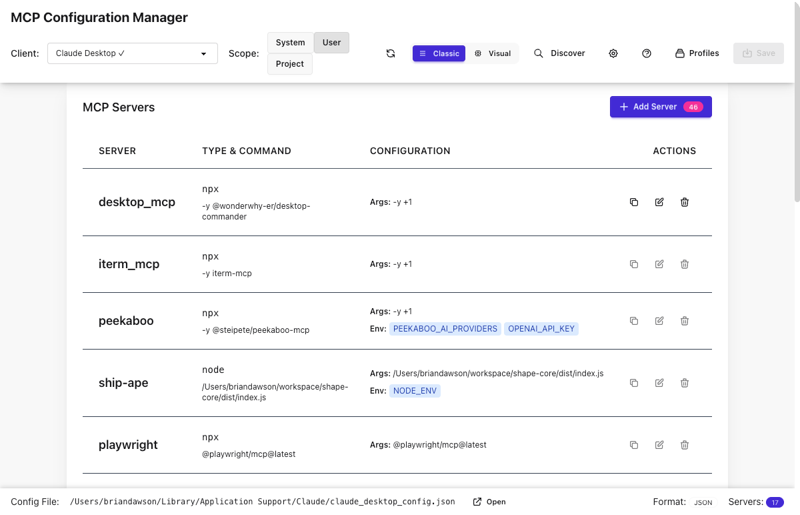
Enter MCP Conﬁg Manager
A uniﬁed, visual interface for your AI tools.
Visual Validation: No more JSON syntax errors.
Cross-Client Sync: Write once, update Claude & VS Code.
Server Library: Discover & install with one click.
Live Monitoring: See real-time checks and status.
(Demo UI)

Slide 20
The Context Economy
MCP servers provide power, but they consume Content Window.
The Cost of Context
24k
Tokens / Request
with 5 active servers

Slide 21
The Context Economy
MCP servers provide power, but they consume Content Window.
The Cost of Context
Every connected server adds system prompts and tool deﬁnitions.
24k
Tokens / Request
with 5 active servers

Slide 22
The Context Economy
MCP servers provide power, but they consume Content Window.
The Cost of Context
Every connected server adds system prompts and tool deﬁnitions.
24k
Tokens / Request
with 5 active servers
Too Many Servers = Slower inference & higher cost.

Slide 23
The Context Economy
MCP servers provide power, but they consume Content Window.
The Cost of Context
Every connected server adds system prompts and tool deﬁnitions.
24k
Tokens / Request
with 5 active servers
Too Many Servers = Slower inference & higher cost.
Solution: Toggle servers On/Off instantly based on task.

Slide 24
The Origin Story
The Pain Point
Manual Conﬁg Hell: Editing JSON for Claude, VS Code, Gemini...
Inconsistency: Conﬁg drift between tools.
Syntax Errors: One missed comma breaks the whole agent.
"I needed a uniﬁed graphical interface to stop wrestling with JSON ﬁles."

Slide 25
A Tale of Two Agents
We used different AI agents for different phases of development.

Slide 26
A Tale of Two Agents
We used different AI agents for different phases of development.
Phase 1: Planning 🧠
Claude Desktop
Strategy & PRD Market Analysis
Architecture Design

Slide 27
A Tale of Two Agents
We used different AI agents for different phases of development.
Phase 1: Planning 🧠
Claude Desktop
Phase 2: Building 🛠
Claude Code / VS Code
Strategy & PRD
Writing TypeScript
Market Analysis
File Sys Ops
Architecture Design
Iterative Testing

Slide 28
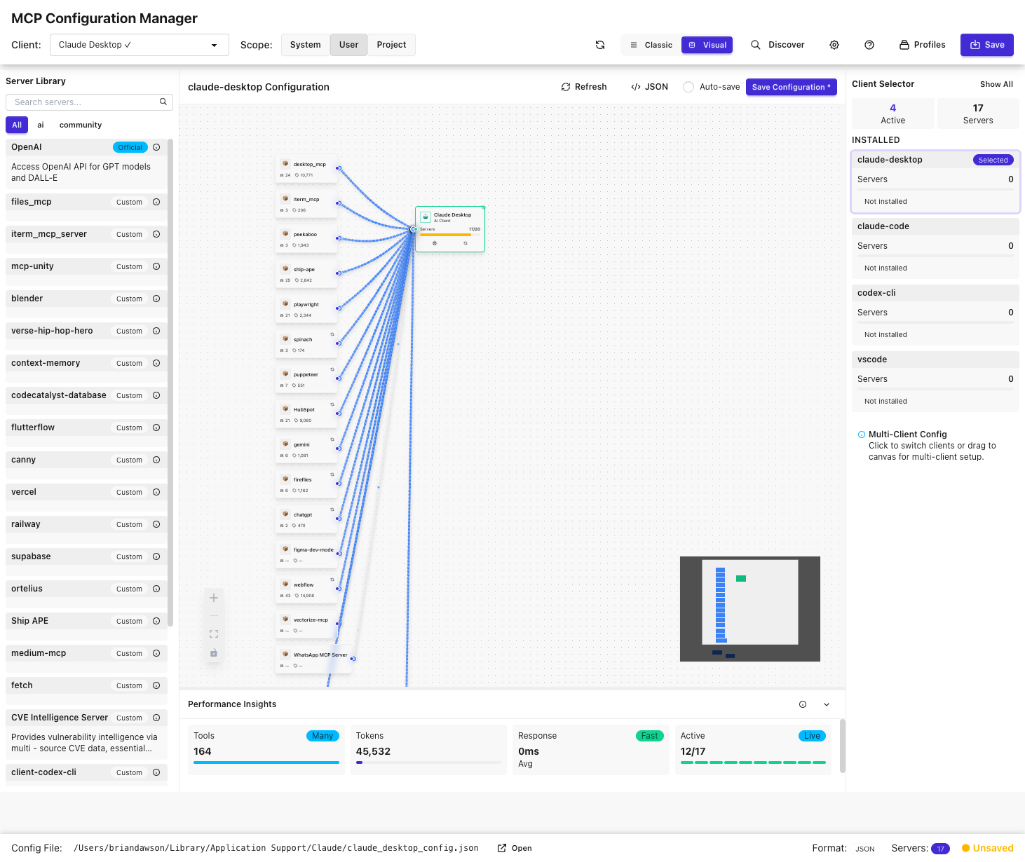
MCP Beyond Conﬁg: Testing
We use Playwright MCP to give AI agents "eyes" on our test results.
Intelligent Diagnosis

Slide 29
MCP Beyond Conﬁg: Testing
We use Playwright MCP to give AI agents "eyes" on our test results.
Intelligent Diagnosis
run npm test:e2e via MCP.

Slide 30
MCP Beyond Conﬁg: Testing
We use Playwright MCP to give AI agents "eyes" on our test results.
Intelligent Diagnosis
run npm test:e2e via MCP. Agent sees the failure + screenshot.

Slide 31
MCP Beyond Conﬁg: Testing
We use Playwright MCP to give AI agents "eyes" on our test results.
Intelligent Diagnosis
run npm test:e2e via MCP. Agent sees the failure + screenshot. Result: Self-healing tests.

Slide 32
MCP for Work Tracking
Connecting Requirements to Code.
Work Item Integration
// .mcp.json (Expanded)
{
"jira-server": {
"command": "npx",
"args": ["-y", "mcp-jira"],
"env": { "JIRA_API_TOKEN": "..." }
}
}

Slide 33
MCP for Work Tracking
Connecting Requirements to Code.
Work Item Integration
Fetch "Acceptance Criteria" from Jira/Linear.
// .mcp.json (Expanded)
{
"jira-server": {
"command": "npx",
"args": ["-y", "mcp-jira"],
"env": { "JIRA_API_TOKEN": "..." }
}
}

Slide 34
MCP for Work Tracking
Connecting Requirements to Code.
Work Item Integration
Fetch "Acceptance Criteria" from Jira/Linear.
Generate implementation plan based on the ticket.
// .mcp.json (Expanded)
{
"jira-server": {
"command": "npx",
"args": ["-y", "mcp-jira"],
"env": { "JIRA_API_TOKEN": "..." }
}
}

Slide 35
MCP for Work Tracking
Connecting Requirements to Code.
Work Item Integration
Fetch "Acceptance Criteria" from Jira/Linear.
Generate implementation plan based on the ticket.
Update ticket status upon PR creation.
// .mcp.json (Expanded)
{
"jira-server": {
"command": "npx",
"args": ["-y", "mcp-jira"],
"env": { "JIRA_API_TOKEN": "..." }
}
}

Slide 36
Let's See It In Action
Live Demo

Slide 37
Built WITH MCP
We practiced what we preach. This project was built using MCP servers.
Tools Used:
// .mcp.json (Actual Project Config)
{
"mcpServers": {
"figma-dev-mode": {
"command": "npx",
"args": ["-y", "mcp-remote", "..."], "type": "local"
}
}
}
This allowed the AI coding agent to "see" the design requirements clearly.

Slide 38
Built WITH MCP
We practiced what we preach. This project was built using MCP servers.
Tools Used:
Figma Dev Mode: To inspect designs directly in the IDE.
// .mcp.json (Actual Project Config)
{
"mcpServers": {
"figma-dev-mode": {
"command": "npx",
"args": ["-y", "mcp-remote", "..."], "type": "local"
}
}
}
This allowed the AI coding agent to "see" the design requirements clearly.

Slide 39
Built WITH MCP
We practiced what we preach. This project was built using MCP servers.
Tools Used:
Figma Dev Mode: To inspect designs directly in the IDE.
// .mcp.json (Actual Project Config)
{
"mcpServers": {
"figma-dev-mode": {
"command": "npx",
"args": ["-y", "mcp-remote", "..."], "type": "local"
}
}
}
Filesystem & Git: Standard context servers.
This allowed the AI coding agent to "see" the design requirements clearly.

Slide 40
Q & A
Thank you!
github.com/itsocialist/mcp-conﬁg-manager

Slide 41
```

