Slide 1
JCU MA5851 Data Science Master Class 1
Assignment 3
Document 4: Assignment Video Presentation
Student: Sacha Schwab
Date: 8 December 2021

Slide 2















1. Project Overview
Project
Webcrawler
csv
Preprocessor
NLP Engine
Structure &
Save
Text cleaning
Keyword
parser
Clustering
Parser
Tokenizer
Entity
detector
model.pickle
html
Collector
Vectorizer
Sentiment
detector
Further use e.g. Quant Analytics
WWW (Yahoo Finance)

Slide 3
2. Artifacts

Slide 4
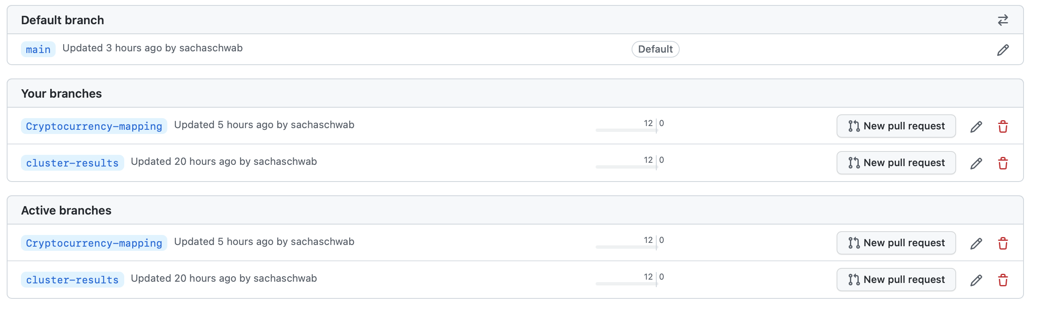
3. Code Management - Branches

Slide 5
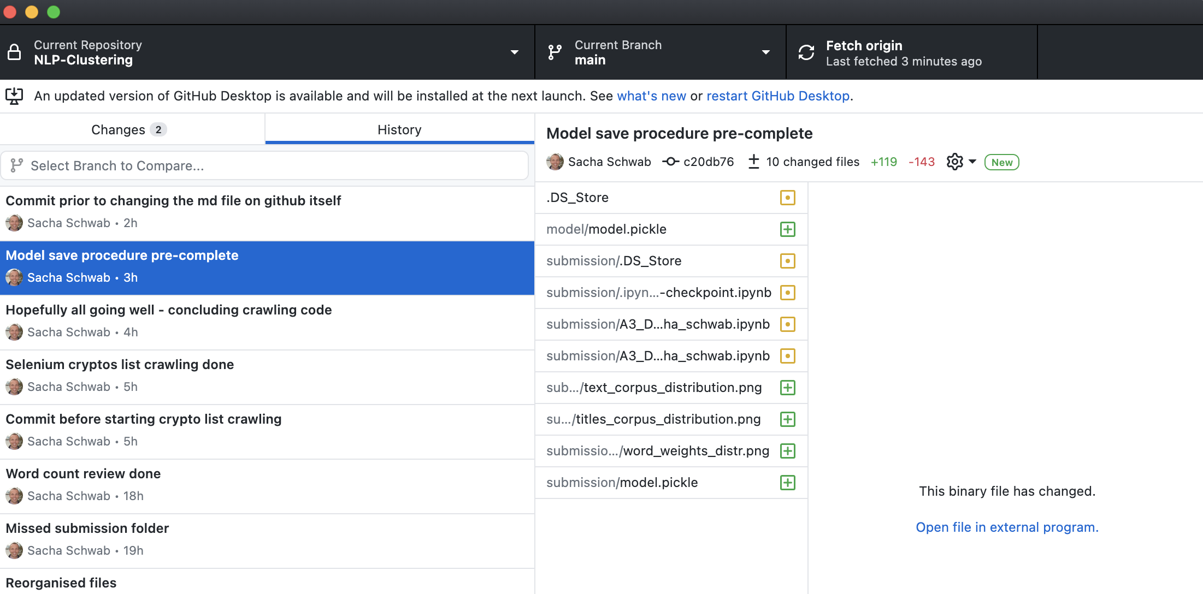
3. Code Management - Commits

Slide 6
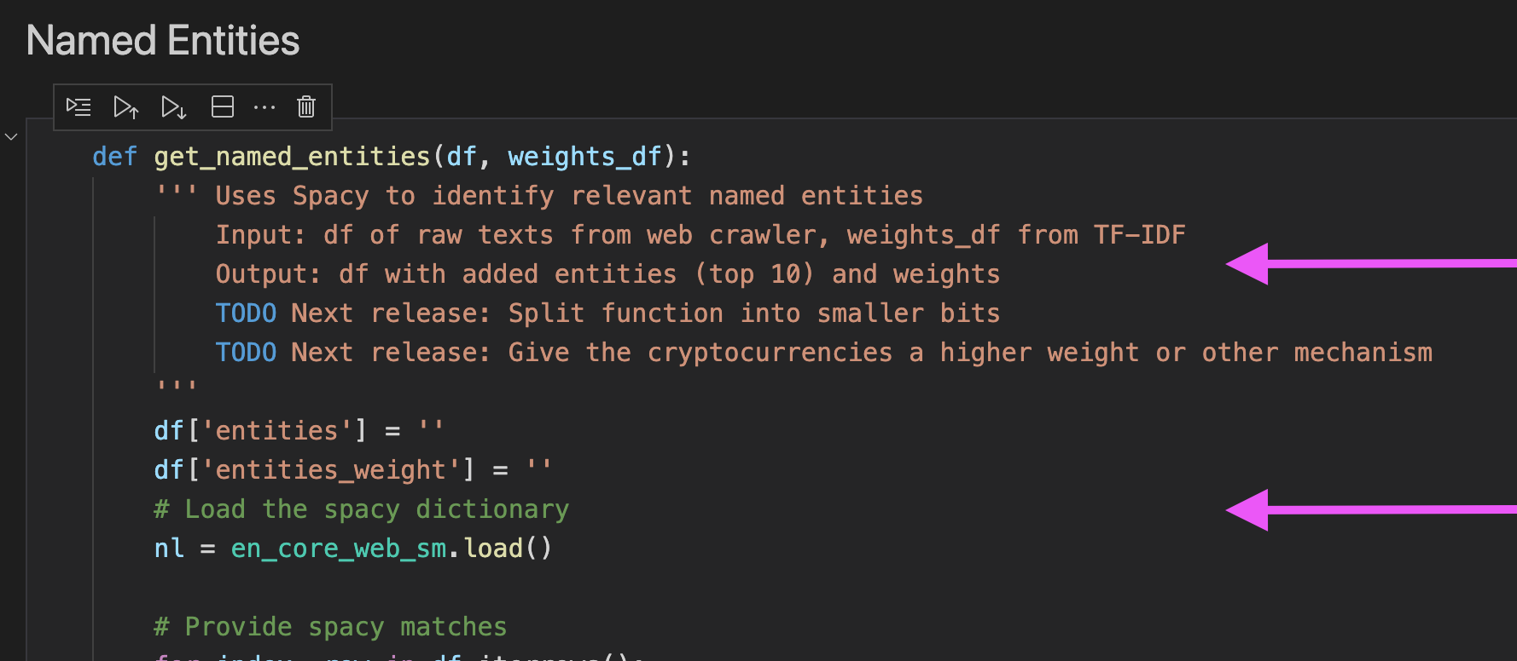
3. Code Management - Comments

Slide 7
4. Limitations Data
Harversted data (1.2MB) and model (291kB) are lightweigth: Scaling and requests should not produce any stretches mid-term
Consider however building an API in case the project takes off on user side (quant analysts, …)
Daily jobs:
Webcrawler: Daily jobs access a limited amount of articles (20-50). Performance to be revisited as soon as additional websources are crawled.
Model refresh (NLP tasks): Code performance to be ameliorated during future releases (list comprehensions, unnecessary if’s and looops) => Backlog: - Named entities + keyword extraction performance

Slide 8



Webcrawler workflow
Webcrawler
main
page
request
https://finance.yahoo.com/cryptocurrencies/
Data
parse
article
urls (href)
csv
article
pages
requests
parse
title, body,
date
https://finance.yahoo.com/.../

