Slide 1
JCU MA5851 Data Science Master Class 1
Assignment 3
Document 4: Assignment Video Presentation
Student: Sacha Schwab
Date: 8 December 2021

Slide 2















1. Project Overview
Project
Webcrawler
csv
Preprocessor
NLP Engine
Structure &
Save
Text cleaning
Keyword
parser
Clustering
Parser
Tokenizer
Entity
detector
model.pickle
html
Collector
Vectorizer
Sentiment
detector
Further use e.g. Quant Analytics
WWW (Yahoo Finance)

Slide 3



Webcrawler workflow
Webcrawler
main
page
request
https://finance.yahoo.com/cryptocurrencies/
Data
parse
article
urls (href)
csv
article
pages
requests
parse
title, body,
date
https://finance.yahoo.com/.../

Slide 4
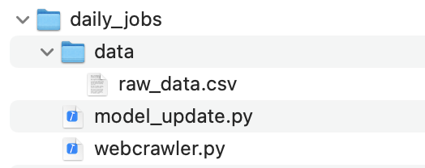

2. Requirements & Artifacts
Requirements:
- Git
- Python 3.7
- Any IDE supporting Jupyter Notebook files¨
- Libraries and package downloads: See model_update.py / webcrawler.py (below)
Instructions:
git clone https://github.com/sachaschwab/NLP-Clustering.git
copy folder “daily_jobs” and content to server
copy folder ’model’ to customer target drive / server
schedule for daily run : > python webcrawler.py > pythonmodel_update.py

Slide 5
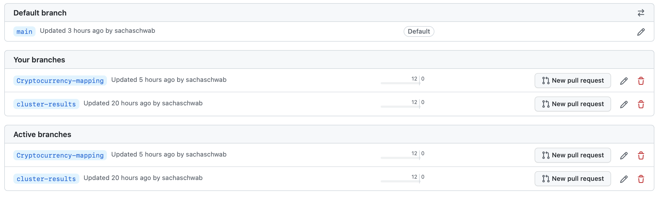
3. Code Management - Branches

Slide 6
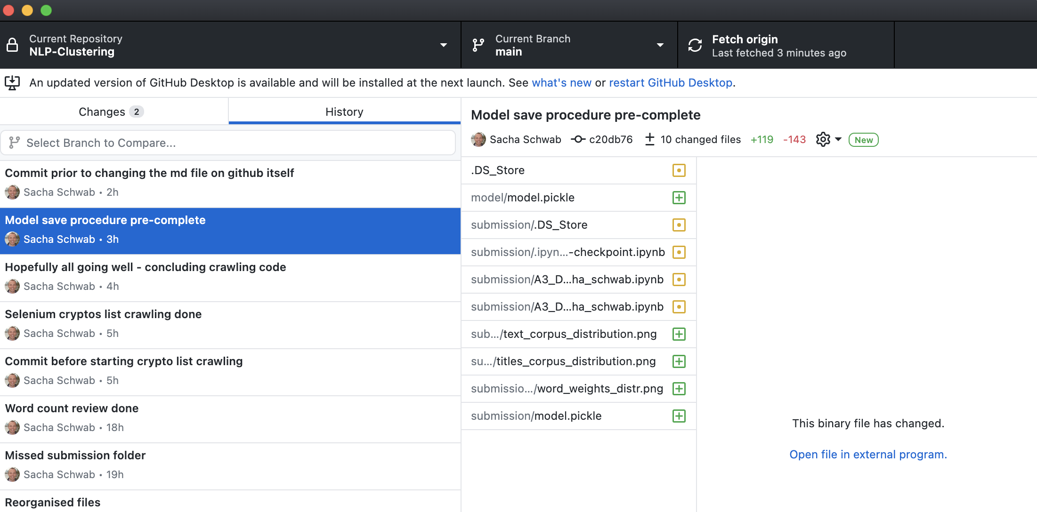
3. Code Management - Commits

Slide 7
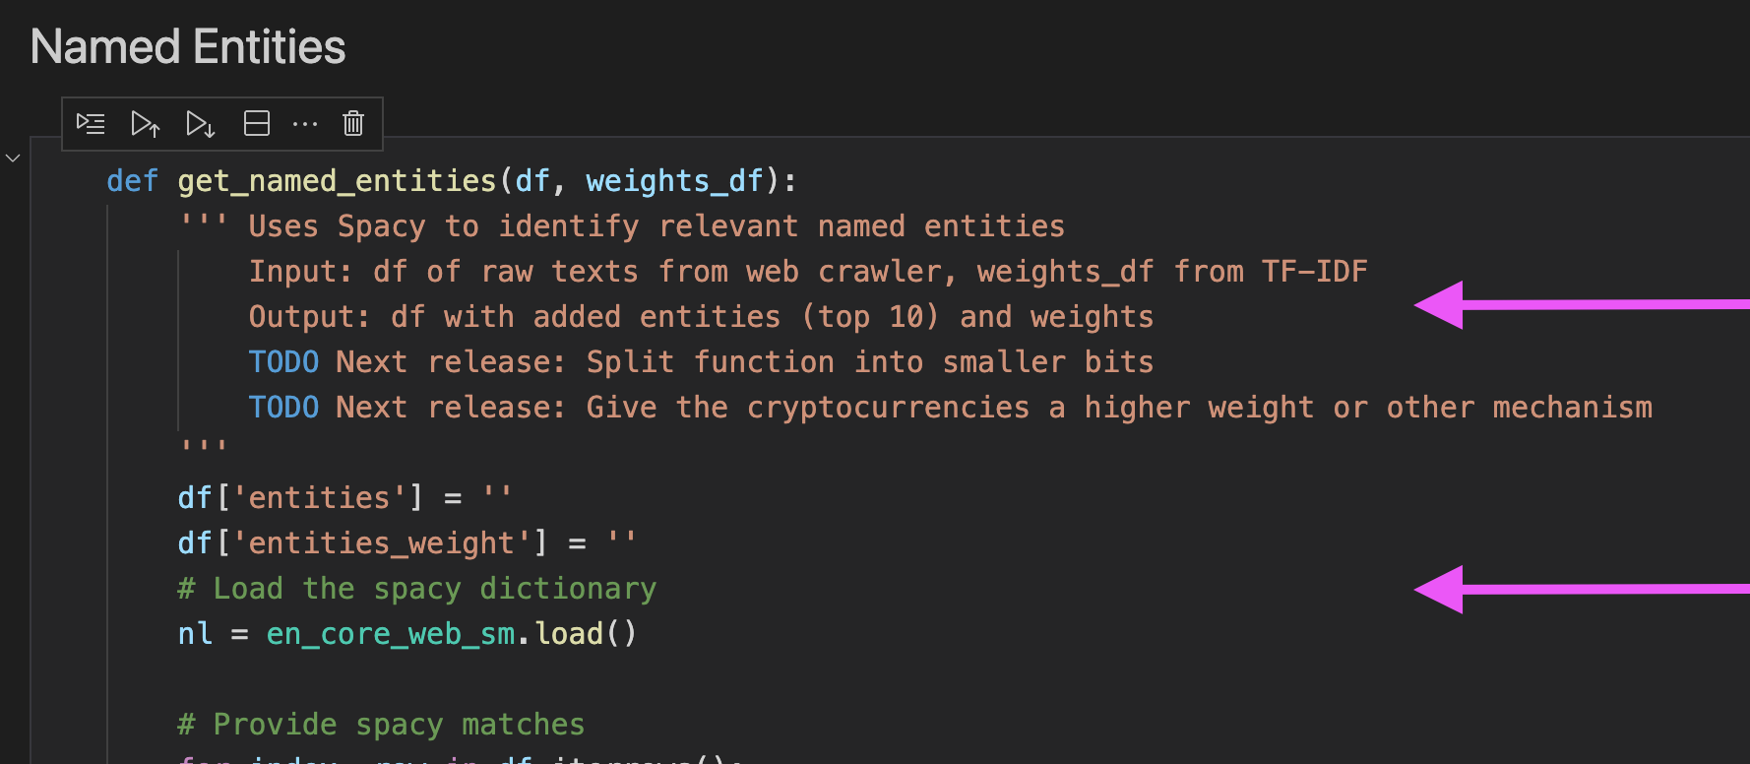
3. Code Management - Comments

Slide 8
4. Limitations Data
Harversted data (1.2MB) and model (291kB) are lightweigth: Scaling and requests should not produce any stretches mid-term
Consider however building an API in case the project takes off on user side (quant analysts, …)
Daily jobs:
Webcrawler: Daily jobs access a limited amount of articles (20-50). Performance to be revisited as soon as additional websources are crawled.
Model refresh (NLP tasks): Code performance to be ameliorated during future releases (list comprehensions, unnecessary if’s and looops) => Backlog: - Named entities + keyword extraction performance - Manage NLP-added data (features); currently, the model refresh runs for all crawled articles
Further points to be considered for next releases: Backup of raw data and model, model versioning / governance

