Slide 1
“PARKINSON’S DISEASE PREDICTION SYSTEM “
by
Sachchit kolekar

Slide 2
Problem Definition
→ Predicts whether the person has disease or not based on symptoms (in order to improve medical attention given to patients)
→ Classical Diagnosis
→ Machine Learning algorithms use a computer aided prediction can be made by inputting the symptoms.

Slide 3
Literature survey:
The healthcare environment is still 'information rich' But 'knowledge poor'. There is a wealth of data available within the health care systems.
However, there is a lack of effective analysis tools to discover hidden relationships in data.
Today medical services have come a long way to treat patients with various diseases.
Some of which cannot be seen with a naked eye and comes instantly when its limitations are reached.
Today diagnosing patients correctly and administering effective treatments have become quite a challenge

Slide 4
Working
Input Symptoms are given to the machine learning algorithm which has been trained using dataset of Multiple diseases with their symptoms
Machine learning algorithm predicts the disease accordingly.
Fig: Block diagram for Disease Prediction by System using Supervised Learning
Input data/biomedical measurements
Disease with Symptoms Dataset
Machine Learning
algorithm
Predicted Disease

Slide 5
Working 1: Initial part
▸ Import all the packages required i.e. Tkinter for GUI, numpy to performnumerical operations and pandas for reading the csv files.
▸ Create a list which contains all the symptoms which are according the CSV file
▸ Create another list which contains the diseases.
Then, create a empty list.L1 and L2, both have equal length.
L1 | SYM1 | SYM2 | SYM3 | SYM4 | SYM5 | SYM6 | SYM7 | SYM8
L2 | 0 | 0 | 0 | 0 | 0 | 0 | 0 | 0

Slide 6
Working 2: Dataset part
Perform same steps for both testing and training dataset
1. Using pandas read the CSV file
2. Replace with index
3. Make X as symptoms and Y as disease.
S1 | S2 | S3 | S4 | S5 | S6 | S7 | S8 |  | PROGNOSIS
0 | 0 | 0 | 1 | 0 | 1 | 0 | 0 |  | 0
0 | 1 | 0 | 0 | 0 | 0 | 0 | 0 |  | 1
1 | 0 | 0 | 0 | 0 | 0 | 0 | 1 |  | 2
0 | 0 | 0 | 0 | 0 | 0 | 0 | 0 |  | 3

Slide 7
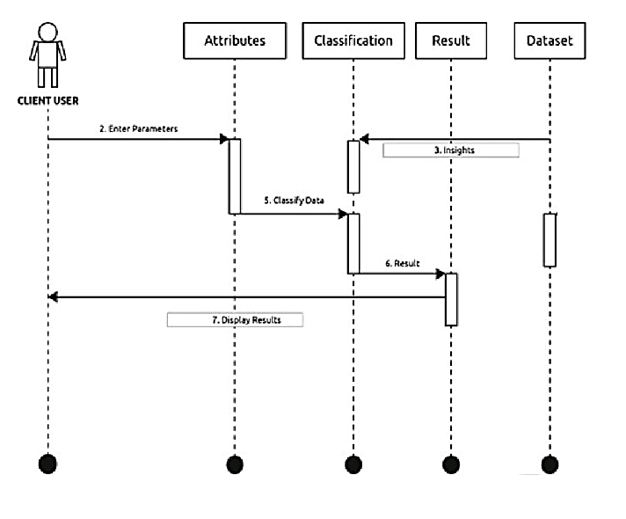
Sequence Diagram:

Slide 8
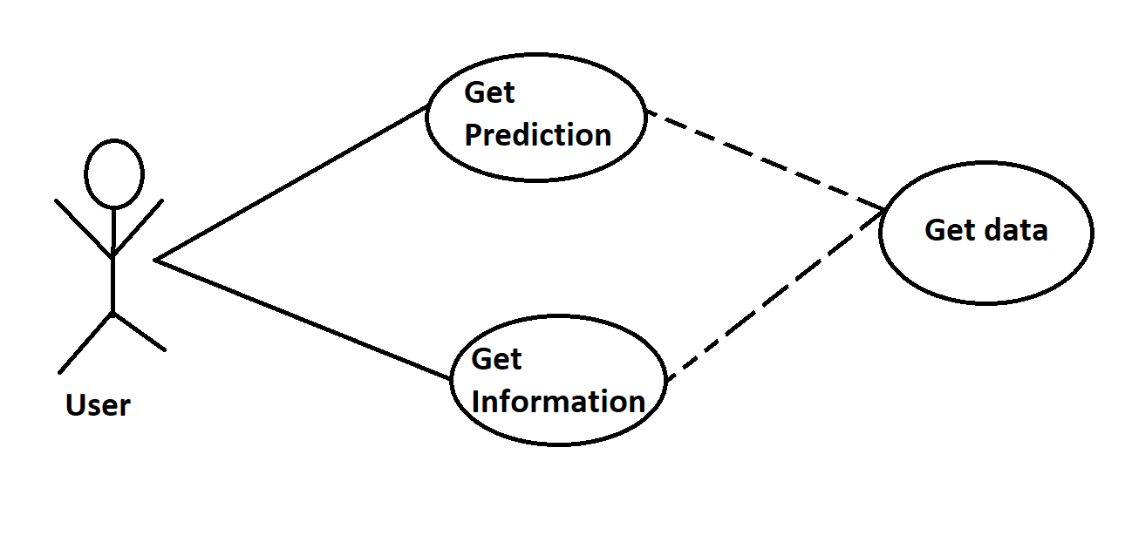
Use Case Diagram:

Slide 9
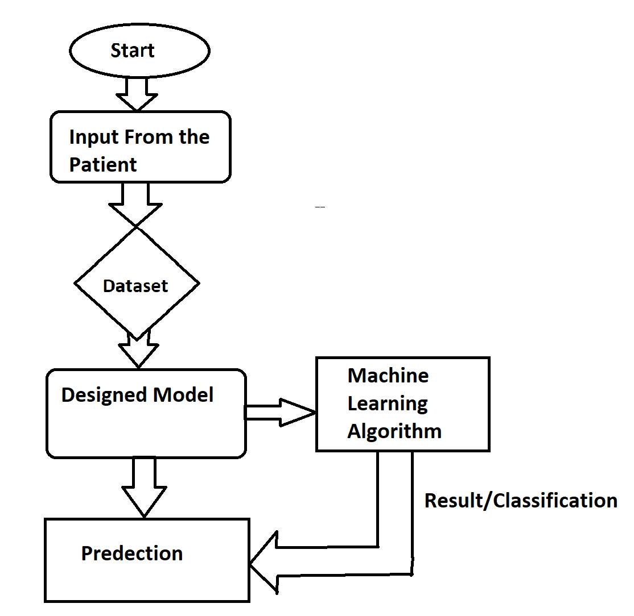
Flowchart:

Slide 10
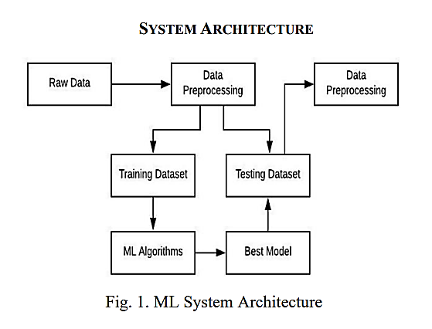

Slide 11
Conclusion
Parkinson’s disease prediction model is used to predict particular diseases at a time. Here based on the user input disease will be predicted. The choice will be given to user. If the user want to predict disease or if the user don’t enter any disease type then based on user entered inputs corresponding model will be invoked and predicted. The advantage of Parkinson’s disease prediction model in advance can predict the probability of occurrence of the disease and also can reduce mortality ratio.

Slide 12
References:
[1] 'Exploiting Nonlinear Recurrence and Fractal Scaling Properties for Voice Disorder Detection'
[2] https://towardsdatascience.com/streamlit-hands-on-from-zero-to-your-first-awesome-web-app-2c28f9f4e214
[3] https://www.analyticsvidhya.com/blog/2017/09/naive-bayes-explained/
[4] https://ijarcce.com/papers/multiple-disease-prediction-using-different-machine-learning-algorithms-comparatively-2/
[5] https://www.igi-global.com/book/handbook-research-disease-prediction-through/237838

Slide 13
Q & A:
Q1) What’s the source of data?
The data for training is provided by the uci machine learning repository.
Q 2) What was the type of data?
The data was the combination of numerical and Categorical values.
Q 3) After the File validation what you do with incompatible file or files which didn’t pass the validation?
Files like these are moved to the Achieve Folder and a list of these files has been
shared with the client and we removed the bad data folder.

Slide 14
Q 5) How logs are managed?
We are using different logs as per the steps that we follow in validation and
modeling like File validation log , Data Insertion ,Model Training log , prediction log
etc.
Q 6) What techniques were you using for data pre-processing?
Removing unwanted attributes
Visualizing relation of independent variables with each other and output variables
Checking and changing Distribution of continuous values
Removing outliers
Cleaning data and imputing if null values are present.
Converting categorical data into numeric values.
Scaling the data

