Slide 1
TCR innovations
“Insurance Management System
Using Python Django”
Presented by:
Mr. Sachchit Kolekar

Slide 2
ABSTRACT
This system is a multi-user web-based application system. It manages all the insurance policies of the customer. Admin has more features than that of the customer. Here, admin account can be created using createsuperuser command. After logging in to the system, admin can perform the CRUD operations of the customer, policies, categories. Also, admin can view all the registered users and give response to the question asked by the customers.

Slide 3
INTRODUCTION
This Python Django insurance administration system project is primarily concerned with dealing with insurance policies. The system also shows all of the various categories, along with their policies. Additionally, the system enables for the management of client records. This project is clearly separated into two sections: Customer and Admin Panel. In this online application’s summary, a consumer may easily register and begin utilizing it. Initially, the system displays all of the user’s possible insurance coverage.

Slide 4
PROBLEM STATEMENT
The project is focused on Insurance Management System, which shows information about different parts of insurance company, such as Agent, Customer, Policy, Employee, ClaimHandling and other related concepts, such as Claim, Premium, and different kinds of Insurancepolicies.

Slide 5
NEED FOR THE WORK
Customers want to be able to buy with confidence in both the non-life insurance and life and pensions sectors, Customers want products, and the purchasing process, to be simple and transparent so they can understand what they are buying. They want to build long-term relationships with insurance providers based On trust, and to have confidence that the products they are buying Are right for them and meet their needs.
So to fulfil the requirements and need of the insurer we have developed one methodology which will attract the people.And the system will be a user friendly so all peoples who have knowledge about insurance or not they all will accept the insurance

Slide 6
SCOPE
The scope of the project here, is to implement a database management system.
such that, it uses the different tables to evaluate the performance of Insurance company.

Slide 7
Working
person needs to either sign up or login
apply for the policies
admin approves the policy
check history/ask questions

Slide 8
HARDWARE & SOFTWARE REQUIREMENTS
Hardware Requirement
Intel Quad core 1.7 GHZ Processor
Minimum 10 GB HD.
Minimum 4 GB of RAM.
Software Requirement :
VScode
Python 3.7.0
Django
nvidia gpu driver

Slide 9
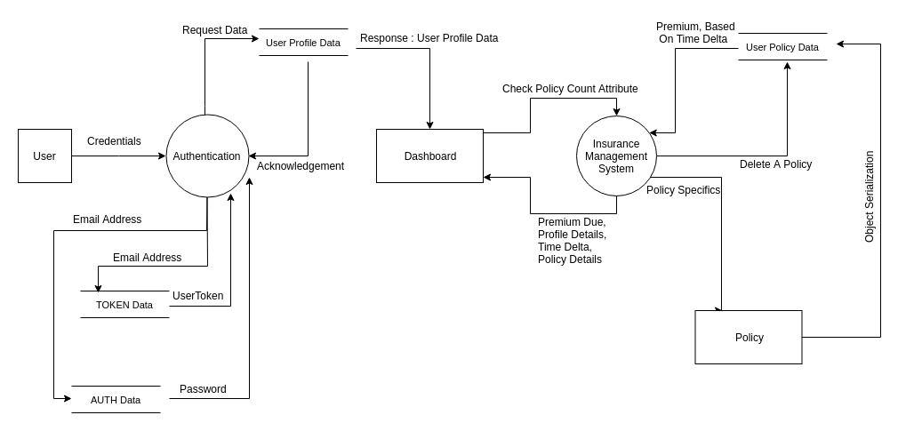
System Architecture

Slide 10
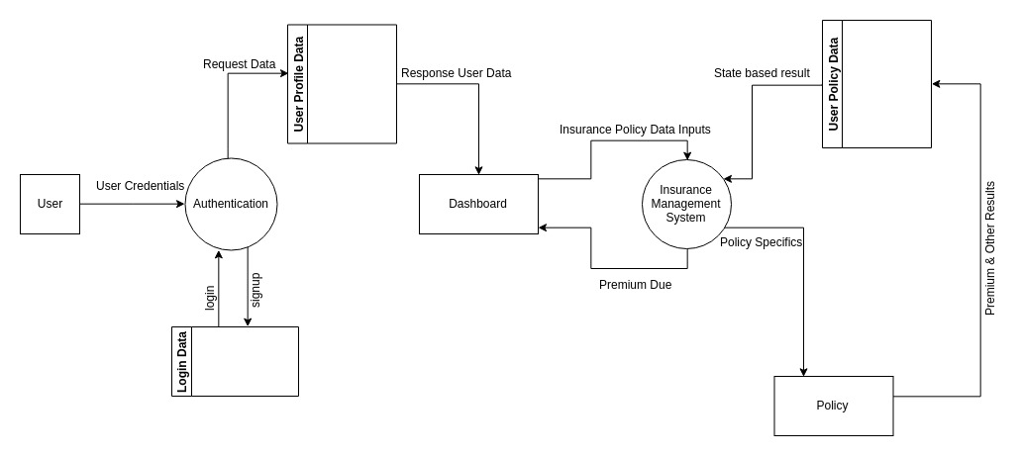
Use Case Diagram

Slide 11
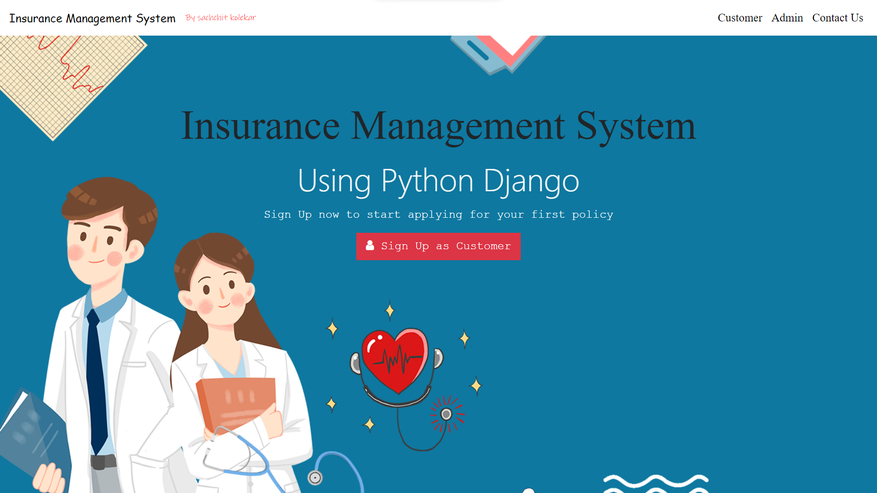
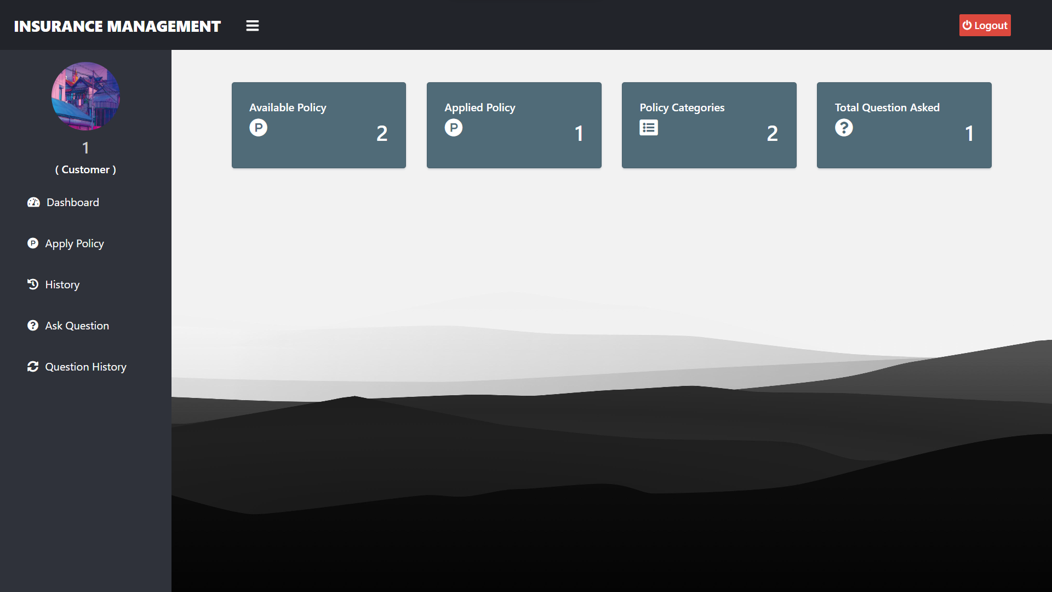
customer panel

Slide 12
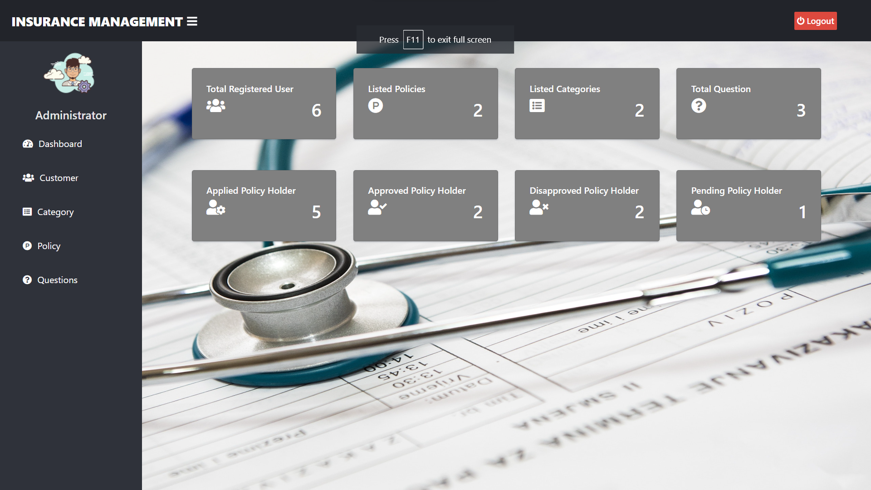
Admin panel

Slide 13
CONCLUSION
By the implementation of this website, there shall be a transparency in the field of insurance industry and will help in the centralization of the insurance taking policies.
There has to be a control over the money invested but theinsurance companies in a huge diversity like India. If such system is implemented it could result in various helps to thepublic as well as the governmental body for the development of the country.

Slide 14
REFERENCES
http://www.irdaindia.org/regulations/TheInsuranceAct1938er126042004.doc
“http://www.irda.gov.in/ADMINCMS/cms/NormalData_Layout.aspx?page=PageNo264&mid=3.2.10”
“http://www.irda.gov.in/ADMINCMS/cms/NormalData_Layout.aspx?page=PageNo129&mid=3.1.9”

Slide 15
Thank you!

