Slide 1
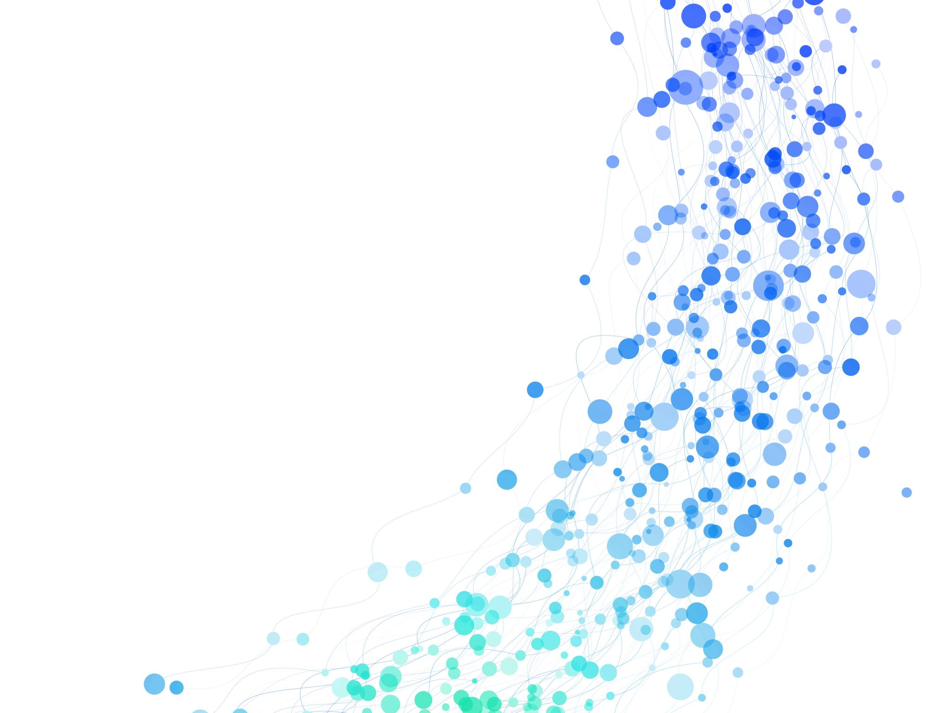
Analysis of Video in Distributed Environment for Object Detection
ANIRUDH PRAshaNt Kalghatkar
Sachin Kashinath Rathod
Notes:
Hello Everyone, Welcome to Data Center Scale Computing Project Presentation. Title of the project is Analysis of Video in Distributed Environment for Object Detection. My name is Sachin Rathod and my teammate is Anirudh Kalghatkar.
Let's look at the overview and goals of the project.

Slide 2
Overview of Project
Object Detection using Pre-trained DNN Model
Split Video into individual frames
Each frame is processed by different worker nodes
Combine all the processed frames back to get original frame order
Notes:
Our project focused on implementing a distributed video frame processing system for Object detection using a pre-trained Deep Neural Network (DNN). The objective was to input a video into the system and receive an output video where objects are highlighted, along with their count in each frame and the objects can be cars, people, or any other object supported by pre-trained DNN. This was achieved by dividing the video into individual frames, independently processing each frame for object detection using the pre-trained DNN at the worker nodes, and then merging the frames while maintaining the original order by the master node. The outcome is a modified video with highlighted objects and their respective counts. The project leverages distributed processing for scalability and efficiency, contributing to the intersection of data center scale computing, deep learning, and video analytics.
For our project we have configure pre-trained DNN to detect humans.
Lets move on to Software Components and their interactions .

Slide 3
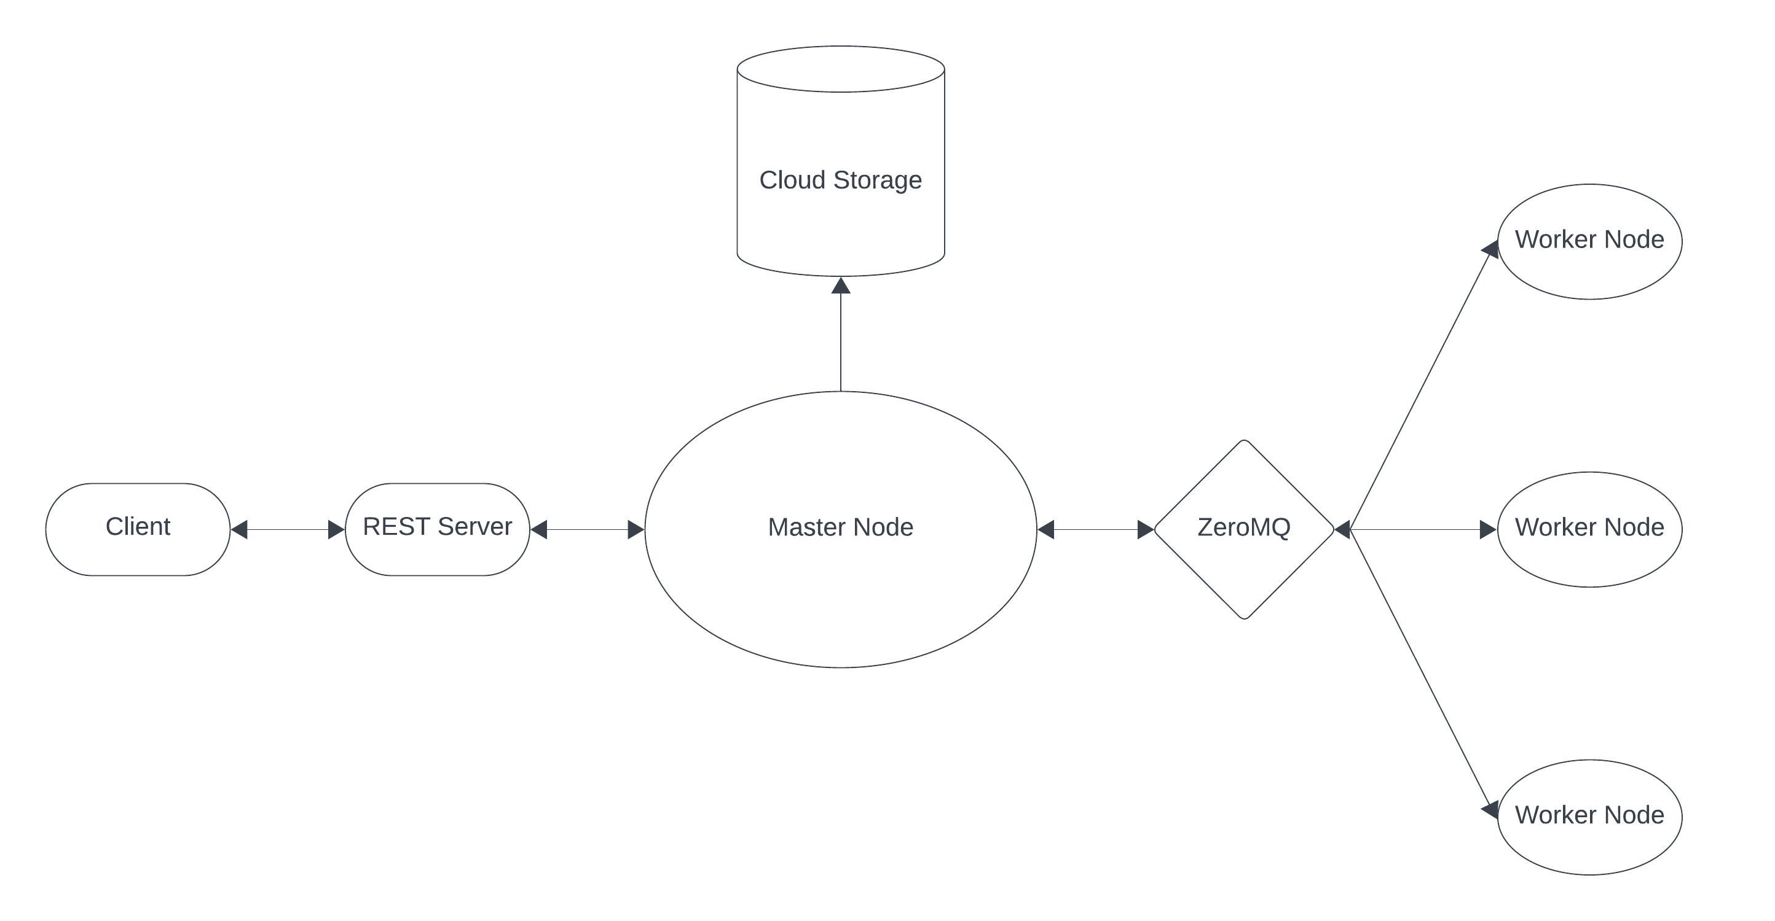
Architecture Diagram
Notes:
We have four main components as shown in the architecture diagram those are
Rest Server – For client server interaction.
Then Virtual Machines – For master and worker nodes.
Also We have made use of ZeroMQ – for message queue. Reason for choosing ZeroMQ is because it has special wrapper called as ImageZMQ for transferring images/
Lastly, Google Cloud Storage – to store and retrieve original and processed videos.
Now, speaking on the interactions between each components.
Client/front end app makes a post request to the rest-server with video data attached as a base64 string.
Then rest-server uploads the video to the google cloud storage and sends back the public url of the video to the client.
Upon receiving the public url back from the rest-server, client now makes a request for analysis of the video by sending in the public url.
Rest-server then commands master node to process the video.
At master node – the video is downloaded and split into frames, then the batches of frames are put into the message queue, here we have set 100 as a batch number for the frames.
Then worker nodes pick up the frame batch from the message queue and start analyzing the video for human detection. Upon completion of the analysis these frame batches are sent back to the master node where the frames get merged while maintaining the original order. Once the video is merged, it is uploaded to the google cloud storage and the public url is sent back to the client.
Now, Anirudh will walk you through the demo and testing the of the system.

Slide 4
Demo

Slide 5
Testing / Debugging

Slide 6
Thank You

