Slide 1
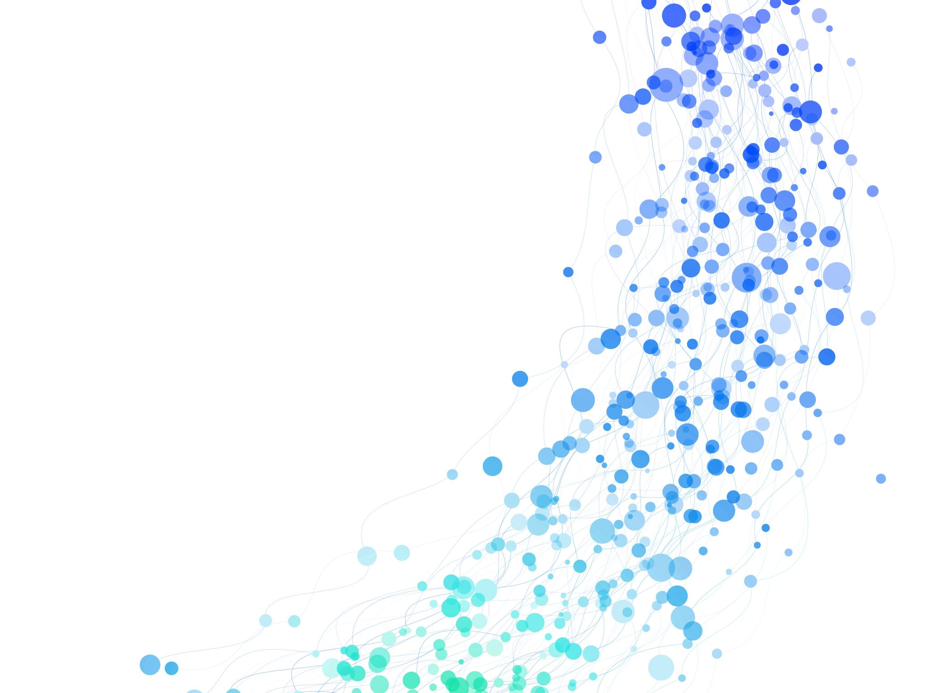
Analysis of Video in Distributed Environment for Object Detection
ANIRUDH PRAshaNt Kalghatkar
Sachin Kashinath Rathod

Slide 2
Overview of Project
Object Detection using Pre-trained DNN Model
Split Video into individual frames
Each frame is processed by different worker nodes
Combine all the processed frames back to get original frame order

Slide 3
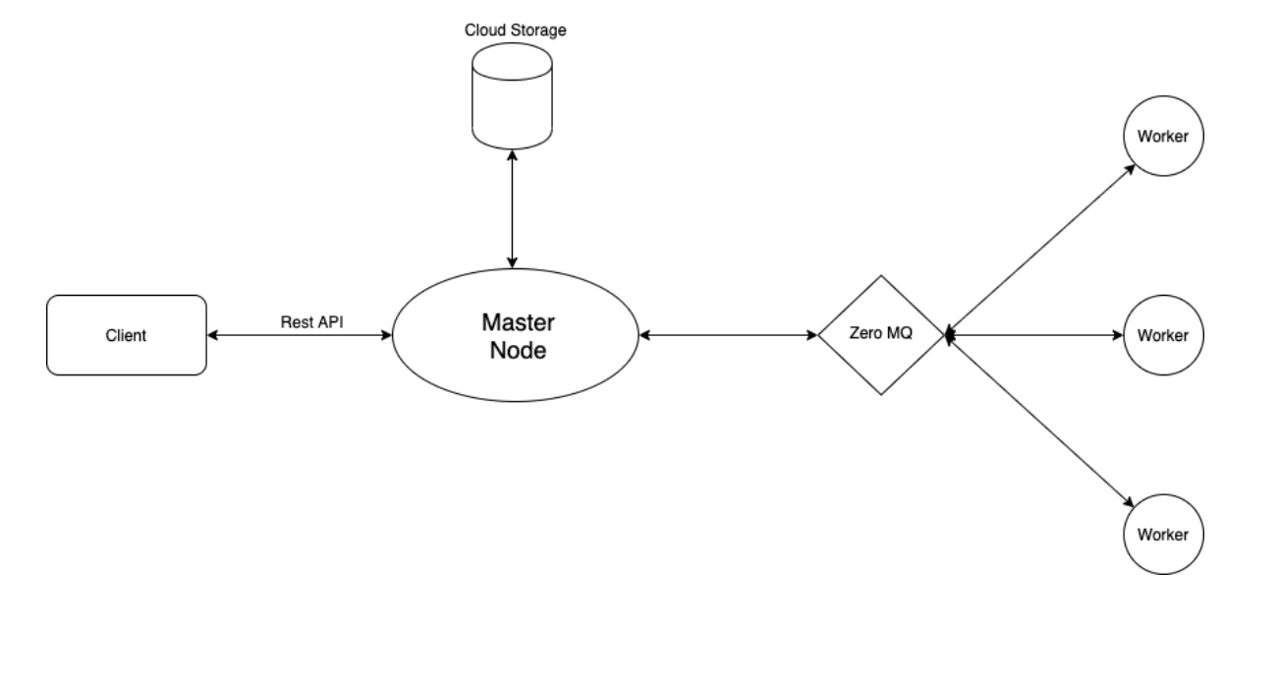
Architecture Diagram

Slide 4
Demo

Slide 5
Testing / Debugging

Slide 6
Thank You

