Slide 1
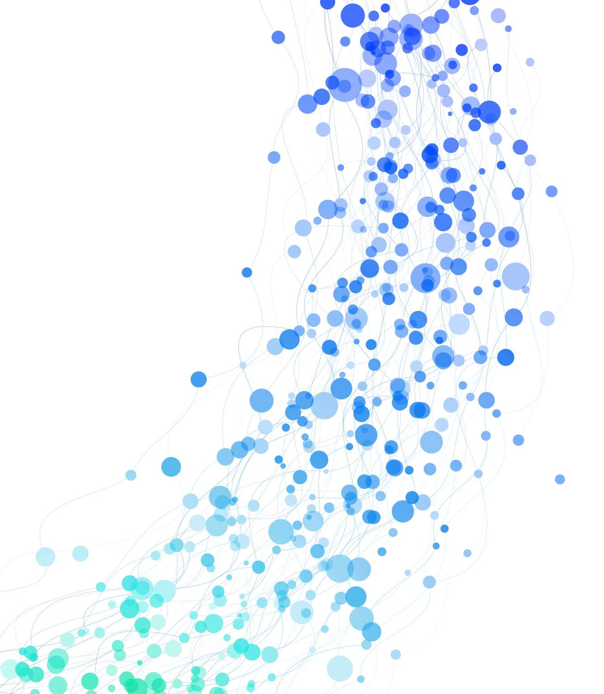
Hey ESRI A project to showcase various services provided by ESRI. And to incorporate NLP to support services over voice command.
This project is built using Ionic | Angular | Capacitor.

Slide 2
Features
Explore Tab
Hey ESRI Tab
Directions Tab

Slide 3
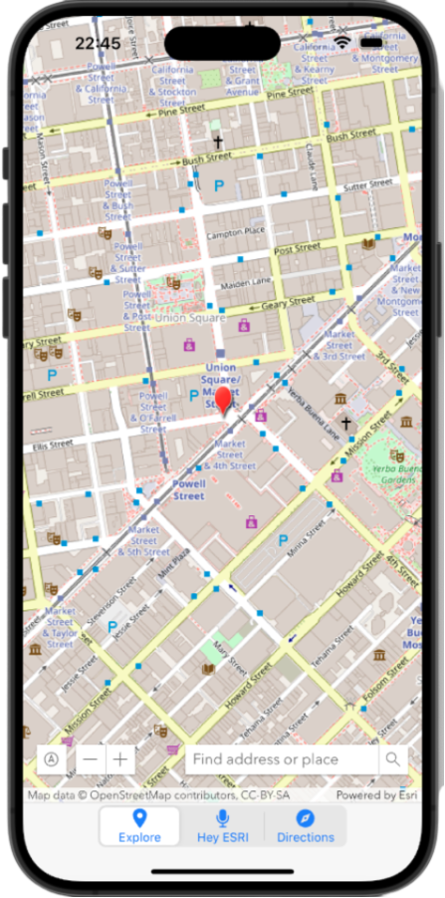
1. Explore Tab Contains search widget, zoom widget and custom current location button.

Slide 4
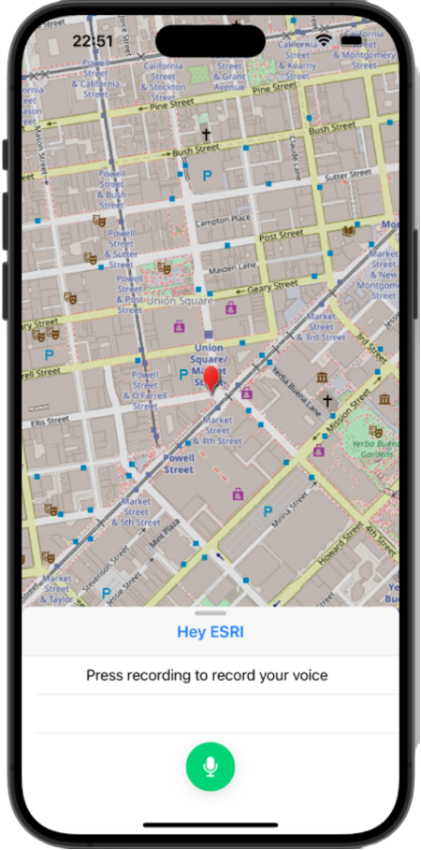
2. Hey ESRI Tab Contains speech recognition feature where user can perform tasks via voice command.

Slide 5
Available voice commands
Search location: Example - Search Boulder, Search Denver.
Directions: Example - Give Me Directions From Boulder To Denver, Find Directions From Boulder To Denver, Give Me Direction From Boulder To Denver, Find Direction From Boulder To Denver
Find nearby places: Example - Find nearby food, Find nearby gas station
Navigate to current location: Example - My current location, Show me my current location, Give my current location

Slide 6
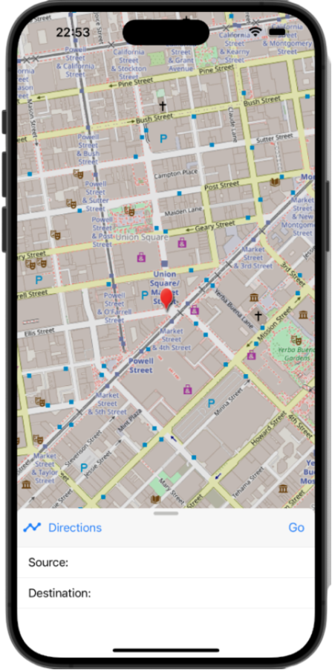
3. Directions Tab Contains directions wizard where user can manually enter source and destination and get the directions.
Notes:
As soon as user enters place name, system makes a get call to GeocodeServer Rest Api provided by ESRI. And this get call provides with the suggestions which are then displayed to user for selection.

Slide 7
Available Platforms
ios devices
Web
Note: Web version has limitations with speech recognition hence Hey ESRI tab do not work well with web version of the app.

Slide 8
Demo

Slide 9
ESRI Services and APIs
Base Map
Widget
Find Places
Reverse Geocoding
Marker Symbols
ArcGIS Maps SDK for JS

Slide 10
Future Works
Include features like current weather, weather predictions, disaster predictions.
Integrate Natural Language Processing to enhance speech to service abilities. Currently, speech to service works over bunch of pre-defined speech patterns. Hence, NLP will eliminate pre-defined speech patterns.
Enhance user interface and build app for android devices.

Slide 11
Thank You

