Slide 1


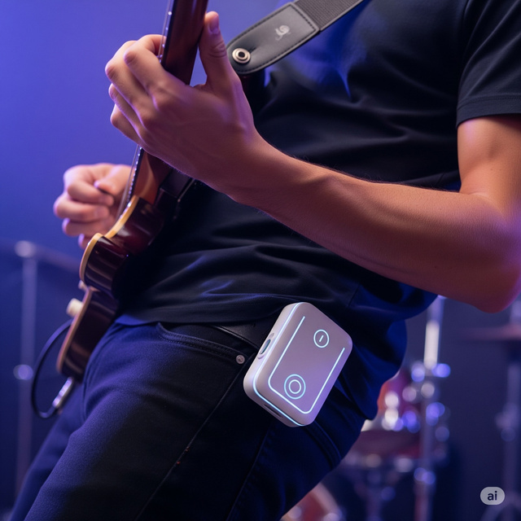




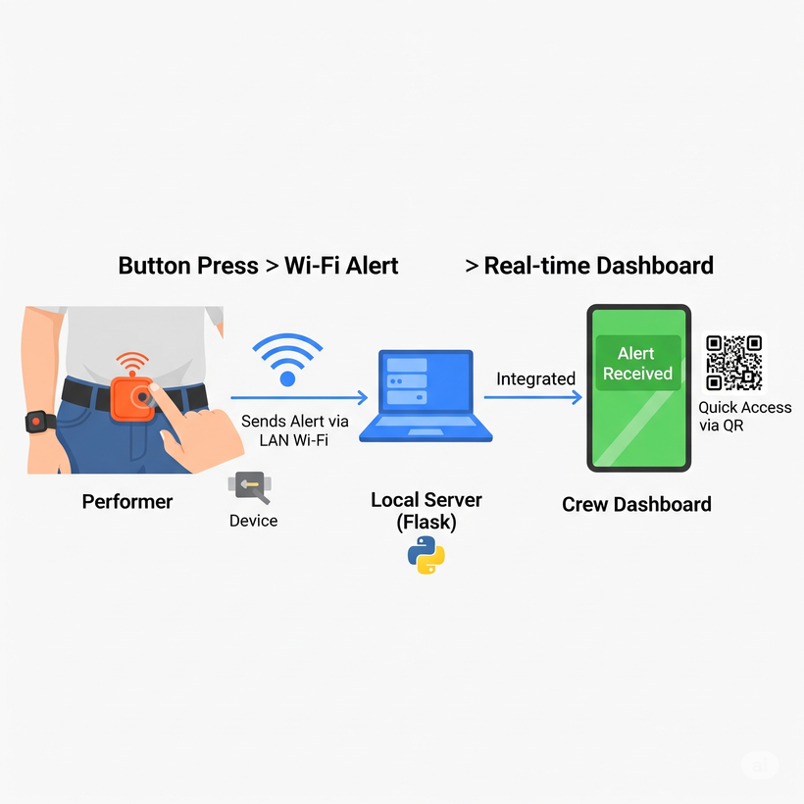

WIRELESS EMERGENCY ALERT SYSTEM FOR LIVE PERFORMERS
Key FEATURES
Instant Alerts - Instant alert with performer’s name & timestamp with a single press of a button
Problem
  In live shows, artists struggle to silently and quickly notify technical teams of urgent issues.
  Noise, chaos, and poor visibility make traditional hand signals or shouting ineffective — resulting in delays and disrupted performances
Audible Notification – Audio buzz to ensure crew attention
Responsive Dashboard – Use on desktop, tablet, or phone — no app required
A performer presses a wearable button, triggering a Wi-Fi alert sent to a local Flask server, which instantly updates a real-time crew dashboard accessible via QR code
QR-Based Sharing – Easy dashboard access via dynamic QR code
Solution
  A wearable device with a main centre button
  Silently notifies the crew in real-time via a web-based dashboard.
  Ensure zero disruption to the flow of the performance
Auto Network Detection – Smart IP identification for easy setup.
Tab-based UI – Simple controls for sound & sharing

