Slide 1
MOCK LAYOUT — content is final, slide structure to be re-fitted to the official SIH template
KaarigarAI
THE POPULATION
64.66 lakh
The AI Virtual Business Manager for Marginalized Artisans
handloom and handicraft artisans in India
2.72 crore
artisans enrolled under PM Vishwakarma
One photo. One voice note. In her own language.
71%
of handloom weavers are women
Problem Statement SIH26090
AI-Driven Market Linkage and Smart Cataloging Mobile Application for Marginalized Artisans
Ministry of Social Justice and Empowerment · Software · Miscellaneous
Team Algorhythm
9 in 10
handlooms are in rural India
Notes:
Mock deck. Open by naming the population, not the technology.

Slide 2
The barrier is not market access. It is production.
Fairs give a burst of sales, then nothing. Between them, these artisans have no digital presence at all.
Amazon Karigar, GeM, ONDC and Flipkart Samarth all accept artisan sellers. The artisan simply cannot produce what those platforms demand: a clean photograph, a well-written description in the right language, and a competitive price.
WHAT A LISTING NEEDS — AND WHY IT FAILS
A photograph
Cluttered background, poor light, wrong crop
Photography, copywriting and pricing are three separate professional skills. A single artisan is unlikely to have any of them — and low literacy means even filling in a listing form is out of reach.
A description
Spoken language is not the listing language
A price
So the app must substitute for a photographer, a translator, a copywriter and a pricing analyst at once — and then carry the finished listing to a buyer.
No market reference, so priced flat and low
A buyer
Reachable only during a fair, for three days

Slide 3
How it works — five steps, no typing at any point
Everything before "publish" happens on the device and survives a dead network.
1
2
3
4
5
Capture
Enhance
Speak
Price
Publish
→
→
→
→
A rough phone photo of the craft
Background removed, light corrected, cropped to e-commerce ratios
A voice note in her own language, transcribed and translated
A price band with a plain explanation and a fair-price floor
Bilingual listing, read back aloud and confirmed by voice
THEN THE HALF MOST SOLUTIONS FORGET — GETTING IT TO A BUYER
Storefront + offer inbox
Marketplace export bundle
Share card
Stall QR poster
Her whole catalogue on one page; one structured offer; she accepts by voice
One tap builds the GeM, ONDC, Karigar and ODOP upload package
One image she forwards on WhatsApp herself — nothing to register
A fair visitor becomes a year-round contact, on a permanent URL

Slide 4
What we build
Three features are mandated by the problem statement. Five more answer the half it asks for but rarely gets.
MANDATED — DELIVERED IN FULL, AND EXTENDED
ADDED — AIMED AT MARKET LINKAGE AND LITERACY
AI Image Enhancer
Voice-first first run
rembg + OpenCV. Background removal, light and white balance, saliency crop, texture close-up for textiles.
Register without reading: tiles that speak their own name, digits only
Storefront + offer inbox
The direct answer to "connect with larger B2B buyers"
Multilingual Auto-Cataloger
whisper.cpp + IndicTrans2 + Gemini. Craft glossary preserves authentic terms. Read back aloud before publishing.
Voice order and offer status
She asks aloud and hears the answer — the loop closes
Maker story
Dynamic Pricing Assistant
Provenance is the margin. Same voice pipeline, near-zero cost
Image and transcript become attributes; XGBoost returns a band; SHAP explains it; a floor prevents underpricing.
Market linkage toolkit
Export bundle, share card, stall QR

Slide 5
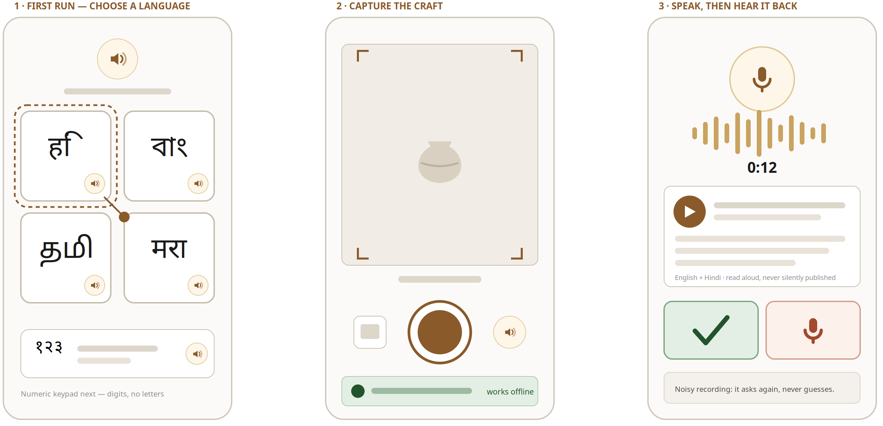
The interface, for someone who cannot read
Grey bars mean text she is not expected to read — every one has a speaker beside it. No screen offers more than two real choices.
Wireframes — layout, hierarchy and touch targets. Replace with product screenshots as the build progresses.

Slide 6
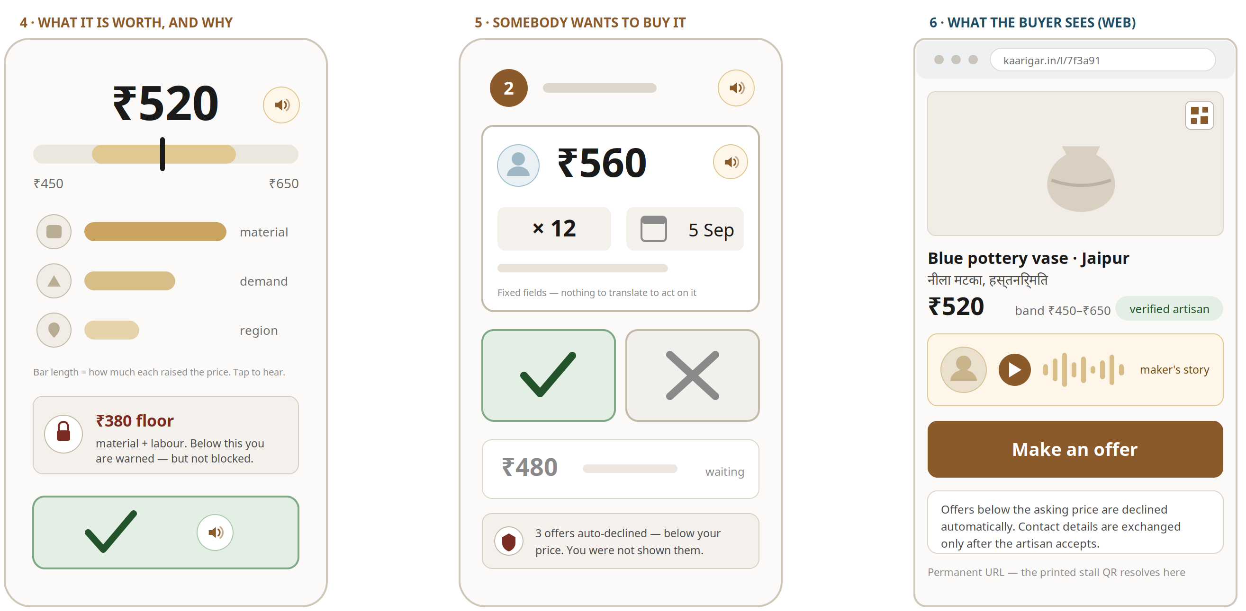
Price, offers, and what the buyer sees
SHAP as three bars rather than a table. Two buttons and one number. The buyer side is deliberately ordinary.
The only screen that assumes reading is the buyer’s — boutique owners, exporters and procurement staff.

Slide 7
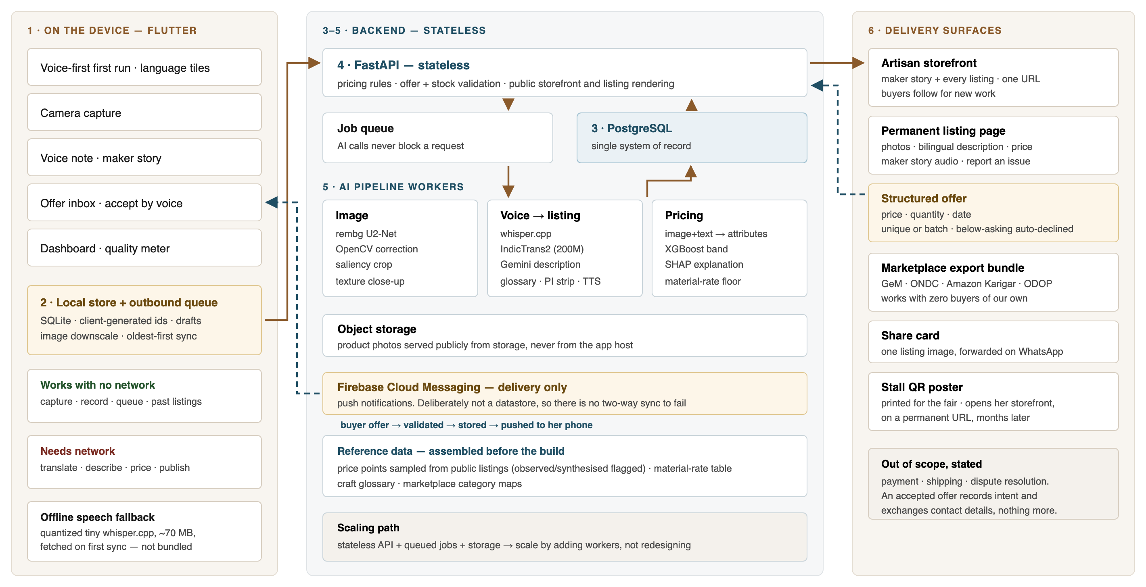
Technical approach
Six layers. One system of record. Every component free or open-source.

Slide 8
Feasibility and viability
Every choice is locked, and every known failure mode has a stated response.
THE STACK — NO ALTERNATIVES LISTED, BECAUSE INDECISION COSTS MORE THAN A SUBOPTIMAL CHOICE
CLIENT
BACKEND
RECORD
VISION
SPEECH
Flutter
FastAPI, stateless
PostgreSQL
rembg + OpenCV
whisper.cpp (tiny on device)
TRANSLATE
TEXT
PRICING
PUSH
IndicTrans2 200M
Gemini free tier
XGBoost + SHAP
FCM — delivery only
Risk | Response
Noisy village recording, or a mis-heard craft word | Confidence check then re-record; craft glossary fuzzy-corrects before writing
No connectivity for days | Capture, record and queue offline; oldest-first sync; client ids prevent duplicates
An unseen craft category | Wider band and stated low confidence — never a confident wrong number
Two buyers want the same piece | Stock decrements under a row lock on each acceptance; unique is the quantity-one case
A middleman operates the app for her | Account and stall QR bound to her own number; earnings visible only in her view
No venue internet or an exhausted free tier | Rehearsed offline path, local speech model, responses pre-cached
Roughly forty-five cases are registered across voice, photography, pricing, offers, connectivity, misuse and demo-day risk; fifteen are flagged must-handle.

Slide 9
Impact and benefits
The demand side is not the constraint. The artisan making the goods is simply not in the channel.
64.66 lakh
2.72 crore
₹33,123 cr
64%
handloom and handicraft
artisans in India
artisans enrolled under
PM Vishwakarma
handicraft exports in 2024-25,
from ₹20,083 cr a decade ago
of artisans are women;
most are SC, ST or OBC
WHAT WOULD CHANGE FOR HER
A year-round channel. Listings persist between fairs, and a printed stall QR turns a one-day visitor into a permanent contact.
A floor under her price. The app never suggests below material plus labour, and warns before she goes under it.
A reason to charge more. The maker story restores the provenance a bare product photograph destroys.
Useful on day one. The export bundle feeds marketplaces that already have buyers, so we need none of our own.
HOW WE WOULD KNOW IT WORKED
Under 2 minutes
photograph to published listing, in connected time — against hours or never today
Listings per artisan per month
and the share of months with any activity: what "year-round" means in practice
Share of listings with an offer
plus accepted price against the band midpoint — deliberately not against the floor, which would only confirm itself
Sources: PIB, 9 December 2025 · Rajya Sabha reply, 1 December 2025 · Fourth All India Handloom Census 2019-20. Full list on the references slide.

Slide 10
The live demo — seven beats
It ends on the buyer, because market linkage is half of what the problem statement asks for.
1
First run
5
Offline
Register with no reading. Tap a tile that speaks its own name; hear the code read aloud.
Disable the network. Capture continues, the listing queues, and it syncs with no duplicate.
2
Photograph
6
The buyer
A raw, badly lit phone photo becomes a clean e-commerce image, with a texture close-up.
Scan the stall QR — it opens her storefront. Play the story, send an offer; she accepts by voice.
3
Voice note
7
Linkage
A regional-language description becomes a bilingual listing — then it is read back for confirmation.
One tap builds the GeM upload bundle; the stall QR prints. Close on a real scheme she may qualify for.
4
Price
A band, a plain-language explanation, and the floor visibly refusing an underpriced suggestion.
Payment and shipping are out of scope, and we say so: an accepted offer records intent and exchanges contact details, nothing more.

Slide 11
Research and references
Every figure quoted above, and every component named. All links checked.
SCHEMES AND SECTOR DATA
OPEN-SOURCE COMPONENTS
Handicrafts at the Heart of India’s Rural Economy — PIB, 9 Dec 2025
AI4Bharat IndicTrans2 — models and paper
pib.gov.in — PRID 2200859
github.com/AI4Bharat/IndicTrans2 · arXiv 2305.16307
PM Vishwakarma enrolment, Rajya Sabha reply, 1 Dec 2025
whisper.cpp — local inference; Whisper paper
newsonair.gov.in
github.com/ggml-org/whisper.cpp · arXiv 2212.04356
Fourth All India Handloom Census 2019-20, Ministry of Textiles
rembg background removal; U²-Net paper
archive.org / handlooms.nic.in
github.com/danielgatis/rembg · arXiv 2005.09007
PM Vishwakarma scheme portal
XGBoost; SHAP paper
pmvishwakarma.gov.in
xgboost.readthedocs.io · arXiv 1705.07874
Office of the DC (Handicrafts) and DC (Handlooms)
OpenCV · Flutter · FastAPI · PostgreSQL
handicrafts.nic.in · handlooms.nic.in
opencv.org · flutter.dev · fastapi.tiangolo.com
MARKETPLACES AND POLICY
Firebase Cloud Messaging · Google AI Studio
firebase.google.com · aistudio.google.com
Government e-Marketplace · ONDC · Amazon Karigar
gem.gov.in · ondc.org · amazon.in/karigar
A NOTE ON SOURCES
One District One Product, DPIIT — PIB, 23 Jan 2026
Where a statistic exists in both a primary government release and a secondary summary, the primary is cited. Two earnings figures come from a secondary summary of ministry material and are presented as evidence about the sector, not as predictions for this application.
odop.dpiit.gov.in
DPDP Act 2023 and DPDP Rules, notified 14 Nov 2025
meity.gov.in · indiacode.nic.in

Slide 12
We built the app to be the professional photographer, translator, copywriter and pricing analyst an artisan could never afford to hire — and then to find her a buyer.
One photo. One voice note.
KaarigarAI · Problem Statement SIH26090 · Team Algorhythm
Notes:
Close here, then take questions. If time is short, cut beats 2 and 5 of the demo, never beat 6.

