Slide 1
Book1
File created on: 2/19/2026 11:59:22 AM

Slide 2
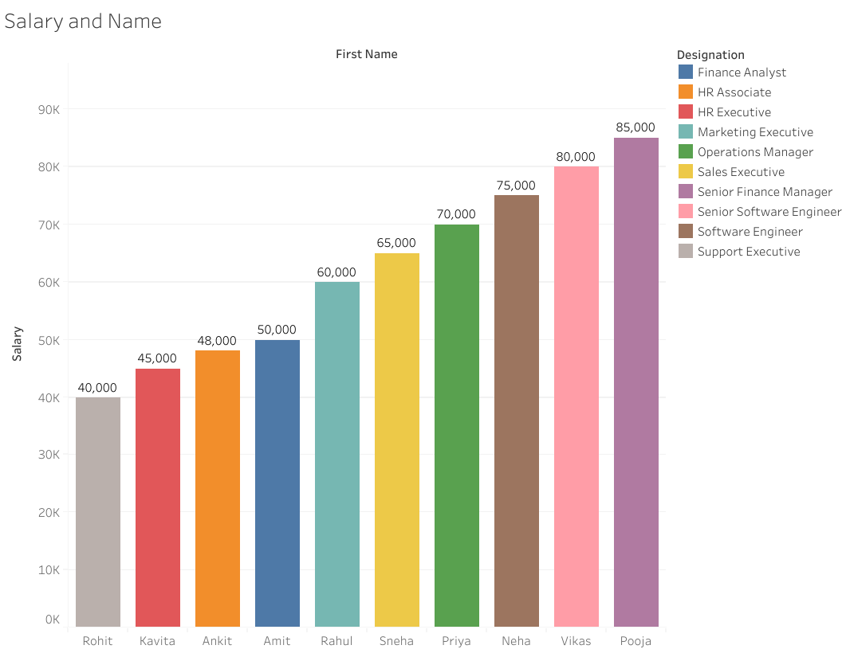

Slide 3
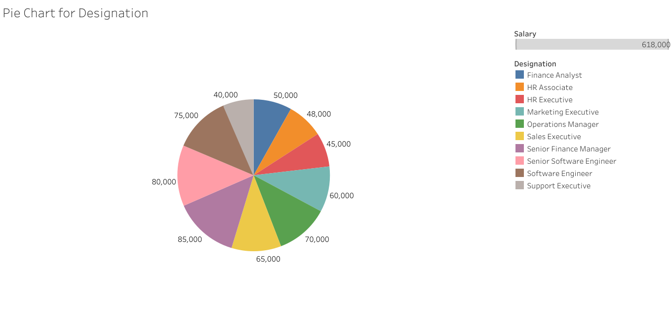

Slide 4
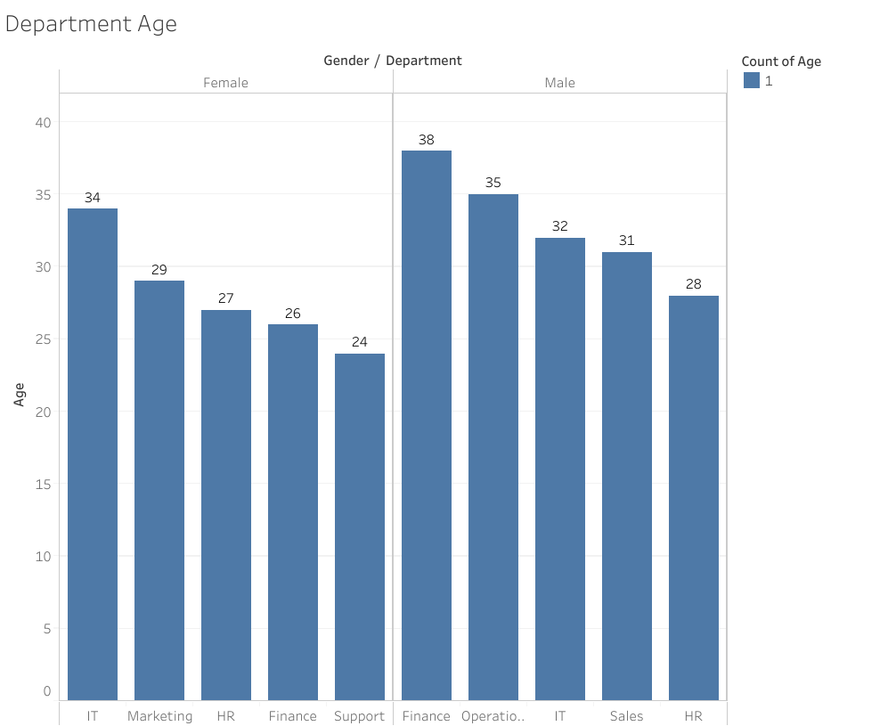

Slide 5
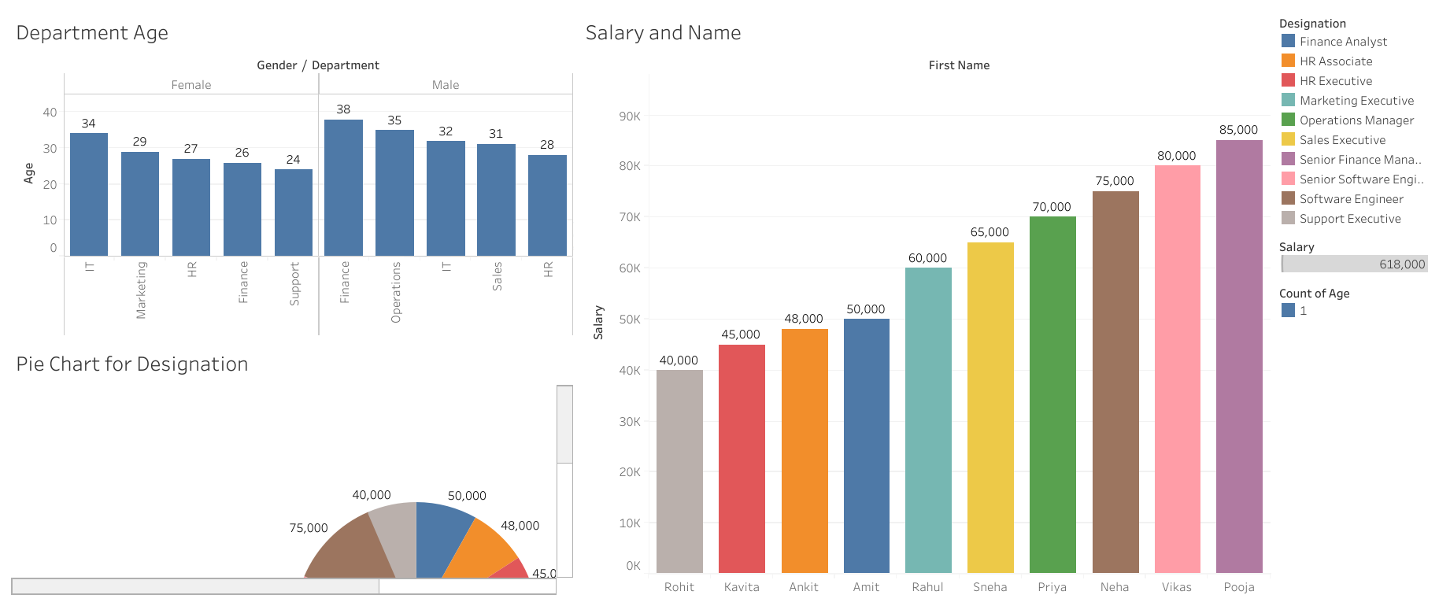

Slide 6
