Slide 1
Seasonal Agriculture Performance Analysis
Major Project – VOIS AICTE Batch 1 2026–2027
Sachi Kangutkar | D.G. Ruparel College of Arts, Science and Commerce
AICTE STU ID: STU683c6582c99651748788610

Slide 2
Problem Statement
Agricultural performance is affected by seasonal environmental conditions, farming practices, resource availability and market conditions.
Raw agricultural data does not directly explain how performance changes across seasons.
The project investigates seasonal differences using patterns, trends, relationships and variations in the supplied dataset.

Slide 3
Project Description
Analyze agricultural records across Kharif, Rabi and Zaid seasons.
Clean missing numeric observations and prepare data for analysis.
Compare yield, profit, production, water use and disease/pest risk.
Investigate crop-level and irrigation-level differences.
Present evidence-based findings and recommendations.

Slide 4
Who Are the End Users?
Farmers and farm managers – seasonal planning and resource decisions.
Agricultural planners – comparison of seasonal performance.
Analysts and researchers – identifying patterns for further investigation.
Agricultural organizations – evidence-based planning and monitoring.

Slide 5
Technology Used
Python 3 and Jupyter Notebook
Pandas and NumPy for data preparation and analysis
Matplotlib for visualization
Microsoft Excel / XLSX for dataset handling
Statistical summaries, grouping, correlation and comparative analysis

Slide 6
# Major Project: Seasonal Agriculture Performance Analysis
**Student:** Sachi Kangutkar
**College:** D.G. Ruparel College of Arts, Science and Commerce, University of Mumbai
**Project Type:** VOIS AICTE Batch 1 2026–2027 Major Project
## Problem Statement
Agricultural performance changes with seasonal environmental conditions, farming practices, resource availability and market conditions. This project analyzes the supplied agricultural dataset to identify seasonal differences, trends, relationships and variations in agricultural performance.
## Objectives
- Explore and understand the dataset.
- Clean and prepare the data.
- Compare agricultural performance across seasons.
- Identify seasonal patterns and trends.
- Investigate relationships between environmental/resource variables and outcomes.
- Compare crops and irrigation methods.
- Produce evidence-based conclusions and recommendations.

Slide 7
import pandas as pd
import numpy as np
import matplotlib.pyplot as plt
df = pd.read_excel("seasonal_agriculture_performance_dataset.xlsx")
print("Shape:", df.shape)
display(df.head())
display(df.info())
# 1. Data Quality Check
print("Missing values:")
display(df.isna().sum()[df.isna().sum() > 0])
print("Duplicate rows:", df.duplicated().sum())
print("Season counts:")
display(df["Season"].value_counts())

Slide 8
### Cleaning
The supplied data contains missing values in `Rainfall_mm`, `Soil_Moisture_pct`, and `Yield_Tonnes_Ha`. Because these are numeric variables, missing values are replaced with their respective medians. Duplicate rows are not removed because the dataset contains no duplicates.
clean = df.copy()
for col in ["Rainfall_mm", "Soil_Moisture_pct", "Yield_Tonnes_Ha"]:
clean[col] = clean[col].fillna(clean[col].median())
clean["Profit_Margin_pct"] = np.where(
clean["Revenue_INR"] != 0,
clean["Profit_INR"] / clean["Revenue_INR"] * 100,
np.nan
)
clean["Cost_per_Tonne_INR"] = np.where(
clean["Production_Tonnes"] != 0,
clean["Total_Cost_INR"] / clean["Production_Tonnes"],
np.nan
)
print("Remaining missing values:", int(clean.isna().sum().sum()))
display(clean.head())

Slide 9
## 2. Seasonal Performance Analysis
season_summary = clean.groupby("Season").agg(
Farms=("Farm_ID","count"),
Avg_Yield_Tonnes_Ha=("Yield_Tonnes_Ha","mean"),
Total_Production_Tonnes=("Production_Tonnes","sum"),
Avg_Revenue_INR=("Revenue_INR","mean"),
Avg_Cost_INR=("Total_Cost_INR","mean"),
Avg_Profit_INR=("Profit_INR","mean"),
Avg_Water_Used_m3=("Water_Used_m3","mean"),
Avg_Disease_Risk_pct=("Disease_Pest_Risk_pct","mean")
).round(2)
display(season_summary)
plt.figure(figsize=(8,5))
plt.bar(season_summary.index, season_summary["Avg_Yield_Tonnes_Ha"])
plt.title("Average Yield by Season")
plt.xlabel("Season")
plt.ylabel("Yield (Tonnes/Ha)")
plt.tight_layout()
plt.show()
season_summary = clean.grou

Slide 10
plt.figure(figsize=(8,5))
plt.bar(season_summary.index, season_summary["Avg_Profit_INR"])
plt.title("Average Profit by Season")
plt.xlabel("Season")
plt.ylabel("Average Profit (INR)")
plt.tight_layout()
plt.show()
## 3. Crop Analysis
crop_summary = clean.groupby("Crop").agg(
Farms=("Farm_ID","count"),
Avg_Yield_Tonnes_Ha=("Yield_Tonnes_Ha","mean"),
Avg_Profit_INR=("Profit_INR","mean"),
Avg_Disease_Risk_pct=("Disease_Pest_Risk_pct","mean")
).sort_values("Avg_Yield_Tonnes_Ha", ascending=False).round(2)
display(crop_summary)
plt.figure(figsize=(9,5))
plt.bar(crop_summary.index, crop_summary["Avg_Yield_Tonnes_Ha"])
plt.title("Average Yield by Crop")
plt.xlabel("Crop")
plt.ylabel("Yield (Tonnes/Ha)")
plt.xticks(rotation=35, ha="right")
plt.tight_layout()
plt.show()
plt.bar(season_summary.index, season_summary["Avg_Profit_INR"])
plt.title("Average Profit by Season")plt.figure(figsize=(8,5))
plt.xlabel("Season")
plt.show()
)
plt.xlabel("Season")
plt.ylabel("Average Profit (INR)")
plt.tight_layout()
plt.show()
plt.figure(plt.show()

Slide 11
## 4. Irrigation Analysis
irrigation_summary = clean.groupby("Irrigation_Method").agg(
Avg_Yield_Tonnes_Ha=("Yield_Tonnes_Ha","mean"),
Avg_Profit_INR=("Profit_INR","mean"),
Avg_Water_Used_m3=("Water_Used_m3","mean")
).sort_values("Avg_Yield_Tonnes_Ha", ascending=False).round(2)
display(irrigation_summary)
plt.figure(figsize=(8,5))
plt.bar(irrigation_summary.index, irrigation_summary["Avg_Yield_Tonnes_Ha"])
plt.title("Average Yield by Irrigation Method")
plt.xlabel("Irrigation Method")
plt.ylabel("Yield (Tonnes/Ha)")
plt.xticks(rotation=20)
plt.tight_layout()
plt.show()
## 5. Environmental Relationship
corr_cols = [
"Rainfall_mm","Avg_Temperature_C","Humidity_pct","Sunlight_Hours_Day",
"Soil_Moisture_pct","Nitrogen_kg_ha","Phosphorus_kg_ha","Potassium_kg_ha",
"Fertilizer_kg_ha","Seed_Quality_Score","Yield_Tonnes_Ha",
"Water_Used_m3","Disease_Pest_Risk_pct","Profit_INR"
]
corr = clean[corr_cols].corr(numeric_only=True)["Yield_Tonnes_Ha"].sort_values(ascending=False)
display(corr)

Slide 12
plt.figure(figsize=(8,5))
plt.scatter(clean["Rainfall_mm"], clean["Yield_Tonnes_Ha"], alpha=0.35, s=12)
plt.title("Rainfall vs Yield")
plt.xlabel("Rainfall (mm)")
plt.ylabel("Yield (Tonnes/Ha)")
plt.tight_layout()
plt.show()
## 6. Key Findings
1. **Kharif has the highest average yield** among the three seasons in the supplied dataset.
2. **Kharif also has the highest average profit**, while Zaid has a negative average profit.
3. **Zaid uses the highest average amount of water**, while Rabi uses the lowest average water among the three seasons.
4. **Kharif shows the highest average disease/pest risk** in this dataset.
5. **Sugarcane has a much higher average yield** than the other crops, so crop comparisons should consider crop-specific production characteristics.
6. **Drip irrigation has the highest average yield** among the irrigation methods in the dataset.
7. The analysis identifies associations and patterns; it does **not** establish causal relationships.
## 7. Recommendations
- Use seasonal performance comparisons when planning crop and resource allocation.
- Investigate the higher disease/pest risk observed in Kharif and consider targeted monitoring.
- Evaluate drip irrigation practices for situations where water efficiency and yield are priorities.
- Review Zaid-season costs, water use and market outcomes because its average profit is negative.
- Analyze crop-specific economics rather than relying only on overall yield because crop types have very different yield scales.
- Continue collecting consistent environmental, resource and economic data to improve future seasonal planning.

Slide 13
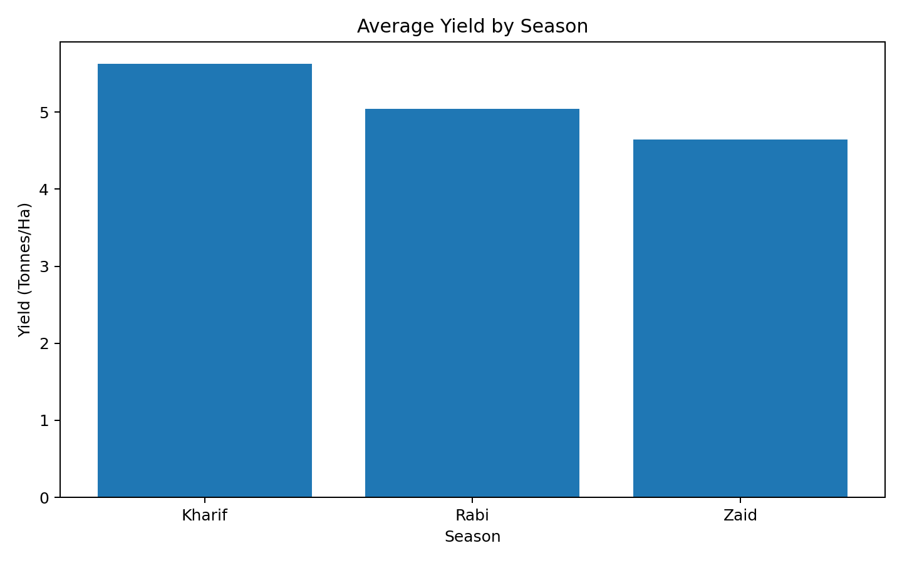
Results – Average Yield by Season

Slide 14
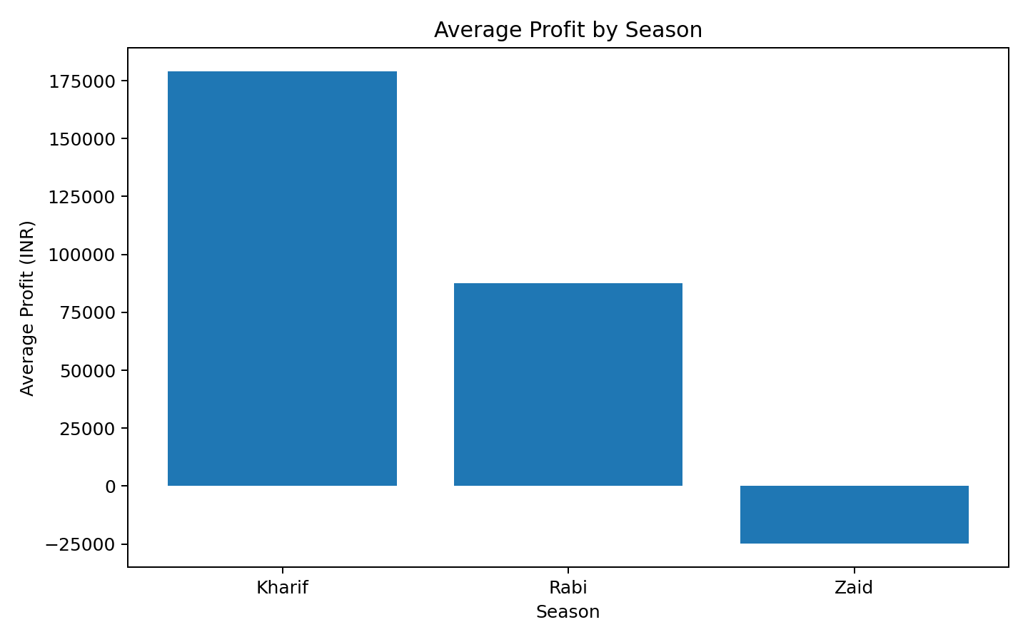
Results – Average Profit by Season

Slide 15
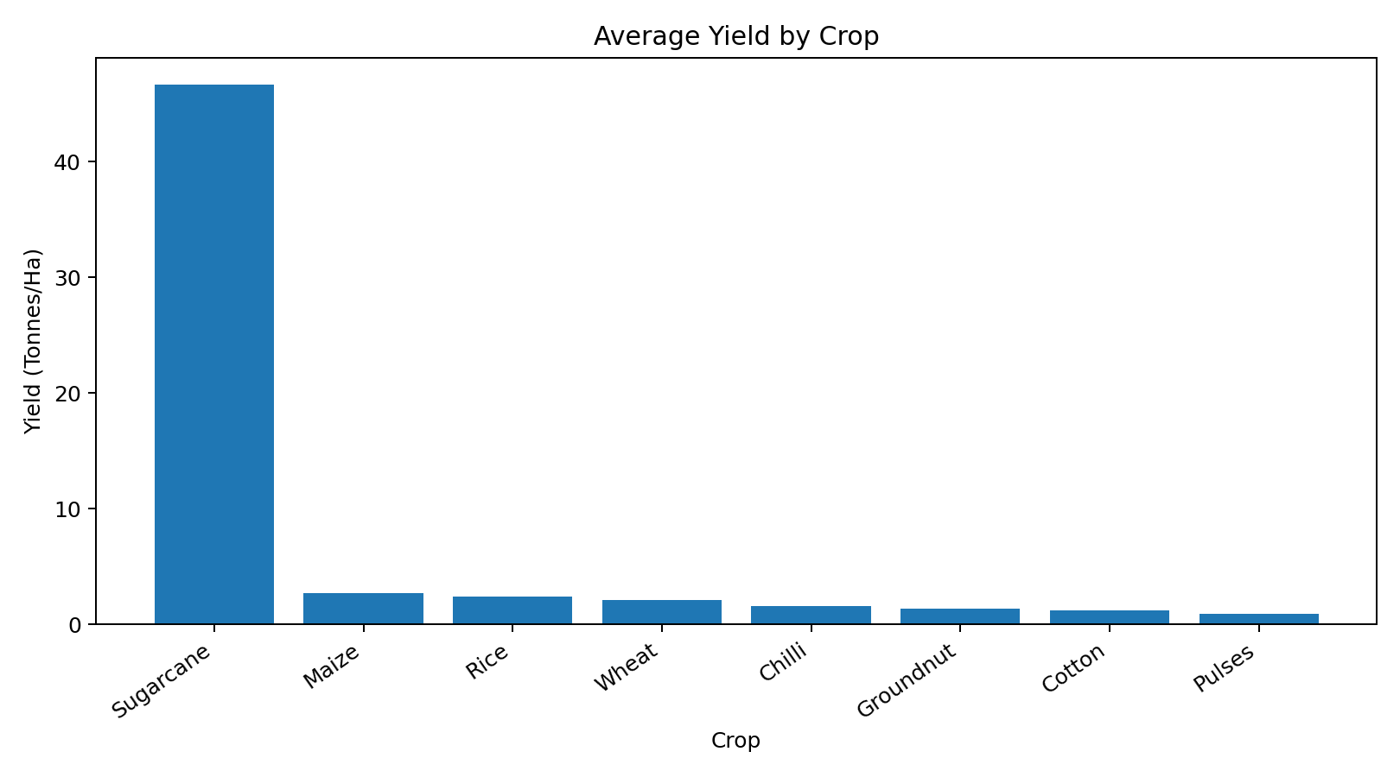
Results – Average Yield by Crop

Slide 16
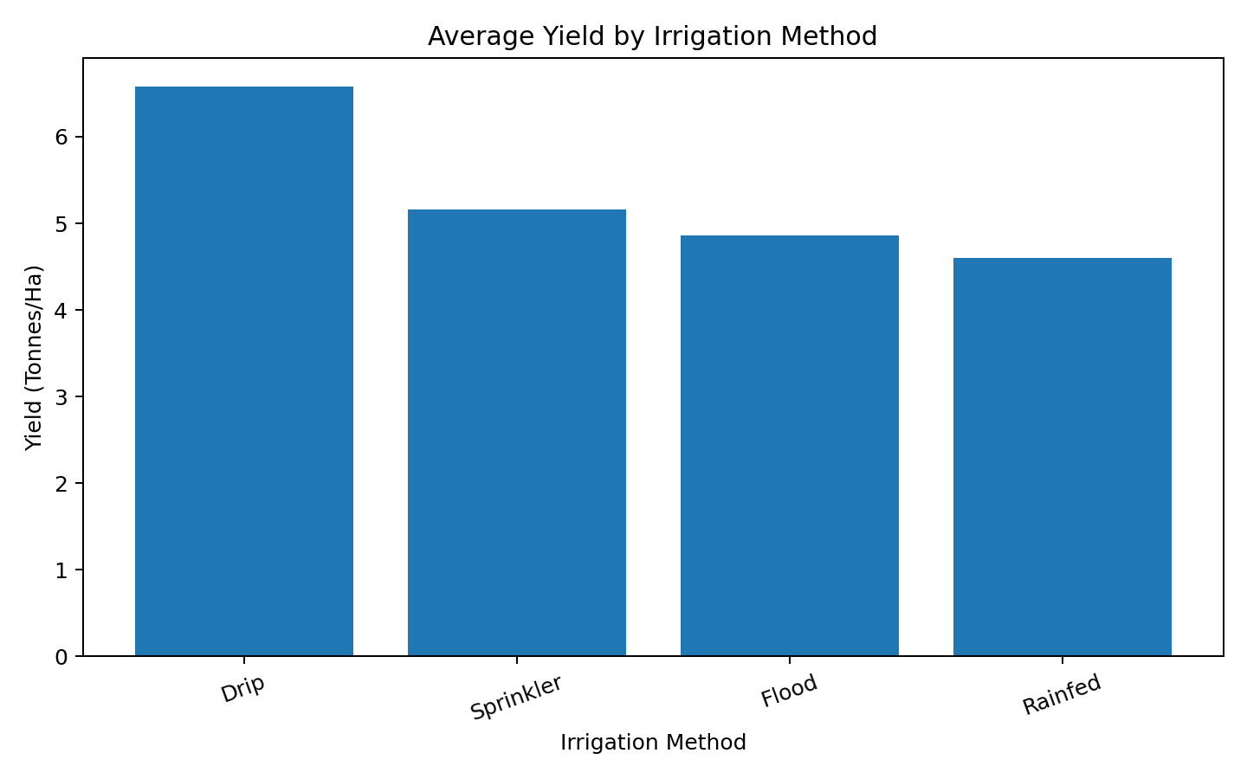
Results – Yield by Irrigation Method

Slide 17
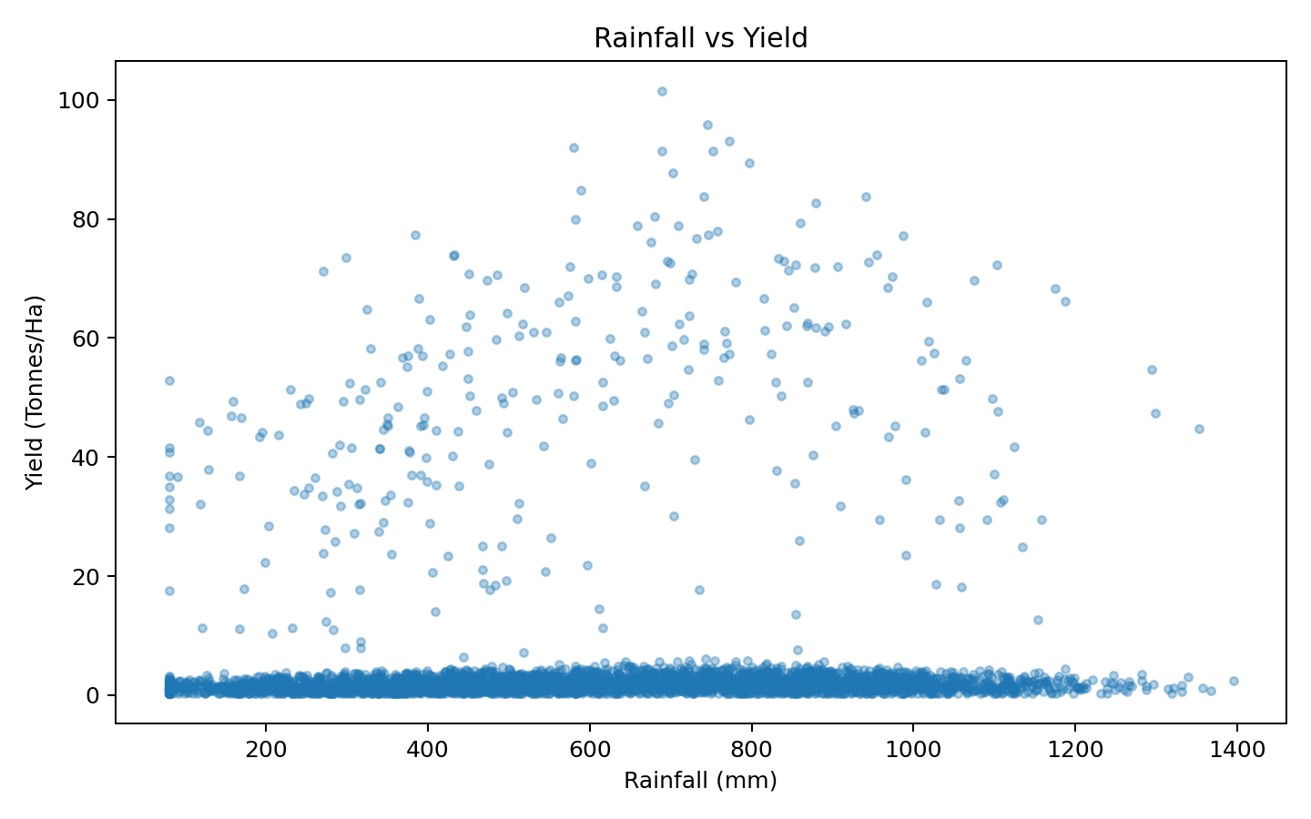
Results – Rainfall vs Yield

Slide 18
Key Findings
Kharif has the highest average yield: 5.63 tonnes/ha.
Kharif has the highest average profit: ₹178,914.65.
Zaid has the lowest average yield: 4.64 tonnes/ha and negative average profit.
Zaid has the highest average water use: 6,419.89 m³.
Kharif has the highest average disease/pest risk: 54.47%.
Drip irrigation has the highest average yield among irrigation methods.

Slide 19
Future Scope
Build an interactive Power BI dashboard for seasonal monitoring.
Add time-series data to study multi-year seasonal changes.
Use predictive models for yield and profit forecasting.
Develop region-specific recommendations using district-level analysis.
Add weather forecasts and market-price feeds for real-time decision support.

Slide 20


Slide 21
GitHub Link
Upload the notebook, cleaned dataset, charts and README to your GitHub repository.
Suggested repository name: git@github.com:sachikangutkar/Seasonal-Agriculture-Performance-Analysis-project.git

Slide 22
Conclusion
The dataset shows meaningful differences in yield, profit, water use and disease/pest risk across seasons.
Seasonal, crop and irrigation comparisons can support evidence-based agricultural planning.
The results describe observed patterns; further investigation is needed before causal decisions.

Slide 23
Thank You

