Slide 1
The AI Content Engine
Trend → Publish in 2 Minutes · 5 Platforms · 300 Posts/Month
Housing.com Hackathon 2026 · Multi-Agent AI
₹8L/mo saved
2 min
5 platforms
3-pass QA
vs agency team
end-to-end run
simultaneously
brand-safe output

Slide 2
The Problem: Content at Scale is Broken
⏱ Speed Gap
💸 Cost Cliff
Housing market moves daily — RERA rulings, RBI rate cuts, city micro-trends. A 4-person content team can't process 15 trending topics and publish before they peak.
₹8–10 lakh/month for a full content team: 1 strategist, 2 writers, 1 social manager. Output: ~60–80 posts/month. Cost per post: ₹10,000–16,000.
🎯 Quality Drift
🔗 Platform Blindness
Brand voice inconsistency across writers. Instagram caption ≠ LinkedIn tone. No systematic QA. Political or factually wrong posts slip through.
Same content pasted across 5 platforms. Twitter's 280 chars. Instagram's hashtag game. YouTube Shorts scripts. Each platform has different physics — one draft doesn't fit all.
Housing.com × Multi-Agent AI
2

Slide 3
Introducing
The AI Content Engine
A fully automated, multi-agent pipeline that monitors real-time trends, generates platform-native content, enforces 3-pass brand safety QA, and publishes to 5 channels — in under 2 minutes.
Claude Opus 4.7
LangGraph
5 Platforms
3-Pass QA
Hinglish Voice
SEO Articles
Slack Bot
Engagement Prediction
Housing.com × Multi-Agent AI
3

Slide 4
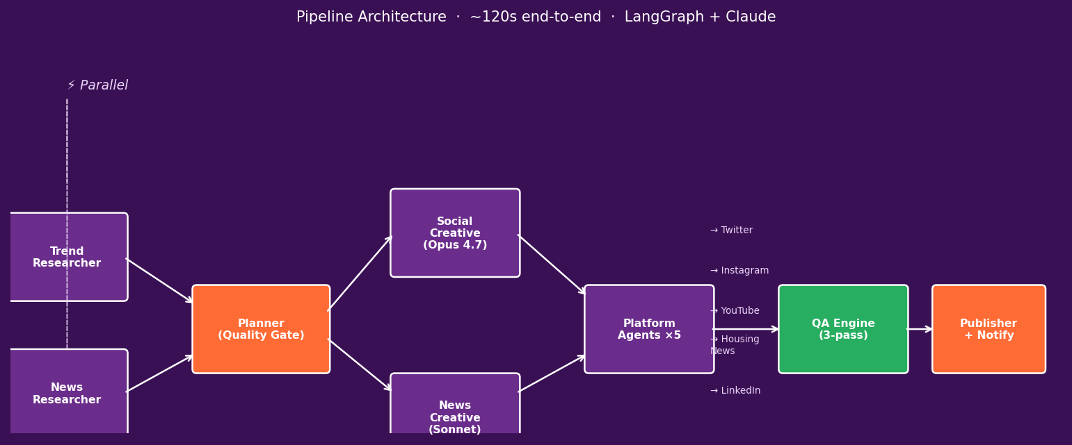
Architecture: 8-Node Multi-Agent Pipeline
Housing.com × Multi-Agent AI
4

Slide 5
What Each Agent Does
🔍 Researcher
Sonnet 4.6
📰 News Creative
Sonnet 4.6
Tavily web search across 12 credible RE sources. 5 rounds max. 8 news items with relevance scoring.
700–1000 word SEO articles. H2 structure, pull quote, internal links, ≤70 char headline. CMS-ready JSON output.
📈 Trend Researcher
Sonnet 4.6
🖥 Platform Agents ×5
Sonnet 4.6
Aggregates Google Trends + YouTube India + Reddit + Twitter. 15 trend items with Hinglish creative hooks.
Twitter (≤280 chars + thread), Instagram (story slides + reel script), YouTube, LinkedIn, Housing.com News.
🗂 Planner
Gemini Flash
🛡 QA Engine
Multi-model
Quality gate. Filters off-topic content. Max 5 social + 3 news briefs. OMIT anything with no genuine RE angle.
3-pass: Safety gate (binary, Gemini Flash) → Quality scoring (7 dimensions, Sonnet) → Engagement prediction (Opus).
✍️ Social Creative
Opus 4.7
📤 Publisher
No LLM
Zomato method: trend is HERO, housing is PUNCHLINE. Hinglish, 2 emojis max, meme-ready card concept.
Deterministic. Saves to disk (dry run) or posts live. Slack summary per run. retry=None (non-idempotent).
Housing.com × Multi-Agent AI
5

Slide 6
Sample Output: Twitter Thread (Auto-generated, RERA Topic)
@HousingDotCom · Thread
Model
Opus 4.7 (creative tier)
🚨 8,212 projects just received RERA notices in Maharashtra alone. Is your dream home on the list? Bank accounts frozen. Sales halted. Registrations cancelled. Here's how to check before it's too late 👇 https://housing.com/in/buy/mumbai
Hook type
Stat-based urgency
Platform
Twitter thread (4 parts)
Chars
238 / 280 (✓ within limit)
2/ In the last 30 days, 3 regulators dropped the hammer: • MahaRERA: 8,212 notices (Mumbai + Pune) • Telangana RERA: 11% refund ordered on defrauded buyers • Haryana RERA: ₹52 crore penalty threat
Hashtags
#RERA #MahaRERA + 3 more
Links
2 internal (Mumbai, Pune SRP)
Run time
~8s for creative node
✅ QA Score: 6.4 / 10 ✅ Safety: PASSED 📊 Pred. ER: 7.15%
Housing.com × Multi-Agent AI
6

Slide 7
Sample Output: Instagram (Branded Card + Story Slides + Reel Script)
housing.com
Story Slides (auto-generated):
⚠️ 8,212 projects just received RERA notices. Is YOUR project safe?
Slide 1 — HOOK: '8,212 housing projects. RERA notices. Is YOUR project safe? Swipe →'
Slide 2 — THE CRACKDOWN: Maharashtra, Telangana, Haryana — all in 30 days
Slide 3 — WHAT'S AT RISK: Bank accounts frozen, sales halted, ₹52Cr penalty
Slide 4 — YOUR CHECKLIST: 5-step RERA verification guide
Check. Verify. Buy Smart.
Slide 5 — CTA: Search RERA-verified homes on Housing.com 🔗 Link in bio
Reel Concept:
0–4s: dramatic text reveal 'Is your dream home on this list?' | 5–22s: on-camera presenter outside Mumbai building, 5-step checklist flash | 23–28s: Housing.com app CTA
✅ QA Score: 6.8 / 10 ✅ Safety: PASSED 📊 Pred. ER: 5.7% 🏷 Hashtags: 28
Housing.com × Multi-Agent AI
7

Slide 8
Sample Output: Housing.com News (SEO Article, 800 words, CMS-ready)
SEO Title:
8,212 Projects Got RERA Notices: How to Check If Your Home Is at Risk
Format
CMS-ready JSON + Markdown
Primary keyword: how to check RERA registration · Reading time: 4 min
SEO Title
≤ 70 chars ✓
MahaRERA just sent show-cause notices to 8,212 housing projects. Telangana RERA ordered an 11% interest refund to defrauded buyers. Haryana threatened a ₹52 crore penalty on a developer selling unregistered floors. If you are buying a home in 2026, this is the only article you need to read first... ## What Just Happened: Three RERA Crackdowns in 30 Days Maharashtra's RERA has issued show-cause notices to 8,212 housing projects for failing to file mandatory Quarterly Progress Reports (QPRs). The breakdown: 4,644 in Mumbai Metropolitan Region, 1,957 in Pune... ## The 60-Second RERA Check Every Buyer Must Do ✅ Step 1: Ask for the RERA Registration Number ✅ Step 2: Verify on Your State's RERA Portal ✅ Step 3: Check QPR Status...
Meta Desc
≤ 160 chars ✓
H2 Structure
4 sections ✓
Pull Quote
Independently shareable ✓
Schema
NewsArticle JSON-LD
Internal Links
3 embedded contextually
QA Score
8.0 / 10
Safety
PASSED ✓
Pred. ER
2.1% (CTR-focused)
Internal links: 3 Housing.com SRP pages embedded contextually
8
Housing.com × Multi-Agent AI
8

Slide 9
The Creative Strategy: The Zomato Method
Social content fails when housing is the HERO and the trend is the footnote. It works when the TREND is the hero and housing is the punchline.
Trend: IPL final
Trend: Budget ₹12L tax-free
Trend: Coldplay concert
❌ Weak: 'Celebrating RCB's win! Buy a home in Bangalore! 🏠' ✅ Strong: 'RCB waited 18 years to win the IPL. You've been waiting to buy a ghar for 3. Maybe 2025 is both our years. 🏆' #RCBvKKR #GharKhojna
❌ Weak: 'Budget 2025 is great for home buyers!' ✅ Strong: 'Finance minister just made ₹12L tax-free. Your EMI just got more affordable than your rent. Check how much home you can afford now 👇' #Budget2025 #HomeLoan
❌ Wrong: 'Coldplay is coming! Buy a home near the venue!' ✅ OMIT: No genuine housing angle → planner drops it (Planner quality gate working as designed)
Trend is HERO · Housing is PUNCHLINE · Hinglish + max 2 emojis · First hashtag = trending tag
Housing.com × Multi-Agent AI
9

Slide 10
Quality Gate: 3-Pass AI Review on Every Post
Pass 1 Safety Gate
Pass 2 Quality Score
Pass 3 Engagement Pred.
Gemini Flash ~$0.001/post
Sonnet 4.6 ~$0.012/post
Opus 4.7 ~$0.015/post
Binary PASS/FAIL Hard blocks: • Political party names • Communal / religious attacks • Price guarantees with numbers • Defamation / insider info Always allowed: • Govt schemes (PMAY, RERA) • Women homebuyers • Market data with attribution
7-dimension scoring (0–10) Twitter: Trend dominance (35%) + Shareability (30%) + Hinglish wit (25%) + CTA quality (10%) Threshold < 5.0 → REVISE Up to 2 revision loops
Behavioural prediction Outputs: • pred_impressions • pred_engagement_rate • pred_confidence Historical Housing.com data + platform engagement physics + trend momentum signal
→
→
Revision loop: REVISE decision → platform agent reruns with specific fix instructions → re-evaluated (max 2 attempts)
Housing.com × Multi-Agent AI
10

Slide 11
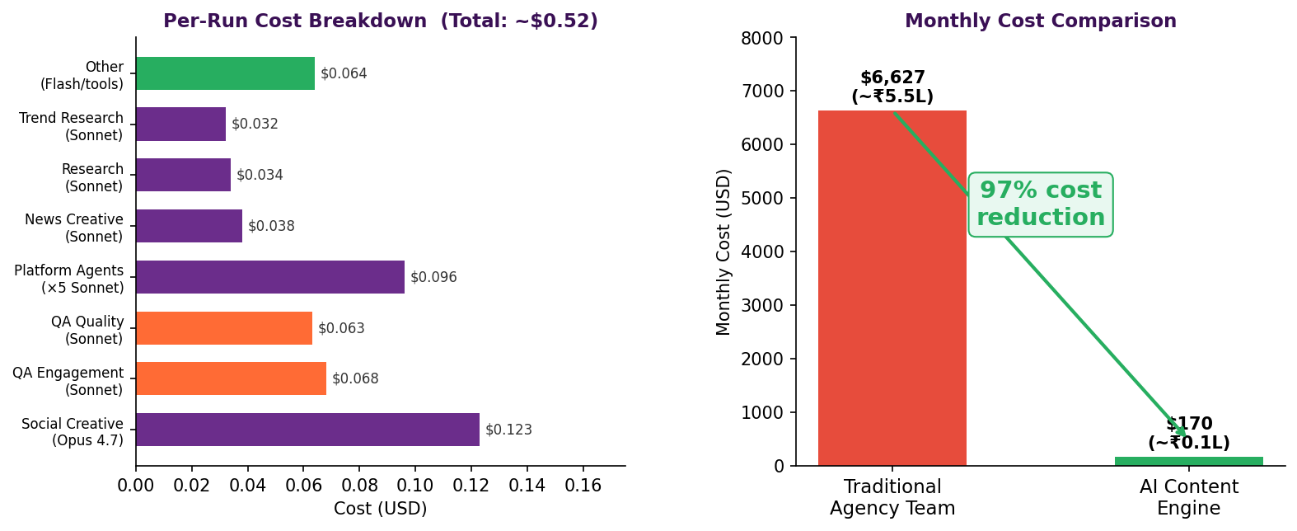
The Economics: 97% Cost Reduction vs Traditional Agency
Housing.com × Multi-Agent AI
11

Slide 12
Business Impact
₹8L–10L/mo
300
agency cost replaced
posts / month
Traditional 4-person content team
vs ~60–80 from human team (5× volume)
₹14,000/mo
5
all-in AI cost
platforms
LLM + infra + search APIs
Twitter, Instagram, YouTube, LinkedIn, Housing.com News
97%
<2 min
Housing.com × Multi-Agent AI
12
cost reduction
per full pipeline run
Payback period: < 2 months
Trend → QA → Ready to publish

Slide 13
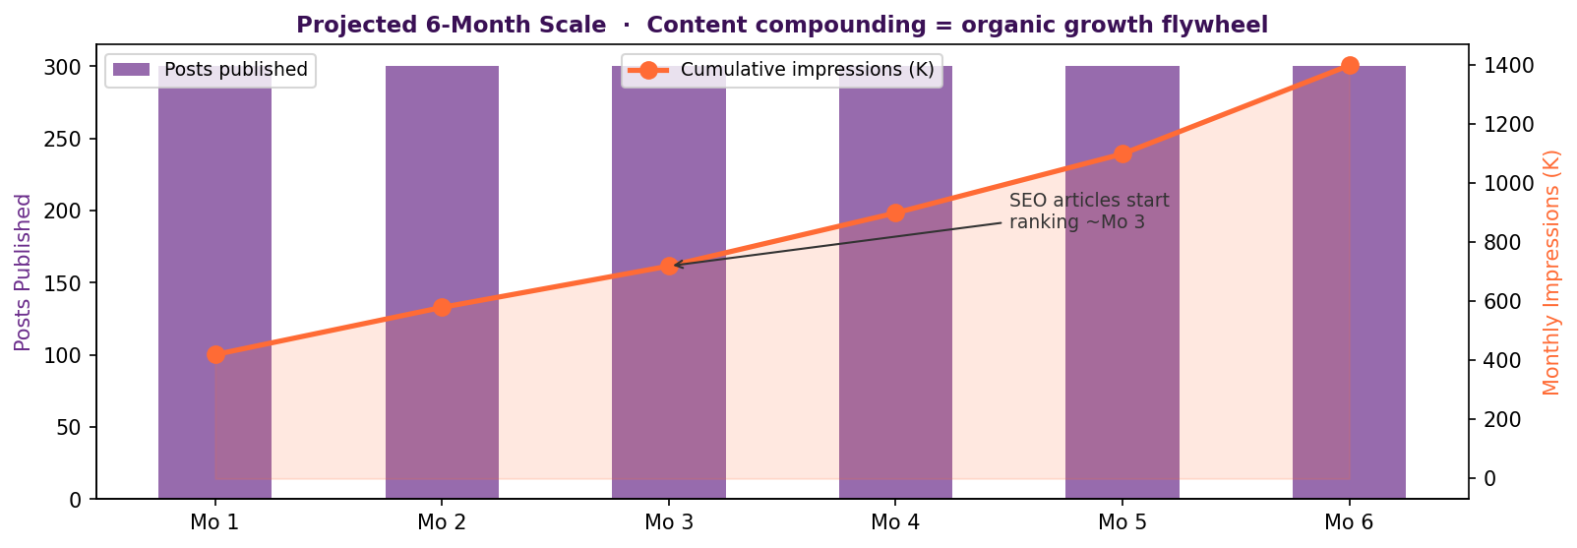
Scale: 6-Month Content Compounding Projection
Engagement estimates based on Housing.com platform benchmarks · Twitter ER: 1.5–7% · Instagram ER: 5–7% · News CTR: 2–3%
Housing.com × Multi-Agent AI
13

Slide 14
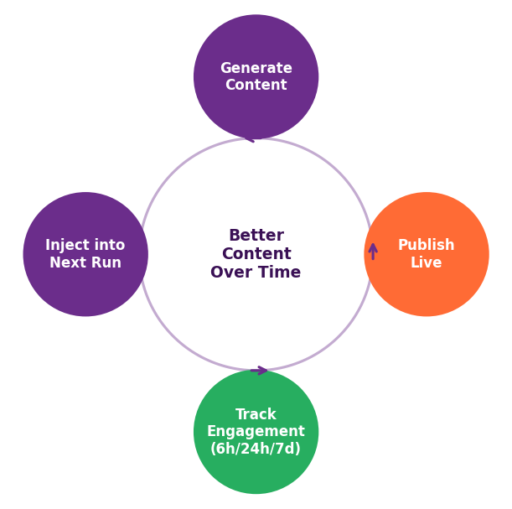
The Feedback Flywheel: The System Gets Smarter Every Day
How the loop works:
1. Publish
Every approved post is stored with QA scores + predicted engagement
2. Track
Engagement jobs fetch actual metrics at 6h, 24h, and 7 days post-publish
3. Learn
get_performance_history() identifies top/bottom performers by topic, tone, city
4. Inject
Performance context injected into social_creative prompt every run
5. Improve
Creative agent learns: cricket+Bengaluru gets 3× more ER than market analysis
Realistic improvement: ~22% engagement rate gain over first 50 runs · Plateaus as easy signal is harvested
Housing.com × Multi-Agent AI
14

Slide 15
Deployment: 5 Ways to Run It
🖥 Scheduled Server
💬 Slack Bot
🔌 REST API
python main.py serve
python main.py slack-bot
POST /run · GET /runs/{id}
9 AM + 6 PM IST daily. APScheduler triggers automatically. FastAPI REST API for manual control.
DM '@HousingBot content idea' → pipeline runs → Slack thread reply in 2 mins. Triggered by marketing team.
Any system can trigger a run. Async response with run_id. Real-time status polling. CI/CD integration.
🖱 React Dashboard
⌨️ CLI (this demo)
python main.py ui
python main.py run
Browser UI: run history, QA scores, published posts, engagement tracking, feedback collection.
Single pipeline run with live progress bar. 2-3 minutes. Outputs saved to output/<run_id>/
Housing.com × Multi-Agent AI
15

Slide 16
Technology Stack
AI / LLM
Orchestration
Data & Tools
Infrastructure
Claude Opus 4.7
LangGraph
Tavily + Serper
FastAPI
Social creative, engagement prediction
Stateful multi-agent graph, parallel fan-out/in
Real-time web search across 12 RE domains
REST API + async run management
Claude Sonnet 4.6
AsyncSqliteSaver
Google Trends + Reddit
APScheduler
Research, news creative, QA quality, platforms
Checkpointing — crash-resumable runs
Social trend aggregation (4 sources)
Cron-style scheduling (9 AM + 6 PM IST)
Gemini 2.5 Flash
RetryPolicy
SQLite + SQLAlchemy
React + Vite
Planner, QA safety, extraction (53% cheaper)
Exponential backoff on all non-publisher nodes
Post storage, QA history, engagement tracking
Real-time dashboard UI
PIL (Pillow)
1080×1080 branded card generation (no DALL-E cost)
Housing.com × Multi-Agent AI
16

Slide 17
Case Study: RERA Crackdown → 5 Platform Posts in 97 Seconds
0s
researcher_node
Tavily fetches 8 RE news stories + 5 RERA-specific articles (Sonnet 4.6)
8s
trend_researcher
Google Trends: #RERA trending + 15 total trend items with Hinglish hooks
19s
planner_node
RERA story → 2 briefs: social (Hinglish urgency) + news (SEO buyer guide)
27s
social_creative
Opus 4.7: 'Is your dream home on this list?' Zomato-style urgency hook
35s
news_creative
Sonnet: 800-word SEO article '8,212 Projects Got RERA Notices...'
53s
platform_agents ×5
Async: Twitter thread (4 parts) + Instagram (5 story slides + reel) + YouTube Short + Housing News
71s
qa_agent
Safety: PASS · Quality: 6.4–8.0/10 Engagement: 5.7%–7.15% predicted
97s
publisher
4 posts saved (dry run) 2 internal links per post · Slack summary sent
Housing.com × Multi-Agent AI
17

Slide 18
Roadmap: What's Next
Now ✅ Hackathon Demo
Month 1–2 Production Deploy
Month 3–6 Scale & Intelligence
5-platform auto-publish
Live posting to all 5 platforms
Vernacular expansion (Hindi, Tamil, Telugu)
3-pass QA engine
Human-in-the-loop approval UI
Video generation (Sora API)
Hinglish social + SEO news
PostgresSaver for multi-worker
Personalized city microsites
Slack bot trigger
A/B model routing testing
Builder partnership content
Engagement prediction
Hooks bank weekly refresh
Engagement prediction V2 (trained on real data)
2 min end-to-end runtime
Monitoring + alerting dashboard
WhatsApp channel integration
Housing.com × Multi-Agent AI
18

Slide 19
The AI Content Engine is live.
300 posts/month. ₹14,000/month all-in. Brand-safe, platform-native, Hinglish-first.
✅ Deploy Now
📊 Pilot 30 days
🚀 Scale
DRY_RUN=false + platform keys → Live in 30 minutes
Run alongside human team Measure engagement delta
Multi-city, multi-language → Housing.com #1 PropTech content brand
Demo: python main.py run · Output in: output/<run_id>/
Built at Housing.com Hackathon 2026 · Multi-Agent AI Stack
19

