Slide 1
Analytics & Data Understanding
OUTLINES:
1. Business Case
2. Describing the Data - Data Description Report
3. Exploring the Data (Insights)

Slide 2
Business Case:
Determining and understanding that the respective client will experience any kind of financial obstacle in upcoming time while using the credit lines.
This method will help the bank,to determine the portfolio of client that the respective client should be approved for thier loan or not.

Slide 3
Data Description Report:
Variable Name | Description
SeriousDlqin2yrs | Person experienced 90 days past due delinquency or worse
RevolvingUtilizationOfUnsecuredLines | Total balance on credit cards and personal lines of credit except real estate and no installment debt like car loans divided by the sum of credit limits
age | Age of borrower in years
NumberOfTime30-59DaysPastDueNotWorse | Number of times borrower has been 30-59 days past due but no worse in the last 2 years.
DebtRatio | Monthly debt payments, alimony,living costs divided by monthy gross income
MonthlyIncome | Monthly income
NumberOfOpenCreditLinesAndLoans | Number of Open loans (installment like car loan or mortgage) and Lines of credit (e.g. credit cards)
NumberOfTimes90DaysLate | Number of times borrower has been 90 days or more past due.
NumberRealEstateLoansOrLines | Number of mortgage and real estate loans including home equity lines of credit
NumberOfTime60-89DaysPastDueNotWorse | Number of times borrower has been 60-89 days past due but no worse in the last 2 years.
NumberOfDependents | Number of dependents in family excluding themselves (spouse, children etc.)

Slide 4
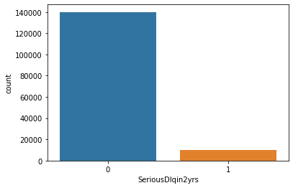
Exploring the Data & Insights
6.6% clients in data are defaulted
SeriousDlqin2yrs (the probability of having default in next two years)
1: Dfaulter
0: Non-Defaulters
count 150000.000000
mean 0.066840
std 0.249746

Slide 5
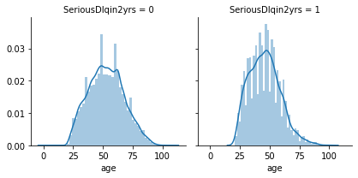
Exploring the Data & Insights: Age
Young Client B/W 23/25 to 50 are the one who is defaulting
Mean 52 yrs
Min 21 yrs old
25% 41 yrs old
50% 52.yrs old
75% 63 yrs old
Max 109 yrs old
Age Range (Unique Values in Data)
([ 45, 40, 38, 30, 49, 74, 57, 39, 27, 51, 46, 76, 64, 78, 53, 43, 25, 32, 58, 50, 69, 24, 28, 62, 42, 75, 26, 52, 41, 81, 31, 68, 70, 73, 29, 55, 35, 72, 60, 67, 36, 56, 37, 66, 83, 34, 44, 48, 61, 80, 47, 59, 77, 63, 54, 33, 79, 65, 86, 92, 23, 87, 71, 22, 90, 97, 84, 82, 91, 89, 85, 88, 21, 93, 96, 99, 94, 95, 101, 98, 103, 102, 107, 105, 109])

Slide 6
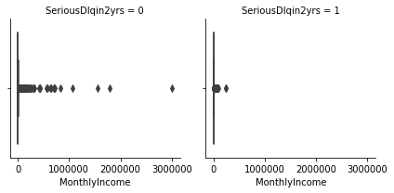
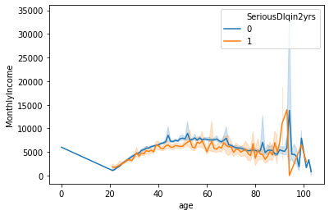
Exploring the Data & Insight: MothlyIncome
Monthly Income’s behaviour for defaulters and Non defaulters are likely similar in data
count 120269.00
mean 6670.22
std 14384.67
min NA Due To Null Values
25% 3400.00
50% 5400.00
75% 8249.00
max 3008750.00
Missing values are observed
Can be treated with median due to outliers

Slide 7
About Data Quality
In sample data quality was moderate as following points have been noticed
In age column max age was 109
In PastDue Data there was strong corelation.
Monthly Income can be a very important feature but null values were present.

