Slide 1
Loan Delinquency Prediction
India ML Hiring Hackathon 2019
Sachin Rastogi

Slide 2
My Approach
Understood the problem statement and related features.
Created baseline model with only numeric data.
Performed exploratory data analysis and noted down the insights.
Applied feature engineering to get best outcome.
Experimented with different classification models and selected XGB classifier based on results.
Performed k-fold cross validation.
Improvised probability threshold to get better results.
Predicted target value for test data and uploaded the results.
Refer following slides for more details.

Slide 3
Data-preprocessing / feature engineering ideas.
Created dummy features out of “source”, "financial_institution” and “loan_purpose” categorical features.
As dataset is highly imbalanced, used SMOTE for over sampling of minority class.
Created a new feature “credit_score” based on “borrower_credit_score”, “number_of_borrowers” and “co-borrower_credit_score”. In case of co-borrowers, lowest score among borrowers will be counted.
Using domain knowledge, converted credit_score to different bins
no_score for 0-299
very_poor for 300-579
fair for 580-669
good for 670-739
very_good for 740-799
exceptional for 800 and beyond

Slide 4
Data-preprocessing / feature engineering ideas continue…
Since there is an implicit ordinal relationship among “credit_score” bins, credit score bins are converted to Ordinal variable.
Interest rate measures the riskiness of the borrower, i.e. the riskier the borrower, the higher the interest rate. I have defined an ordinal relationship among different interest rates and created bins out of that. Since there is an implicit order among rates, interest rate bins are converted into ordinal variable.
Converted dtype of “origination_date” and “first_payment_date” to pandas datetime object.
Observed a specific pattern with first payment date and delinquency status, so created a specific ordinal encoding for “first_payment_date”.
Since there is a fixed difference of two months between “origination_date” and “first_payment_date”, dropped “origination_date” as a feature.

Slide 5
How does your final model look like? How did you reach it?
Applied XGBoost classifier with K-Fold cross validation. I also tried Logistic Regression in place of XGBoost but XGBoost gave better results.
Applied SMOTE for oversampling of minor class. I also tried RandomOverSampler and RandomUnderSampler in place of SMOTE.
I have explained SMOTE with cross validation on next slide.

Slide 6
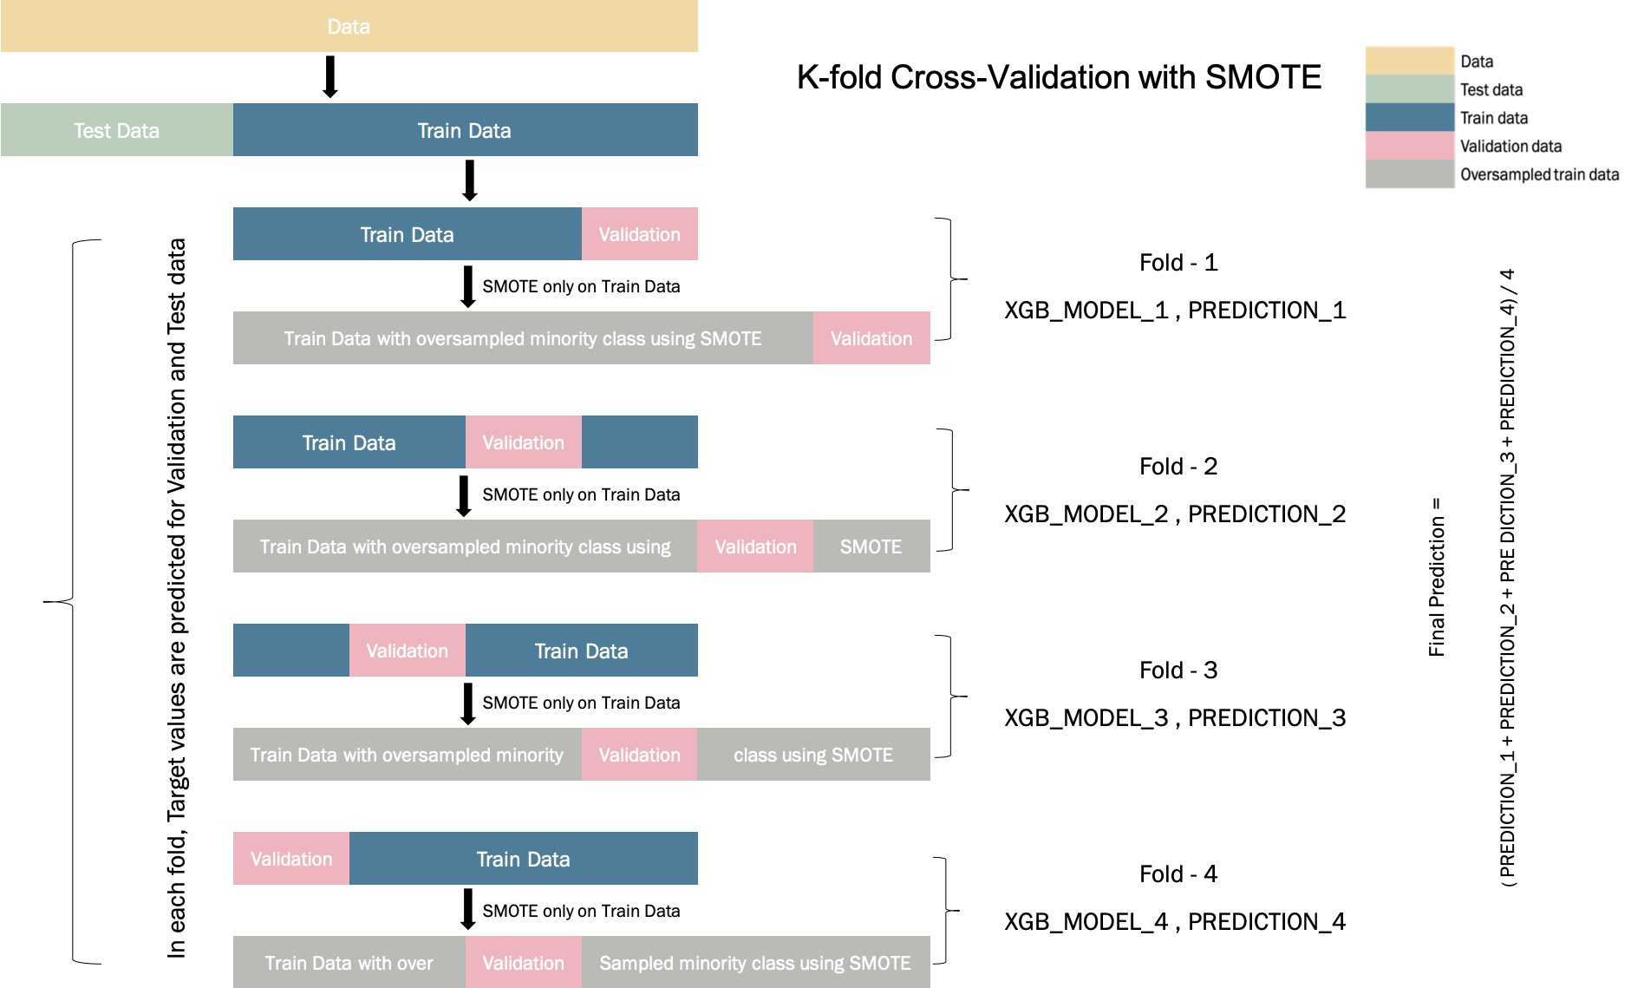
How does your final model look like? How did you reach it?

Slide 7
What are the key takeaways from the challenge, if any?
Domain knowledge is very important, if not aware, understand about all the features before starting the problem.
Feature engineering is key, don’t underestimate it. Trust your instinct and try different encoding schemes.
Never ignore nitty-gritty of features e.g. if we want to create a new feature “credit_score” from features like “borrower_credit_score” and “co-borrower_credit_score”, we need to choose the lowest score among them. In a joint loan, financial institutes always consider lower credit score among them for loan approval.
It is very important to have a communication channel with stake holders responsible for business to understand any doubt with respect to data.
E.g. It is not clear how "m1" is aligned with "origination_date" or "first_payment_date". Loans with "loan_term" less than 6 months with 0 loan delinquency between m1-m12 will always have m13 as 0. So those rows can be treated differently.

Slide 8
5 things a participant must focus on while solving such problems?
Understand the problem statement before start fitting the model.
Feature engineering is very important to get good results from your model. Get best out of it.
Try different techniques to solve class imbalance problem and choose best among them.
Always keep an eye on Data Leakage. E.g. SMOTE and K-Fold cross validation order, Feature scaling and K-Fold cross validation.
Domain knowledge is very important, if not aware, read or consult with respective business owners.

Slide 9
Important finance terms and their meaning
Loan-to-Value (LTV) Ratio: The ratio of the principal balance of a mortgage loan to the value of the securing property, as determined by the purchase price or Appraised Value, whichever is less.
Delinquency: A loan becomes delinquent when you make payments late (even by one day) or miss a regular installment payment or payments. For example, assume a recent college graduate fails to make a payment on his student loans by two days. His loan remains in delinquent status until he either pays, defers, or forebears his loan.
Debt-to-Income (DTI) ratio: You can add up all your monthly debt payments and divide them by your gross monthly income. Your gross monthly income is generally the amount of money you have earned before your taxes and other deductions are taken out.

Slide 10
Important finance terms and their meaning, continue…
Interest-Rates: Interest rate measures among other things (such as time value of money) the riskiness of the borrower, i.e. the riskier the borrower, the higher the interest rate. With interest rate in mind, we can then determine if the borrower is eligible for the loan.
Credit-Scores: In case of joint loan, lowest score among co-owners will be counted as credit score for the loan.

